Slide 1
Granovetter-hypothesis
Lili Nemes

Slide 2
Background

Slide 3
The strength of weak ties
Mark Granovetter, 1973
Citations: 73054
B
A
C
Weak and strong ties.
No strong tie is a bridge -> bridges are weak ties.

Slide 4
Structure and tie strengths in mobile communication networks
DATA
FINDINGS
Hard to obtain
Communication network – mobile call graph
Link – reciprocated pair of phone calls
Link weight – aggregated duration of calls
Local coupling between tie strengths and network topology
Bridges – weak links
Strong ties – within communities
CONSEQUENCES
EXPLANATION
Removal of ties in order of weakness
Diffusion – the weakness of weak and strong ties
Removal of bridges <-> removal of ties within communities
Diffusion – strength of intermediate ties.

Slide 5
My work

Slide 6
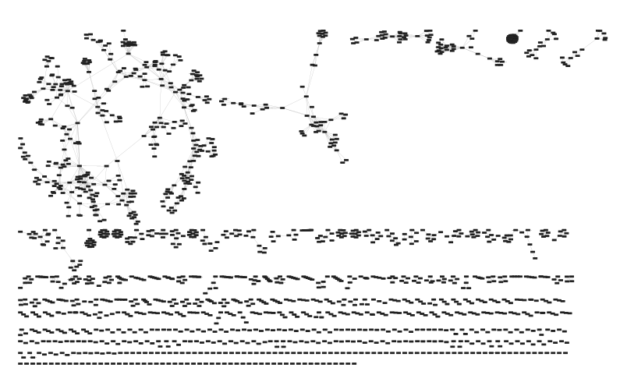
Co-authorships in network science
Nodes: 1589
Links: 2742
Size of the giant component: 379
Number of links in the giant component: 914
Number of components:
396
M. E. J. Newman, Phys. Rev. E 74, 036104 (2006).

Slide 7
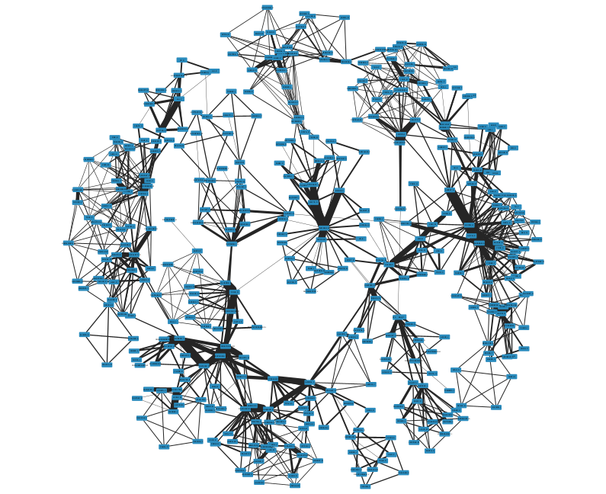
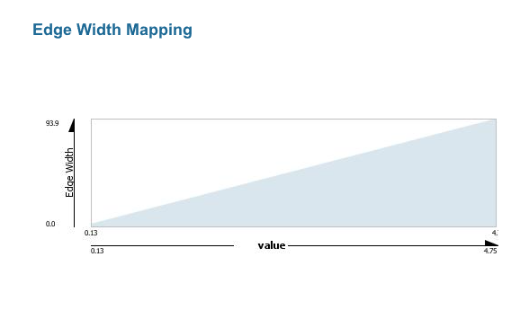
Link weights in the giant component
The giant component consists of smaller clusters.
Majority of strong ties are found within the clusters.
Links connecting communities are mostly weaker.
Consistent with the strength of weak ties theory.

Slide 8
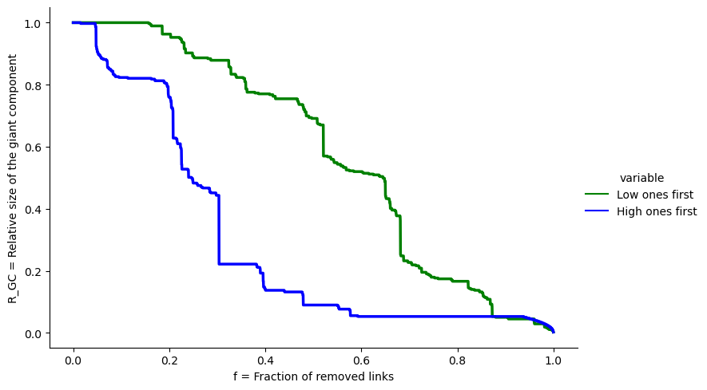
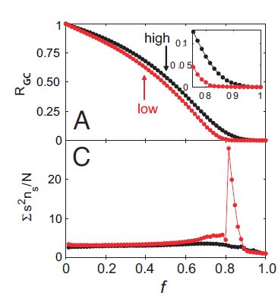
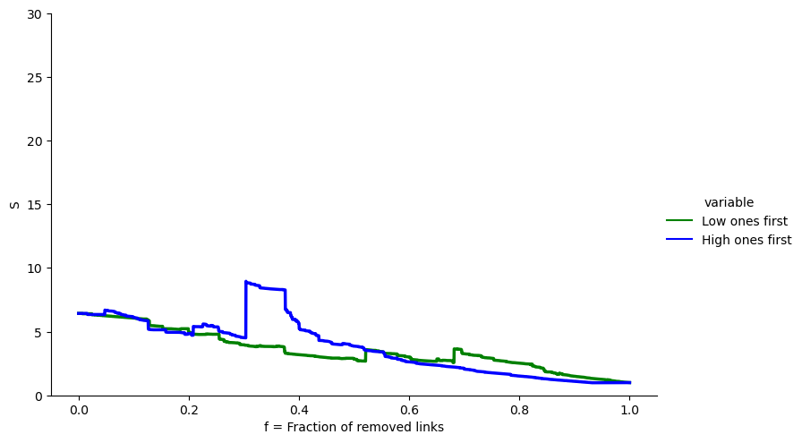

Results of the link removal experiment
Based on tie strengths
The exact opposite of what the study found!
$$χ=S=\sum{\frac{n_{s}∗s^{2}}{N}}$$
The sensitivity of the system to small perturbations that try to drive the system from one phase to the other.

Slide 9
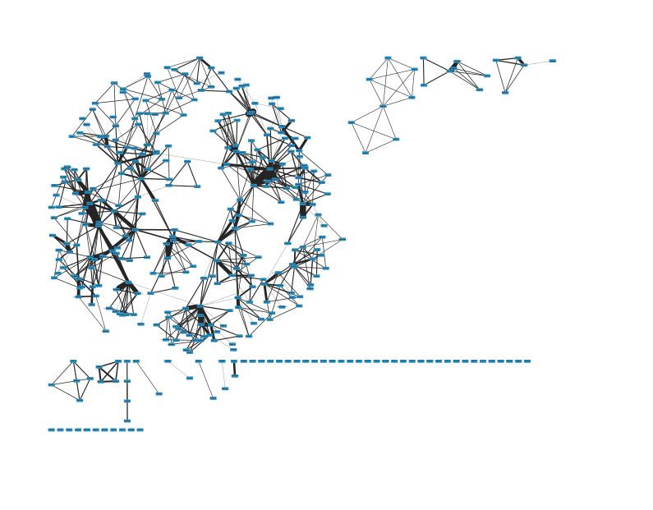
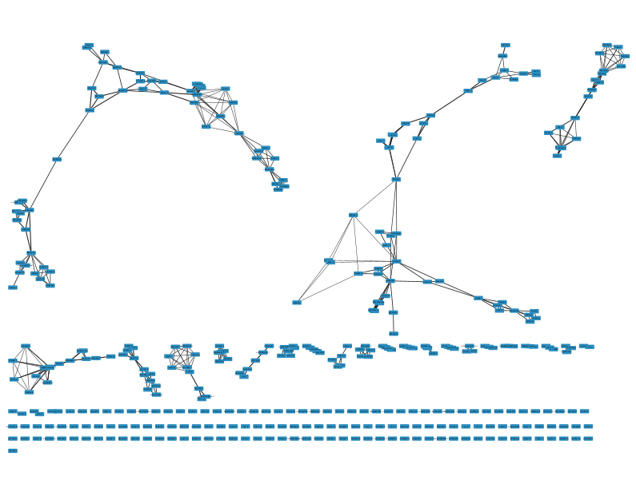
The two networks at f=0.4
Weak ties first
Strong ties first

Slide 10

Value of O – the relative topological overlap of the neighbourhood of two nodes
The proportion of two nodes’ (i and j) common neighbours.
Number of common nodes
$$O_{ij}= \frac{n_{ij}}{(\left(k_{i}−1\right)+\left(k_{j}−1\right)−n_{ij})}$$
If 0: no common friends, potential bridge.
If 1: part of the same circle.

Slide 11
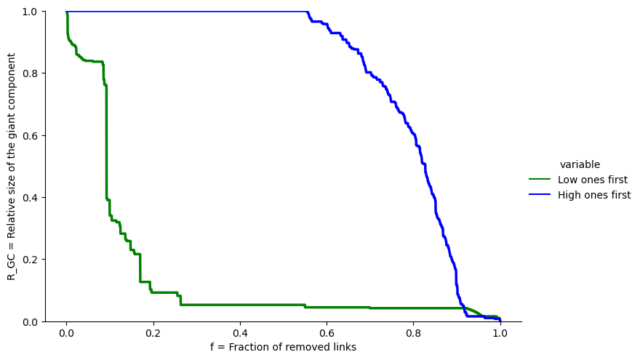
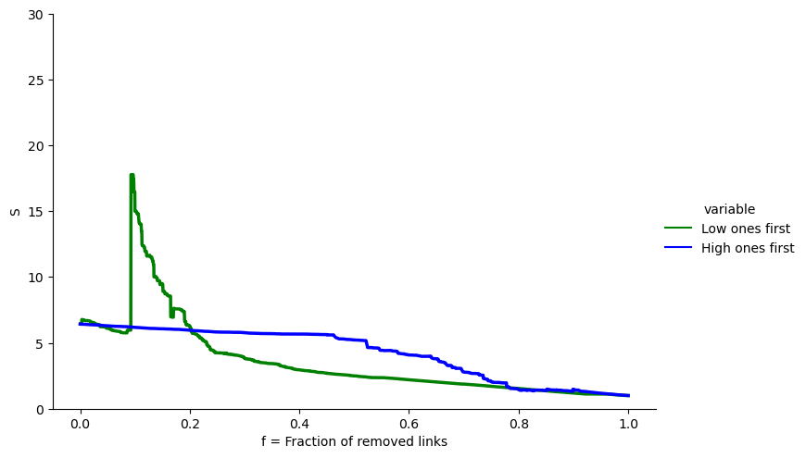
Results of the link removal experiment
Based on the relative topological overlap of neighbourhoods
Transition point – phase transition, sudden disintegration.

Slide 12
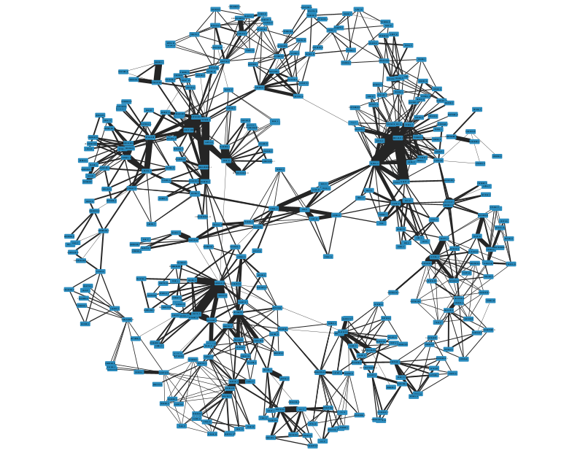
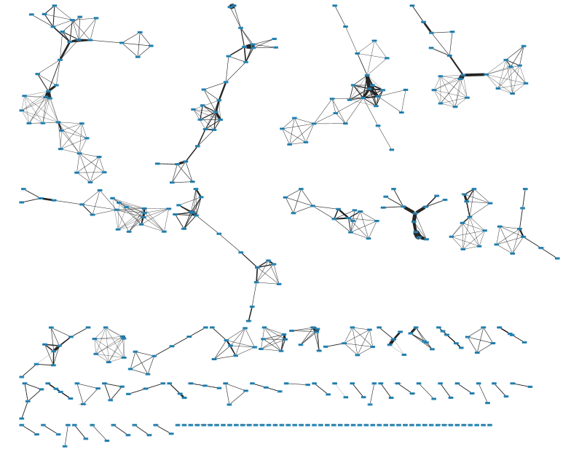
The two networks at f=0.2
Low O ties first
High O ties first

Slide 13




Reasons why my results differ from the original study’s
The data was different!!
Mobile call network <-> Co-authorship network
VOLUME
SIZE OF GCC
NATURE
STUDY:
STUDY:
STUDY:
$$N=4.6 ∗ {10}^{6}$$
84.1% of nodes
Mobile calls, informal relationships
$$L=7 ∗ {10}^{6}$$
MY DATASET:
MY DATASET:
MY DATASET:
$$N=1589$$
23.9% of nodes
Working relationship
$$L=2742$$

Slide 14
Further research, Applications
COMMUNICATION network in the job market
Diffusion in social networks
Social media
For building and maintaining weak ties, i.e. LinkedIn
Information, ideas – enterprises.
There are studies both highlighting the importance of strong and weak ties when looking for a job.

Slide 15
SUMMARY
STRENGTH OF WEAK TIES
IN COMMUNICATION NETWORKS
REPEATING THE EXPERIMENT
APPLICATIONS AND FURTHER RESEARCH

Slide 16
Readings
The original strength of weak ties study:
https://snap.stanford.edu/class/cs224w-readings/granovetter73weakties.pdf
The structure and tie strengths in mobile communication networks study:
https://doi.org/10.1073/pnas.0610245104
https://www.techtarget.com/whatis/definition/weak-tie-theory#:~:text=It%20was%20first%20introduced%20by,valuable%20in%20terms%20of%20providing
https://news.stanford.edu/stories/2023/07/strength-weak-ties
https://news.mit.edu/2022/weak-ties-linkedin-employment-0915
https://www.cs.kent.ac.uk/people/staff/saf/share/great-missenden/reference-papers/Weak%20Ties.pdf

