Slide 1
Time Series Assignment (D0M63a) 2022/2023
Lili Vandermeersch r0691855

Slide 2
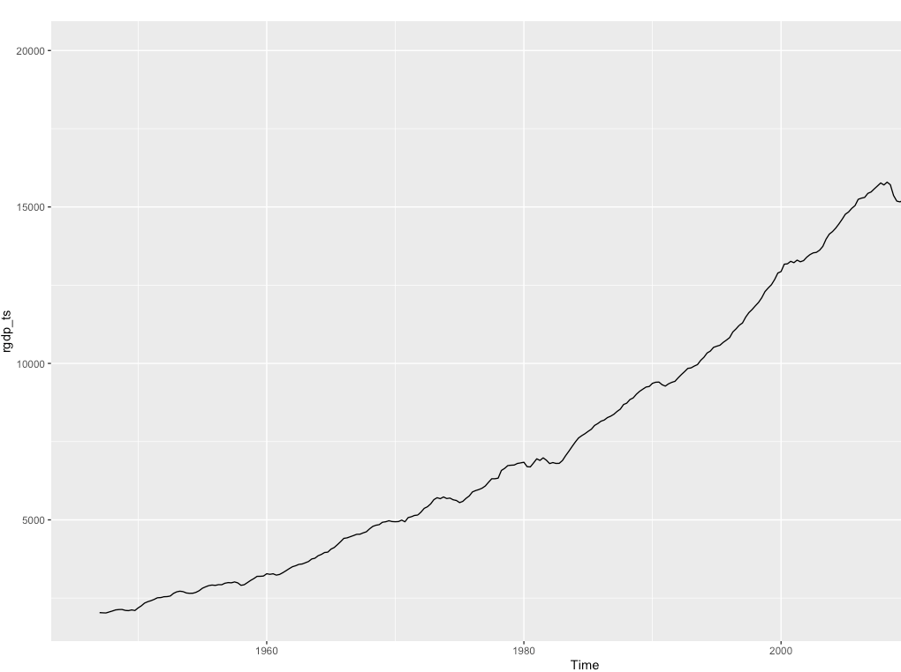

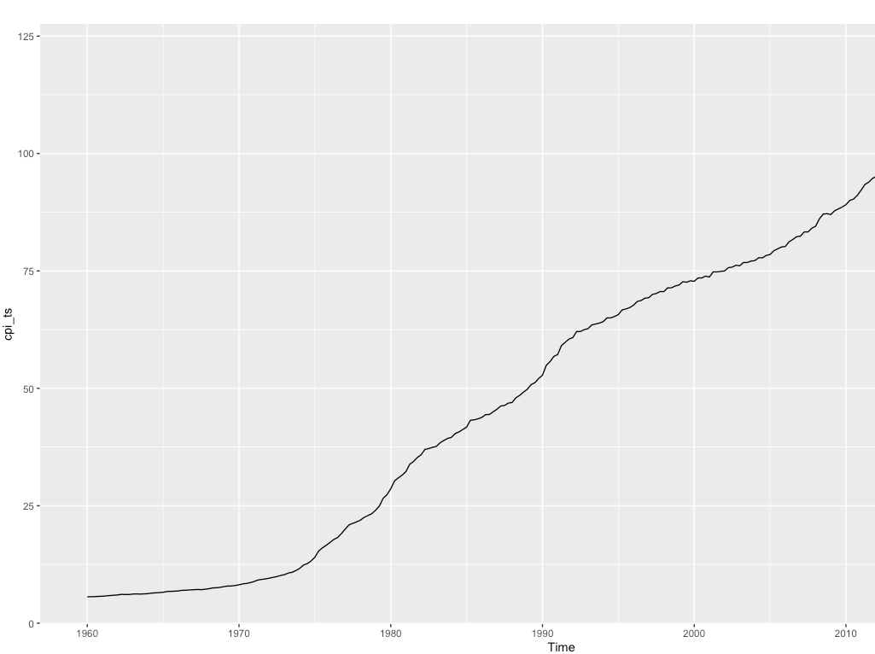

Introduction
rGDP: The first data data set contains quarterly, seasonally adjusted data on the real gross domestic product of the United Kingdom in billions of chained 2012 dollars from Q1 1947 to Q3 2022 (303 observations). Source: Federal Reserve Bank of St. Louis. Data available at https://fred.stlouisfed.org/series/GDPC1 .
CPI: The second data set contains the consumer price index of all items in the United Kingdom. Index 2015=100, Quarterly data, not seasonally adjusted from Q1 1960 until Q3 2022 (251 observations). Source: Federal Reserve Bank of St. Louis. Data available at https://fred.stlouisfed.org/series/GBRCPIALLQINMEI

Slide 3
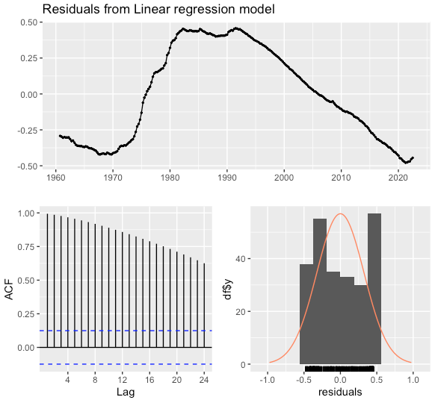
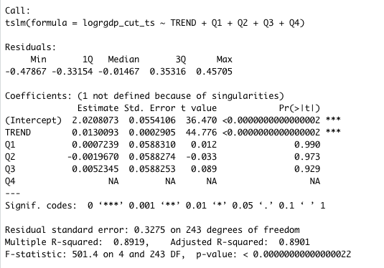
Univariate Analysis
Linear regression
4 quarterly dummies and trend
Assuming the model valid, we can interpret the output as follows:
R^2: 89.19% of all variance in the logarithmic transformation of real GDP is explained by the regressors
p-value of F-statistics highly significant - all predictor variables/regressors jointly are highly significant
Trend was significant. Ceteris paribus Log(rGDP) increases by 0.013 = 1.3% quarterly, on average.
Intercept significant but we would leave it in, even if it wasn't.
No seasonal effect. Seasonal dummies not significant.
High R^2 and high residual autocorrelation can be signs of spurious regression. Residuals clearly not white noise.
They violate homoscedasticity assumptions => model performs well but is invalid!
The mean of the residuals is close to zero but there is significant correlation in the residuals series.
The time plot of the residuals shows that the variation of the residuals differ quite a bit across the historical data.
There also seems to be an extreme value in Q2 2020 most probably due to Covid. The residual variance cannot be treated as a constant.
This can also be seen in the histogram of the residuals. The histogram suggests that the residuals are not normal.
Consequently, forecasts based on this model should not be made.

Slide 4
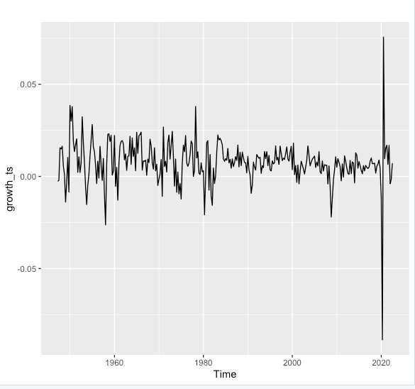
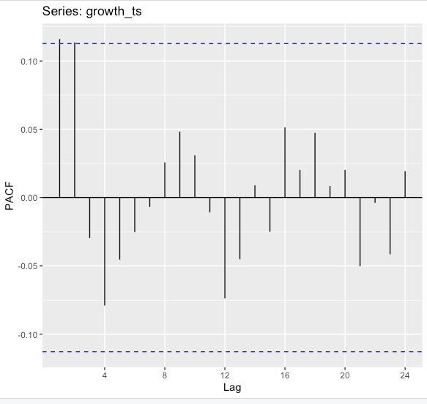
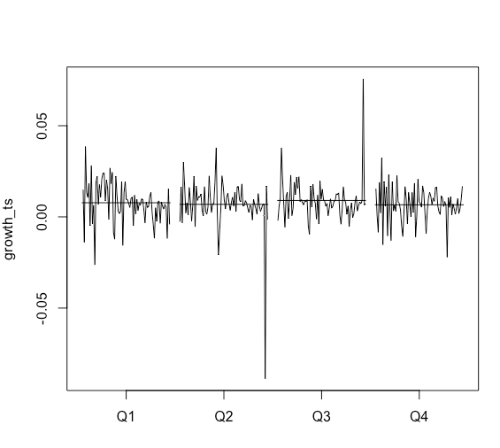
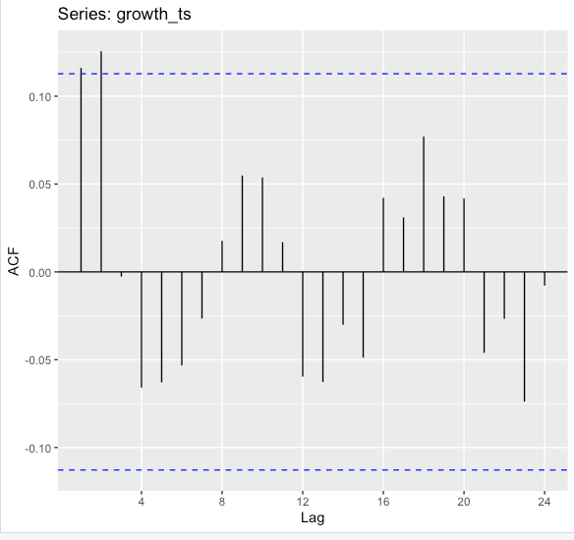
Log(rGDP) is integrated of order 1
Diff(log(rGDP)) = Growth is stationary
Mean effects don’t differ much – no significant seasonality.
Augmented Dickey-Fuller (ADF) test - Testing non-stationarity of log(rGDP) => p-value <5%, we reject H0 and conclude that the time series is stationary.=> i.e., integrated of order one (not stationary in levels, but stationary in differences).
ACF shows 1 borderline and one significant autocorrelation at lag 1 and 2 respectively => MA(1) or MA(2)
PACF shows 2 significant correlations at lags 1, 2. We also observe a a slower decrease in the ACF as the lags increase – could be due to the trend, while the “scalloped” shape due to the seasonality but lags are not significant. => AR(2)
Therefore, the following models have been specified and estimated
Goodness of fit measures used were BIC and AIC while Ljung-Box test used to evaluate validity of the models.
Model | Highest ord. terms significant | Box test/Valid | AIC | BIC
ARIMA(1,1,0) | Yes | No | -1776.688 | -1769.26
ARIMA(0,1,1) | Yes | Yes | -1758.35 | -1750.923
ARIMA(1,1,1) | Yes | Yes | -1832.30 | -1821.16
ARIMA(0,1,2) | Yes | Yes | -1781.716 | -1770.575
ARIMA(2,1,0) | Yes | Yes | -1800.563 | -1789.422

Slide 5

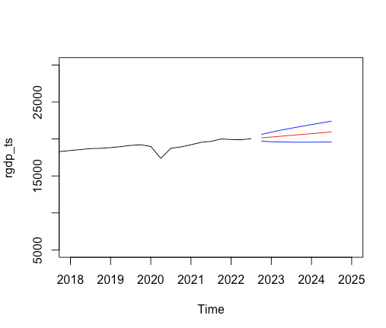
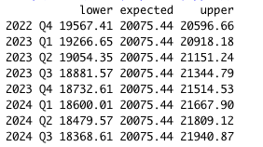
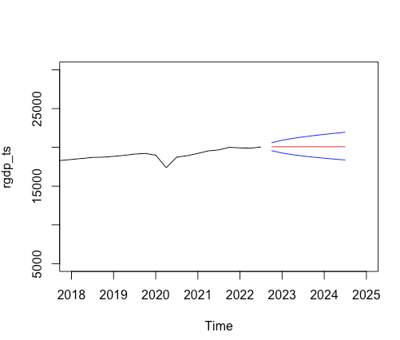
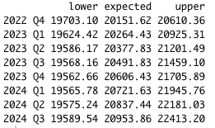
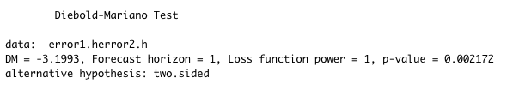
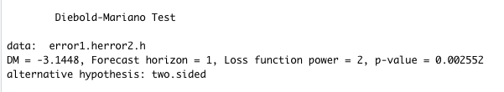
Forecasting and model Comparison
Forecasts by best and worst performing models. Prediction interval widens over time, as the more we predict ahead, the larger the uncertainty.
Root mean square errors (RMSE) and Mean absolute errors (MAE) have been summarized below.
Diebold-Mariano test
We obtain a p-values = 0.00 < 5%, thus we reject the H0’s and conclude that the forecast performance of the two models, using both the absolute and the squared value loss, are is significantly different. Model (111) performs significantly better.
ARIMA(0,1,1)
Measure | ARIMA(0,1,1) | ARIMA(1,1,1)
RMSE | 0.0000624855 | 0.0000330855
MAE | 0.005526283 | 0.004071873
ARIMA(1,1,1)

Slide 6
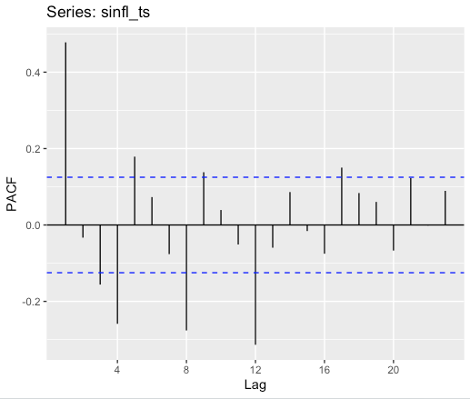
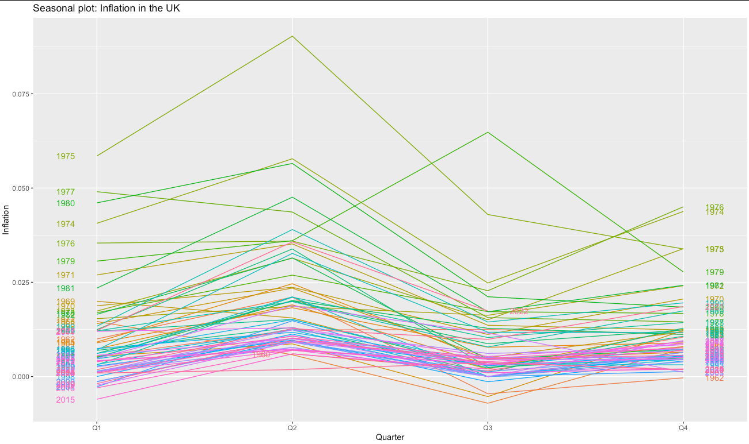
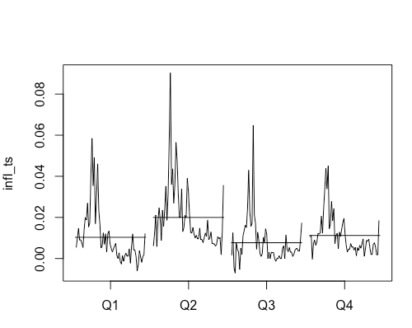
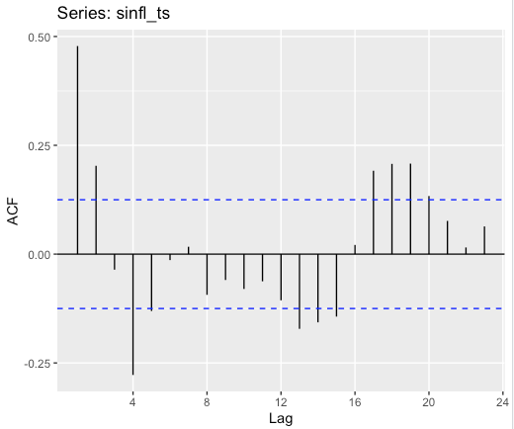
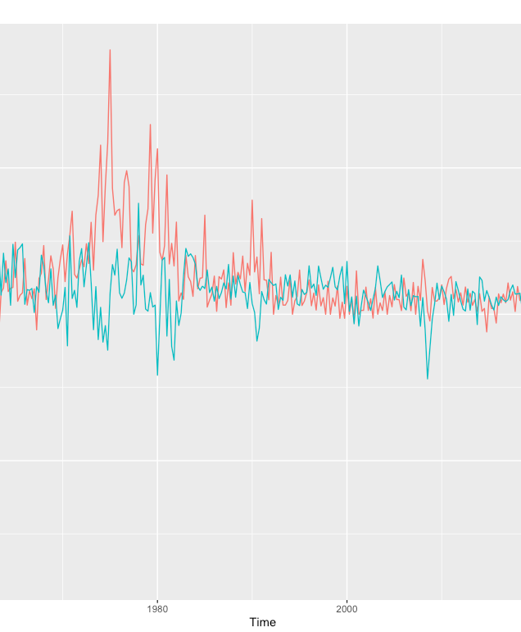
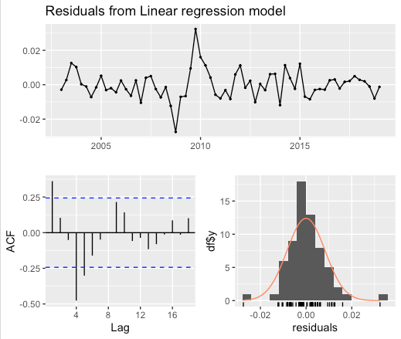
Multivariate Analysis
The raw CPI data showed strong seasonality and a strong stochastic trend. A SARIMA analysis was conducted to account for the seasonality effects and the trend in the log-transformed data
Monthplot of Inflation (diff(log(CPI) still showed different mean effects and seasonality
SARIMA models (2,1,2)(1,1,1), ARIMA(1,2,1)(1,0,1), and ARIMA(1,1,1)(1,1,1) all proved valid fits for the log transformed data.
Correlogram of Inflation: MA(2) seems to repeat, seasonality present.
Partial correlogram: AR(2) repeats, seasonality present.
Seasonally differenced Inflation and rGDP Growth were both stationary, while log(rGDP) and Inflation were integrated of order one.
LINEAR MODEL
A linear regression was carried out on both the original data, i.e., CPI on rGDP, and the transformed data Inflation on Growth.
rGDP ~ CPI Assuming the model was valid:
R^2: 96.96% of all variance in rGDP is explained by CPI (driven by time and trend, neither stationary
p-value of F-stat: all predictor variables/regressors are jointly not significant
This model seems to perform very well, nevertheless it is not a valid model. The figure below plots the residuals, which are clearly not white noise. We observe significant autocorrelations, which is confirmed by the low p-value of the Box-Ljung test.
Seasonal Growth ~ Seasonal Infl (both stationary). Assuming the model was valid:
R^2: 0.17% of all variance in seasonal growth is explained by seasonal inflation.
p-value of F-stat: all predictor variables/regressors are jointly not significant
Model residuals violate heteroscedasticity assumptions. Box test results in p-value = 0,00, hence we reject H0 and conclude that the model is invalid.
Seasonal plot: Inflation
Inflation and GDP growth in the UK

Slide 7
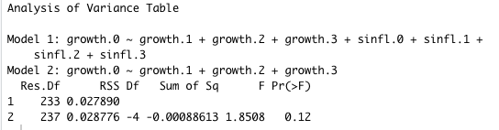
DISTRIBUTED LAG MODELS & AUTOREGRESSIVE DISTRIBUTED LAG MODELS
Distributed and autoregressive distributed lag models to quantify the lagged effects of seasonal inflation on GDP growth. The findings have been summarized in the table below.
All models are validated because there were no significant correlations of residuals and residuals are all white noise.
GRANGER CAUSALITY
A statistical hypothesis test for determining whether one time series is useful in forecasting
another
p-value = 0.12 => thus we do not reject H0 of no Granger Causality. We conclude that seasonal
inflation has no incremental explanatory power in real GDP growth.
Model | Significant lag in regression | Significant residuals | Box-test p-value | Validity, white noise?
DLM(1) | Lag 1 | 0.0165 | 0.9942 | Yes
DLM(2) | Lag 1 | 0.0346 | 0.9967 | Yes
ADLM(1) | Lag 1 | 0.0171 | 0.9945 | Yes
ADLM(2) | Lag 1 and 2 (sinfl.1, growth.2) | 0.0288, 0.0498 | 1 | Valid
ADLM(3) | Lag 1 (sinfl.1) | 0.0316 | 1 | Valid

Slide 8
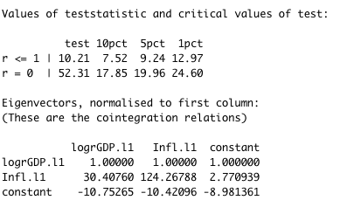
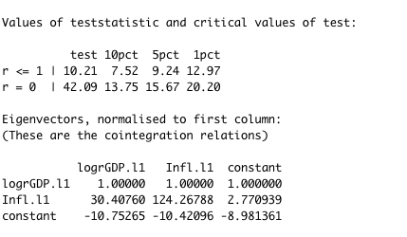
Cointegration
Johansen’s trace test statistic
Cointegration occurs when two (or more) time series have a long run-equilibrium. They move together in a way that the linear combination results in a stationary time series.
An Engle-Granger test was run to detect cointegration if present.
Augmented Dickey-Fuller test => if residuals stationary => cointegration.
We obtain a test-statistics of -1.3538 which is larger that the Engle-Granger ADF test statistics for one explanatory variable of −3.41. Thus, we cannot reject H0 of no cointegration and therefore conclude that log real GDP and inflation are not cointegrated.
Johansen test run too - allows for more that one cointegrating relationship, is symmetric and more powerful.
The order of the VAR model in levels selected by Schwarz Information Criterion is 5.
Conclusion from trace statistic:
We reject H0: r = 0 at all significance levels, however we cannot reject H0: r<=1 at all levels
For r=0, the test statistics is larger than then the critical value (52.31 > 24.60), thus there is at least one cointegrating relation. For r=1, the test statistics is smaller then the critical value for a 99% confidence interval (10.21 <12.97). Ergo there is one cointegrating relation => Hence, log(rGDP) and Infl are cointegrated. There is one cointegrating relation.
The cointegrating equation is a stationary linear combination of log(rGPS) and Inflation.
Let δt be a stationary time series, then the cointegrating equation is
-10.75265 + logGDP(t) + 30.41Infl(t).
If you reject both r = 0 and r <= 1 that would mean that r is = 2 (r cannot be greater than the number of series in the system, which is 2). That implies there are at least two different linear combinations of the variables that are stationary (among combinations where the first weight is normalized to 1). That means the two series would both need to be stationary to begin with, and hence there is no cointegration. This is not the case here.
We employ an alternative statistic, the maximum-eigenvalue statistic . The reported λmax statistics does not differ much from trace statistic; the critical value (42,09) is still higher than test statistic => We conclude that the logarithm of real GDP is cointegrated with Inflation.
Johansen’s maximum eigenvalue test statistic

Slide 9
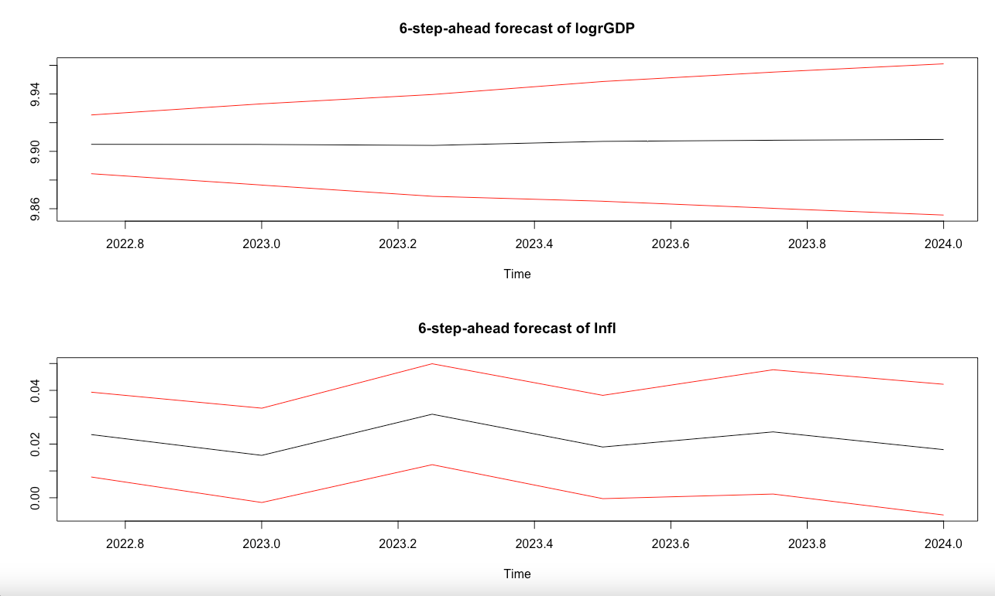
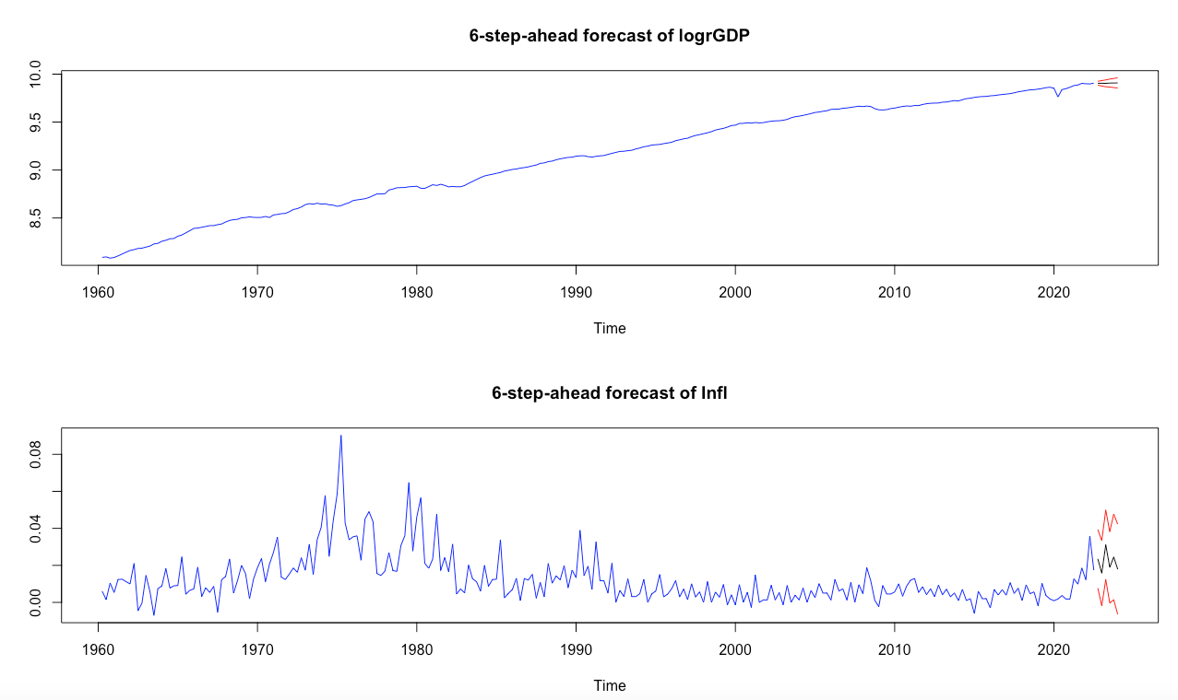
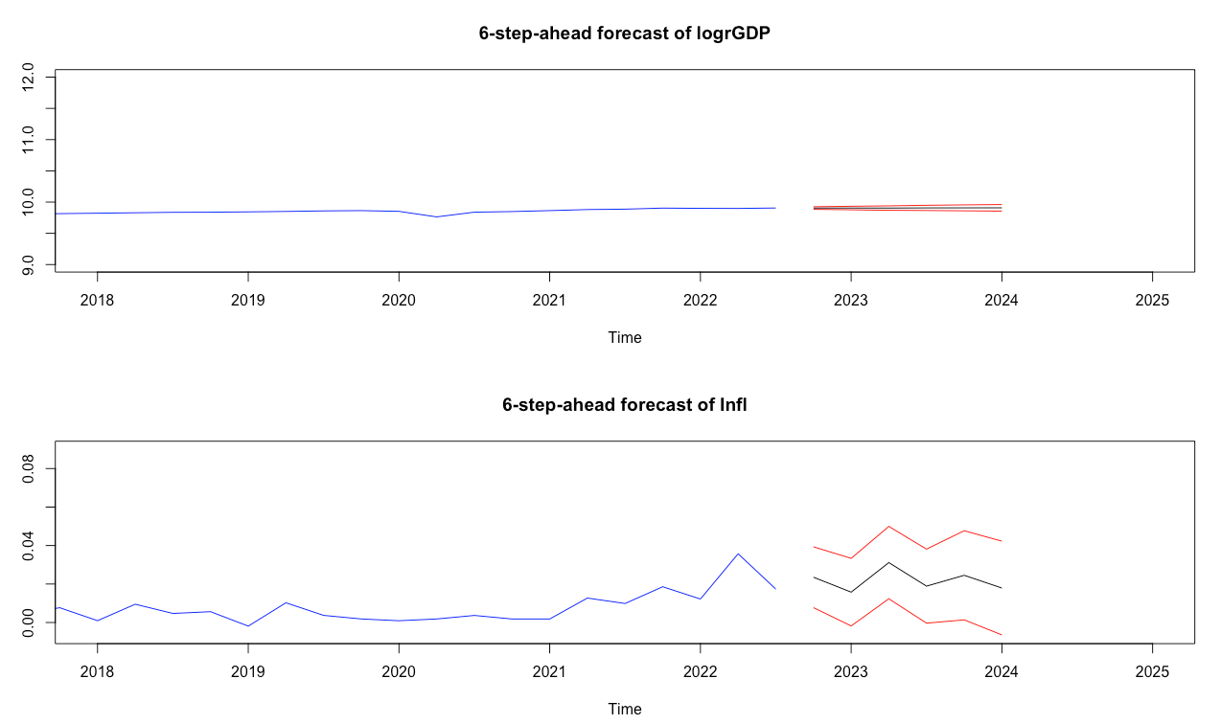
VECM MODELS
VECM model
Through VECM we can interpret long-term and short-term relationships. It has more efficient coefficient estimates then VAR. We observe small negative error correction terms, close to zero. These measure the speed of adjustment towards long-run equilibrium. As observed, this as close to zero, -0.0059358 and -0.0005745 for logrGDP and Inflation respectively. Hence, it appears that logrGDP and will neither diverge nor converge fast or significantly and might not have a long-run equilibrium.
FORECASTING
Using the VECM(1) model, a 6-step-ahead forecast has been prepared. VECM can still be used for short-run dynamics, even if co-integration is not present.
The plots on the left depict the model predictions for the next 6 quarters. The prediction interval once again gets wider with time.

Slide 10
ConCLUSION
The current paper attempts to gain a better understanding of underlying causes, trends and systemic patterns that drive change in real GDP and CPI. For this, end, two time series were analysed.
Univariate Analysis
Real GDP was integrated of order one. After differencing, a log transformation was applied for ease of interpretation => GDP Growth.
CPI was integrated of order 2. Again, the data was log transformed before differencing twice => Seasonally differenced Inflation
A linear model proved insufficient to model the relationship between time and the variables, residuals violated homoscedasticity assumptions.
The stationary series were fitted with different ARIMA most of which proved to be good fits to the data. Various performance measures were used to compare them, such as BIC and AIC for in-sample and RMSE and MAE for out-of-sample criteria. The difference between the forecasting power of the best and worst performing models was statistically significant, as per the Diebold-Mariano test.
Multivariate Analysis
Linear model wasn’t sufficient to describe the relationship between the variables.
Different SARIMA models were fitted to log(CPI), the most parsimonious having 6 parameters.
Distributed and autoregressive distributed lag models were fitted to quantify the lagged effects of seasonal inflation on GDP growth. We concluded that although some lags were independently significant there wasn’t enough evidence against no Granger Causality. We concluded that seasonal inflation has no incremental explanatory power in real GDP growth.
Cointegration
Engle-Granger test conclude that log real GDP and inflation are not cointegrated.
Johansen test (symmetric and more powerful) found one cointegrating equation.
VECM gives small, negative error correction terms, close to zero. These measure the speed of adjustment towards long-run equilibrium. The logrGDP and Inflation might not have a long-run equilibrium.

