Slide 1
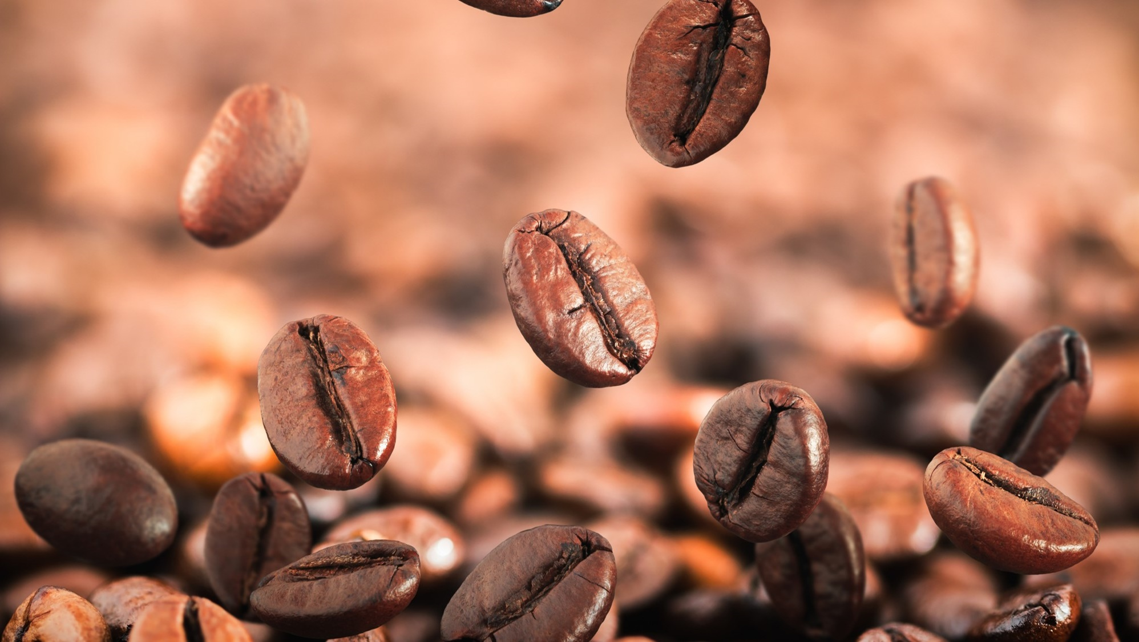
Maven Roasters
Mid–Year Analysis Report
Jan-June 2023 Sales
Stores:
Hell’s Kitchen
Astoria
Lower Manhattan

Slide 2

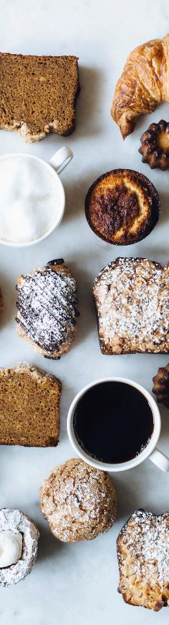

Introduction
Welcome to Maven Roasters’ sales report. A glimpse into the daily pattern of a coffee shop chain in New York City. This presentation explains the story behind every cup served across three locations, revealing when and where customers shop, what they love to buy, and how sales fluctuate throughout the week, day, and month.
From the early morning coffee rush to the quiet afternoon tea orders, this insightful report highlights top-selling products, busiest hours, and store-level performance, offering a comprehensive view of how Maven Roasters brews its success, one transaction at a time.

Slide 3
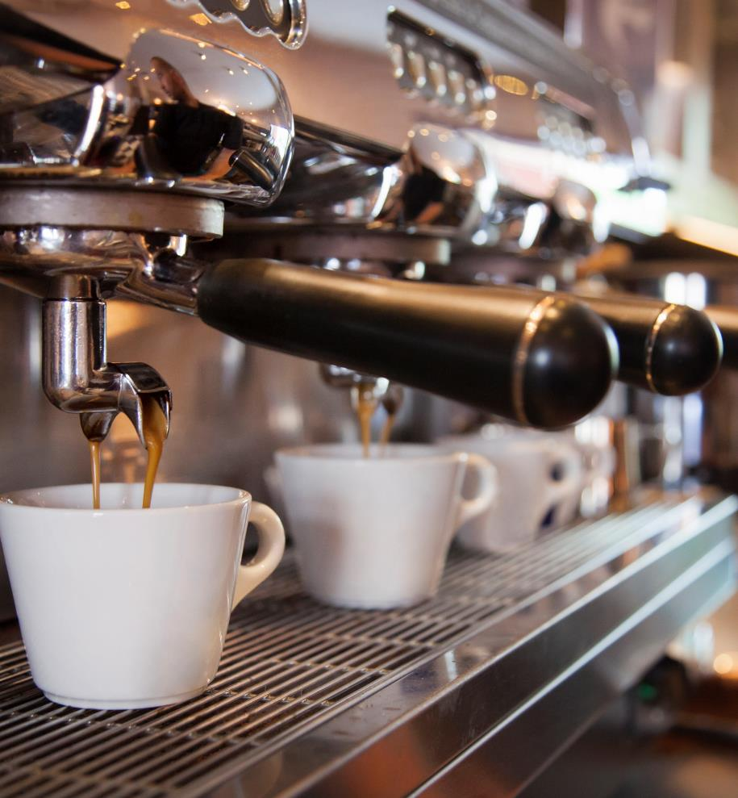
Agenda
What has been the sales trend for Maven roasters over time?
Busiest days.
Products performance
Recommendations.

Slide 4

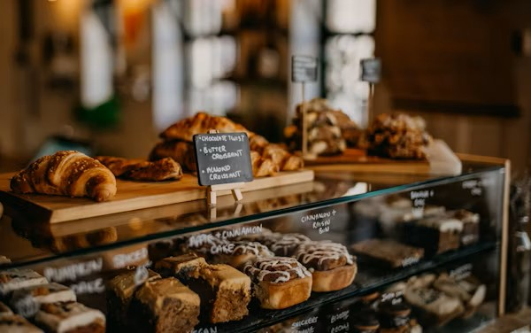

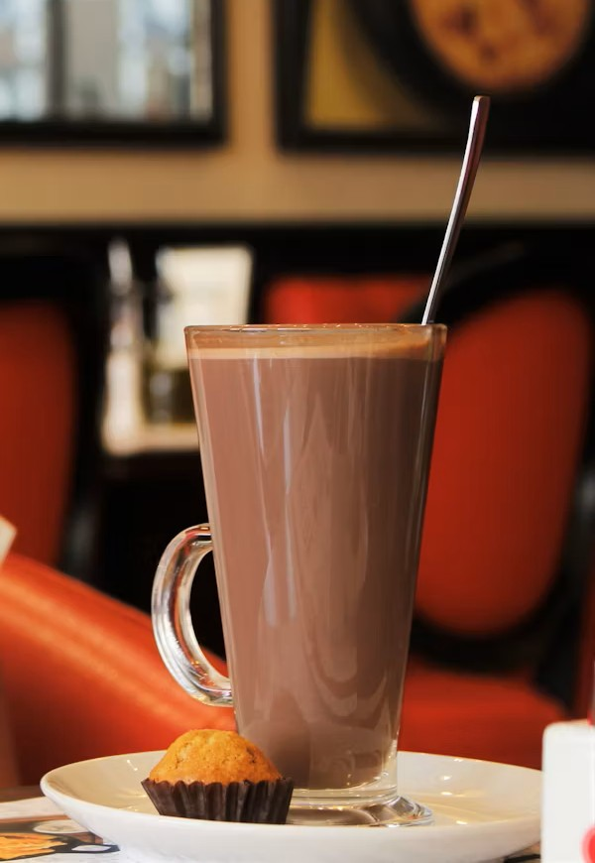
Products we offer
Coffee
Bakery
Tea
Chocolate
Coffee Types:
Coffee beans
Brewed Coffee
Espresso
Drip Coffee
Bakery Products:
Biscotti
Pastry
Scone
Tea Types:
Chai Tea
Herbal Tea
Black Tea
Green Tea
Chocolate Types:
Drinking Chocolate
Organic Chocolate

Slide 5
Key Insights Summary
Hell’s Kitchen recorded the highest store sales at $237K, though store performance remained well-balanced across all locations.
Maven Roasters’ sales grew steadily from February ($76K) to June ($166K), achieving a 118% increase.
Sales peaked on Mondays and Fridays, with the highest hourly sales at 10 AM.
Coffee ($270K) and Tea ($196K) were the top categories, driven by Barista Espresso, Brewed Chai Tea, and Hot Chocolate. Bakery items contributed moderately, while packaged chocolate and specialty items had lower sales.

Slide 6
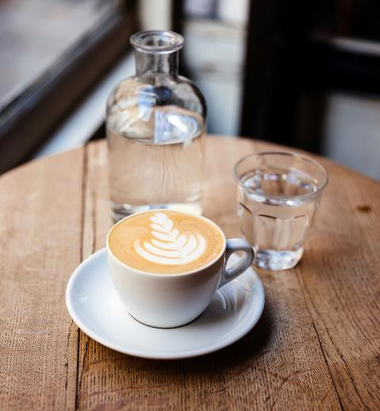

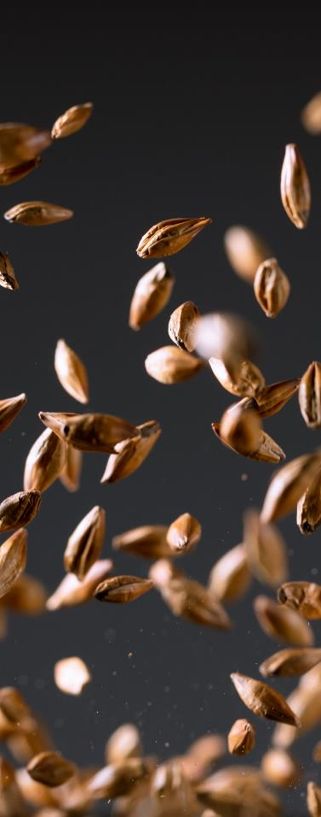

Section 1: Mid – Year Sales
What has been the sales trend for Maven Roasters over time?

Slide 7
1.1 Sales by location
Key Observations:
Balanced Store Performance - Sales across all three locations are very close, showing consistent customer demand and operational performance.
Hell’s Kitchen Leads Slightly - With $237K in sales, Hell’s Kitchen is the top-performing store.
No Underperforming Store - There’s no significant sales drop across any location, suggesting all stores are performing at a similar level.

Slide 8
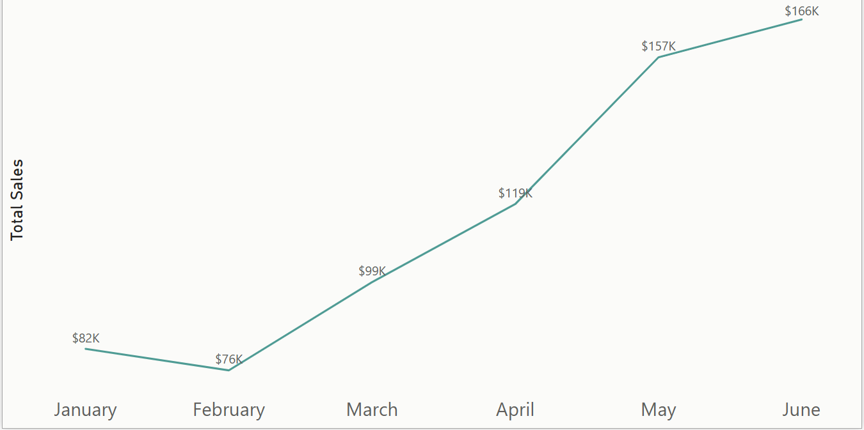
1.2 Sales by the month
Monthly sales trendline
This Graph shows how the sales across the three locations have fluctuated, with the highest sales being seen in June at $166K.
Sales reached a low point in February at $76K. From February onward, sales consistently increased month-over-month.
March sales rose by 30% to $99K, and April continued the growth with a 20% increase to $119K.
May experienced the maximum growth, rising 32% to $157K.
Sales peaked in June at $166K, marking the highest point in the period.
Overall, sales grew by approximately 118% from February to June

Slide 9
Section 2: Daily Sales
Which days of the week tend to be busiest?

Slide 10
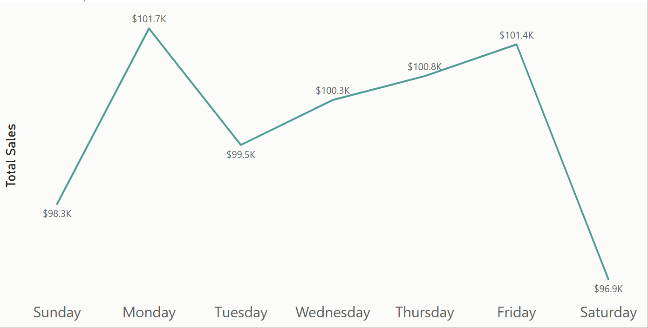
2.1 Sales by day of the week
Key observations:
Monday ($101.7K) and Friday ($101.4K) are the two busiest days.
Tuesday through Thursday are relatively stable around $99.5K – $100.8K.
Sunday ($98.3K) and especially Saturday ($96.9K) are the lowest sales days.
Possible interpretation:
Monday’s peak could reflect people restocking or visiting after the weekend.
Friday may capture end-of-week treats, social visits, or pre-weekend purchases.
The weekend drop may indicate reduced commuter foot traffic or shifting customer habits toward other leisure activities.
Daily sales trend line

Slide 11
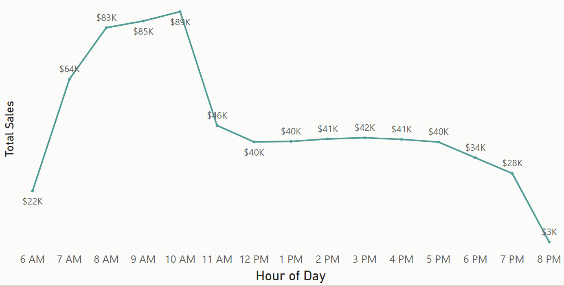
2.2 Sales by hour of the day
Key observations:
Sales start picking up sharply from 6 AM ($22K) to 8 AM ($83K).
Sales peak at 10 AM with $89K, which is the busiest hour of the day.
After 10 AM, sales begin to decline steadily, dropping to $46K by 11 AM and stabilizing around $40–42K between 12 PM and 5 PM.
Sales continue declining into the evening, reaching $3K by 8 PM, the lowest hourly sales.
Hourly sales trend line

Slide 12
Section 3: Product Sales
Which products are sold most and least often?
Which product drives the most revenue for the business?

Slide 13
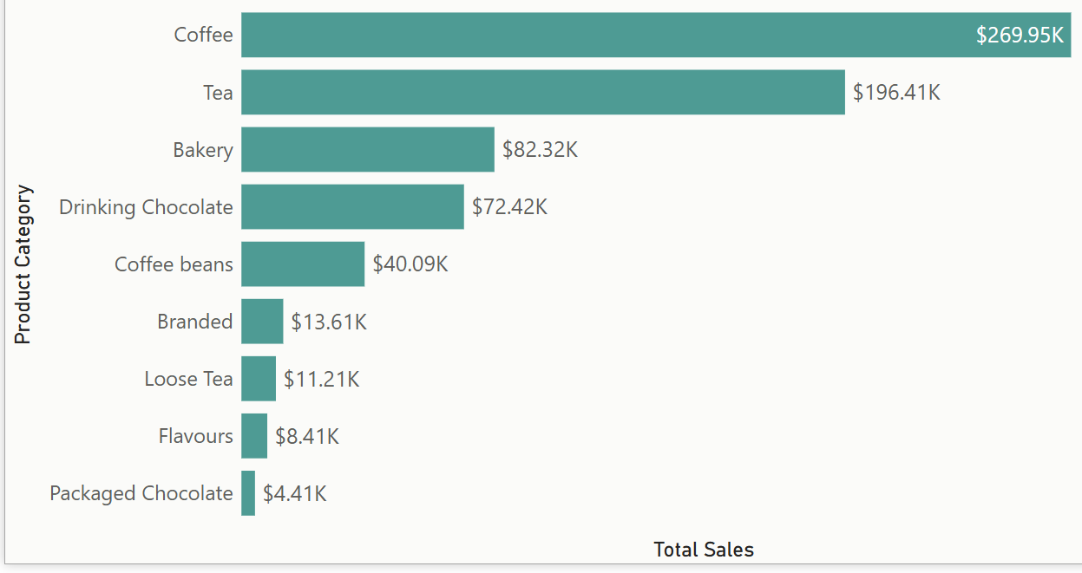
3.1 Sales by the product category
Sales by Product Category
This graph shows the revenue generated from each product category during this period.
Key Observations:
Coffee is the top-selling category with $269.95K, clearly leading all others.
Tea is second at $196.41K — together, Coffee and Tea contribute a huge share of overall revenue.
Bakery ($82.32K) and Drinking Chocolate ($72.42K) form a strong middle tier.
Lower revenue is seen in categories like Coffee Beans ($40.09K), Branded Items ($13.61K), Loose Tea ($11.21K), Flavours ($8.41K), and Packaged Chocolate ($4.41K).

Slide 14
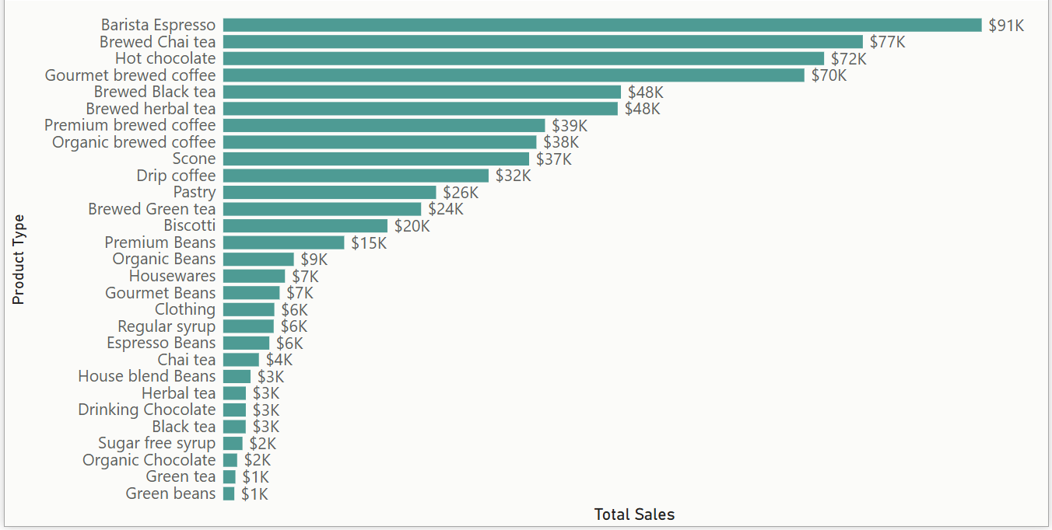
3.2 Sales by the product type
Sales by Product Type

Slide 15
3.2 Sales by the product type
Key Observations:
Barista Espresso leads all product types with $91K in sales.
The next top performers are:
Brewed Chai Tea ($77K)
Hot Chocolate ($72K)
Gourmet Brewed Coffee ($70K)
Brewed Black Tea and Brewed Herbal Tea (both $48K)
The bakery subtypes (Scone $37K, Pastry $26K, Biscotti $20K) contribute meaningfully, but much less than beverages.
Lower-selling items include various bean types, syrups, branded merchandise, and chocolates, many contributing less than $10K.
A long tail of small-selling items suggests opportunities for targeted promotions or inventory optimization

Slide 16
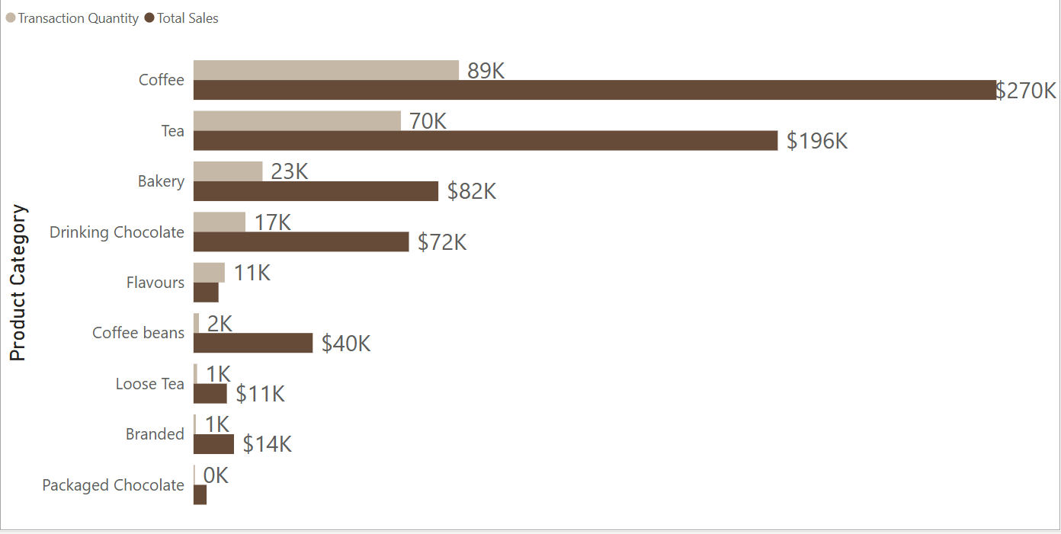
3.3 Product category volume analysis
Quantity ordered and sales generated by Product category
Key observations
Coffee and Tea dominate total sales volume.
Bakery and Drinking Chocolate contribute moderate volumes.
Coffee Beans, Branded, and Specialty items show much lower unit sales, but contribute higher prices per unit.

Slide 17
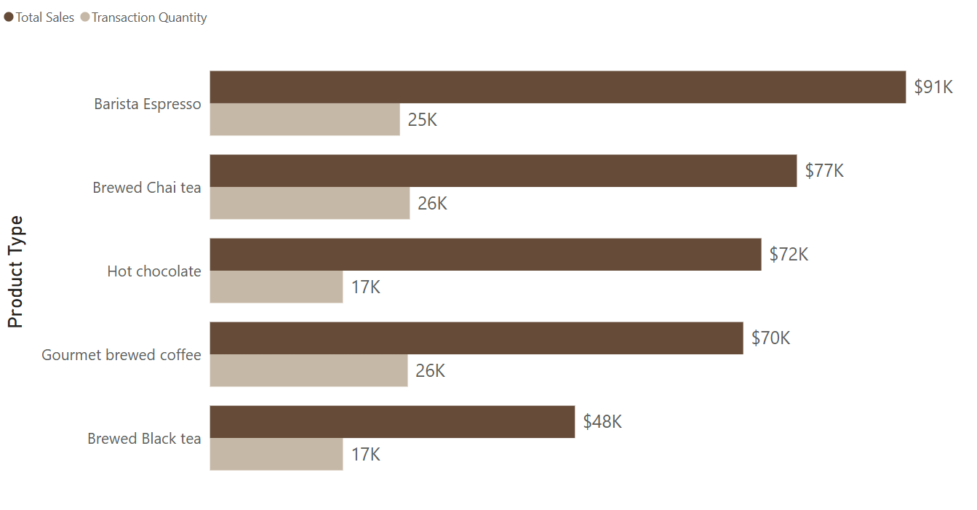
3.4 Product type volume analysis
Quantity ordered and sales generated by Product Type
(Top 5)
Key observations
Barista Espresso leads in total revenue ($91K), driven by a higher price point despite slightly lower volume (25K units).
Brewed Chai Tea and Gourmet Brewed Coffee dominate in sales volume (26K units each), making them key high-frequency sellers.
Hot Chocolate balances strong revenue ($72K) with moderate volume (17K units), supported by premium pricing.

Slide 18
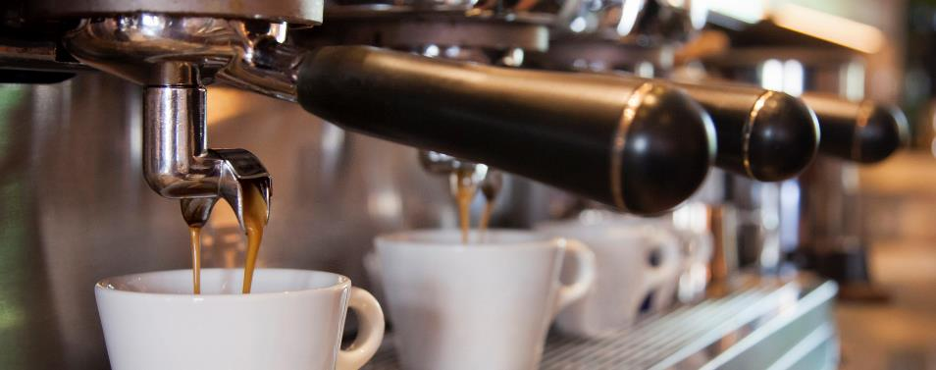

Overall Summary
The analysis confirms steady sales growth throughout the first half of the year, strong morning demand, and the dominance of main beverage products in both volume and revenue.
All store locations performed consistently, while bakery items contributed valuable complementary sales. Volume analysis highlighted both high-frequency everyday items and lower-volume premium offerings, each playing distinct roles in the business’s product mix.

Slide 19
Recommendations
Optimize morning operations – Prioritize staffing & inventory between 7–10 AM to capture the highest sales volume.
Promote top-selling beverages – Focus promotions on Espresso, Chai Tea, Hot Chocolate & Gourmet Coffee.
Grow bakery cross-sales – Use bundles and combos to grow add-on sales from Scones, Pastries & Biscotti.
Monitor under-performing product lines – Evaluate strategies for Packaged Chocolate, Flavors & Coffee Beans.
Maintain balanced store-level performance – Maintain operational consistency across all stores
Review pricing strategies – Explore small price adjustments on high-volume products to optimize margins.

Slide 20

Thank You

Slide 21
Appendix
This is a breakdown of the products type available in each product category:
Bakery → Biscotti, Pastry, Scone
Branded → Clothing, Housewares
Coffee → Barista Espresso, Drip Coffee, Gourmet Brewed Coffee, Organic Brewed Coffee, Premium Brewed Coffee
Coffee Beans → Espresso Beans, Gourmet Beans, Green Beans, House Blend Beans, Organic Beans, Premium Beans
Drinking Chocolate → Hot Chocolate
Flavours → Regular Syrup, Sugar-Free Syrup
Loose Tea → Black Tea, Chai Tea, Green Tea, Herbal Tea
Packaged Chocolate → Drinking Chocolate, Organic Chocolate
Tea → Brewed Black Tea, Brewed Chai Tea, Brewed Green Tea, Brewed Herbal Tea

