Slide 1
Chapter 13: The Peripheral Nervous System and Reflex Activity_Part A Bio 241 Dr. Jordan

Slide 2
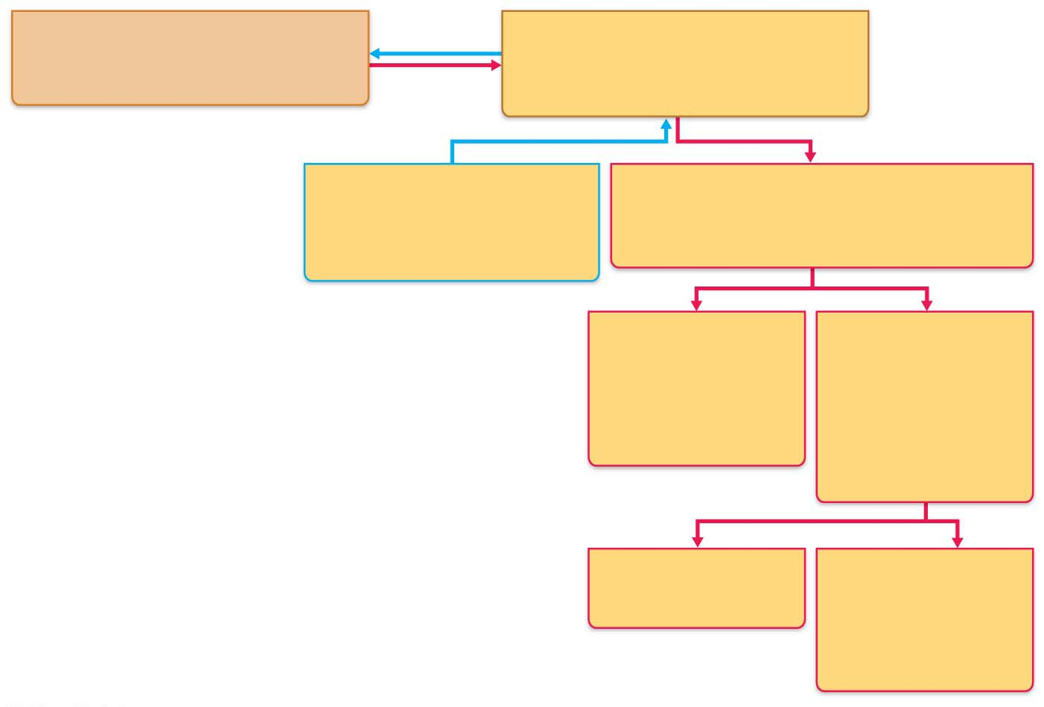
PNS in the structural organization of the Nervous System
Central nervous system (CNS)
Peripheral nervous system (PNS)
Brain and spinal cord
Cranial nerves and spinal nerves
Integrative and control centers
Communication lines between the CNS
and the rest of the body
Sensory (afferent) division
Motor (efferent) division
Somatic and visceral sensory
nerve fibers
Motor nerve fibers
Conducts impulses from
receptors to the CNS
Conducts impulses from the CNS
to effectors (muscles and glands)
Brain useless without links to outside world
Orders sent from CNS to voluntary muscle and other effectors of the body allow us to move/take care of own needs
PNS provides the links from and to world outside our body
Nerves
Somatic nervous
system
Autonomic nervous
system (ANS)
Somatic motor
(voluntary)
Visceral motor
(involuntary)
Conducts impulses
from the CNS to
skeletal muscles
Conducts impulses
from the CNS to
cardiac muscle,
smooth muscle,
and glands
Sympathetic division
Parasympathetic
division
Mobilizes body systems
during activity
Conserves energy
Promotes house-
keeping functions
during rest
Structure
Function

Slide 3
Transmission Lines: Nerves and Their Structure and Repair
Nerves and Associated Ganglia
Structure and Classification
Nerve: cordlike organ of PNS
Bundle of myelinated and nonmyelinated peripheral axons enclosed by connective tissue
Two types of nerves: spinal or cranial, depending on where they originate

Slide 4
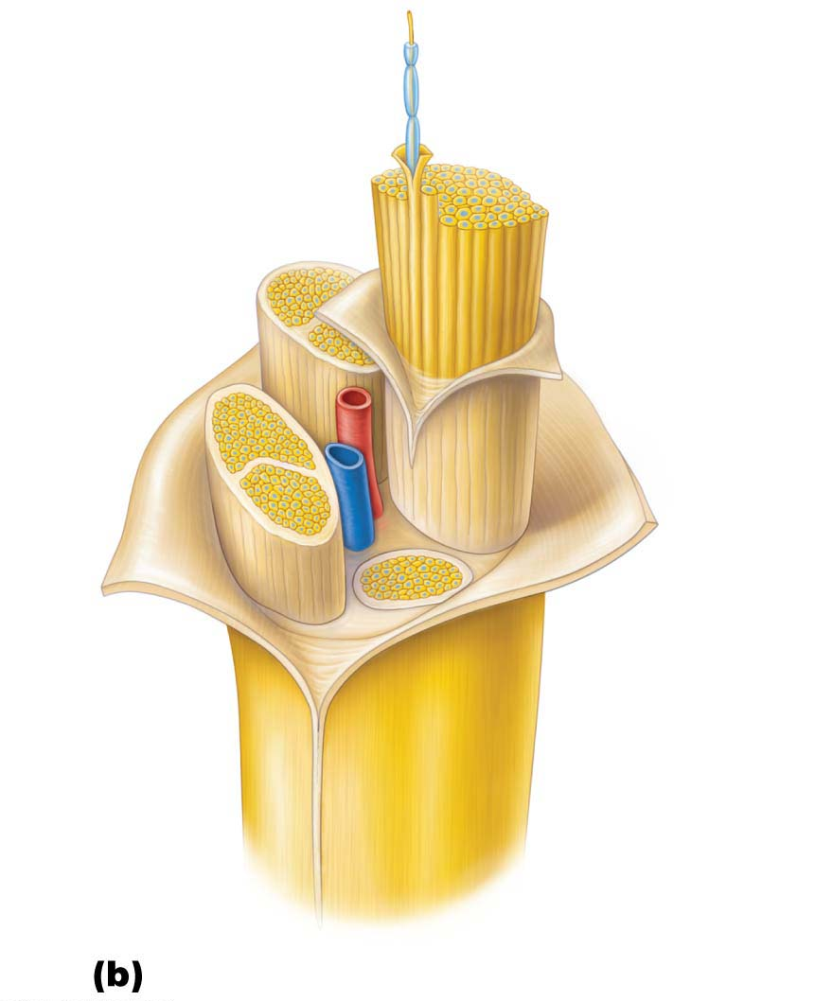
Structure and Classification (cont.)
Connective tissue coverings include:
Endoneurium:
Loose connective tissue
Perineurium
Coarse connective tissue
Fascicles
Epineurium
Tough fibrous sheath
Axon
Endoneurium
Myelin sheath
Perineurium
Epineurium
Fascicle
Blood
vessels

Slide 5
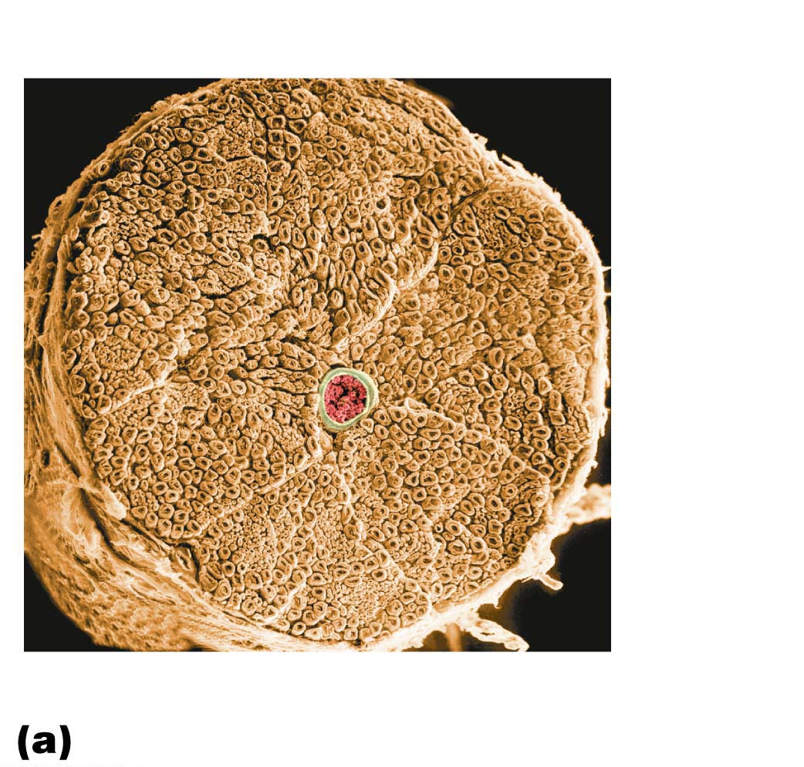
Figure 13.4a Structure of a nerve.
Endoneurium
Perineurium
Nerve
fibers
Blood
vessel
Fascicle
Epineurium

Slide 6
Structure and Classification (cont.)
Most nerves are mixtures of afferent and efferent fibers and somatic and autonomic (visceral) fibers
Nerves are classified according to the direction they transmit impulses
Mixed Nerves: contain both sensory and motor fibers
Sensory (afferent) Nerves: impulses only toward CNS
Motor (efferent) Nerves: impulses only away from CNS

Slide 7
Structure and Classification (cont.)
Pure sensory (afferent) or pure motor (efferent) nerves are rare; most nerves are mixed
Types of fibers in mixed nerves:
Somatic afferent
Somatic efferent
Visceral afferent
Visceral efferent

Slide 8
Structure and Classification (cont.)
Ganglia:
Contain neuron cell bodies associated with nerves in PNS
Ganglia associated with afferent nerve fibers contain cell bodies of sensory neurons
Dorsal root ganglia (sensory, somatic)
Ganglia associated with efferent nerve fibers contain autonomic motor neurons
Autonomic ganglia (motor, visceral)

Slide 9
Regeneration of Nerve Fibers
Mature neurons are amitotic, but if the soma (cell body) of the damaged nerve is intact, the peripheral axon may regenerate in PNS
CNS Axons
Most CNS fibers never regenerate
CNS oligodendrocytes bear growth-inhibiting proteins that prevent CNS fiber regeneration
Scar tissue
Treatment:
Neutralizing growth inhibitors
Blocking receptors for inhibitory proteins
Destroying scar tissue components

Slide 10
Regeneration of Nerve Fibers (cont.)
PNS Axons
PNS axons can regenerate if damage is not severe
Axon fragments and myelin sheaths distal to injury degenerate (Wallerian degeneration)
Macrophages clean dead axon debris; Schwann cells are stimulated to divide
Axon filaments grow through regeneration tube
Axon regenerates, and new myelin sheath forms

Slide 11
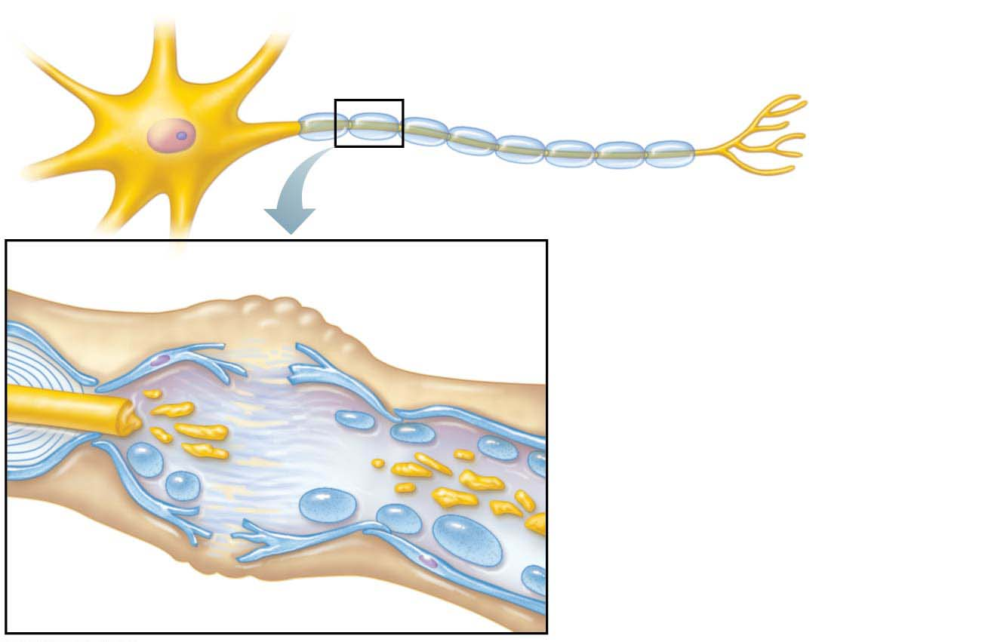
Figure 13.5-1 Regeneration of a nerve fiber in a peripheral nerve.
Endoneurium
Schwann cells
1. The axon fragments
• The cut axon ends seal themselves off.
• Axon transport is interrupted, causing the cut ends to swell.
• Without access to the cell body, the axon (and its myelin sheath) begins to disintegrate distal to the injury.
• Degeneration of the distal end of the cut axon, called Wallerian degeneration, spreads down the axon.
Droplets of
myelin
Fragmented
axon
Site of nerve damage

Slide 12
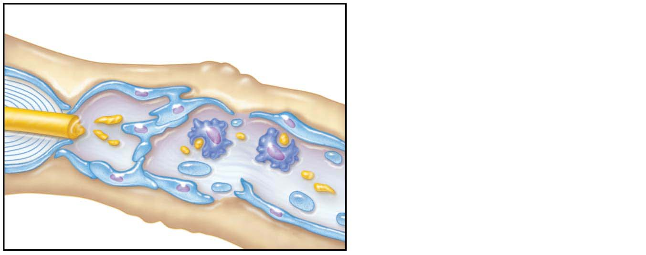
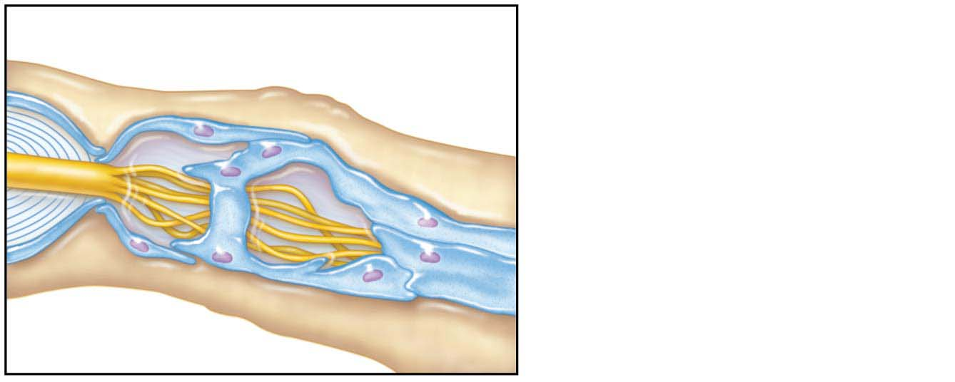
Figure 13.5-2,3 Regeneration of a nerve fiber in a peripheral nerve.
2. Schwann cells and macrophages clean out the dead axon distal to the injury.
• Surviving Schwann cells engulf the myelin fragments and secrete chemicals that recruit macrophages.
• Macrophages help dispose of the debris and release chemicals that stimulate Schwann cells to divide.
Schwann cell
Macrophage
Aligning Schwann cells form
regeneration tube
3. Axon filaments grow through
a regeneration tube.
• Schwann cells release growth factors and express cell adhesion molecules (CAMs) that encourage axon growth.
• Schwann cells line up along the tube of remaining endoneurium, forming a regeneration tube that guides the regenerating axon “sprouts” across the gap to their original contacts.
Fine axon sprouts
or filaments

Slide 13
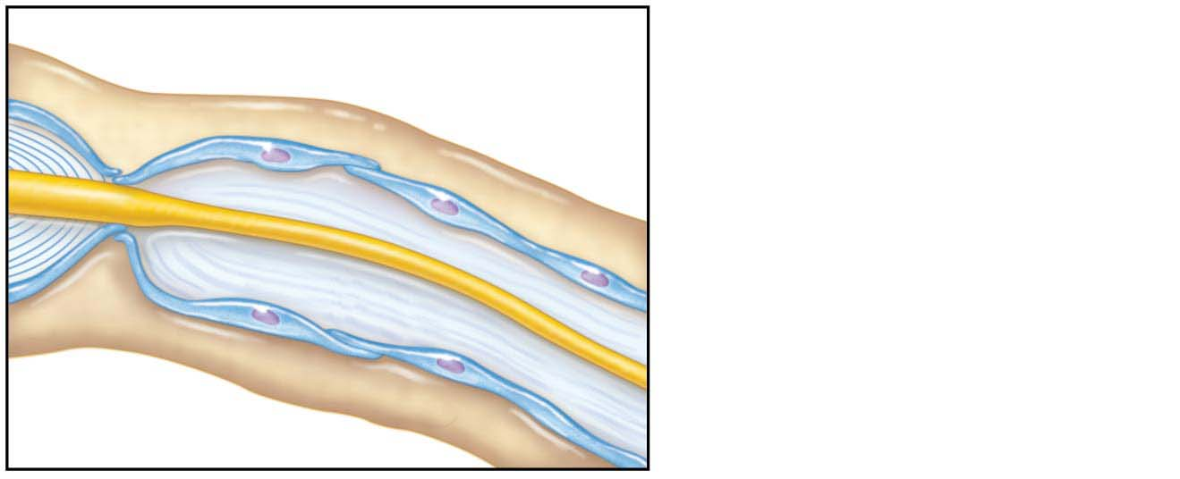
Figure 13.5-4 Regeneration of a nerve fiber in a peripheral nerve.
Schwann cell
New myelin
sheath forming
4. The axon regenerates and a new myelin sheath forms.
• The Schwann cells protect and support the regenerating axon and ultimately produce a new myelin sheath.
Single enlarging
axon filament

