Slide 1
Mendelian Transmission
Abductive Problem Solving
Genetics Cognitive Tutor
Unit Reimplemented with CTAT
HCII Biology
Albert Corbett Beth Jones
Ben MacLaren Linda Kauffman
Angela Wagner Aaron Mitchell
.

Slide 2
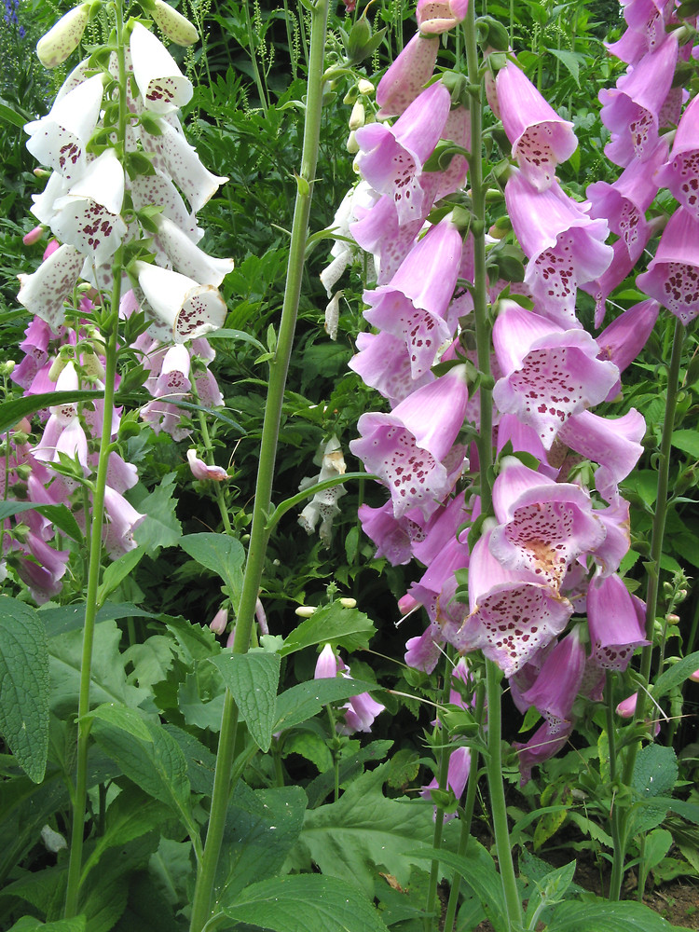
Foxglove
http://newfs.s3.amazonaws.com/taxon-images-1000s1000/Plantaginaceae/digitalis-purpurea-fl-dkausen.jpg

Slide 3
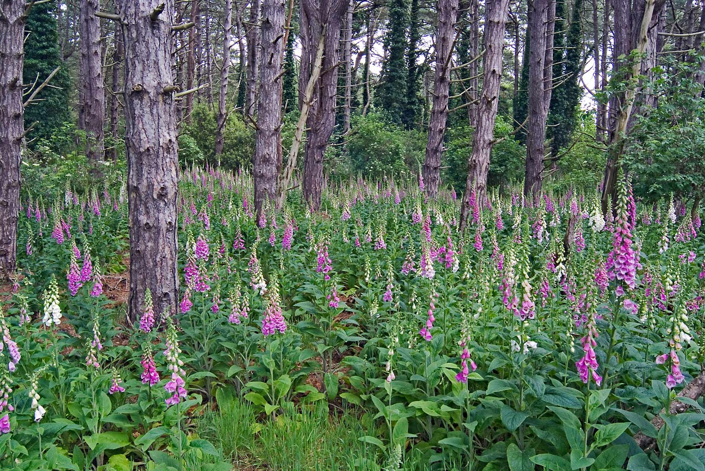
Foxglove
http://silvertreedaze.blogspot.com/2011/01/what-wood-you-do.html

Slide 4
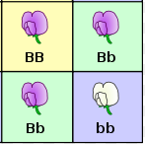
Mendelian Transmission
• A trait (e.g., flower color) is controlled by one gene
  We also use the term “Phenotype”
The gene has two alleles (i.e., alternative versions, e.g., B & b, dominant and recessive versions, resp.)
• Simple dominance applies:
Genotype Phenotype
BB (Homozygous dominant) pink
Bb (Heterozygous) pink
bb (Homozygous recessive) white

Slide 5
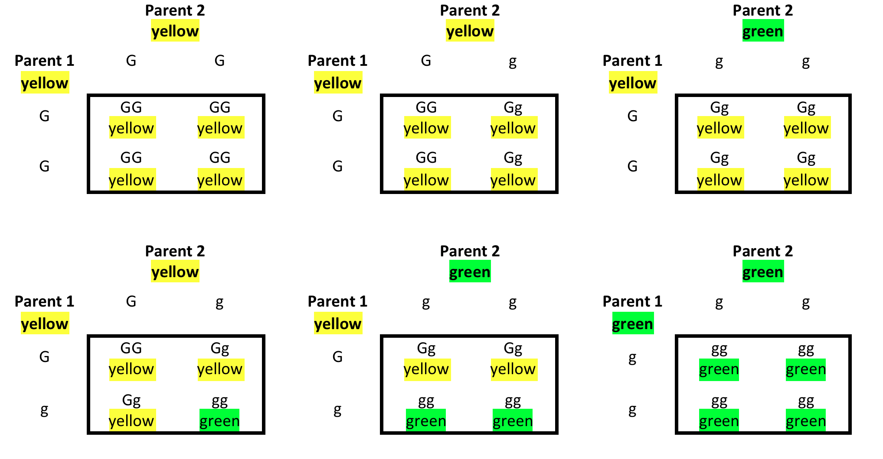
Mendelian Transmission (2)
Each offspring inherits one copy of each gene (i.e., one allele) from each parent;
The single gene copy that each parent transmits is selected randomly with equal probability
Can be summarized in 6 Punnett squares

Slide 6
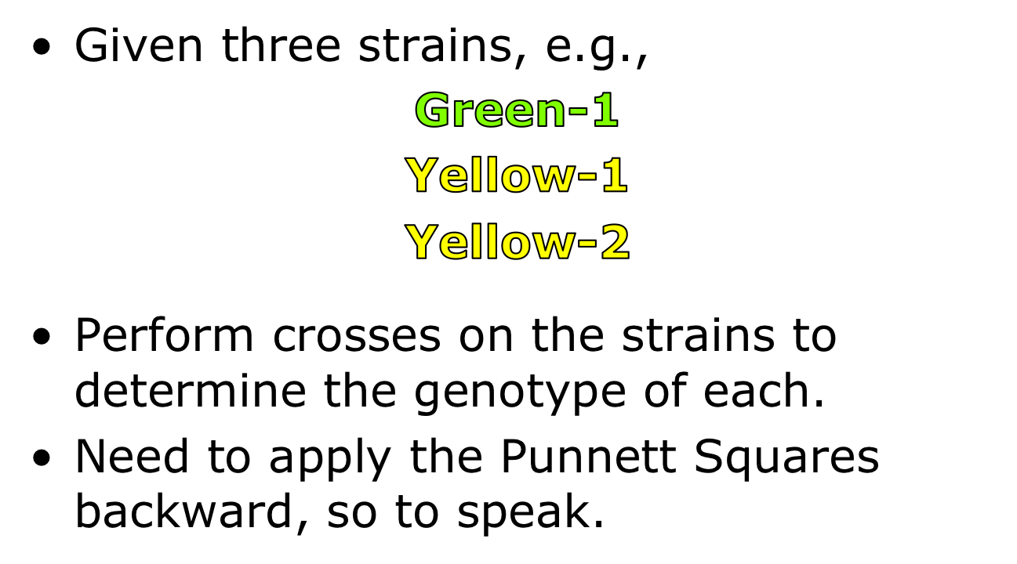
Abductive Problem Solving

Slide 7
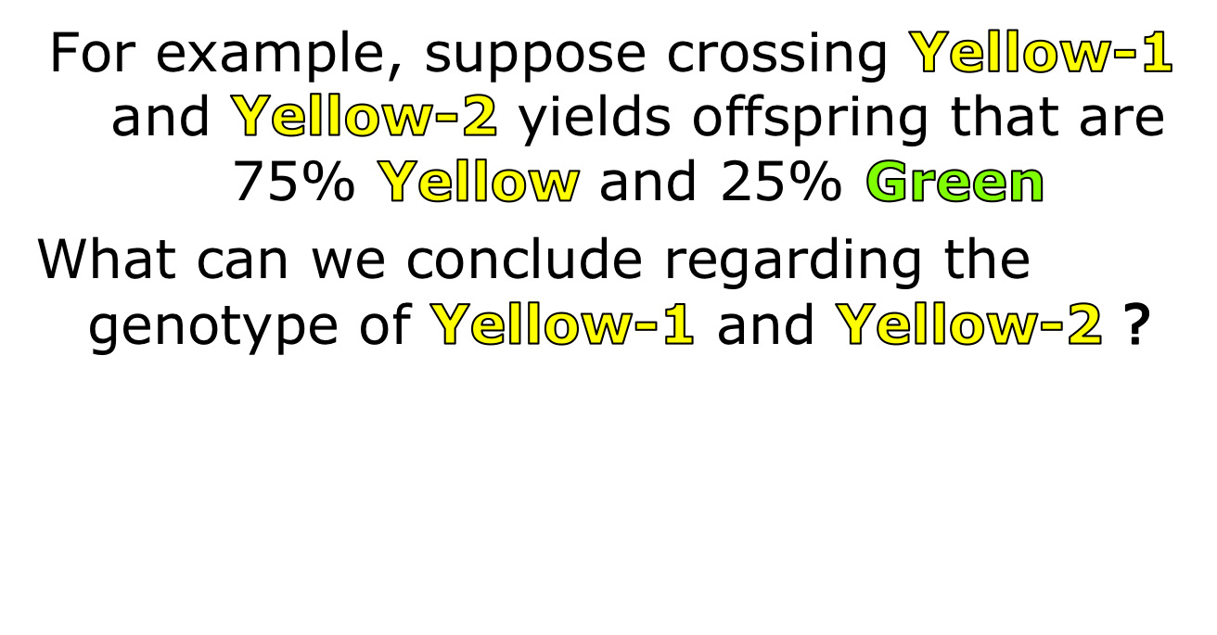

Slide 8
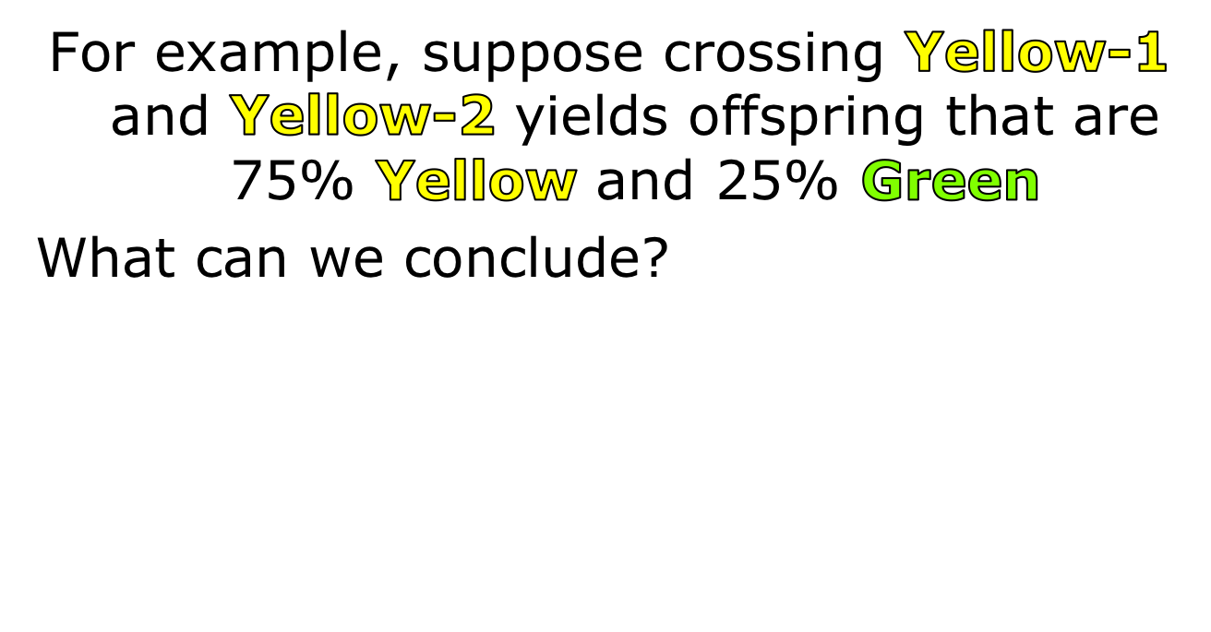
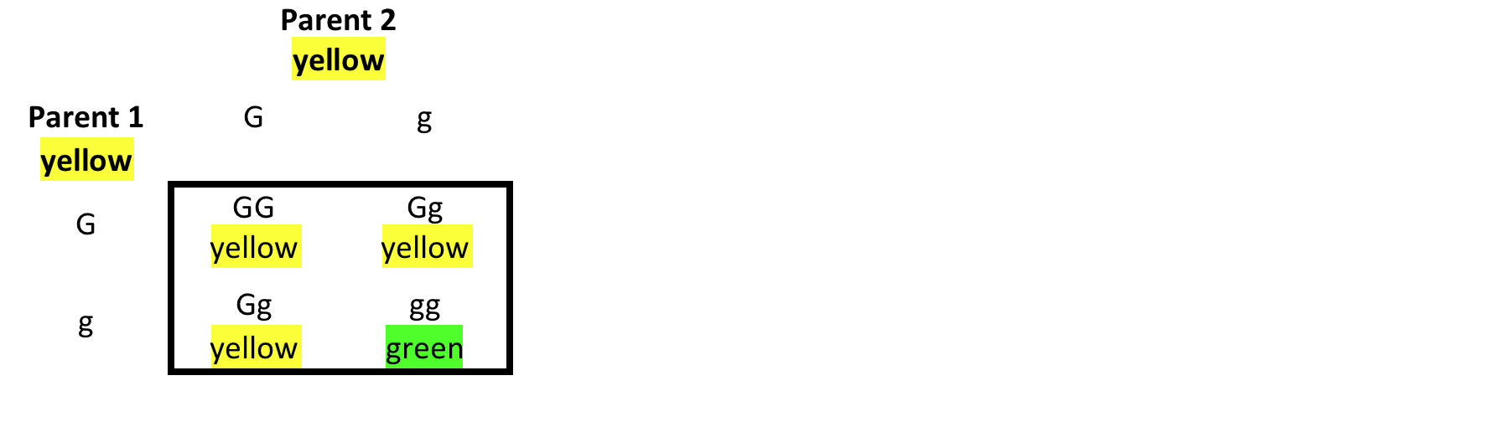
Only one of the squares has the same distribution of phenotypes among parents and offspring.

Slide 9

Both parents must be heterozygous.
As a general rule, 75%/25% offspring always means both parents are heterozygous. This occurs only when the two parents have the same phenotype. The third strain (assuming it has a different phenotype) must be homozygous recessive.

Slide 10
For a different species, suppose crossing strains Blue-1 and Blue-2 yields offspring that are 100% Blue. Assume we do not know if Blue is the phenotype expressed by the dominant or recessive allele. (We want to find out.)
What can we conclude about the genotype of Blue-1 and Blue-2 ?

Slide 11
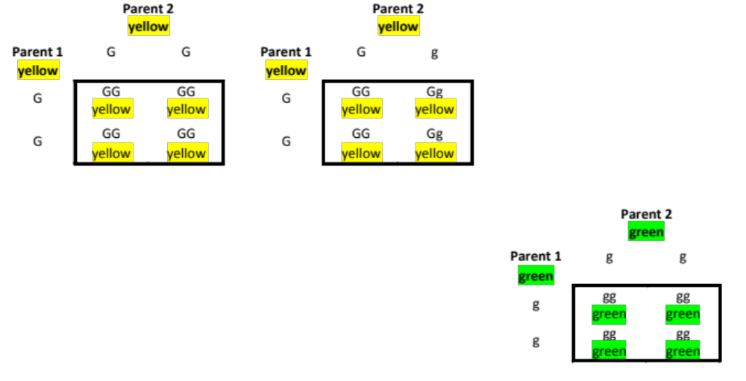
For example, suppose crossing Blue-1 and Blue-2 yields offspring that are 100% Blue.
What can we conclude?
Three squares have the same distribution of phenotypes among parents and offspring.

Slide 12
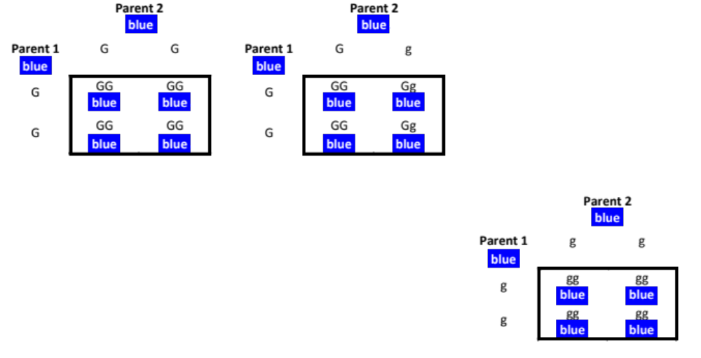
For example, suppose crossing Blue-1 and Blue-2 yields offspring that are 100% Blue.
What can we conclude?
What can we conclude? Either both parents are homozygous (could be either homozygous dominant or homozygous recessive) or one is homozygous dominant and the other heterozygous. This is such a weak conclusion that we will ignore it in the tutor. That is, no conclusion or partial conclusions will be entered in the tutor interface when parents with the same phenotype have offspring 100% of whom also have that phenotype.

Slide 13
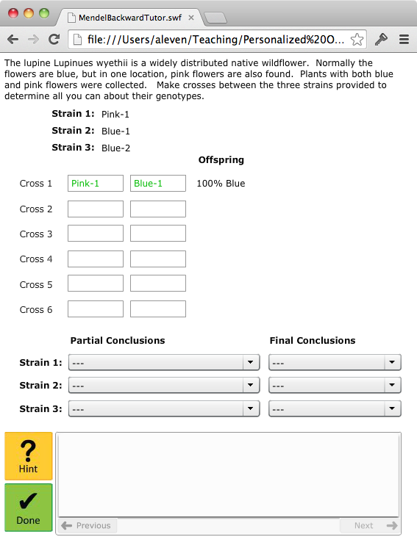
The Interface:
• Perform Crosses
• Draw Conclusions
(5 Possible)
Final Conclusions
Homozygous Dominant
Homozygous Recessive
Heterozygous
Partial conclusions
Homozygous
Heterozygous-OR-
Homozygous Recessive

Slide 14

The Interface:
• Perform Crosses
• Draw Conclusions
(5 Possible)
Final Conclusions
Homozygous Dominant
Homozygous Recessive
Heterozygous
Partial conclusions
Homozygous
Heterozygous-OR-
Homozygous Recessive

Slide 15
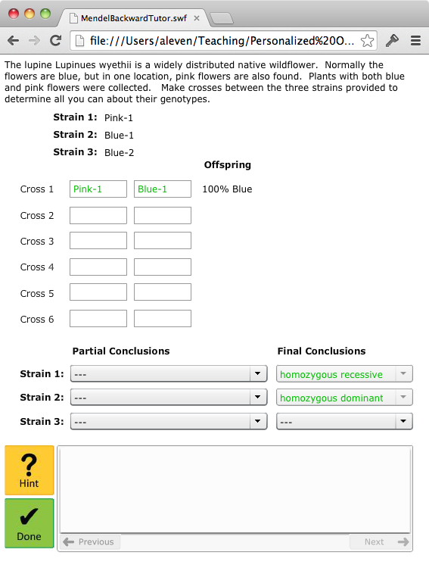
The Interface:
• Perform Crosses
• Draw Conclusions
• And so on

Slide 16
 | 100%/0% | 75%/25% | 50%/50%
Same strain (i.e., same phenotype)
Diff strains, same phenotype
Diff strains, different phenotype
In order to write the rules for abductive reasoning about Mendelian transmission, it helps to fill out this table. In each cell, you may enter the partial or full conclusions about the two strains being crossed that can be inferred directly from the result of the cross. You can fill out the table by systematically working through the 6 Punnett squares in the “declarative instruction” document, as illustrated in the previous slides. The numbers at the top of the columns refer to the frequencies of each trait in the offspring, as can be gleaned from the Punnett squares. Hint: not all cells are possible.

Slide 17
Inferences from crossing two strains
(6 rules)
IF a strain is crossed with itself
And the offspring are 100/0
THEN
Partial conclusion: homozygous
IF two different strains are crossed
And the offspring are 75/25
Then
Final conclusion for each strain: heterozygous

Slide 18
Inferences across crosses
IF a strain has partial conclusion (HR or Het) and has partial conclusion H
THEN final conclusion for that strain = HR
IF a strain has no final conclusion
And a different strain with the same phenotype = HR
THEN final conclusion for the first strain = HR
IF a strain has no final conclusion
And a strain with a different phenotype = HD/Het
THEN final conclusion for the first strain = HR
If a strain has no final conclusion and has partial conclusion (HR or Het)
And a strain with diff phenotype = HR
THEN final conclusion for first strain = Het
IF a strain has no final conclusion and has partial conclusion H
And a strain with the same phenotype = HD/HT
THEN final conclusion for the first strain = HD

Slide 19
Additionally
Tutor must know when all inferences that can be drawn after a certain cross, have been done

