Slide 1
Coding With Eclipse
Pratical Tips and Tricks
Pr. Olivier Gruber
olivier.gruber@imag.fr
Full-time Professor
Université Grenoble Alpes

Slide 2
Outline
The Workbench and workspace basics
  Perspectives and views
  Workspaces and projects
Developing in Java
  Java project basics
  Coding key features
  Debugging key features
  Testing basics
  Performance basics

Slide 3
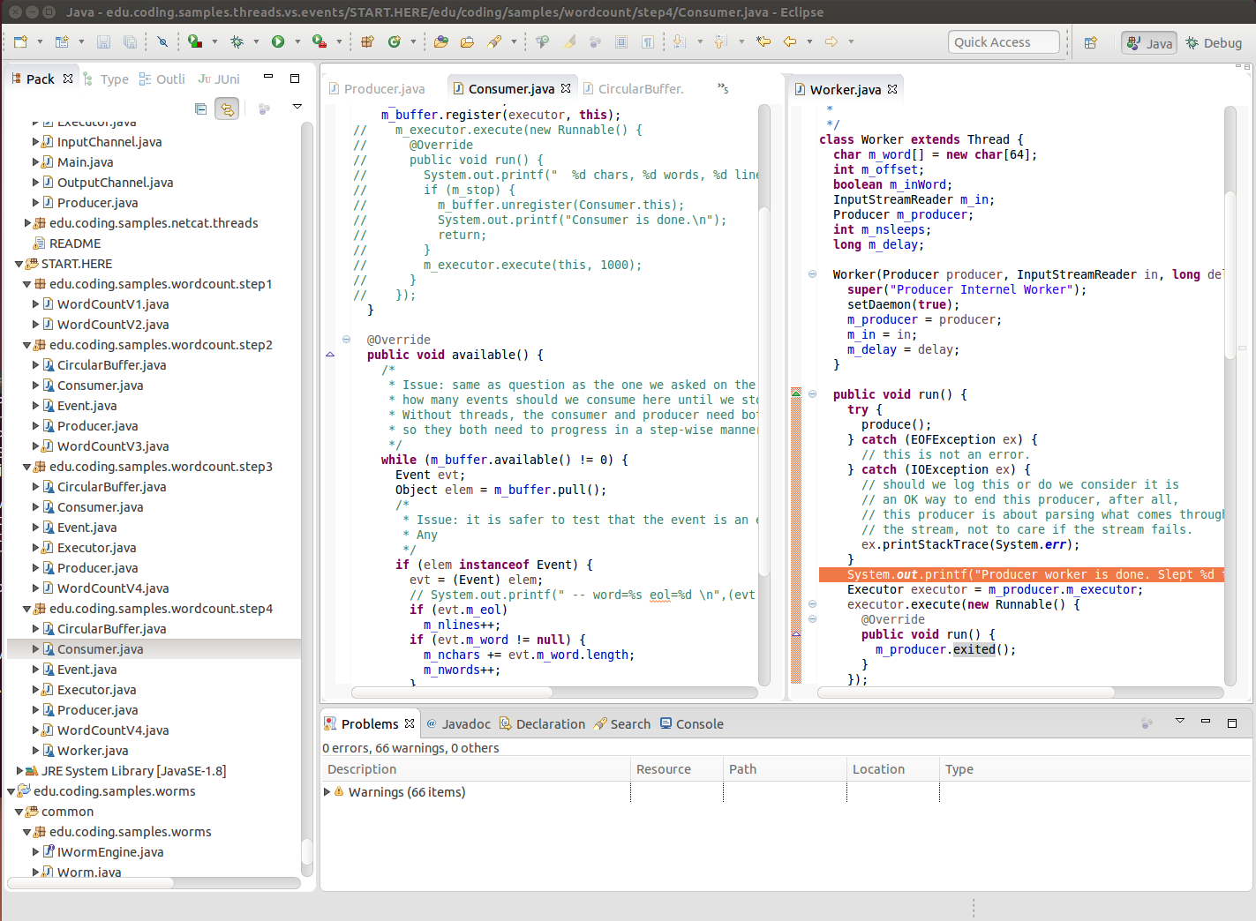
Eclipse Workbench – The Java Perspective

Slide 4
Eclipse Workbench
Perspectives
  A perspective is a activity-oriented layout of views on the screen
    Java perspective or C/C++ perspective
    Debugging perspective
  The screen shows the current perspective
    But you can have multiple perspectives open
    You can switch between them
    Menus and toolbars change when switching between perspectives
    To open a perspective, use menus: Window → Perspective
  A perspective can host any view
    To open a view, use menus: Window → Show View
  A perspective layout is a grid
    Views can be moved around by drag and drop

Slide 5
Eclipse Workbench
Each Perspective
  A activity-oriented organization of views than can be cusomized
Current perspective (Java)
Package Explorer
Perspective
switcher
An view ''Editor''
A view ''Problems''

Slide 6
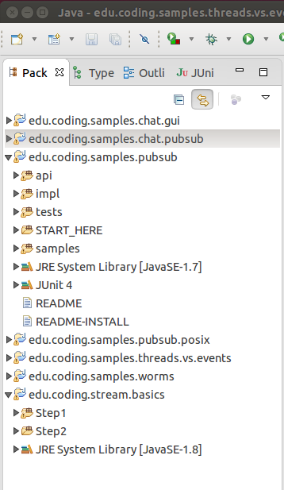
Eclipse Workspace
Package Explorer
View
Workspace
  Corresponds to a directory in the file system
    Called the Workspace directory
  Contains a set of projects
    Each project corresponds to a subdirectory
    Projects may also be linked to workspace
Created Project
  Created as a subdirectory to the workspace
Imported Project
  From another location than the Workspace directory
Each project has a nature
  One project may be a Java project
  While another may be C/C++ project
Projects

Slide 7
Java Project
Process Outline
  Create the project with a name
  Align compatibility levels
    Choose a Java level for your code (Java 1.8 for example)
    Setup Java compiler to a compatible level (Java 1.8)
    Choose an installed Java platform that is installed (JavaSE-1.8)
  A bit of history about Java
    The Java language exist in multiple versions – from 1.0 up to 1.8
    The Java platform exist also in multiple versions – from 1.0 up to 1.8
    The Java platform is a runtime to execute Java programs
      It can be a Java Runtime Enviroment (JRE) or a Java Developer Kit (JDK)
      As a developer, always install a JDK, it has more tools that you will need
    The platform comes in different profiles
      Standard Edition (JavaSE), Enterprise Edition (JavaEE), Minimum Edition (J2ME)
      Install JavaSE on a desktop/laptop

Slide 8
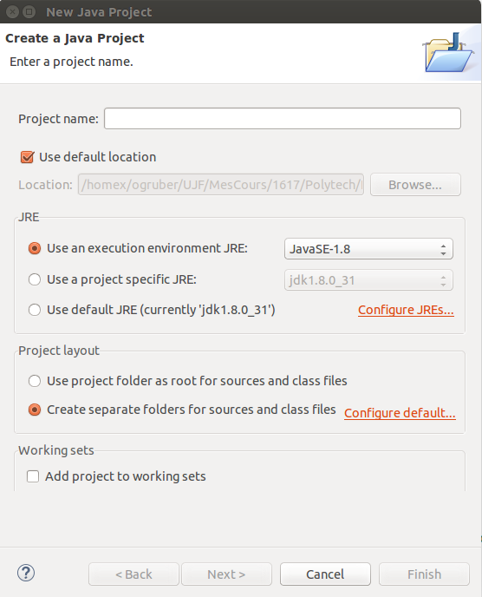
Eclipse Workspace – New Java Project
Creating a new Java project
  Menu: File → New → Java Project
  Choose a name
  Choose a location
Choose an execution environment
  Must be compatible with the code
  Choose the latest is ususally safe
  You may have to configure JREs
Choose a layout
  Better to separate sources and class files
Default location in the
Worskpace directory

Slide 9
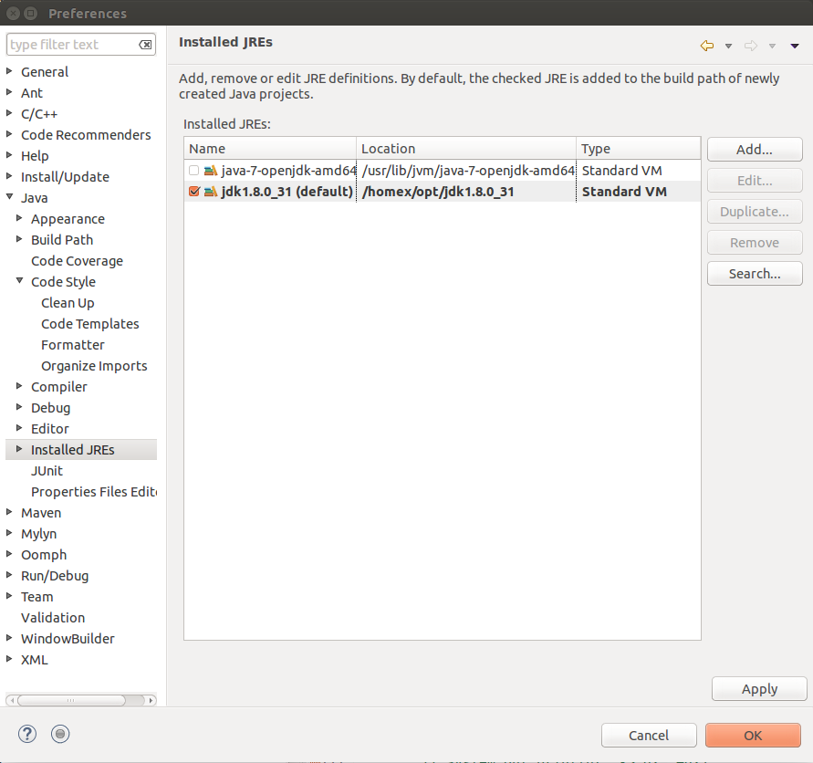
Eclipse Workspace – Java Runtime Environment Setup
Configuring JREs
  Installed JREs and JDKs
  Always install a JDK
  From Oracle website
  Make it the default
To get this dialog, use menus
Window → Preferences
Drill down to
Java
Installed JREs

Slide 10
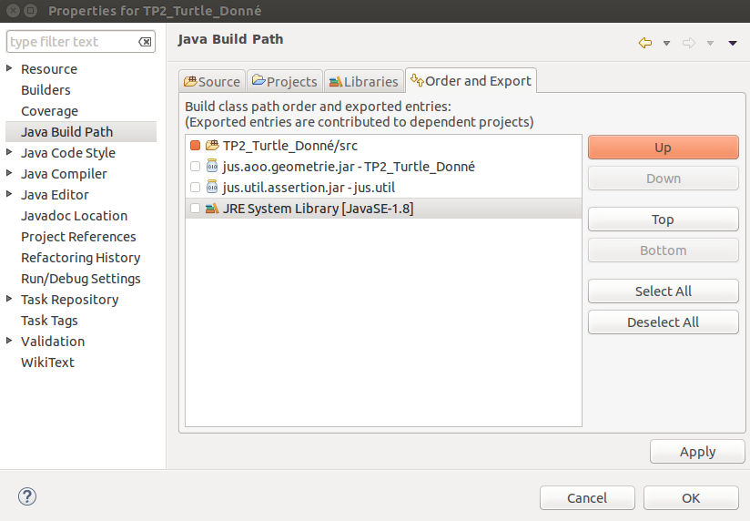
Eclipse Workspace – Java Project Setup
Setup your Java Build Path
  Right-click on a project in the Package Explorer view → Properties (Alt-Enter)
Edit tabs
Summary
Sources
Libraries
Compatible
JRE System Library

Slide 11
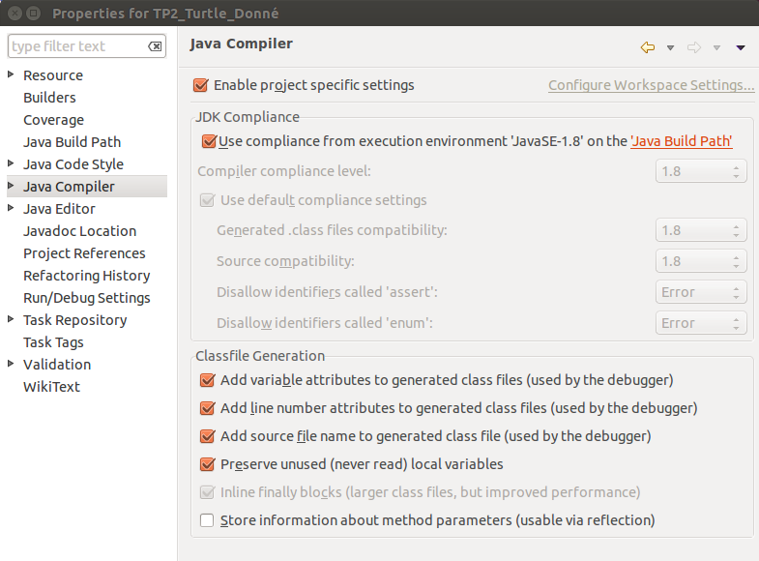
Eclipse Workspace – Java Project Setup
Setup the Java Compiler
  Choose JDK compliance
  Select debug infos
Two levels of settings

Slide 12
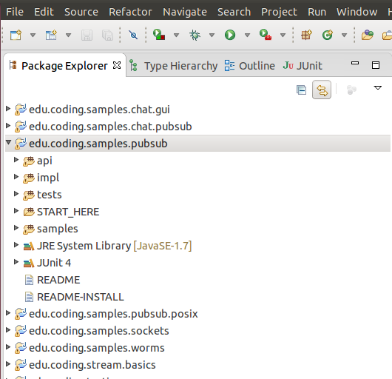
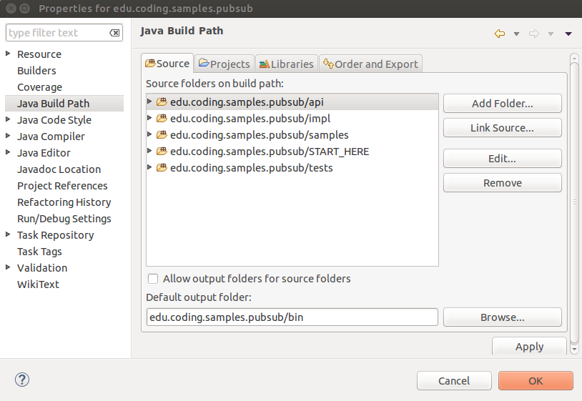
Eclipse Workspace – Java Project Setup
Projects
  You can use multiple source directories
  But usually one output folder
Where your code is
Where the compiler generates class files

Slide 13
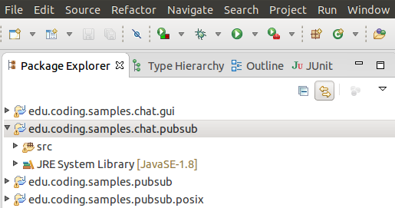
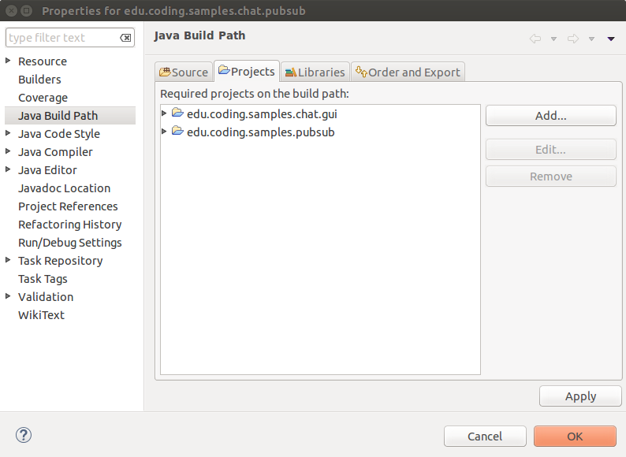
Eclipse Workspace – Java Project Setup
Projects
  Can depend on each others
  Cycles are possible (advanced option)

Slide 14
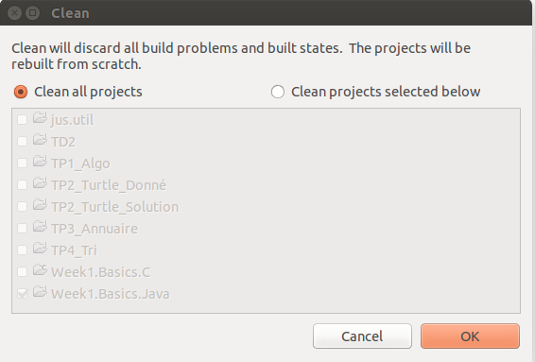
Eclipse Workspace – Java Project Build
Project Menu
  Automatic build is the default
  Very accurate/efficient in Java
Project Clean
  Sometimes cleaning is necessary
  Alt-P → Clean

Slide 15
Eclipse – Java Coding

Slide 16
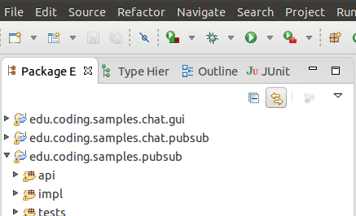
Eclipse – Java Coding
Java Editing
  Multi-editors (drag-and-drop, sort of a grid layout)
  Split editors (Alt-W-E or Ctr-_ Ctr-{)
  Tab management
    Close current tab (Ctr-W)
    Close all tabs (Ctr-Shift-W)
    Change tab (Ctr-PgUp, Ctr-PgDown)
    Choose tab (Ctr-E + regular expression)
Navigator
  Synchronized navigation
  Collapse all

Slide 17
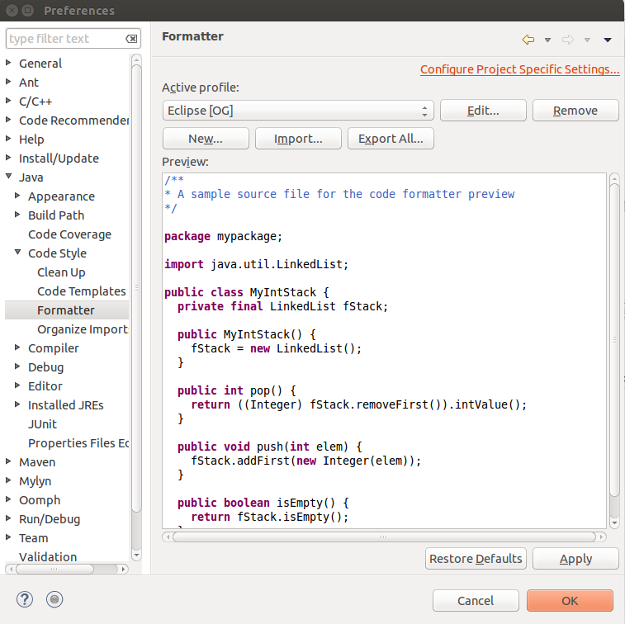
Eclipse – Java Coding
Java Editing
  Setup your preferences (Alt-W-P)
    Edit your Java Formatter profile
      Java → Code Style → Formatter
      No tabs, 2 spaces
      Comment reformattting (disable/enable)
      Choose a coding style
  Pretty printing
    Pretty printing (Ctr-Shift-F)
    Organize imports (Ctrl-Shift-O)
Export/Import preferences
  Across your workspaces
  Across team members

Slide 18
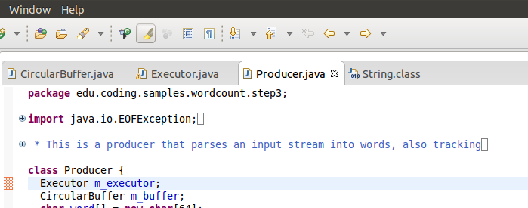
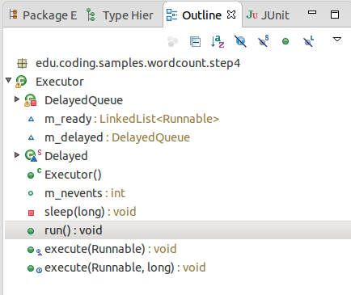
Eclipse – Java Coding
Java code navigation
  Search engine
  Class search (Ctlr-Shift-T + regexp)
  Select and hit F3
  Use arrows with drop-down
  References (right-click or Ctr-Shift-G)
Outline
  Outline view (can be sorted a-z)
  Outline popup (Ctlr-o + regexp)

Slide 19
Eclipse – Java Debugging
Eclipse has a fantastic debugger for Java
  Use it – You will love it
  Really well integrated withint the Eclipse environment
What is a debugger for?
  A debugger is a tool to watch the execution of a program
  It allows you to single step through the execution
    Single stepping means to execute one instruction/line at a time
  It allows you to set breakpoints and run the program until it hits a breakpoint
    A breakpoint is a point in your program where the execution will stop
  It allows you to introspect your program
    When the execution is suspended
    The debugger shows you the call stack, local variables, etc.

Slide 20
Eclipse – Java Debugging
Java perspective vs Debug perspective
  Java perspective is to develop Java program
  Debug perspective is to debug programs
How to get started
  Set a breakpoint on the first line of the main method
    In the Package Explorer, scroll to your class and then to its main method
    Double-click on the left edge of the editor at the first line of the main method
  Then launch the execution
    In the Package Explorer, scroll to your class and then to its main method
    Right-click on the class with the static main method
    Select Debug-As → Java Application
The first time, Eclipse may ask you
If you want to switch to the Debug perspective
Click remember my decision and says yes.
WHILE DEVELOPING,
ALWAYS EXECUTE
UNDER THE DEBUGGER!
You never know when a bug will show up...

Slide 21
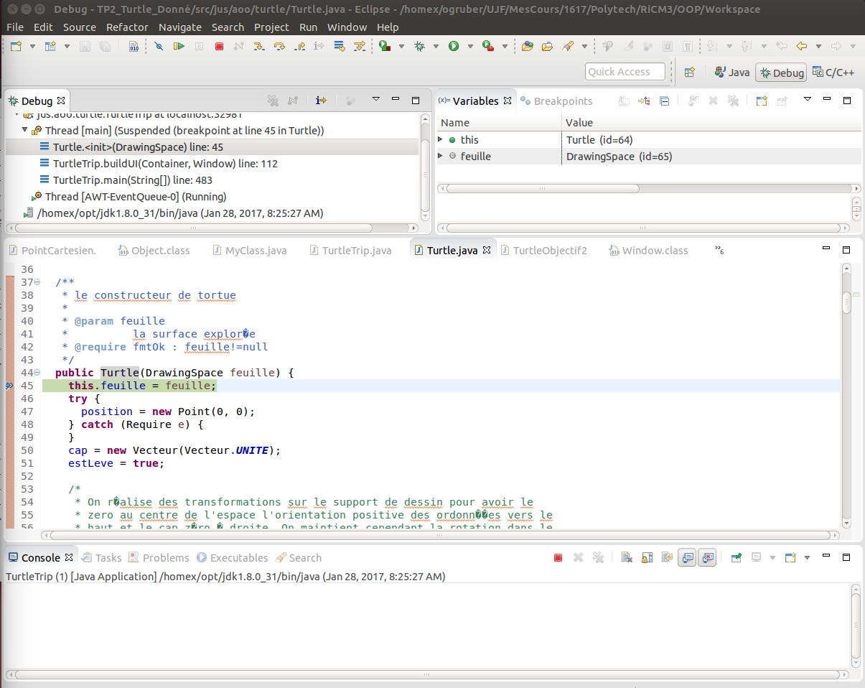
Eclipse – Java Debugging
Variables
Call stack
Breakpoints
Up &
Down
Current line

Slide 22
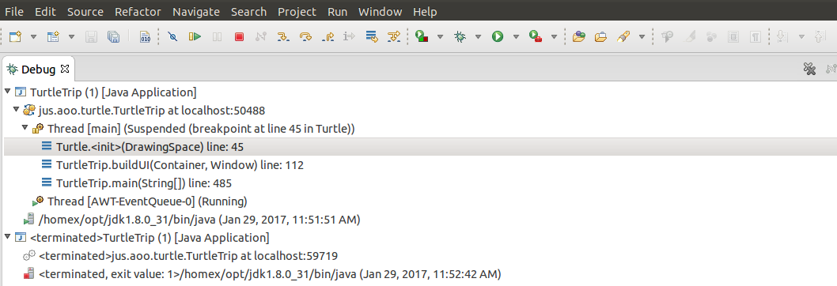
Eclipse – Java Debugging
One Java Application
under debug...
Launched class: jus.aoo.turtle.TurtleTrip
Main thread
(flow of execution)
Local debug (localhost:50488)
GUI Thread (AWT)

Slide 23
Eclipse – Java Debugging
Terminated debug session
One can use multiple debug sessions at the same time in Eclipse
Make sure you terminate all sessions that you no longer follow

Slide 24
Eclipse – Java Stepping
Go (F8)
Step in (F5)
Terminate session
Step over (F6)
Step out (F6)

Slide 25
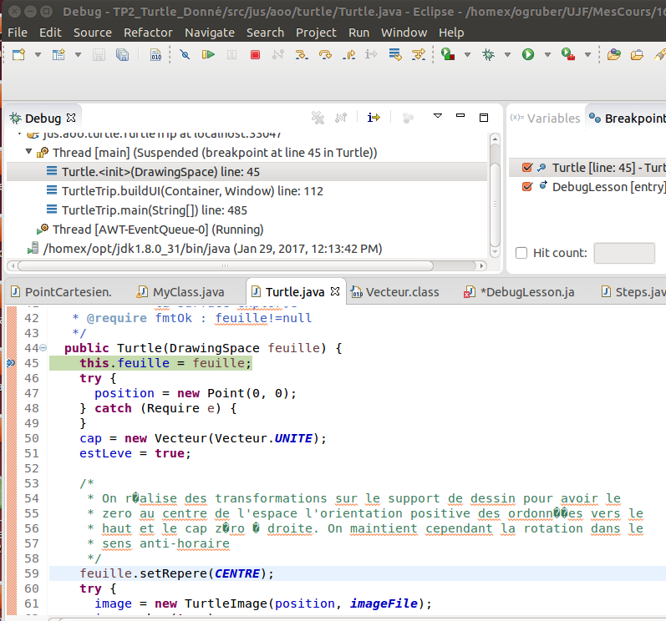
Eclipse – Java Stepping
Set breakpoints by
double-clicks on the left edge
of the window
Top tricks:
Run to selection (Ctlr-F5)
Run to line (Ctlr-R)

Slide 26
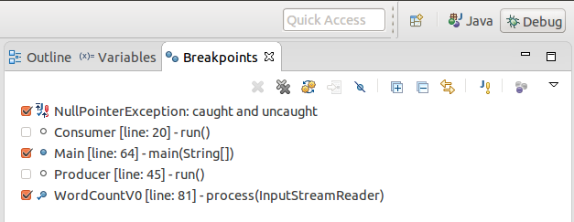
Eclipse – Java Stepping and Breakpoints
Single stepping summary
  F5 (step into) Ctlr-F5 (step into selection)
  F6 (step over)
  F7 (step out)
  F8 (go)
  Ctlr-R (run to line)
Breakpoints
  On thrown exception
    Caught or Uncaught
  On a given line
To add a breakpoint
for an exception
Active/Inactive breakpoints
Note: to change your key bindings
Alt-w → Preferences
General → Editor → Keys

Slide 27
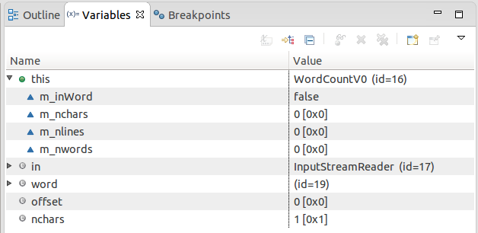
Eclipse – Java Debugging
Introspecting variables via the Variables View
  Receiver (this)
  Method arguments
  Local variables
Values
  In decimal/hexadecimal
  Walk through objects
  Calling Object.toString()
Note: there is a bug in the variable tab sometimes
You are left with only one column
Drop-down menu → layout → select columns
Select a new column and all will come back

Slide 28

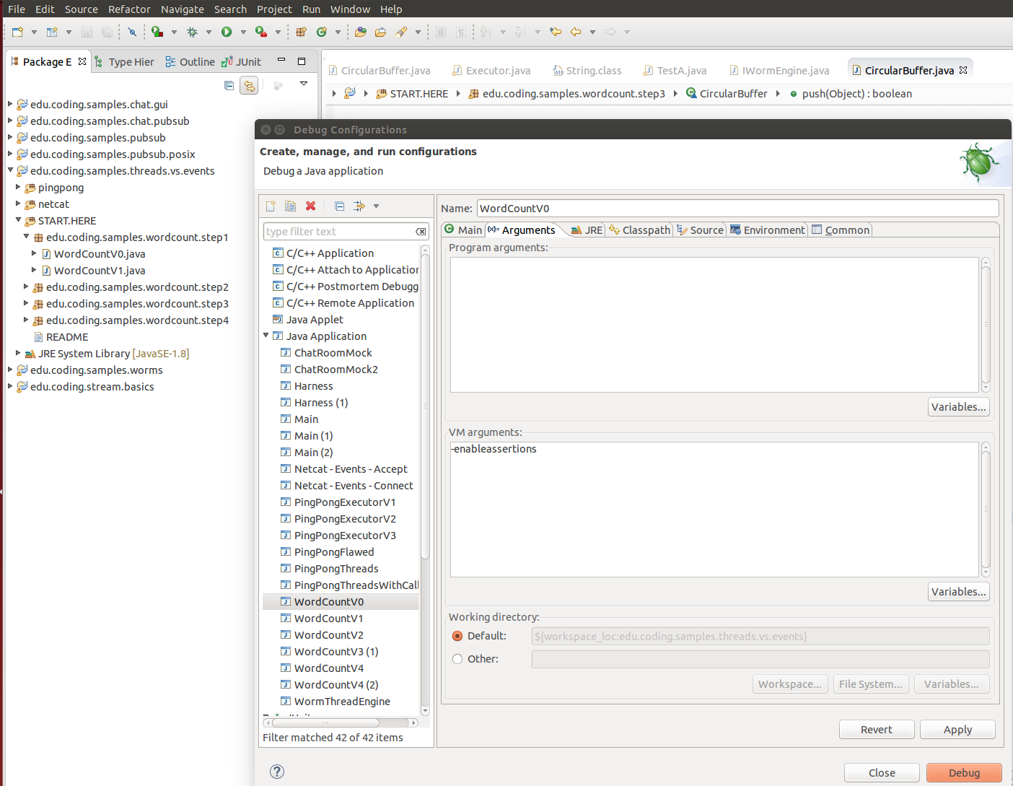
Debug Configurations
Drop-down combo → Debug configurations
Enable assertions
Class
with the static main
method

Slide 29
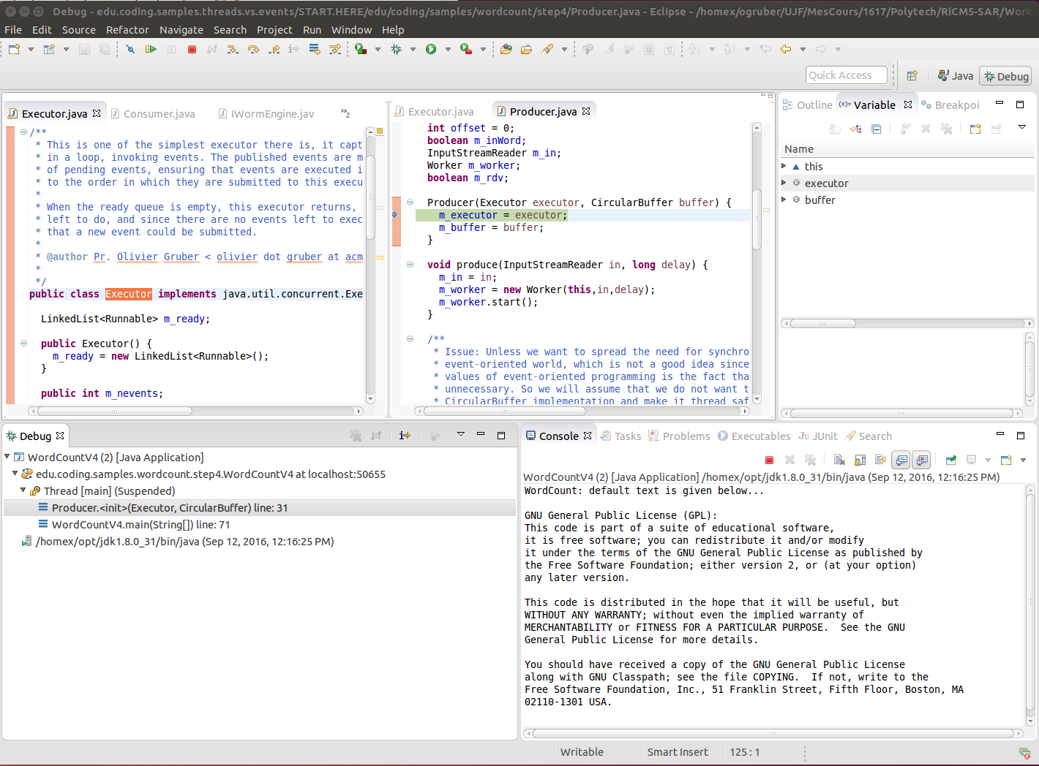
Eclipse – Java Debugging – Use your own layout!

Slide 30
Eclipse – Java Unit Testing
JUnit has direct support in Eclipse
  See JUnit/Eclipse documentation
  See given examples
Core points
  Add JUnit (project properties → Java Build Path → Add library)
  You can run/debug as JUnit a Java package or a Java source folder (right-click → debug as)
WHILE JUNIT TESTING, YOU CAN EXECUTE
UNDER THE DEBUGGER ALSO!
Trust me, you will have to debug both your tests and your application...
http://junit.sourceforge.net/doc/cookbook/cookbook.htm
http://help.eclipse.org/mars/index.jsp?topic=%2Forg.eclipse.jdt.doc.user%2FgettingStarted%2Fqs-junit.htm

Slide 31
Eclipse – Java Unit Testing with Coverage
Cobertura
  Runs your JUnit tests gathering coverage information
  See the edu.coding.testing project
  See the cobertura.sh scripts
Coverage is important
  You will be surprised at how even complex tests cover so few lines...
  Most of the times though, 100% is not achievable
Even at 100%, you probably haven't tested all situations
Testing is just hard and necessary.
Regression testing is very important for evolving software.

Slide 32
Eclipse – Java Performance Tuning
Golden rule
  Performance numbers are just numbers, the interpretation is everything
Java Visual VM (jvisualvm)
  It is your health monitor for your Java Runtime Environments (JREs)
  It is part of the Oracle JDK (in the bin directory, with java)
Why bother with Java Visual VM?
  Machines are extremely fast → Hide performance problems
JVisualVM – main features
  CPU usage, showing garbage collection overhead
  Heap evolution, showing memory usage
  Showing threads, loaded classes

Slide 33
Eclipse – Java Performance Tuning
Golden rule
  Performance numbers are just numbers, the interpretation is everything
Java Visual VM (jvisualvm)
  It is your health monitor for your Java Runtime Environments (JREs)
  It is part of the Oracle JDK (in the bin directory, with java)
Small Java test harness
  See edu.coding.testing project → edu.coding.perfs package
  A simple harness that supports running multiple benchmarks
    With warmup or not
    Computes averaged elapsed time over several execution (default is 10)
    With forced garbage collection in between runs (or not)
    With basic support for hprof
  Yourkit (https://www.yourkit.com/)
    Seems a pretty complete and advanced profiling framework for Java and DotNet

Slide 34
Conclusion
Hope this talk helped you.
Happy coding...

Slide 35
Eclipse – Setup
Windows/Mac users...
  You are on your own with Google
Linux users
  My setup is like this
  Because of GTK issues, on Ubuntu 14.04, with Eclipse Mars
$ more ~/bin/eclipse
#!/bin/sh
export JAVA_HOME=/homex/opt/jdk1.8.0_31/
PATH=$PATH:$JAVA_HOME/bin
export SWT_GTK3=0
export UBUNTU_MENUPROXY=0
/homex/opt/eclipse-mars/eclipse -showlocation $*

Slide 36
Eclipse – Setup
Eclipse.ini
$ more /homex/opt/eclipse-mars/eclipse.ini
-startup
plugins/org.eclipse.equinox.launcher_1.3.100.v20150511-1540.jar
--launcher.library
plugins/org.eclipse.equinox.launcher.gtk.linux.x86_64_1.1.300.v20150602-1417
-product
org.eclipse.epp.package.java.product
--launcher.defaultAction
openFile
-showsplash
org.eclipse.platform
--launcher.XXMaxPermSize
256m
--launcher.defaultAction
openFile
--launcher.appendVmargs
-vmargs
-Dosgi.requiredJavaVersion=1.7
-XX:MaxPermSize=256m
-Xms256m
-Xmx1024m

Slide 37
Eclipse Workbench
Each Perspective
Current perspective (Java)
Package Explorer
Perspective
switcher
An "Editor"
A view ''Problems''

Slide 38
Eclipse Workspace
Package Explorer
View
Projects
Source folders
Project for Java 1.7
Project for Java 1.8

Slide 39
Eclipse Workspace – New Java Project
Default location in the
Worskpace directory
Choose a JRE
You might have to configure
the JRE you want
Choose a layout

Slide 40
Eclipse Workspace – Java Runtime Environment Setup
Configuring JREs
  Installed JREs and JDKs
  Always install a JDK
  From Oracle website
  Make it the default
To get this dialog, use menus
Window → Preferences
Drill down to
Java
Installed JREs

Slide 41
Eclipse Workspace – Java Project Setup
Edit tabs
Summary
Select the Java Build Path
Sources
Libraries
Compatible
JRE System Library

Slide 42
Eclipse Workspace – Java Project Setup
Exported source folder
Unexported libraries
Unexported
JRE System Library

Slide 43
Eclipse Workspace – Java Project Setup
Setup the Java Compiler
  Choose JDK compliance
  Select debug infos
Two levels of settings

Slide 44
Eclipse Workspace – Java Project Setup
Where your code is
Where the compiler generates class files

Slide 45
Eclipse Workspace – Java Project Setup

Slide 46
Eclipse Workspace – Java Project Build
Project Menu
  Automatic build is the default
  Very accurate/efficient in Java
Project Clean
  Sometimes cleaning is necessary
  Alt-P → Clean

