Slide 1

Automating TS generation and optimization with RDkit and XTB/ORCA
Spring 2022 Coding Camp
Liliana C. Gallegos
March 30, 2022

Slide 2
workflow
Motivation: To generate a high-throughput data generation (i) for a diverse library of substrates, (ii) comparable to QM data, (iii) without the large computing time as DFT, (iv) for metal-complex intermediates and transition states structures, (v) executable in Jupyter notebook.
SMILES
SMARTS: generate geometries
Build TS: transform geometries with TS measurements
TS: Constrain optimization & hessian calc.
Ground state: Opt & hessian calc.
Optimize with XTB
Optimize with ORCA
Ground state: Opt with freq. calculation
TS: Hess calc then, TS optimization with freq. calc
Collect thermo data:
free-energies, imag. frequencies
SMARTS: http://organica1.org/seminario/daylight.pdf
ORCA manual 4.2.1: https://www.afs.enea.it/software/orca/orca_manual_4_2_1.pdf
XTB solvation: https://xtb-docs.readthedocs.io/en/latest/gbsa.html
Notes:
- Recheck radical pathway

Slide 3
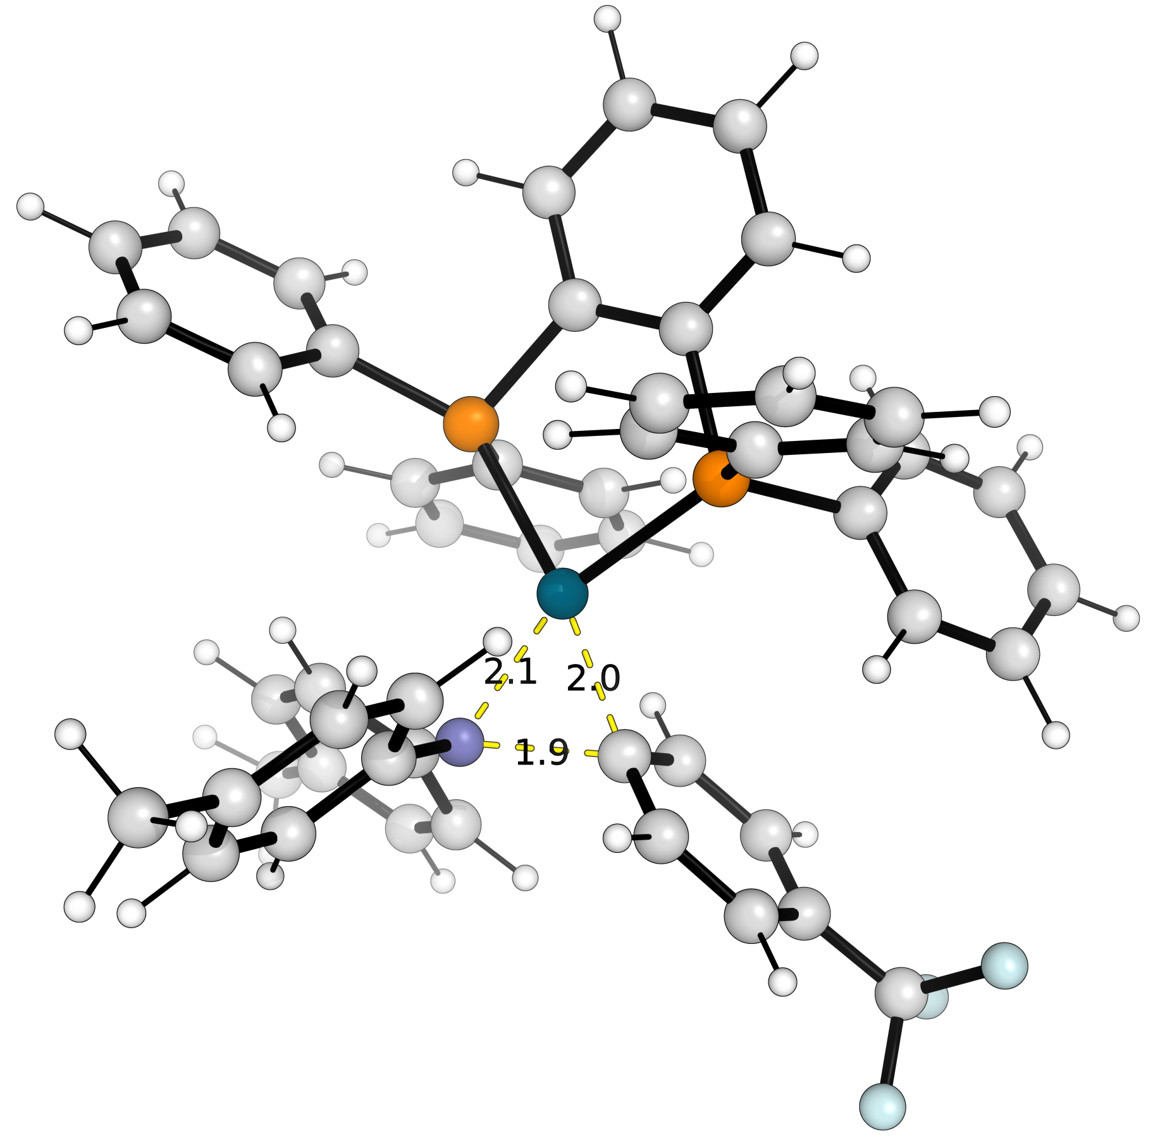
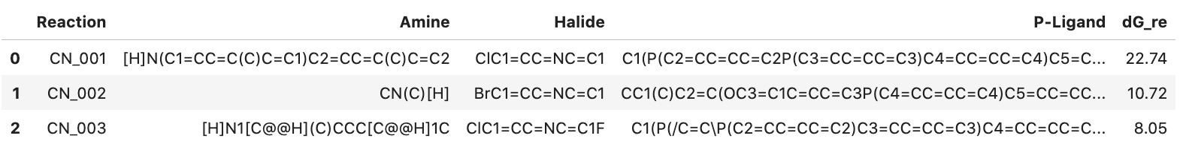
Metal-complex Example
DFT optimized: Pd-complex
reductive elimination TS structure
C-N bond reaction
Ligand
Aryl
Amine
CN_001
CN_002
CN_003
Notes:
- Recheck radical pathway

