Slide 2
Mercury
It’s the smallest planet of them all
Earth
Venus
Venus is the second planet from the Sun
Power 1
Neptune
It’s the farthest planet from the Sun
Mars
Saturn
Saturn was named after a Roman god

Slide 4
Step-by-step coding
01
02
03
04
Earth
Mercury
Jupiter
Saturn
It’s the only planet known to harbor life
Mercury is the closest planet to the Sun
Jupiter is the biggest planet of them all
Saturn was named after a Roman god

Slide 5
Icon pack

Slide 6
Alternative resources
Here’s an assortment of alternative resources whose style fits the one of this template:
Icons:
Networking Icon Pack
Network

Slide 7


Slide 8
Case study
Challenge
Results
Solution
Mercury is the closest planet to the Sun and the smallest planet in the Solar System
Venus has a beautiful name and is the second planet from the Sun. It’s terribly hot
Jupiter is the biggest planet. It's also one of the brightest objects in the night sky

Slide 9

Company A
Competitors
Company B
Mercury is the closest planet to the Sun and the smallest one in the Solar System—it’s only a bit larger than the Moon
Venus has a beautiful name and is the second planet from the Sun. It’s very hot and has a poisonous atmosphere

Slide 10
Features
Mercury
Venus
Mars
Jupiter
Saturn
Neptune
It’s the closest planet to the Sun
Venus is the second planet from the Sun
Mars is actually a very cold place
Jupiter is the biggest planet of them all
It’s composed of hydrogen and helium
It’s the farthest planet from the Sun

Slide 11
Project timing
Our model
Marketing
Assessment
Technology
Training
Venus has a beautiful name
Despite being red, Mars is a cold place
Mercury is quite a small planet
Jupiter is the biggest planet of them all

Slide 12

Thanks!
Do you have any questions?
youremail@freepik.com
+91 620 421 838
yourwebsite.com
Please keep this slide for attribution

Slide 13


Alternative resources
Here’s an assortment of alternative resources whose style fits that of this template:
Landing page template artificial intelligence
Abstract artificial intelligence background

Slide 14
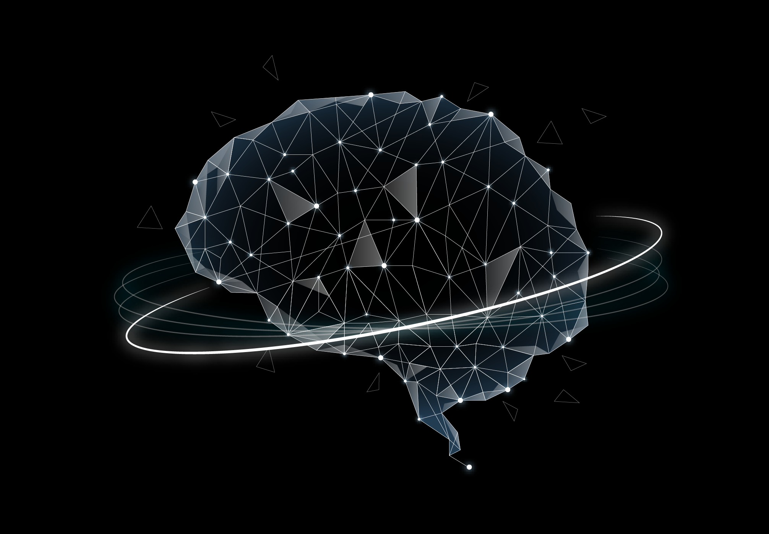

Alternative resources
Here’s an assortment of alternative resources whose style fits that of this template:
Flat artificial intelligence background
Artificial intelligence landing page template

Slide 15
event timeline
EVENT NUMBER 1
EVENT NUMBER 2
EVENT NUMBER 3
EVENT NUMBER 4
Add text here.
Add text here.
Add text here.
Add text here.
EVENT NUMBER 5
EVENT NUMBER 6
EVENT NUMBER 7
EVENT NUMBER 8
Add text here.
Add text here.
Add text here.
Add text here.

Slide 16
Day schedule
9.00 - 11.30
12.00 - 13.00
16.30 - 18.30
23rd | November | Monday
Design review
International call
Kick-off meeting
Mercury is the closest planet to the Sun and the smallest
Despite being red, Mars is a cold place, not hot
Jupiter is the biggest in our Solar System and a gas giant

