Slide 1

Eucarol Plus
dr. Péter Bohus
21/07/2020

Slide 2



Slide 3

eucarol plus

Slide 4
eucarol plus tank-mix adjuvant
developed and patented by Lamberti
registered by Lamberti in Hungary under alias Microbio
usable for herbicide, fungicide and insecticide treatments
main application with herbicides
frequent usage in combi-pack
microemulsion

Slide 5
registration in Hungary
Microbio distributed by Adama, previously Cheminova
Eucarol Plus distributed by Syngenta
registration number: 04,2/407-1/2012
expiry date of registration: 31 January 2022
application rate: 0,1-0,2% in aqueous spray
only ground application, aerial application is not permitted
shelf life: 2 years

Slide 6
chemical background
mixture of 3 actives
all of them are multi-component substances
simple analytical tool is not available for the complex mixture which includes inerts too (for example water)
typical chemical interaction between esters (fatty acids methylesters, APG citrate) and water is hydrolysis
fatty acids methylester
ethoxylated fatty alcohol
alkylpolyglucoside citrate

Slide 7
quality control parameters
water content
pH in undiluted and diluted (1%) form
density
appearance

Slide 8

shelf life

Slide 9
shelf life
the period of time during which a product, if stored correctly, is expected to comply with the specification as determined by stability studies on a number of batches of the product
the shelf-life is used to establish the expiry date of each batch

Slide 10
shelf life and stability
the storage conditions recommended by manufacturer on the basis of stability studies should guarantee the maintenance of quality, safety, and efficacy throughout the shelf-life of a product
usual storage condition: dry and cool store house in original sealed containers, protect from frost, sunshine
stability studies are indispensabile
the expiry date and storage conditions must be indicated on the label

Slide 11
accelerated stability testing
the data thus obtained, in addition to those derived from real-time stability studies, may be used to assess longer-term chemical effects under nonaccelerated conditions and to evaluate the impact of short-term excursions outside the label storage conditions, as might occur during shipping
studies designed to increase the rate of chemical degradation and physical change of a product by using exaggerated storage conditions as part of the formal stability testing protocol
the results of accelerated testing studies are not always predictive of physical changes (for that reason is important to examine real storage)

Slide 12
batch
therefore expected to be homogeneous
a defined quantity of product processed in a single process or series of processes
usually at least 3 different batches should be examined

Slide 13
expiry date
it is established for each batch by adding the shelf-life period to the date of manufacture
the date given on the individual container (usually on the label) of a product up to and including which the product is expected to remain within specifications, if stored correctly

Slide 14
real time stability studies
the results are used to establish the shelf-life, to confirm the projected shelf-life, and to recommend storage conditions
experiments on the physical, chemical, eventually biological characteristics of a product, during and beyond the expected shelf-life and storage periods of samples under the storage conditions expected in the intended market

Slide 15
stability and degradation
certain deviation/degradation is acceptable but product must comply its specification
the ability of a product to retain its chemical, physical, properties within specified limits throughout its shelf-life

Slide 16
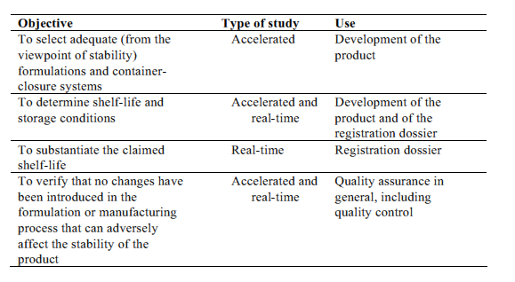
main objectives of stability testing

Slide 17
how to evaluate shelf life
OECD draft guidance document for storage stability testing of plant protection and biocidal products
principal point: specification and requirements
CIPAC MT 46
CIPAC MT 39
real storage test

Slide 18
quality control
the properties and composition must be submitted for registration
tolerancies (min and max values) can be found in registration document
the producer is responsible for the quality
the specification must contain all such properties which can be measured for quality control; specification must provide tolerancies because each batch can be different in certain degree from any other batch
the procucer must garantee that product characteristics and performance remain inside the tolerancies it measurements are being carried out before expiry date of given batch.
authority usually requires FAO proposals

Slide 19
Thank you for your attention!
dr. Péter Bohus
pbohus4@gmail.com

