Slide 1
Crawling Twitter Data

Slide 2


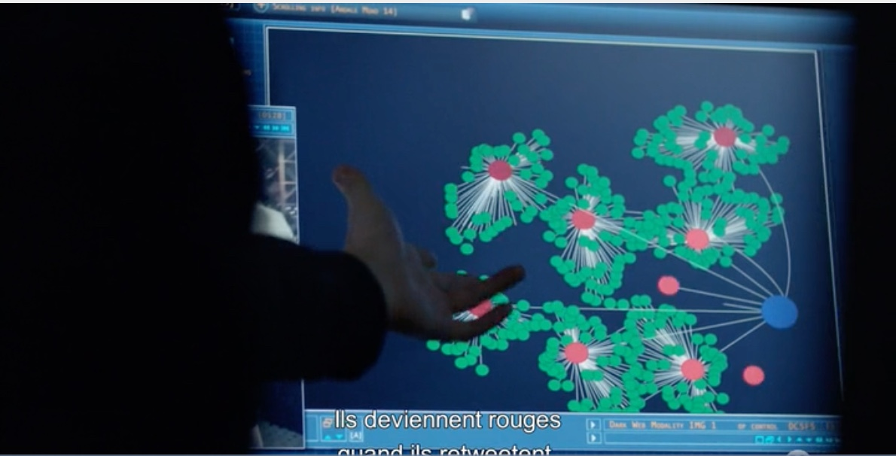
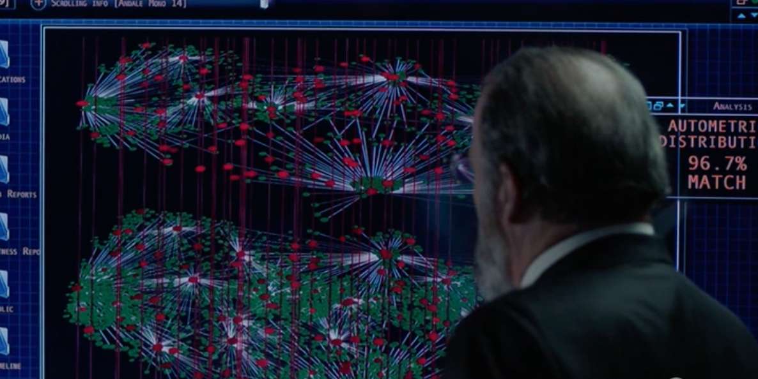
Why crawling data on Twitter?
This is a fake news
This is a retweet
This is a node
This is a network of retweets
This is a very dangerous situation for national security

Slide 3
What we’ll cover today?
01
Get your Twitter Credentials
02
Perform simple queries with R on Twitter
03
Community Detection in the @RLadiesBerlin Twitter account
04
A small Exercise

Slide 4
01
Get your Twitter Credentials

Slide 5
01 Get your Twitter Credentials
1 - Register your app with your Twitter account here: https://apps.twitter.com/
2 - Create an app:
Website: Anything starting with http:// and not a twitter URL
Callback: not necessary

Slide 6
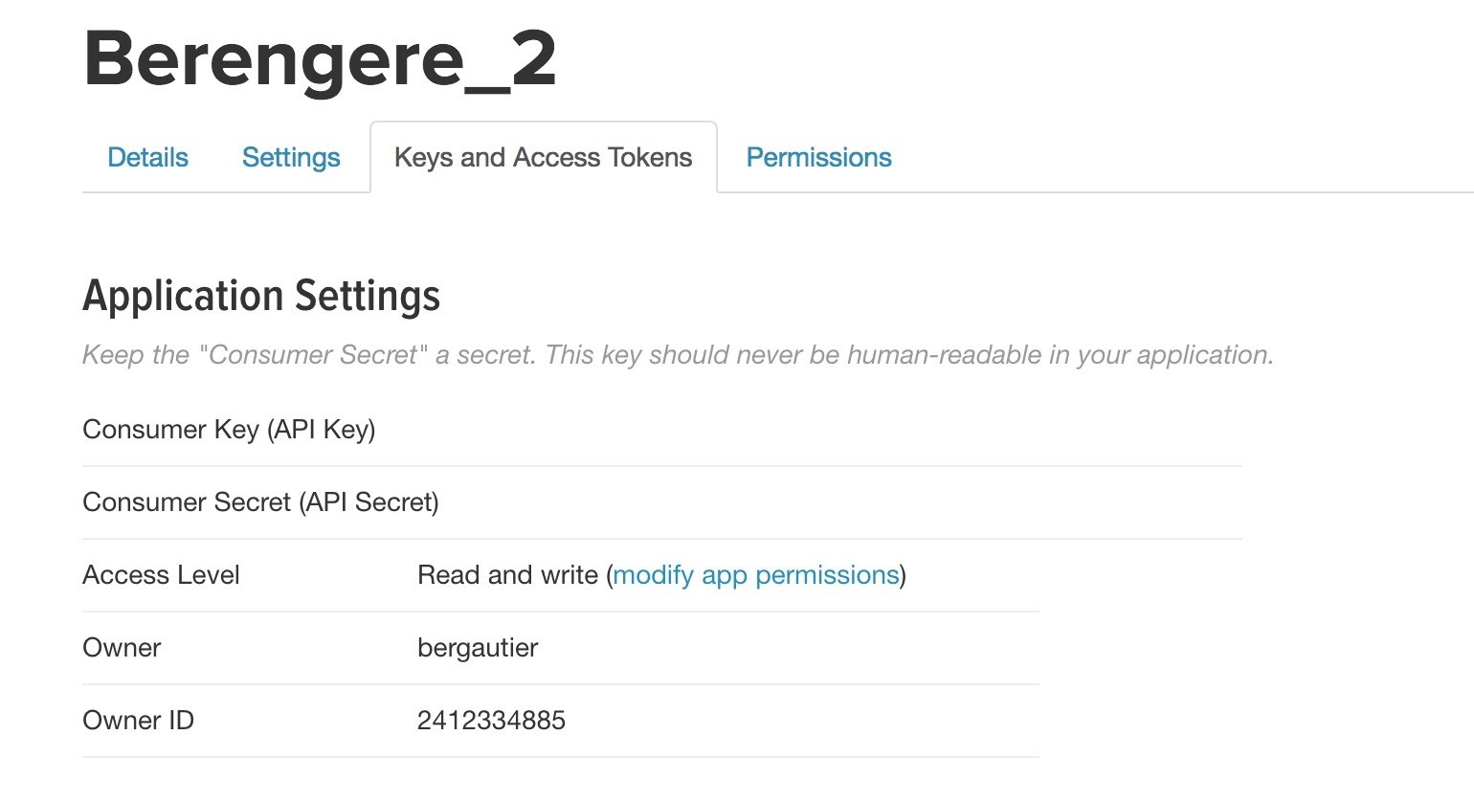
01 Get your Twitter Credentials

Slide 7
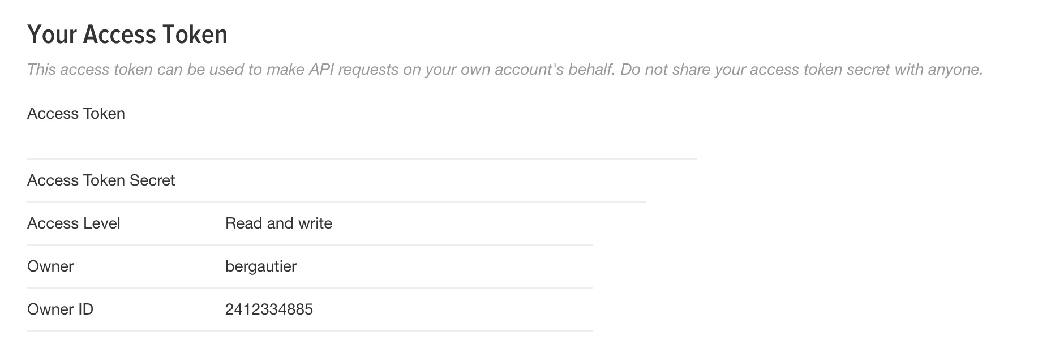
01 Get your Twitter Credentials
« Generate your Access Token »

Slide 8
01 Get your Twitter Credentials
key = your_consumer_key
apisecret = your_consumer_secret
accesstoken = your_access_token
accesstokensecret = your_access_token_secret

Slide 9
02
Perform a simple query on Twitter with R

Slide 10
02 Perform a simple query on Twitter with R

Slide 11
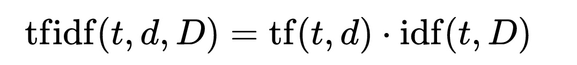
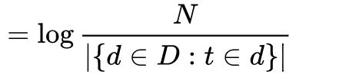
02 Perform a simple query on Twitter with R
TF-IDF for: Term frequency–Inverse document frequency
number of times a term t occurs in document d.
is a measure of how much information the word provides, that is, whether the term is common or rare across all documents
With:
N: total number of documents / Number of documents in our dataset that contains the term
Log to dampen the effect of the idf function

Slide 12
03
Detect communities in @RLadiesBerlin Twitter users network

Slide 13
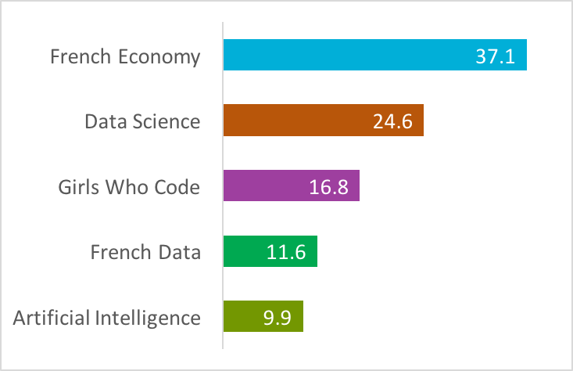
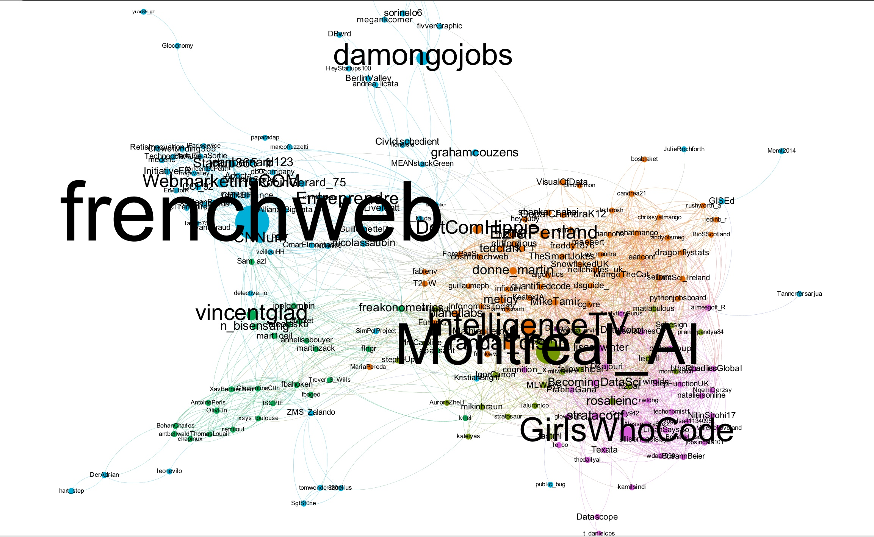
03 Detect communities

Slide 14
03 Detect communities

Slide 15
03 Detect communities
„Modularity“ algorithm (Louvain Method)
Modularity=fraction of the edges that fall within the given groups minus the expected fraction if edges were distributed at random. [-1,1]
Initially, each node is assigned to a community on its own.
In every step, nodes are re-assigned to communities in a local, greedy way: each node is moved to the community with which it achieves the highest contribution to modularity.
When no nodes can be reassigned, each community is considered as a node on its own, and the process starts again with the merged communities.
The process stops when there is only a single node left or when the modularity cannot be increased any more in a step.

Slide 16
04
Ex: Who are the red people?

Slide 17
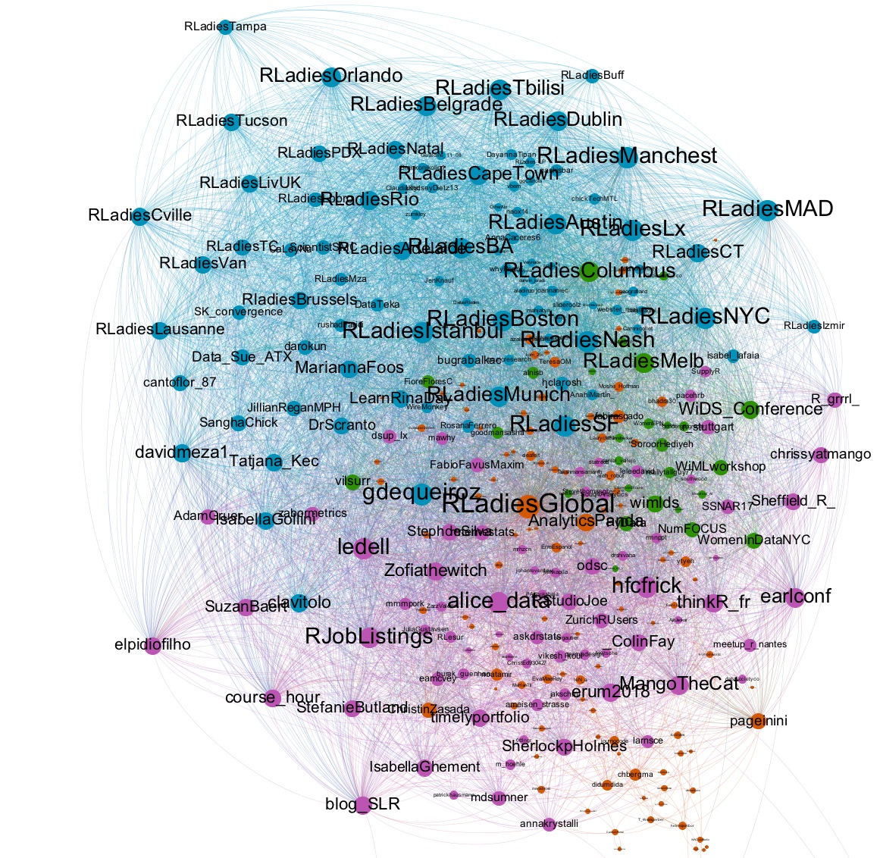
Rladies
US Women in data science
R community
Who are the red ?

Slide 18
04 Ex: Who are the red people?
(1) Get the followers of @RLadiesBerlin
(2) Get their „Description“
(3) Merge with the community information
(4) For each community, create a clean text corpus
(5) For each cleaned text corpus, create a wordcloud
(6) Who could be the followers in the red community?

