Slide 1
Prepareration for Python Beginners Workshop
Slides by Marie Dedicova and Ines Gütt 2017

Slide 2

Plan for the evening
Get your Laptops ready!
Install Python
Install Editor
Git & GitHub
Github account
Install Github Desktop
Create Repository
Push

Slide 3
:)
If you got stuck: Please ask!
If you don’t get something: Please ask!
If you need something: Please ask!
Have fun and be excellent to each other!

Slide 4
Find your group to start with the Set up
If possible: Group by operating system

Slide 5
Install: Python 3, a code editor and Github Desktop
Find all links at: github.com/id-gue/PyLadiesWorkshop

Slide 6



What is:
Git?
GitHub?
GitHub Desktop?

Slide 7
Git Version control system for tracking changes in computer files

Slide 8
GitHub website & hosting service for git stuff

Slide 9
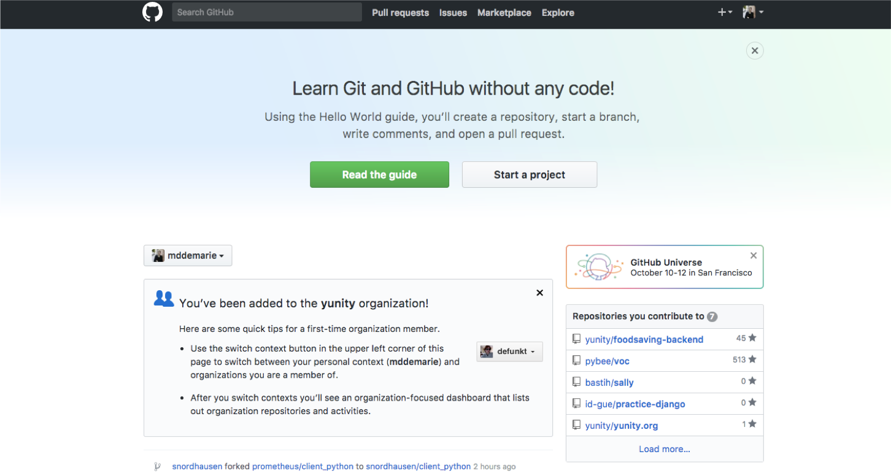
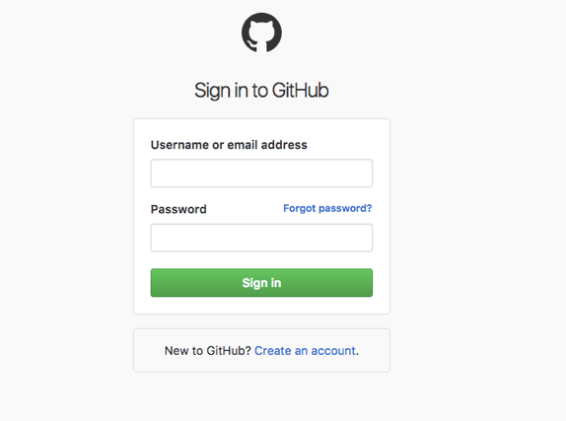
Create an account on:
github.com

Slide 10
What is:
Repository [folder]
Commit [changes]
Push [upload]

Slide 11
GitHub Desktop Software for first steps in git/github, visualizes code changes

Slide 12
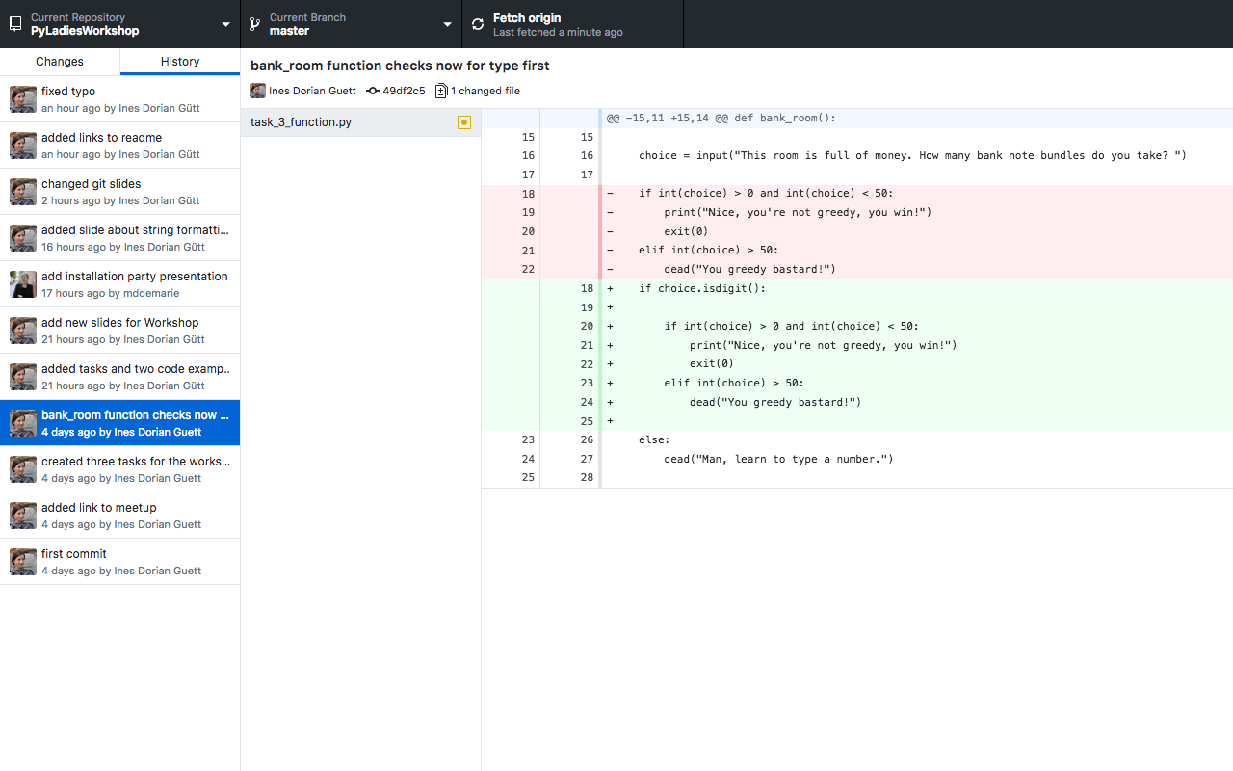

Slide 13
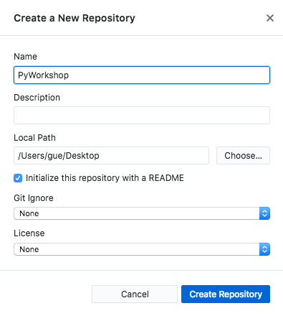
Create a new Repository in
Github Desktop

Slide 14

Open your new README.me in your code editor, add some text and save it.

Slide 15
Commit! Push!
And find it on github.com!

Slide 16
Congrats! You made your first commit!!!
See you tomorrow at 10:00 am. \o/ Thanks to all of our great coaches!!!

Slide 17
Plan for the tomorrow
Intro
First Steps in Python
Write your own game
Lunch!
Some more basics
Improve your game
What’s next

