Slide 1
Tipps for the start
SLIDE FOR COACHES
Ask your students what they remember from yesterday (What is a code editor, a commit? etc).
Do every step together with the students.
Your students will need more individual help in the afternoon than in the morning. Have 1 coach for 4-6 students in the morning, and 1 coach for 2-3 students in the afternoon.

Slide 2
Programming in Python for absolute Beginners
Slides by Marie Dedikova & Ines Guett 2017

Slide 3
Plan for today
Intro
Type together: First Steps in Python
Lunch!
Write your own game
Type together: Functions and Lists
Improve your game
What’s next

Slide 4
Do not copy - paste!!!
Writing CODE is understanding!

Slide 5
It is ok not to understand!
1. You will understand later
2. Most programmers do “Trial & Error”

Slide 6
Let's write some code!
Type together

Slide 7
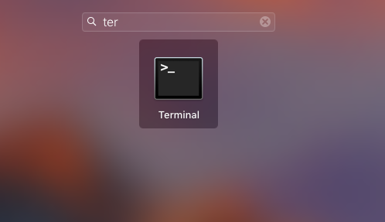
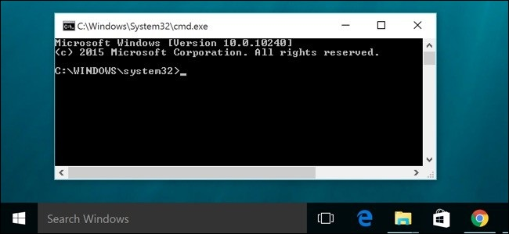
Go to your Terminal
Mac
Win

Slide 8
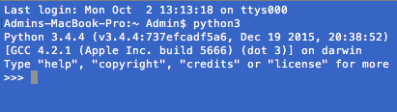
Type python3 on Mac or python on Windows

Slide 9
Printing & Strings
print(“Hello World”)
name = "Marie"
print("Hello %s" % (name))

Slide 10
Variables
my_variable = “coffee”
print(my_variable)
my_variable * 4
my_variable.upper()

Slide 11
Simple Math
dogs = 4
cats = 3
snakes = 2
total = dogs + cats + snakes
print(total)
# But the weather was weird and 3x more snakes were born.
snakes = 3 * snakes
dogs = dogs - 3

Slide 12
Compare Things
4 > 2
5 < 1
1 == 1
5 != 2
6 >= 12 / 2
5 <= 6
6 > 2 and 2 < 3
6 > 2 and 2 > 3
6 > 2 or 2 > 3

Slide 13
Boolean - True or False
a = True
a
b = 2 > 5
b
True and True
False and True
True or 1 != 1

Slide 14
Errors are friends! :)
len(23493)
city = “Tokyo”
print(ctyi)
print(flower)
3 > “Python”

Slide 15
IF Statements
people = 20 cats = 5
# Try this:
if people > cats: print("The world is boring!")
# Do you get an error? Why?

Slide 16
ELSE Condition
cats += 20
if people > cats: print("The world is boring!")
else:
print(“Ohh, way too many cats!”)

Slide 17
ELIF Condition
volume = 38
if volume < 20: print("It's kinda quiet.") elif 20 <= volume < 40: print("It's nice for background music") else: print("My ears are hurting! :(")

Slide 18
Let's use a code editor!

Slide 19
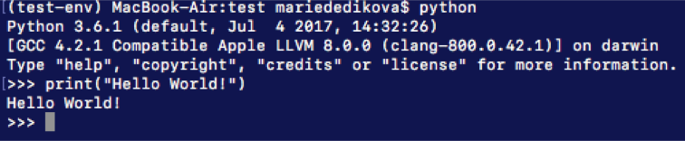
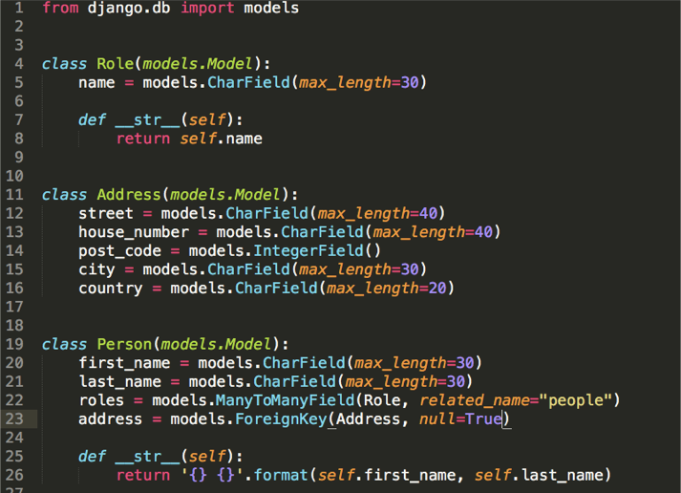
Ways of Writing </>
IN TERMINAL:
IN CODE EDITOR:

Slide 20
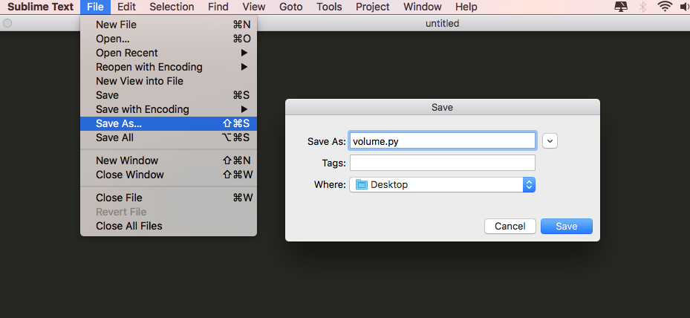
Open Sublime

Slide 21
Write This + Save:
print("The world is beautiful! Enjoy the sound!")

Slide 22
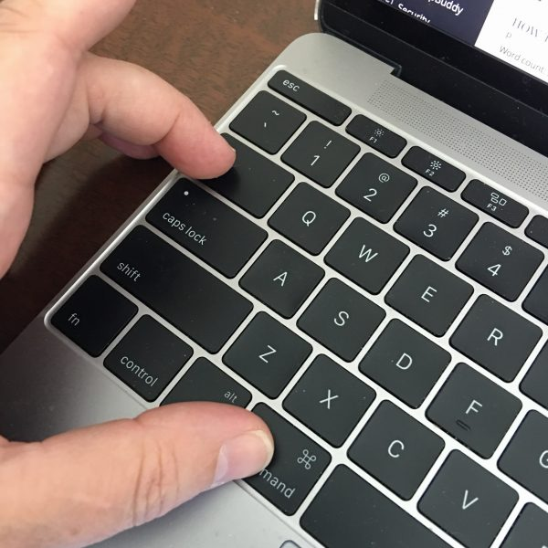
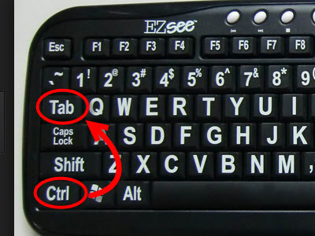
Switch Like a Pro!
Mac
Win

Slide 23
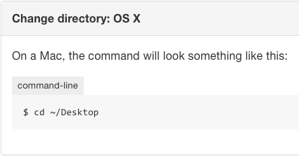
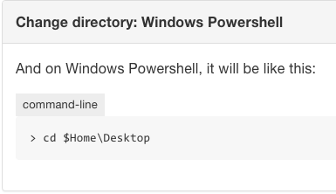
Change Directory
Mac
Win

Slide 24
Execute the File
Mac
Win
$ python3 volume.py
> python volume.py

Slide 25
Write This + Save:
print("The world is beautiful! Enjoy the sound!")
input(“What is your favorite song? ”)
song = input(“What is your favorite song? ”)
name = input(“What is your name?”)
print(“Your name is %s and your favorie song is %s.” % (name, song)

Slide 26
Build your own text adventure.
With Python and the Shell

Slide 27
Instruction for task 1 and task 2
SLIDE FOR COACHES
Get the python file task_1 from the repository you found this slides in and run it in terminal.
Open the file in a code editor and ask your students if they can explain what happens in line 1, line 2, etc.
Give your students ca. 30 min to create their own task_1 and another 15 min for task_2.

Slide 28
Task 1
Type the text adventure and add the door “2”.

Slide 29
Lessons learned:
Conditional Statements
& Comparator ‘equal to’
Notes:
You can put an if-statements inside another if-statements

Slide 30
Task 2
Ask the player for her name and use it in the game.

Slide 31
Lessons learned:
String replacement with %s and %

Slide 32
Push your files to Github
In Github Desktop:
Commit
Push
Then check if you find your files on github.com

Slide 33
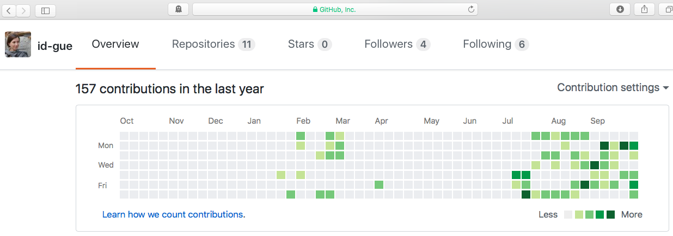
Green fields on Github Profile!!! Yeay!!

Slide 34
Functions
def sound(volume):
if volume < 20: print("It's kinda quiet.") elif volume < 40: print("It's nice for background music") else: print("My ears are hurting! :(")
sound(42)

Slide 35
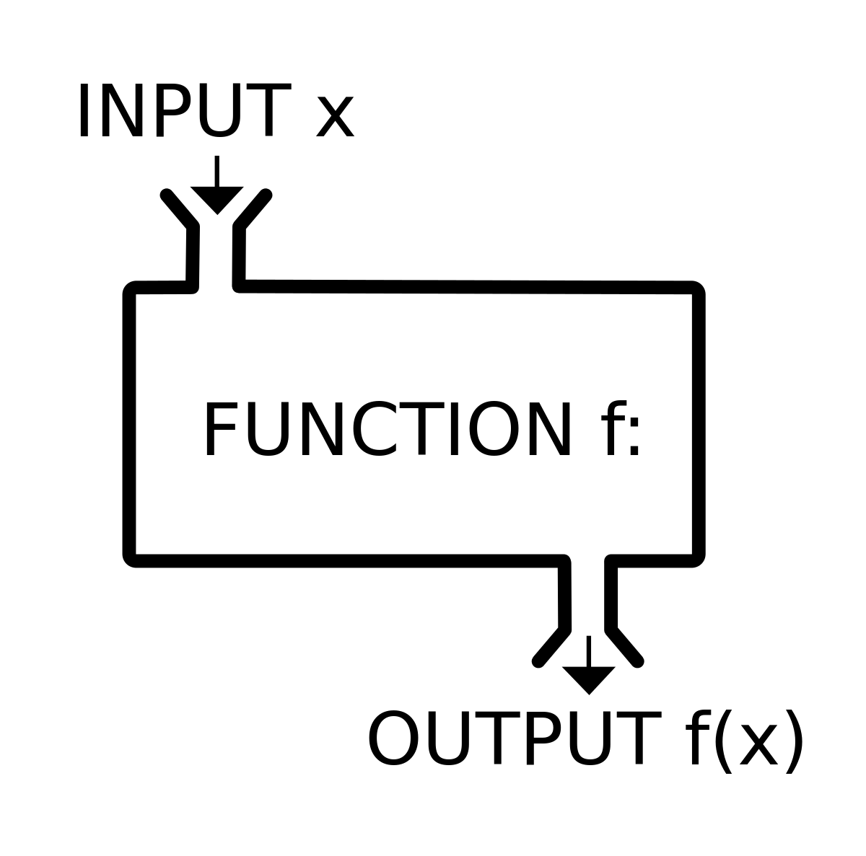
Create whole world!

Slide 36
Lists & Loops
corb = [“apple”, “strawberry”, “kiwi”, “grape”]
for fruit in corb:
print(fruit)

Slide 37

Algorithmic
thinking!!! Well done!

Slide 38

Libraries
import this

Slide 39
Build your own text adventure.
Part 2

Slide 40
Task 3:
Create a function to avoid to repeating yourself

Slide 41
Lessons learned:
Create functions and use them

Slide 42
Push your files to Github
In Github Desktop:
Commit
Push
Then check if you find your files on github.com

Slide 43
Yeay, you did it!!!

Slide 44
What’s next?
Learning materials

Slide 45
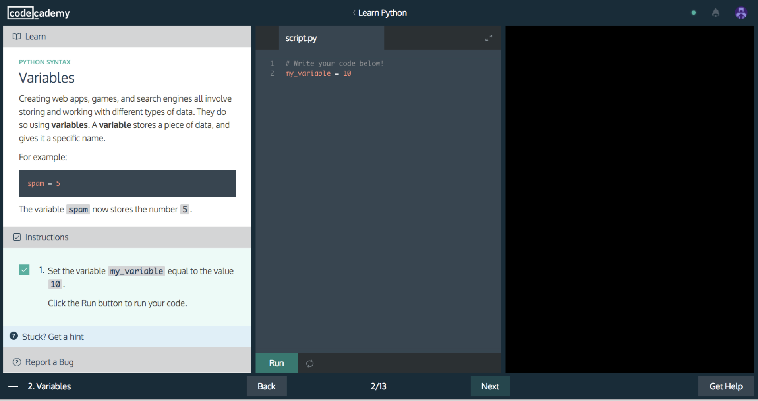
Feedback

Slide 46
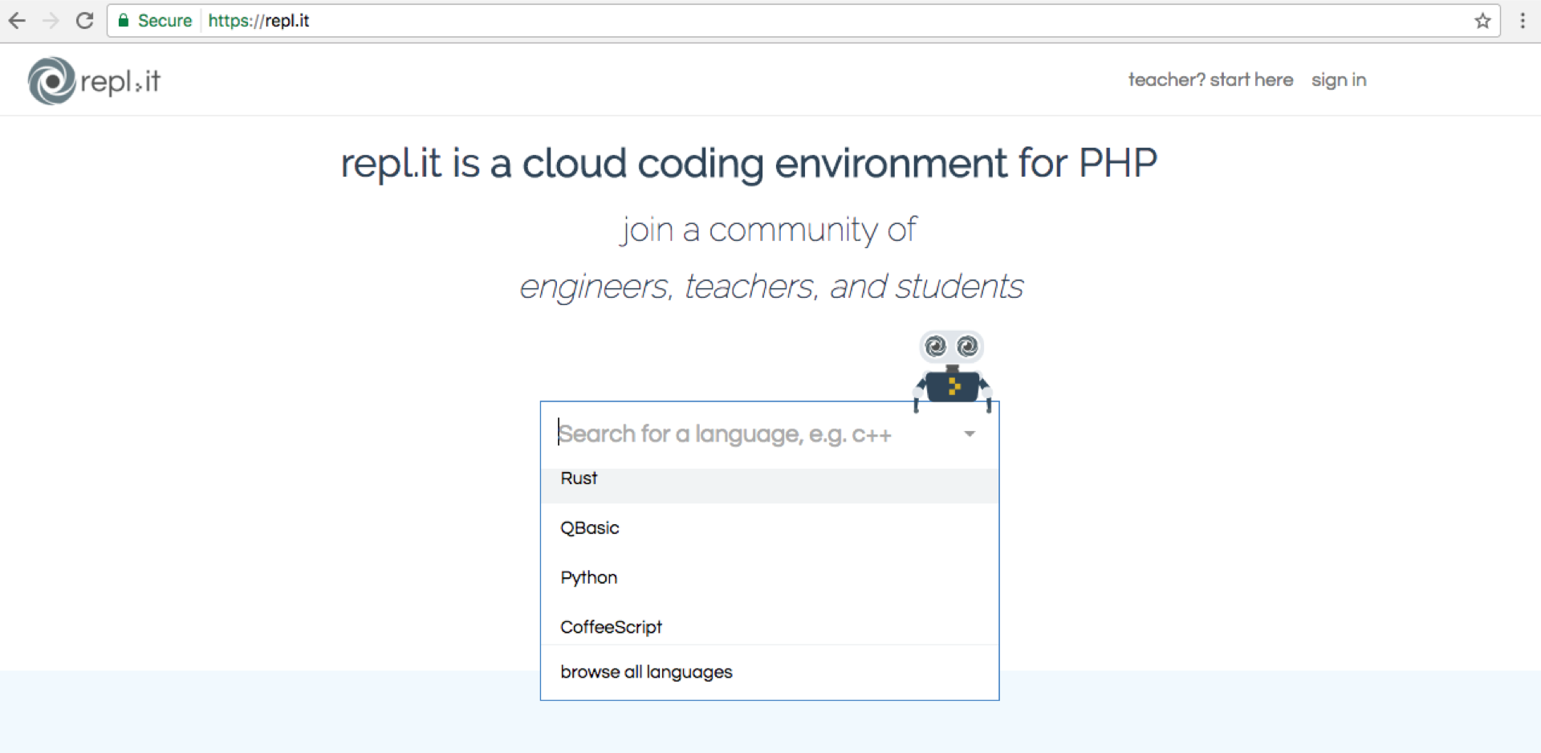
Feedback

Slide 47

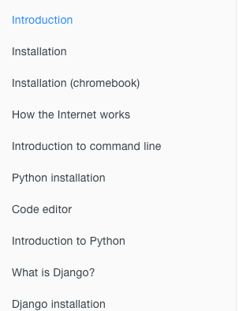

Slide 48
Be a Part of Commuity!
That makes learing much more fun!

Slide 49






Slide 50





Financial Aid as Woman
You get paid for travelling to conferences: LGBT, women ...

Slide 51
Happy coding!!!
Thanks to: PyLadies, SoundCloud and all of our great coaches!!!

