Slide 1
Survival Analysis for Patients Suffered Heart Attacks
2020 – YSU – ASDS – ML in Healthcare – Hovsepyan Lilit

Slide 2
Content
3. Data
1. Problem
Formulation of a medical problem
Covariates,
Data Preprocessing,
Data Analysis
01
02
03
04
2. Models
4. Results
Mathematical Introductory part, Models Used
Analysis of the Results & Conclusion

Slide 3
01
Problem

Slide 4
Introduction
01
All the patients suffered heart attacks at some point in the past. Some are still alive and some are not. The survival and still-alive variables, when taken together, indicate whether a patient survived for at least one year following the heart attack.
Formulation of a medical problem
The problem was to predict from the other variables the survival month based on the covariates in Echocardiogram heart attack dataset.

Slide 5
02
Models

Slide 6



Survival Analysis
Kaplan-Meier estimates
Log-rank test
Cox proportional hazards
02
Survival Analysis is a set of methods to analyze the time to occurrence of an event. These methods are widely used in clinical experiments to analyze the 'time to death', but nowadays these methods are being used to predict the 'when' and 'why' of customer churn or employee turnover (հոսունություն) as well.
H0: no difference in survival S(t) between the two groups
H1: survival curves are different
Similar to the Chi-square test:
Compare the survival functions based on a pooled estimate of
Observed events (O) in group of interest
Expected events (E) in group of interest
Variance in the data
The Cox proportional-hazards is a regression model commonly used for investigating the association between the survival time of patients and one or more predictor variables.
Log[h(t)/h0(t)] = b1x1 + … bpxp
Used to measure the fraction of patients living for a certain amount of time after treatment

Slide 7
Kaplan-Meier vs Cox
02
Only Categorical
Cox Model
01
Can’t incorporate numeric explanatory variables, it can only incorporate categorical X’s
Categoric &/or Numeric
01
Can incorporate more explanatory variables (including any mix of numeric and/or categorical X’s)
02
Less X’s
Can’t include many X’s because need a new line for each group
Semi-Parametric
02
03
Non-parametric
Semi-parametric, doesn’t assume a constant hazard (hazard can change over time )
Since non-parametric, no simple form to summarize relationship (e.g. no slope b)
Log [h(t)/h0(t)] = b1x1 + … + bpxp
KM Limitations

Slide 8
03
Data

Slide 9
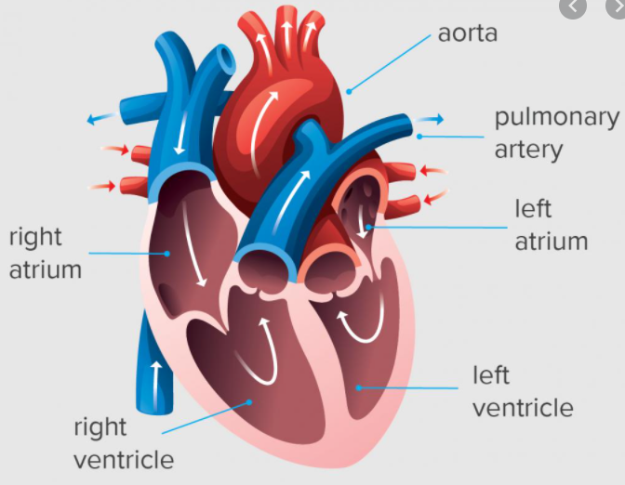
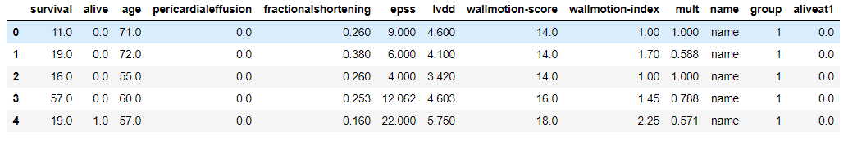
Covariates
1. Survival
2. Alive
3. Age
4. Pericardial-effusion
5. Fractional-shortening
6. epss
7. lvdd
8. wall-motion-score
9. wall-motion-index
03
The number of months patient survived (has survived, if patient is still alive). Because all the patients had their heart attacks at different times, it is possible that some patients have survived less than one year but they are still alive. Such patients cannot be used for the prediction task mentioned above.
A binary variable. 0=dead at end of survival period, 1 means still alive
Age in years when heart attack occurred
binary. Pericardial effusion is fluid around the heart. 0=no fluid, 1=fluid (normal range between 10-50 ml )
a measure of contractility (կծկողականություն) around the heart lower numbers are increasingly abnormal (25-45% , normal value is mostly higher than 28%)
E-point septal separation, another measure of contractility. Larger numbers are increasingly abnormal. (<= 8mm)
left ventricular end-diastolic dimension. This is a measure of the size of the heart at end-diastole. Large hearts tend to be sick hearts. (men: 42 to 59 mm; women: 39 to 53 mm)
a measure of how the segments of the left ventricle are moving (normal wall motion grossly corresponds to an LVEF of 60%)
equals wall-motion-score divided by number of segments seen. Usually 12-13 segments are seen in an echocardiogram.

Slide 10
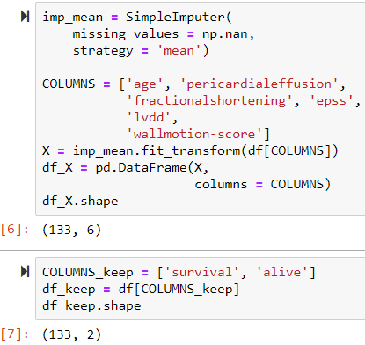
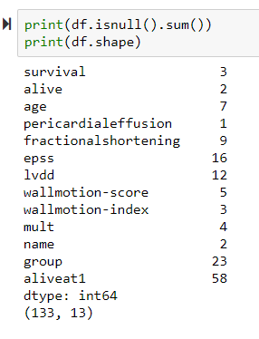
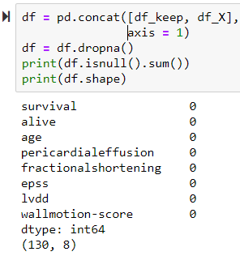
Data Preprocessing
1. Check missing values
3. For “survival” & “alive” drop NA
2. Impute missing values with mean
03

Slide 11
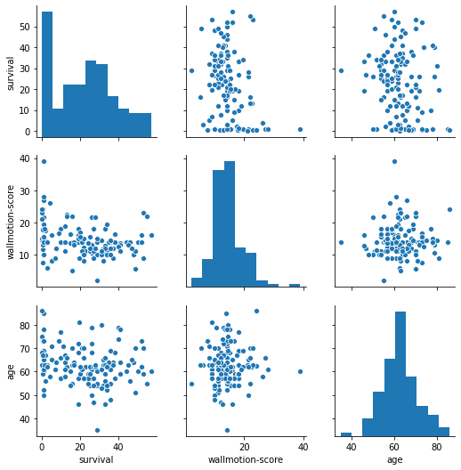
Data Analysis
03

Slide 12


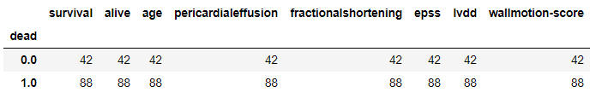
Data Analysis (cont.)
03
Check censored data
For alive = 1 patients, because they are alive during data collection period and we do not know their survival months after the data collection, they are regarded as censored data. Hence, the following analysis needs to consider the censored data by making dead variable below.
We have 88 non-censored data and 42 censored data.

Slide 13

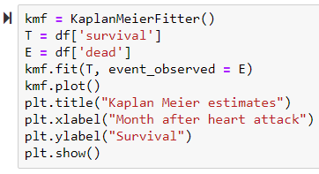
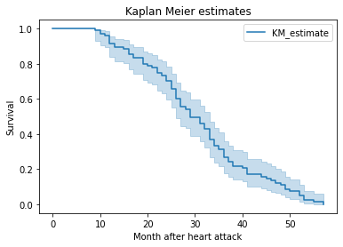
Data Analysis (cont.)
03
Kaplan-Meier Estimate
Comments:
In Pair plot for all covariates vs survival there was a slightly negative relationship of age and wallmotion-score to survival
It’s used median to make two groups within each variable to see difference in survival time.

Slide 14
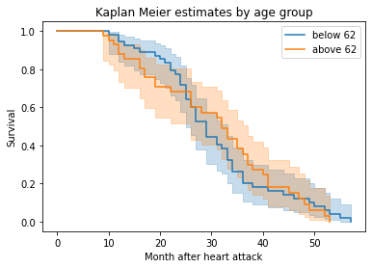
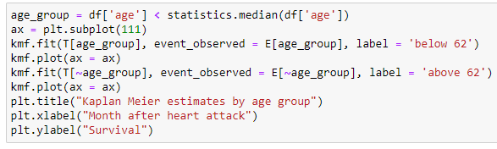

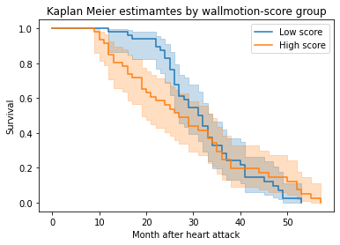
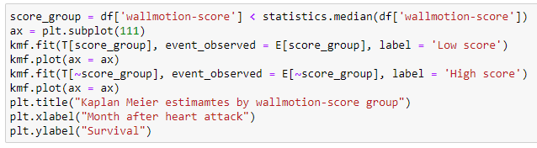

Data Analysis (cont.)
03
Kaplan-Meier Estimates by
Age group
Log-rank / Age
"test_statistic" here is a chi-square statistic. It shows chi-square statistic 9.98 (0.44), and p-value is less than 5% (0.54). Thus, I confirm that there is a significant difference (there is no sig. diff.) in suvival time by wallmotion score (age) group for the first 2 year after heart attack.
Kaplan-Meier Estimates by
Wallmotion-score group
Log-rank / Wallmotion Score

Slide 15
04
Results

Slide 16

Results
Cox proportional hazards model
04
Whether this model is significant or not depends on the result of Log-likelihood ratio test at the bottom of the summary. This statistic follows Chi-square distribution with 2 degree of freedom, and p-value is 0.0048. It says this cox model is significant so that statistical inference is based on this model. Wallmotion-score group is a risk factor for survival time, but age is not by checking p-values. Negative sign of wallmotion-score variable indicates that the patients with low wallmotion score reduce the risk of death. Hazard ration of wallmotion-score is 0.28, which means it reduce in hazard since it is less than 1 and it reduces the hazard by 72% (1 - 0.28). Thus, I conclude that for the first two years after each patient experiences heart attack, the people with high wallmotion score would have a higher risk of death so that we can pay attention to this group of patients.

Slide 17
Thanks!
Do you have any questions?
hovsepyanlilit11@gmail.com

