Slide 1
Telemarketing Decision:
Data Mining and Modeling will help bank make decision
Shuxin Zhu-501148088
Dec 06,2022

Slide 2
Telemarketing Decision:
Data Mining and Modeling will help bank make decision
Portuguese bank marketing dataset
from 2008 to 2013
41187 clients and 20 inputs
preprocessing
mining and modeling data

Slide 3
Data mining
acquisition and analysis
data pre-processing
data modeling

Slide 4
Data preprocessing
checking, deleting or correcting abnormal data
no missing values and duplicate values

Slide 5
Numerical characterization
Category type feature processing
numerical
20 features, 10 of which are numeric
other Feature
transform the category-type features into numeric features by performing ordinal encoding or dummy variable operations.

Slide 6
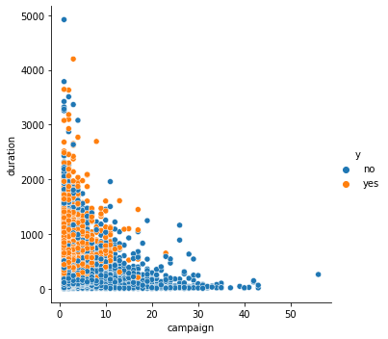
YES VS NO
unbalanced
normalization
Min-max normalization

Slide 7
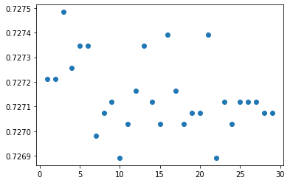
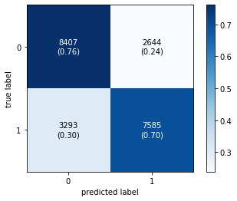
Telemarketing modeling study
logistic regression modeling
Precision: 0.498
Recall score: 0.514

Slide 8
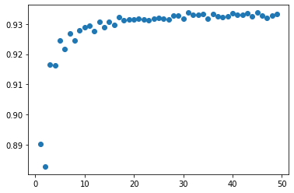

Telemarketing modeling study
random forest modeling
Precision: 0.498
Recall score: 0.514

Slide 9
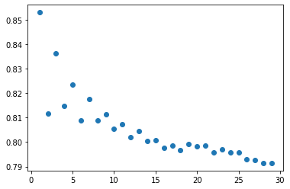
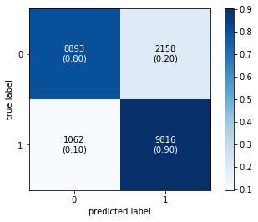
Telemarketing modeling study
K- Nearest Neighbor
Precision: 0.893
Recall score: 0.805

Slide 10
Precision: 0.893
Recall score: 0.805
Conclusion

Slide 11
Missing/Unknow
Min-Max
preprocessing
feature
normalization
modeling
Logistic Regression
Random Forest
KNN
numerical VS Other Feature

Slide 12
After research
Lack of data set.
Improvement of data processing method
Handling
unstructured data with new techniques.

Slide 13
S. Moro, P. Cortez and P. Rita(2014). A Data-Driven Approach to Predict the Success of Bank Telemarketing. Decision Support Systems, Elsevier, 62:22-31
S. Moro and R. M.S. Laureano(2011). Using Data Mining for Bank Direct Marketing: An Application of The Crisp-DM Methodology.
Becker, D. & Becker, P.B (1994). Customer Service and the Telephone. Business Skills Express.
Galbraith, J. R. & Kazanjian, R. K. (2006). Strategy Implementation, Structure Systems and process, St 12 Paul, MN: West Publishing.
Klosek, J. (2003). The legal guide to e-business. Westport, CT: Praeger
Marshall, J.J. & Vredenburg, H. (1991). The roles of outside and inside sales representatives: Conflict or cooperation? Journal of Direct Marketing. Volume 5, Issue 4.
Miller, J.B. (2004). Mainstream Marketing Services. Federal Trade Commission: Resources and Legal Analysis. Retrieved from: ReclaimDemocracy.org.
Zajas, J.R. & Church, O.D. (1997). Applying Telecommunications and Technology from a Global Business Perspective.
REFERENCE

Slide 14
Thank you
Q&A

