Slide 1



Slide 2

1 S T E P
By Lucy Gardener

Slide 3
Contents
Introduction
Target Audience
Client Demands
Search Engine Optimisation
Proposed Designs
Home Page
Classes Page
Contact Us Page
Mobile Pages
Cotent Management System/Admin Controls
Website Hierarchy
Dynamic vs static Sites
Accessibility
Legal requirements
Questions

Slide 4
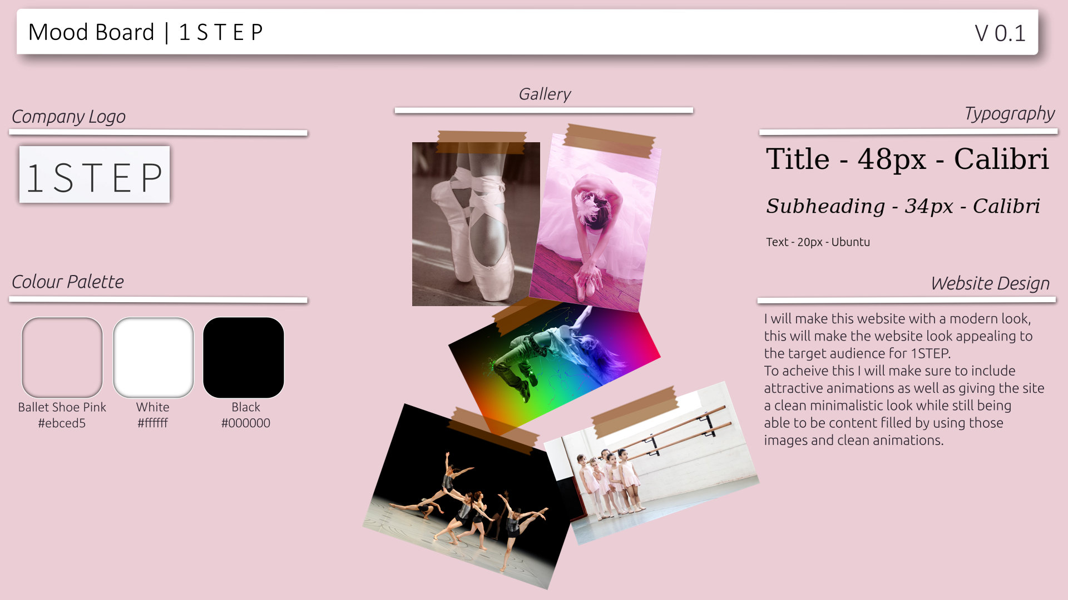
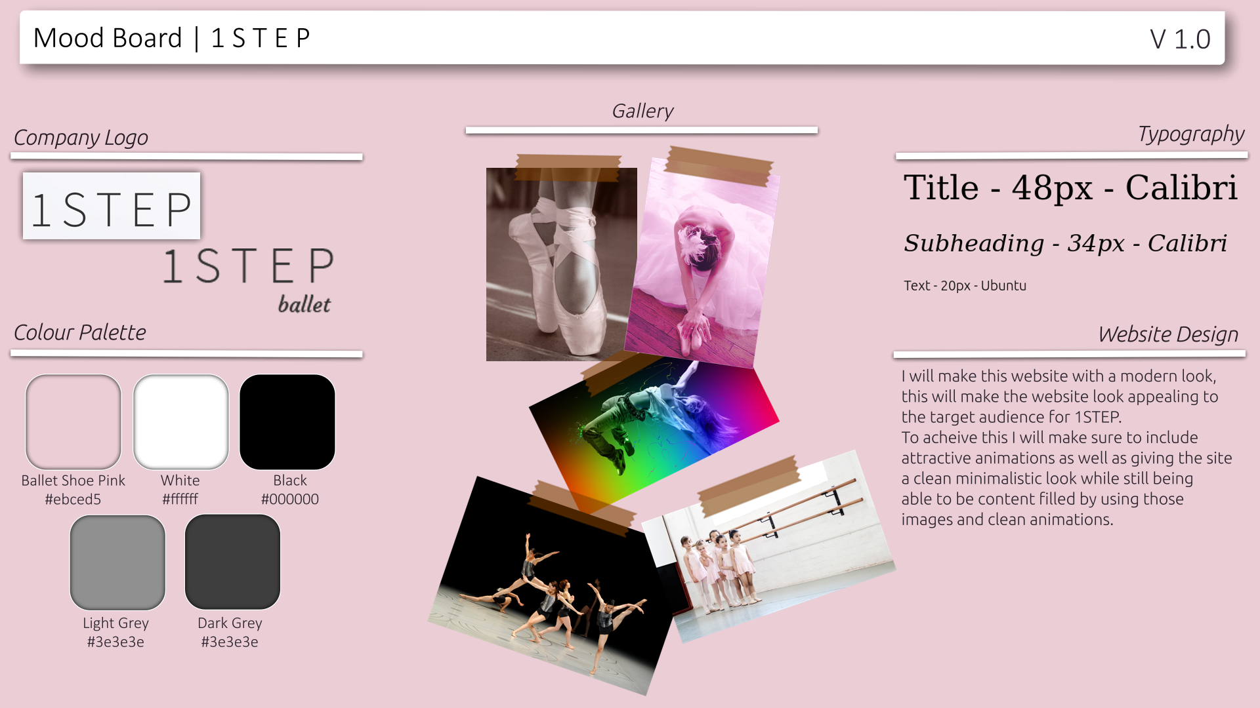
MoodBoard

