Slide 1



Slide 2

1 S T E P
By Lucy Gardener

Slide 3
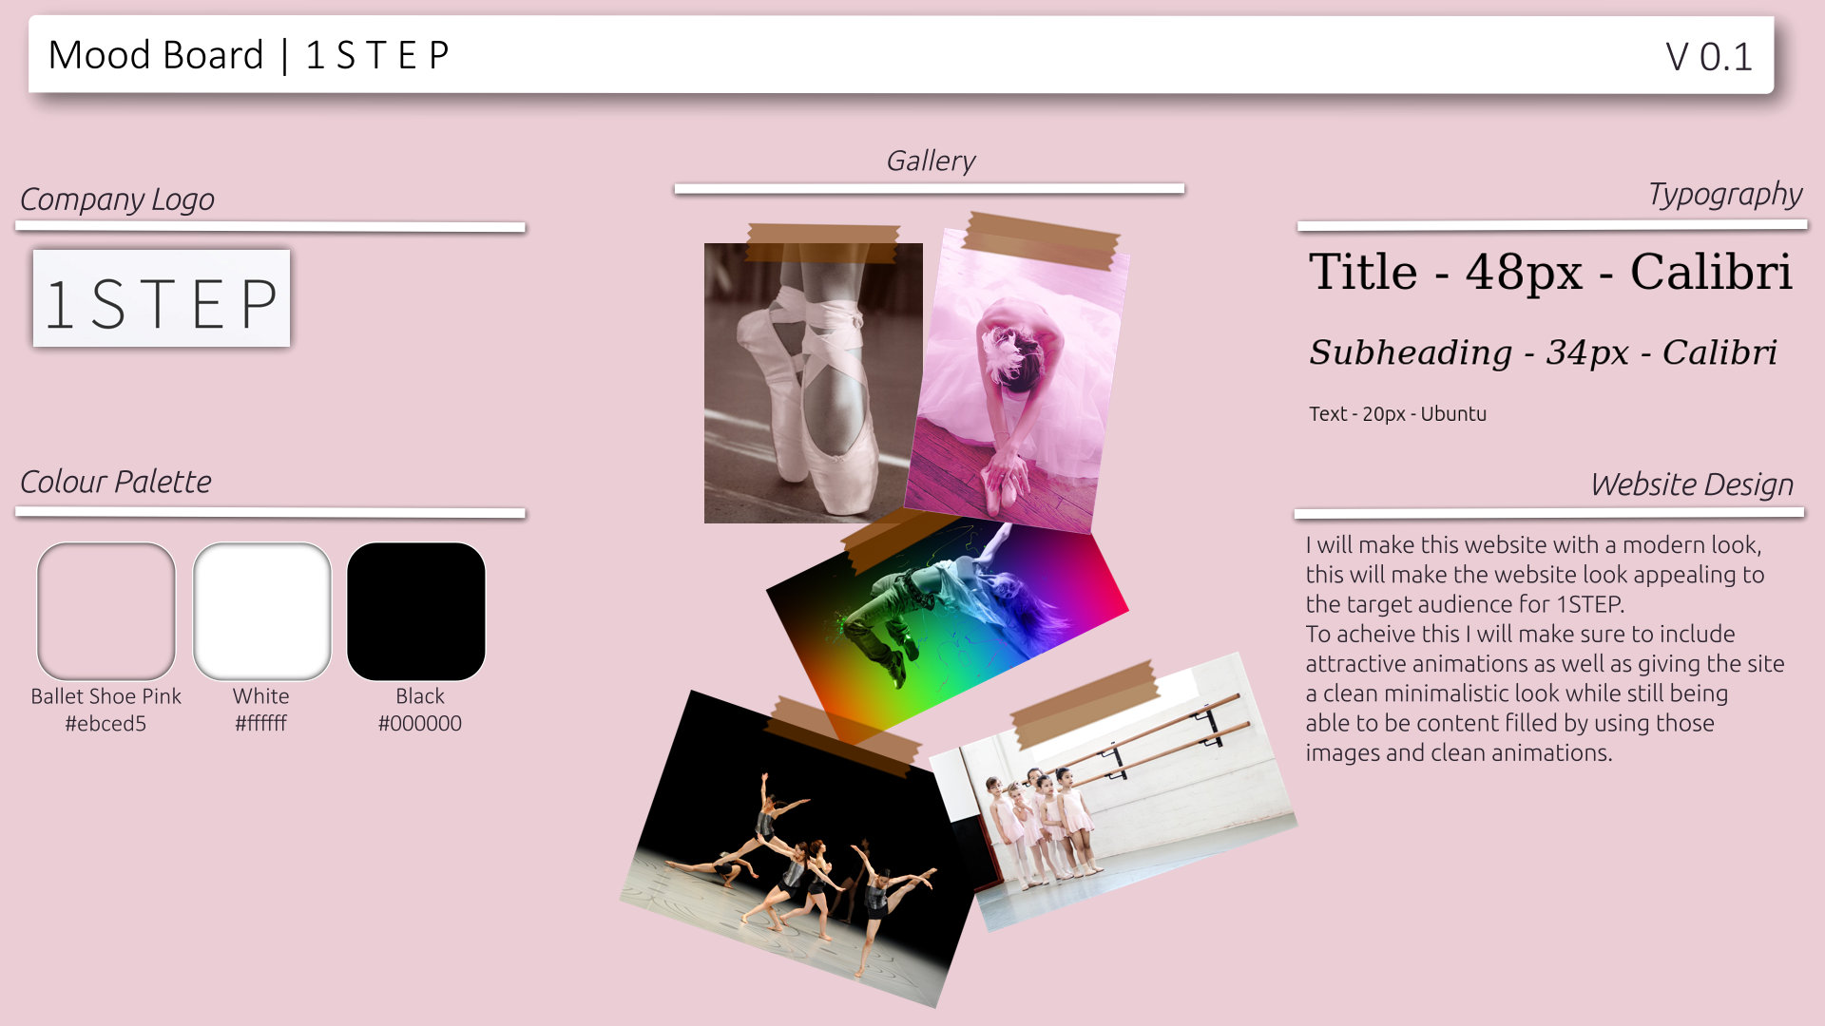
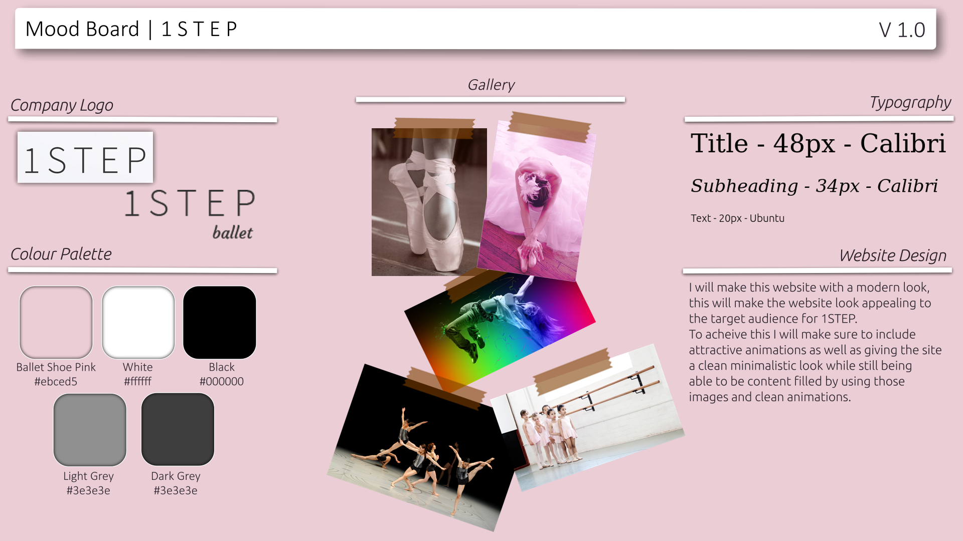
MoodBoard

