Slide 1
ALGORITHMS II — END-OF-TERM PROJECT
Shortest-Path Queries on Weighted Graphs
Comparative Algorithm Design and Complexity Analysis
Four algorithmic approaches • three graph representations • theory + experiment
Project Group: Berfin Güneri – Murat Emre Öztürk – Berkay Bıyık – Faruk Emre Afşar | Spring Semester 2025–2026
Results: profile "full", seed 20252

Slide 2
The Problem: Shortest-Path Query
▸ Given: a weighted directed graph G = (V, E) and weights w: E → ℝ
▸ Wanted: the minimum total-weight path between two nodes
– Single-source (SSSP): from one source to all
– All-pairs (APSP): between every pair of nodes
▸ The goal is NOT merely to find the correct answer —
– but to solve the same problem with different algorithmic decisions
– and to understand the performance / scaling / memory effects
▸ "Query" = the cost of running from one source given a built graph
Takeaway
• There is no single "best algorithm."
• The right choice depends on input size, density, query count, and the sign of the weights.
• This presentation shows that decision with data.
2 / 18

Slide 3
Four Approaches — The Design Space
# | Approach | Representation | Philosophy
1 | Dijkstra + Binary Heap | Adjacency list | On-demand, time-optimized
2 | Dijkstra + Array Scan | Adjacency matrix | Dense-graph-optimized, simple
3 | Bellman-Ford | Edge list | Generality: negative weights
4 | Floyd-Warshall | Adjacency matrix | Heavy preprocessing, O(1) query
▸ All three graph representations + four distinct strategies are covered
▸ Meaningful pairwise comparisons: 1—2 (same algorithm, different data structure) · 1—3 (different strategy) · 1—4 (on-demand vs. preprocessing)
▸ A natural split for a four-member group: one approach per member
3 / 18

Slide 4
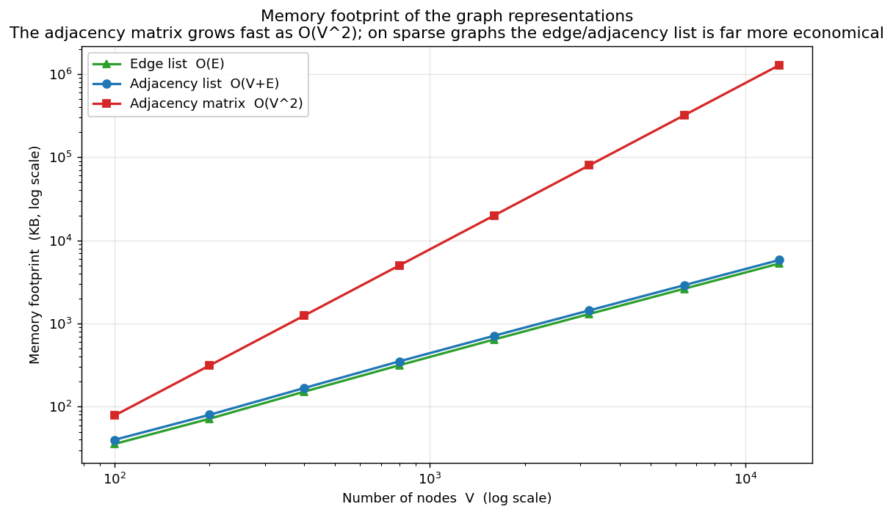
Graph Representations — A Decision Independent of the Algorithm
▸ Edge list — O(E) memory; "iterate over all edges" is natural (Bellman-Ford)
▸ Adjacency list — O(V+E); "the neighbors of u" is fast (Dijkstra-Heap)
▸ Adjacency matrix — O(V²); O(1) edge query, vectorizes (Dijkstra-Array, Floyd-Warshall)
▸ The representation choice determines both memory and the cost of the fundamental operation
Takeaway
• The adjacency matrix grows as O(V²): on large sparse graphs, matrix-based approaches DO NOT FIT in memory (Experiment D).
4 / 18

Slide 5
Approach 1: Dijkstra + Binary Heap + Adjacency List
▸ Greedy: at each step pick the not-yet-finalized node closest to the source
▸ The binary heap answers the "minimum" query in O(log V)
▸ "Lazy deletion": an improved node is re-pushed onto the heap
▸ Early stopping: stop when the target is reached (speeds up single-pair queries)
Complexity
Time: O((V + E) log V)
Memory: O(V + E)
On a sparse graph ≈ O(V log V)
Philosophy
On-demand, time-optimized. With negative edges the greedy assumption breaks → it becomes incorrect.
5 / 18

Slide 6
Approach 2: Dijkstra + Array Scan + Adjacency Matrix
▸ The same greedy strategy, but with NO priority queue
▸ At each step the min node is found by a linear scan of the array, O(V)
▸ Relaxation is done over a row of the adjacency matrix, O(V)
▸ The cost is entirely independent of the number of edges
Complexity
Time: O(V²)
Memory: O(V²)
On a dense graph O(V²) ≤ O(E log V)
Philosophy
Structural simplicity, dense-graph-optimized. On large sparse graphs O(V²) memory → infeasible.
6 / 18

Slide 7
Approach 3: Bellman-Ford + Edge List
▸ No greedy assumption needed: relax all edges for V−1 passes
▸ Works CORRECTLY with negative weights
▸ If one extra pass still relaxes → negative cycle
▸ Early stopping: stop if nothing changes (much faster in practice)
Complexity
Time: O(V · E)
Memory: O(V + E)
Worst case is worse than Dijkstra
Philosophy
Generality — correctness before speed. Solves what Dijkstra cannot.
7 / 18

Slide 8
Approach 4: Floyd-Warshall + Adjacency Matrix
▸ Shortest paths between all node pairs (APSP)
▸ Dynamic programming: for each intermediate node k, all (i,j) are updated
▸ After preprocessing, each query is an O(1) matrix lookup
▸ Detects a negative cycle as a negative value on the diagonal
Complexity
Preprocessing: O(V³)
Query: O(1)
Memory: O(V²)
Philosophy
Heavy preprocessing, ~free queries. Wasteful for a single query, ideal for many.
8 / 18

Slide 9
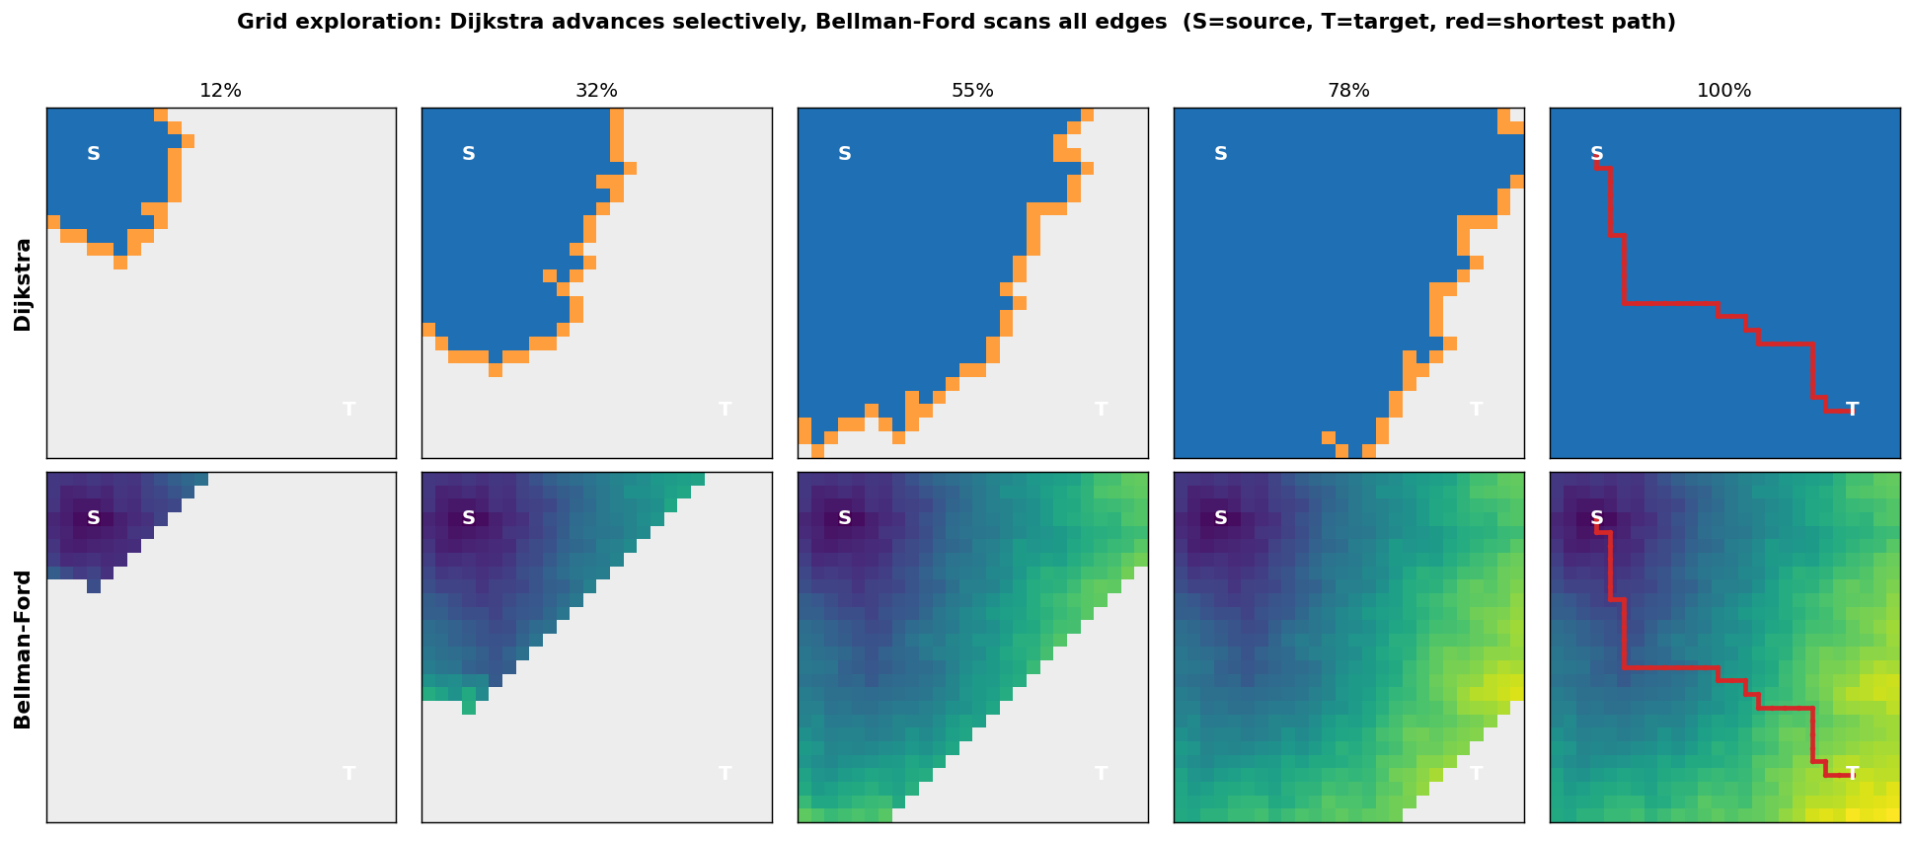
Algorithms at Work — Visual Simulation
Takeaway
• Dijkstra (top): the blue region grows in order of distance; it works only on the thin orange "frontier"
• Bellman-Ford (bottom): each pass relaxes all edges INDISCRIMINATELY; the distance field spreads like a wave
• Both find the same path (red) — the difference is IN THE WORK DONE
• The full animations (GIF) are in the results/animations/ folder; can be played live during the presentation
9 / 18

Slide 10
Theoretical Complexity — Summary
Approach | Preprocessing | Query | Memory | Negative weights
Dijkstra + Binary Heap | — | O((V+E) log V) | O(V+E) | No
Dijkstra + Array Scan | — | O(V²) | O(V²) | No
Bellman-Ford | — | O(V · E) | O(V+E) | Yes (+ cycle)
Floyd-Warshall | O(V³) | O(1) lookup | O(V²) | Yes (+ cycle)
Takeaway
• Dijkstra-Heap scales best on sparse graphs · Dijkstra-Array wins on dense graphs (O(V²) ≤ O(E log V))
• Floyd-Warshall: terrible for a single query, ideal for many — the preprocessing philosophy
10 / 18

Slide 11
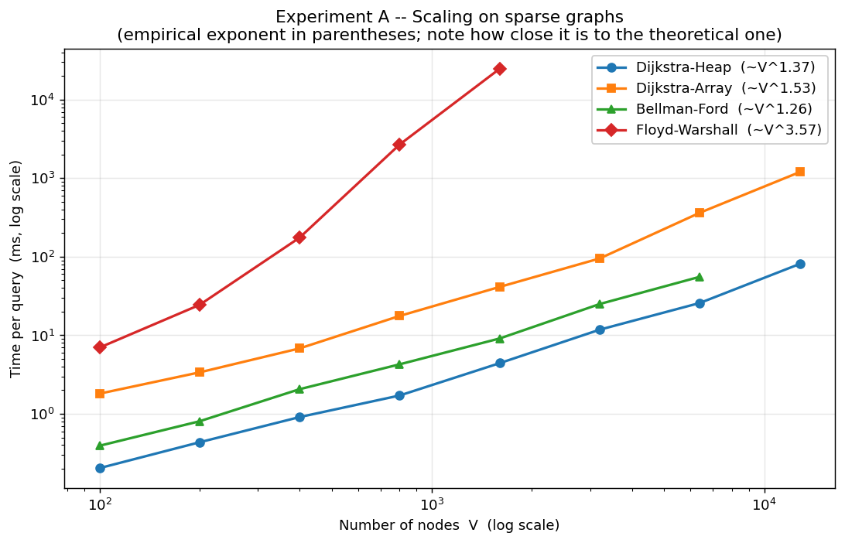
Experiment A — Scaling with the Number of Nodes
Takeaway
• The curve ordering exactly confirms the theoretical complexity
• At V = 1600, Floyd-Warshall is ~5,610× slower than Dijkstra-Heap
• With O(V³), Floyd-Warshall becomes "infeasible" earliest
• Dijkstra-Heap is the best-scaling approach
11 / 18

Slide 12
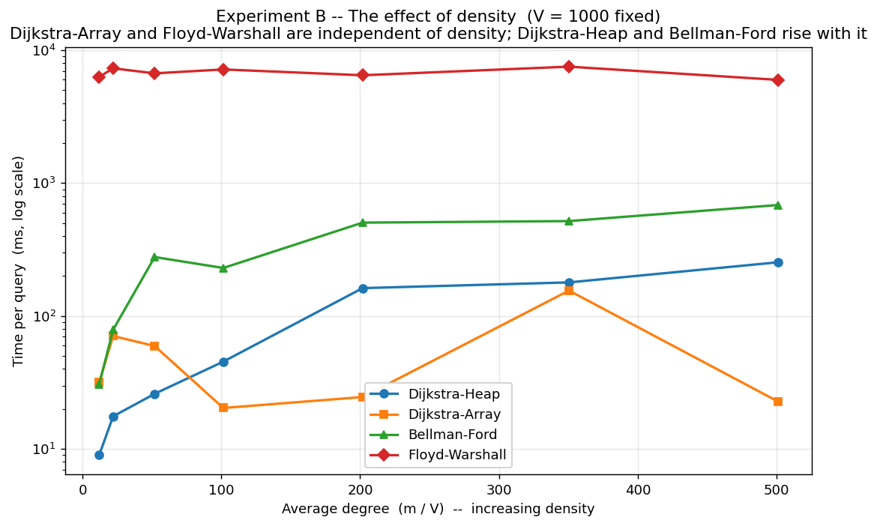
Experiment B — The Effect of Edge Density
Takeaway
• Dijkstra-Array and Floyd-Warshall: time is flat (independent of density)
• Dijkstra-Heap and Bellman-Ford: rise with density
• At the sparse end Dijkstra-Heap leads; as it gets denser Dijkstra-Array overtakes it
• The "best algorithm" depends on the graph's density
12 / 18

Slide 13
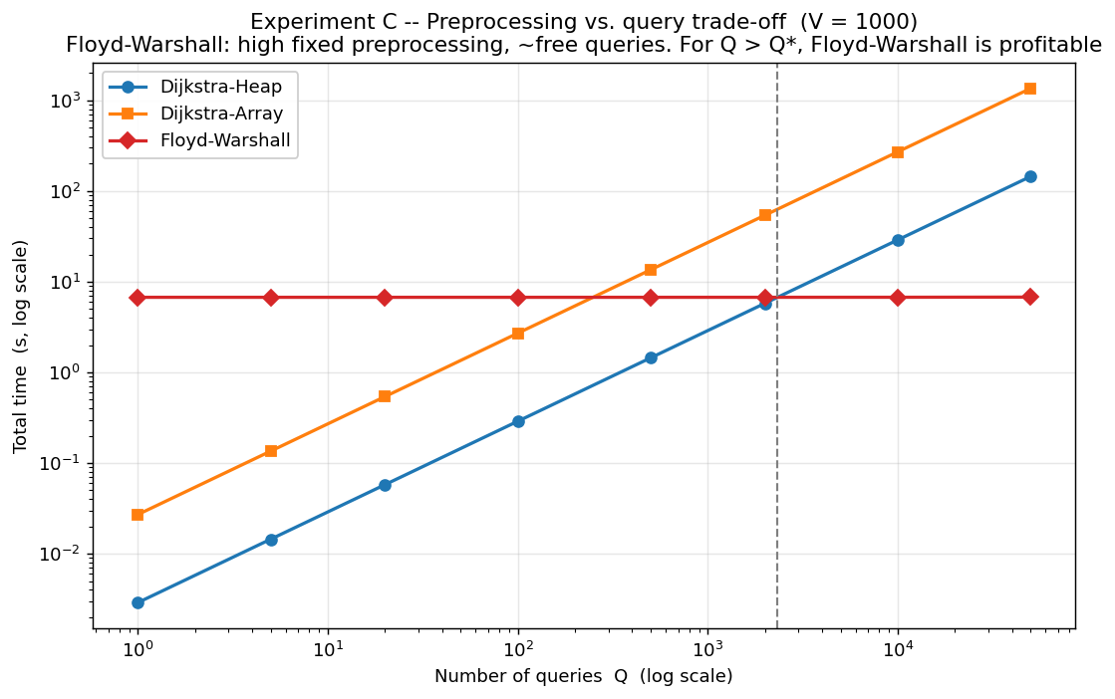
Experiment C — Preprocessing / Query-Count Trade-off
Takeaway
• Dijkstra: pays from scratch on every query (directly proportional)
• Floyd-Warshall: high fixed preprocessing, ~free queries
• Break-even point: Q* ≈ 2330 queries
• Heavy preprocessing makes sense only in the many-query scenario
13 / 18

Slide 14
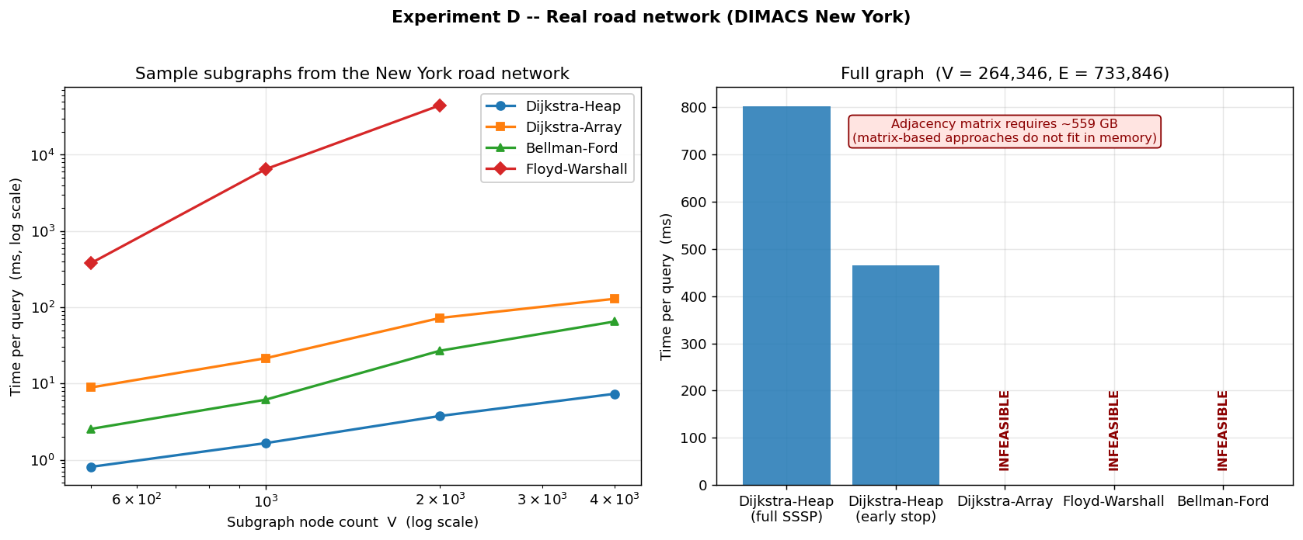
Experiment D — Real Road Network (DIMACS New York)
Takeaway
• 264,346 nodes, 733,846 arcs — real road distances
• Dijkstra-Heap answers an SSSP over the whole network in 802.8 ms, with 13 MB
• Adjacency matrix ~559 GB → Dijkstra-Array and Floyd-Warshall INFEASIBLE
• The representation choice can by itself determine feasibility
14 / 18

Slide 15
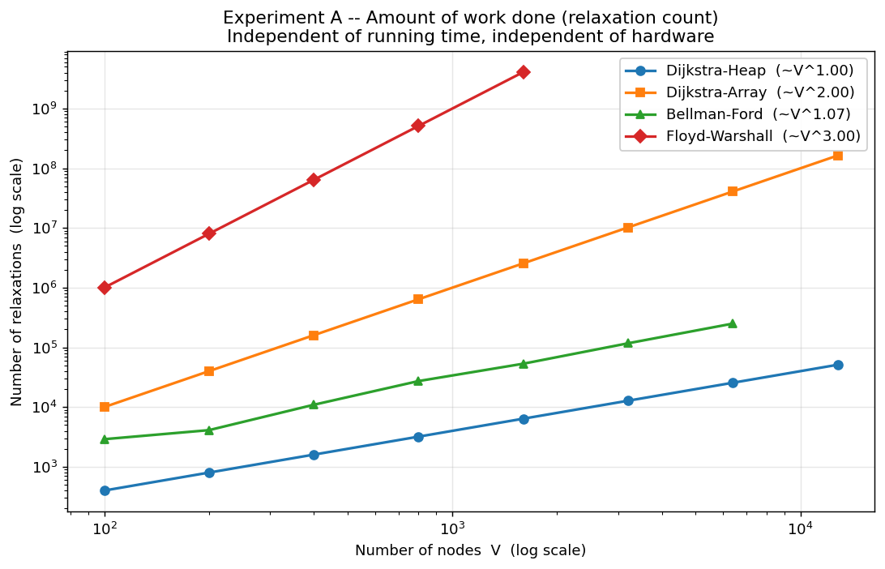
Comparing Theory with Experiment
Takeaway
• Operation-count (relaxation) exponents match theory EXACTLY: 2.00 / 3.00 / ≈1
• Hardware- and language-independent verification
• Time exponents deviate: NumPy overhead (small V) and memory bandwidth (large V²)
• Theory gives the ordering; hardware constants shape it
15 / 18

Slide 16
Which Approach, When?
Scenario | Recommended | Why
Large, sparse graph; few queries | Dijkstra + Binary Heap | O((V+E) log V), low memory
Small/medium, very dense graph | Dijkstra + Array Scan | O(V²) ≤ O(E log V)
Many queries; the graph is fixed | Floyd-Warshall | O(V³) preprocessing amortizes
Negative weights / cycle | Bellman-Ford | Dijkstra becomes incorrect; correctness is essential
Unweighted graph | BFS | O(V+E); weighted ones are needlessly expensive
Takeaway
• Trade-offs: preprocessing vs. query · memory vs. access speed · speed vs. generality · theory vs. empirical constants
16 / 18

Slide 17
Conclusion
▸ All four approaches verified (cross-checks, hand examples, path reconstruction)
▸ General-purpose, scalable option Dijkstra + Binary Heap — the only practical option on the 264-thousand-node real road network (802.8 ms/query)
▸ The "best" depends on the input Dijkstra-Array if dense, Floyd-Warshall if many queries, Bellman-Ford if negative
▸ The representation choice is decisive O(V²) memory makes matrix-based approaches infeasible on large sparse graphs (~559 GB)
▸ Theory vs. experiment operation-count exponents match theory exactly; time exponents are shaped by constant factors/hardware
Takeaway
• Complexity analysis gives the DIRECTION of the decision; experimental measurement gives the CONSTANTS, the crossover points, and the feasibility limits.
17 / 18

Slide 18
Thank You
Questions and discussion

