Slide 1
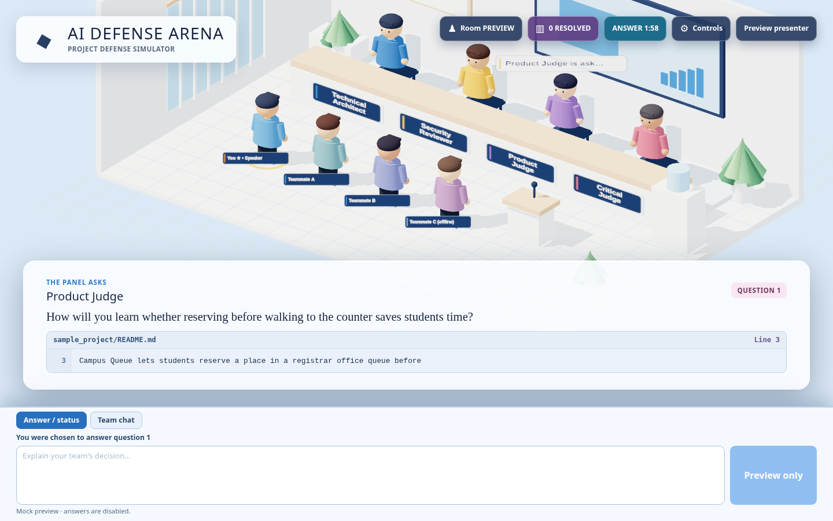
PROJECT DEFENSE SIMULATOR
AI DEFENSE
ARENA
Practice defending your own code as a team—before the real panel.
4 AI panelists
Exact citations
Live team room
Actual app UI · mock preview question
ai-defense-arena.onrender.com ↗
AI DEFENSE ARENA
01 / 08

Slide 2
THE PROBLEM
Building a project is not the same as defending it.
01
02
03
Surprise questions
Generic practice
Team pressure
A real panel can challenge the choices you did not rehearse.
Ordinary prompts miss the details in your own README and code.
Everyone needs a fair chance to speak with a clock running.
The goal
Turn project files into realistic, evidence-based defense practice.
AI DEFENSE ARENA
02 / 08

Slide 3
THE EXPERIENCE
One upload becomes a guided team defense.
1
Upload project
2
Join the room
3
AI asks
Source files or a ZIP
Up to four defenders
Question + exact source line
4
Vote for speaker
5
Answer together
6
Review coaching
15 seconds per question
2 minutes; private team chat
Transcript + next step
4–8 resolved turns · every judge speaks at least once · a missed answer stays marked unanswered
AI DEFENSE ARENA
03 / 08

Slide 4
THE AI PANEL
Four perspectives. One shared project context.
T
Technical Architect
S
Security Reviewer
Design choices, architecture, and tradeoffs
Real security implications in the uploaded code
P
Product Judge
C
Critical Judge
User value, workflow, and success measures
Assumptions, alternatives, and evidence
One AI service uses role-specific prompts. It may ask one immediate follow-up, then moves to the next judge.
AI DEFENSE ARENA
04 / 08

Slide 5
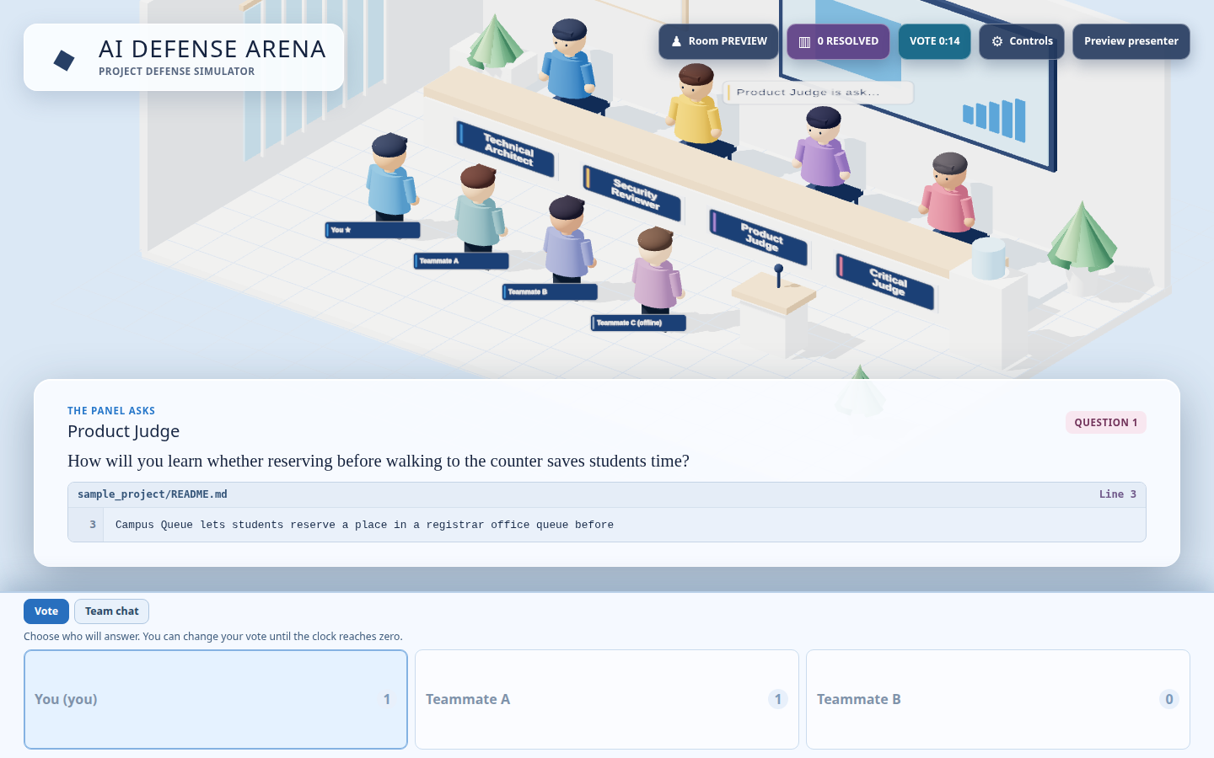
IN THE ROOM
Questions stay tied to the project’s own files.
SOURCE
Filename, line number, and exact text are shown.
SPEAKER
The team votes before the answer clock starts.
SUPPORT
Private chat helps the chosen defender respond.
Illustrative UI preview; real questions are generated from uploaded project text.
AI DEFENSE ARENA
05 / 08

Slide 6
HOW IT WORKS
A small, deliberate architecture for the demo.
BROWSER
→
ROOM SERVER
→
AI PANEL
React + Three.js
FastAPI + WebSockets
OpenAI Responses API
↑
↑
↓
INPUT
ROOM STATE
GROUNDING
Uploaded code + docs
Votes, timers, answers, chat
Validate file + exact line
Single Render service · source text stays in memory · room state resets on restart
AI DEFENSE ARENA
06 / 08

Slide 7
WHAT I MADE
I shaped the product and shipped the working prototype.
THE PRODUCT
MY CONTRIBUTION
A playable defense room
Set the vision
Four AI judge roles and four defender seats.
An AI panel that reads the team’s actual project.
Evidence-based questions
Directed the design
Every question displays a validated source line.
Roles, citations, multiplayer flow, timers, UX.
Timed team play
Reviewed checkpoints
Speaker voting, answer clock, and private chat.
Tested behavior and steered each iteration.
Useful coaching
Delivered the demo
Saved transcript with strengths and improvements.
Private repository and Render deployment.
AI coding agents accelerated implementation; I owned the direction, review, and release decisions.
AI DEFENSE ARENA
07 / 08

Slide 8
LIVE DEMO
Can your team defend
the choices behind its code?
https://ai-defense-arena.onrender.com
01
Upload source files
02
Join with a room code
03
Vote, answer, review
Prototype note: rooms are in memory and reset when the service restarts.
AI DEFENSE ARENA
08 / 08

