Slide 1
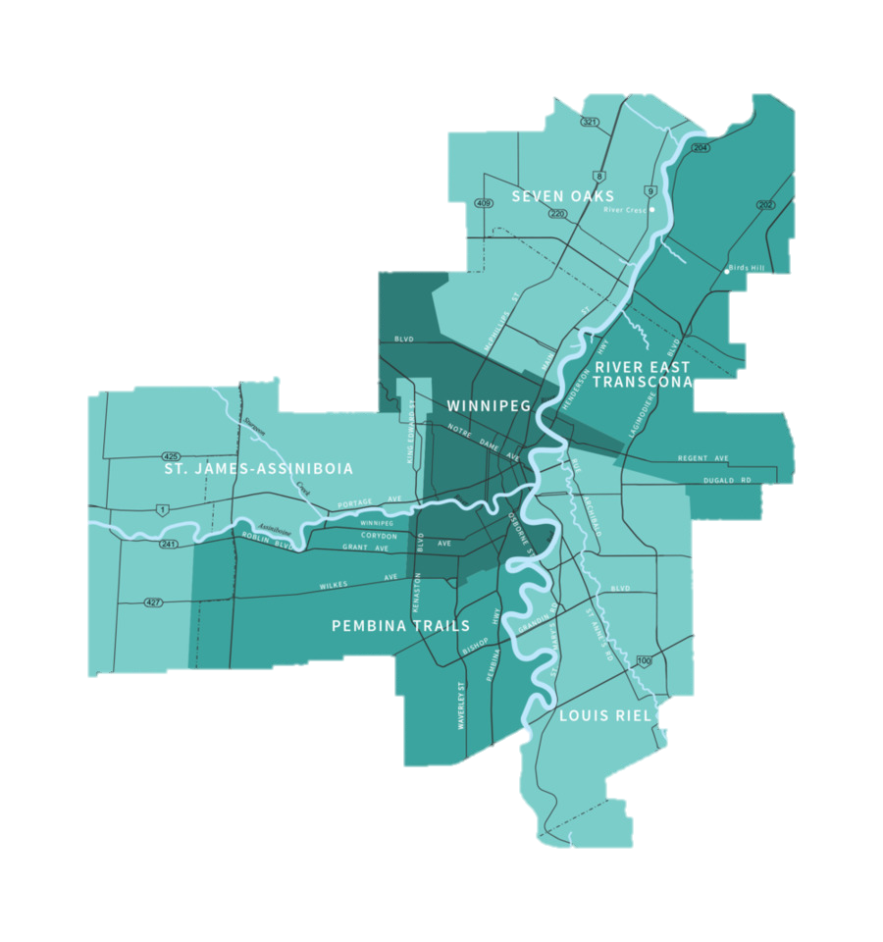
Choosing the best area of Winnipeg to live with children
Capstone Project - The Battle of the Neighborhoods
Applied Data Science Capstone by IBM/Coursera
Sultanova Liliya
Ufa - 2020

Slide 2
Problem
In my project, I analyzed which parts of the city of Winnipeg are best suited for living with children, in terms of safety, proximity to schools, and availability of various activities.
Interest
This project is intended for families with children who want to move to live in Winnipeg. It can also be useful for realtors offering to buy a house or apartment for families with school-age children.

Slide 3
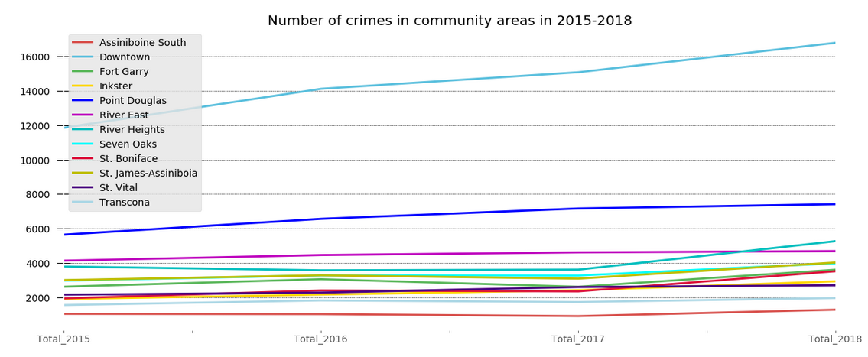
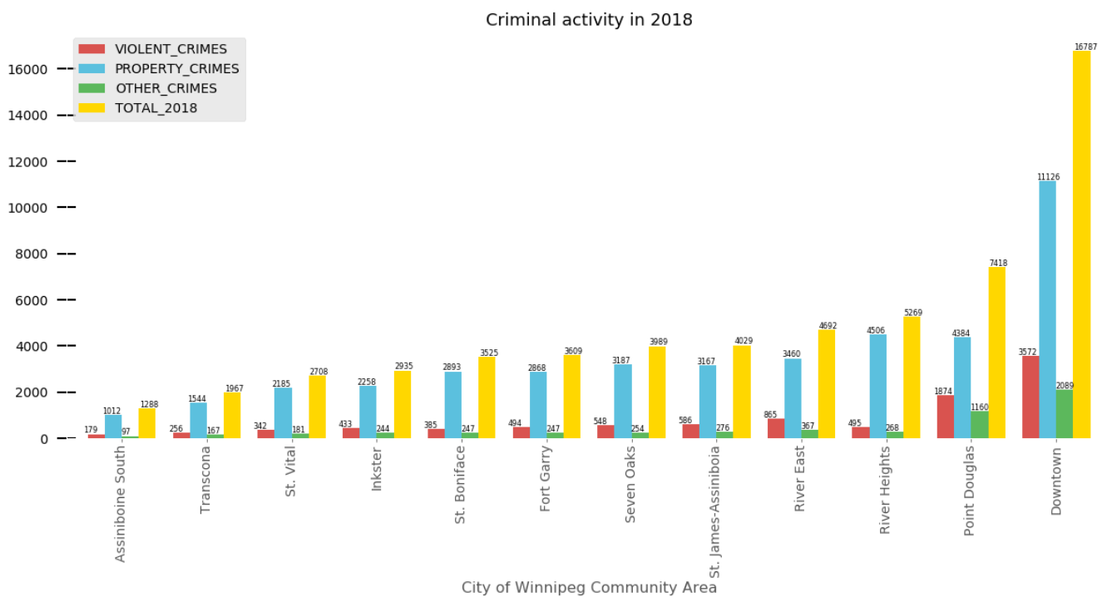
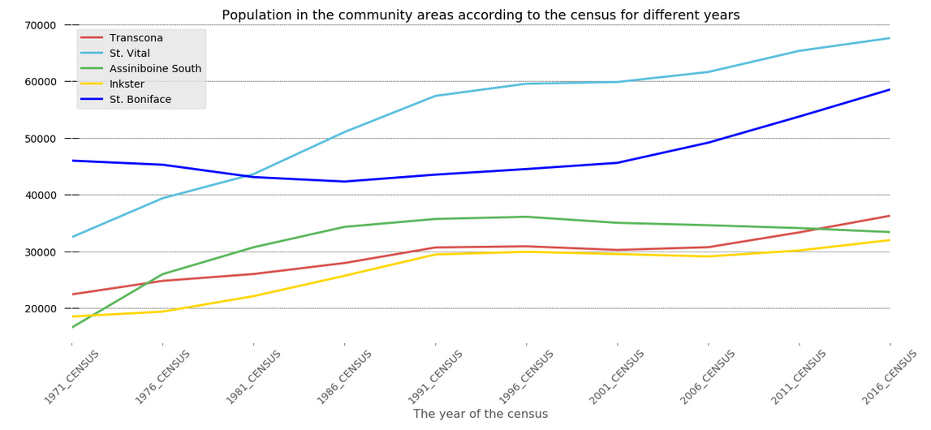
Consider the criminal situation in Winnipeg and choose the safest areas
The graph shows that the most crimes were committed in the Downtown, the least crimes were committed in Assiniboine South. We also see an increase in the number of crimes by year in all areas of Winnipeg.

Slide 4
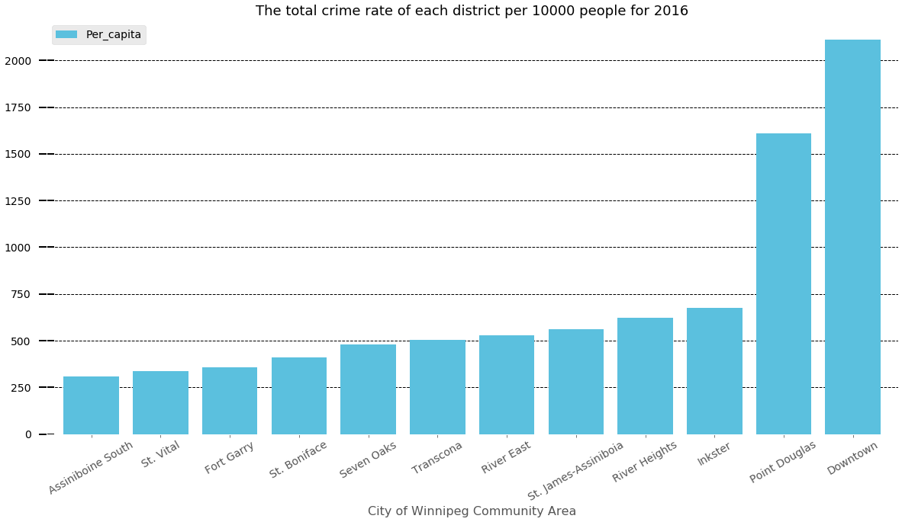
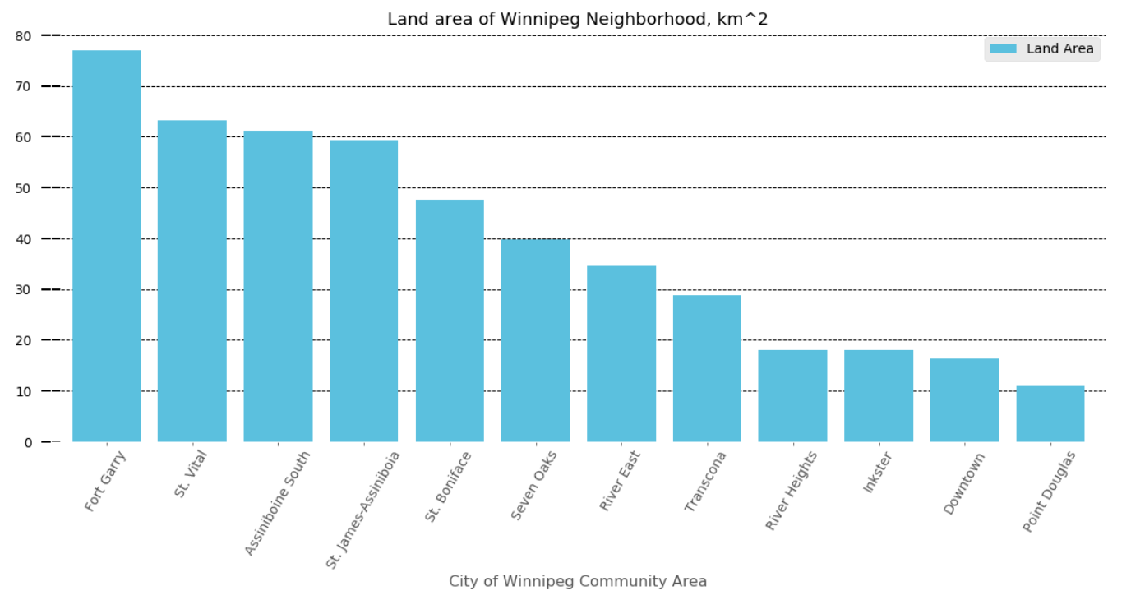
Find the number of crimes committed per capita in each district
Formula for calculating the total crime rate per 10000 people:
K = P *10000 / N
where K is the crime rate
N - the number of facts or the number of persons who have committed crimes
P– population

Slide 5
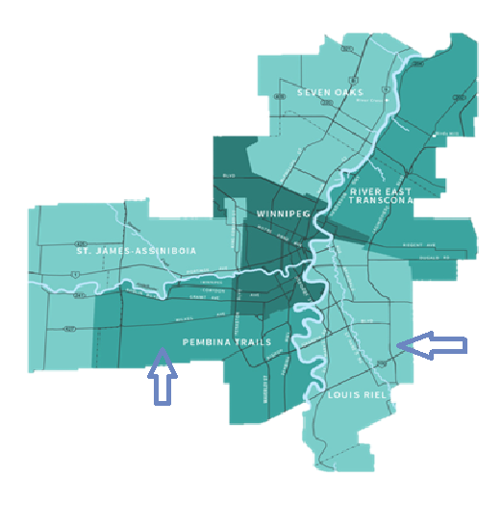
Choosing the School Division
St.Vital and St.Boniface are part of the Louis Riel School Division.
The main part of the Ford Garry and Assiniboine South are part of the Pembina Trails School Division , so we will continue to review the schools of only these school divisions.

Slide 6
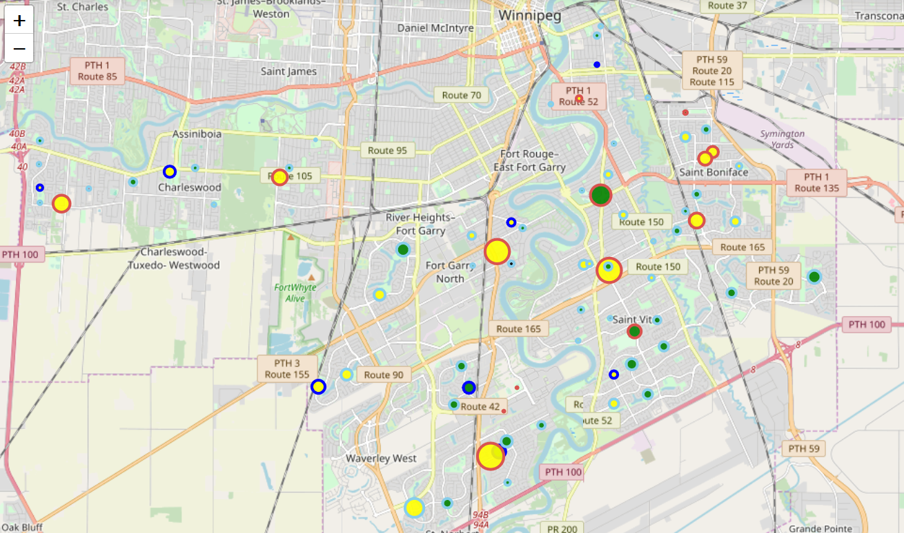
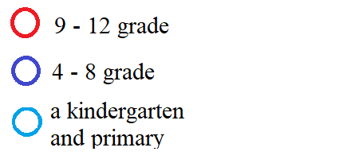
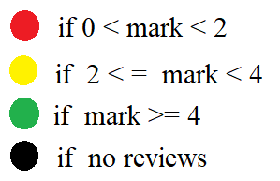
All Winnipeg schools belonging to the Louis Riel and
Pembina Trails school division are mapped
The color of the circle indicates which classes are in school:
Filling the circle indicates what reviews about the school:
The map shows the number of students in each school: the radius of the circle for each school is divided by 100 students and rounded to an integer in the larger direction.

Slide 7
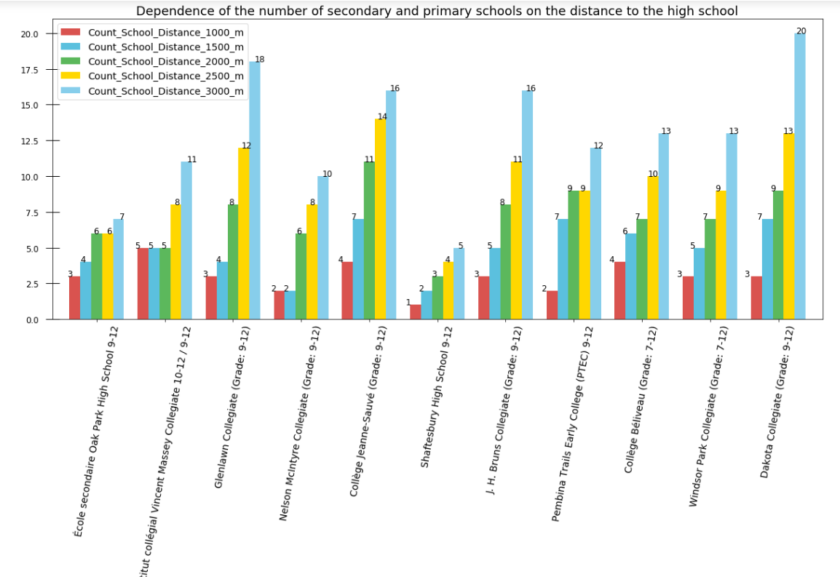
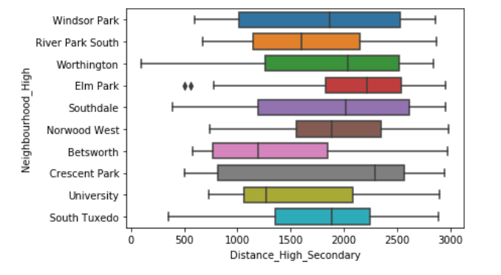
Determining the distance between schools
cos(d) = sin(φА)·sin(φB) + cos(φА)·cos(φB)·cos(λА − λB), L = d·R, earth's radius R = 6378137m
Since there are only 11 schools in grades 9-12, we calculate the distance from all elementary schools to high schools.

Slide 8
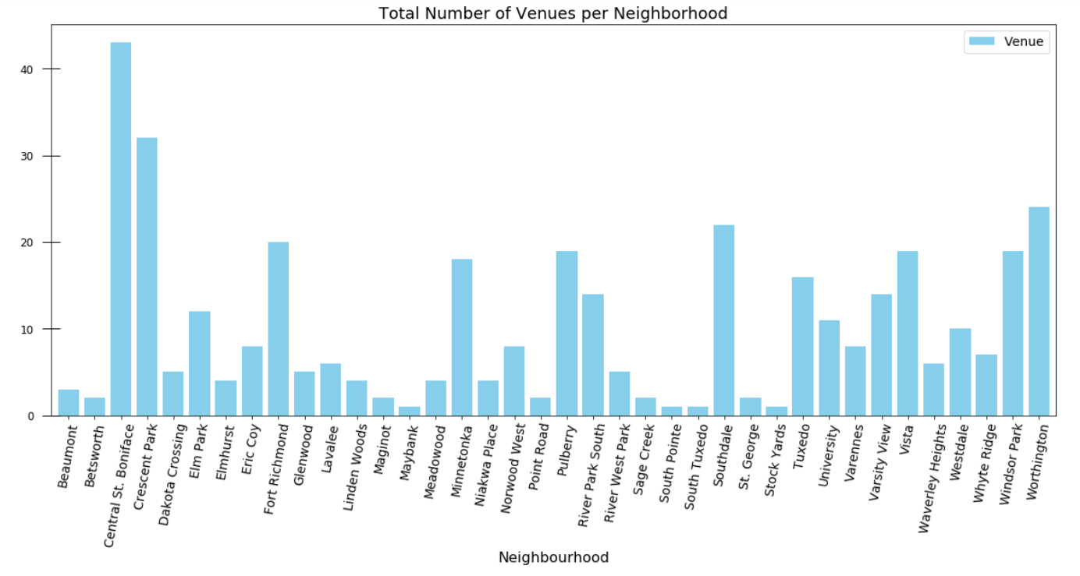
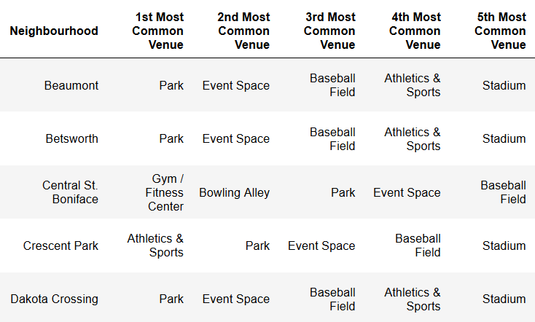
Use Foursquare API to generate a list of venues per borough
I looked at what places there are
in each area for sports:

Slide 9
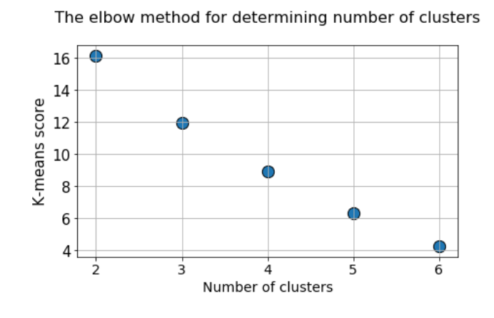
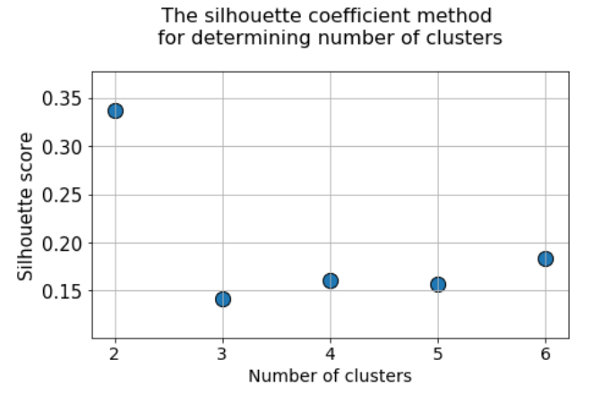
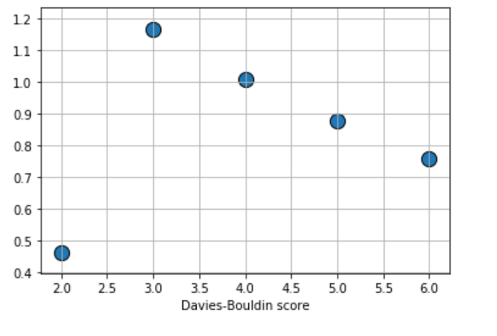
The clustering method is used to
find schools with similar characteristics
Features for clustering: enrollment of school, program English or French, average mark, the number of secondary schools is closer than 1000 meters, area where there is soccer field or stadium, baseball field, bowling alley, dance studio, sports club, football stadium, gym, fitness center, event space, park.
Therefore, the most appropriate number of clusters is 3

Slide 10
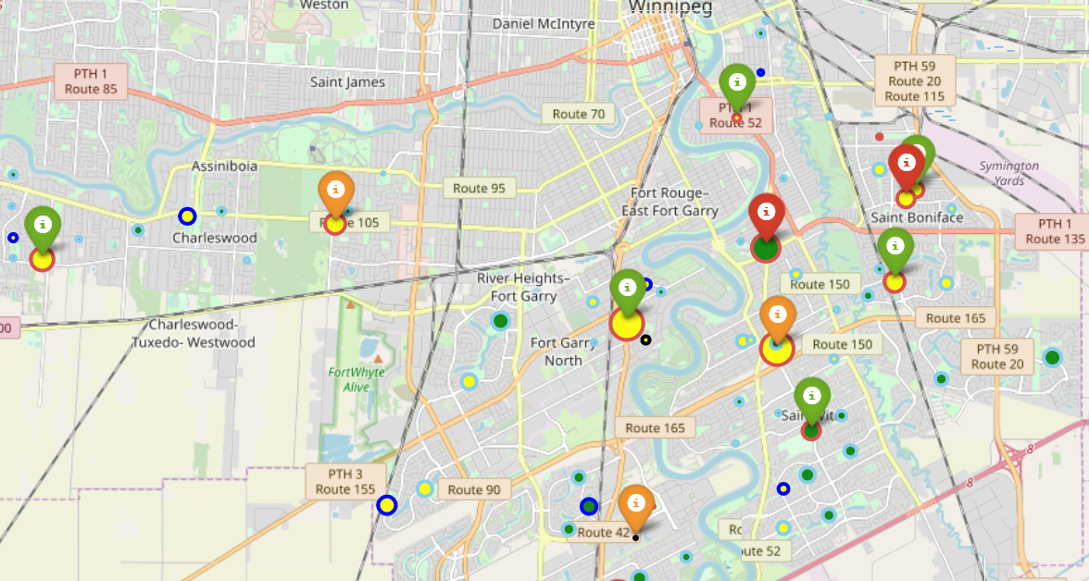
On this map is shown areas where you can rent or buy housing, depending on the requirements for the school, to make clusters visible they are drawn as icons.

Slide 11
Conclusions
In my work:
I analyzed which areas of Winnipeg are the safest and most comfortable to live with children.
Indicated places for rent and home purchases of which the primary middle and high schools are the closest.
Considered what other factors influence the choice of residence.

Slide 12
Data sources:
The Louis Riel School Division:
https://www.lrsd.net/School/Community-of-Schools/Pages/default.aspx
Pembina Trails School Division:
https://www.pembinatrails.ca/School/SchoolList/Pages/default.aspx
The criminal situation of each district:
https://www.winnipeg.ca/police/AnnualReports/annualreports.stm.
Census data for 1996, 2001, 2006 and 2011, 2016 by district:
https://www.winnipeg.ca/census/sitemap/sitemap.asp .
City of Winnipeg Currently Active Official Property Addresses and Associated Coordinates: https://data.winnipeg.ca/City-Planning/Addresses/cam2- ii3u.
Forsquare API : https://developer.foursquare.com/.
Thank you for your attention!

