Slide 1

Freeform Programming Assessment
Topic - Powerlifting
Photo: Nottingham Strong

Slide 2
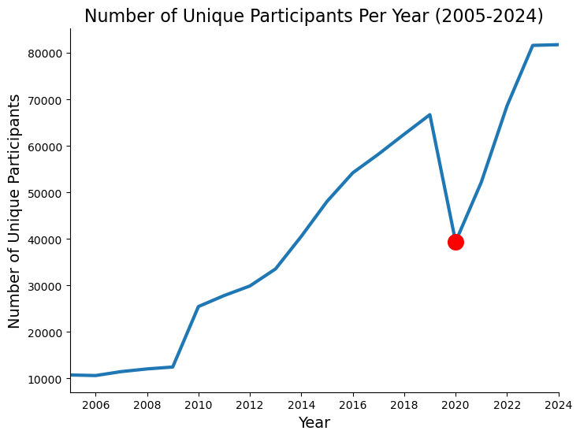
Powerlifting
Goal is to achieve the heaviest combined total weight for squat, bench press, and deadlift
Has seen a surge in popularity in recent years
Drop in participation in 2020 due to COVID-19 and lockdowns

Slide 3
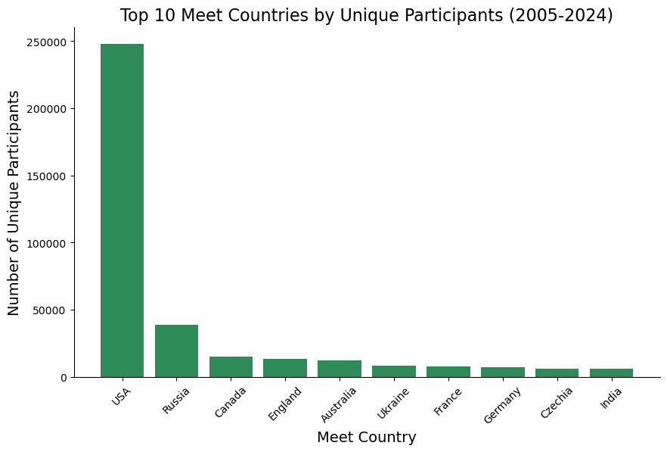
Demographic
USA appears to host the most meets
Russia, Ukraine, Canada, and England also have large participation
Lifter nationality was missing data for 950,000 people – meet country is a better indicator

Slide 4
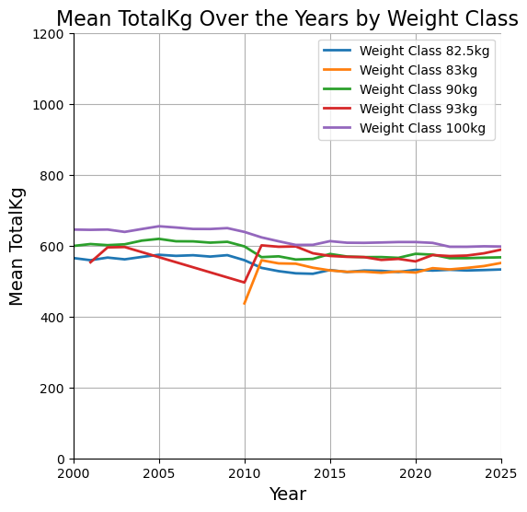
Performance Change?
Used the mean Total Kg lifted for the 5 most common weight classes
Some decrease around 2010 for 100kg, 90kg, and 82.5kg
The 83kg class was only added in 2010 when federations such as the IPF began to use it

Slide 5
Initial Difficulties
Downloaded .csv file was 700MB – had to cut out some data before making my initial git repo
Had to restart git repo due to accidentally multiplying the saved data inside it

