Slide 1
EN.580.428
Genomic Data Visualization
Lesson 6
Differential Expression Analysis
Prof. Jean Fan

Slide 2
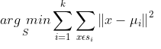
K-means clustering algorithm on tSNE?
Gene B
Gene A

Slide 3
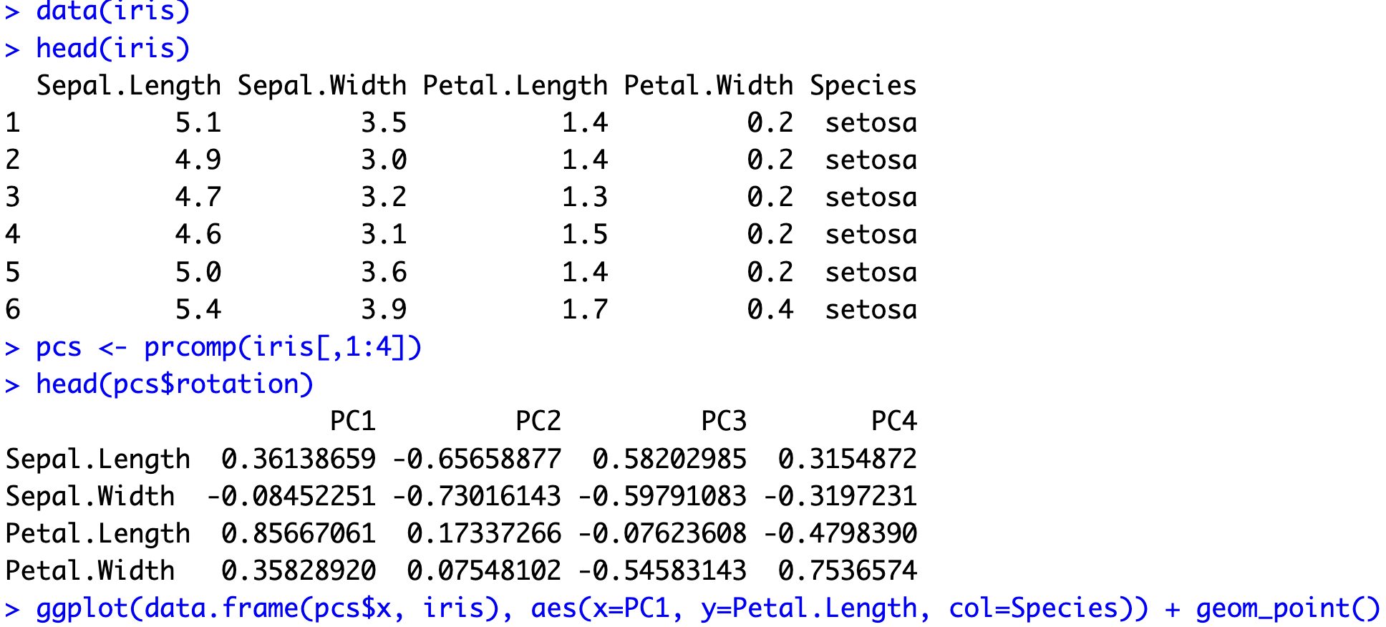
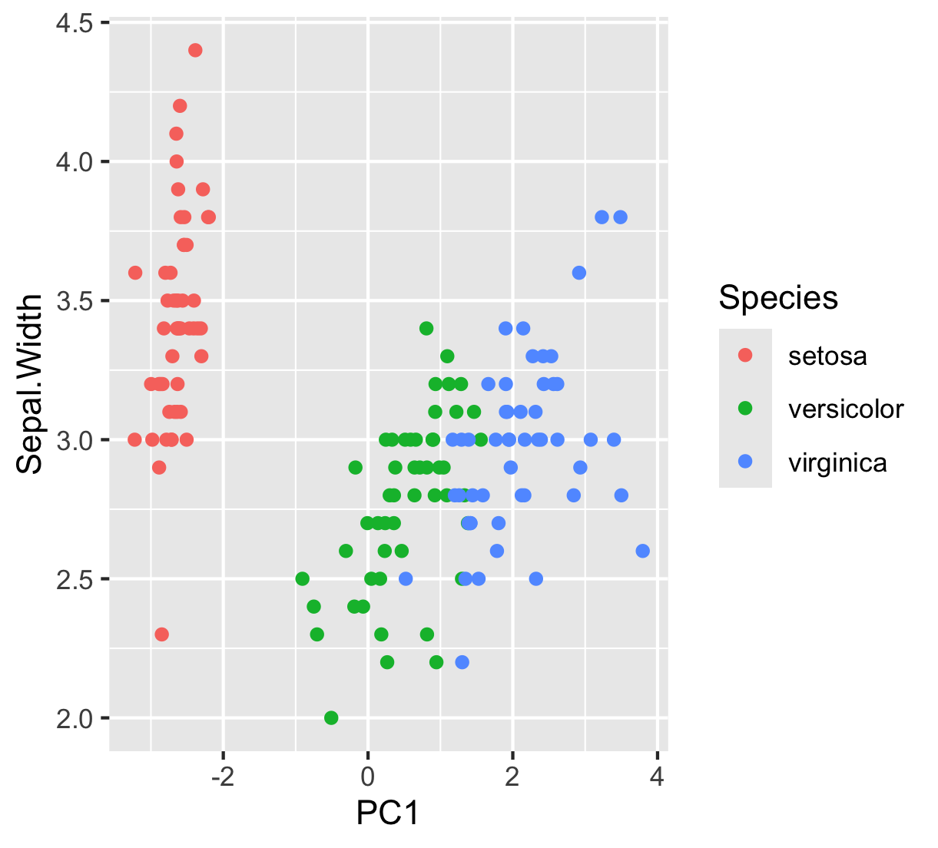
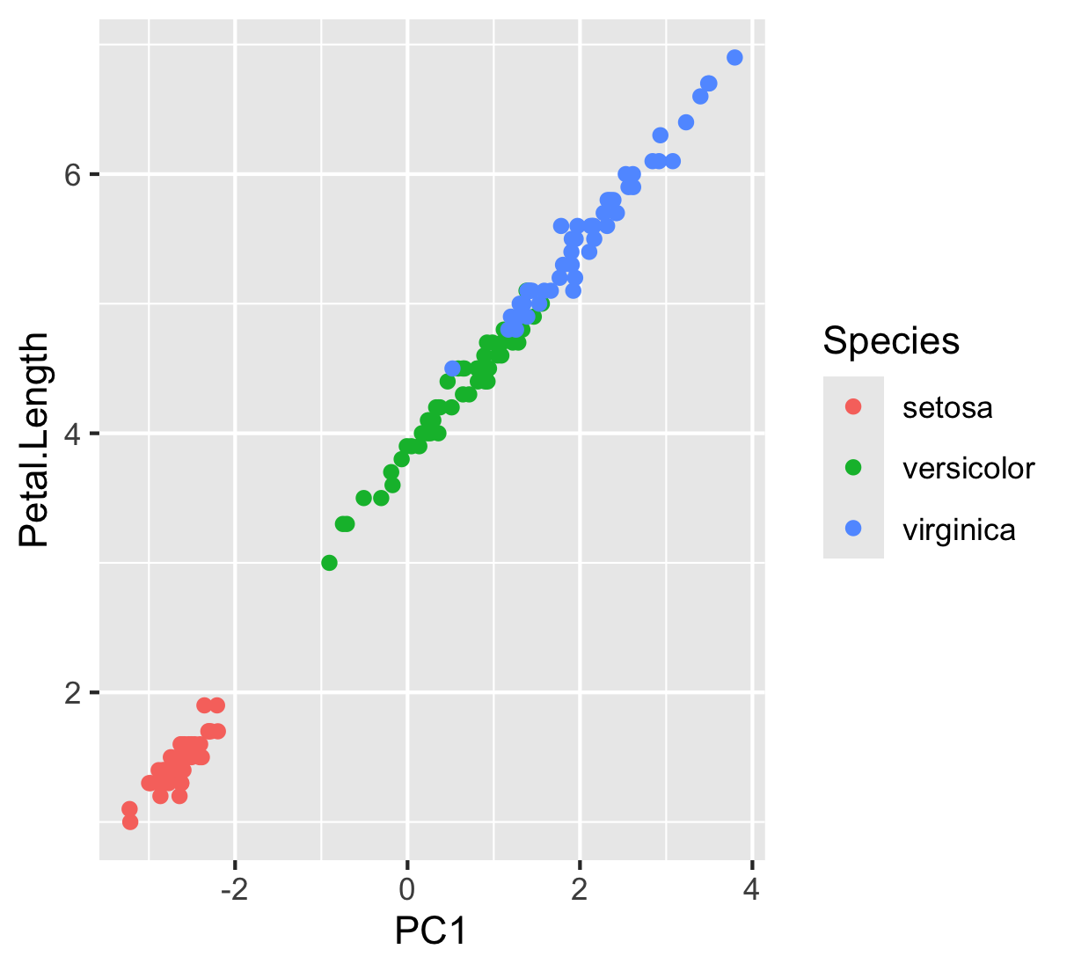
Practice

Slide 4
Learning objectives
Learn about and apply statistical approaches to identify differentially expressed genes

Slide 5
Definitions
Gene B
Differentially expressed genes
Differentially upregulated genes
Gene A

Slide 6
Motivation
Why identify differentially expressed genes?
Notes:
Differentially expressed genes
Differentially upregulated genes

Slide 7
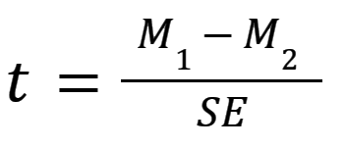
T-test: testing a difference of means (intuition)

Slide 8
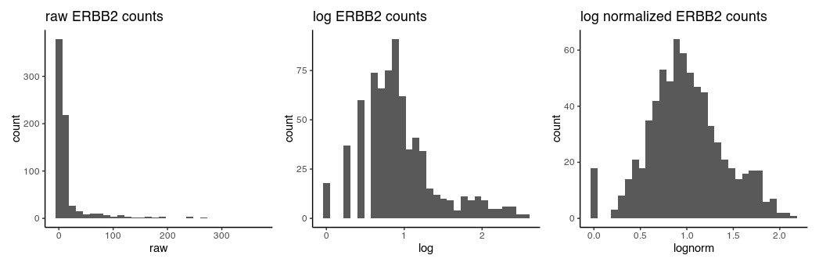
T-test assumptions and data visualization
that the data are quantitative and plausibly Gaussian
that the two samples come from distributions that may differ in their mean value, but not in the standard deviation

Slide 9
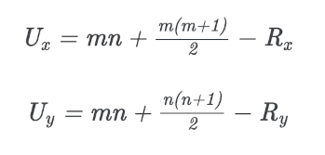
Wilcoxon Rank Sum Test (Mann–Whitney U test ): testing a difference in ranks (intuition)

Slide 10
Other statistical tests
Many other tests that incorporate different normalizations, error modeling, Bayesian approaches, etc
Goal is to improve our statistical power in detecting true positives and true negatives while minimizing false positives and false negatives
  Often becomes a trade-off with speed and computational complexity

Slide 11
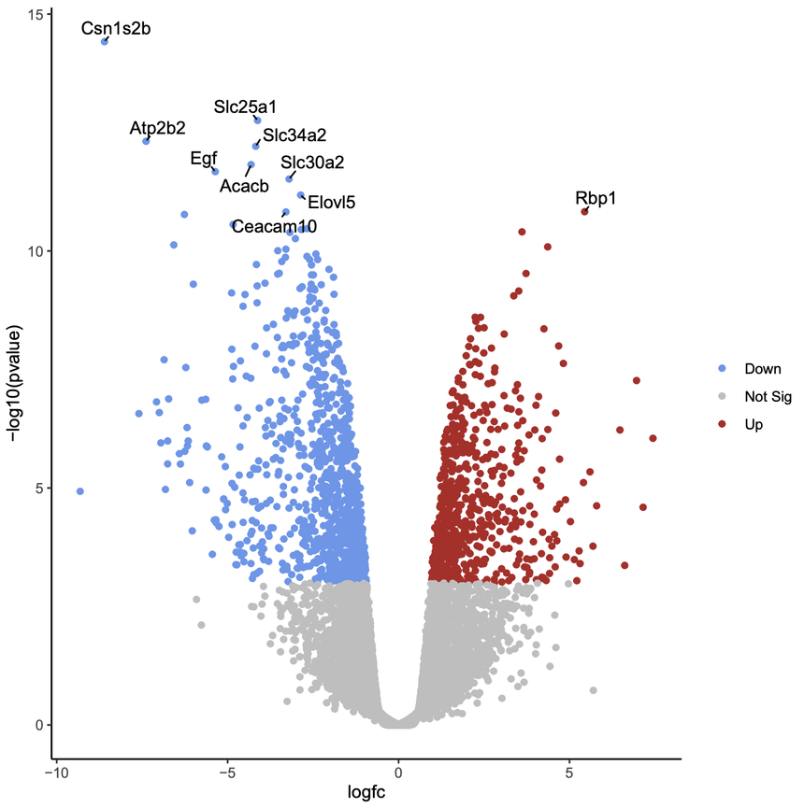
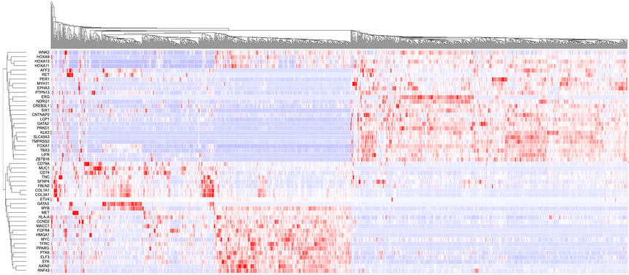
Common visualizations

Slide 12
Discussion (no right answer)
Practice
In a spatial transcriptomics experiment, we perform k-means clustering to identify 10 cell clusters. For one cell cluster, there is only 1 gene significantly upregulated. Do you believe this cell cluster represents a distinct cell-type? Why or why not?

Slide 13
Discussion (no right answer)
Practice
In a spatial transcriptomics experiment, we perform k-means clustering to identify 10 cell clusters. For one cell cluster, there are are 100 genes significantly upregulated. But this cell cluster only has 2 cells. Do you believe this cell cluster represents a distinct cell-type? Why or why not?

Slide 14
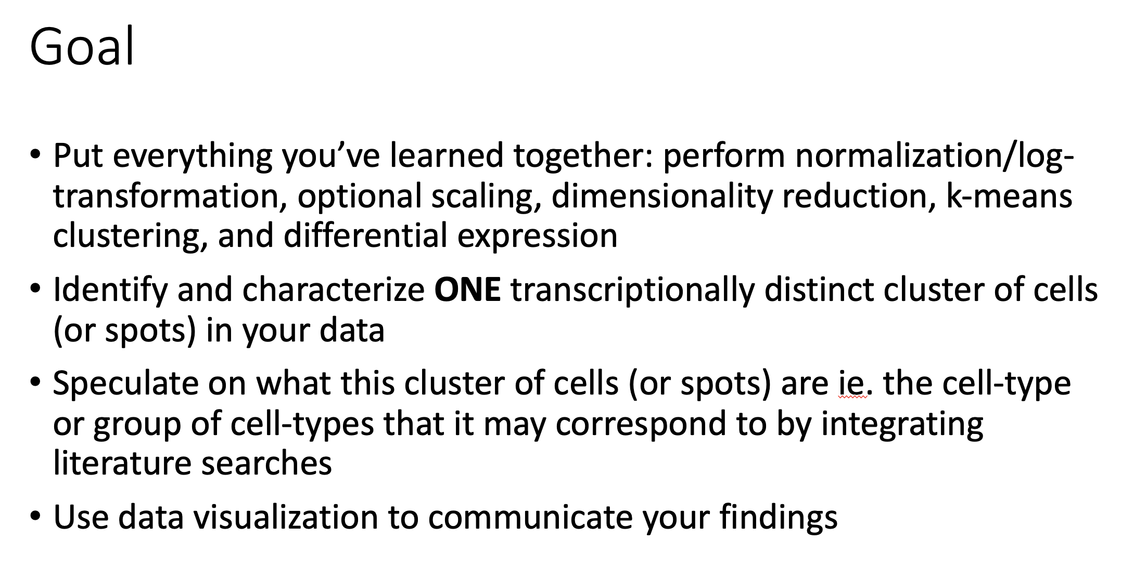
Homework (due next Wednesday)

Slide 15
Tips of what not to do

Slide 16
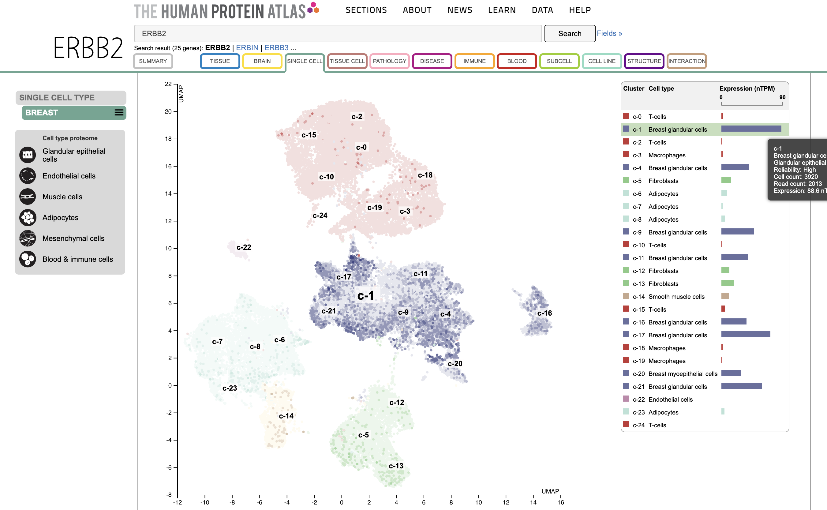
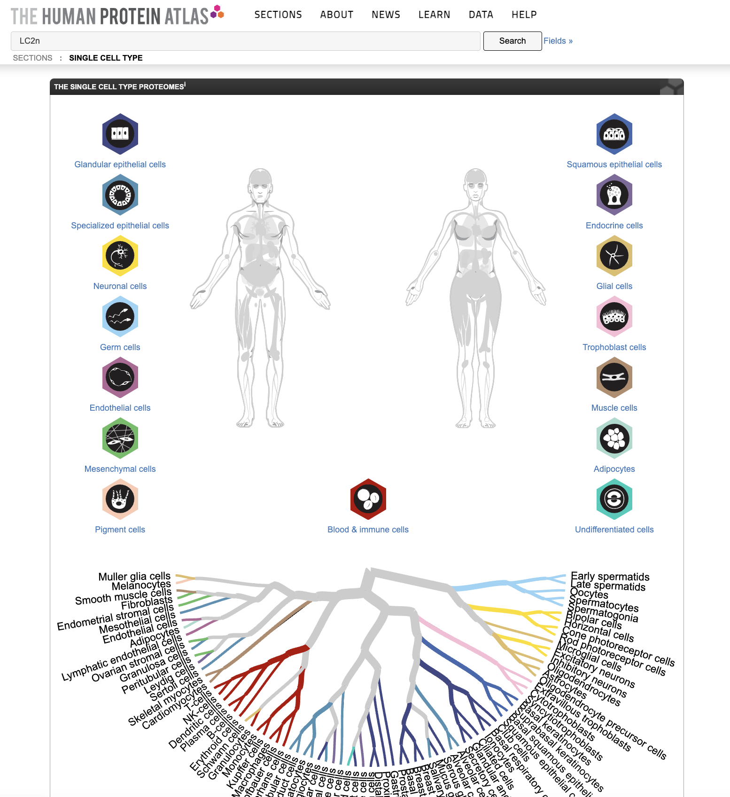
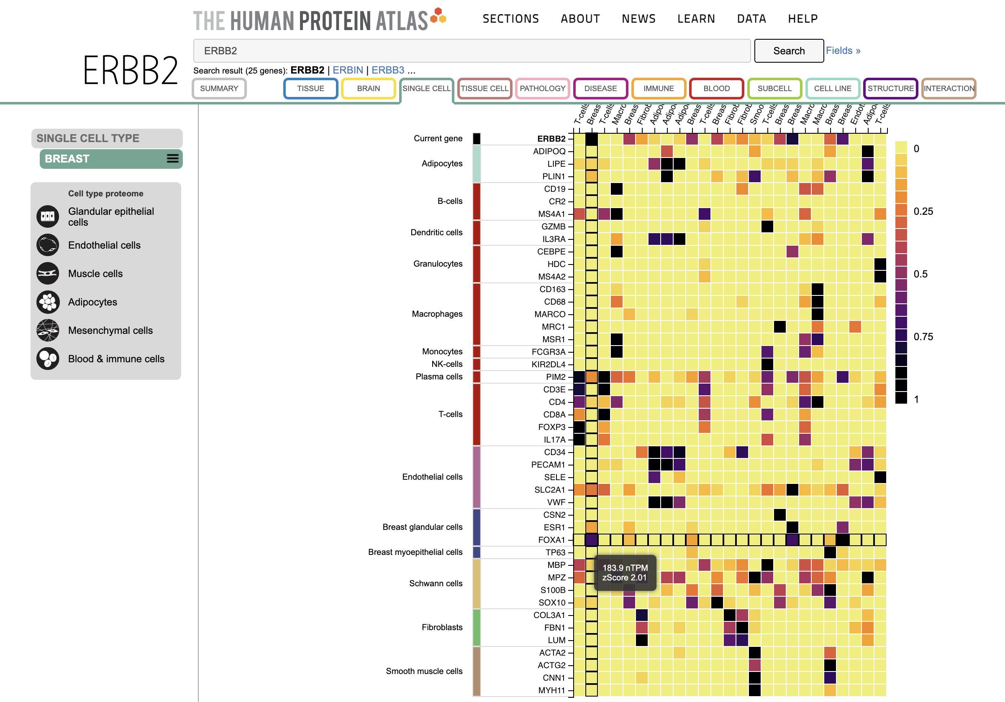
https://www.proteinatlas.org/humanproteome/single+cell+type

