Slide 1
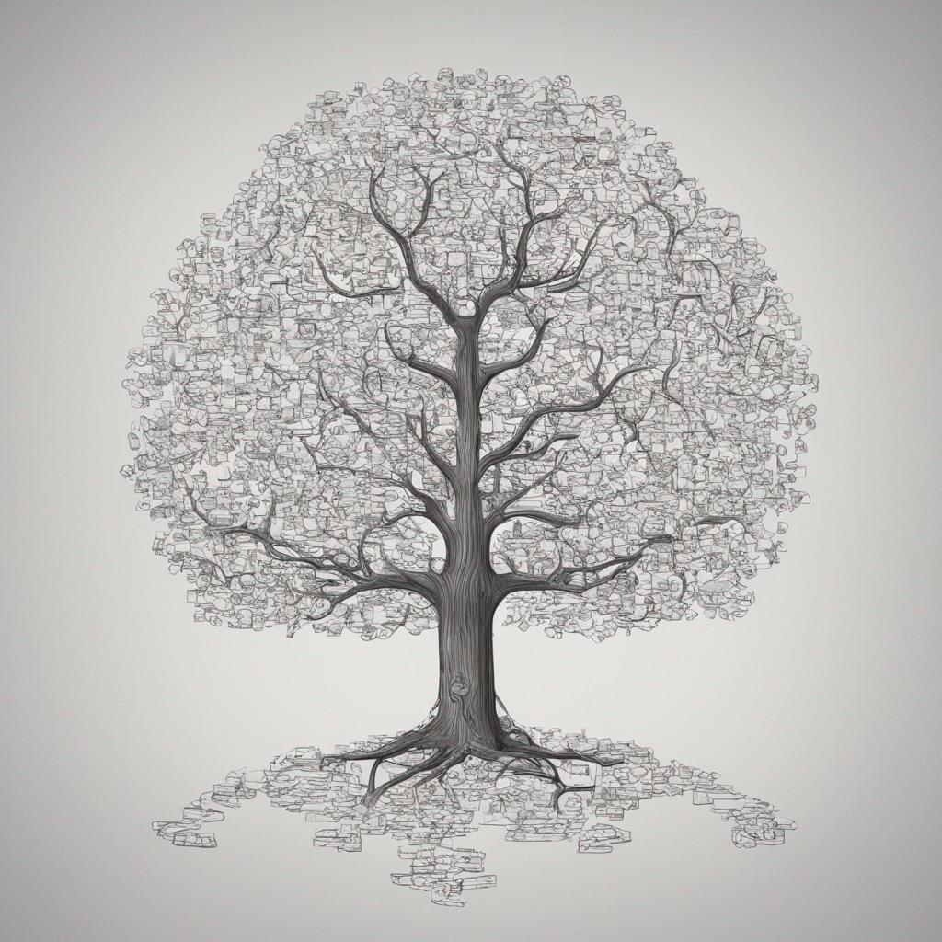
The 2-3 Tree Algorithm
Welcome to the world of the 2-3 tree algorithm! In this presentation, we will explore the fascinating concept of the 2-3 tree, and how it solved the imbalanced tree problem.
by Lillian Wassim

Slide 2
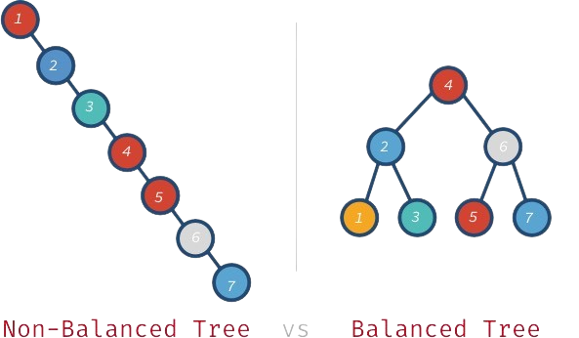
The Problem of Imbalanced Trees
An imbalanced binary tree is one where the depths of the nodes in the left and right subtrees can vary significantly. This imbalance can lead to performance issues when performing operations on the tree.

Slide 3
Transform and Conquer Strategy
Discover the power of the transform and conquer strategy. By transforming complex problems into other problems or transforming data structures to other data structures , you will see how this approach allows us to effectively tackle the challenges posed by imbalanced trees.

Slide 4

Introduction to 2-3 Trees
Get ready to dive into the world of 2-3 trees! Learn about their structure, properties, and how they address the imbalance problem. Explore how these balanced trees maintain order and balance, ensuring optimal algorithm performance.

Slide 5
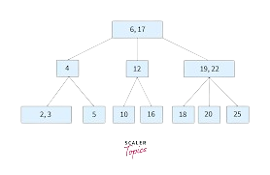
Always Balanced Tree
A 2-3 tree maintains balance by adhering to specific rules during insertion and deletion operations, ensuring that it always remains balanced. In a 2-3 tree, each node can have either two elements (in a 2-node) or three elements (in a 3-node), and the tree remains balanced.

Slide 6
Insertion:
Lets try to do an example to understand better.
We have an array of numbers lets insert it in the tree.
[ 9 , 5 , 8 , 3 , 2 , 4 , 7 ]

Slide 7
How 2-3 Tree Works
Insert (5)
9
5
Insert (9)

Slide 8
How 2-3 Tree Works
Insert (8)
5
8
9
Insert (5)
IT IS TIME TO SPLIT

Slide 9
How 2-3 Tree Works
Insert (8)
5
8
9

Slide 10
How 2-3 Tree Works
8
Insert (3)
3
5
9

Slide 11
How 2-3 Tree Works
8
Insert (2)
3
9
2
5
IT IS TIME TO SPLIT

Slide 12
How 2-3 Tree Works
8
8
3
2
9
2
2
3
5
5

Slide 13
How 2-3 Tree Works
3
8
Insert (4)
2
4
5
5
9

Slide 14
How 2-3 Tree Works
3
8
Insert (7)
4
5
7
9
2
5
IT IS TIME TO SPLIT

Slide 15
How 2-3 Tree Works
3
8
2
4
5
7
9
IT IS TIME TO SPLIT AGAIN

Slide 16
How 2-3 Tree Works
3
5
8
2
4
7
9

Slide 17
How 2-3 Tree Works
3
5
8
2
4
7
9

Slide 18

Transitions in Node Movement During Insertion
1
Splitting Nodes
2
Merging Nodes
3
Rotating Nodes

Slide 19
Analysis of the Algorithm
The time complexity for various operations in a 2-3 tree, such as search, insertion, and deletion, is generally o(log n), where n is the number of elements in the tree. This complexity arises due to the balanced nature of the 2-3 tree.

