Slide 1
Term weighting for feature extraction on twitter : a comparison between bm25 and tf-idf
Ammar Ismael Kadhim , 2019 International Conference on Advanced Science and Engineering (ICOASE)
組員: M10909112 石家安 M10909120 樊驊 M10915050 林紹瑜 M10915095 薛宇翔

Slide 2
Introduction
Method
Experiment & Result
Conclusion

Slide 3

Introduction

Slide 4
introduction
Due to the large volume of tweets in diverse topics, the classification of tweets on Twitter.
Feature extraction is a significant stage in the process of initial text classification.
Term frequency-inverse document frequency (TF-IDF) is normally utilized to weight the keywords
BM25 can be defined as the ranked function that it used to rank corresponding text documents with respect to their relation to the specific search query.
This paper introduces a comparative between BM25 and TF-IDF techniques for feature extraction.
Experimental results show that the TF-IDF performs better than BM25 according to the performance classification metrics.

Slide 5
background
Feature extraction is to transform a text document from any format into a list of features that can be easily processed by text classification techniques.
Feature extraction is one of significant preprocessing techniques in data mining and text classification that computes features value in documents.
This paper presents a comparative study of feature extraction techniques. Two techniques were evaluated BM25 and TF-IDF to weight the terms on Twitter.

Slide 6
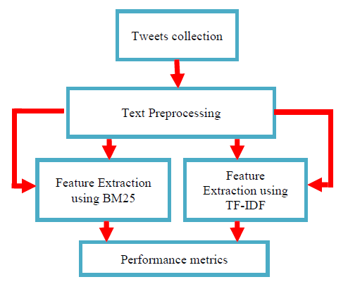
Proposed approach
This paper comprises: Tweets collection using application programming interface (API), text preprocessing using tokenization, stop words and stemming
Feature extraction using two different methods and comparison between TF-IDF and BM25 methods based on performance metrics

Slide 7

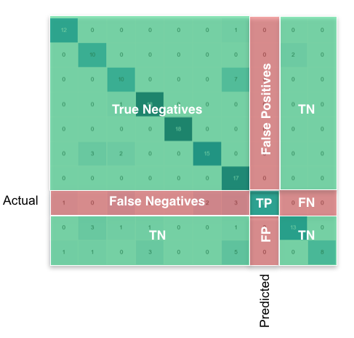
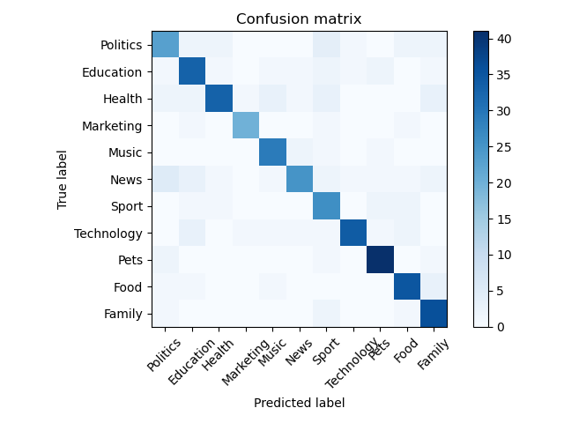



Performance matrix(multi-classification)

Slide 8
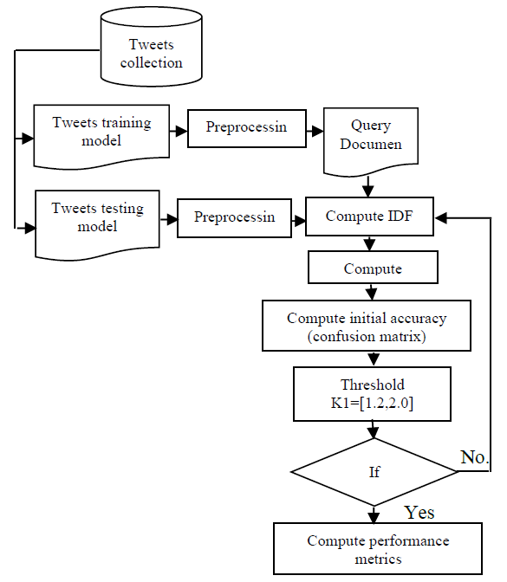
Proposed approach - BM25
Flowchart of BM25 method.

Slide 9
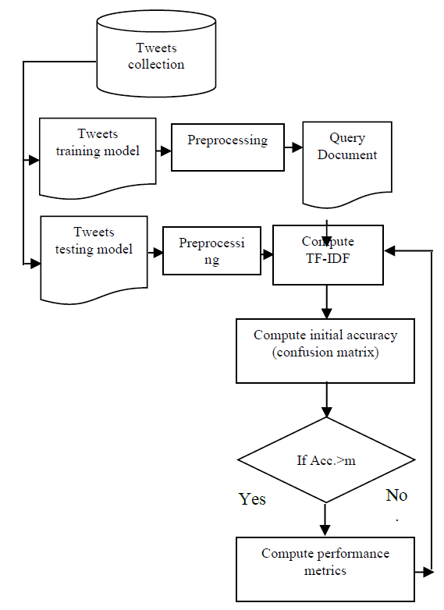
Proposed approach - tf-idf
A semantic step is very significant to select the proposed keywords that carried the same meaning of the tweet, and reject others tweets set.
The whole procedure of feature extraction using TF-IDF as displayed in left.

Slide 10

Methodology

Slide 11
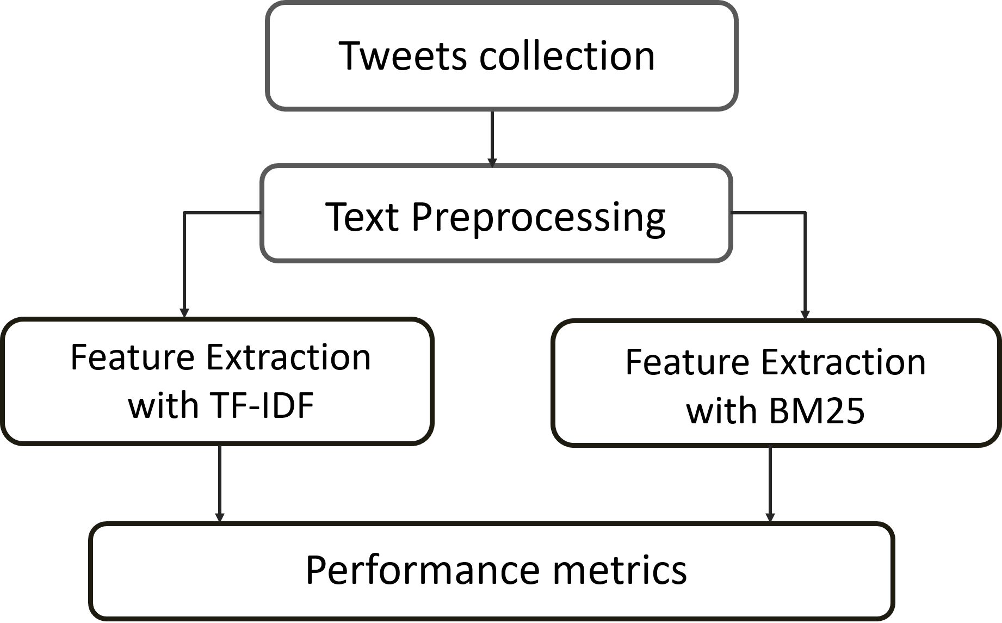
Flow chart

Slide 12
Data collection & Data Preprocessing
1
Using Tweepy package to request Twitter Streaming API
2
Remove noise text, like HTML, ‘RT’ and @people words
Text preprocessing using tokenization, lower case,
stop words and snowball stemming, emoji to text…etc
3
Notes:
Stream API實時提供搜索結果。

Slide 13
Our dataset
Class | Amount
Politics | 200
Education | 200
Health | 200
Marketing | 200
Music | 200
News | 200
Sport | 200
Technology | 200
Pets | 200
Food | 200
Family | 200

Slide 14
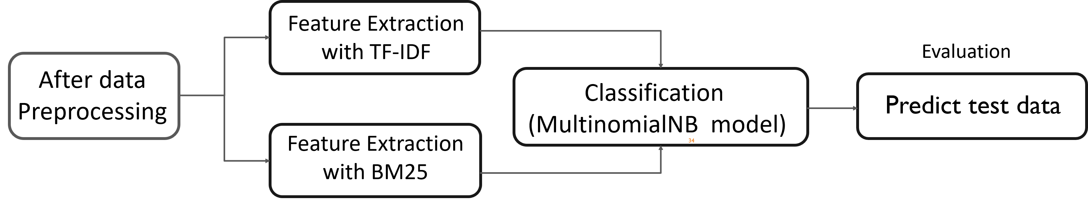
Text classification

Slide 15

Experiments & Results

Slide 16
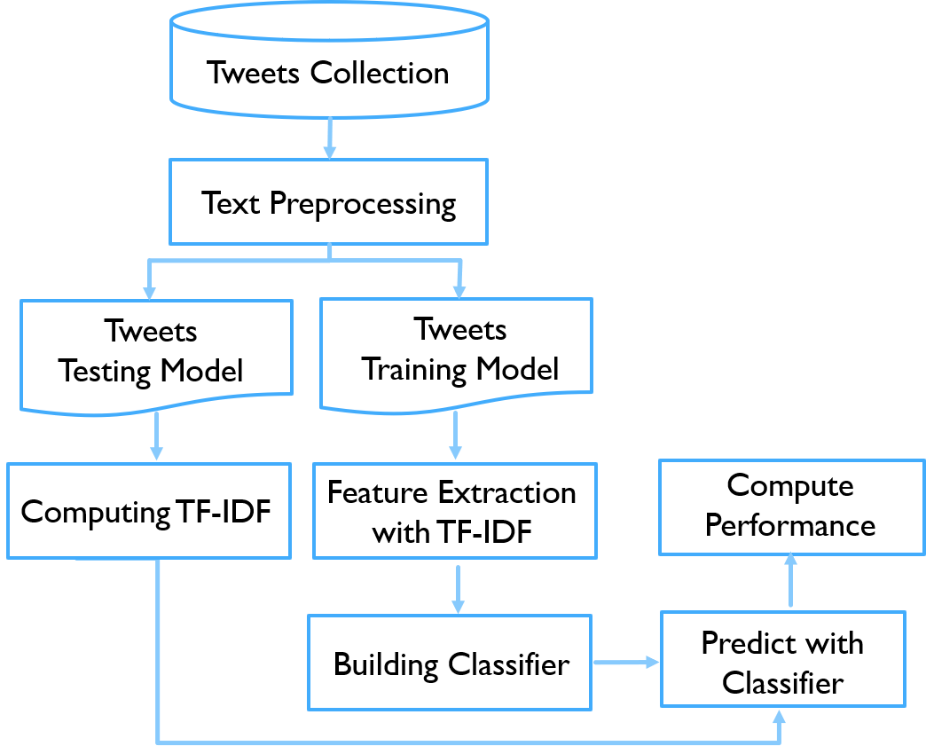
TF-IDF
Preprocess collection
Emojitotext
remove_punctuation
Tokenize
remove_stopwords
word_lemmatizer
word_stemmer
Split training and test data
Training data : 1760
Test data : 440

Slide 17
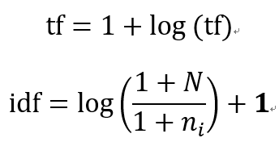
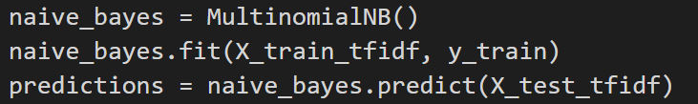
TF-IDF

Slide 18
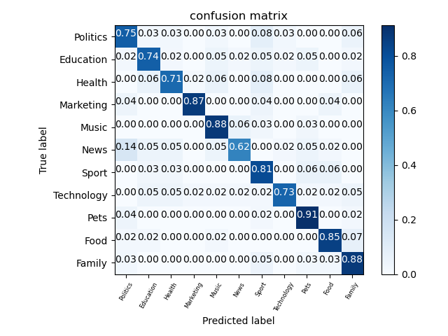
TF-IDF

Slide 19
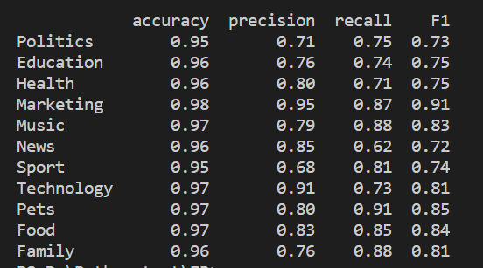
TF-IDF

Slide 20
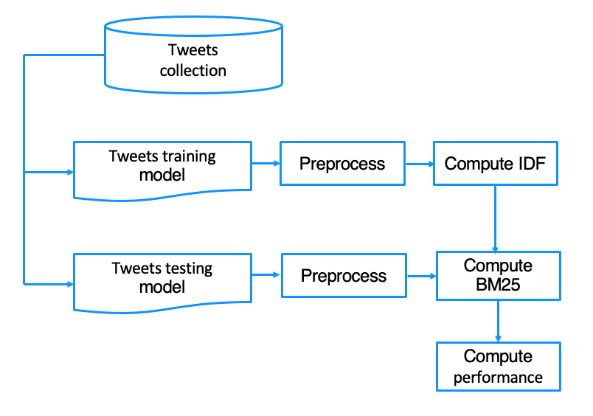
bm25
Step 1: Preprocess data
Step 2: Compute IDF by training data (global info.)
Step 3: Transform data by BM25
Step 4: Fit Naive Bayes classifier by training set
Step 5: Predict test data set result

Slide 21
bm25
Preprocess collection and split
Emojitotext
remove_punctuation
Tokenize
remove_stopwords
word_lemmatizer
word_stemmer
Split training and test data
Training data : 1760
Test data : 440

Slide 22
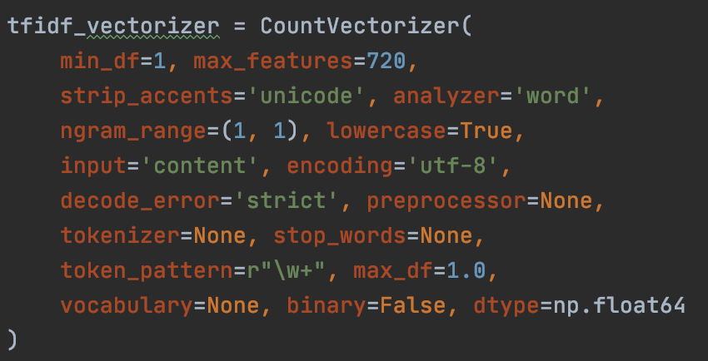
bm25
CountVectorizer
min_df=1, max_features=720, strip_accents='unicode', analyzer='word', ngram_range=(1, 1), lowercase=True, input='content', encoding='utf-8', decode_error='strict', preprocessor=None, tokenizer=None, stop_words=None, token_pattern=r"\w+", max_df=1.0, vocabulary=None, binary=False, dtype=np.float64

Slide 23


bm25

Slide 24
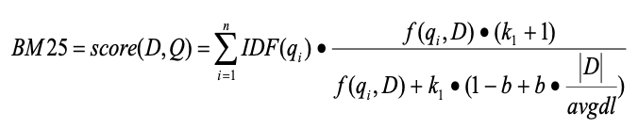
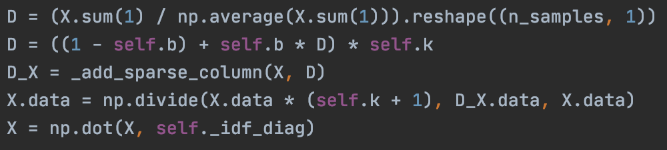
bm25

Slide 25
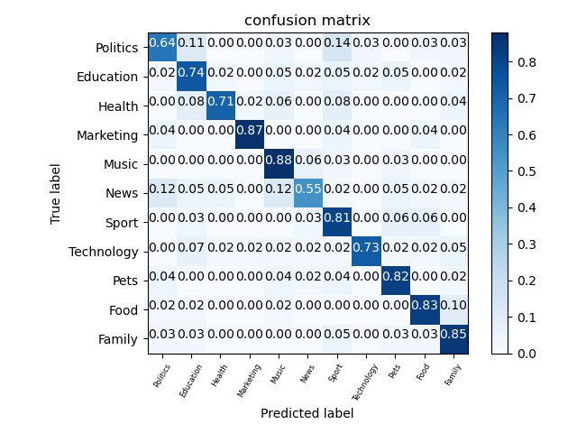

bm25

Slide 26
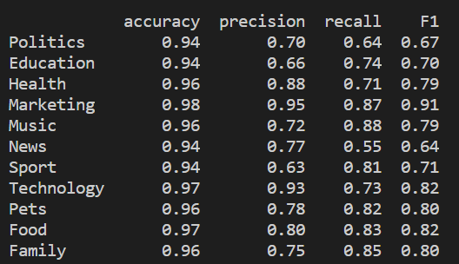
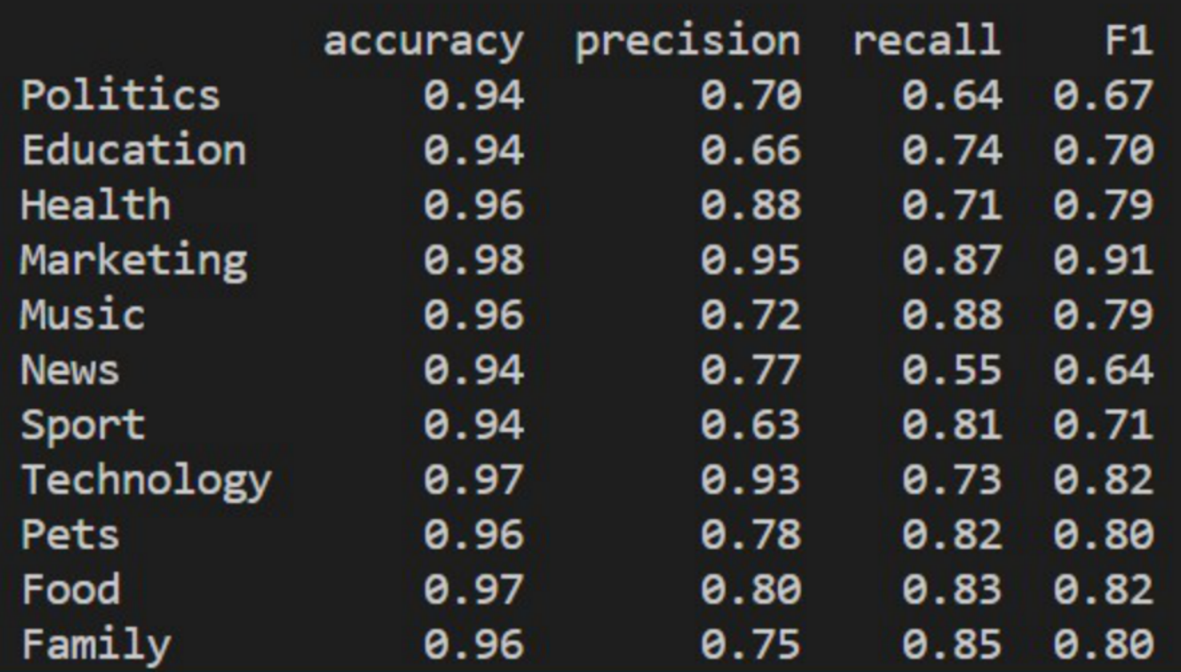
bm25

Slide 27

Conclusion

Slide 28
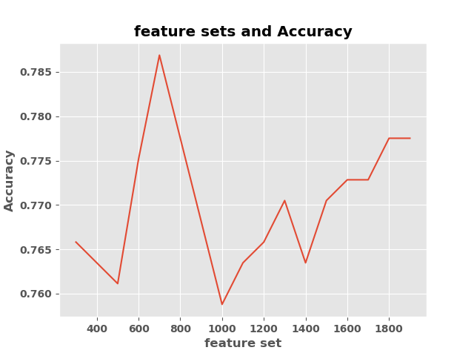
~720

Slide 29
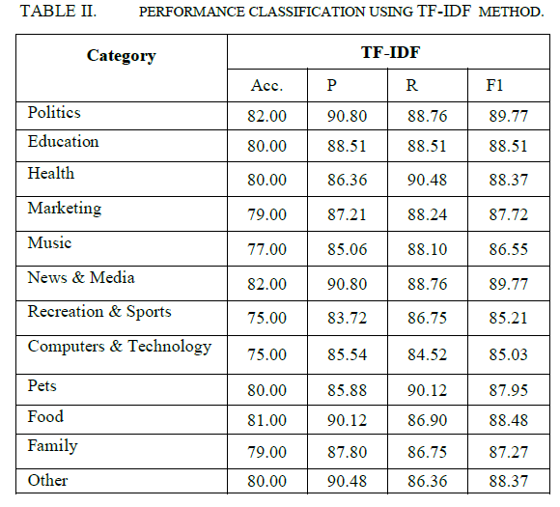
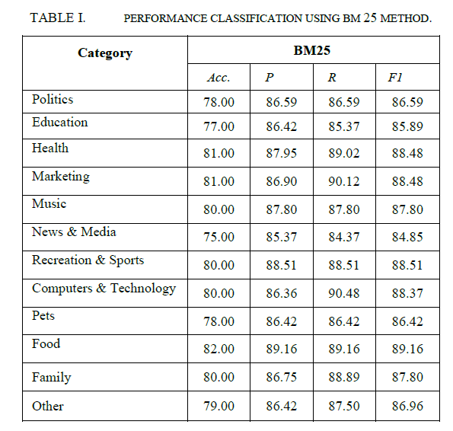

Slide 30
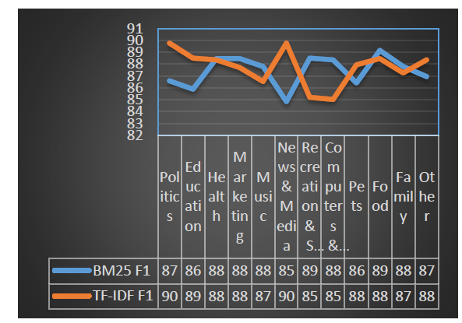
▼ Comparison between BM25 and TF-IDF according to F1-measure.

Slide 31
▼TF-IDF
▼BM25

Slide 32
F1-MEATURE
CLASS

Slide 33
▼TF-IDF
▼BM25

Slide 34
REFERENCE
Twitter API tutorial : https://developer.twitter.com/en/docs
Emoji to text : https://pypi.org/project/demoji/
Stop words : https://github.com/stopwords-iso/stopwords-en
Bayesian Classifier : https://pyecontech.com/2020/03/06/python%E5%AF%A6%E4%BD%9C-%E8%B2%9D%E6%B0%8F%E5%88%86%E9%A1%9E%E5%99%A8-bayesian-classifier/

Slide 35
謝謝大家

