Slide 2
Unused slides

Slide 3



+
Total Points: 1800
Notes:
If you get more than 1800 stars, you will be in the top 10% of your age!
[click for effect]

Slide 4

1
2
3
4
5

Slide 5
1
2
3
4
5

Slide 6
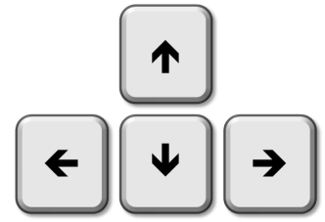


+
Notes:
You will press the left arrow key to pick the card on the left,
And press the right arrow key to pick the card on the right.
[click for effect]
Now, put your left index finger on the left arrow key
[click for effect]
And put your right index finger on the right arrow key.
Okay, let’s practice!

