Slide 1
Meeting with Robert
10/12/2023

Slide 2
Dissertation task

Slide 3
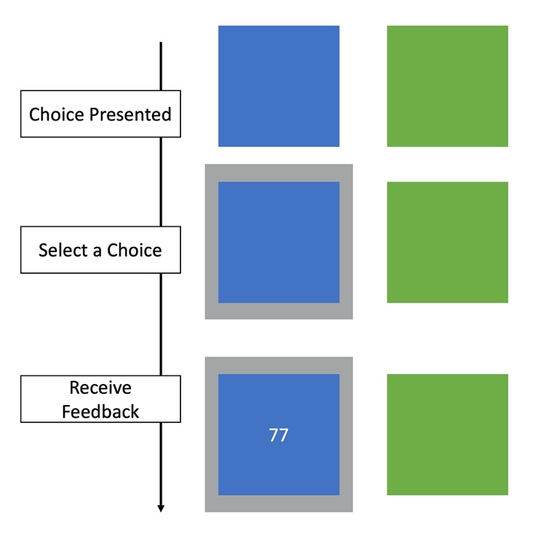
Stochasticity and volatility in task design - Original
Block | Reward probability of the blue box | Variance of reward points
Stable | ~ 75% | 5
Stochastic | ~ 75% | 20
Volatile | alternate between 80% and 20% every 20 or 30 trials | 5
Notes:
I plan to use a two-armed bandit task, and the paradigm shows what children will see in each trial – choices were presented, they select a choice, and receive feedback on reward points.
There will be 3 blocks in the task: stable, volatile, and stochastic.
The reward probability of the blue box will be fixed for stable and stochastic block, but alternate from low to high in the volatile block;
The variance of reward points will be low (e.g., 5) in the stable and volatile block, but higher (e.g., 20) in the stochastic block.
One hypothesis that we’d be interested in testing is, the estimation for for stochasticity and volatility would adjust accordingly in each block, which results in opposing changes in learning rate. And this effect might be more evident in children with high unpredictability.
However, one possible factor that would complicate the story is that the estimation for stochasticity and volatility will not be a uniform pattern even within children with unpredictability.
Debating:
Whether the stable block should be deterministic, such that reward probability of the blue box is 100% instead of probabilistic?
Whether reward points should be presented in discrete numbers such as number of stars versus reward points.

Slide 4

Stochasticity and volatility in task design - Current
Feedback presentation
Instead of showing numbers that could range [0, 100], will only have 15 stars.
2. Number distribution
Two non-overlapping, deterministic reward distributions in stable and volatile phase, details below
Two overlapping, stochastic reward distributions in the stochastic phase, details below
Google doc (the three tables)*
*may adjust later based on pilot results

Slide 5
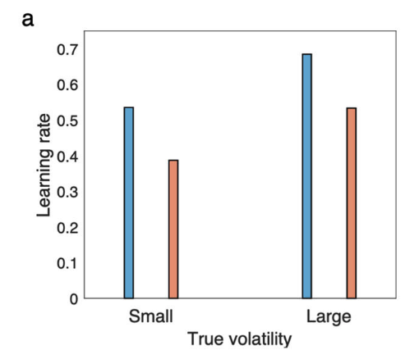
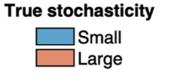
Stochasticity and volatility in computational modeling
A model for learning based on the joint estimation of stochasticity and volatility (Piray & Daw, 2021)
Notes:
Model details see page 2 Results – Model (cannot understand…)

Slide 6
Go-NoGo task
Monetary feedback version
Affective feedback version

Slide 7
Study aims
Aim 1: Examine inaction bias (i.e., NoGo response in Go conditions) as a mechanism that might account for reduced exploration in children with high unpredictability
Aim 2: Compare monetary versus affective feedback in reward learning

Slide 8









Press to win
No press to win
Press to not lose
No press to not lose
+ 10 points!
- 0 point
+ 0 point
- 10 point!
Notes:
To examine adaptive learning in 10-13-year-olds, we used a modified Go-NoGo task where children learn from trial and error what is the correct response to each animal.
There are four animals in total, two requires action, or Go, and the other two requires inaction, or NoGo.
Further, we manipulated valence of feedback, such that two animals gives points for correct actions, and the other two take away points as punishment for wrong actions.

Slide 9
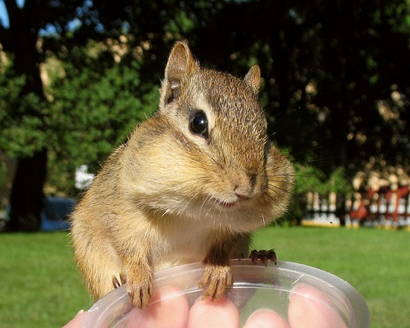
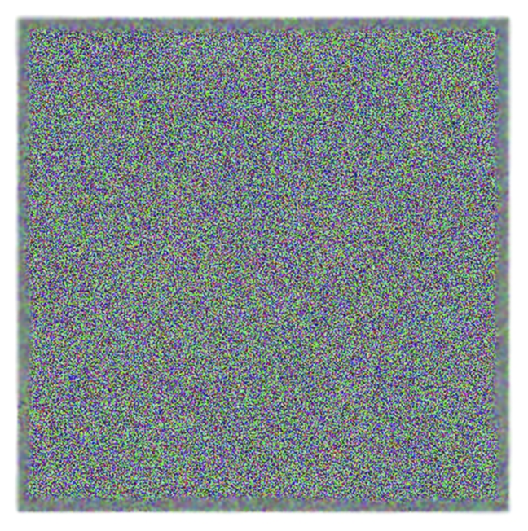
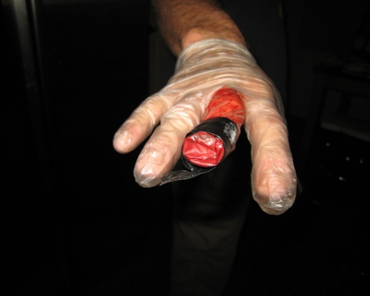
Press to win
No press to win
Press to not lose
No press to not lose

Slide 10
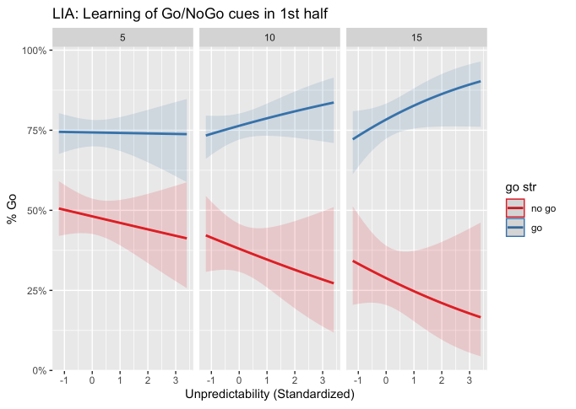
Unpredictability confers an advantage in instrumental reward learning
Monetary feedback
N = 129
(Three-way interaction, odds ratio = 1.04; p < 0.001)
Notes:
X axis
Y axis
Red and blue lines
Three panels: 5th, 10th, and 15th trial. During the first half of the task where most learning occurs.
As the game unfolds, children with more unpredictability had more Go response for Go cues, and less Go response for NoGo cues, indicating that they can better distinguish between go and nogo cues based on feedback.
Preliminary data suggests that unpredictability seem to confer an advantage in action learning
Larger gap indicates better distinction between Go and NoGo cues, which means better action learning.
children with more unpredictability can better distinguish between go and nogo cues using monetary reward and loss as feedback.
How to reconcile it with EXP finding that increased unpredictability is associated with more habitual responding?
First, connect to VLU: There aren’t difference in how children respond to conditioned stimuli, but the difference is more about the decision making where they face threats. In Horizon task there’s no loss of reward points. (look at next slide)
Second, this task did not manipulate uncertainty as a task component.
It is possible that the inflexible decision-making in horizon task is triggered by uncertainty.

Slide 11
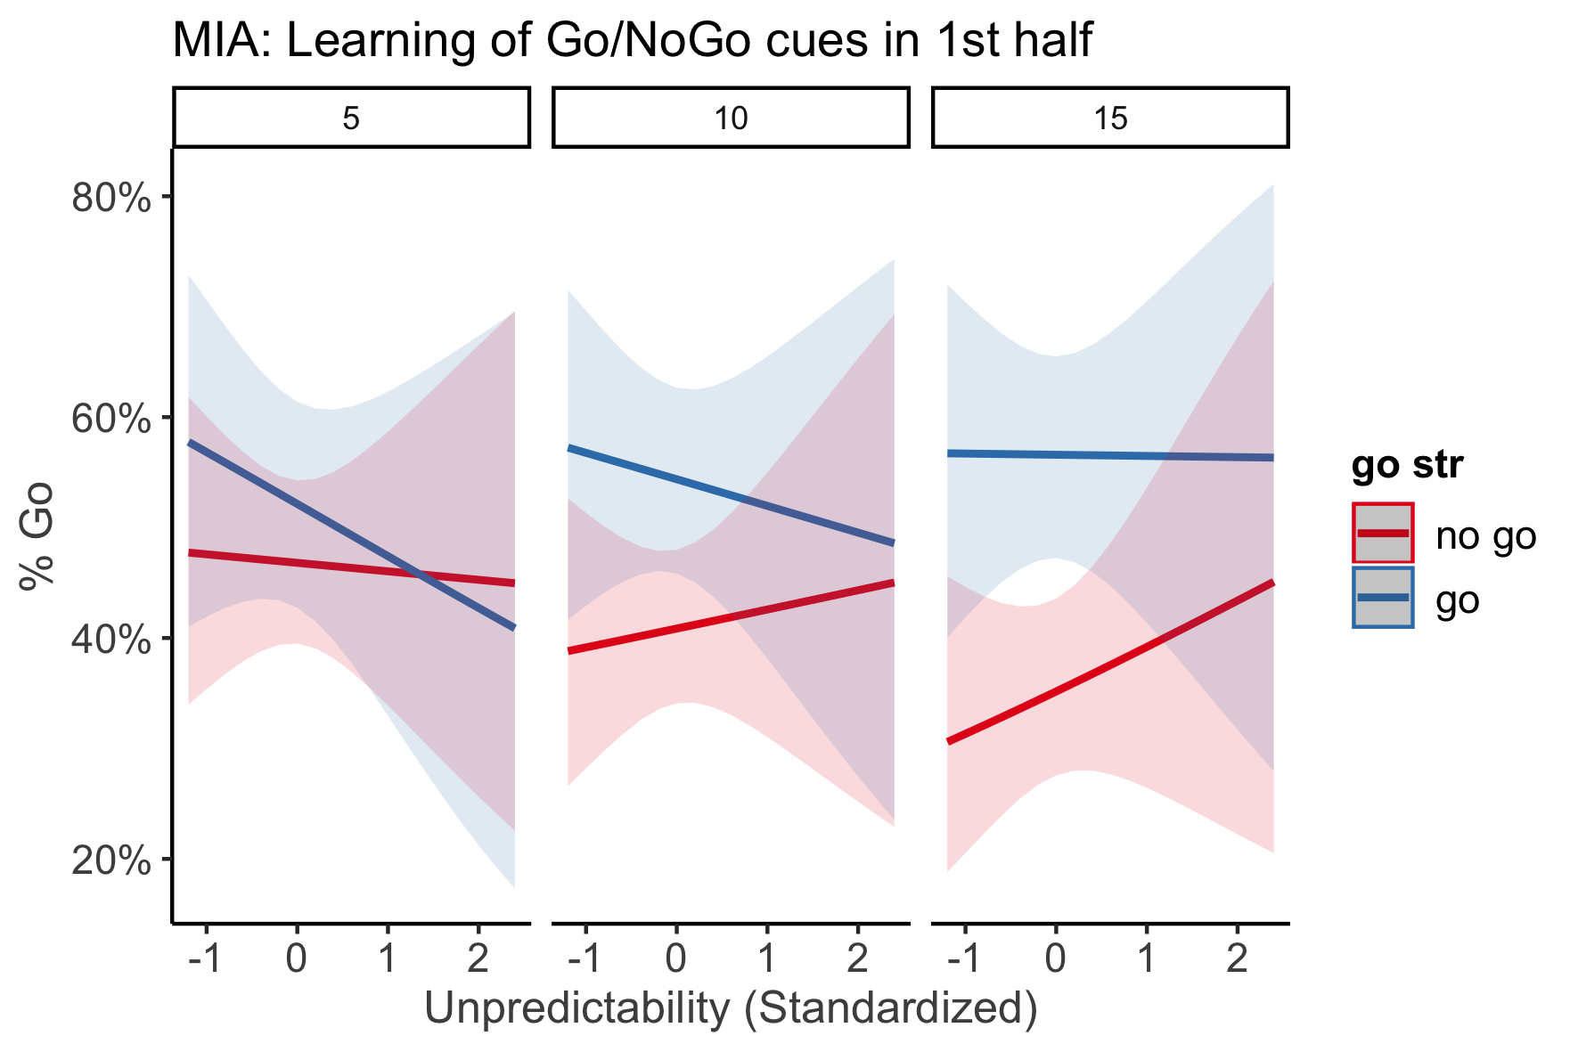
Unpredictability does not confer an advantage in instrumental reward learning
Affective feedback
N = 54

Slide 12
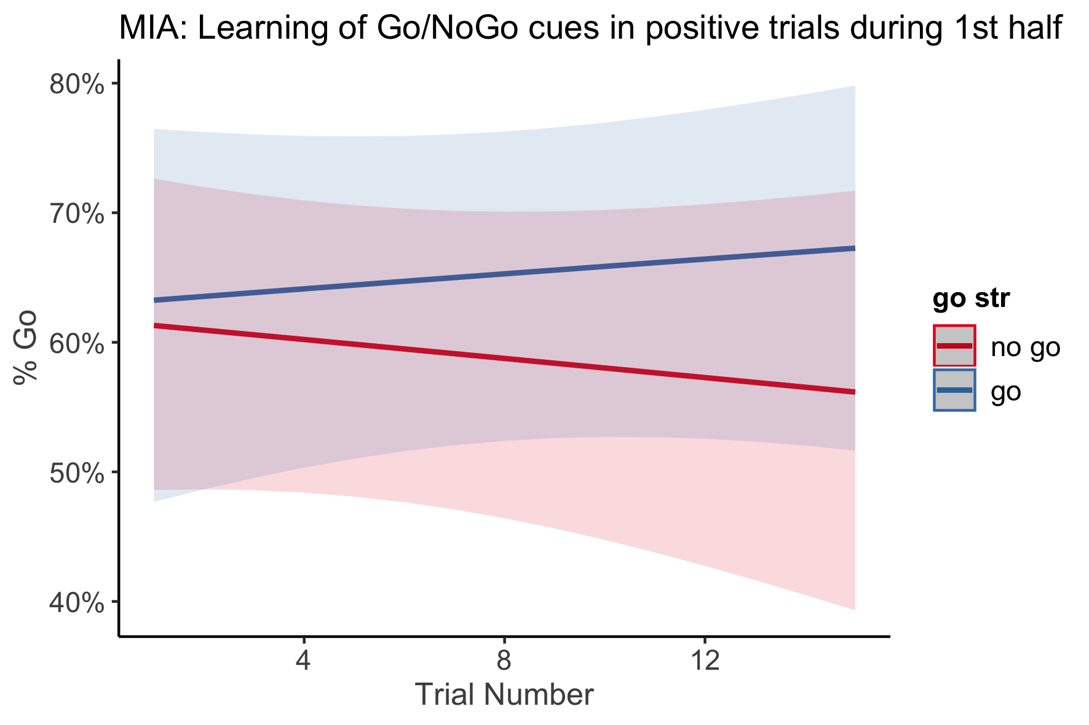
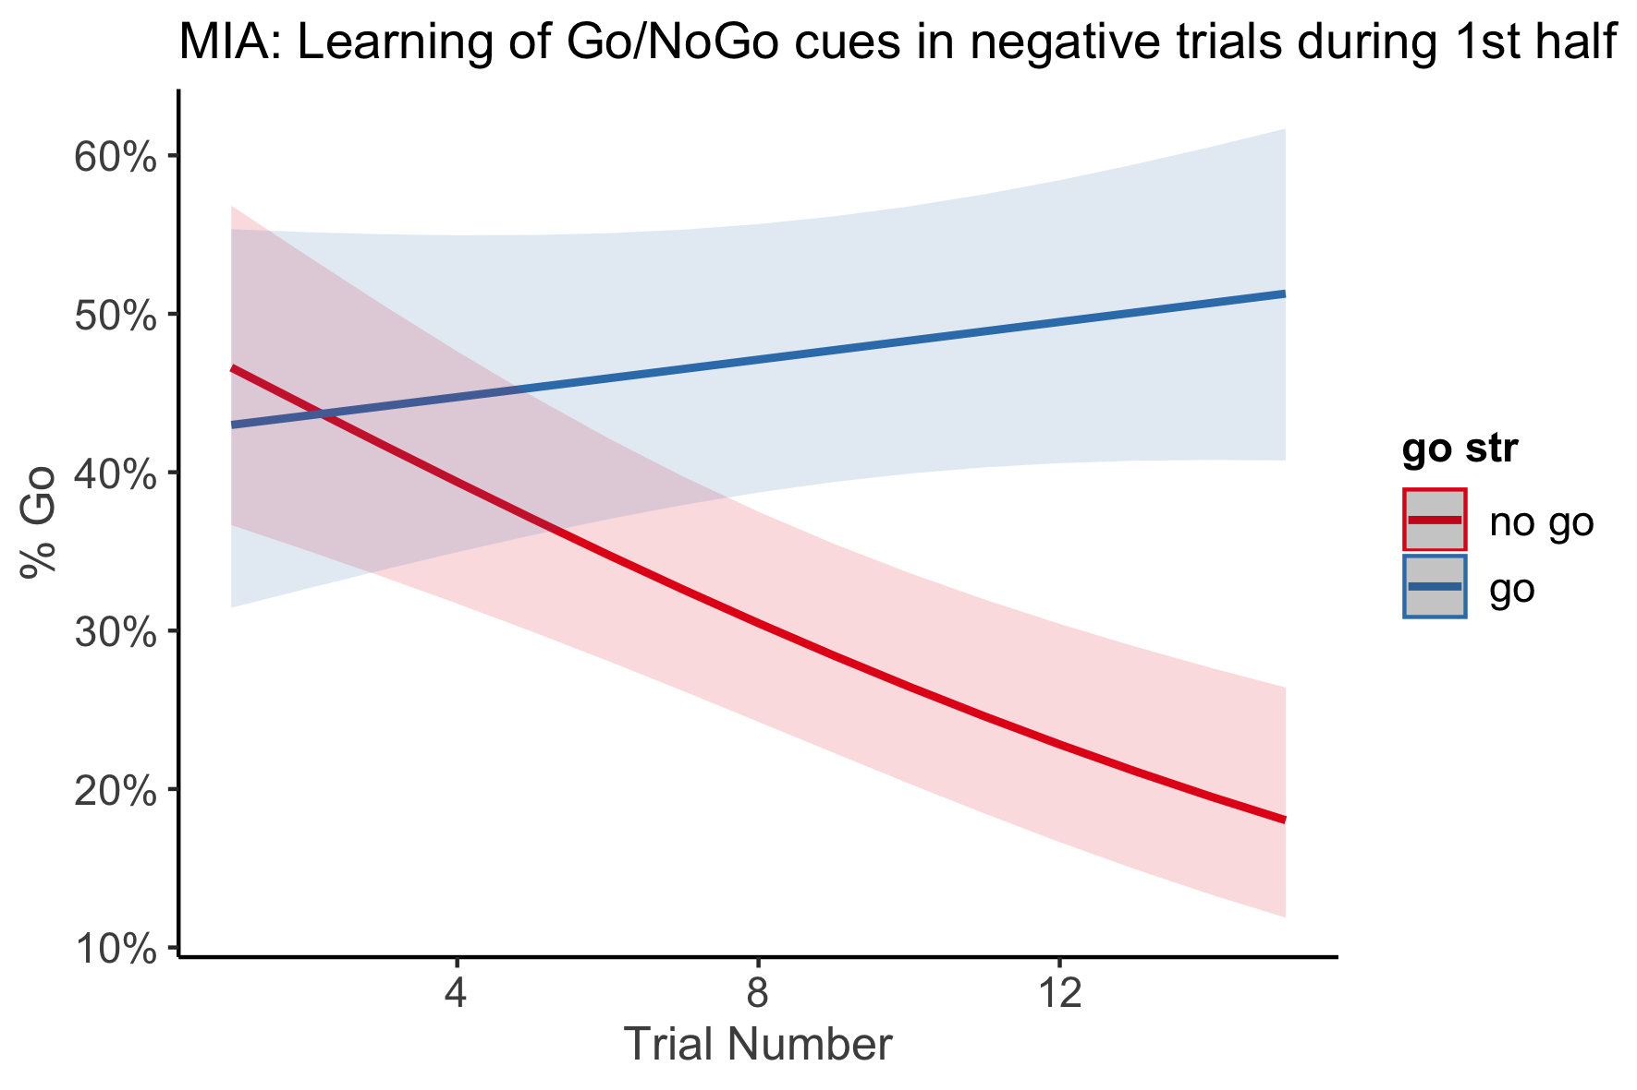
+ 10 points!
- 10 points!
Notes:
This effect is for all children in the first half of the game.
We didn’t have evidence that this increased learning in response to punishments is associated with unpredictability.

Slide 13
Potential computational modeling analyses
Model learning curve
Hypothesis: Unpredictability is associated with a faster learning curve but only with monetary feedback
Model reward and punishment bias
Hypothesis: Unpredictability is associated with an increased punishment bias but only with monetary feedback
Acute stress selectively impairs learning to act
(de Berker et al., 2016, Figure 4)

