Slide 1
In this game you get to pick either the blue or the green card.

Slide 2
Each time, you can only pick one of these two cards to get the stars.

Slide 3
The two cards will give you different numbers of stars.
One card will give you more than the other.
Sometimes it’s the blue card.

Slide 4
Sometimes it’s the green card.
You will not always get 15 stars even if you pick the better card;
it can change all the time.

Slide 5


A reward bar will show the total stars that you have earned.
If you get more than 1800 stars, you will be in the top 10% of your age!
Total Points: 1800

Slide 6
Get as many stars as you can!
Total Points: 1800

Slide 7
+
At the beginning of each round, you will see a in the middle of the screen.
+
Total Points: 0

Slide 8
The cards can switch LEFT and RIGHT from time to time. Please pay attention!
+
Total Points: 0

Slide 9

To choose the card on
LEFT side of the screen,
press the LEFT arrow key
26
+
Total Points: 0

Slide 10

To choose the card on
RIGHT side of the screen,
press the RIGHT arrow key
26
+
Total Points: 0

Slide 11
Then, you get to see the stars that count into your total points.
Total Points: 14

Slide 12

3 Games
Each game has a different color screen.

Slide 13
13
7
1
Game 1
13
7
2
13
7
3
Compare the numbers from pair 1 to pair 5, then think which card wins in each pair?
4
13
7
Note: here we use numbers to show the stars.
5
13
7

Slide 14
13
7
1
Game 1
13
7
2
One color card always wins!
13
7
3
Compare the numbers from pair 1 to pair 5, then think which card wins in each pair?
4
13
7
Note: here we use numbers to show the stars.
5
13
7

Slide 15
15
10
1
Game 2
15
10
2
5
12
3
Compare the numbers from pair 1 to pair 5, then think which card wins in each pair?
4
5
12
Note: here we use numbers to show the stars.
5
5
12

Slide 16
15
10
1
Game 2
15
10
2
The winning card stays the same for a few times before it switches.
5
12
3
Compare the numbers from pair 1 to pair 5, then think which card wins in each pair?
4
5
12
Note: here we use numbers to show the stars.
5
5
12

Slide 17
10
12
1
Game 3
14
10
2
12
8
3
Compare the numbers from pair 1 to pair 5, then think which card wins in each pair?
4
9
10
Note: here we use numbers to show the stars.
5
13
9

Slide 18
10
12
1
Game 3
14
10
2
The winning card can change each time, because the stars are different.
12
8
3
Compare the numbers from pair 1 to pair 5, then think which card wins in each pair?
4
9
10
Note: here we use numbers to show the stars.
5
13
9

Slide 19
3 Games
One color card always wins!
The winning card stays the same for a few times before it switches.
The winning card can change each time, because the stars are different.

Slide 20
3 Games
One color card always wins!
The winning card stays the same for a few times before it switches.
The winning card can change each time, because the stars are different.
The background color will NOT tell you which game it is.
We change the background color all the time.
To know which game you’re playing, the only way is to try it out!

Slide 21

Act Fast!
You must respond in 2 seconds.
Otherwise, you’ll time out, which takes away 10 points!

Slide 22
Every once in a while, we’ll ask you some questions.
Please answer them to your best knowledge based on what you
have seen in the past few trials.
Read these questions now.
You will practice answering them in a moment.

Slide 23
Which box earns you more points?*
Blue
Green

Slide 24
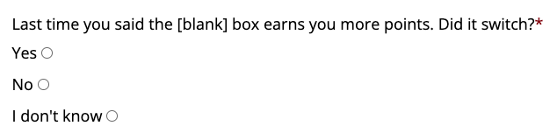
In the game, [blank] will be either “green” or “blue” based on your past choices.

Slide 25
Based on what you see, how many stars will you get from the box that earns you more point?
Click the stars below to tell us your best guess

Slide 26
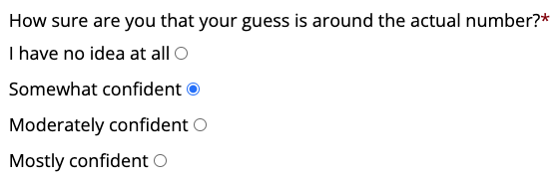

Slide 27
To win the game:
Each game has a different rule. Try to figure out which game you are playing. It will help you choose the winning card.
Act fast. If you timeout, 10 points will be taken away from your earnings. Remember, the blue and green card can switch left and right sides, so please pay attention.

Slide 28
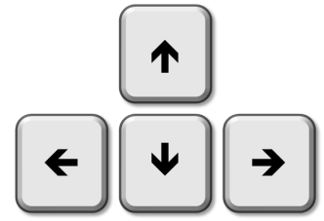


Now let’s practice!
Left index finger
on left arrow key
Right index finger
on right arrow key

Slide 29
Instructions after the practice

Slide 30
3 Games
One color card always wins!
The winning card stays the same for a few times before it switches.
The winning card can change each time, because the stars are different.
The background color will NOT tell you which game it is.
We change the background color all the time.
To know which game you’re playing, the only way is to try it out!

Slide 31
To win the game:
Each game has a different rule. Try to figure out which game you are playing. It will help you choose the winning card.
Act fast. If you timeout, 10 points will be taken away from your earnings. Remember, the blue and green card can switch left and right sides, so please pay attention.

Slide 32
Before each block

Slide 33
Now you are playing a new game.
Try to get as many stars as you can!

Slide 34
Qualtrics graphs

Slide 35

Game 3
Surveys
Surveys
Surveys
Game 1
Game 2

Slide 36
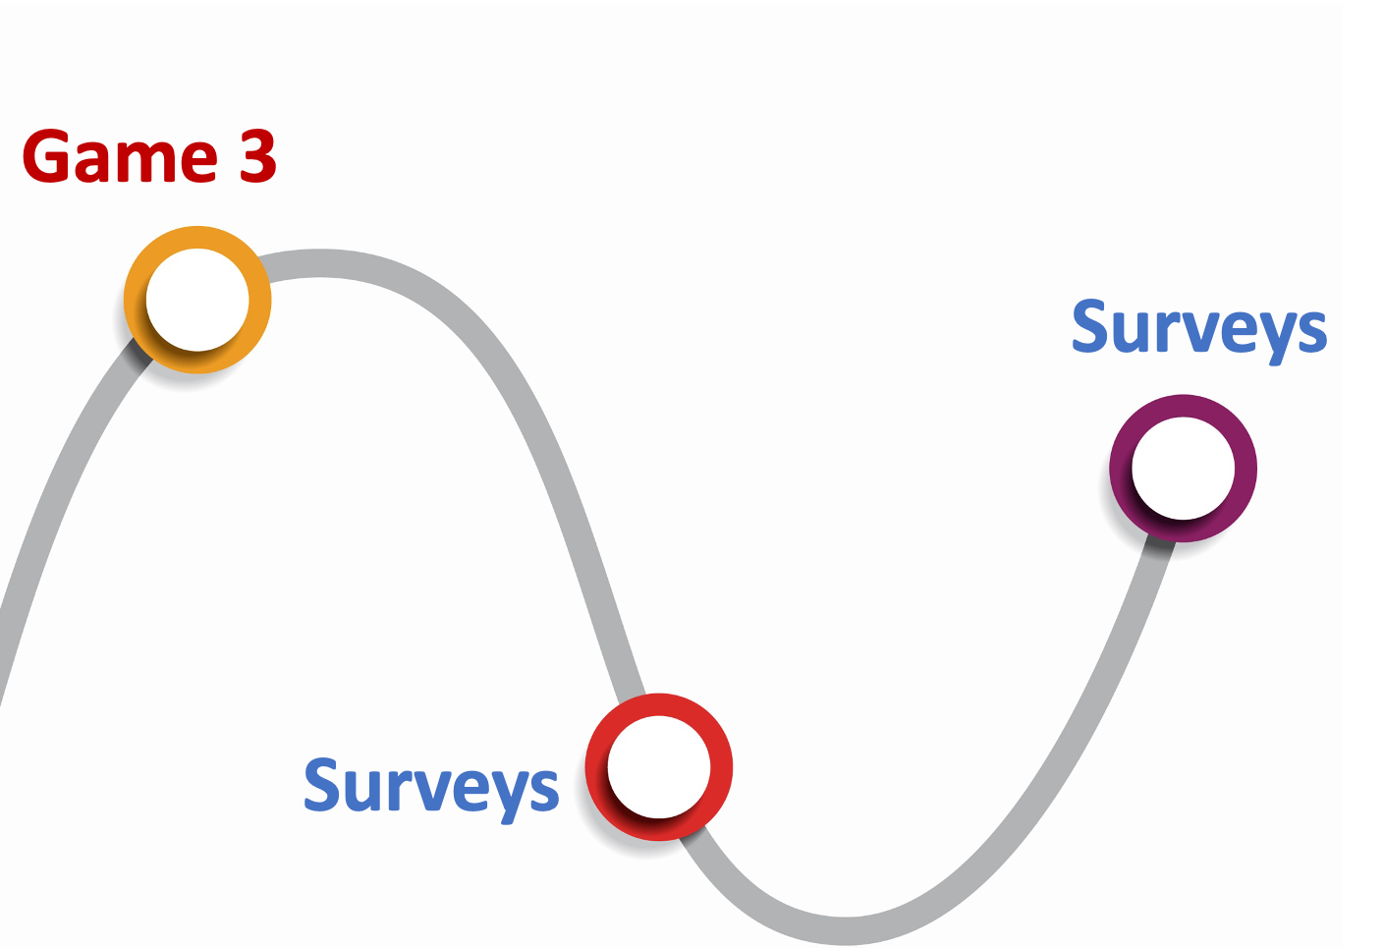

Slide 37
Not used slides

Slide 38
3 Games
In one game, one colored card will always give more stars than the other.
In a second game, the better card switches from one color card to the other.
In a third game, the stars that each card gives changes each time you see new boxes.
Remember: the background color will NOT tell you which game it is.
We change the game order all the time.

Slide 39
Are you ready to practice the game?
You can click “previous” or press the left arrow key to
view the previous slides again.

Slide 41
Game 1
Game 2
Game 3
1
2
3
4
5

Slide 42
Game 1
One color will always give more stars than the other.

Slide 43


1st pair
Game 1
One color will always give more stars than the other.
In the 1st pair:
The blue card gives 15 stars
The green card gives 8 stars.

Slide 44
1st pair
Game 1
One color will always give more stars than the other.
2nd pair
In the 2nd and 3rd pairs:
The blue card keeps giving 15 stars
The green card keeps giving 8 stars.
3rd pair
One color card always wins!

Slide 45
Game 2
In a second game, the better card switches from time to time.

Slide 46


1st pair
Game 2
In a second game, the better card switches from time to time.
In the 1st pair:
The blue card gives 10 more stars than the green card

Slide 47

1st pair
Game 2
In a second game, the better card switches from time to time.
2nd pair
In the 2nd and 3rd pairs:
The green card gives 2 more stars than the blue card.
3rd pair
The winning card will be the same for a few times before it switches.

Slide 48
Game 3
In a third game, the stars that each card gives change from trial to trial.

Slide 49
1st pair
Game 3
In a third game, the stars that each card gives change from trial to trial.
In the 1st pair:
The blue card gives 15 stars, and the green card gives 8 stars.

Slide 50


1st pair
Game 3
In a third game, the stars that each card gives change from trial to trial.
2nd pair
In the 2nd and 3rd pairs:
The blue and green cards give different number of stars each time.
3rd pair
The winning card can change each time.
Notes:
It is harder to tell how many stars you will get from each card.

Slide 51
3 Games
In one game, one colored card will always give more stars than the other.
In a second game, the better card switches from one color card to the other.
In a third game, the stars that each card gives changes each time you see new boxes.

Slide 52
Pay attention to the color of the screen to see if the GAME has changed.
The color will NOT tell you which game it is. We change the game colors all the time.
Game 1
Game 2
Game 3

Slide 53
There are 3 decks of cards in this game.
Each time a new set shows up, the background changes.
3 decks of cards

Slide 54
In one deck, one color will always give more stars than the other.
For example, the blue card always gives 15 stars, and the green card always gives 8 stars.
1st trial
2nd trial
3rd trial

Slide 55
In a second deck, the better card switches from time to time.
For example, the blue card gives 10 more stars in the first 2 trials, and the green card gives
2 more stars starting from the 3rd trial.
1st trial
2nd trial
3rd trial

Slide 56
In a third deck, the stars that each card gives change from trial to trial.
For example, the blue card gives 15, 11, and 3 stars, and the green card gives
8, 15, and 1 star. It is harder to tell how many stars you will get from each card.
1st trial
2nd trial
3rd trial

Slide 57
3 decks of cards
Note: the background color will NOT tell you which deck it is.
We change the deck order all the time.
In one deck, one color will always give more stars than the other.
In a second deck, the better card switches from time to time.
In a third deck, the stars that each card gives change from trial to trial.

Slide 58
There are 3 decks of cards in this game. Each deck has a different rule.
In the following 3 slides, count how many stars each card gives in every trial.
3 decks of cards

Slide 59
In one set, one color will always give more stars than the other.
1st trial
Important Note
Here, we show two cards at the same time as an example. But in the real game, you only choose to see one card at a time, which will make the game more difficult.
So, please try really hard to find out the better card!
15th trial
30th trial

Slide 60
In a second set, the better card switches, but the stars they give
are around the same.
1st trial
Important Note
Here, we show two cards at the same time as an example. But in the real game, you only choose to see one card at a time, which will make the game more difficult.
So, please try really hard to find out the better card!
10th trial
20th trial
30th trial

Slide 61
In a third set, the stars that each card gives vary a lot,
so it’s more difficult to tell.
1st trial
Important Note
Here, we show two cards at the same time as an example. But in the real game, you only choose to see one card at a time, which will make the game more difficult.
So, please try really hard to find out the better card!
10th trial
20th trial
30th trial

Slide 62
But they can switch!
The blue card could be better for 20 times,
and the green card could be better for the next 30 times.
So you have to try it out.

Slide 63
There will be 3 sets of cards with different background colors.
You will have a break after each set.
Now let’s start!

Slide 64
Manipulation questions

Slide 65
Which box earns you more points?*
Blue
Green

Slide 67
Based on what you see, how many stars will you get from the box that earns you more point?
Click the stars below to tell us your best guess

Slide 69
In one set, one color will always give more stars than the other.
In a second set, the better color switches, but the stars they give are around the same.
1
1
…
…
…
…
15
15
…
…
…
…
30
30
…
…
…
…

Slide 70
In a third set, the stars that each card gives vary a lot, so it’s more difficult to tell.
Important Note
Here, we show two cards at the same time as an example. But in the real game, you only choose to see one card at a time, which will make the game more difficult.
So, please try really hard to find out the better card!
…
…
…
…
…
…

Slide 71
In a third set, the stars that each card gives vary a lot, so it’s more difficult to tell.
1
Important Note
Here, we show two cards at the same time as an example. But in the real game, you only choose to see one card at a time, which will make the game more difficult.
So, please try really hard to find out the better card!
…
…
15
…
…
30
…
…

Slide 72
…
…
…
…
…
…

Slide 74



Slide 75
3 types of games
There are three different types of games, as you can tell by the background color.

Slide 76
3 types of games
There are three different types of games, as you can tell by the background color.
In one set, one color will always give more stars than the other;

Slide 77
3 types of games
There are three different types of games, as you can tell by the background color.
In one set, one color will always give more stars than the other;
In a second set, sometimes one color gives more stars, sometimes the other color gives more stars;

Slide 78
3 types of games
There are three different types of games, as you can tell by the background color.
In one set, one color will always give more stars than the other;
In a second set, sometimes one color gives more stars, sometimes the other color gives more stars;
In a third set, the stars that each card gives vary a lot, so it’s more difficult to tell.

Slide 79
3 types of games
When the background color changes, you are entering a new type of game.
You have to figure out which type of game you are playing.
This way you know better how to choose!

Slide 80
To choose the box on THIS side of the screen, press the left arrow key.
Score: 0
26
77
58

Slide 81
To choose the box on THIS side of the screen, press the right arrow key.
Score: 0
26
77
58

Slide 82
After you pick the blue or green box, the one that was the right choice will light up.
26
77
58

Slide 83
REMEMBER: The box with the most points isn’t always the right box. Sometimes it is and sometimes it is not.
You only get points if you choose the right box!
26
77
58

Slide 84
Try to get as many points as you can.
You will be able to add up all of the points you get and trade them in for a prize at the end of the game.
The more points you have, the better the prize you will get with your points.

Slide 85
We have 3 different kinds of prizes.
There are small prizes, medium prizes, and bigger prizes.
When you get enough points for a small prize, the computer will show that you reached the small star.

Slide 86
We have 3 different kinds of prizes.
There are small prizes, medium prizes, and bigger prizes.
When you get enough points for a medium prize, the computer will show that you reached the middle star.

Slide 87
We have 3 different kinds of prizes.
There are small prizes, medium prizes, and bigger prizes.
And when you get enough points to choose the best prize, the computer will show that you reached the big star at the end.

Slide 88
When you start, the computer screen will look something like this.
77
58

Slide 89
To choose the box on THIS side of the screen, press the left arrow key.
Score: 0
26
77
58

Slide 90
To choose the box on THIS side of the screen, press the right arrow key.
Score: 0
26
77
58

Slide 91
After you pick the blue or green box, the one that was the right choice will light up.
26
77
58

Slide 92
REMEMBER: The box with the most points isn’t always the right box. Sometimes it is and sometimes it is not.
You only get points if you choose the right box!
26
77
58

Slide 93
If you reach the small star, you will win $5.
If you reach the medium star, you will win $10
If you reach the big star, you will win $20

Slide 94
Here are some hints to help you win
In each game, only color is going to be right most of the time. It will not be right every time. But you should try to figure out which color usually wins.
Remember, that no color is always going to win. Sometime you might want to take a chance to earn A LOT of points even if you are not sure which color will win.

Slide 95
OK, before we start, can you say the rules back to me, so I can be sure you understand. It is ok to ask questions and we can also go over the instructions again if you want to.

Slide 96

Good Luck!

Slide 97
+

Slide 98
26

Slide 99
26

Slide 100
Choose the green card for this pair
+

