Slide 2
Unused slides

Slide 3

1
2
3
4
5

Slide 4
1
2
3
4
5

Slide 5
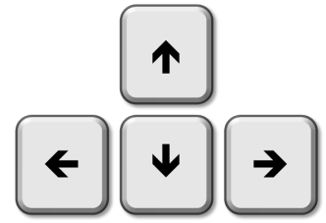



+
Notes:
You will press the left arrow key to pick the card on the left,
And press the right arrow key to pick the card on the right.
[click for effect]
Now, put your left index finger on the left arrow key
[click for effect]
And put your right index finger on the right arrow key.
Okay, let’s practice!

