Slide 1

+
Notes:
Hi, welcome!
In this game you get to pick between two color cards.
[click for effect]
They give you different numbers of stars.
[click for effect]
One card will give you more stars than the other,
making it the winning card.

Slide 2
+
Notes:
For example, in this turn, the blue card has 15 stars
[click for effect]

Slide 3
+
Notes:
but the green card only has 5 stars.
[click for effect]

Slide 4
+
Notes:
So the blue card wins!
[click for effect]

Slide 5

+
Notes:
But we will not show you how many stars each card gives before you pick.
[click for effect]
You have to make a guess for each choice.

Slide 6
+
Total Points: 0
Notes:
A reward bar will show the total stars that you have earned.
[click for effect]

Slide 7


Get as many stars as you can!
Total Points: 1800
Notes:
Your goal in this game is to get as many stars as you can!
That is, you want to fill the reward bar as much as possible!

Slide 8

3 Rounds
Notes:
You will play for 3 rounds. When a new round starts, the color of cards change. [click for effect]
Each round may be different from each other.
To win the most stars, you will find out which color usually wins in each round.
Sometimes the winning color stays the same. Sometimes it changes!

Slide 9

Act Fast!
You must respond in 2 seconds.
Otherwise, you’ll time out, which takes away 10 stars!

Slide 10
To get the most stars:
Remember, there are 3 rounds. Each round is a new one.
In each round, try each color and see how many stars you get. The winning color may stay the same, or it may change!
Act fast. If you timeout, 10 stars will be taken away from your earnings.

Slide 11
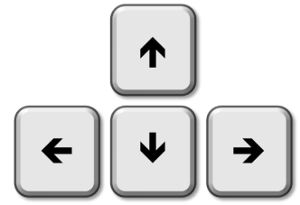


+
Notes:
You will press the left arrow key to pick the card on the left,
And press the right arrow key to pick the card on the right.
[click for effect]
Now, put your left index finger on the left arrow key
[click for effect]
And put your right index finger on the right arrow key.
[click for effect]
When you see the plus sign between the two cards, it’s the time for you to pick!
Okay, let’s practice!

