Slide 1
In this game you get to pick either the blue or the green card.

Slide 2
Each time, you can only pick one of these two cards to get the stars.

Slide 3
One card will give you more stars than the other.
Sometimes it’s the blue card.

Slide 4
Sometimes it’s the green card.
You will not always get 15 stars even if you pick the better card;
it can change all the time.

Slide 5


A reward bar will show the total stars that you have earned.
If you get more than 1800 stars, you will be in the top 10% of your age!
Total Points: 1800

Slide 6
Get as many stars as you can!
Total Points: 1800

Slide 7
+
At the beginning of each round, you will see a in the middle of the screen.
+
Total Points: 0

Slide 8
The cards can switch LEFT and RIGHT from time to time. Please pay attention!
+
Total Points: 0

Slide 9

To choose the card on
LEFT side of the screen,
press the LEFT arrow key
26
+
Total Points: 0

Slide 10

To choose the card on
RIGHT side of the screen,
press the RIGHT arrow key
26
+
Total Points: 0

Slide 11
Then, you get to see the stars that count into your total points.
Total Points: 14

Slide 12

3 Games
Each game has a different color screen.

Slide 13


1st pair
Game 1
One color will always give more stars than the other.
In the 1st pair:
The blue card gives 15 stars
The green card gives 8 stars.

Slide 14
1st pair
Game 1
One color will always give more stars than the other.
2nd pair
In the 2nd and 3rd pairs:
The blue card keeps giving 15 stars
The green card keeps giving 8 stars.
3rd pair

Slide 15


1st pair
Game 2
In a second game, the better card switches from time to time.
In the 1st pair:
The blue card gives 10 more stars than the green card

Slide 16

1st pair
Game 2
In a second game, the better card switches from time to time.
2nd pair
In the 2nd and 3rd pairs:
The green card gives 2 more stars than the blue card.
3rd pair

Slide 17
1st pair
Game 3
In a third game, the stars that each card gives change from trial to trial.
In the 1st pair:
The blue card gives 15 stars, and the green card gives 8 stars.

Slide 18


1st pair
Game 3
In a third game, the stars that each card gives change from trial to trial.
2nd pair
In the 2nd and 3rd pairs:
The blue and green cards give different number of stars each time.
It is harder to tell how many stars you will get from each card.
3rd pair

Slide 19
Pay attention to the color of the screen to see if the GAME has changed.
The color will NOT tell you which game it is. We change the game colors all the time.
Game 1
Game 2
Game 3

Slide 20
3 Games
In one game, one colored card will always give more stars than the other.
In a second game, the better card switches from one color card to the other.
In a third game, the stars that each card gives changes each time you see new boxes.

Slide 21

Act Fast!
You must respond in 2 seconds.
Otherwise, you’ll time out, which takes away 10 points!

Slide 22
Every other 10-15 trials, we’ll ask you some questions.
Please answer them to your best knowledge based on what you
have seen in the past few trials.
You can read these questions in the following pages and move on
by clicking “next”. You will practice answering them in a moment.

Slide 23
Which box earns you more points?*
Blue
Green

Slide 24
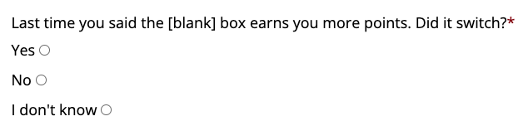
In the game, [blank] will be either “green” or “blue” based on your past choices.

Slide 25
Based on what you see, how many stars will you get from the box that earns you more point?
Click the stars below to tell us your best guess

Slide 26
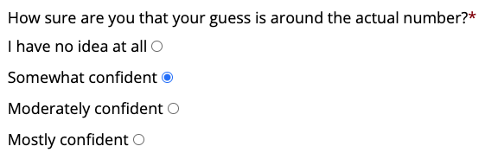

Slide 27
To win the game:
Each deck has a different rule. Think about which deck you are playing. It will help you figure out the better card more easily.
Act fast. If you timeout, 10 points will be taken away from your earnings. Remember, the blue and green card can switch left and right sides, so please pay attention.

Slide 28
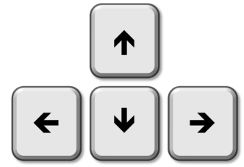


Left index finger
on left arrow key
Right index finger
on right arrow key

Slide 29
Are you ready to practice the game?
You can click “previous” or press the left arrow key to
view the previous slides again.

Slide 30
Instructions after the practice

Slide 31
3 Games
In one game, one colored card will always give more stars than the other.
In a second game, the better card switches from one color card to the other.
In a third game, the stars that each card gives changes each time you see new boxes.
Remember: the background color will NOT tell you which deck it is.
We change the deck order all the time.

Slide 32
To win the game:
Each deck has a different rule. Think about which deck you are playing. It will help you figure out the better card more easily.
Act fast. If you timeout, 10 points will be taken away from your earnings. Remember, the blue and green card can switch left and right sides, so please pay attention.

Slide 33
Before each block

Slide 34
Now you are playing a new deck of cards.
Try to get as many stars as you can!

Slide 35
Qualtrics graphs

Slide 36

Game 3
Surveys
Surveys
Surveys
Game 1
Game 2

Slide 37
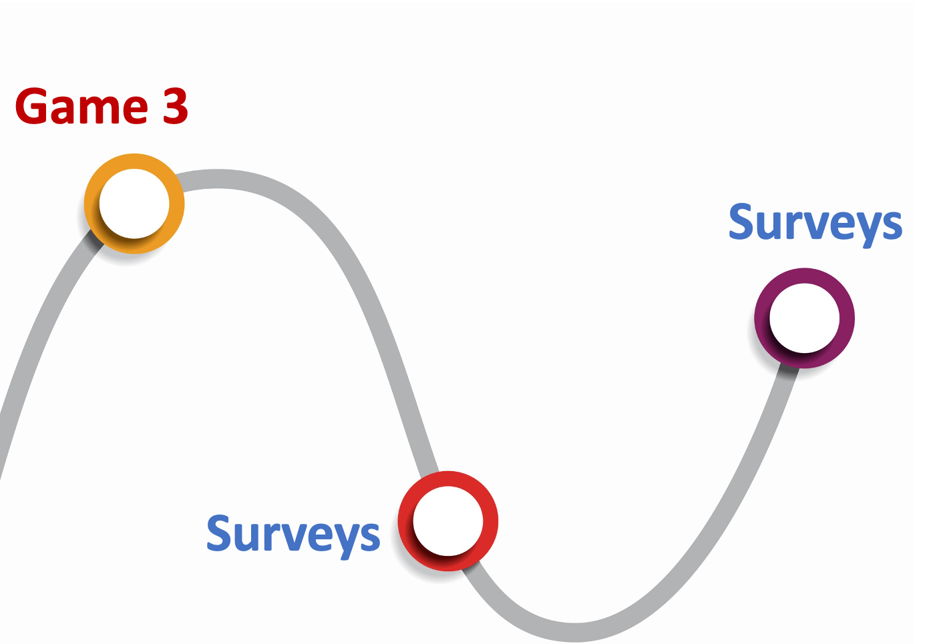

Slide 38
Not used slides

Slide 39
There are 3 decks of cards in this game.
Each time a new set shows up, the background changes.
3 decks of cards

Slide 40
In one deck, one color will always give more stars than the other.
For example, the blue card always gives 15 stars, and the green card always gives 8 stars.
1st trial
2nd trial
3rd trial

Slide 41
In a second deck, the better card switches from time to time.
For example, the blue card gives 10 more stars in the first 2 trials, and the green card gives
2 more stars starting from the 3rd trial.
1st trial
2nd trial
3rd trial

Slide 42
In a third deck, the stars that each card gives change from trial to trial.
For example, the blue card gives 15, 11, and 3 stars, and the green card gives
8, 15, and 1 star. It is harder to tell how many stars you will get from each card.
1st trial
2nd trial
3rd trial

Slide 43
3 decks of cards
Note: the background color will NOT tell you which deck it is.
We change the deck order all the time.
In one deck, one color will always give more stars than the other.
In a second deck, the better card switches from time to time.
In a third deck, the stars that each card gives change from trial to trial.

Slide 44
There are 3 decks of cards in this game. Each deck has a different rule.
In the following 3 slides, count how many stars each card gives in every trial.
3 decks of cards

Slide 45
In one set, one color will always give more stars than the other.
1st trial
Important Note
Here, we show two cards at the same time as an example. But in the real game, you only choose to see one card at a time, which will make the game more difficult.
So, please try really hard to find out the better card!
15th trial
30th trial

Slide 46
In a second set, the better card switches, but the stars they give
are around the same.
1st trial
Important Note
Here, we show two cards at the same time as an example. But in the real game, you only choose to see one card at a time, which will make the game more difficult.
So, please try really hard to find out the better card!
10th trial
20th trial
30th trial

Slide 47
In a third set, the stars that each card gives vary a lot,
so it’s more difficult to tell.
1st trial
Important Note
Here, we show two cards at the same time as an example. But in the real game, you only choose to see one card at a time, which will make the game more difficult.
So, please try really hard to find out the better card!
10th trial
20th trial
30th trial

Slide 48
But they can switch!
The blue card could be better for 20 times,
and the green card could be better for the next 30 times.
So you have to try it out.

Slide 49
There will be 3 sets of cards with different background colors.
You will have a break after each set.
Now let’s start!

Slide 50
Manipulation questions

Slide 51
Which box earns you more points?*
Blue
Green

Slide 53
Based on what you see, how many stars will you get from the box that earns you more point?
Click the stars below to tell us your best guess

Slide 55
In one set, one color will always give more stars than the other.
In a second set, the better color switches, but the stars they give are around the same.
1
1
…
…
…
…
15
15
…
…
…
…
30
30
…
…
…
…

Slide 56
In a third set, the stars that each card gives vary a lot, so it’s more difficult to tell.
Important Note
Here, we show two cards at the same time as an example. But in the real game, you only choose to see one card at a time, which will make the game more difficult.
So, please try really hard to find out the better card!
…
…
…
…
…
…

Slide 57
In a third set, the stars that each card gives vary a lot, so it’s more difficult to tell.
1
Important Note
Here, we show two cards at the same time as an example. But in the real game, you only choose to see one card at a time, which will make the game more difficult.
So, please try really hard to find out the better card!
…
…
15
…
…
30
…
…

Slide 58
…
…
…
…
…
…

Slide 60



Slide 61
3 types of games
There are three different types of games, as you can tell by the background color.

Slide 62
3 types of games
There are three different types of games, as you can tell by the background color.
In one set, one color will always give more stars than the other;

Slide 63
3 types of games
There are three different types of games, as you can tell by the background color.
In one set, one color will always give more stars than the other;
In a second set, sometimes one color gives more stars, sometimes the other color gives more stars;

Slide 64
3 types of games
There are three different types of games, as you can tell by the background color.
In one set, one color will always give more stars than the other;
In a second set, sometimes one color gives more stars, sometimes the other color gives more stars;
In a third set, the stars that each card gives vary a lot, so it’s more difficult to tell.

Slide 65
3 types of games
When the background color changes, you are entering a new type of game.
You have to figure out which type of game you are playing.
This way you know better how to choose!

Slide 66
To choose the box on THIS side of the screen, press the left arrow key.
Score: 0
26
77
58

Slide 67
To choose the box on THIS side of the screen, press the right arrow key.
Score: 0
26
77
58

Slide 68
After you pick the blue or green box, the one that was the right choice will light up.
26
77
58

Slide 69
REMEMBER: The box with the most points isn’t always the right box. Sometimes it is and sometimes it is not.
You only get points if you choose the right box!
26
77
58

Slide 70
Try to get as many points as you can.
You will be able to add up all of the points you get and trade them in for a prize at the end of the game.
The more points you have, the better the prize you will get with your points.

Slide 71
We have 3 different kinds of prizes.
There are small prizes, medium prizes, and bigger prizes.
When you get enough points for a small prize, the computer will show that you reached the small star.

Slide 72
We have 3 different kinds of prizes.
There are small prizes, medium prizes, and bigger prizes.
When you get enough points for a medium prize, the computer will show that you reached the middle star.

Slide 73
We have 3 different kinds of prizes.
There are small prizes, medium prizes, and bigger prizes.
And when you get enough points to choose the best prize, the computer will show that you reached the big star at the end.

Slide 74
When you start, the computer screen will look something like this.
77
58

Slide 75
To choose the box on THIS side of the screen, press the left arrow key.
Score: 0
26
77
58

Slide 76
To choose the box on THIS side of the screen, press the right arrow key.
Score: 0
26
77
58

Slide 77
After you pick the blue or green box, the one that was the right choice will light up.
26
77
58

Slide 78
REMEMBER: The box with the most points isn’t always the right box. Sometimes it is and sometimes it is not.
You only get points if you choose the right box!
26
77
58

Slide 79
If you reach the small star, you will win $5.
If you reach the medium star, you will win $10
If you reach the big star, you will win $20

Slide 80
Here are some hints to help you win
In each game, only color is going to be right most of the time. It will not be right every time. But you should try to figure out which color usually wins.
Remember, that no color is always going to win. Sometime you might want to take a chance to earn A LOT of points even if you are not sure which color will win.

Slide 81
OK, before we start, can you say the rules back to me, so I can be sure you understand. It is ok to ask questions and we can also go over the instructions again if you want to.

Slide 82

Good Luck!

Slide 83
+

Slide 84
26

Slide 85
26

Slide 86
Choose the green card for this pair
+

