Slide 1

Big Data Databases
Vicente Cerverón
Computer Science Department
School of Engineering www.uv.es/etse
Universitat de València - SPAIN

Slide 2
Index
The need for databases Q1?
Relational Databases
Big Data and Databases
The NoSQL movement
NoSQL data models
Query-Driven DB Design
Column-Oriented Databases
Document Databases
Graph Databases
Demo: Cassandra / MongoDB / Neo4J

Slide 3
The early days: File Systems
Applications used file systems to store data
Drawbacks (Silberschatz) :
Data redundancy and inconsistency
Multiple file formats, duplication of data in different files
Difficulty in accessing data
Need to write a new program for each new task
Integrity problems (no explicit constrains)
Hard to control concurrent users
Security problems to be solved

Slide 4
Main reasons to “jump” to Databases
Q2 – Concept ?
Q3 – Reasons ?
you want to store controlled and interrelated data, and we want to have them together with their description;
you want to allow diverse users to concurrently access data with different privileges (read / write);
you have a large volume of data and you want to quickly access certain data.

Slide 5
Why to use Databases?
From file systems to data banks (databases)
(Ramakrishnan)
Q4 – Benefits ?
Data independence and efficient access.
Reduced application development time.
Data integrity and security.
Uniform data administration.
Concurrent access.
Recovery from crashes.

Slide 6
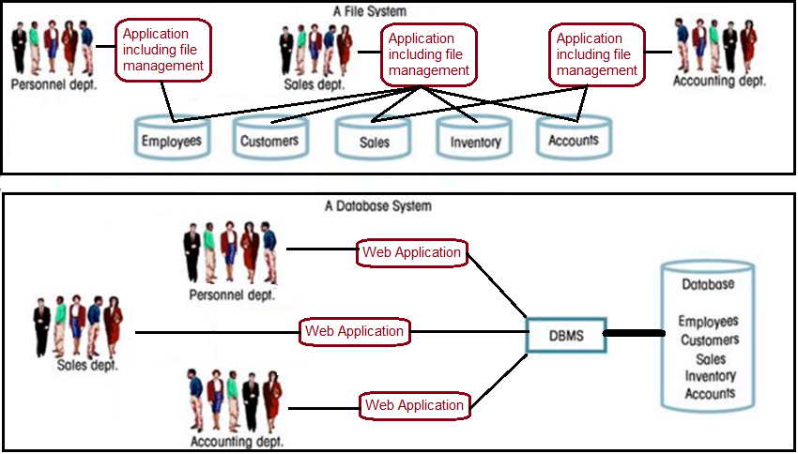
File System vs Database system
Q5 – name DBMS ? Q6 – Typology ?

Slide 7
Data models: relational model
Codds foundation paper “A relational model of data for large shared data banks” (1970)
The relational model is based in the use of relations (tables)
Each relation (table) has a description of its columns (fields), each one with a data domain.
The model includes integrity constraints (primary keys, foreign keys) and other constraints.

Slide 8
Relational Databases
Relational Database Management Systems RDBMSs are the predominant technology for structured data.
From the 70s-80s relational databases
relying on the relational calculus and
providing “standard” querying facilities: SQL
have been widely adopted
and are often thought of as the only alternative for data storage accessible by multiple clients in a consistent way.

Slide 9
New approaches over the years
Different approaches such as object databases or XML stores have not gained adoption.
These alternative have been absorbed by relational database management systems.
But new requirements, specially for Web 2.0 applications, have lead to specific database developments diverging in different aspects from the relational model.
Q7 – New challenges with data?

Slide 10
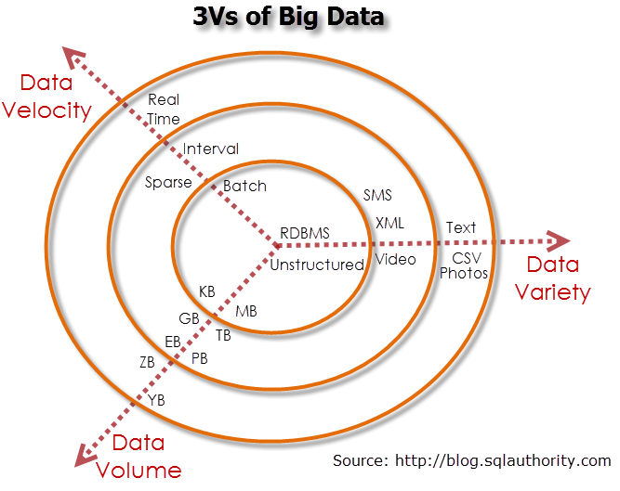
The 3 Vs of Big Data

Slide 11
The NoSQL origins
NoSQL is used to refer to a heterogeneous set of models and systems to optimize the management of data in application environments in which relational DBs were not the best solution:
need to manage data at high speed (may be relaxing some checks);
need to manage large volumes of data;
need for highly distributed systems with high availability
need for more flexible data schemes;

Slide 12
First non-relational implementations
The first non-relational databases were ad hoc solutions built for specific applications:
BigTable (Google, 2003)
Marklogic (2005)
Dynamo (Amazon, 2007)
Cassandra (Facebook, 2008)
These solutions have influenced the development of new datastores, and most of them became open source software.

Slide 13
The NoSQL movement
In a NoSQL meet-up in San Francisco in 2009
“NoSQLers came to share how they had overthrown the tyranny of slow, expensive relational databases in favor of more efficient and cheaper ways of managing data”.
Especially Web 2.0 startups have begun their business without popular Oracle or MySQL.
Instead, they built their own datastores in order to store and process huge amounts of data influenced by new models and solutions.

Slide 14
from http://nosql-database.org/
NoSQL definition: Next Generation Databases mostly addressing some of the points: being non-relational, distributed, open-source and horizontally scalable.
The original intention has been modern web-scale databases. The movement began early 2009 and is growing rapidly. Often more characteristics apply such as: schema-free, easy replication support, simple API, eventually consistent / BASE (not ACID), a huge amount of data and more. So the misleading term "nosql" (the community now translates it mostly with "not only sql") should be seen as an alias to something like the definition above.

Slide 15
Motives of NoSQL practitioners
Avoidance of Unneeded Complexity
High Throughput
Horizontal Scalability on Commodity Hardware
Avoidance of Expensive Object-Relational Mapping
Compromising Reliability for Better Performance
Requirements of Cloud Computing

Slide 16
NoSQL DB characteristics
There is no single data model
They allow more flexible data schemes
In general
They provide languages or interaction methods other than SQL (Not Only SQL)
they are distributed
they are open source
In order to get greater speed and availability they relax checks of consistency and integrity (many checks are made by the applications)

Slide 17
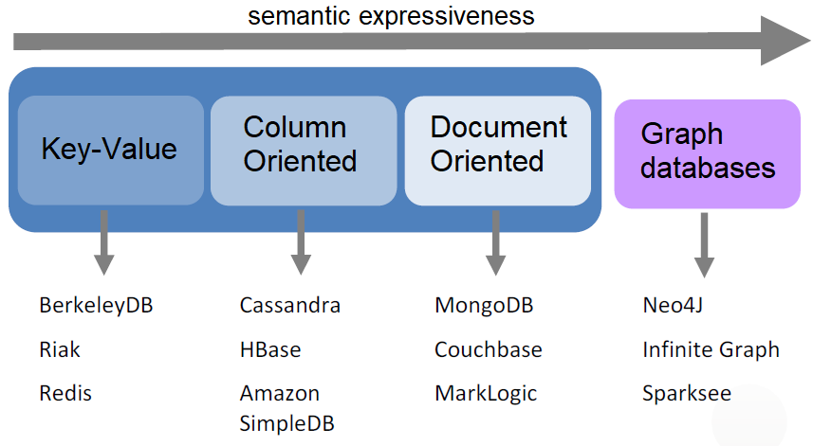
NoSQL data models

Slide 18
Flexible data schemas
The database may not have a predefined data schema.
The schema may vary for different instances of the same entity.
Sometimes DBMS is not aware of the database schema (the data structure is just known by the designer / programmer).
Denormalization techniques are common (data redundancy).

Slide 19
Interaction modes & languages
Some NoSQL databases offer their own query language (similar to SQL)
Others offer access via API libraries.
All NoSQL databases were designed to facilitate the development of web applications, so they provide drivers and libraries for different programming languages (C, C++, Java, PHP, Python …)

Slide 20
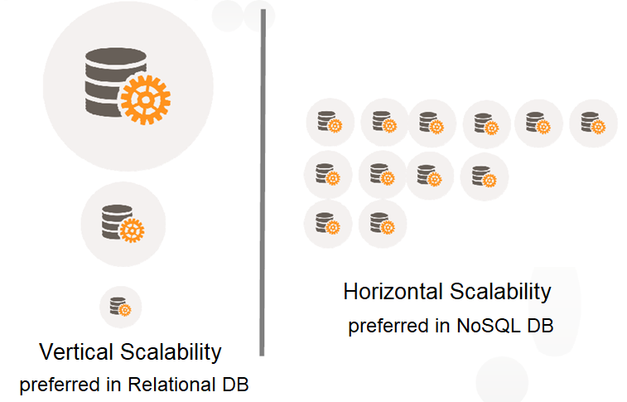
Distribution and Scalability

Slide 21
The CAP-Theorem (1)
Consistency: a distributed system is considered to be consistent if after an update operation of some writer all readers see the same updated values in some shared data source (there are several alternatives to this strict notion of consistency).
Availability: the system is implemented in a way that allows it to continue operation if e.g. nodes in a cluster crash or some HW or SW parts are down.
Partition Tolerance: ability of the system to continue operation in the presence of networks partitions (temporal or permanent). Also the ability to cope with the dynamic addition or removal of nodes.

Slide 22
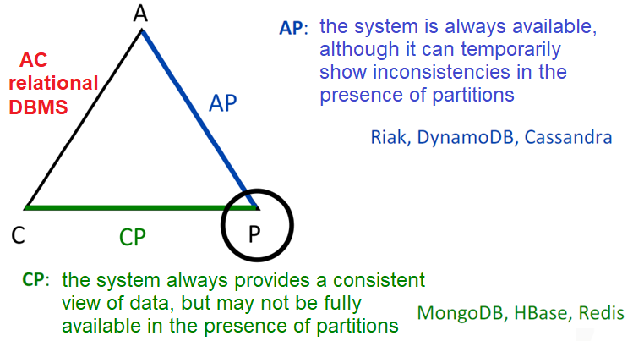
The CAP-Theorem (2)
The CAP-Theorem alleges that one (a system) can AT MOST choose two of these three characteristics.

Slide 23
ACID vs BASE systems
Atomicity
Consistency
Isolation
Durability
For lot of applications and cases availability and partition tolerance are more important than strict consistency
Availability and redundancy in a distributed system using commodity hardware are difficult to achieve with RDBMS
NoSQL BASE approach forfeits ACID C and D in favor of availability, graceful degradation and performance
Basic Availability
Soft-state
Eventual consistency
readers will see the same as time goes on

Slide 24
NoSQL DB drawbacks
Lack of standards
Complexity in management and administration
Lack of maturity and support of technologies
Lack of specialists
Difficulty in determining the most appropriate system for each environment

Slide 25
NoSQL data modeling
ER Diagrams and
Query-Driven Data Modeling

Slide 26
Query-Driven Data Modeling
Analyze the requirements
Identify entities and relationships
Conceptual data model / ER Diagram
Identify the required queries
Application flow
Specify the scheme
Logical data model (relational vs non-relational)
Optimize, optimize, optimize
Physical database design
QDDM

Slide 27
The Twissandra example
Imagine a Twitter-like reduced application, where users may publish tweets, and they may look for other users and follow their publications.
Each user has user_id, username & password
Each tweet has tweet_id, body & timestamp, and is related to its author
A user may follow other user(s) to read his/her tweets, so the DB must store this connection
Q8: Design a RDB for that purpose

Slide 28
Twissandra Relational Model
Conceptual design : ER Diagram
Logical design : relational database
user(uid, username)
tweet(tid, body, timestamp, author_id)
follows(uid_following, uid_followed)
1:N
N:N
follows
user
publish
tweet

Slide 29
Twissandra application flow: actions and queries
Register a new user
Publish a tweet
Store that a user wants to follow another user
Look for a user by id and show his/her data
Look for a tweet by id and show its contents
Look for a user by name and get his/her id
Show which users a user is following (by uid)
Show the followers of a user (given user_id)
Show a userline (of uid, line of his/her tweets)
Show the timeline for a user (line of his/her tweets and tweets of users he/she is following)
Q9 – Efficient queries in large and distributed DB ?

Slide 30
Twissandra efficiency issues in large and distributed DB
Q7 Efficient queries in a large and distributed DB?
Look for a user by id and show his/her data
Look for a tweet by id and show its contents
Look for a user by username and get his/her uid
not by PK
Show which users a user is following (by uid)
Show the followers of a user (given uid)
not by the first component of the PK
Show a userline (line of his/her tweets, given uid)
not by PK, and needs inverse chronological order
Show the timeline for a user (line of his/her tweets and tweets of users he/she is following, given uid)
not by PK, needs inverse chronological order and needs JOIN !

Slide 31
Twissandra denormalized Query-Driven Data Model (I)
Look for a user by id and show his/her data
Users ( uid, username, passwd )
Look for a tweet by id and show its contents
Tweets ( tid, body, timestamp, uid )
Look for a user by username and get his/her uid
Usernames ( username, uid)
Show which users a user is following (by uid)
Following ( uid1, uid2 )
Show the followers of a user (given uid)
Followed ( uid2, uid1 )

Slide 32
Twissandra denormalized Query-Driven Data Model (II)
Show a userline (line of his/her tweets, given uid)
Userline ( uid, tid, body, timestamp)
Show the timeline for a user (line of his/her tweets and tweets of users he/she is following, given uid)
Timeline ( uid, tid, uidauth, body, timestamp)
In this denormalized model: how does the application feed those tables?

Slide 33
Twissandra: actions in a denormalized model
Register a new user
Insert into Users ( uid, username, passwd )
Insert into Usernames ( username, uid)
Store that a user wants to follow another user
Insert into Following ( uid1, uid2 )
Insert into Followed ( uid2, uid1 )
Publish a tweet tid (by a user with his/her uid)
Insert into Tweets
Insert into Userline for this uid
Insert into Timeline for this uid and also insert into Timeline for all his/her followers

Slide 34
NoSQL databases
Column-oriented databases

Slide 35
Column-Oriented Databases (1)
The approach to store and process data by column (the reason of the name) instead of row now subsumes different datastores that integrate column- and row-orientation inspired by Google’s Bigtable:
a distributed storage system for managing structured data that is designed to scale to a very large size on commodity servers.
The data model is a sparse, distributed, persistent multidimensional sorted map.

Slide 36
Column-Oriented Databases (2)
Data are stored in a distributed multidimensional map indexed by a key.
Rows are identified by the key.
Column Families consists of a group of columns and have to be defined in advance.
Columns have a name and store a number of values; each row in a table can have a different number of columns.
Columns may store a specified datatype.

Slide 37
Column-Oriented Databases (3)
As the system should be incrementally scalable, data is partitioned among the nodes of a cluster in a way that allows repartitioning.
Data is distributed among the nodes by a hashing function on the key, and also preserve the order of row-keys when defined.
The key determines the node(s) where a row can be found, then the key definition limits the queries the system can efficiently serve.

Slide 38
Column-Oriented Databases (4)
The system measures and analyze the load information of servers and moves nodes to get the data and processing load balance.
Moreover, to achieve high availability and durability in a cluster, data gets replicated to a number of nodes which can be defined a replication factor.

Slide 39
Apache Cassandra
Cassandra is an open-source implementation derived from Amazon Dynamo (that provides availability and scalability to Amazon's FT system)
For performance reasons, there is no referential integrity (FK) nor secondary indexes.
Therefore, it is not possible to search for fields different from the primary key,
nor can JOINs be executed efficiently.
Data must be denormalized and it forces to Query-Driven Data Modeling

Slide 40
Cassandra key elements
Keyspace (use)
Table (like relational DB tables)
Primary key, Datatypes
Data Definition and Manipulation Language
CQL (through a CQL shell), language like SQL
also API
Partitioning by Keys (simple or composed)
determine the allowed queries

Slide 41
NoSQL databases
Document databases

Slide 42
Document Databases (1)
Document databases departs from simple key-value stores to slightly more complex and meaningful data structures.
A Document consist of a set of named fields that have a keyname (fieldname) and a value.
Semi-structured data
A fieldname has to be unique within a document and its assigned value may be a string, number, boolean, date and ordered list or even other complex types.

Slide 43
Document Databases (2)
Documents are organized in collections.
There is no strict schema for documents in a collection (schema-free database):
each document may have different fields.
The system manage distribution and replication
based on a unique_id key generated by the system for each document,
secondary indexes are allowed to facilitate queries.

Slide 44
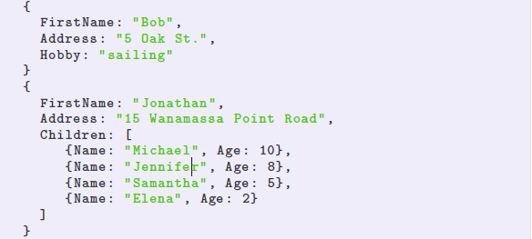
Document Databases (3)
Semi-structured data notation
usually JSON (JavaScript Object Notation)

Slide 45
MongoDB
MongoDB (from the adjective “humongous”, extremely large) is a widely used open-source implementation (supported by 10gen) of document-oriented databases ideas.
MongoDB doesn’t provide an interaction language, applications interact with the database system through API.
It also provides a mongo shell using API-like calls
db.municipios.find( {habitantes:{$gte:500000}} , {poblacion:1, habitantes:1, _id:0} ).sort({habitantes:-1})

Slide 46
NoSQL databases
Graph databases

Slide 47
Graph Databases (1)
A Graph Databases is a database that uses graph structures (with nodes, vertices and properties) to represent and store data.
Each element contains a pointer to its adjacent element, so it is not necessary to use indexes to search for information.
These systems provide index-free adjacency.

Slide 48
Graph Databases (2)
Compared to relational databases, graph DB
are generally faster for associative datasets;
are better to project the structure of object-oriented applications;
scale naturally for large data sets, since they do not require join operations;
are less dependent on a rigid scheme, since they are better at managing data changes in evolutionary schemes.

Slide 49
Graph Databases (3)
Graph Databases are really powerful to manage and explore the relationships between elements, represented as graphs.
Example: calculate the shortest path between two nodes, calculate the diameter of a graph, detect clusters and communities …
Neo4j is a graph-oriented DBMS created by Neo Technologies in 2003, implemented in Java.

Slide 50
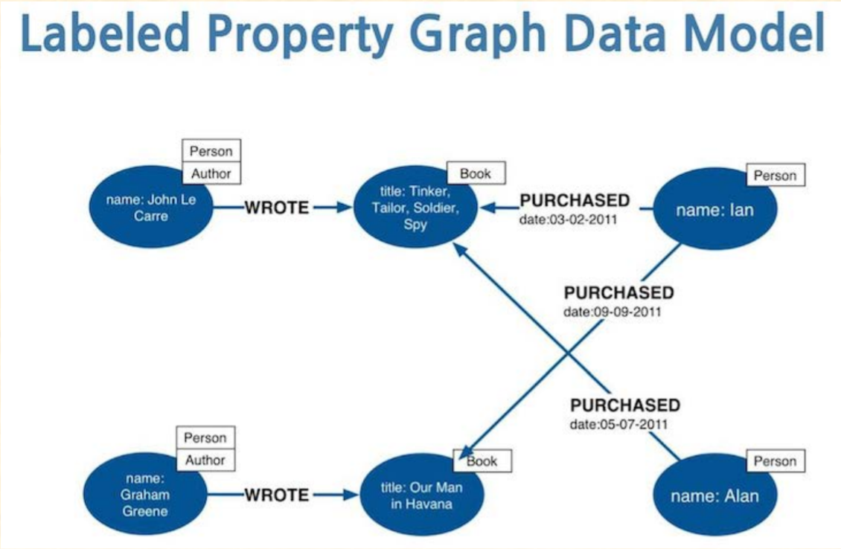
Graph Database Model

Slide 51
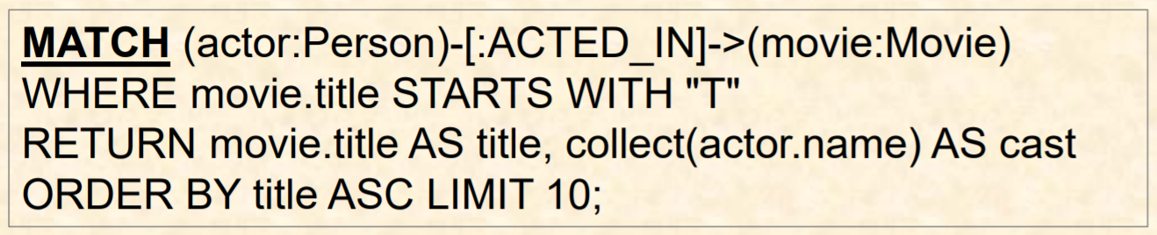
Graph Database Queries
Cypher query language
An example would be

Slide 52
Big Data Databases
Recap

Slide 53
Main reasons to use Databases
you want to store controlled and interrelated data, and we want to have them together with their description;
you want to allow diverse users to concurrently access data with different privileges (read / write);
you have a large volume of data and you want to quickly access certain data.
Q10 Why non-relational databases?

Slide 54
The NoSQL motivations
need to manage data at high speed (may be relaxing some checks);
need to manage large volumes of data;
need for highly distributed systems with high availability
need for more flexible data schemes;
relaxing checks of consistency and integrity
‘returning’ tasks/info to the app/programmer

Slide 55
NoSQL data models

Slide 56
NoSQL References
Strauch, Christof. “NoSQL databases”. Lecture Notes, Stuttgart Media University.
Eben Hewitt. “Cassandra: The Definitive Guide”. O’Reilly Media, Inc.
Agus Kurniawan. “MongoDB Succinctly”. CreateSpace Independent Publishing Platform.
Robinson, Ian, Jim Webber, and Emil Eifrem. “Graph Databases”. O’Reilly Media, Inc.

Slide 57
NoSQL References
Strauch, Christof. “NoSQL databases”. Lecture Notes, Stuttgart Media University.
Eben Hewitt. “Cassandra: The Definitive Guide”. O’Reilly Media, Inc.
Agus Kurniawan. “MongoDB Succinctly”. CreateSpace Independent Publishing Platform.
Robinson, Ian, Jim Webber, and Emil Eifrem. “Graph Databases”. O’Reilly Media, Inc.

Slide 58
Big Data Databases
Vicente Cerverón
Computer Science Department
School of Engineering www.uv.es/etse
Universitat de València - SPAIN

