Slide 1
VI. REVENUE STREAMS
Freemium: try free, then 50,000 VND/month
Main revenue is the Premium subscription from individual users, with no dependence on showroom commissions or tile sales.
Item | Free plan | Advanced plan (Premium)
Fee | 0 VND | 50,000 VND/month (Premium subscription)
3D model creations | 5 turns | More than the free plan; specific number NOT YET DECIDED
Quota refresh cycle | 5 initial turns; policy on additional turns, if any, not yet finalized | NOT YET DECIDED: daily, monthly, or another rule
Room creation and tile try-on | Build a room from scratch or use a sample room; try basic tile designs | Use both room creation modes; benefits beyond the Free plan finalized later
3D model export | Feature is part of the product direction; conditions of use not finalized | Feature is part of the product direction; export format not finalized
Note: users try the real value with 5 free model creations before paying. The Premium quota and refresh rules are not decided, so they must be configurable rather than hard-coded.
NEXROOM / VI. REVENUE STREAMS
SLIDE 6

Slide 2
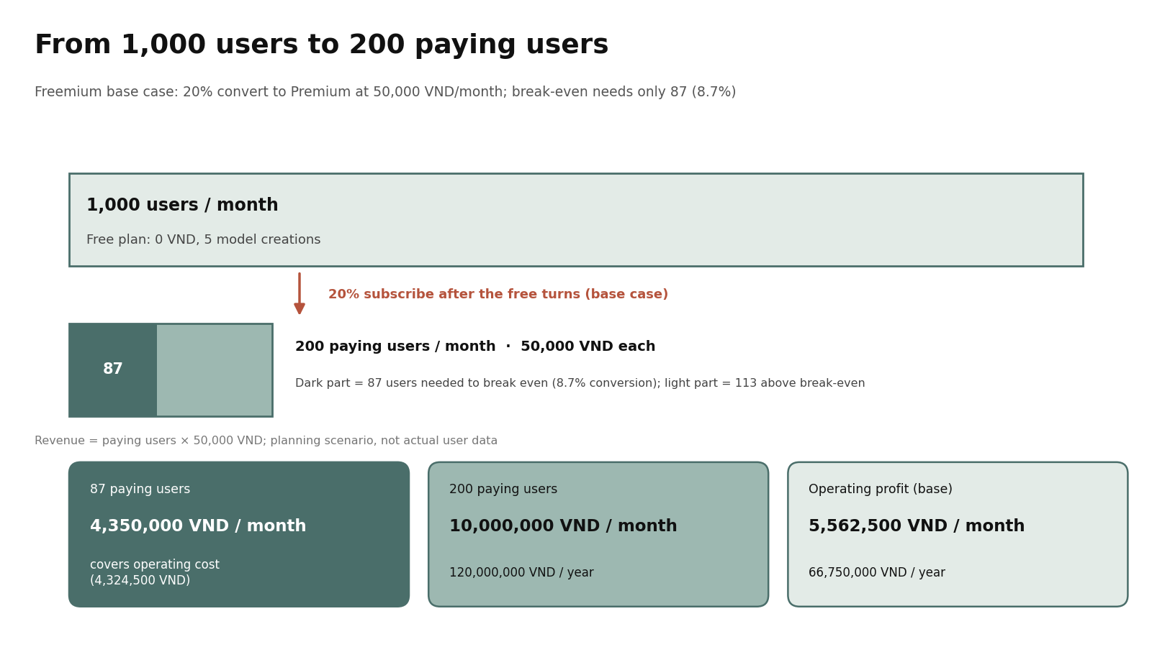

Slide 3
5 RESOURCE GROUPS
NEXROOM
01
Technology platform
Website, 3D room builder, sample room library, accounts, project saving, quota management, subscription tracking, payment
Key
Resources
Priority: Very high
02
Material and sample room library
Tile textures with usage rights; sample room data: layouts, sizes, surfaces, materials
Priority: Very high
03
Human resources
Frontend/3D development, basic backend, UI/UX design, data standardization, testing, content
Priority: Very high
What does Next Room 3D rely on?
04
Infrastructure
Domain name, hosting, database, file storage, backup system
As a student project, the team prioritizes web 3D and open-source solutions to limit licensing costs. Tiles are textures/materials rather than complex models, which can reduce file size and improve performance, but realism must be tested.
Priority: High
05
Intangible assets
Interface design, source code, material processing workflow, brand identity, feedback data
Priority: High
TEXTURES, NOT COMPLEX TILE MODELS

Slide 4
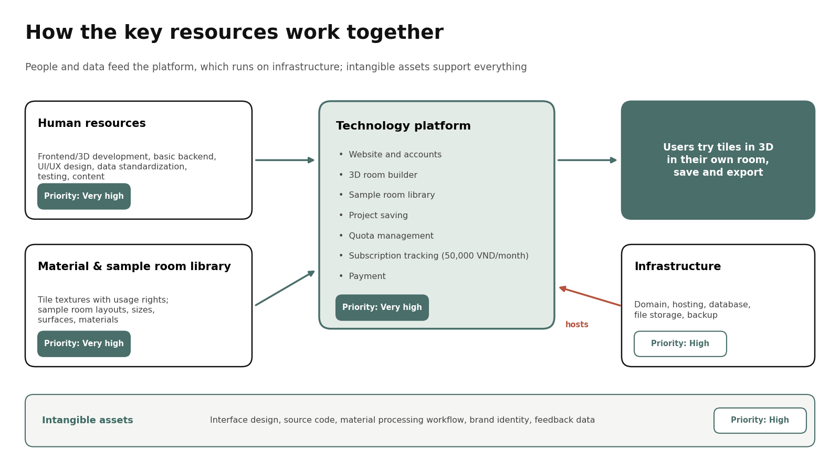

Slide 5
VIII. KEY ACTIVITIES
Four activities keep the product running
Build the tile library, the room builder and the sample rooms, then operate the freemium model reliably.
01
Tile sample library
02
3D room builder
Source
choose data with suitable licenses; record origin, date, usage rights
2 flows
build from scratch, or pick a sample room and change parameters
Standardize
ratio, color, lighting, angle; classify wall/floor tiles and styles
Features
multi-angle view, select walls/floors, apply tiles directly
Textures
convert to materials; test tiling, size, grout lines, speed on screens
MVP
simple operations, undo, project saving, model export
03
Sample room library
04
Freemium & service quality
Content
simple rooms (living room, bedroom) with adjustable shape, size, surfaces
Turns
record turns, show 5 free turns left, assign Premium, track payments
Role
quick starting point; does not replace build-from-scratch
Quota
rules not decided; configure flexibly, no hard-coded number
Scope
room count not finalized; few, stable templates at low cost
Testing
test flows on common devices; refund turns on system errors
Note: advanced features such as construction drawings, BIM, or plumbing/electrical layouts are outside the MVP scope.
NEXROOM / VIII. KEY ACTIVITIES
SLIDE 8

Slide 6
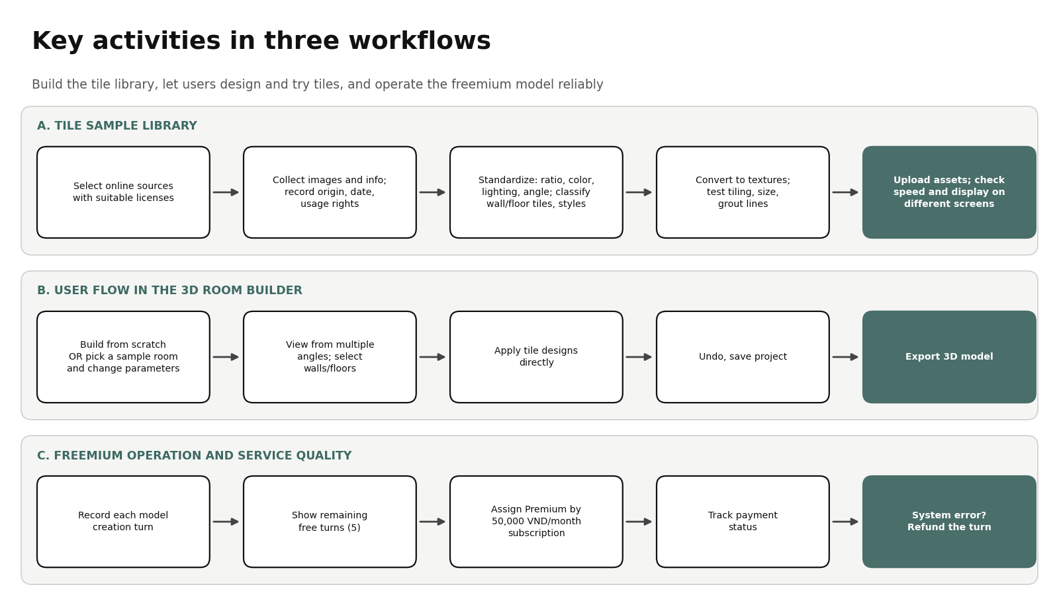

Slide 7
IX. KEY PARTNERS · TECHNICAL AND SERVICE PARTNERS
Technical and service partners, no showroom deals
Next Room 3D is a self-service web product, so it relies mainly on technical and service partners. No signed partnerships with showrooms or tile manufacturers are assumed at this stage.
01
Hosting, VPS, storage & CDN
02
Domain & security providers
03
Payment gateway
04
Tile data & asset providers
Run the 3D website, store models and textures, deliver them fast
Domain name, SSL, basic website protection
Process the 50,000 VND/month subscription and track payment status
Texture images and materials under suitable licenses
Fixed costs: VPS, storage/CDN, database, backup
Domain: 450,000 VND/year
2% of revenue (variable cost)
Record source, collection date, usage rights
05
Open-source 3D libraries
06
Universities & design communities
07
Social platforms
PARTNERSHIP PRINCIPLES
Cheap, easy-to-replace partners with transparent terms
Web 3D foundation to limit licensing costs
Trial users, early feedback, demo opportunities
Facebook, TikTok, Google: reach and user acquisition
Only tile data and assets whose licenses allow the intended use
No license fee; check license terms
Non-cash cooperation
Marketing budget: 2,000,000 VND/month
RISKS TO MONITOR
Dependence on the payment gateway for subscription revenue
Dependence on hosting and CDN for 3D loading speed
Legal risk if tile data or textures are used without proper rights
Note: showroom or tile manufacturer partnerships are a possible future direction, not part of the current model.
NEXROOM · IX. KEY PARTNERS
09

Slide 8
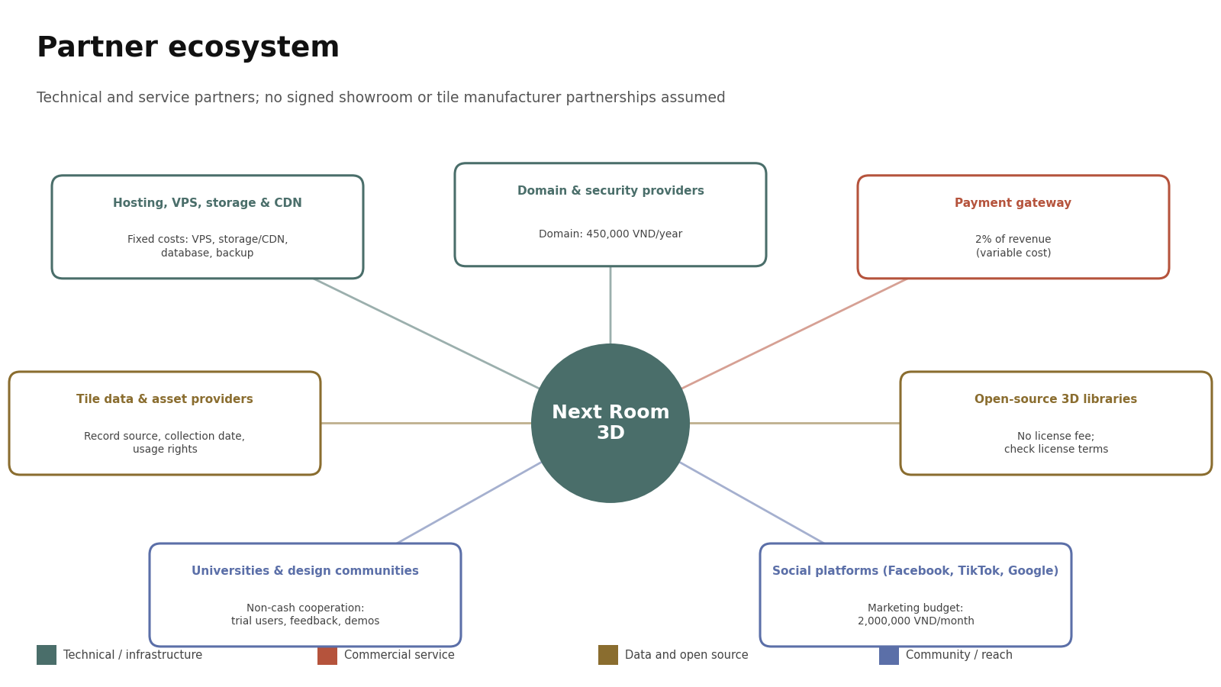

Slide 9
X. COST STRUCTURE
Costs at 1,000 users per month
Free plan of 5 model creations, Premium at 50,000 VND/month; tile data and 3D models are built in-house, with no showroom affiliation.
01
Assumptions
02
CAPEX (one-time)
5,000,000 VND
Users/month
1,000
3D website MVP development
1,500,000
Advanced plan price
50,000 VND
Brand identity and logo design
500,000
Free plan
5 turns
Tile data and initial 3D model setup
1,000,000
Assumed paying rate
20%
Business registration, legal costs
1,500,000
Paying users/month
200
Initial hosting, domain, security
500,000
Calculation period
12 months
Lean MVP budget, not a market quote; amounts in VND.
Forecast scenario for planning, not actual user data.
03
Fixed costs/month
3,837,500 VND
04
Variable costs/month
600,000 VND
Website domain (450,000 VND/year)
37,500
Payment gateway fee (2% × 10,000,000 VND)
200,000
VPS/server running the 3D website
600,000
Contingency for traffic and 3D resources
400,000
Cloud storage and CDN for 3D models
300,000
Contingency rises from 200,000 to 400,000 VND as users double. About 7,200,000 VND/year at the same scale. Amounts in VND.
Database and data backup
200,000
Data collection, new 3D tile samples
200,000
Marketing: Facebook, TikTok, Google
2,000,000
Other management and operating costs
500,000
NEXROOM / X. COST STRUCTURE
SLIDE 10

Slide 10
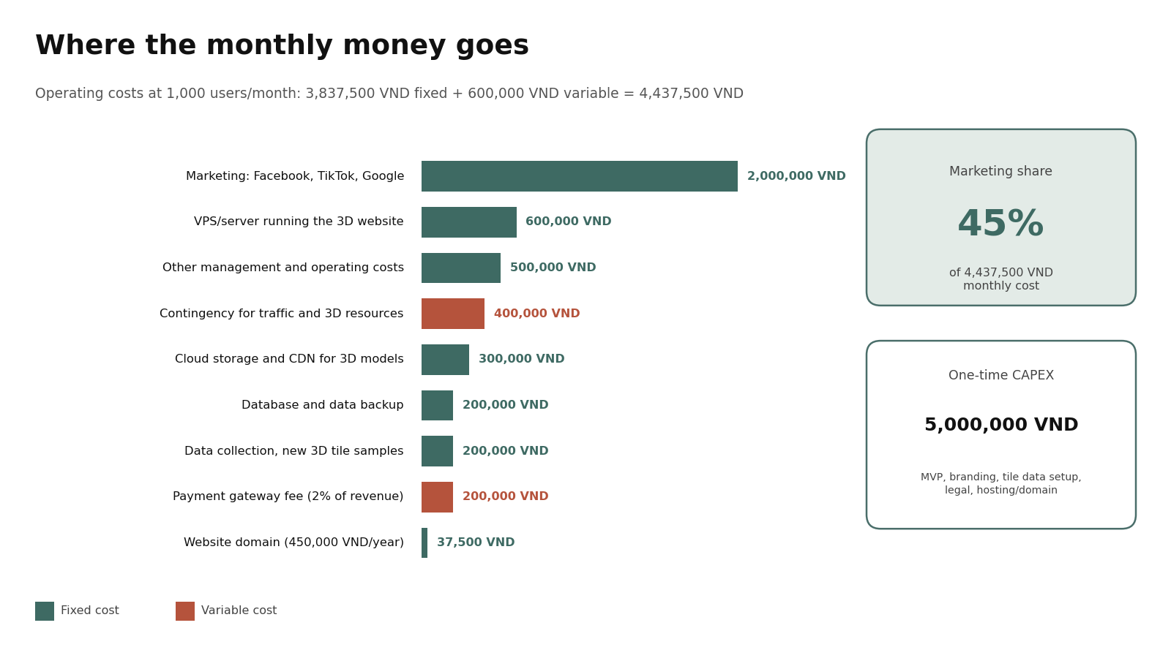

Slide 11
X. COST STRUCTURE · FINANCIALS
Break-even at 87 paying users (8.7%)
Planning scenarios at 1,000 users/month; the base case is a 20% paying rate (200 paying users).
01
Revenue by conversion (VND)
02
Base scenario: 20% (VND)
Rate
Paying users
Revenue/month
Revenue/year
Monthly
12 months
5%
50
2,500,000
30,000,000
Revenue
10,000,000
120,000,000
10%
100
5,000,000
60,000,000
Fixed costs
3,837,500
46,050,000
20%
200
10,000,000
120,000,000
Variable costs
600,000
7,200,000
30%
300
15,000,000
180,000,000
Total costs
4,437,500
53,250,000
50%
500
25,000,000
300,000,000
Operating profit
5,562,500
66,750,000
03
3-year operating costs
04
Break-even point
Year 1
Year 2
Year 3
N = (3,837,500 + 400,000) / 49,000 ≈ 86.48
Fixed costs
46,050,000
49,734,000
53,712,720
Each paying user contributes 49,000 VND after the 2% gateway fee.
Variable costs
7,200,000
7,776,000
8,398,080
Paying users needed
87/month (8.7%)
Total
53,250,000
57,510,000
62,110,800
Revenue at 87 users
4,350,000 VND/month
Costs grow 8% per year from year 2. 3-year total: 172,870,800 VND (177,870,800 VND with the 5,000,000 VND initial investment).
Operating cost
4,324,500 VND/month
Operating profit
25,500 VND/month
Note: at a 20% paying rate the project exceeds break-even by about 113 paying users. These are planning scenarios, not verified results; profit is before tax, initial investment, and costs not yet accounted for.
NEXROOM / X. COST STRUCTURE · FINANCIALS
SLIDE 11

Slide 12


