Slide 1
Master Thesis
Electric Engine Modelling

Slide 2
Objective
To predict 2D and 3D KPIs : Mgrenz(Torque Curve) and ETA(Efficiency Grid) plots for topology invariant IPSM Electric Motors designs.
Regression Problem

Slide 3
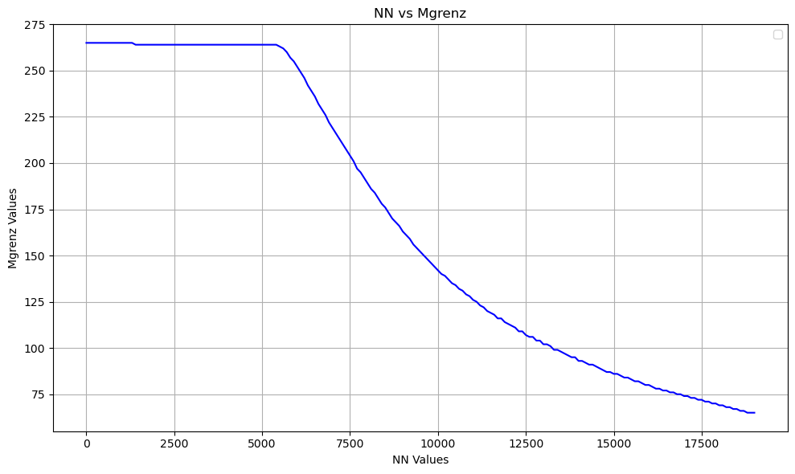
Mgrenz KPI - 2d Plot

Slide 4
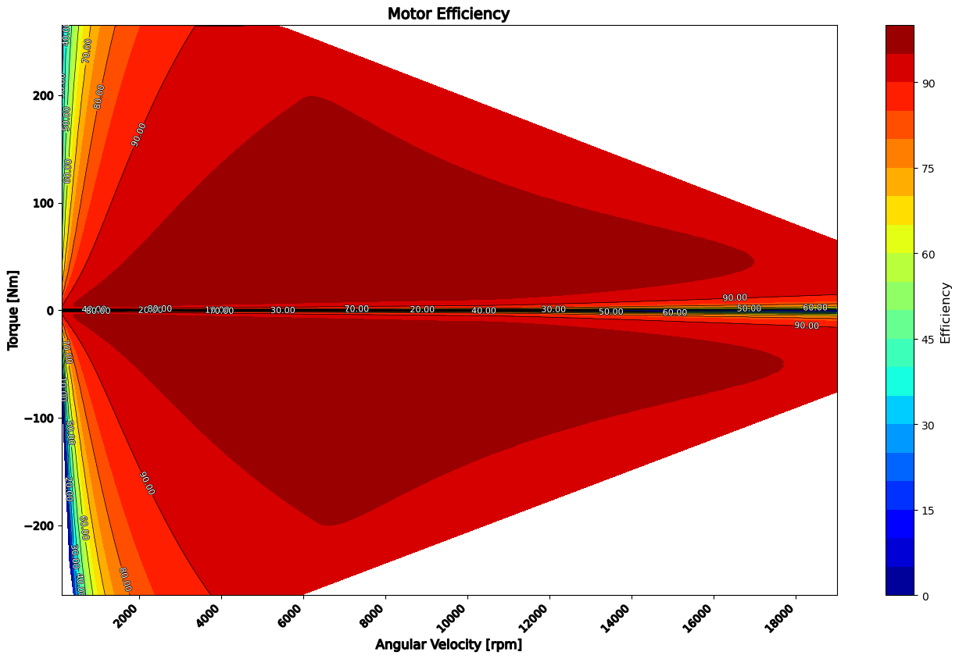
ETA KPI - 3d Plot

Slide 5
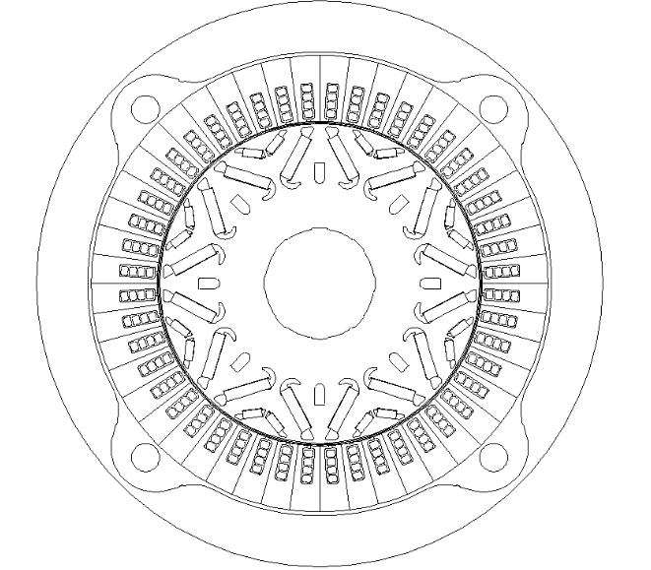
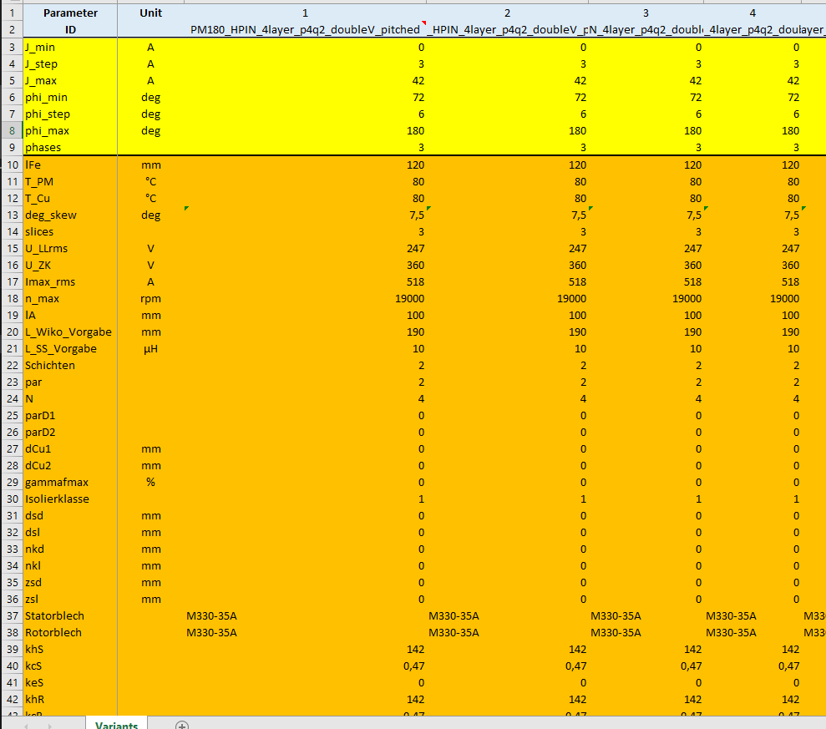
Dataset
Valeo provided ~1500 Double V magnet parametric description

Slide 6
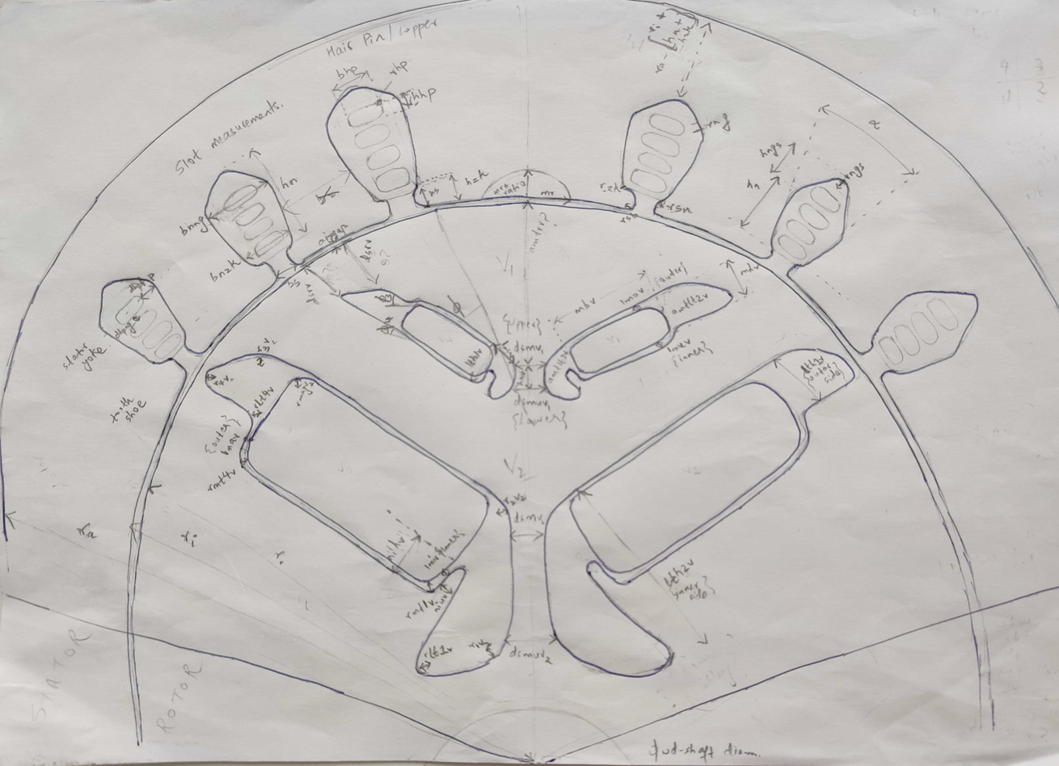
Electric Motor Cross-section

Slide 7
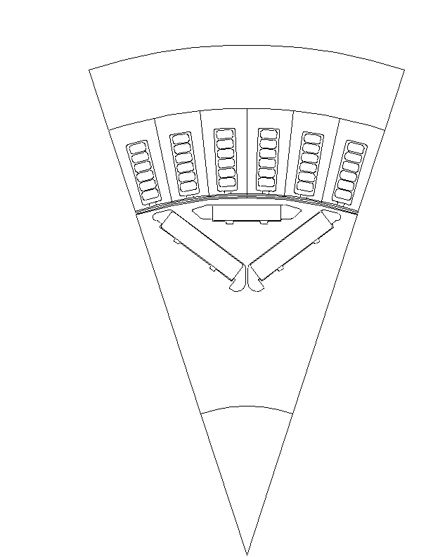
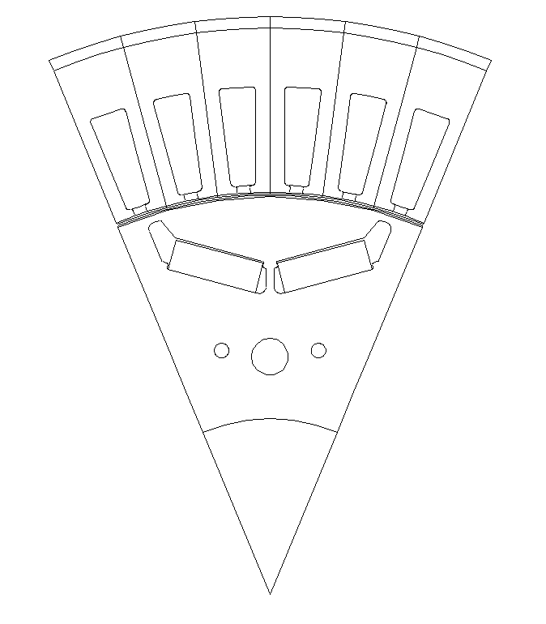
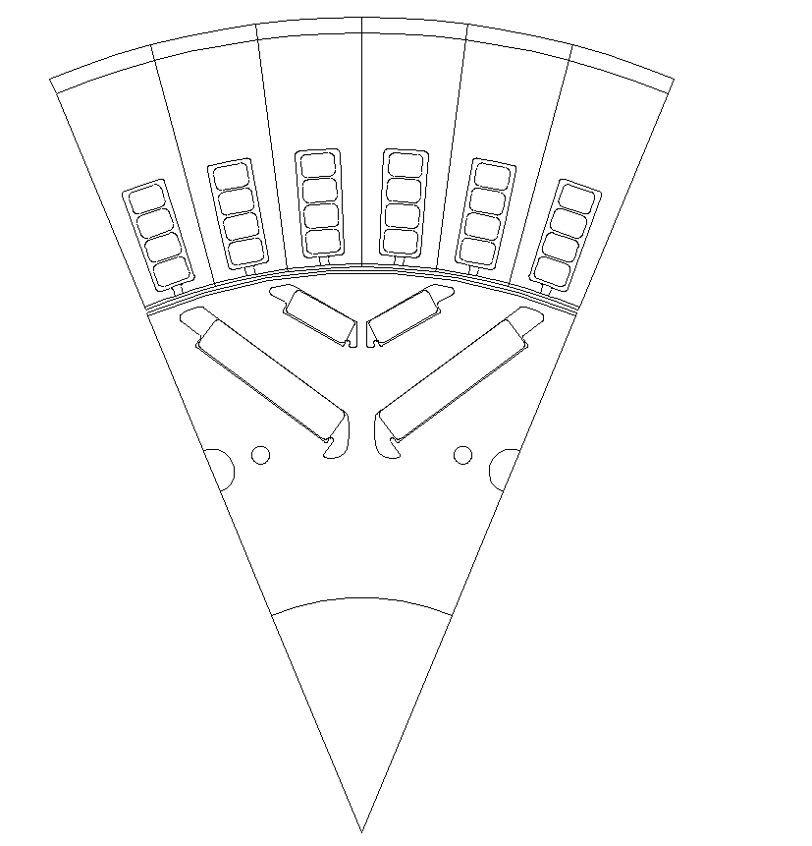
EM Topologies Manufactured by Valeo
Single V Magnet
Nabla Magnet
Double V Magnet

Slide 8
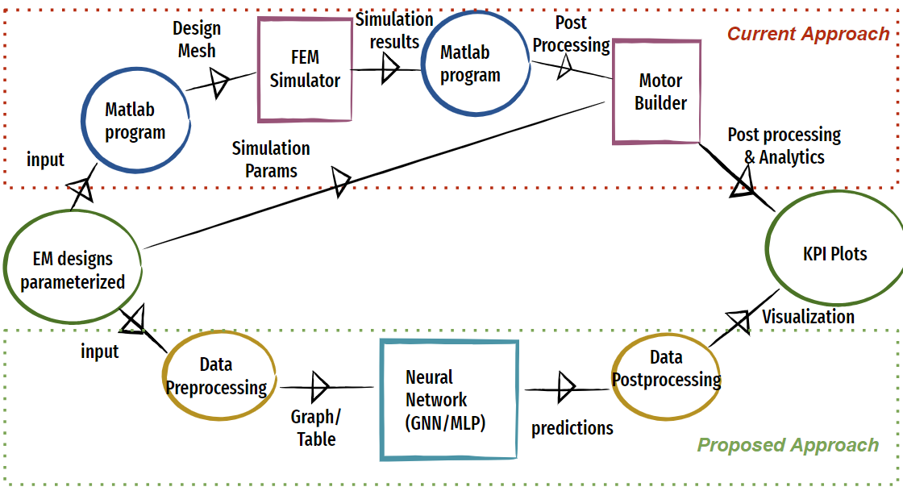
Process Flowchart

Slide 9
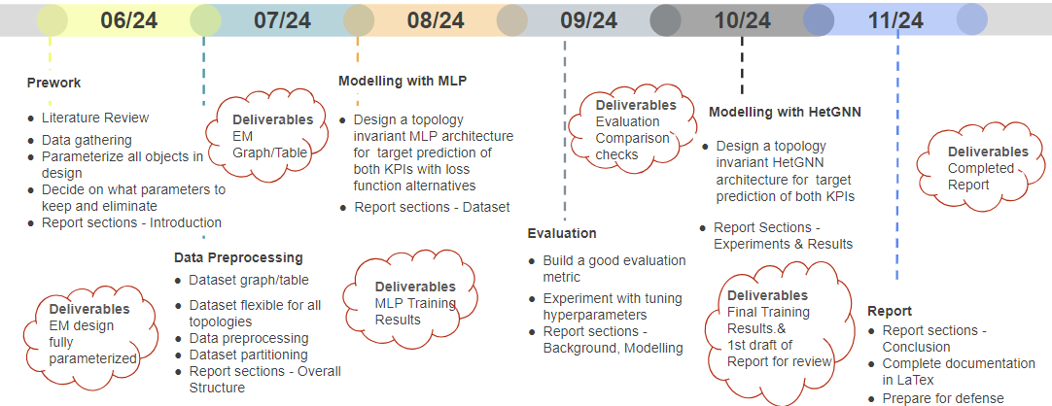
Proposed Timeline

Slide 10
1st Approach

Slide 11
Tabular Representation
Using MLP model
Topology invariance achieved with distinct columns
Geometric connections not explicit
Multiple slots/Magnets/Windings are represented by count as columns

Slide 12
Data Preprocessing
NAN values replaced as -1
All degree values converted to their corresponding radian values
MinMax Scaler - Mgrenz, ETA
Standard Scaler - Input features
All ETA grids padded with the max rows based on Max Mgrenz value
Fixed the incorrect padding of ETA matrix
Cross Fold Validation used to have most data for training- 5 folds and best performing model(lowest combined loss and both outputs scores to be minimum) to be chosen for inference

Slide 13
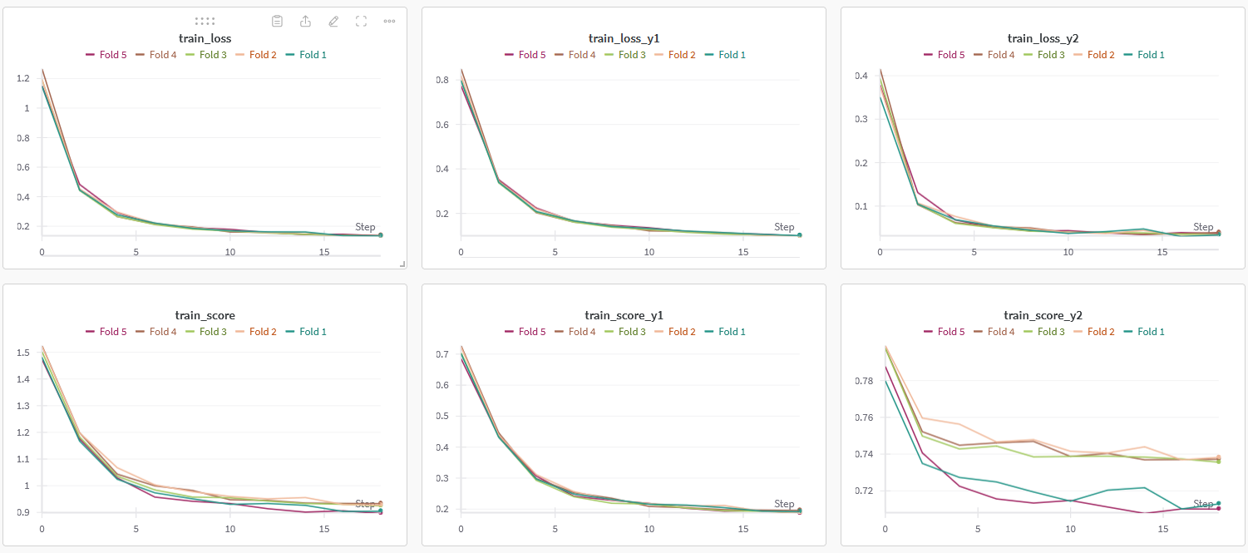
MLP Training Plots

Slide 14
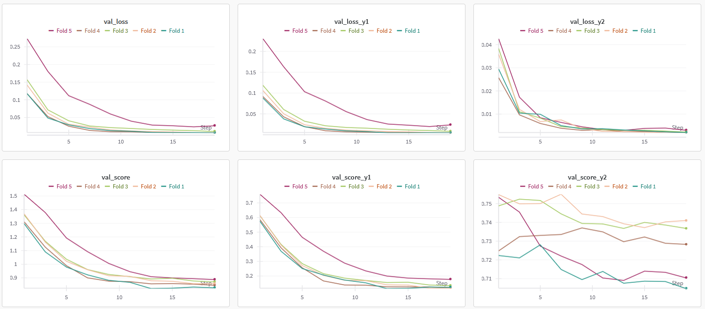
MLP Validation Plots

Slide 15
Loss Calculation
Loss : Mean Squared Error
Total Loss = Loss calculated for 2D KPI + 3D KPI

Slide 16
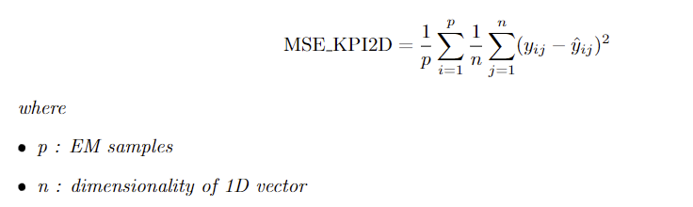
MSE Loss 2D KPI

Slide 17
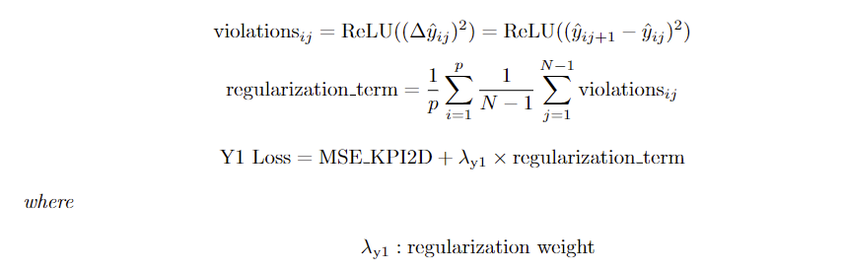
Loss Regularization for 2D KPI
Regularization : MSE Loss L2 regularized such that prediction of a specific element in the array is less than or equal to prior element
To encourage monotonically decreasing array values(as implied by torque curve)
Lambda parameter to control model penalization

Slide 18
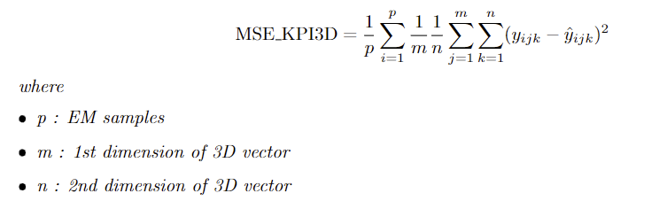
MSE Loss 3D KPI

Slide 19
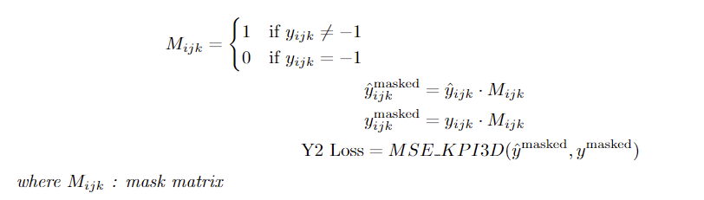
Customizing Loss for 3D KPI
Mask: 0 values in case of NAN(-1) and 1 otherwise
To eliminate any incorrect predictions of the NAN values

Slide 20

Total Loss
Total Loss = Loss calculated for 2D KPI + 3D KPI

Slide 21
Post Processing
Scale input and targets with the same scale used for training
Once predictions are obtained, inverse scale them
Optional : Set values of ETA as 0 for NN= 0

Slide 22
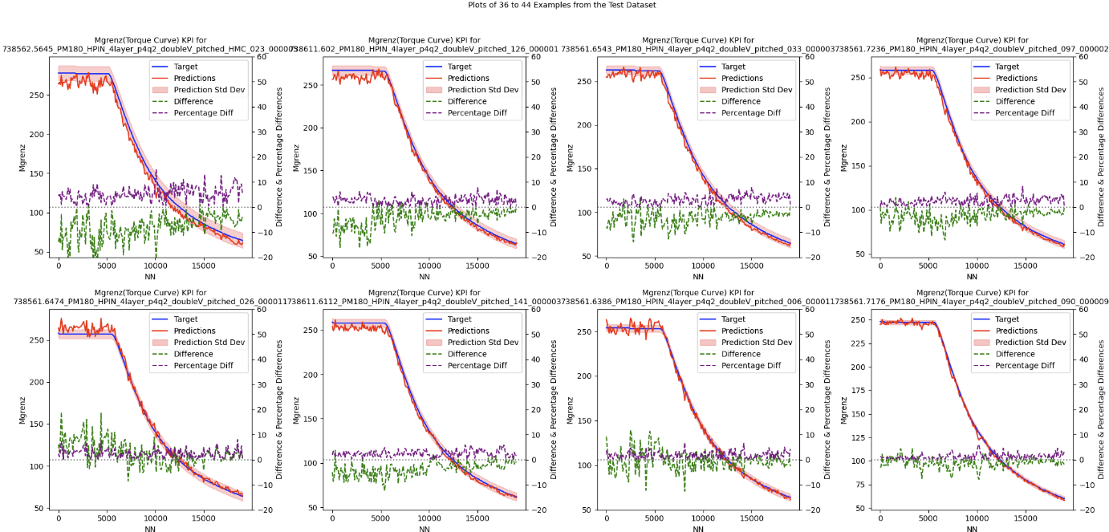
MLP Training Results for KPI prediction Mgrenz

Slide 23
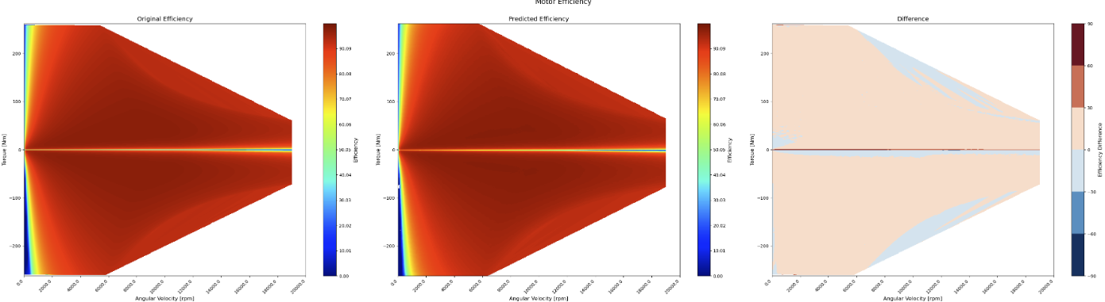
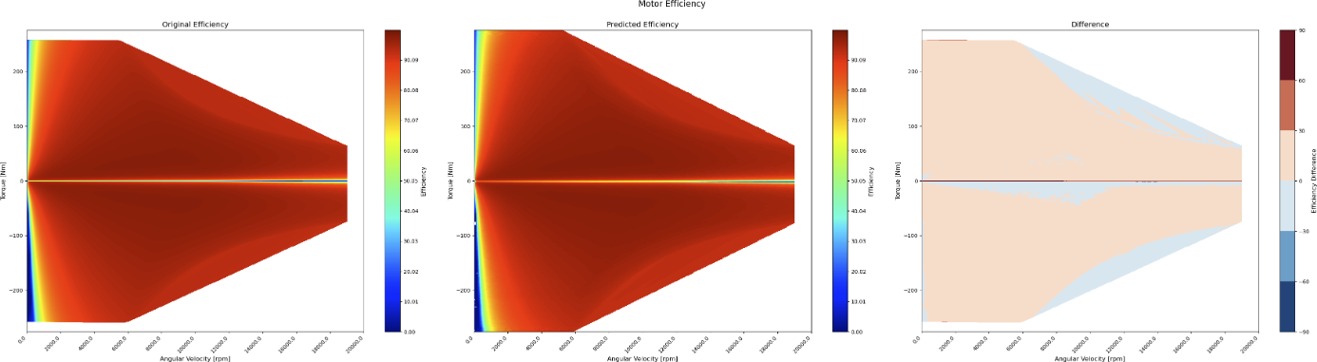
MLP Training Results for KPI prediction ETA

Slide 24
Post Processing
Scale input and targets with the same scale used for training
Use the max value in y1 target prediction from train data to determine grid size for plotting ETA grid as contour plot

Slide 25
Evaluation Metrics
Standard deviation as a Score for both KPIs
Difference and Percentage Difference for 2D KPI and Difference for 3D KPI

Slide 26
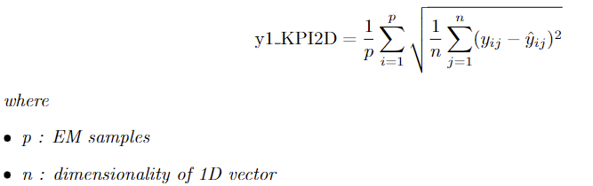
Evaluation Metric for 2D KPI

Slide 27
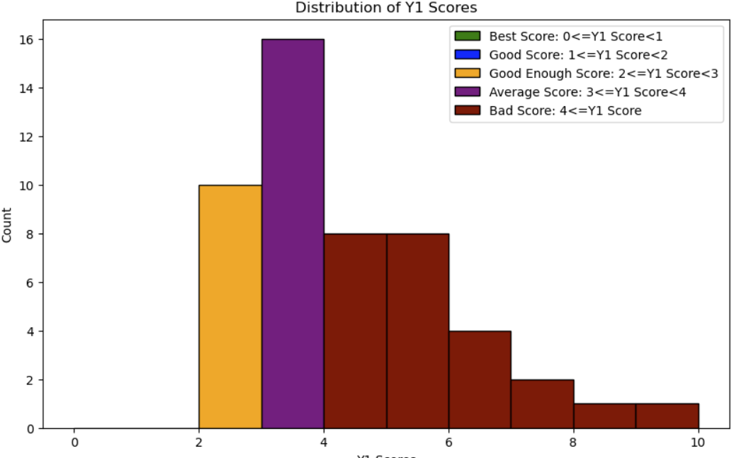
Evaluation Statistics 2D KPI

Slide 28
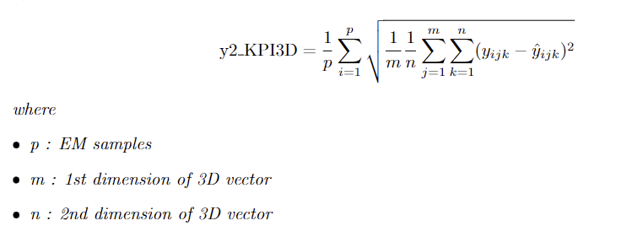
Evaluation Metric for 3D KPI

Slide 29
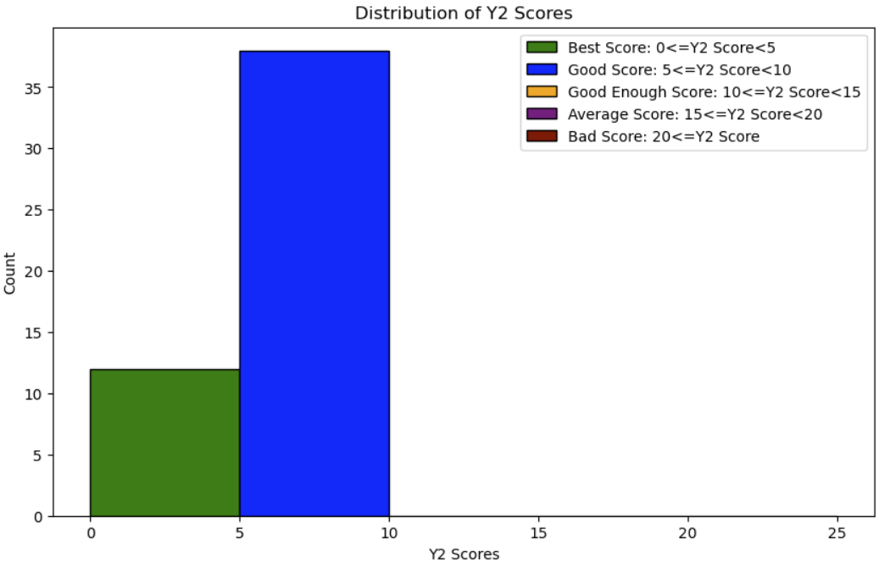
Evaluation Statistics 3D KPI

Slide 30
Graph Representation
Using Hetereogeneous GNN model
Represent data as graph
Topology invariance to be achieved here by having different nodes and edges but node and edge type always would remain consistent
Geometry is much better represented
Multiple slots/Magnets/Windings are represented as different nodes
Apt for our usecase

Slide 31
Thank you

