Slide 1
Master Thesis
Electric Engine Modelling

Slide 2
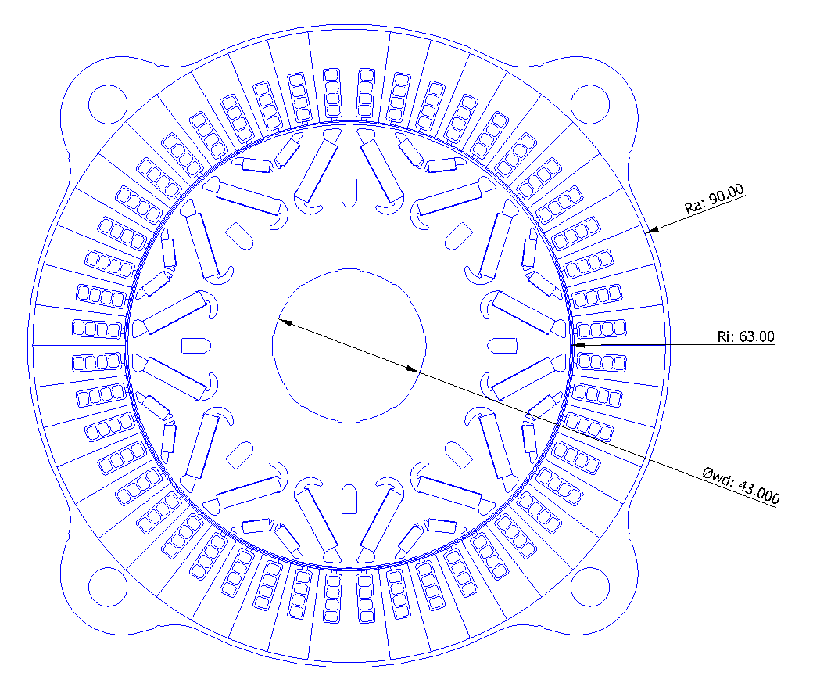
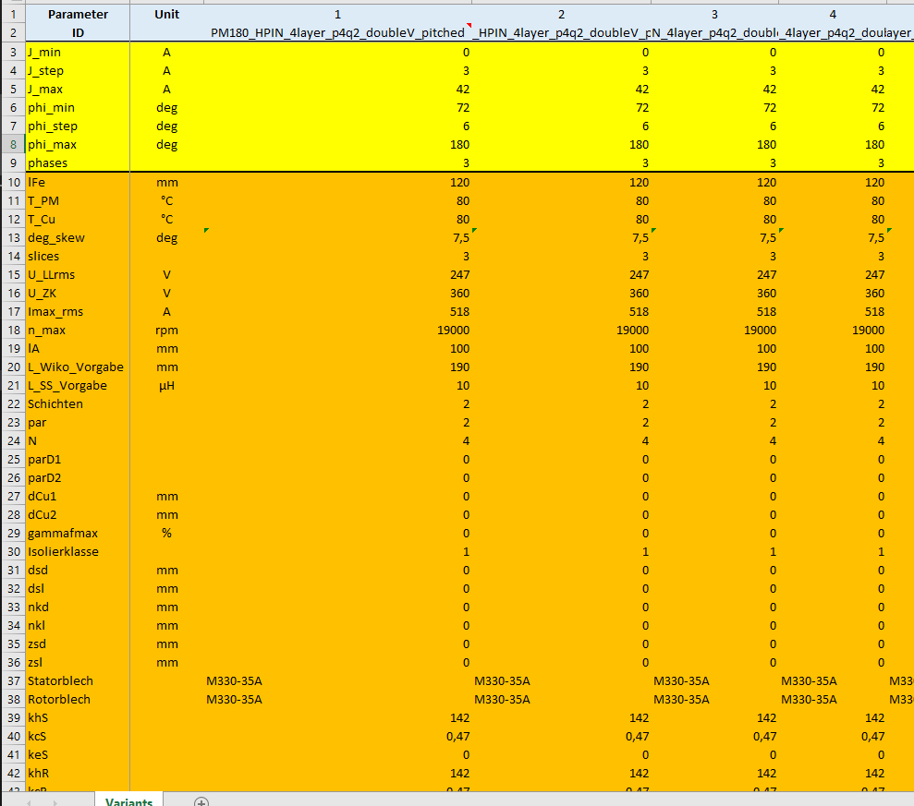
Objective
To predict KPIs : Mgrenz and ETA plots
1500 Double V magnet parametric description

Slide 3
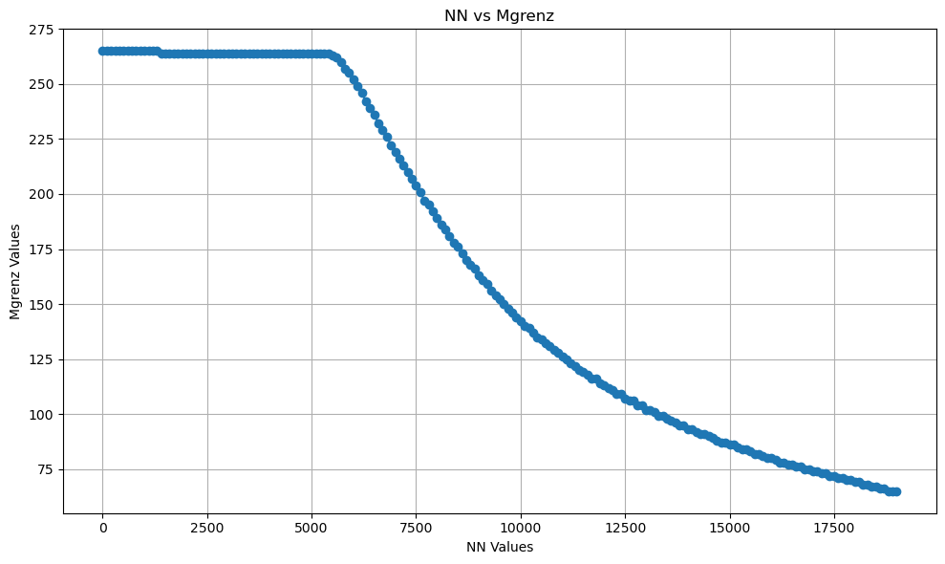
Mgrenz KPI - 2d Plot

Slide 4
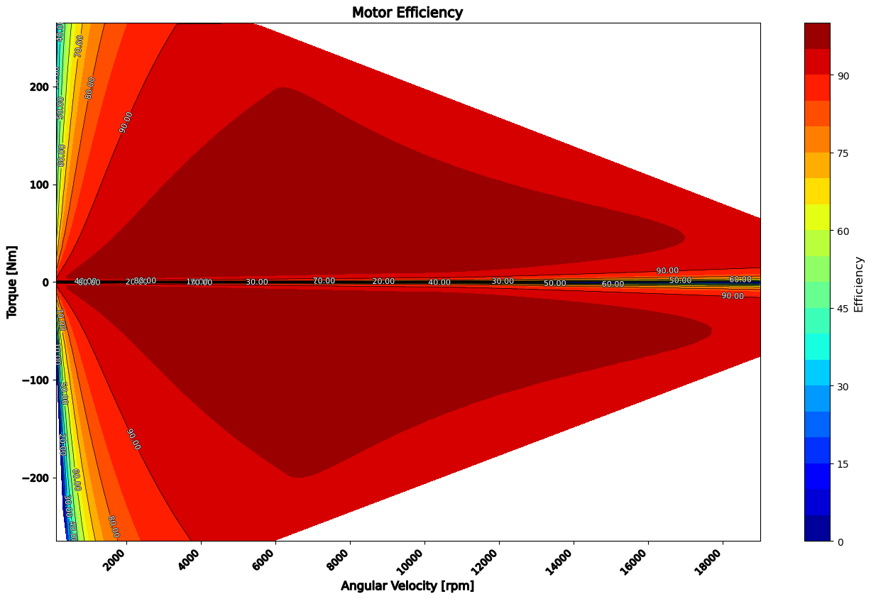
ETA KPI - 3d Plot

Slide 5
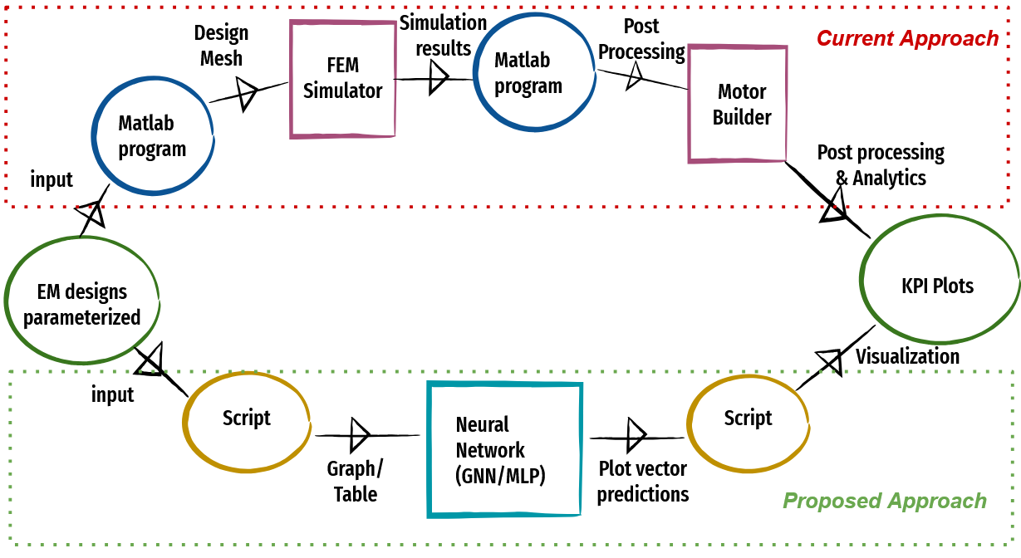
Process FlowChart

Slide 6
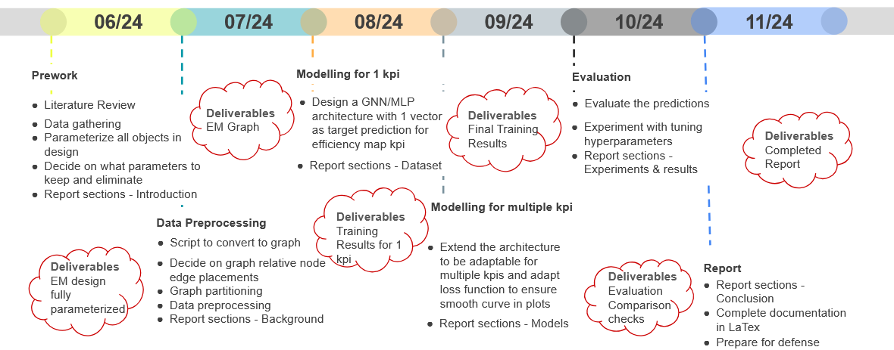
Proposed Timeline

Slide 7
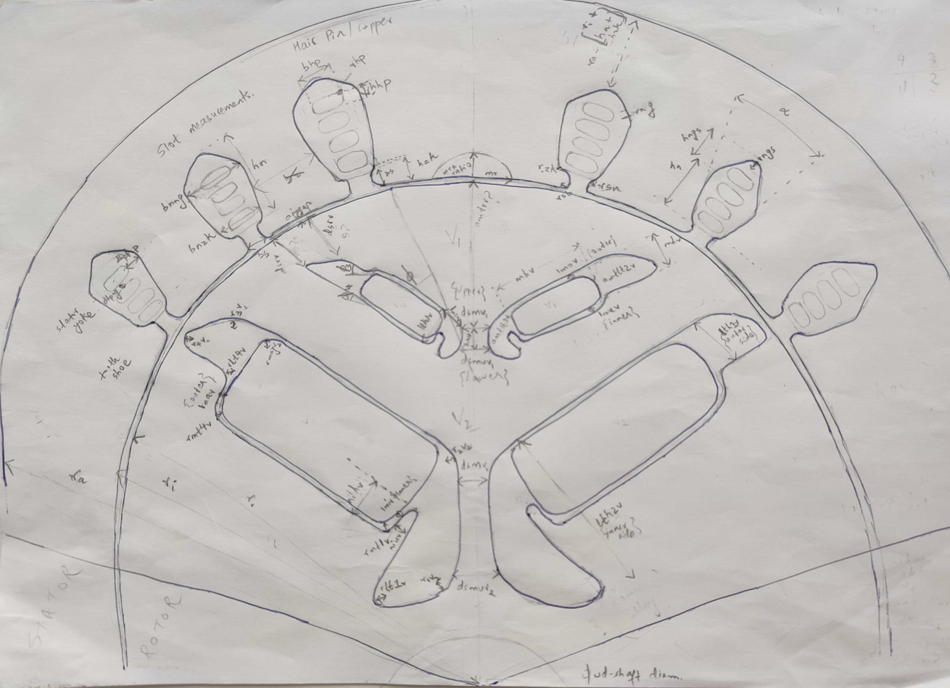
Electric Motor Cross-section

Slide 8
Thank you

