Slide 1
Master Thesis
Electric Engine Modelling

Slide 2
Objective
To predict 2D and 3D KPIs : Mgrenz(Torque Curve) and ETA(Efficiency Grid) plots for topology invariant Electric Motors.
Regression Problem

Slide 3
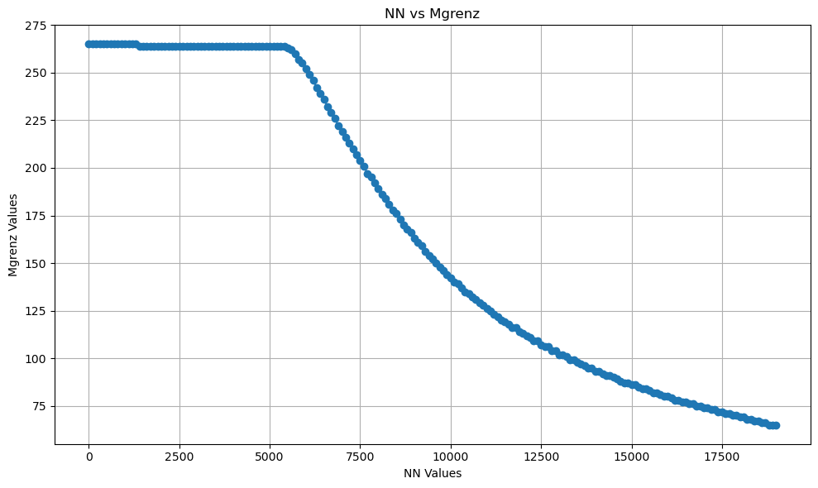
Mgrenz KPI - 2d Plot

Slide 4
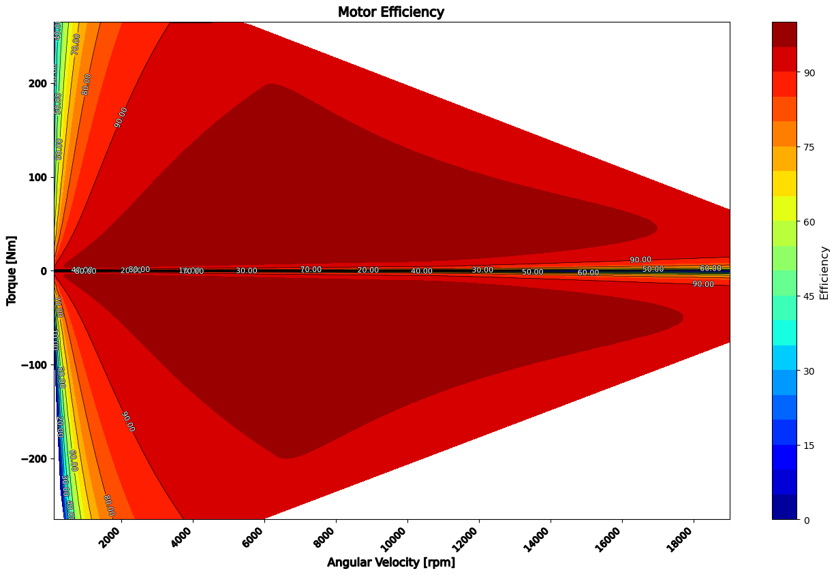
ETA KPI - 3d Plot

Slide 5
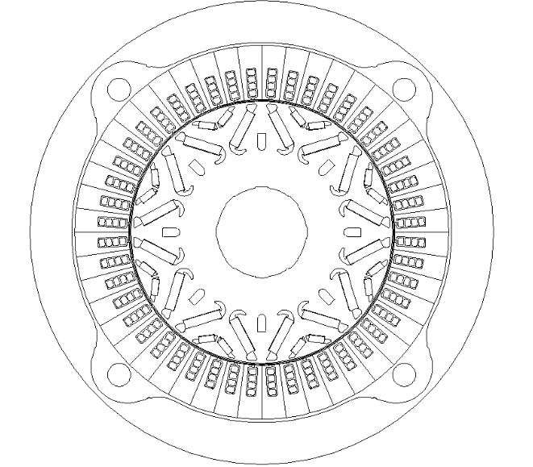
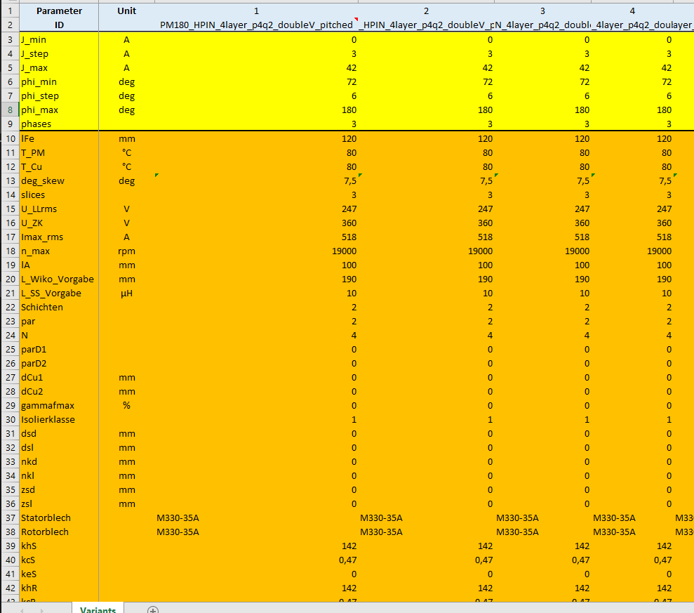
Dataset
Valeo provided ~1500 Double V magnet parametric description

Slide 6
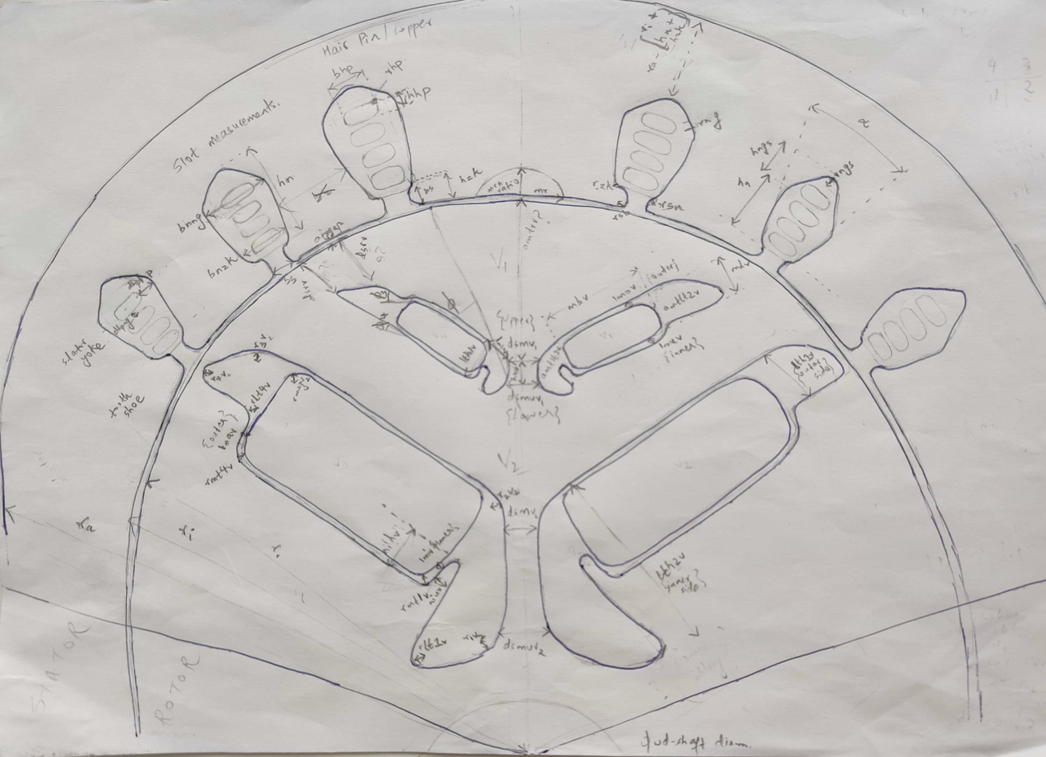
Electric Motor Cross-section

Slide 7
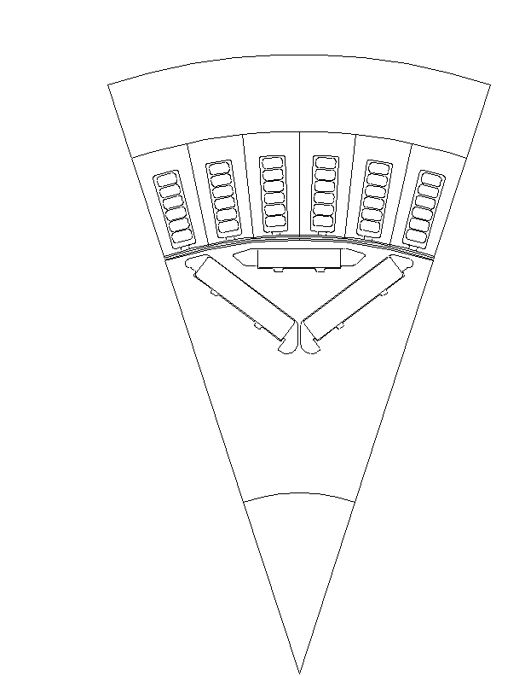
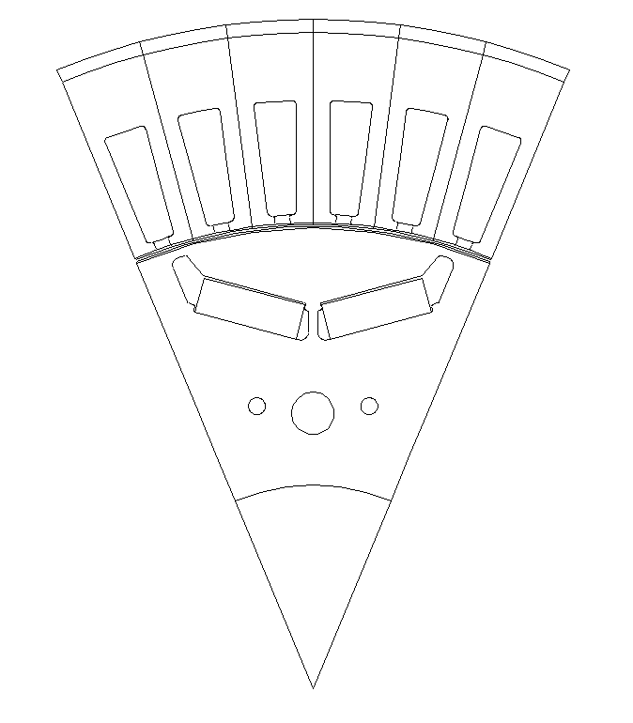
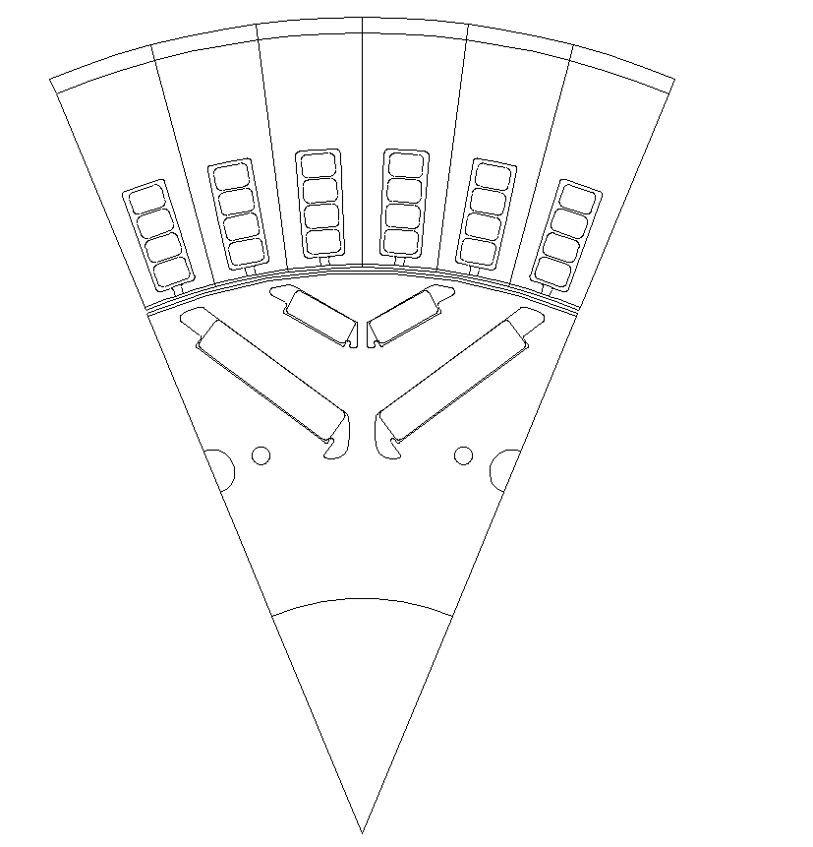
EM Topologies Manufactured by Valeo
Single V Magnet
Nabla Magnet
Double V Magnet

Slide 8
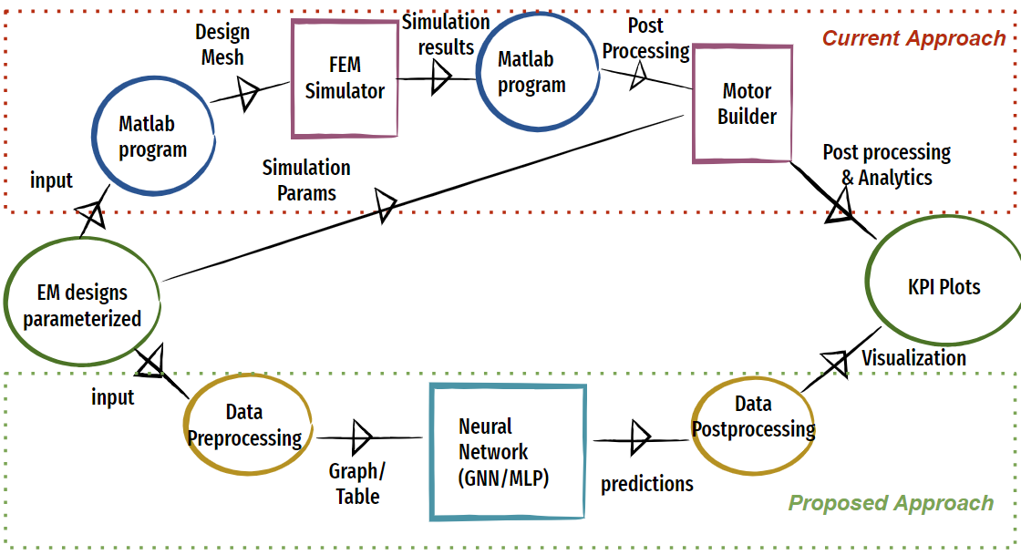
Process Flowchart

Slide 9
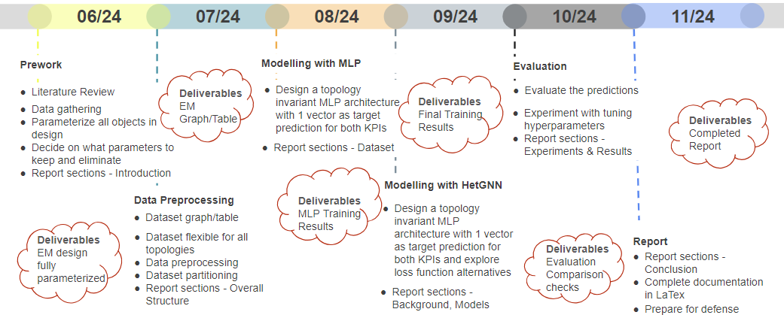
Proposed Timeline

Slide 10
2 Approaches

Slide 11
Tabular Representation
Using MLP model
Topology invariance achieved with distinct columns
Geometric connections not explicit
Multiple slots/Magnets/Windings are represented by count as columns
Not apt for our use case

Slide 12
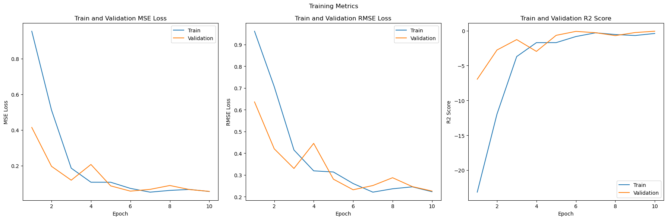
MLP Training Plots for KPI prediction Mgrenz

Slide 13
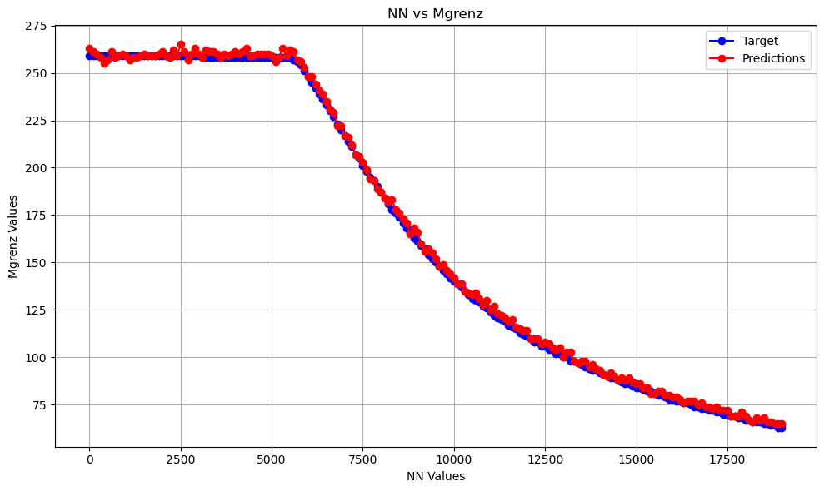
MLP Training Results for KPI prediction Mgrenz

Slide 14
Evaluation Metrics
R2 Score
MSE Loss

Slide 15
Graph Representation
Using Hetereogeneous GNN model
Represent data as graph
Topology invariance to be achieved here by having different nodes and edges but node and edge type always would remain consistent
Geometry is much better represented
Multiple slots/Magnets/Windings are represented as different nodes
Apt for our usecase

Slide 16
Thank you

