Slide 1


Innovid Video EDA & Pathing Analysis

Slide 2
Analysis Feedback - Structure
Ensure when we create views they are reflective of how we invest and/or buy. We will need to create separate views based each campaign
BRAND: Summary view of total impressions is a good place to start (Slide 4 Top Chart)
CAMPAIGN: Show summary breakdown of impressions, 50% completed views, avg CTR and Frequency analysis per campaign. Can also showcase chart from slide 11 GM -> MCM lift and a separate analysis on journey path and multiple creatives but it must be separated by campaign.
CHANNEL:
Within each campaign (MCM and GM) we can look across channels to showcase performance but can’t mix data across campaigns.
CHANNEL DETAILS:
We should create similar views across channels by Publisher, Creative and Audience
TVO should only look at VCR and Unique Reach per Creative (not CTR) based on how the channel works
Programmatic, Lifestyle and Endemic should look at both CTR and VCR (50%) per creative, publisher and audience
Note: we can also look a total audiences view which you have
Trulicity
MCM
GM
TVO
Programmatic
Lifestyle
Endemic
TVO
Programmatic
Lifestyle
Endemic
Audience
Creative
Audience
Creative
Audience
Creative
Creative
Creative
Audience
Creative
Audience
Creative
Audience
Creative
Publisher
Publisher
Publisher
Publisher
Publisher
Publisher
Publisher
Publisher
CAMPAIGN
CHANNEL
PUB, AUDIENCE & CREATIVE

Slide 3
Summary
Data Overview:
The log level data is unique per row by cookie, eventtime, creative id, dma, & placement (information on campaign, publisher, format, etc.).
There are 1 billion Trulicity impressions for 147 million users with 0.4% click-thru rate, 1.4% clicked user %, and 55% video completion rate from 3/7/2020 to 10/3/2020. *
Key Insights:
Ad volume and performance fluctuates over time likely due to changing media strategies than any obvious trends or seasonality.
Media is effectively driving impressions and click-throughs by geography and by diabetic populations.
There is significant variability in impression volume, click-thru rates, and video completion rates by various ad dimensions:
E.g., campaign, creative, tactic, programmatic, video format, video duration, device, and publisher.
Media is effectively driving video ad engagement, but there are diminishing returns to repeated media impressions.
There may be opportunities to improve engagement by varying media messaging mix / sequence and prioritizing impressions to users who had less exposure.
If media impressions are capped, particularly within a fixed time window such as 30 days as of the first impressions, only a small number of users may be lost who would have clicked on the ads.
There are a lot of post-click impressions with ROI to be further analyzed with additional data on its impact on net new downstream conversions.
One of the best improvement opportunities may come from changing the creative of the ads.
Appendix:
Initial summary of the data:
Automated data summary.
Changes and trends report:
Trends of ad volume and KPI overall and by selected ad dimensions.
Time between consecutive impressions:
Time between two consecutive impressions is usually under 5 minutes and doesn’t suggest the impressions need to be de-duped.
* Only time sensitive charts got updated to 10/3/2020 since data was just refreshed since one month ago and other charts may only have the data up to 8/25/2020.

Slide 4
Ad Volume and Performance are Driven mostly by Media Strategies
There are 1 billion Trulicity impressions with an average of 0.4% click-thru rate and 55% video completion rate from 3/7/2020 to 10/3/2020.
Ad volume and performance fluctuates over time likely due to changing media strategies than any obvious trends or seasonality.

Slide 5
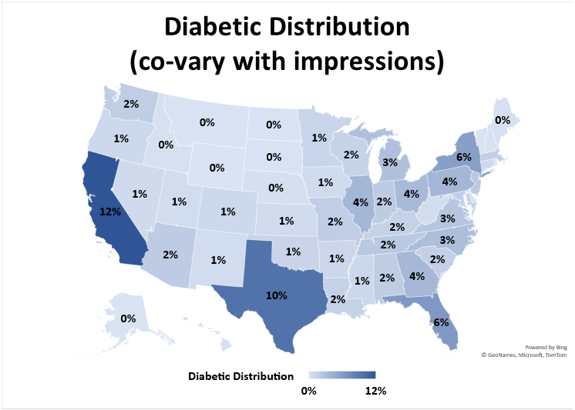
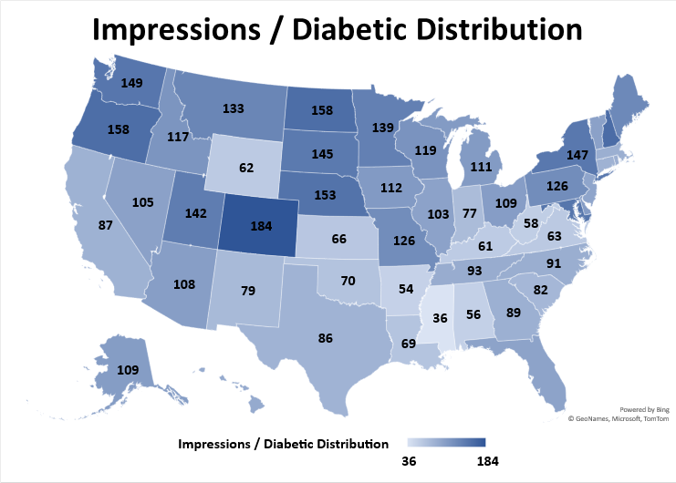
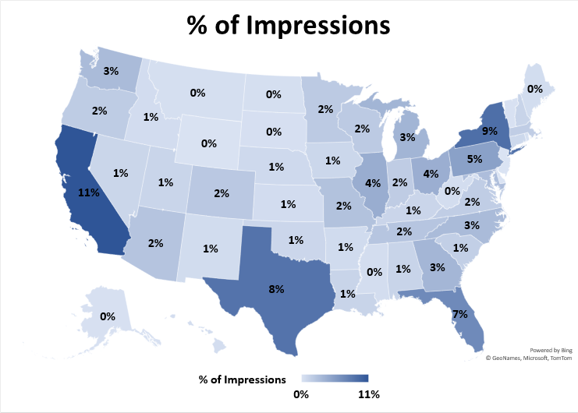
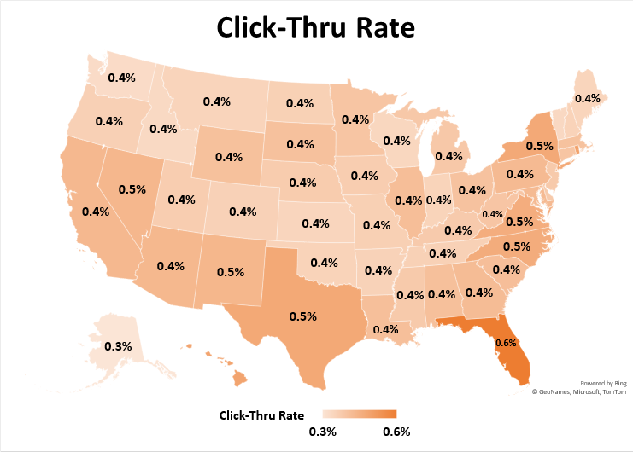
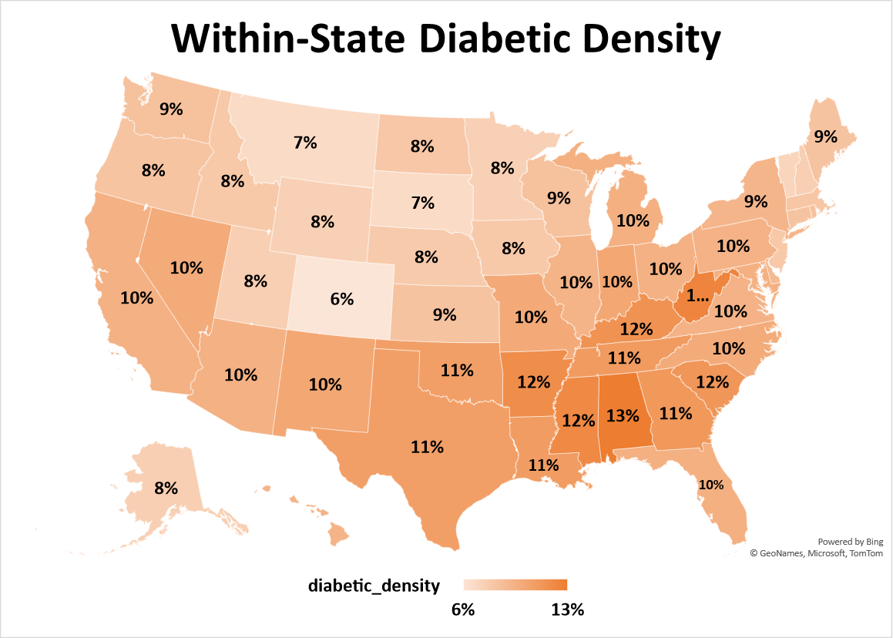
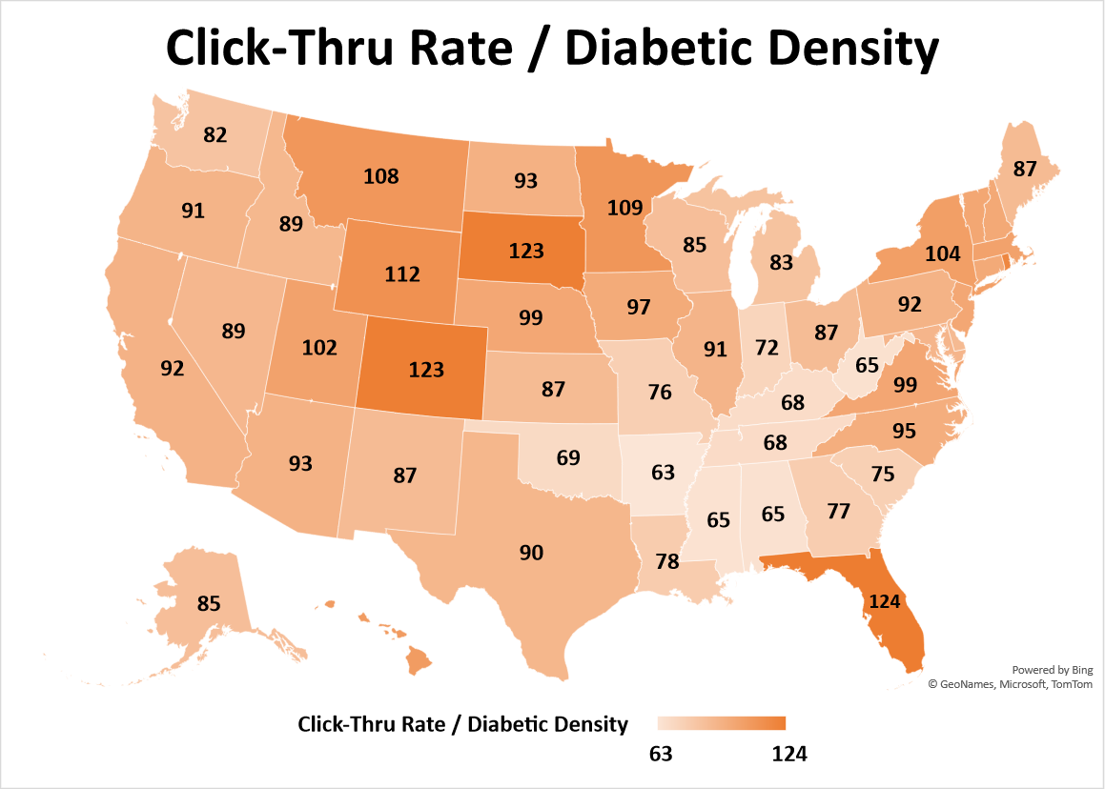
Media Impressions and Click-Thru Rates by Geography and Diabetic Populations
Impressions are properly targeted to the right diabetes populations. They are about uniformly distributed when indexing against the diabetes populations with slight over-indexing for the Upper Midwest and Northeast states.
As expected, conversion rates are higher for the states with higher diabetic population density. However again conversion rates appear to be over-indexing for the Upper Midwest, Northeast states and Florida.
Deeper analysis will be required to confirm/reject this observation and/or to determine if media strategies and tactics adjustments can optimize geography efficiencies.
* Engagement: all of the click-throughs.

Slide 6
Ad Volume and KPIs by Campaign, Creative, and Tactic/Program
There is significant variability in click performance by various ad dimensions.
The highest volume impression groups are not necessarily the highest performing from a click perspective.

Slide 7
Ad Volume and KPIs by Programmatic, Format, or Duration
The most common type of video ads are 60 second pre roll videos, which automatically plays directly before a featured video.
Programmatic video ads had the best click-thru rate.

Slide 8
Ad Volume and KPIs by Device or Publisher
Mobile devices or healthcare websites usually have higher click-thru rates.

Slide 9
Media Performance On Engaging Users
Media is effectively driving video ad engagement, but there are diminishing returns to repeated media impressions and there may be opportunities to:
Cap media impressions for users with more exposure or to prioritize impressions to users with less exposure.
Online TV Video ads may not be prioritizing click performance. Once it’s removed, we can see that both the survival and hazard curves steepen a bit more as expected.
* Click Probability (Hazard) is the number of cookies that clicked at the specific impression count over the total number of remaining cookies.
** Kaplan Meier Survival Curve is calculated over number of impressions.

Slide 10
Impression cap may not cause significant loss on overall engagement
If media impressions are capped, only a small number of users may be lost who would have clicked on the ads.
E.g., when impressions are capped at 7 per user, 56% of total impressions are served to achieve 86% of all potential unique clicks.
There are a lot of post-click (1st click) impressions. Deeper analysis is required to analyze its ROI on net new downstream conversions.
Overall, only ~31% of clicked users didn’t receive post-click impressions, but it’s less at 14% for users who first clicked at the 10th impression.
The more impressions were served before the 1st click, the more likely the users would receive more impressions.

Slide 11
Media Performance On Engaging Users
There are diminishing returns to repeated media impressions, but there may be opportunities to
Serve different media ads that are more engaging.
The majority of the users saw media ads from the same campaign or video format.
Click-thru rates * roughly doubled when media ads were different **.
Test sequencing of media by campaign or video format and engagement levels.
MCM or Pre Roll Plus video ads have the highest click-thru rate overall.
If MCM or Pre Roll Plus video ad is the second ad campaign exposed, the click-thru rate is higher.
* Click-thru rates are the number of cookies that had clicked over the total number of cookies.
** Media ads are the same or different from a campaign or format perspective. We also looked at it from a Creative perspective and found similar insight, which is not shown here with duplicated info.

Slide 12
Analysis of Journey Path Examples
There are 34 million unique journey paths for 147 million cookies with 1 billion ads defined by placement, campaign, creative, and publisher, and click behavior.
One of the best improvement opportunities may come from changing the creative of the ads.
Clicked User % | The 2nd Ad is different for only the dimension below
 | Any | Creative | Placement | Publisher | Campaign
Clicked User % Ratio when ads are different / same | 10 | 10 | 7.4 | 1.6 | 1.3
% of users with different ads by only | 77% | 44% | 44% | 4% | 5%
Different Ads: Clicked User % | 0.50% | 0.50% | 0.37% | 0.30% | 0.25%
Same Ads: Clicker User % | 0.05% | 0.05% | 0.05% | 0.19% | 0.19%
One journey path example (Path 1 below) * with different creatives
Clicked User % is 20 times higher than the counterpart path with the same creatives in both impressions.
Content 2
1.21% of users clicked.
Content 1
Path 1: Creative is different between 2 impressions.
Content 1
Path 2: Both impressions had the same ad.
0.06% of users clicked.
Impression 1
Impression 2
* p-value is < 0.00001. 0.06% = 34 clicks / 53722 impressions, and 1.21% = 355 / 29443. The sample size is one of the largest for journey paths with different creatives.
** Placement: Trulicity MCM_Video_2020_Accuen_Programmatic_dCPM_Cross Device_Preroll_LAL_TTD_Site Visits_:60_NA
Campaign: CY20 - CY20_Q1 - Q4_Diabetes Business Unit_Trulicity_MCM_OLV_ELO_MCM_174
Publisher: The Trade Desk
Creative in Content 1: Prog_LLTR0084000H_FoodTruck_SPA_60_Innovid
Creative in Content 2: Prog_LLTR0084000H_FoodTruck_SPA_60_Innovid HTML EV

Slide 13
Appendix
Initial Summary of Data
Changes and Trends
Time between Consecutive Impressions

Slide 14
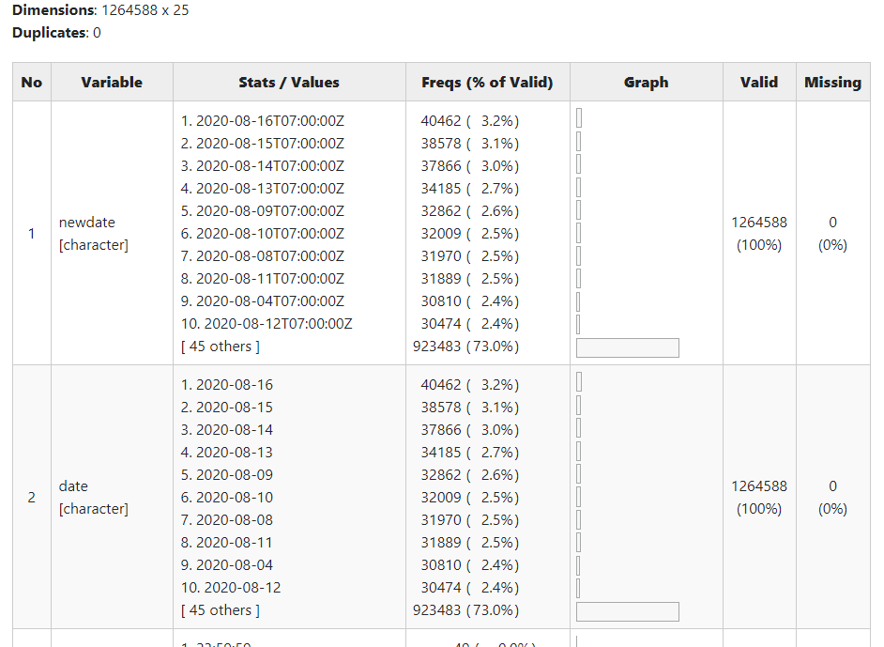
Initial Summary of the data
The data is unique per row by cookie, timestamp, creative id, channel id, unit of event, and placement.
Unit of event refers to impression, click, or a video complete.
Placement has information on campaign, publisher, format, etc.
There are a total of 3.5 billion records with about 25 columns of data after appending the metadata from 3/7/2020 to 10/3/2020.
The initial summary is based on a random sample of 1.26 million records.

Slide 15
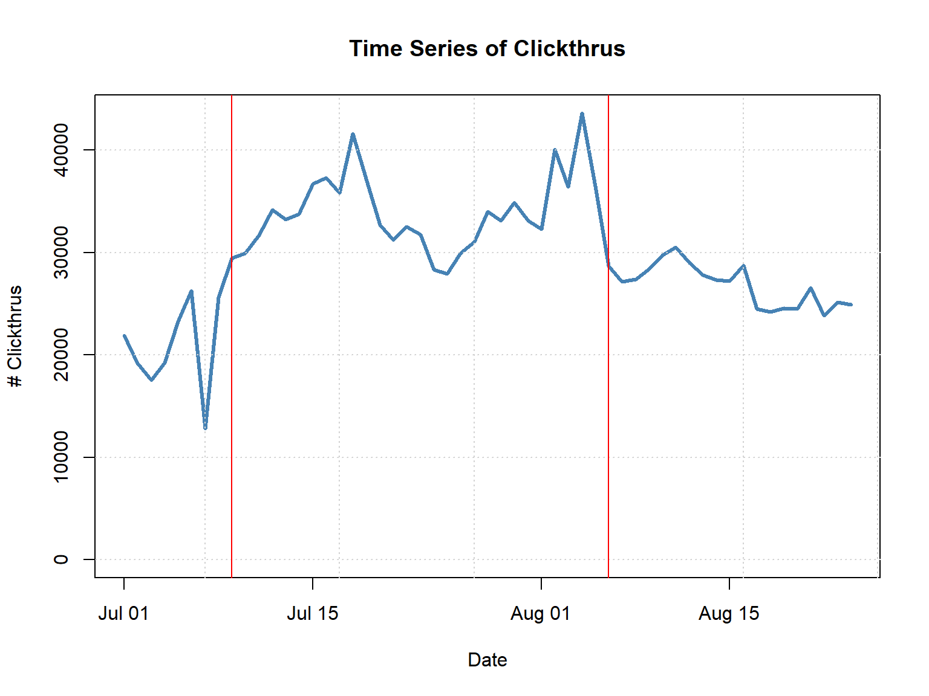
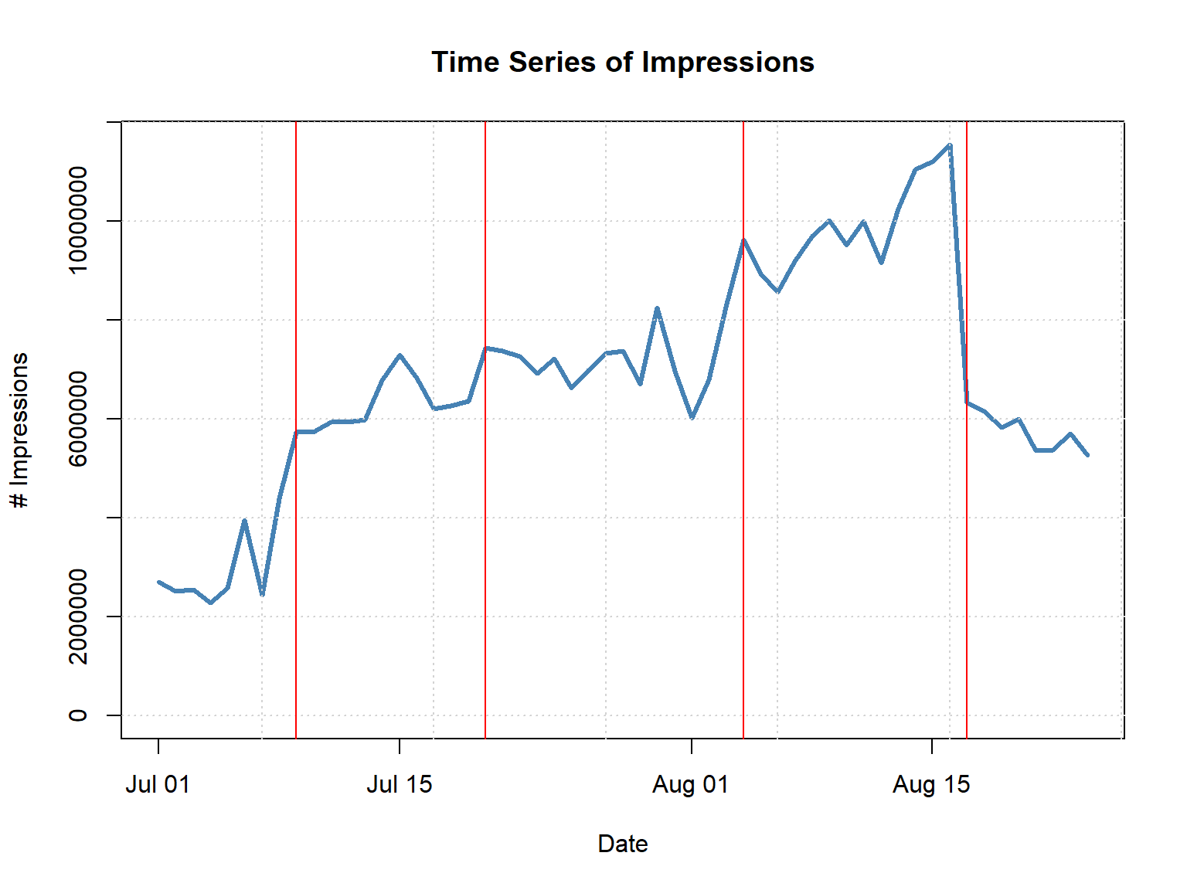
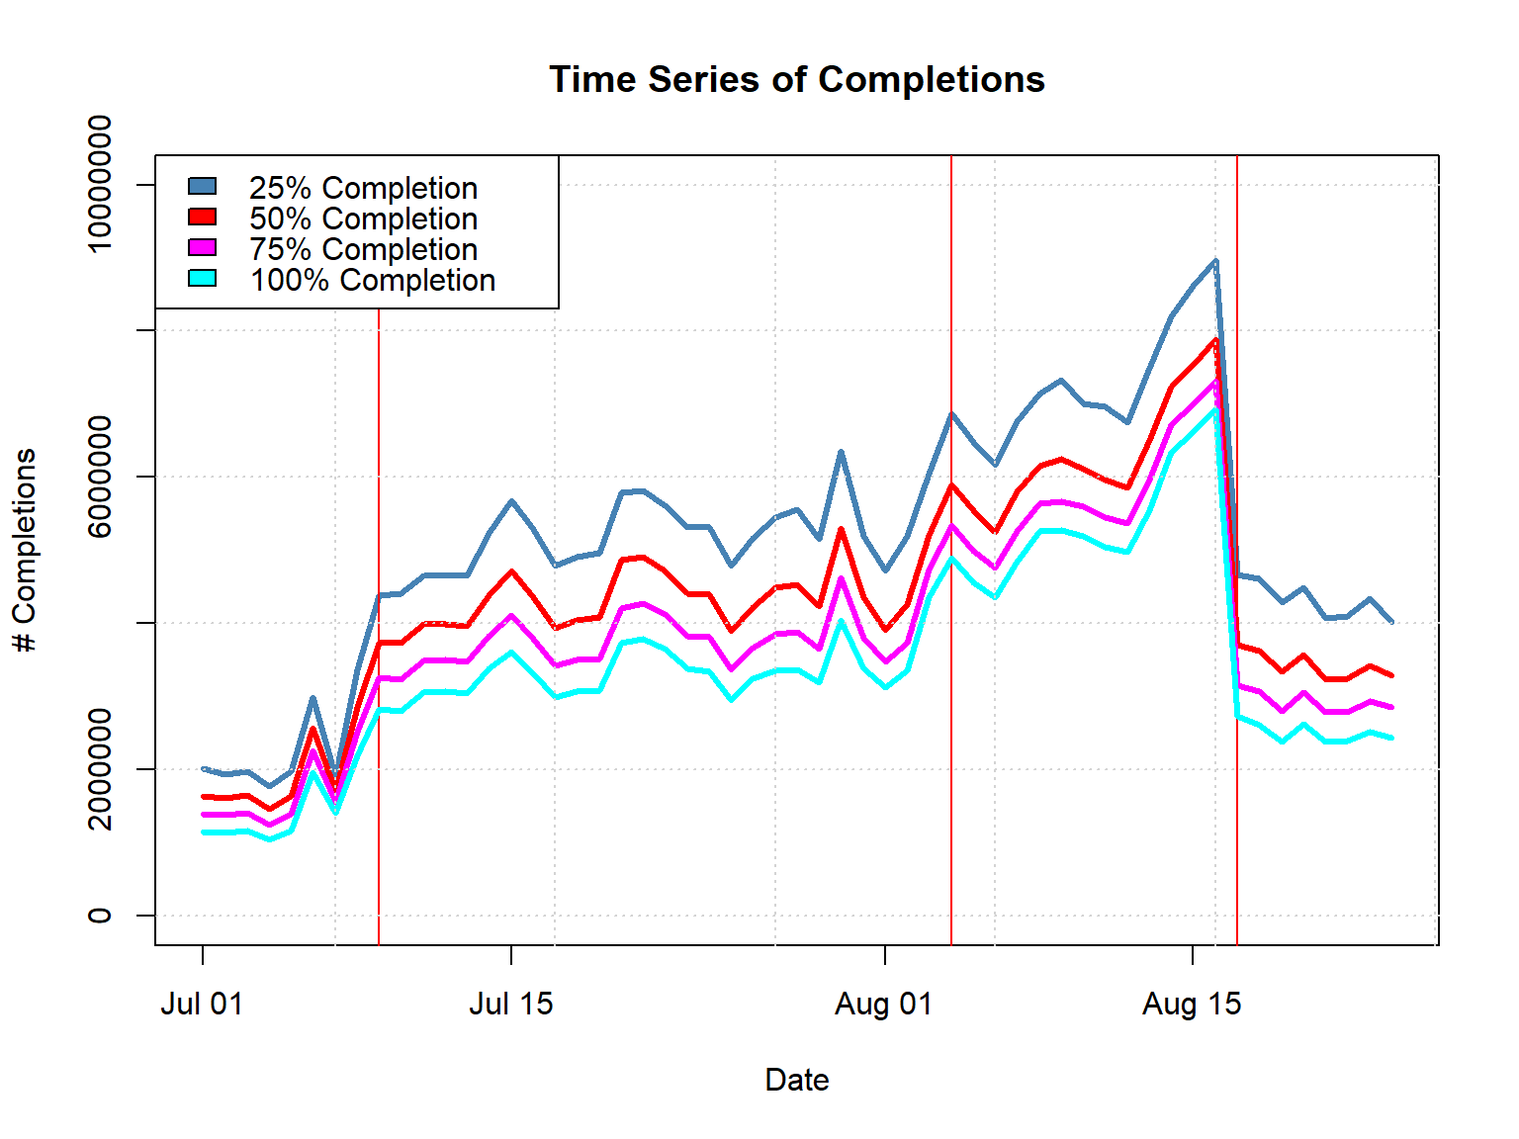
Changes and Trends
Daily impression volume and ad performance is generally consistent.
More data will help inform on any meaningful trends and/or seasonality in the data.
Change points are explored in the time series.*
* For the time series plots, we present change points (red vertical lines) that signify possible changes in the time series. This analysis does not identify the cause for those change points but suggests possible areas for investigation, or at least discussion with subject matter expert on configuration.

Slide 16
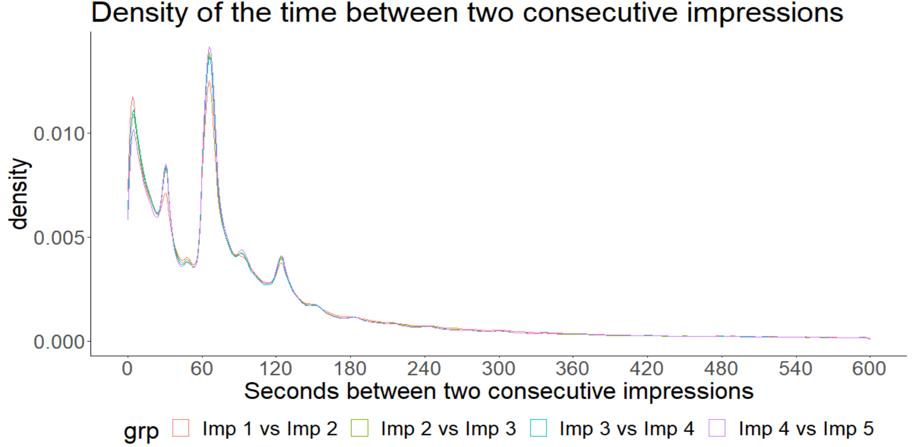
Time between consecutive impressions
Time between two impressions is usually < 5 minutes, but not always within the first few seconds. So the impressions may not need to be de-duped.
There are still a lot of impressions with much longer than 5 minutes in between them, with the median value at about 35 minutes.
The similar distribution of time between different consecutive impressions may suggest most of the journey touchpoints are memoryless regarding the time of the next impression.
& More

Slide 17
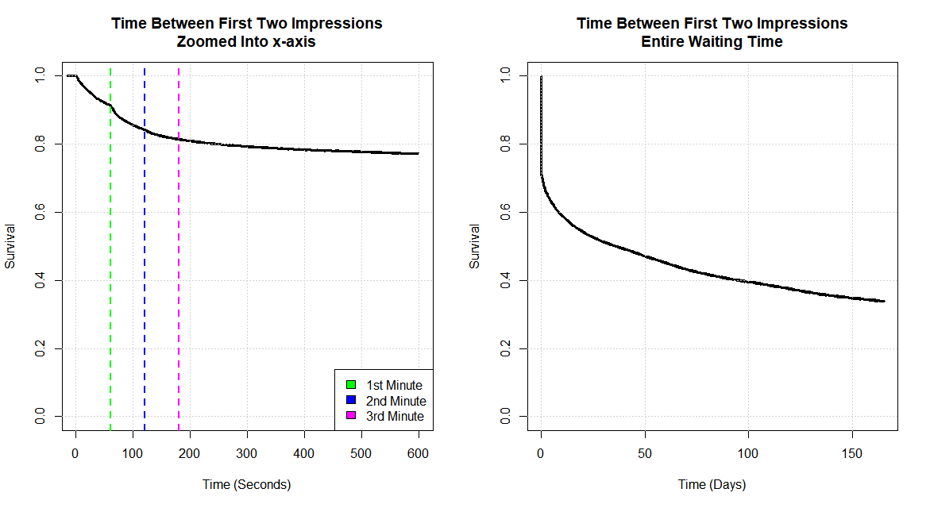
Time between consecutive impressions
The survival curve of the time between the first two impressions shows the same story as in the density curve.
The survival curve over the entire waiting time shows that a lot of users returned after a few days or longer.

