Slide 1
Welcome to STAT 201!
Vincenzo Coia
January 11, 2021

Slide 2
Teaching Team
Instructors:
Vincenzo Coia, PhD
Rodolfo Lourenzutti, PhD
Teaching Assistants:
Creagh Briercliffe
(TBD)

Slide 3
Syllabus
Find on Canvas
Deadlines and how you will be evaluated.
How to engage with the course:
- Monday, Wednesday, Friday (optional).
- Piazza
- Need to meet with an instructor in private? Send us an email!

Slide 4
Idea behind the course
Imagine:
A radio station wants to know the median age of their listeners.
You survey some listeners, calculate the median, and present the number.
What’s the problem with this?

Slide 5
Idea behind the course
Science: present results and communicate uncertainty / evidence.
Question:
What aspects of uncertainty might you present with your results?

Slide 6
Idea behind the course
This course is about providing evidence behind your calculated results, especially by communicating uncertainty in your numeric estimates.
univariate samples
calculating mean, proportion, quantile, etc. to infer about a population.
Two-group comparisons leads to more advanced courses (like STAT 301)

Slide 7
This Week: Sampling

Slide 8
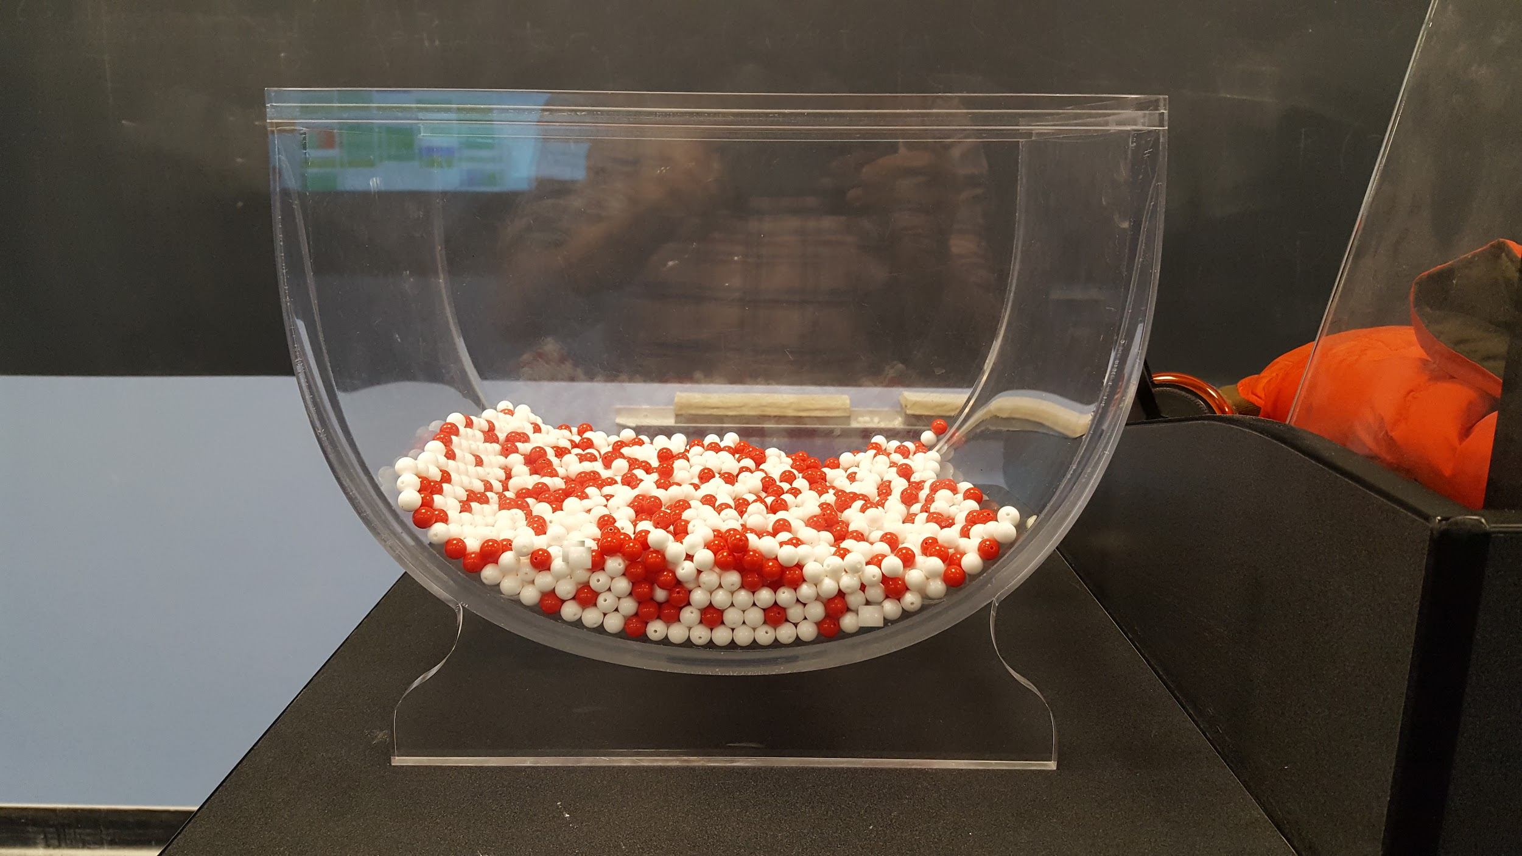
Population
Image from Modern Dive Chapter 7

Slide 9
Population
Population parameter: proportion of red beads
Image from Modern Dive Chapter 7

Slide 10
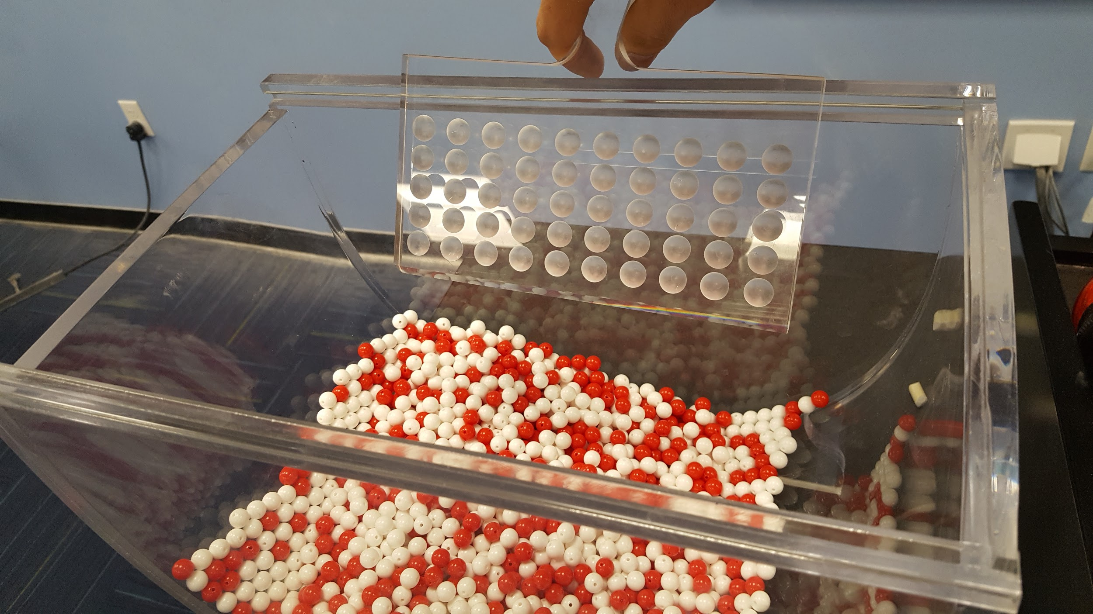
Sampling
Image from Modern Dive Chapter 7

Slide 11
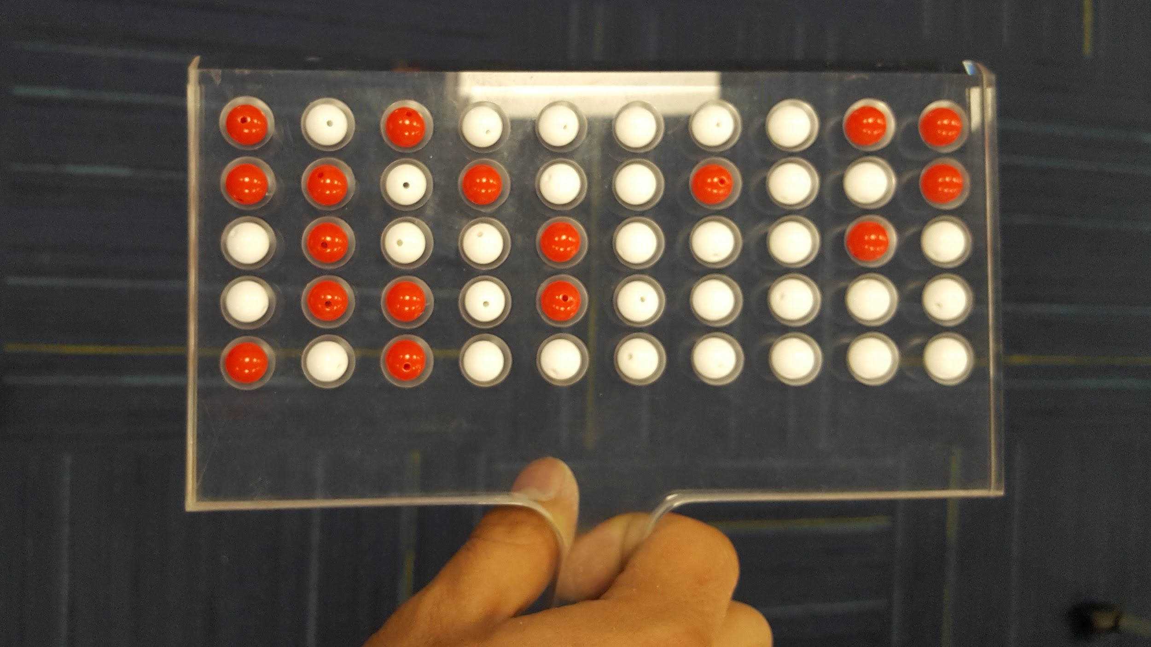
Sample
Image from Modern Dive Chapter 7

Slide 12
Sample
Point Estimate = 17 / 50 = 0.34
Image from Modern Dive Chapter 7

Slide 13
Sample
Observation
Point Estimate = 17 / 50 = 0.34
Image from Modern Dive Chapter 7

Slide 14
Worksheet 1
I'll demonstrate concepts by working through Worksheet 1 (access through canvas)
Let's get you started with opening the worksheet.

