Slide 1

Capstone Project
IBM Certification

Slide 2

Introduction
We will find an optimal location for a restaurant in Etobicoke
We will use our data science powers to generate a few most promising neighborhoods

Slide 3

Data
Based on definition of our problem, factors that will influence our decision are:
Number of existing restaurants in the neighbourhood (any type of restaurant)
Some characteristics of neighbourhoods

Slide 4
Data
Based on definition of our problem, factors that will influence our decision are:
Number of existing restaurants in the neighbourhood (any type of restaurant)
Some characteristics of neighbourhoods
Following data sources will be needed to:
Extract/generate the required data by scraping it from the following website: https://en.wikipedia.org/wiki/List_of_postal_codes_of_Canada:_M
Transform and treat the scraped data
Know the number of restaurants and their type and location in every neighbourhood using Foursquare API

Slide 5
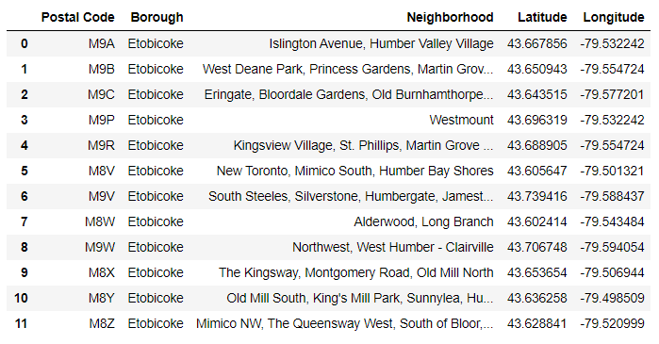
Scraping and transforming data

Slide 6
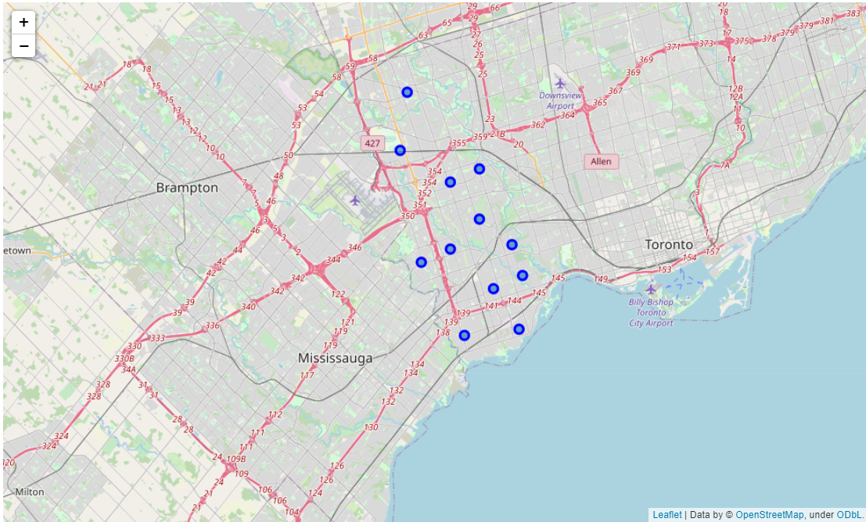
Scraping and transforming data

Slide 7
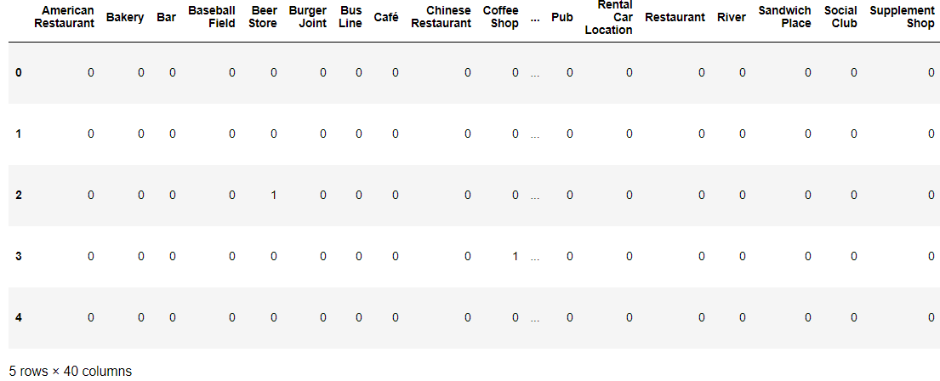
Dummies and scoring

Slide 8
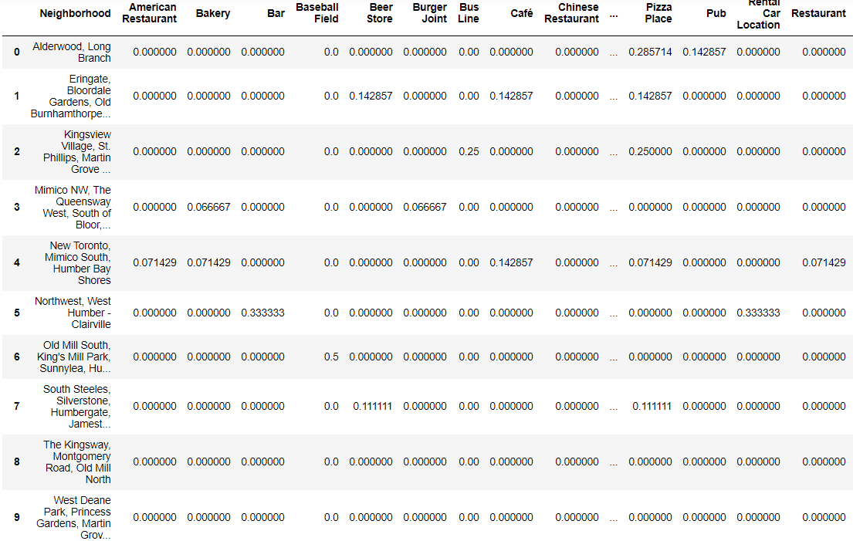
Dummies and scoring

Slide 9
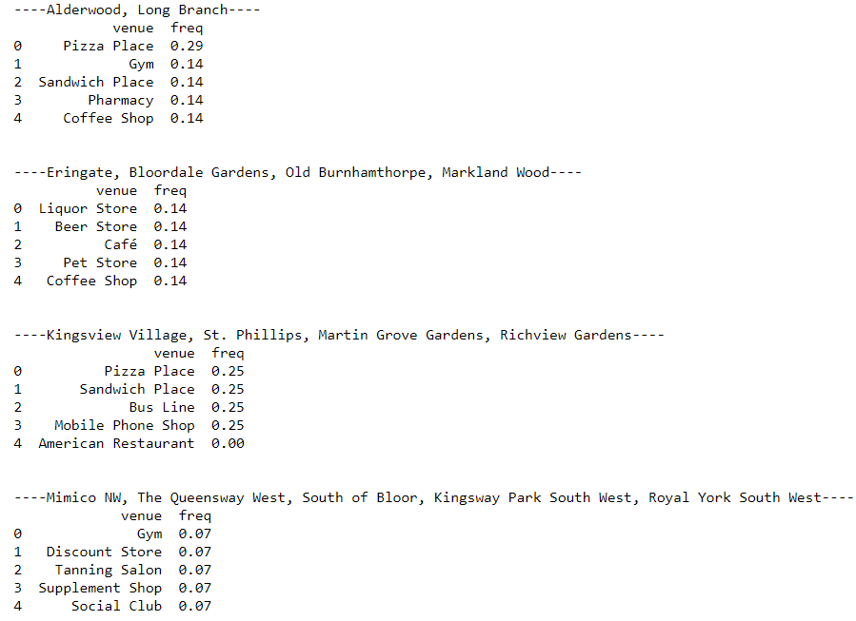
Ranking neighborhoods

Slide 10
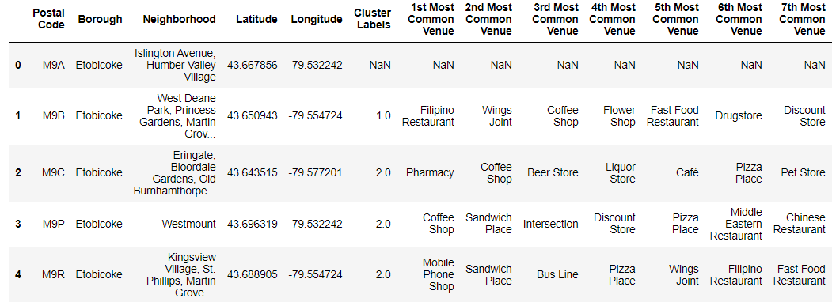
Clustering

Slide 11
Conclusion
This project was great for the following reasons:
It helped me to learn new notions
I practiced what I learnt in IBM courses
I saw a practical way of using data scienc

