Slide 1
B
A
C
ELEC5620 · STAGE 1 · MON 10-12 GROUP 14
AI Trip Planner
D
E
A one-person AI travel agency: seven AI roles plan a trip together, one human runs the company.
A
Ziqi He
B
Tingsong Jin
C
Yi Qiao
D
Jiahang Bian
E
Weihao Wang
Orchestrator
Itinerary and transport
Accommodation and budget
Destination and dining
Workspace and memory
Notes:
Hi, we are Group 14 from the Monday 10 to 12 class, and this is AI Trip Planner, a one-person AI travel agency.

Slide 2



THE PROBLEM
Every travel choice constrains the others
Too many sites
Chatbots invent facts
Our answer
Flights, hotels, maps, food blogs and a budget spreadsheet, each on its own.
One model writes a nice itinerary with made-up prices, and never checks that the parts fit.
Specialist agents plan together on real data, and code checks their work.
AI Trip Planner
AI Trip Planner · ELEC5620 Stage 1 · Mon 10-12 Group 14
02 / 24
Notes:
Planning a trip means juggling many sites, and every choice constrains the others. A chatbot can write an itinerary, but it invents prices and never checks that the parts fit. So we built an agency where specialist agents plan together on real data, and code checks their work.

Slide 3









USERS AND AI ROLES
Two humans, seven AI roles
HUMANS
AI ROLES
Travel Coordinator
Chats with the traveller, builds the TripBrief, asks for missing facts
Traveller
Planning Supervisor
Picks which specialists each step needs
Describes the trip, reads and edits the plan
FIVE SPECIALISTS
Founder / operator
Itinerary
Transport
Accommodation
Destination
Dining
Runs the agency: models, providers, quotas, Agent Lab
Day plan, route checks
Flights, rail, local routes
Stays, room allocation
Sights, customs, packing
Venues, dietary needs
AI Trip Planner · ELEC5620 Stage 1 · Mon 10-12 Group 14
03 / 24
Notes:
There are two humans: the traveller, our customer, and the founder who runs the agency and tests the agents in our Agent Lab. Then seven AI roles: a coordinator that talks to the traveller, a supervisor that assigns work, and five specialists, each with its own prompt and tools.

Slide 4
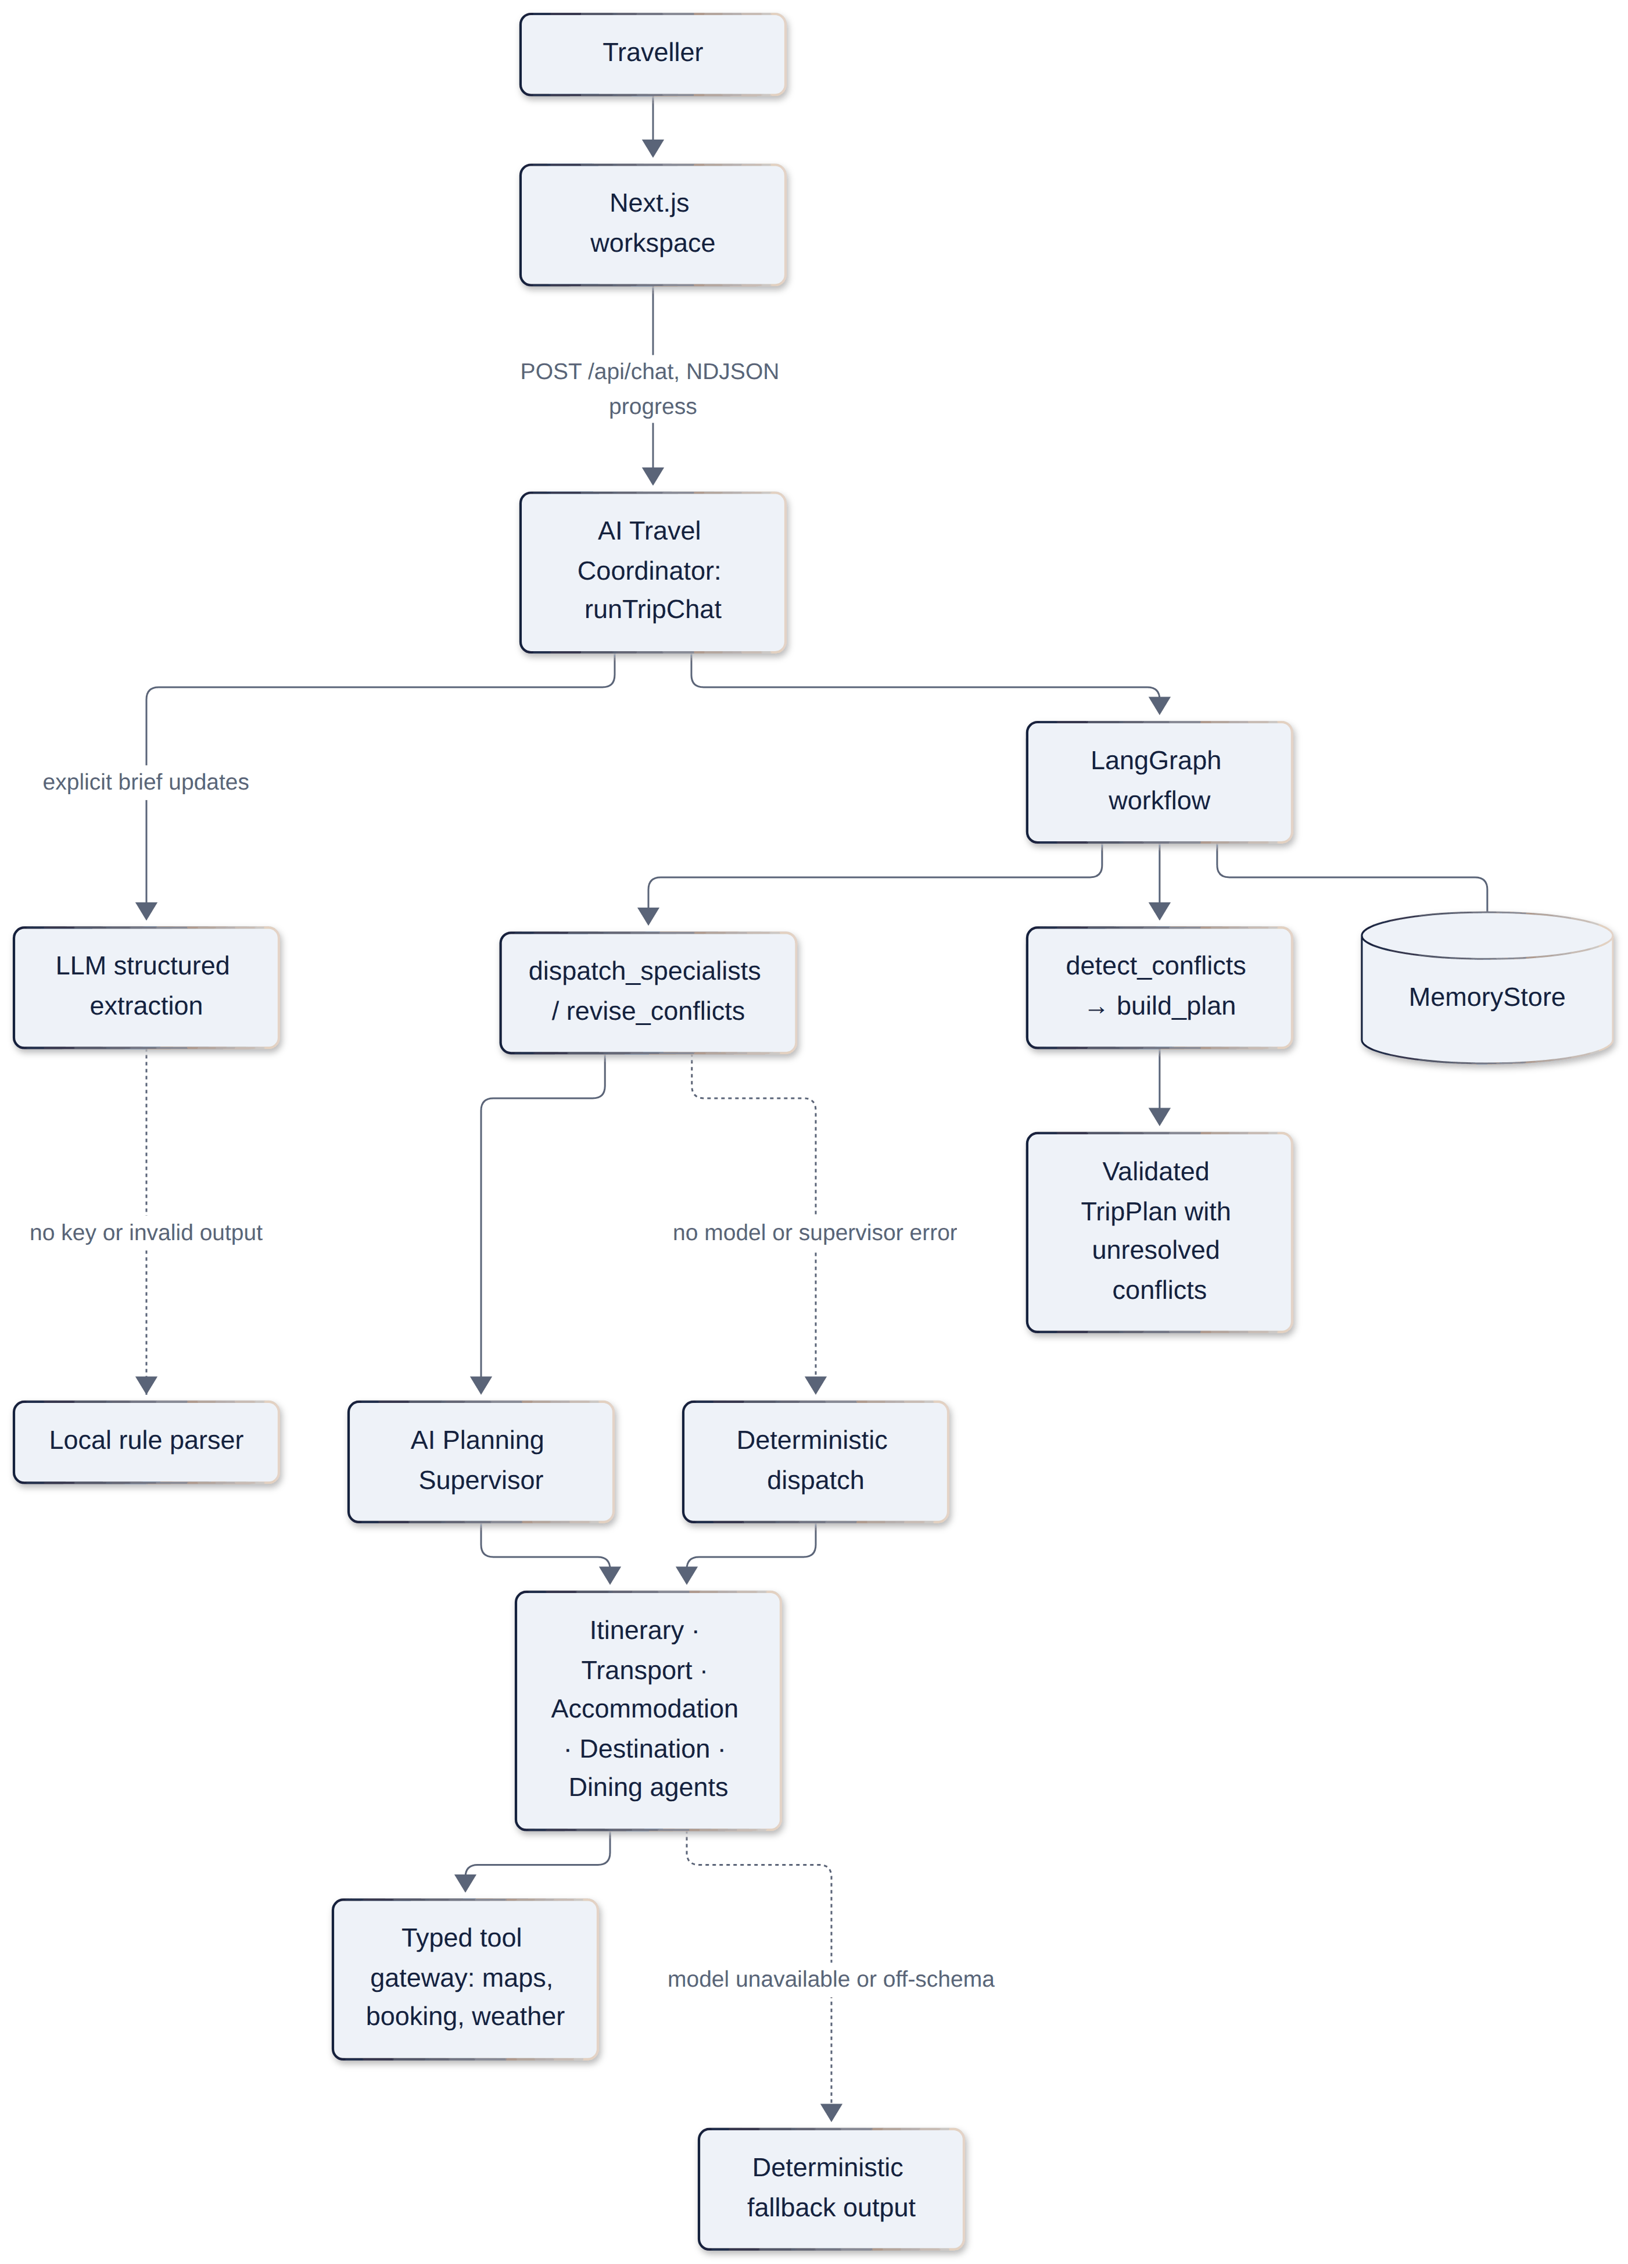
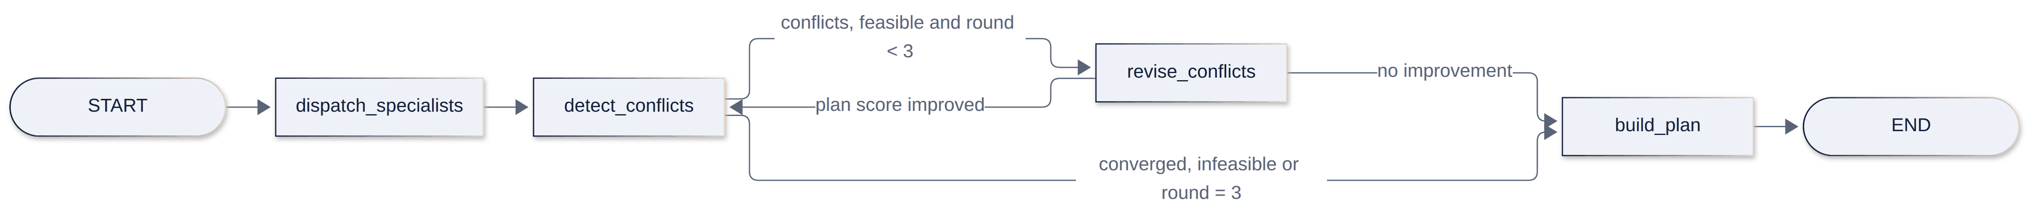
ARCHITECTURE
The graph drives the agents, not the other way round
LANGGRAPH WORKFLOW
REQUEST PATH
1
2
3
1
Plan in stages
Transport, then accommodation, then itinerary and dining, all on one shared board.
2
Code finds conflicts
Budget, time and route conflicts are detected in code, not by a model.
3
Targeted revision
Only the agents involved revise, at most three rounds, kept only if the plan improves.
AI Trip Planner · ELEC5620 Stage 1 · Mon 10-12 Group 14
04 / 24
Notes:
Our key design choice: the LangGraph workflow drives the agents, not the other way round. Specialists plan in stages on a shared board, code detects budget, time and route conflicts, and only the agents involved revise, for at most three rounds. If a model fails, a validated fallback keeps planning working.

Slide 5
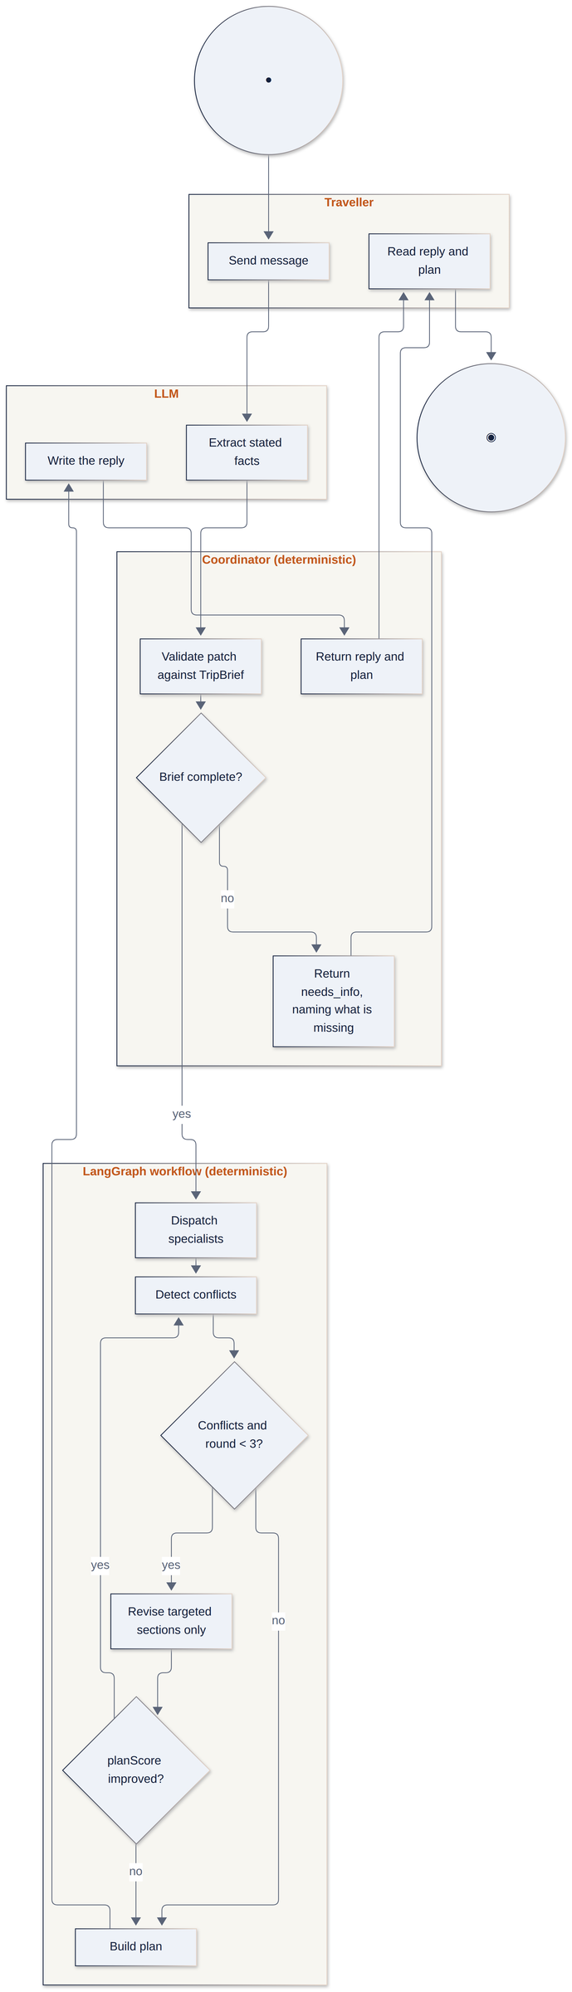
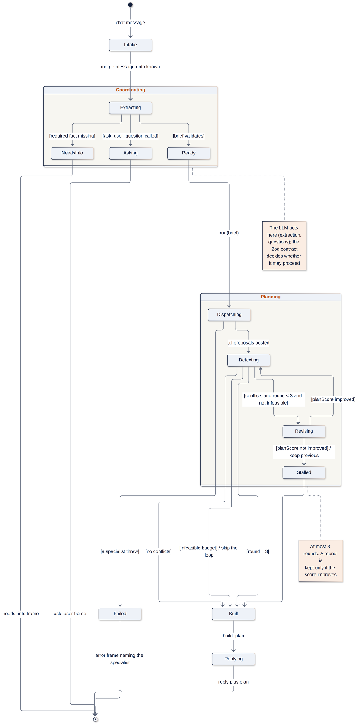
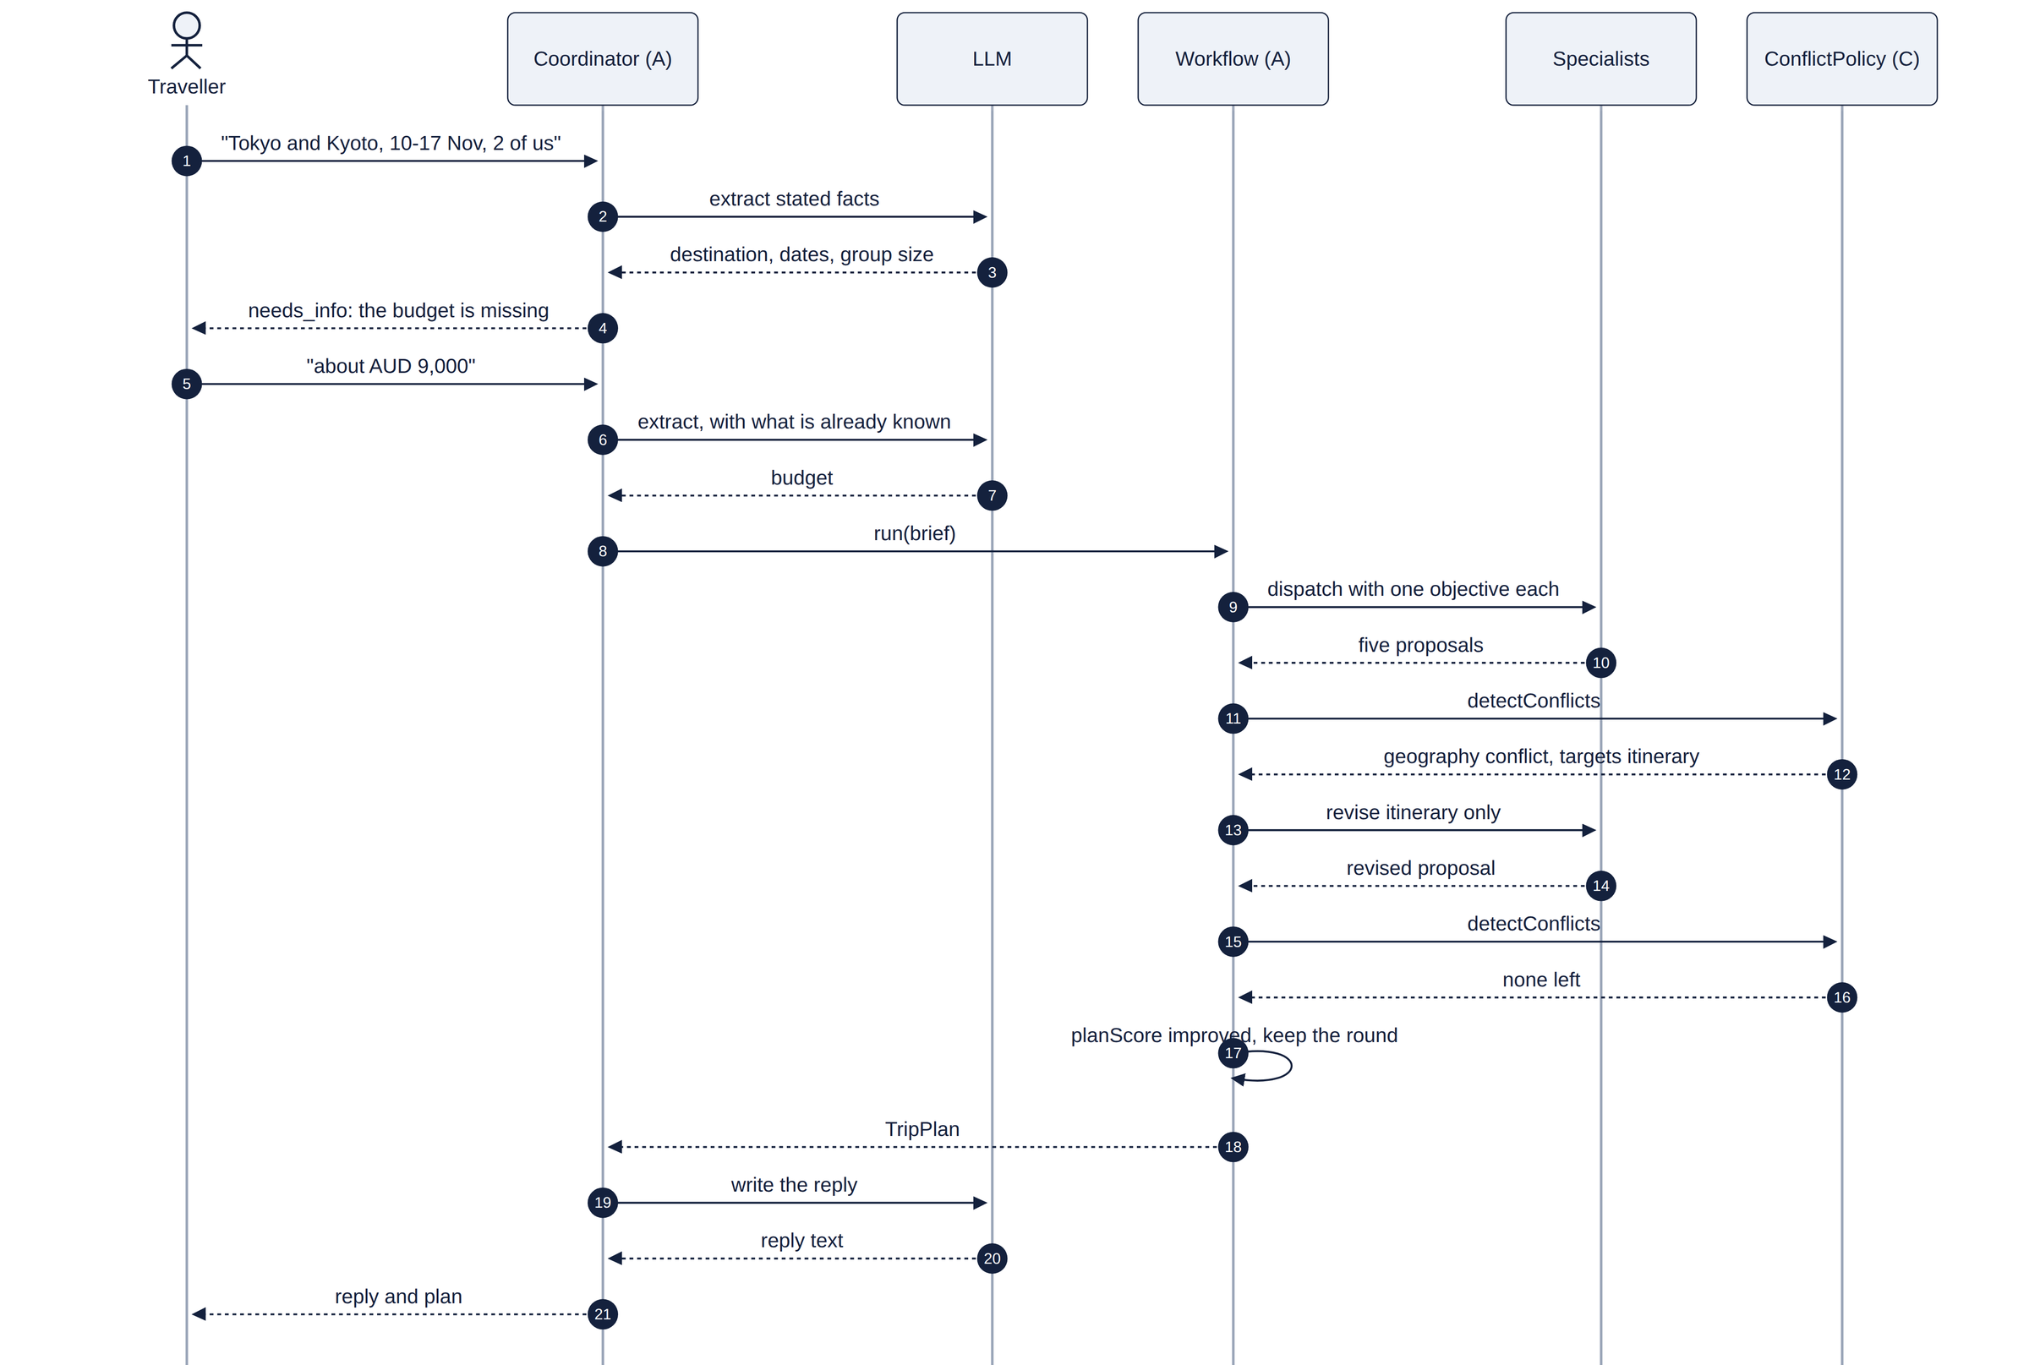
INDIVIDUAL BEHAVIOUR MODELS · UC-A1
Three LLM calls, each fenced by code
Ad hoc requirement AH-A1: understand my one-line request; ask once if something is missing; fix clashes Use case UC-A1 Generate Itinerary
ACTIVITY
SEQUENCE
STATE MACHINE
AI Trip Planner · ELEC5620 Stage 1 · Mon 10-12 Group 14
05 / 24
Notes:
UC-A1 turns one free-text message into a validated plan. The LLM acts three times: it extracts the stated facts, the supervisor delegates to specialists, and it writes the reply. Code fences each step: the Zod contract validates the brief, a missing fact ends the turn with one question instead of a default, and at most three revision rounds run, each kept only if the plan score improves.

Slide 6

REQUIREMENT CLASSIFICATION
Each member owns two core features and one optional
CORE FEATURE 1
CORE FEATURE 2
OPTIONAL
A
Ziqi He
Brief extraction and clarifying questions
Orchestration, revision routing, round control
Agent Lab and Failure Lab
B
Tingsong Jin
Itinerary with route feasibility
Flights, rail and local transport
Traveller-chosen leg mode
C
Yi Qiao
Accommodation, individual or group
Budget management
Keep a booked stay
D
Jiahang Bian
Destination guide
Dining with dietary needs
Weather-based packing
E
Weihao Wang
Chat, timeline and map editing
Preferences and memory
Accounts and cloud sync
Models choose,
code decides.
Agreed scope: a single-user planner with AUD estimates; no booking or payment. No invented prices, no relaxed preferences.
AI Trip Planner · ELEC5620 Stage 1 · Mon 10-12 Group 14
06 / 24
Notes:
We classified requirements into the agreed scope, mandatory capabilities and optional features. Each member owns two core features and one optional one, shown here. Every member also wrote an ad hoc requirement and broke it into functional, non-functional and constraint requirements.

Slide 7







FEATURE MODEL
Seven feature groups with their constraints
Conversation
Multi-agent planning
Specialist roles
Budget
● Chat intake
● Brief extraction
⊕ LLM | rule parser
● Clarifying questions
○ Attachments
● Supervisor delegation
● Staged planning board
● Conflict detection
⊗ budget, time, geography, infeasible
● Targeted revision ≤ 3
● Itinerary ● Dining
● Transport
○ Traveller arranges flights
● Accommodation
⊕ shared | individual ○ booked
● Destination ○ packing
● Cost roll-up in AUD
● Stage allocation
● Minimum-cost floor
Evidence & tools
Workspace
Memory
Notation
● mandatory ○ optional
⊕ exactly one ⊗ one or more
Constraints
Revision requires conflict detection; infeasible budget requires the floor; live providers require keys.
⊕ Live providers | mock fixtures
● Provenance labels
⊕ Timeline | map
● Plan editing
● Preferences & filters
○ Accounts & cloud sync
○ Agent Lab
● Session chat history
● Long-term preferences
⊕ Redis REST | in-process
Non-functional: schema checks at every boundary · money in integer cents · a provenance label on every section
AI Trip Planner · ELEC5620 Stage 1 · Mon 10-12 Group 14
07 / 24
Notes:
The feature diagram groups the system into seven areas, with mandatory, optional and alternative features, such as shared or individual rooms. We added cross-tree constraints and attached non-functional requirements, like money in integer cents.

Slide 8
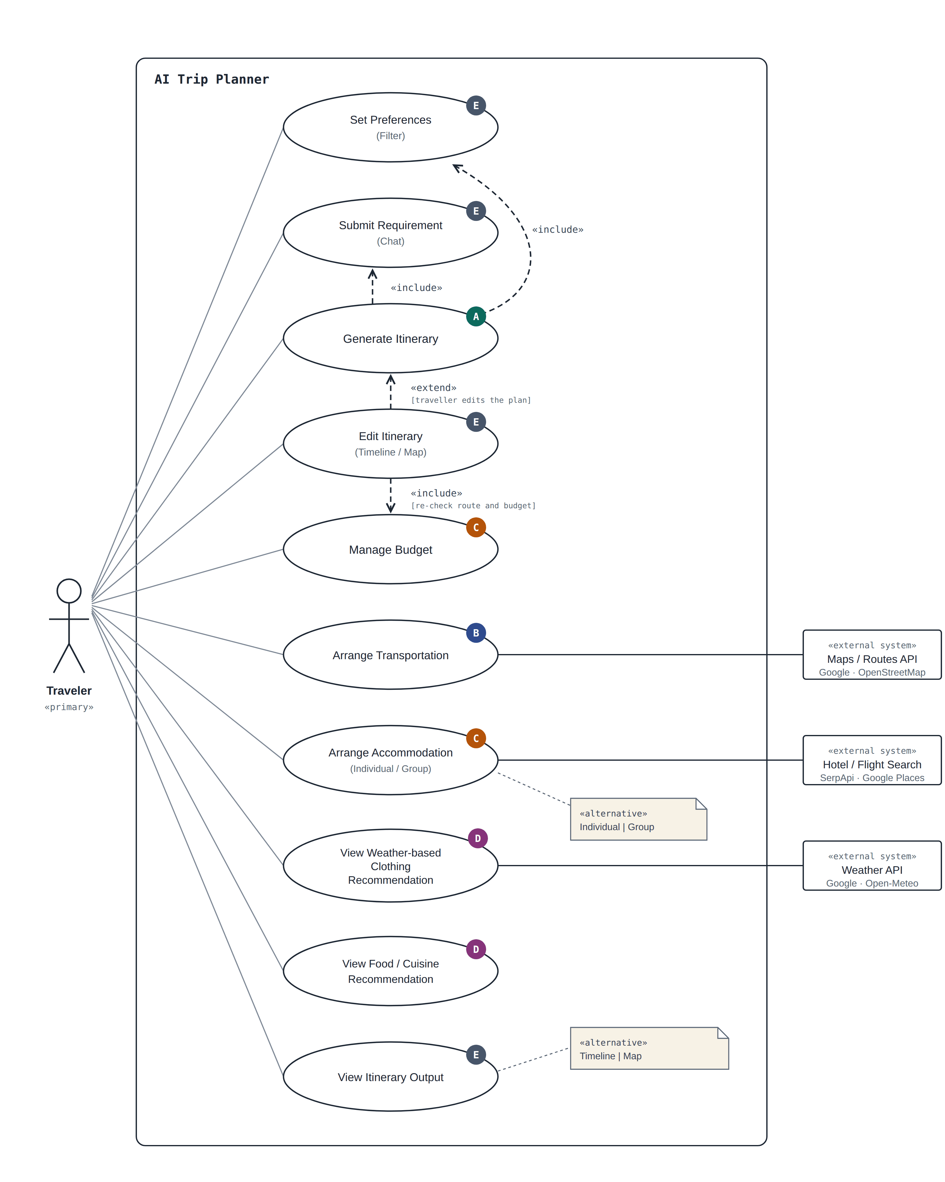
USE CASES
Ten use cases, one traveller, three external systems
WHO OWNS WHICH USE CASE
A
Generate Itinerary
«include» three use cases
B
Arrange Transportation
Maps / Routes API
C
Arrange Accommodation
Hotel search
C
Manage Budget
«extend» Edit Itinerary
D
Weather clothing advice
Weather API
D
Food recommendation
E
Set Preferences · Submit Requirement · Edit · View
AI Trip Planner · ELEC5620 Stage 1 · Mon 10-12 Group 14
08 / 24
Notes:
The use case diagram has one traveller and three external systems. Each member wrote at least one full specification, and our behaviour diagrams come from those.

Slide 9
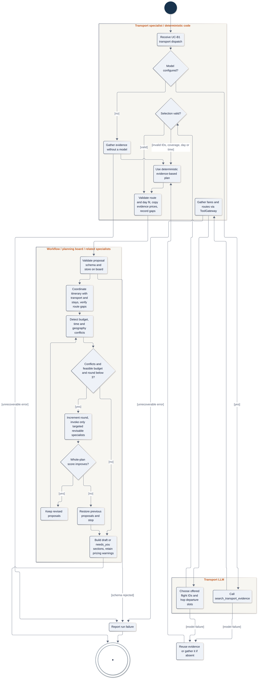
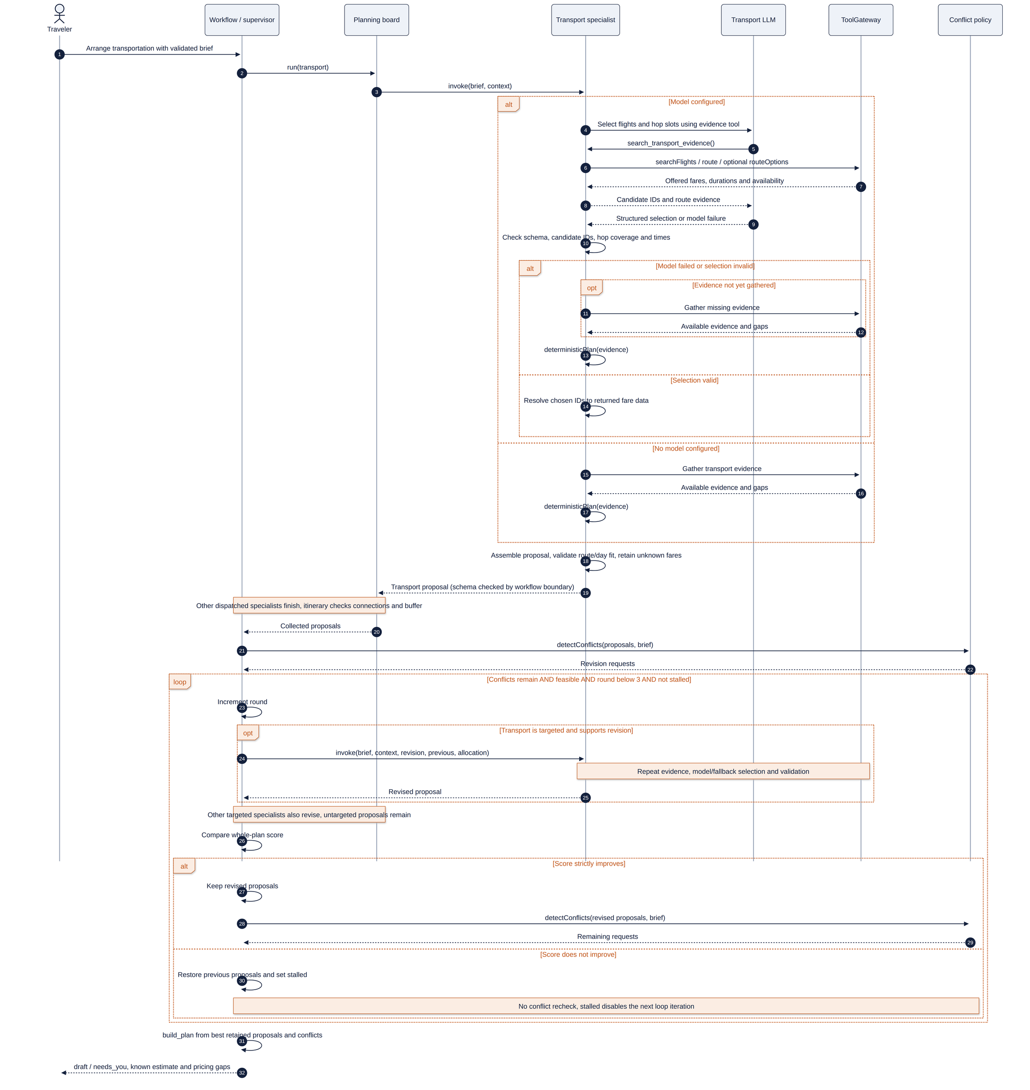
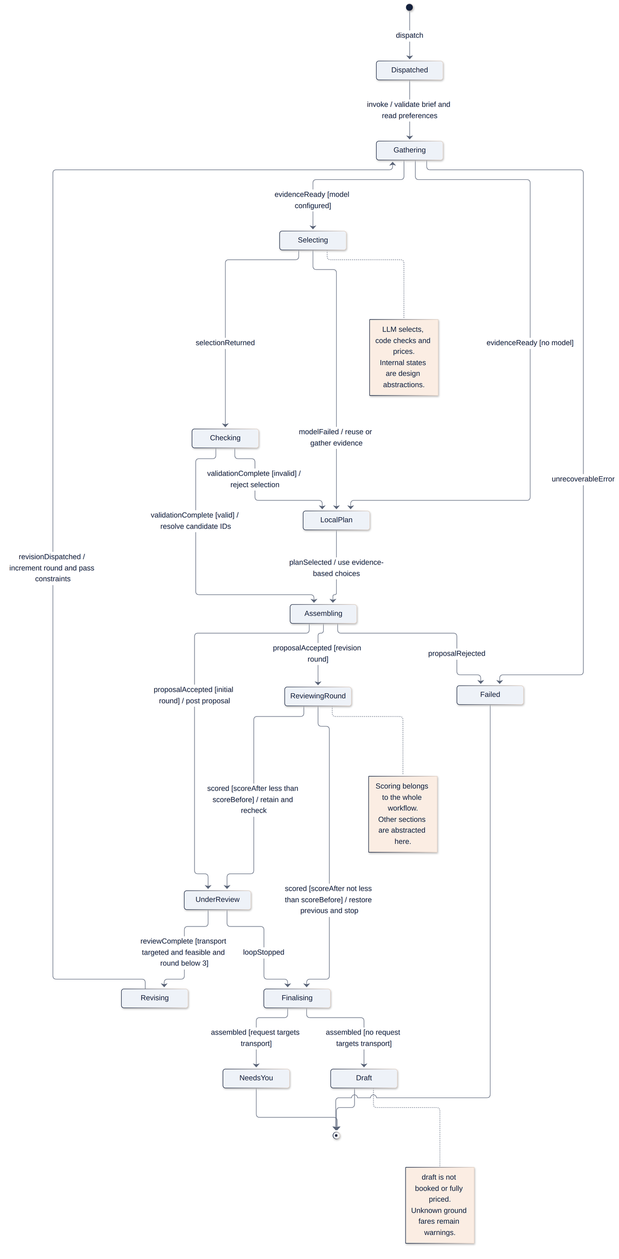
INDIVIDUAL BEHAVIOUR MODELS · UC-B1
The LLM picks offered fares; code checks every hop
Ad hoc requirement AH-B1: use real fares and times; honour my train choice or say it is unavailable Use case UC-B1 Arrange Transportation
ACTIVITY
SEQUENCE
STATE MACHINE
AI Trip Planner · ELEC5620 Stage 1 · Mon 10-12 Group 14
09 / 24
Notes:
UC-B1 arranges flights and moves between cities. The transport LLM only selects offered flight ids and a departure slot for each hop. Code then checks every choice against the evidence, one fare per hop, day bounds and route fit, and takes prices and durations from the providers. A missing fare stays unknown, never free, and an invalid choice falls back to a deterministic plan.

Slide 10



ACCOMMODATION AND BUDGET
From one ad hoc requirement to two use cases
Flights get paid first, so the hotel has to fit in whatever money is left. If the trip ends up over budget, swap the hotel for a cheaper one that still meets my rules. If no hotel can ever fit, tell me the minimum I'd need.
AH-C1, in the traveller's words
UC-C1 Arrange Accommodation
UC-C2 Manage Budget
Rooms from party size
Roll up costs in AUD
Filter by rating and free cancellation
Spread an overrun over what each section can still cut
LLM picks one candidate id
Revise only the sections asked to save
Code validates and prices it in cents
Report the minimum budget when nothing fits
AI Trip Planner · ELEC5620 Stage 1 · Mon 10-12 Group 14
10 / 24
Notes:
Member C owns accommodation and budget. The ad hoc requirement: the hotel must fit the money left after flights, a budget overrun should swap to a cheaper hotel that still meets the traveller's rules, and an impossible budget should name the minimum. That gave two use cases.

Slide 11
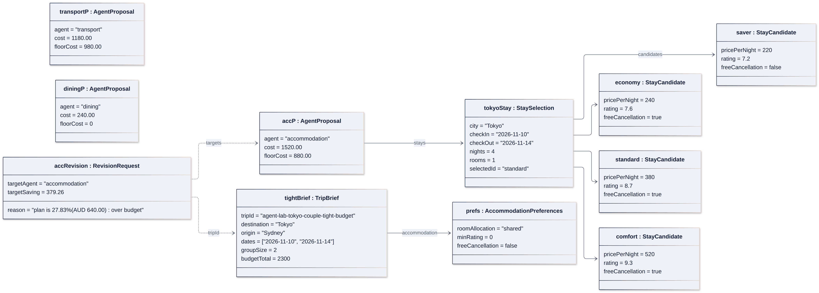
COMPLEX STRUCTURE
Object diagram: a Tokyo trip that is AUD 640 over budget
3
2
1
1
Budget vs total
2
Accommodation asked to save
3
Hotel moves
AUD 2,300 vs 2,940
AUD 379.26
standard → saver
over by AUD 640
overrun spread by room to cut
AUD 1,520 → AUD 880
AI Trip Planner · ELEC5620 Stage 1 · Mon 10-12 Group 14
11 / 24
Notes:
The object diagram snapshots the planning board for a Tokyo trip that is 640 dollars over budget. The hotel prices are real fixture values; transport and dining are illustrative. Accommodation is asked to save 379 dollars, so it moves to the saver hotel.

Slide 12
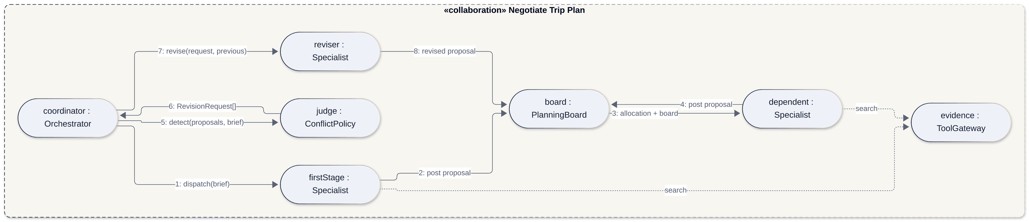
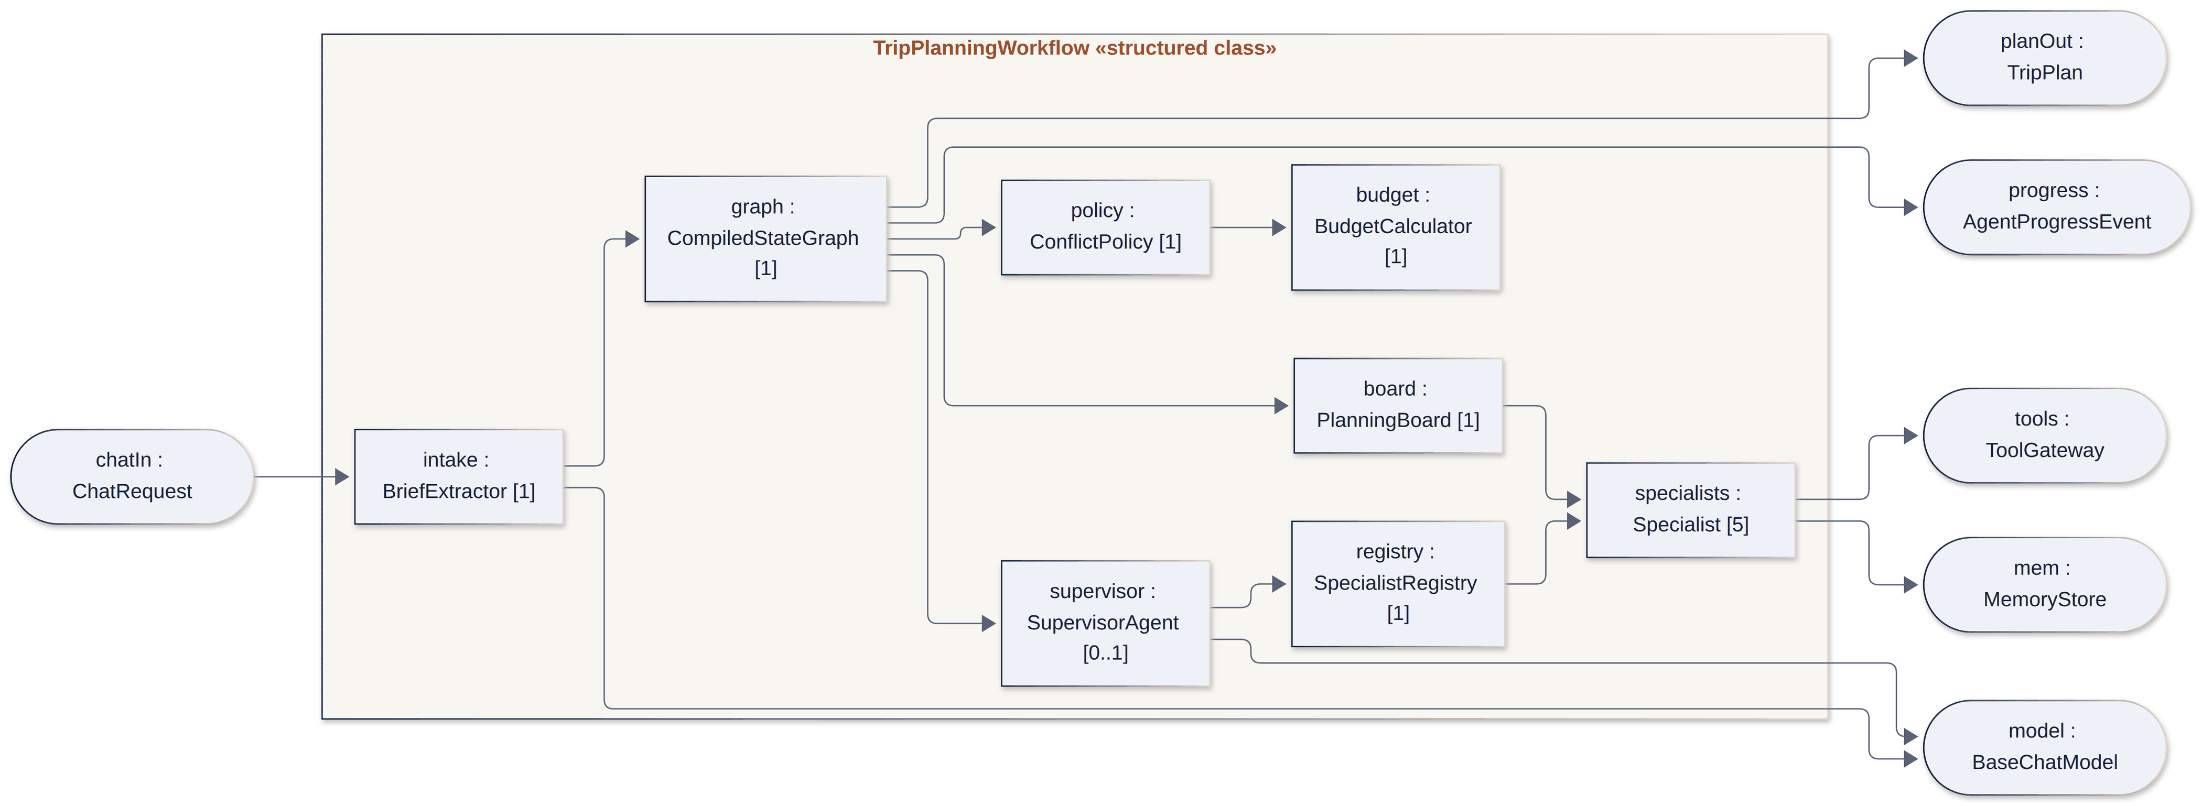
COMPLEX STRUCTURE
Collaboration and structured class
COLLABORATION · NEGOTIATE TRIP PLAN
1
Roles, not classes
My budget code plays the judge: it turns proposals into targeted revision requests.
1
2
Parts with multiplicity
The policy and budget calculator are parts of the workflow, one of each.
STRUCTURED CLASS · TRIPPLANNINGWORKFLOW
3
2
3
Injected ports
Plan, progress, tools, memory and model enter only through ports, so tests swap them.
AI Trip Planner · ELEC5620 Stage 1 · Mon 10-12 Group 14
12 / 24
Notes:
The collaboration shows roles, not classes: the budget code plays the judge that turns proposals into targeted revisions. The structured class shows the workflow's parts and its injected ports.

Slide 13
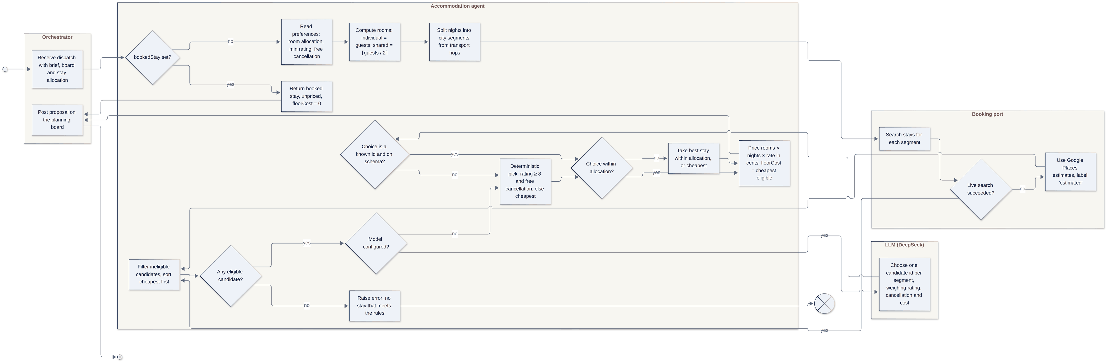
ACTIVITY DIAGRAM · UC-C1
The LLM chooses once; code checks before any price
3
2
4
1
1
LLM, once
Chooses one candidate id per stay.
2
Guarded
Unknown id or off-schema output falls back to a deterministic pick.
3
Booked stay
Skips the search entirely.
4
Priced in cents
Plus the cheapest eligible total as the floor.
AI Trip Planner · ELEC5620 Stage 1 · Mon 10-12 Group 14
13 / 24
Notes:
In this activity diagram the LLM appears once, choosing one candidate id. Around it everything is deterministic: invalid output falls back to a rule, a booked stay skips the search, and prices are in cents.

Slide 14
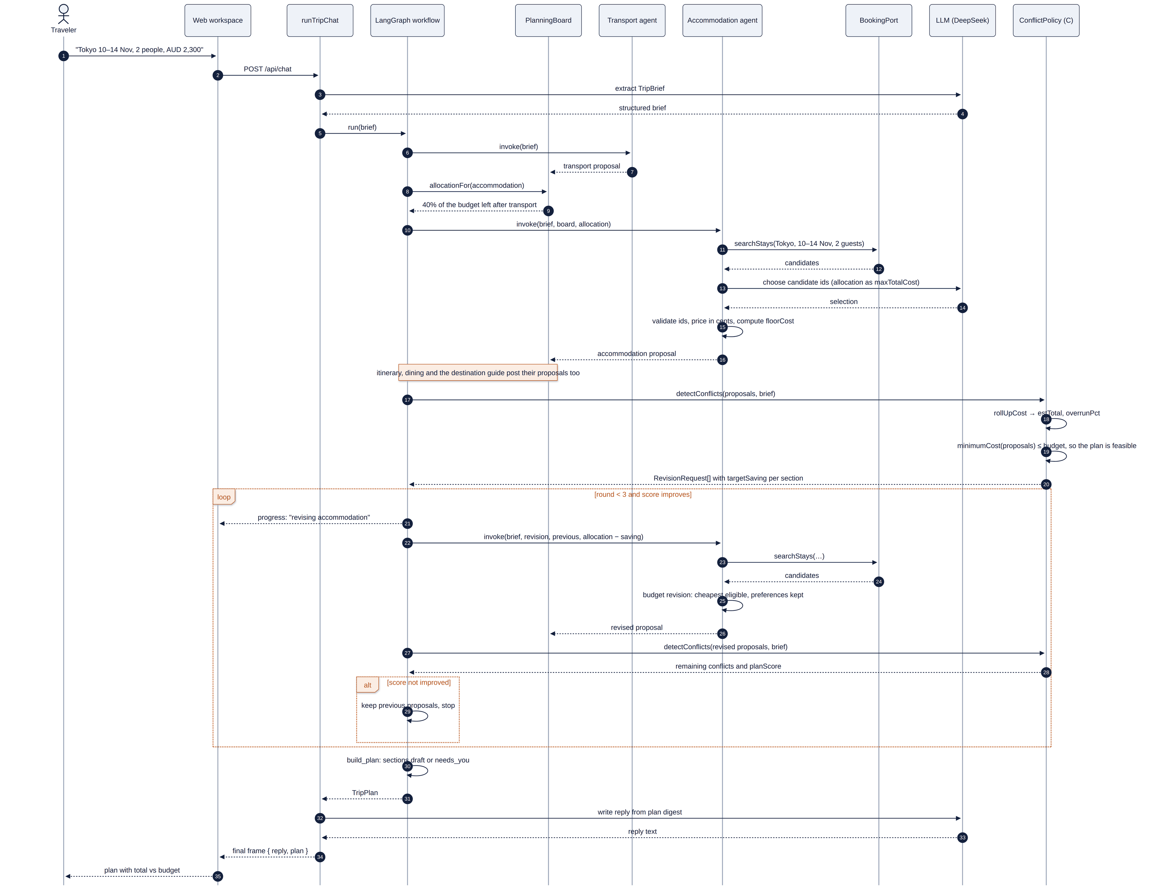
SEQUENCE DIAGRAM · UC-C2
Budget overrun and a targeted revision
1
Round 1
The total is over budget.
2
detectConflicts
Sends a revision request with a target saving.
1
2
3
Round 2
Only the targeted agents revise.
3
4
4
Kept only if better
Otherwise the previous proposals stay. Infeasible: one conflict naming the minimum budget.
AI Trip Planner · ELEC5620 Stage 1 · Mon 10-12 Group 14
14 / 24
Notes:
The sequence diagram shows an overrun: detectConflicts sends a revision only to the agents that can cut, and round two is kept only because the plan score improved.

Slide 15
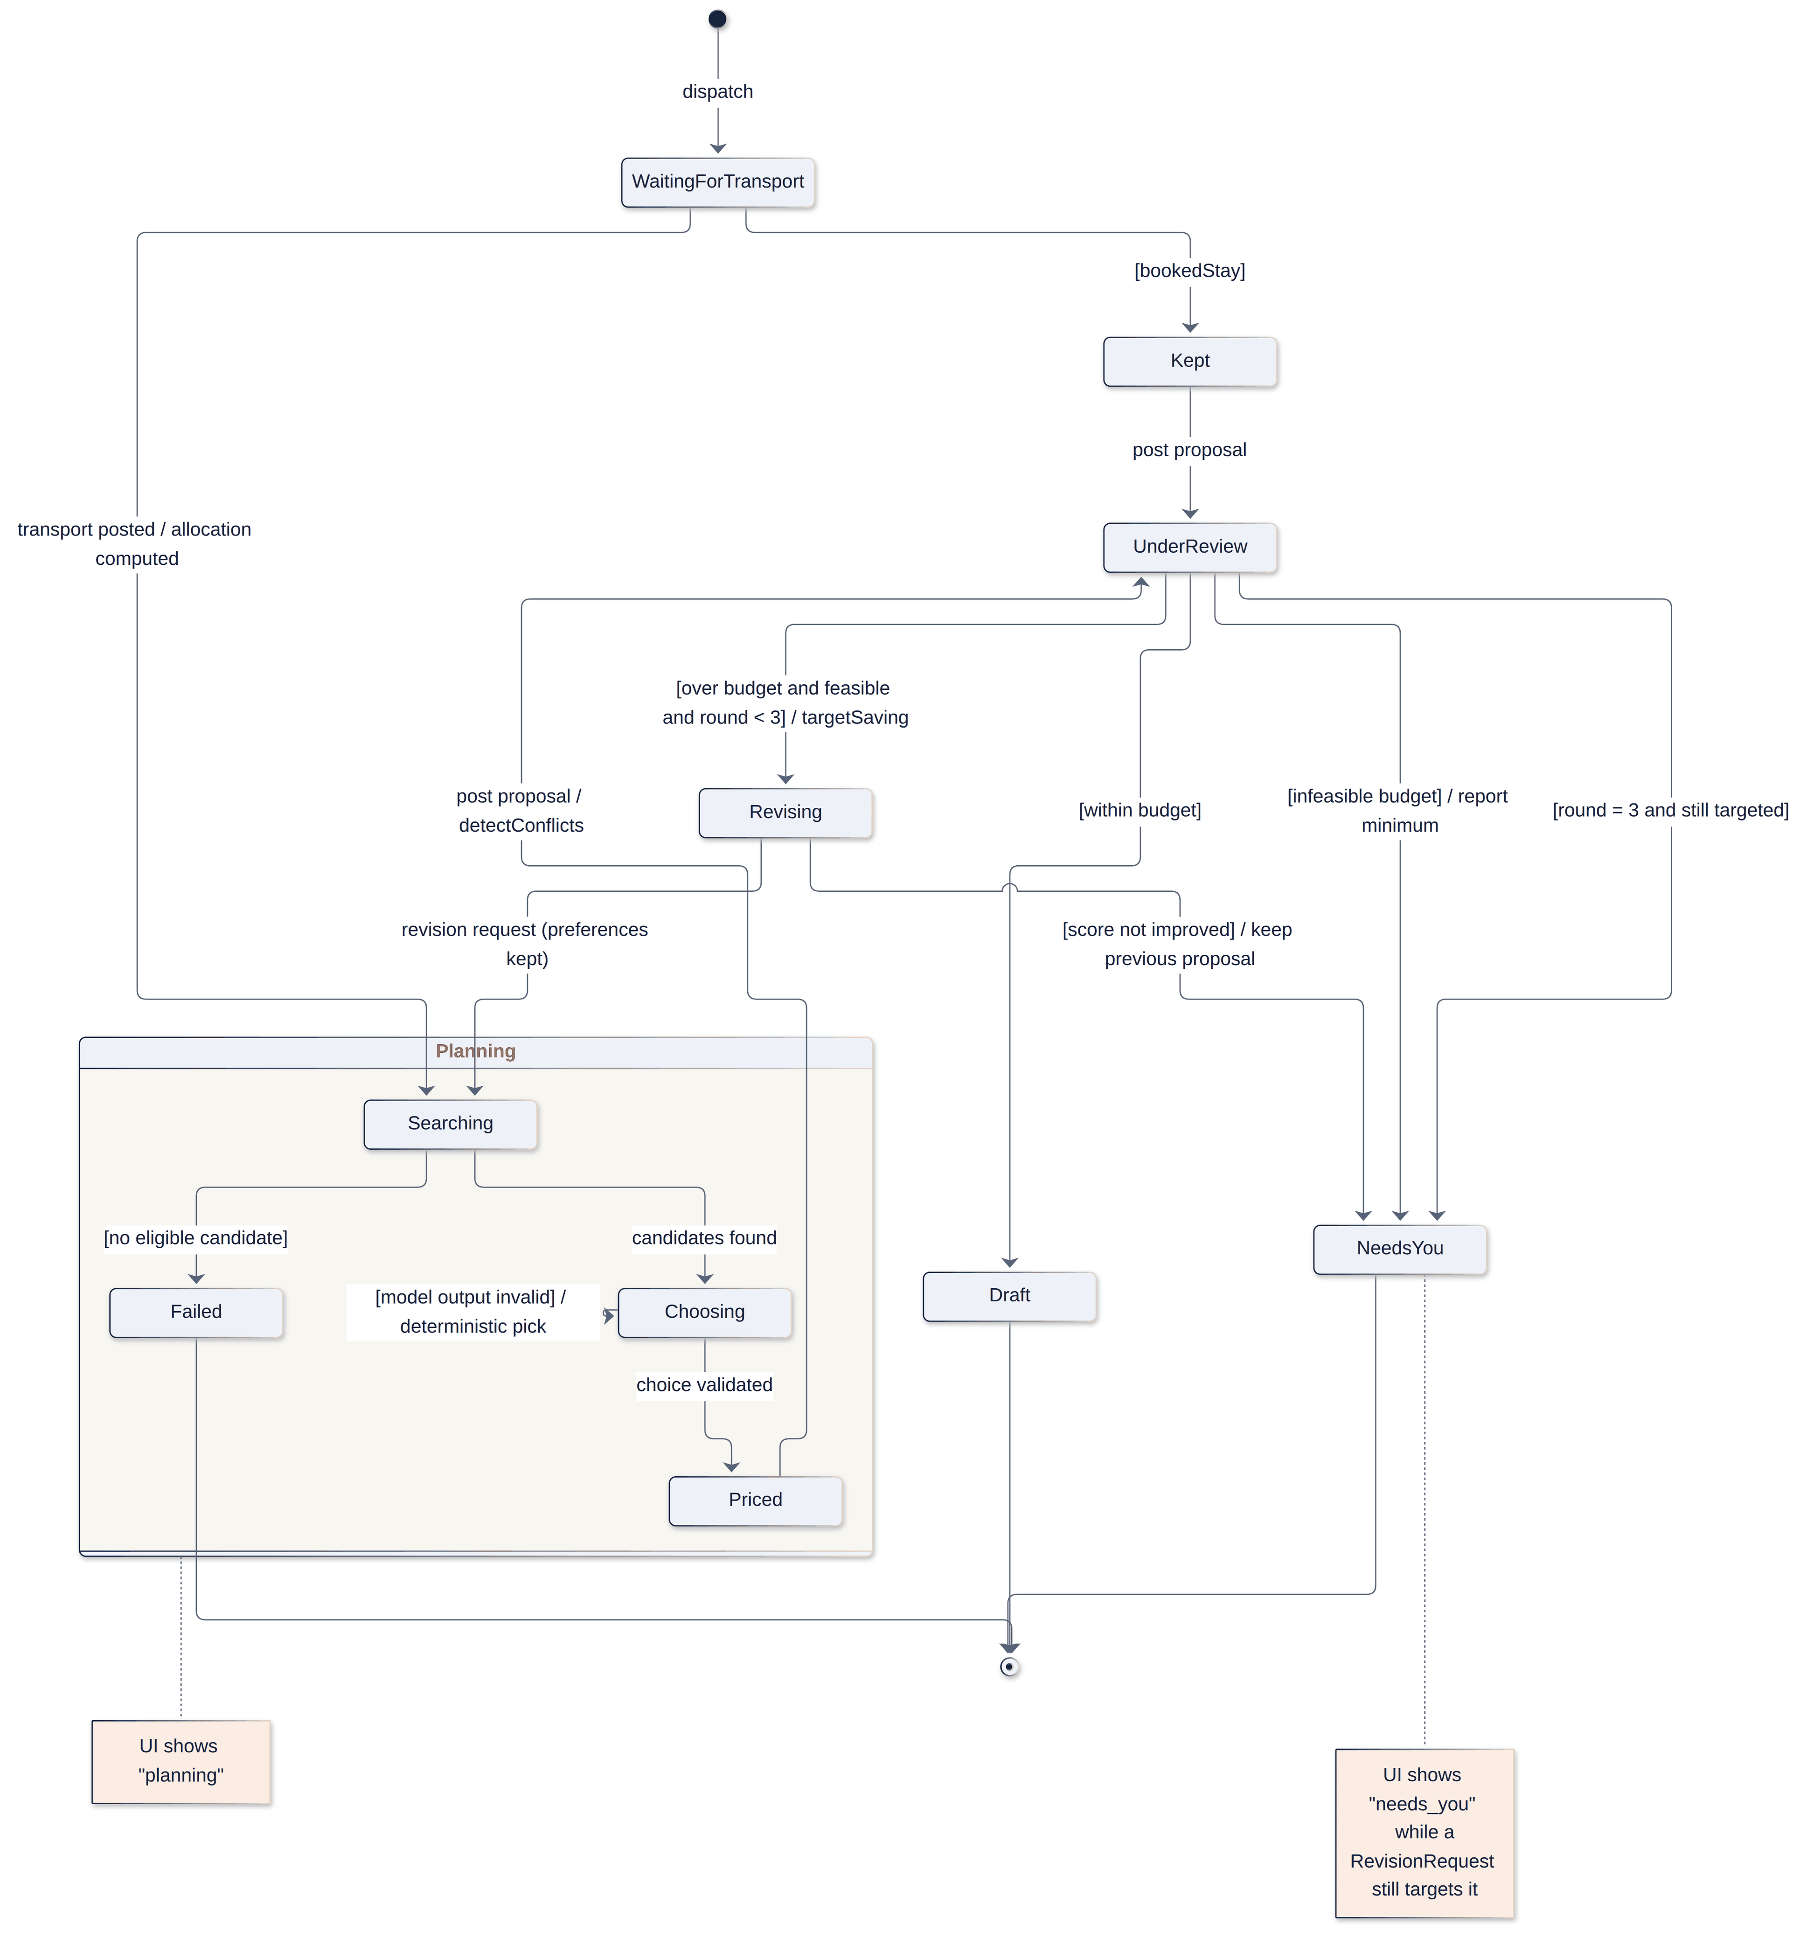

STATE MACHINE
The accommodation section within one planning turn
INTERNAL STATE
TRAVELLER SEES
Waiting
Planning
Kept
UnderReview
Revising
planning
Draft
draft
NeedsYou
needs_you
Failed
run stops
AI Trip Planner · ELEC5620 Stage 1 · Mon 10-12 Group 14
15 / 24
Notes:
The state machine follows the accommodation section through one turn, and maps its internal states onto the three statuses the traveller sees.

Slide 16
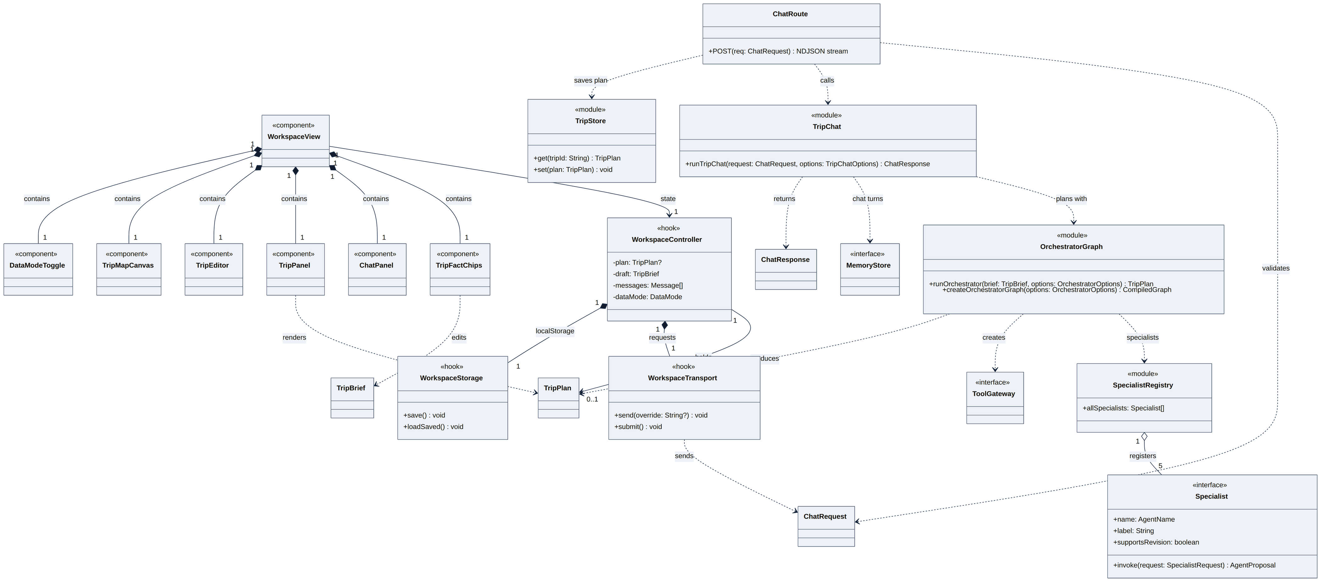
ELEMENTARY STRUCTURE
Six class diagrams drawn from the code
1
2
3
4
5
6
Structural spine
Domain contracts
Specialists
Ports and adapters
Use case trace
Generalisation
AI Trip Planner · ELEC5620 Stage 1 · Mon 10-12 Group 14
16 / 24
Notes:
Our class model has six diagrams drawn from the code. The spine runs from the workspace, through the coordinator and workflow, to specialists that reach tools and memory only through injected interfaces.

Slide 17
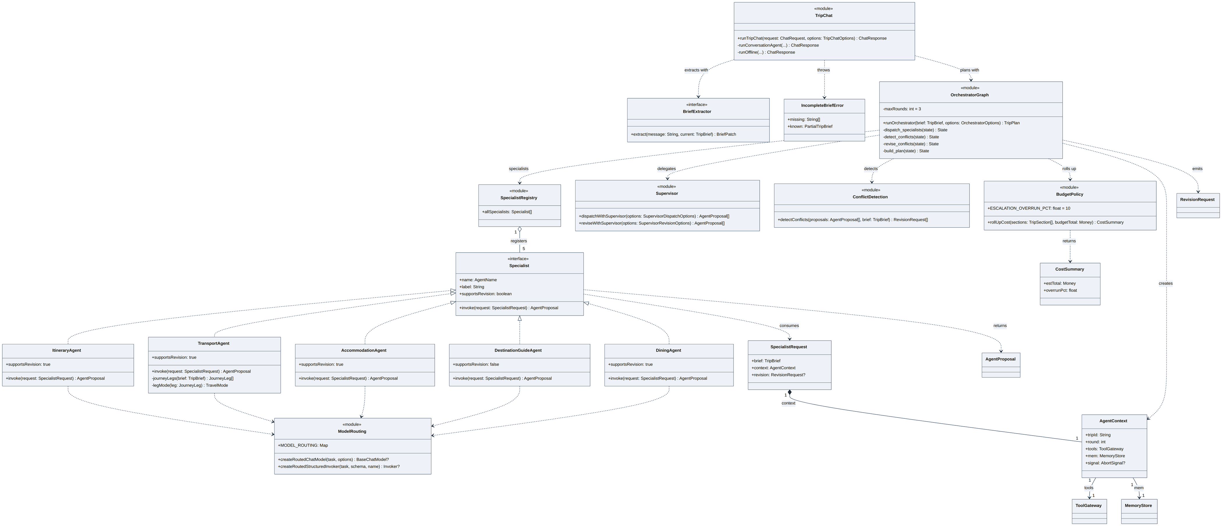
ELEMENTARY STRUCTURE
One Specialist interface, five realisations
2
1
1
Specialist interface
2
Registry ◇ Specialist
TripPlan ◆ TripSection
realisation × 5
aggregation 1 → 5
composition 1 → 0..*
The graph loops over agents without knowing their models.
Agents live on their own; the registry only lists them.
A section cannot outlive its plan.
AI Trip Planner · ELEC5620 Stage 1 · Mon 10-12 Group 14
17 / 24
Notes:
Every agent realises one Specialist interface, so the graph loops over them without knowing their models. The registry aggregates agents, while a plan is composed of its sections.

Slide 18


DESIGN RATIONALE
What we chose, and what we discarded
DECISION
CHOSEN
DISCARDED, AND WHY
Who drives the loop
Deterministic LangGraph
Model-driven loop limits and costs must be testable
Collaboration
Staged board with budget shares
Free agent-to-agent chat control flow would live in model output
Human in the loop
Traveller edits; sections show needs_you
Approval checkpoints confirming applied nothing
LLM provider
DeepSeek
MiniMax pages took 37–81 s against 15–23 s
Prices
Tools only, with provenance
Model estimates it invents hotels and fares
Server state
Redis REST store
Process memory lost on cold starts
AI Trip Planner · ELEC5620 Stage 1 · Mon 10-12 Group 14
18 / 24
Notes:
We discarded a model-driven loop and free agent-to-agent chat, because limits and costs must be testable. We dropped approval checkpoints, since confirming applied nothing, and chose DeepSeek because it was about three times faster.

Slide 19
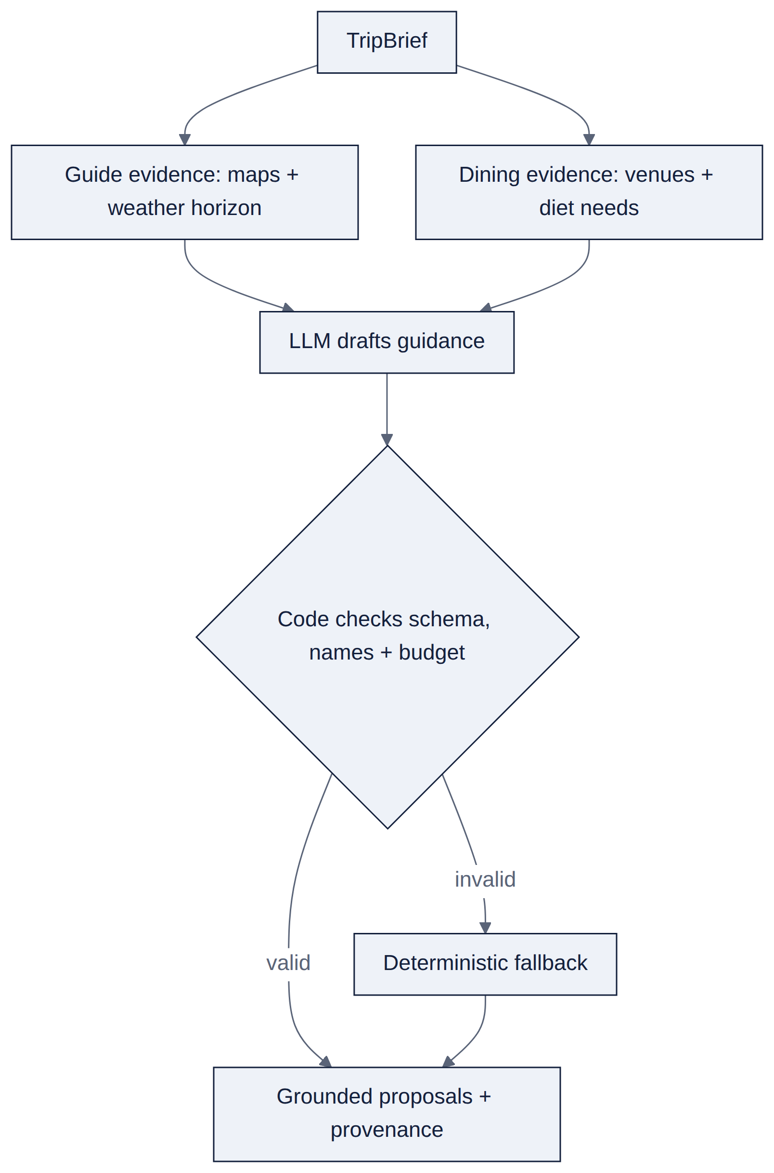
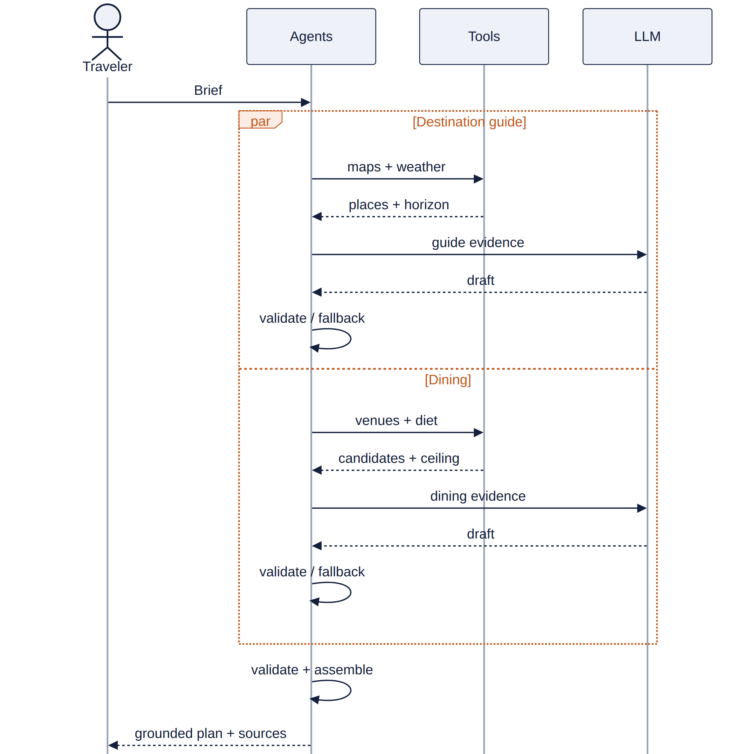
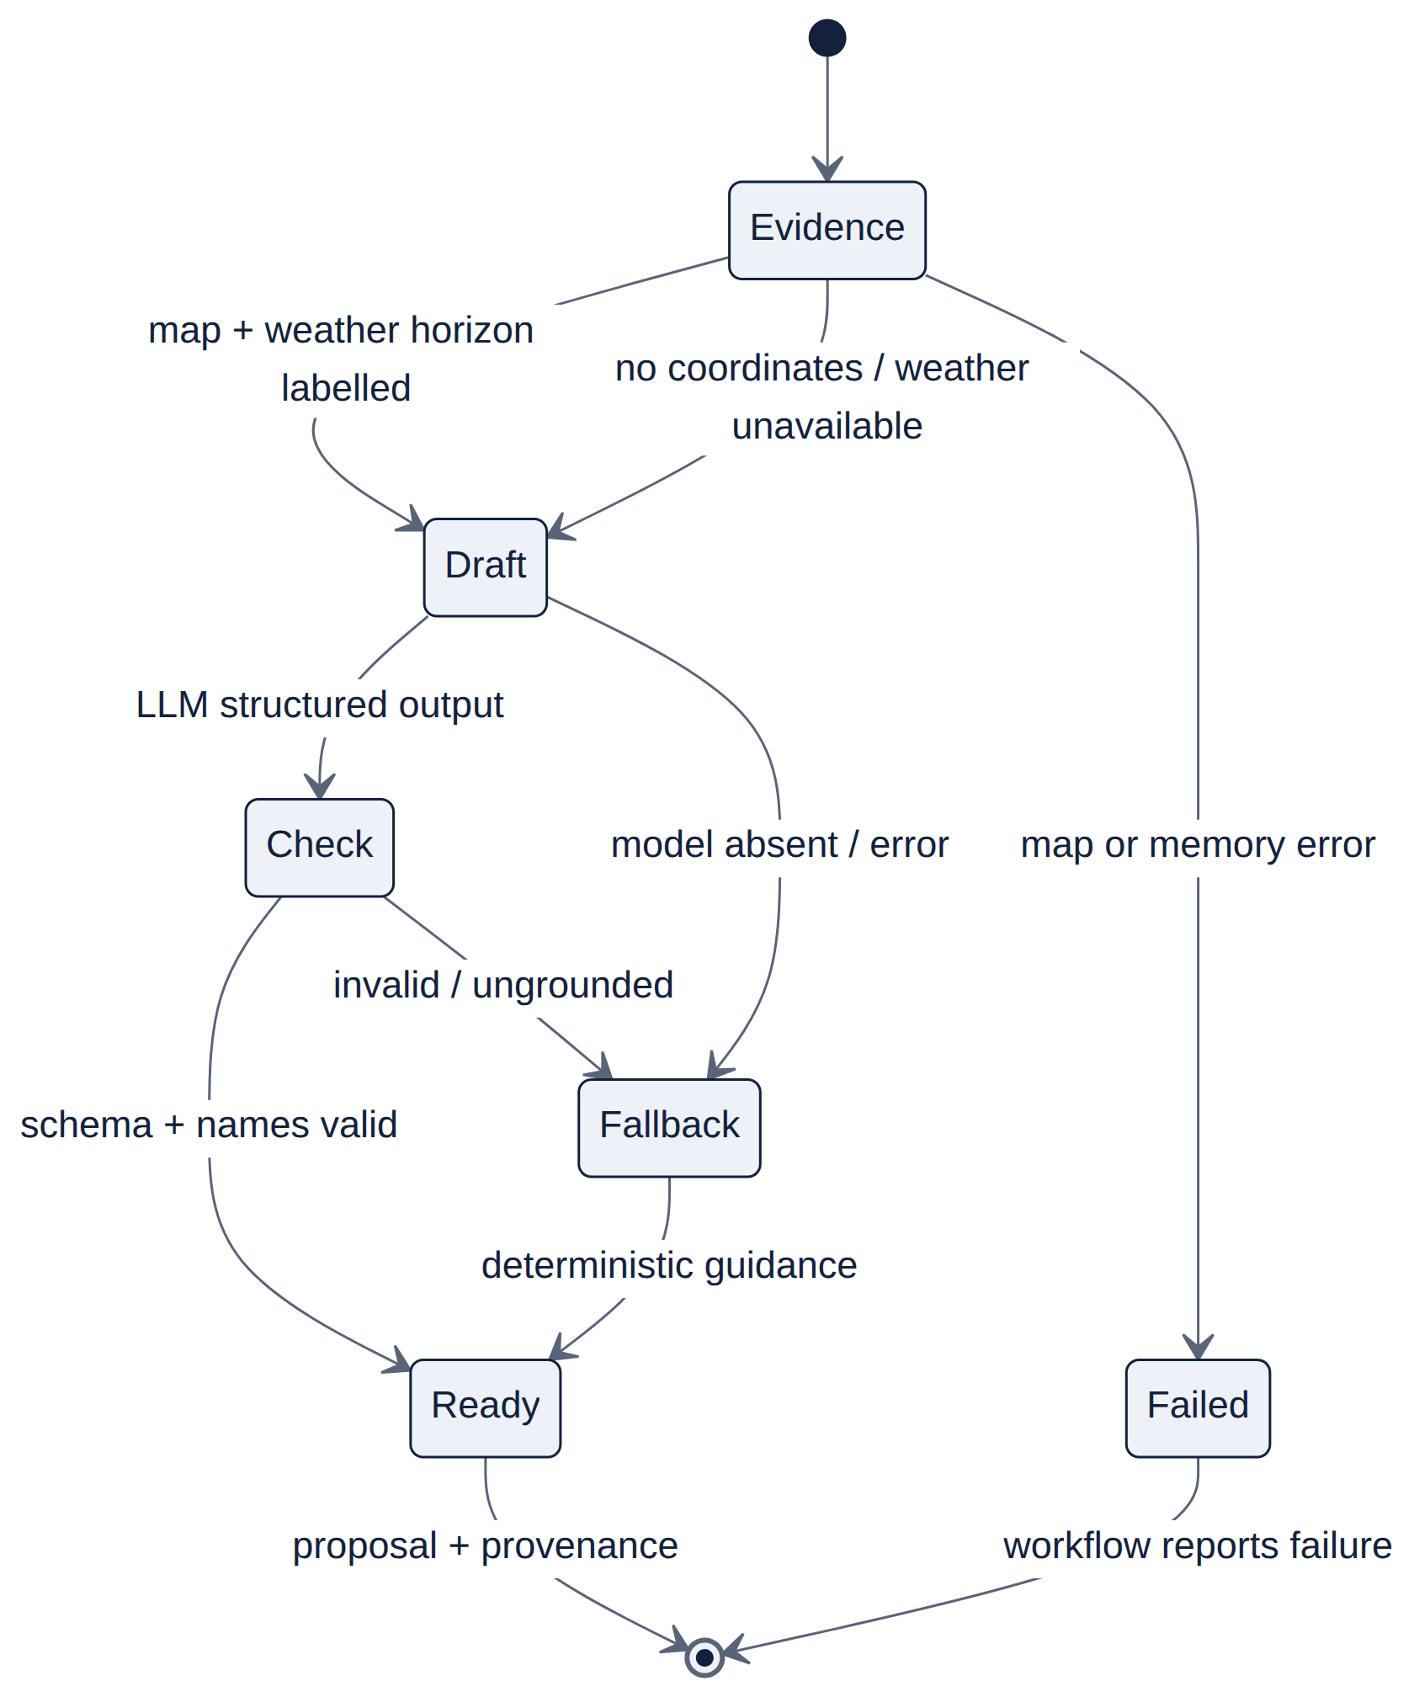
INDIVIDUAL BEHAVIOUR MODELS · UC-D1
Evidence first; the LLM drafts, code decides
Ad hoc requirement AH-D1: pack for my real Kyoto dates; vegetarian, peanut allergy; never claim allergy-safe unless confirmed Use case UC-D1 Weather-based clothing + dining
ACTIVITY
SEQUENCE
STATE MACHINE
AI Trip Planner · ELEC5620 Stage 1 · Mon 10-12 Group 14
19 / 24
Notes:
UC-D1 shows both specialists working from evidence: the guide uses map coordinates and weather data; dining uses restaurant candidates and confirmed dietary preferences. The LLM drafts guidance, while deterministic code validates its output and budget. Forecasts are distinguished from climate context, and unavailable weather is disclosed.

Slide 20
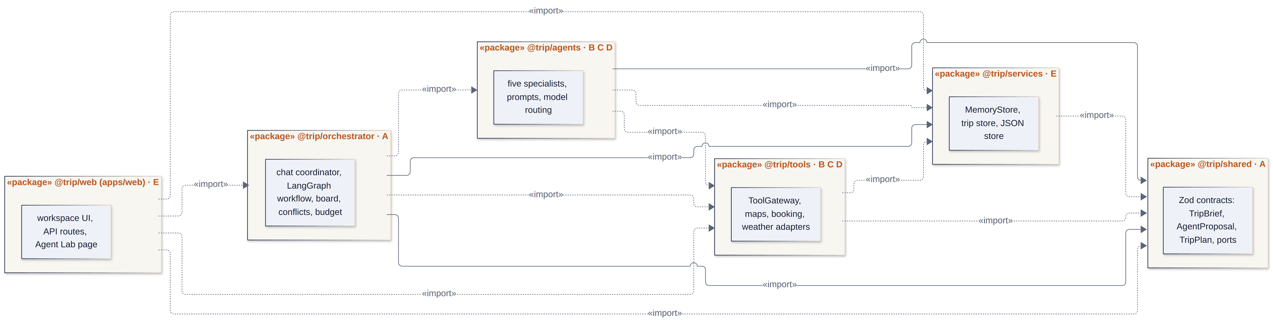




PACKAGE DIAGRAM
Dependencies point inward to the shared contracts
1
2
1
2
Six packages
shared: no dependencies
Nothing imports web
Plug in at interfaces
One monorepo, each package with an owner.
It holds the Zod contracts and ports.
So the planner runs and is tested without a browser.
A new specialist, provider or store.
AI Trip Planner · ELEC5620 Stage 1 · Mon 10-12 Group 14
20 / 24
Notes:
Six packages, each with an owner, all depend inward on the shared contracts, which depend on nothing. New specialists, providers or stores plug in behind existing interfaces.

Slide 21
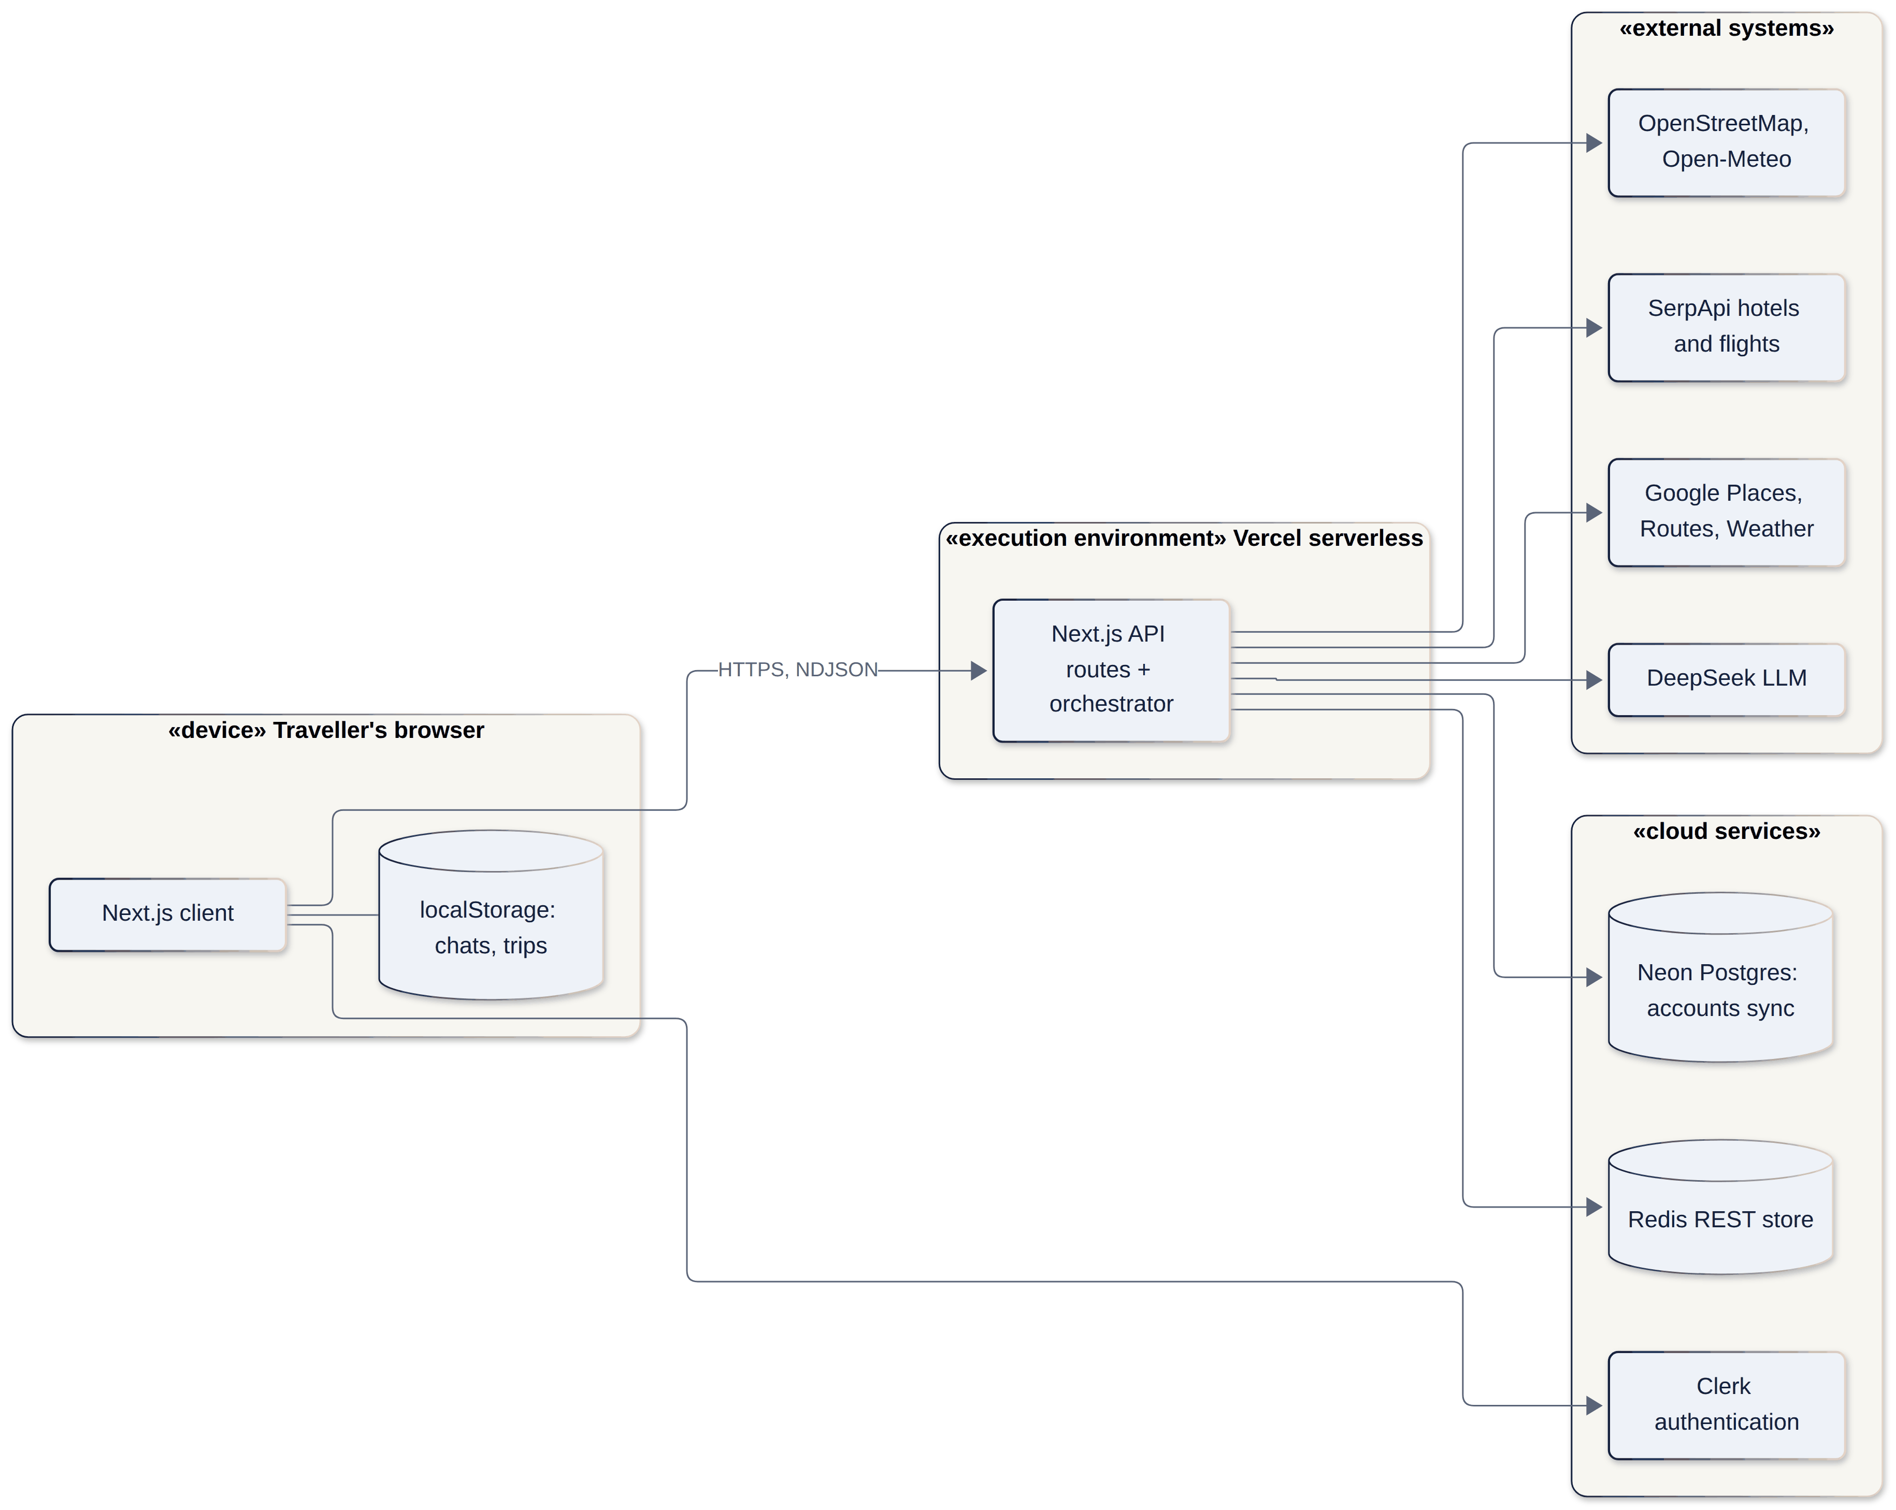

DEPLOYMENT
One serverless app, optional cloud services
1
Browser
Chats and trips in local storage; progress streams as NDJSON.
2
Server
Next.js API routes and the orchestrator.
2
1
3
3
Optional
Redis REST memory, Postgres account sync, Clerk sign-in.
No keys? The same build runs offline on mock data.
AI Trip Planner · ELEC5620 Stage 1 · Mon 10-12 Group 14
21 / 24
Notes:
It deploys as one serverless Next.js app. Memory, account sync and sign-in are optional, and without keys the same build runs fully on mock data.

Slide 22



CHANGE ASSESSMENT AND ACCEPTANCE
How a change gets in
Assess
Accept
Trace it to a requirement and use case
CI green: types, lint, tests, build, docs
Shared contract touched? Write a decision note and tell every owner
End-to-end test leaves a repeatable artifact
Use case postconditions still hold
Reversing a decision? Supersede it in writing
Docs and models updated in the same pull request
KEY ASSUMPTIONS
One traveller per trip
AUD everywhere
Estimates, not bookings
Flights paid first
Models and providers can fail
AI Trip Planner · ELEC5620 Stage 1 · Mon 10-12 Group 14
22 / 24
Notes:
A change must trace to a requirement; a change to shared contracts needs a written decision. A pull request is accepted when CI passes, an end-to-end artifact exists, use case postconditions hold and the models are updated.

Slide 23
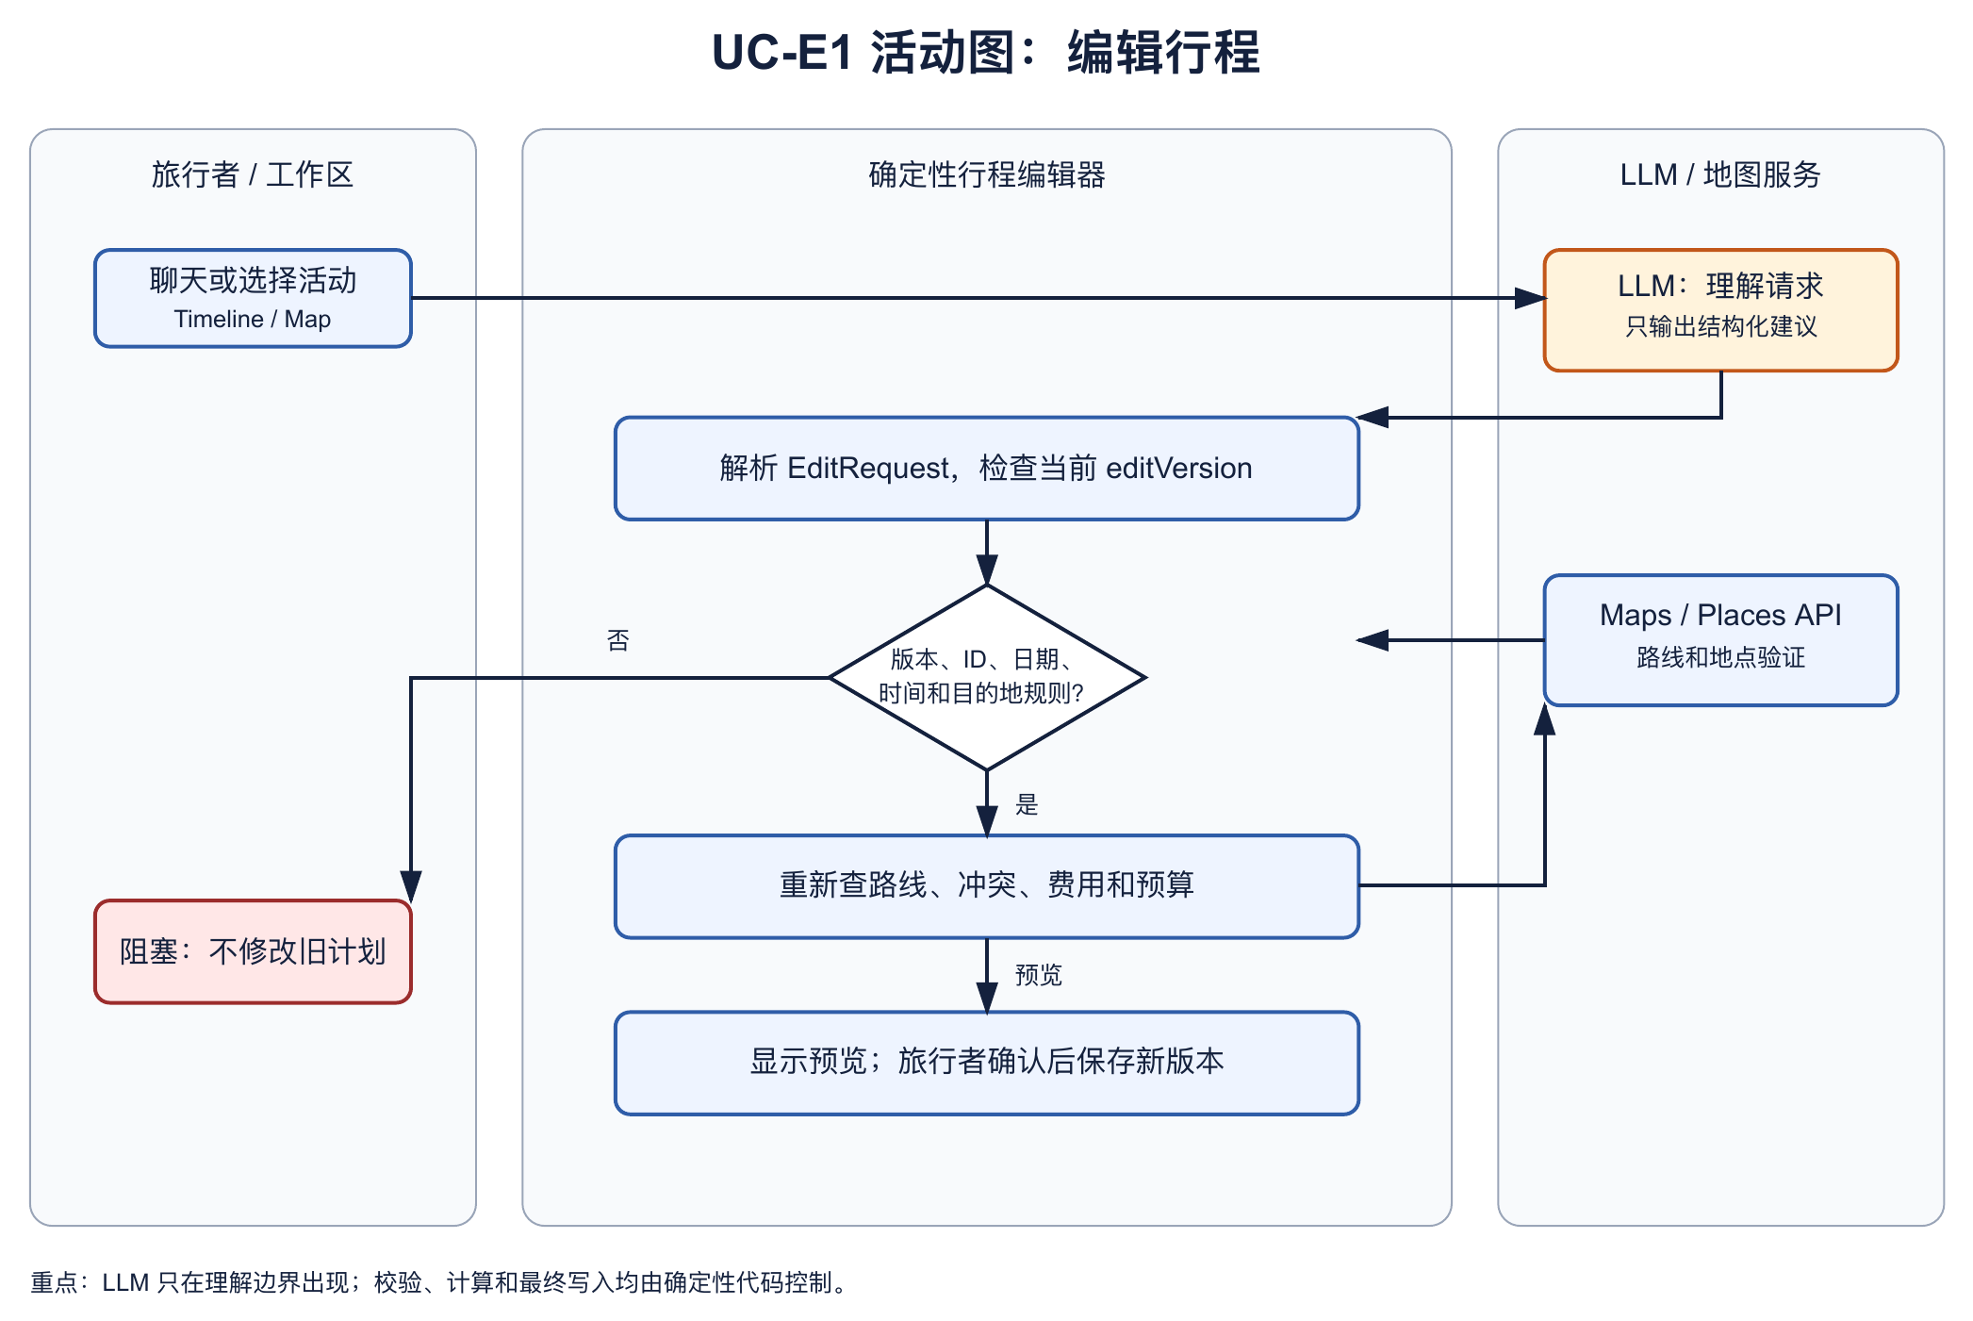
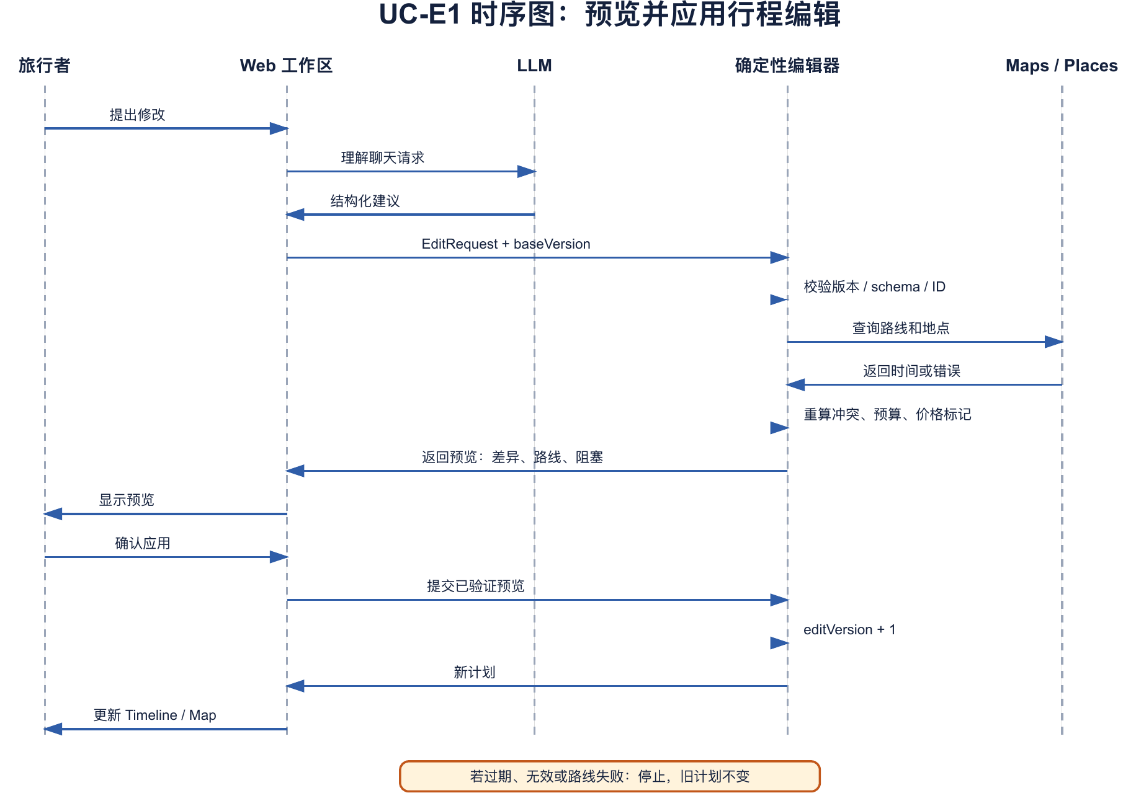
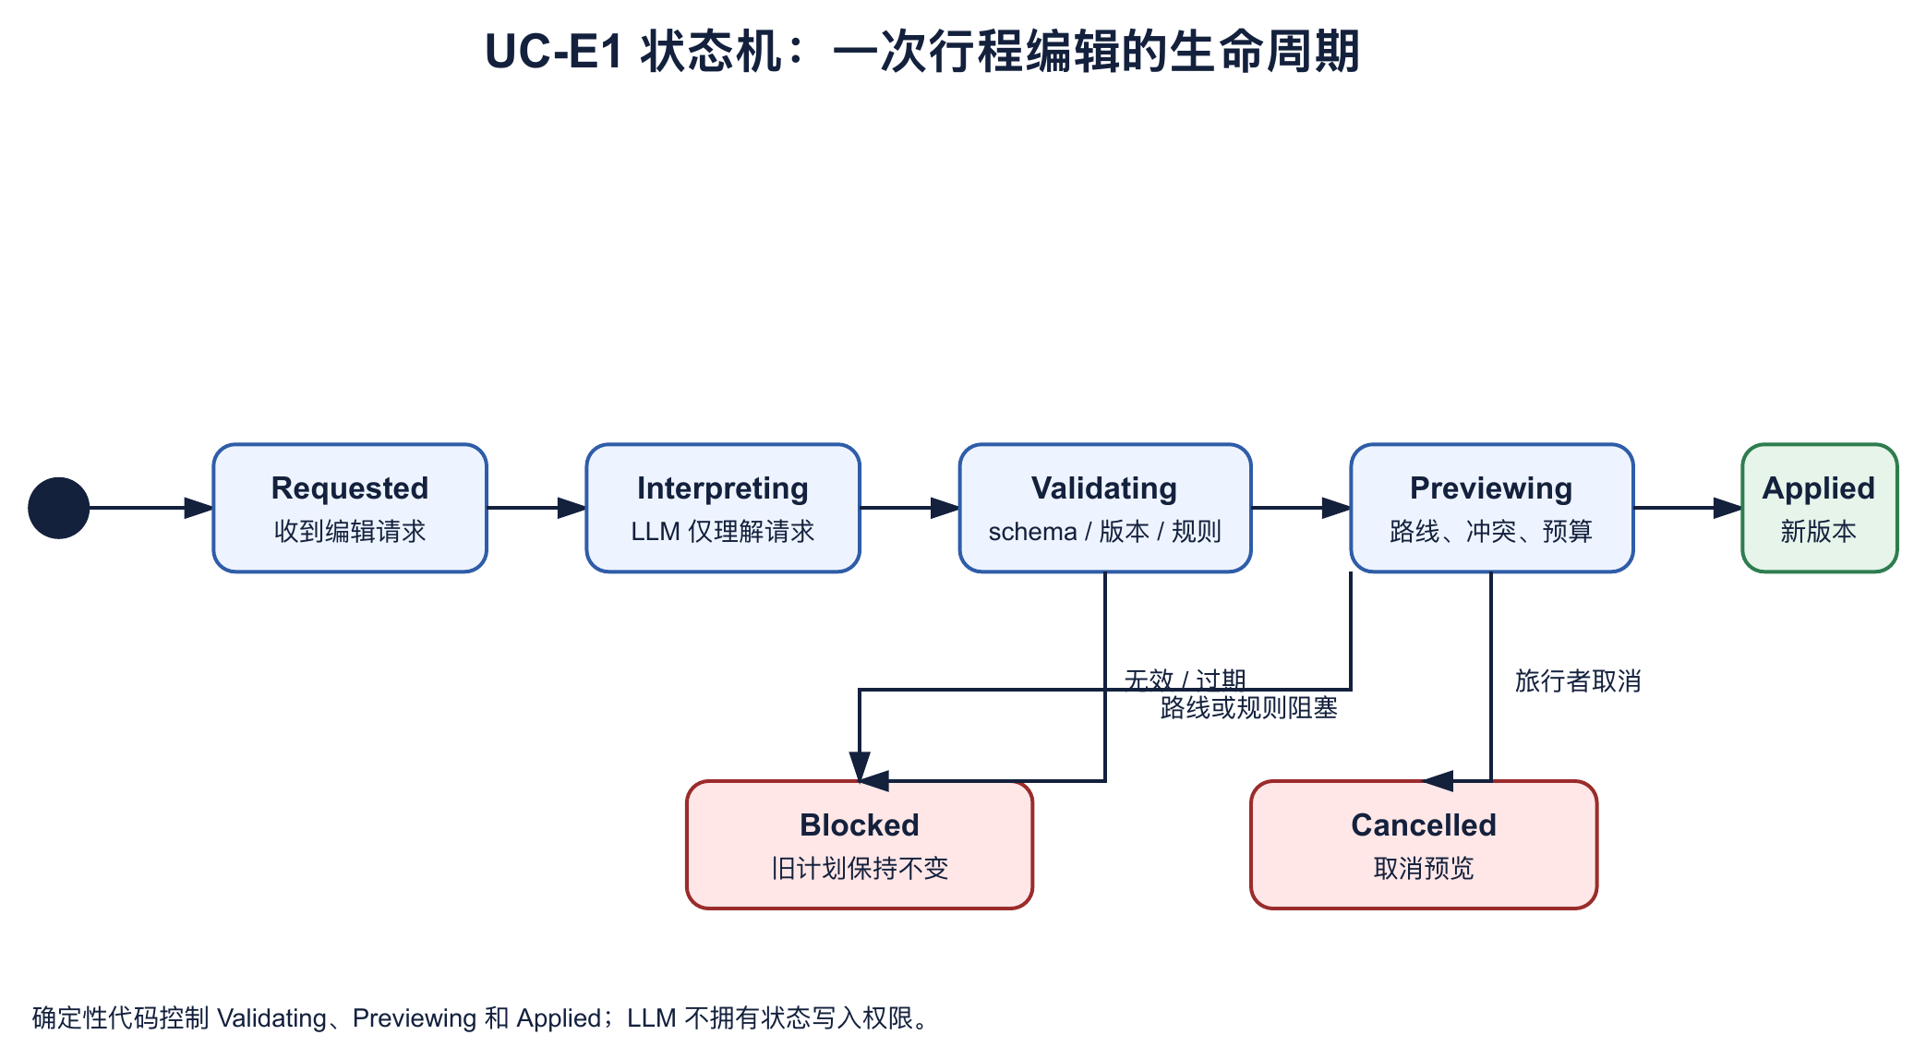
INDIVIDUAL BEHAVIOUR MODELS · UC-E1
Edits are previewed and checked before they apply
Ad hoc requirement AH-E1: change my trip in the timeline or map; check conflicts, routes and budget Use case UC-E1 Edit Itinerary (Timeline / Map)
ACTIVITY
SEQUENCE
STATE MACHINE
AI Trip Planner · ELEC5620 Stage 1 · Mon 10-12 Group 14
23 / 24
Notes:
UC-E1 edits an existing trip through the timeline or map while keeping routes, budget and uncertain prices visible. Timeline and map operations go to a deterministic preview endpoint, which validates the schema and version, checks routes and conflicts, recalculates costs, and marks changed prices as unverified. The chat LLM can update the brief or replan, but it does not create an edit request. The state machine ends in Applied only after the browser accepts the validated preview.

Slide 24
SUMMARY
Models choose.
Code decides.
The traveller stays in control.
Stage 2: verify live providers end to end, extend the Agent Lab, and track the work in Jira.
github.com/Lilstanie/AI_TRIP_PLANNER
A
B
C
D
E
Notes:
In short: models choose, code decides, and the traveller stays in control. Thank you for watching.

