Slide 1


系统的可用性
周烜
华东师范大学
数据科学与工程学院
xzhou@dase.ecnu.edu.cn

Slide 2
什么是可用性（Availability）？
可用性：一个系统处在正常工作状态的时间比例。
An equipment has a mean time to failure (MTTF) of 81.5 years and mean time to repair (MTTR) of 1 hour:
MTTF in hours = 81.5 × 365 × 24 = 713940
Inherent availability (Ai) = 713940 / (713940+1) = 713940 / 713941 = 99.999860%
什么时候发生failure
宕机、磁盘损坏、停电
阻塞、通信故障
程序出错 / Bug
节点被恶意控制

Slide 3


应用的演变

Slide 4

服务器的演变（99.999%）

Slide 5

服务器的演变（99 ~ 99.9%）

Slide 6
Google的计算中心
全球总共 30 多个计算中心
每个中心拥有超过 200 个计算机集群
每个集群拥有超过 1000 台计算机
每天都有故障发生：
每年1-5%的硬盘损坏
每台服务器平均每年宕机2次
每年20次严重网络故障

Slide 7
高可用 – 容错能力 High Availability – Fault Tolerance
如何实现？
冗余节点（Redundancy）+ 数据复制（Replication）
节点发生故障时，切换到（Failover）冗余节点

Slide 8
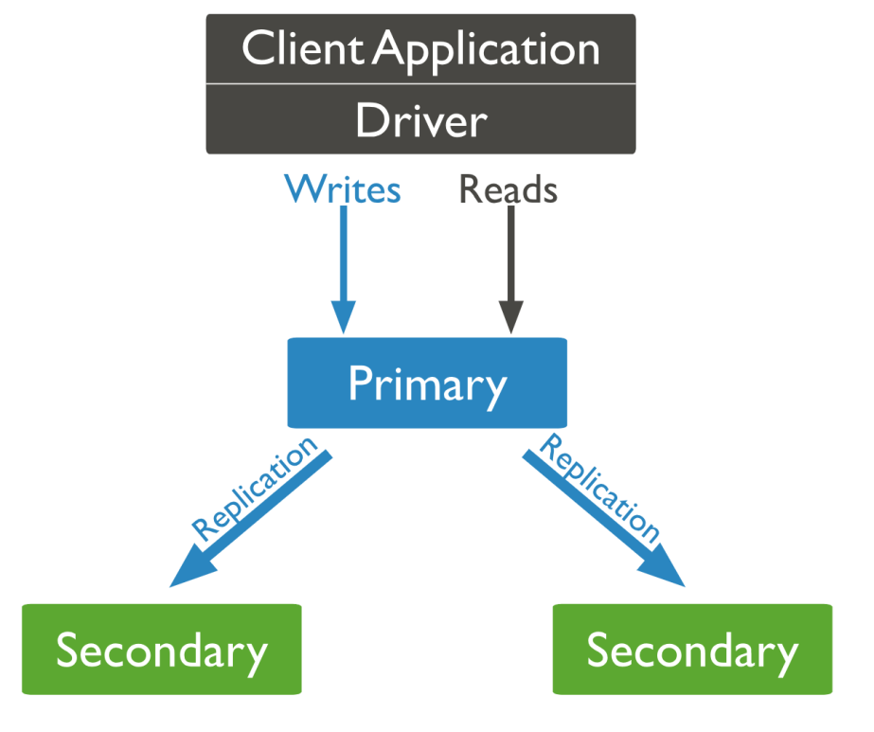
MongoDB的容错方案
A replica set contains several data bearing nodes. One and only one member is deemed the primary node, while the other nodes are deemed secondary nodes.

Slide 9
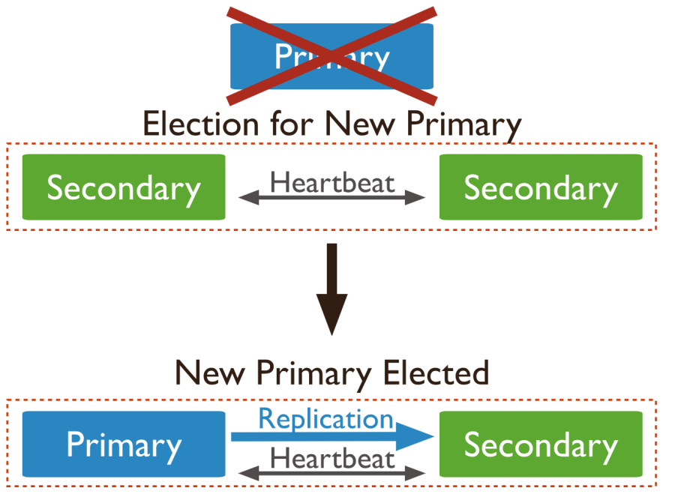
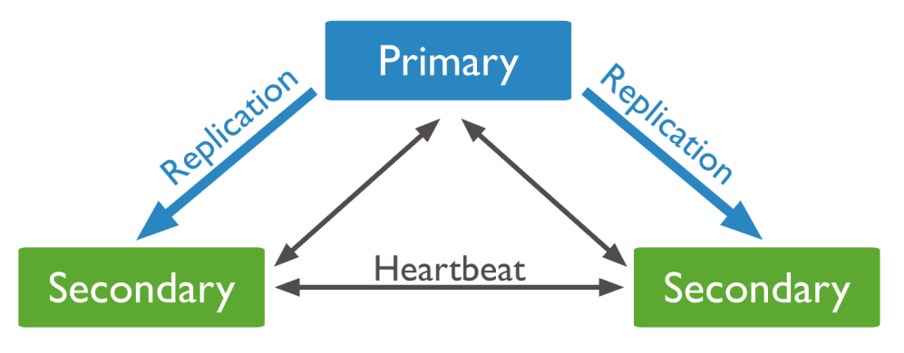
MongoDB的容错方案
When a primary does not communicate with the other members of the set for more than the configured period (10 seconds by default), an eligible secondary calls for an election to nominate itself as the new primary. The new primary resumes normal operations.

Slide 10
为什么是一主两备， 而不是一主一备？

Slide 11
曾经的高可用机制 – 单机热备
期望效果：只要S1和S2其中一个在线，系统即可用
primary
s₁
x = 1
y = 2
x = 3
y = 4
y = 5
s₂
x = 1
y = 2
x = 3
y = 4
y = 5
primary
s₁
x = 1
y = 2
x = 3
y = 4
s₂
x = 1
y = 2
timeout
x = 3
y = 4
y = 5

Slide 12
曾经的高可用机制 – 单机热备
期望效果是否可以达到？
Impossible if timeout is not decisive.
primary
s₁
x = 1
y = 2
undo y
x = 3
x = 4
s₂
x = 1
timeout
x = 3
x = 4
primary
s₁
x = 1
y = 2
timeout
undo y
x = 3
s₂
x = 1
y = 2
timeout
?
x = 5

Slide 13
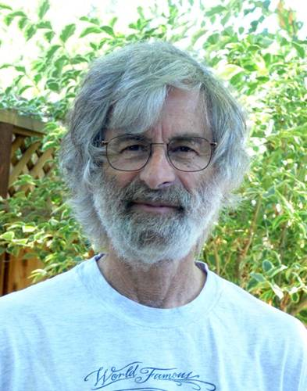
共识机制（Consensus）
一个集群的多数节点正常 → 系统可用
常见的共识机制
Paxos (1989)
Raft (2013)
Leslie Lamport

Slide 14
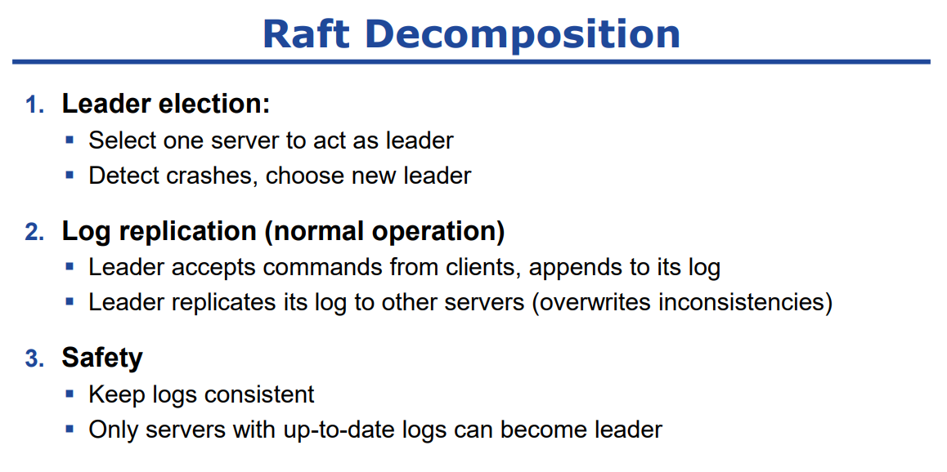
Talk on Raft at CS@Illinois Distinguished Lecture Series by John Ousterhout, August 2016

Slide 15
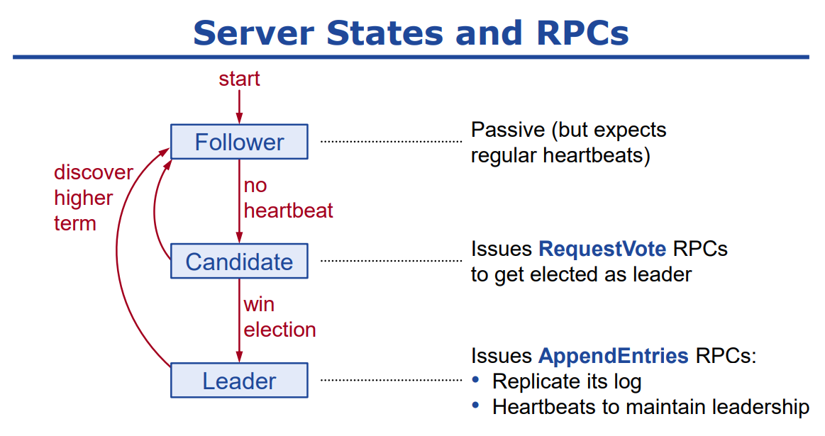
Talk on Raft at CS@Illinois Distinguished Lecture Series by John Ousterhout, August 2016

Slide 16
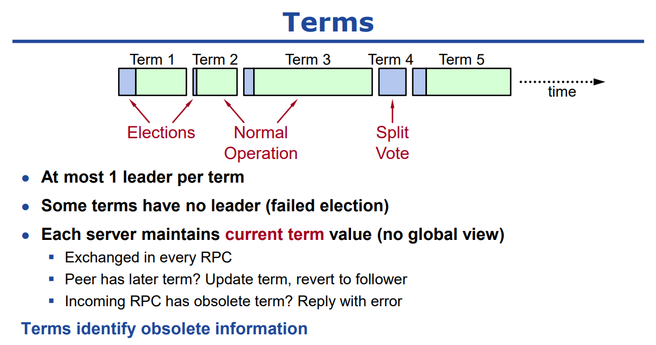
Talk on Raft at CS@Illinois Distinguished Lecture Series by John Ousterhout, August 2016

Slide 17
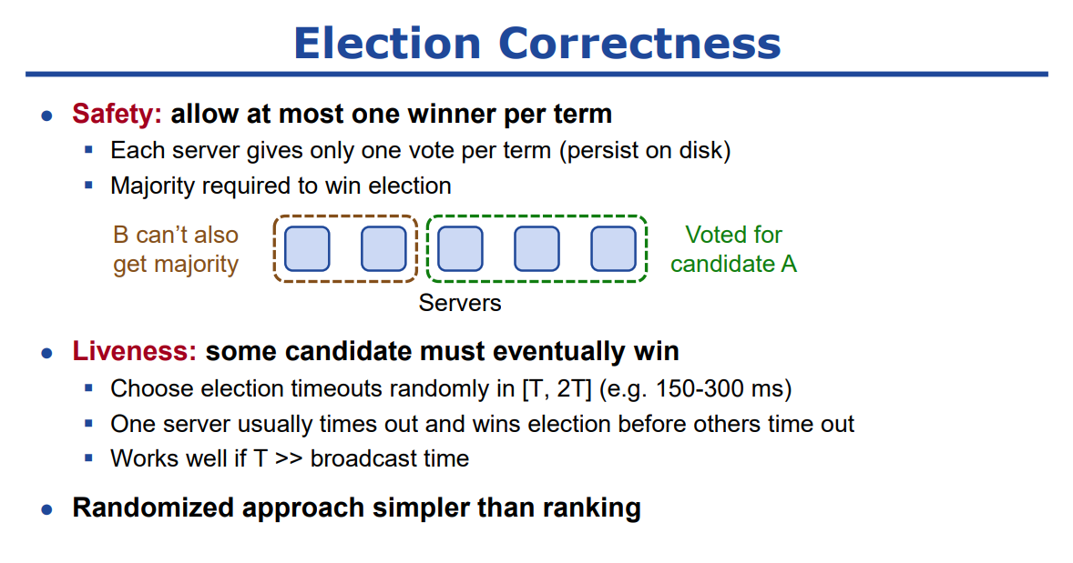
Talk on Raft at CS@Illinois Distinguished Lecture Series by John Ousterhout, August 2016

Slide 18
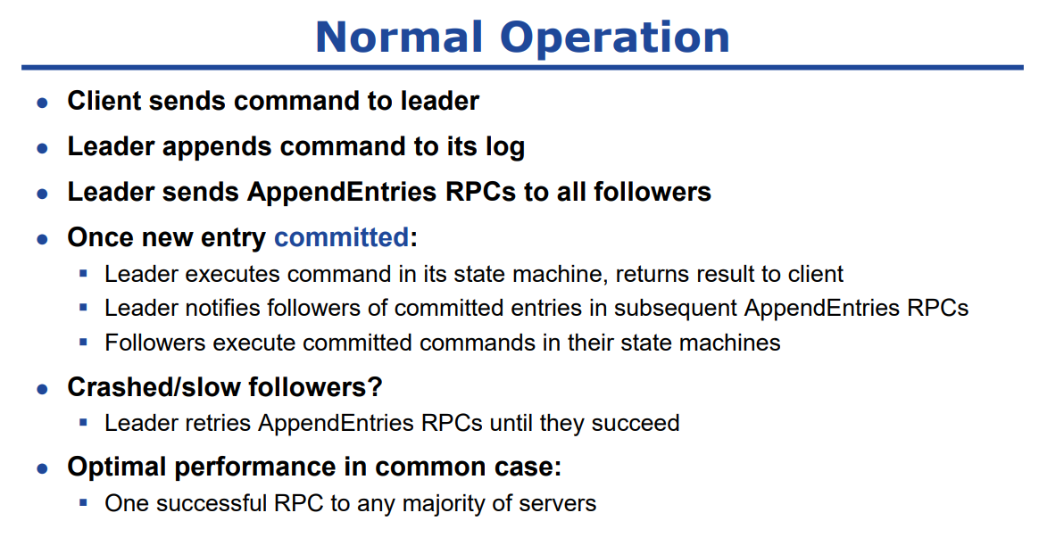
Talk on Raft at CS@Illinois Distinguished Lecture Series by John Ousterhout, August 2016

Slide 19
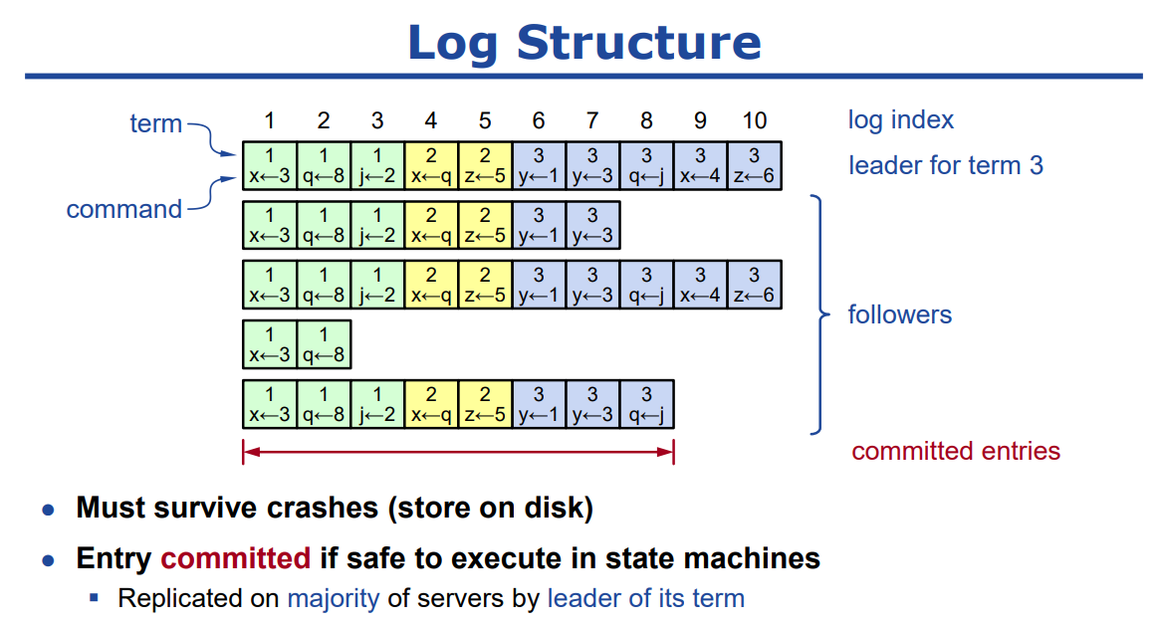
Talk on Raft at CS@Illinois Distinguished Lecture Series by John Ousterhout, August 2016

Slide 20
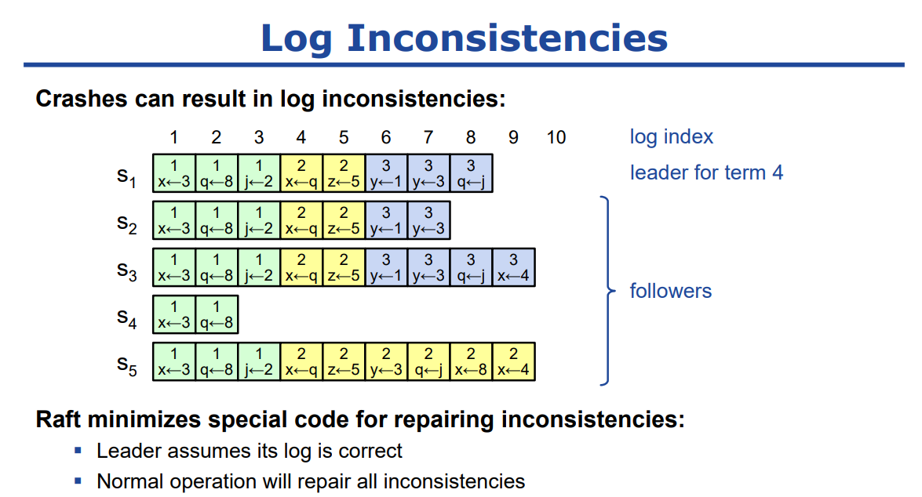
Talk on Raft at CS@Illinois Distinguished Lecture Series by John Ousterhout, August 2016

Slide 21
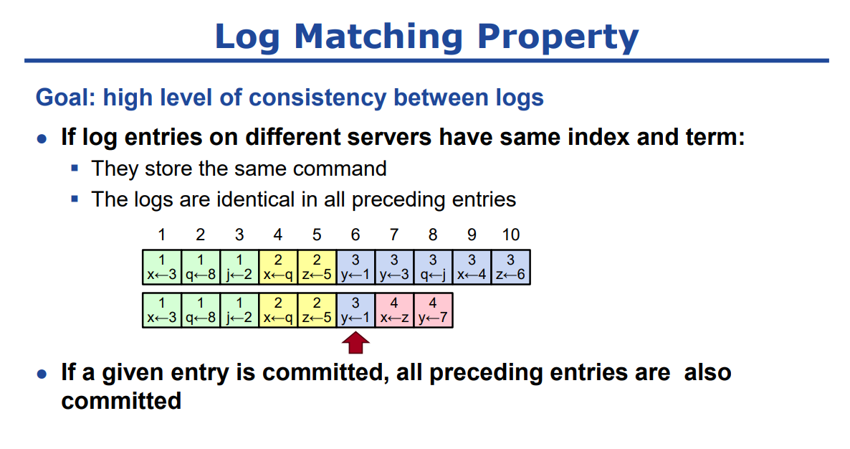
Talk on Raft at CS@Illinois Distinguished Lecture Series by John Ousterhout, August 2016

Slide 22
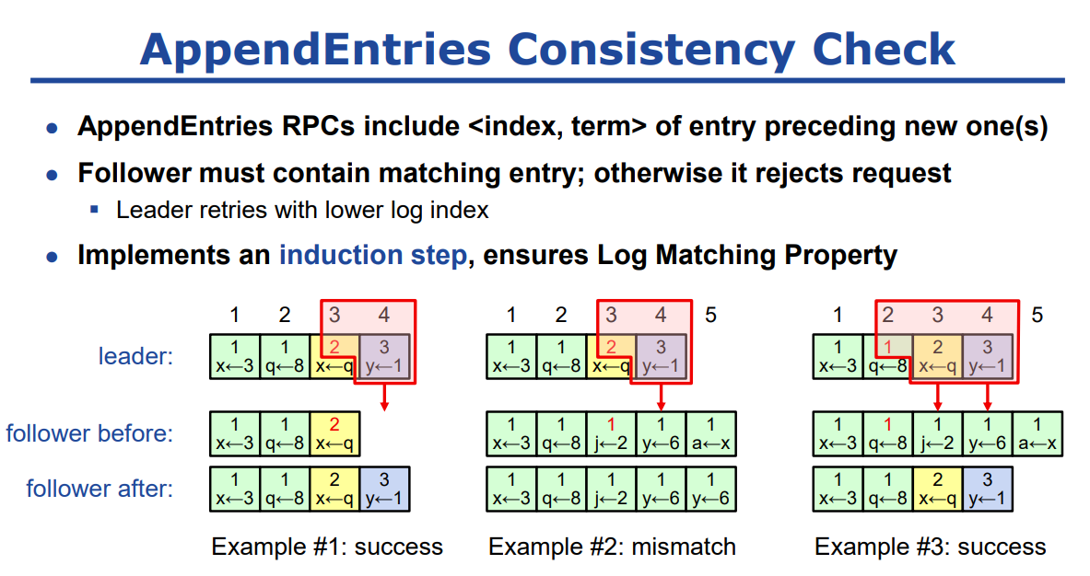
Talk on Raft at CS@Illinois Distinguished Lecture Series by John Ousterhout, August 2016

Slide 23
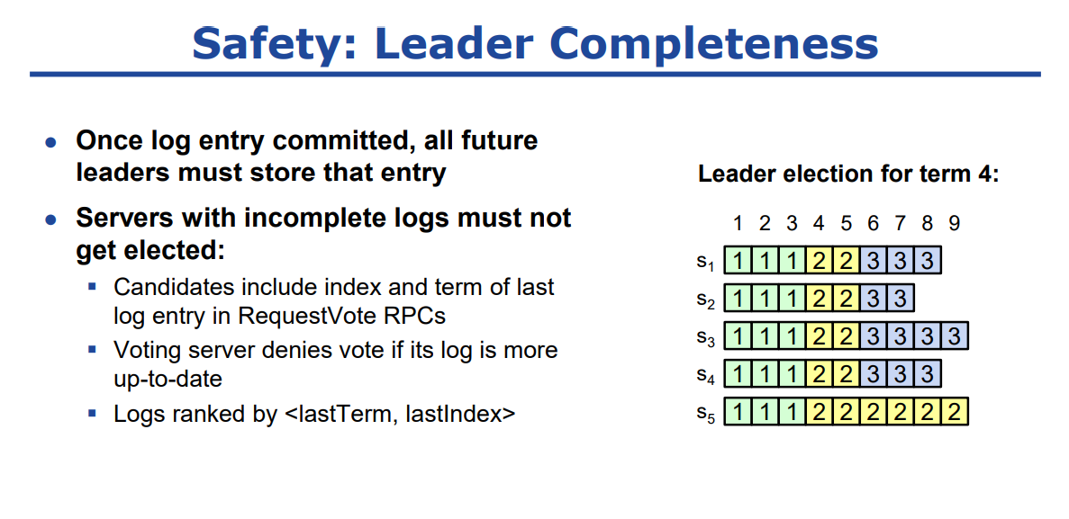
Talk on Raft at CS@Illinois Distinguished Lecture Series by John Ousterhout, August 2016

Slide 24
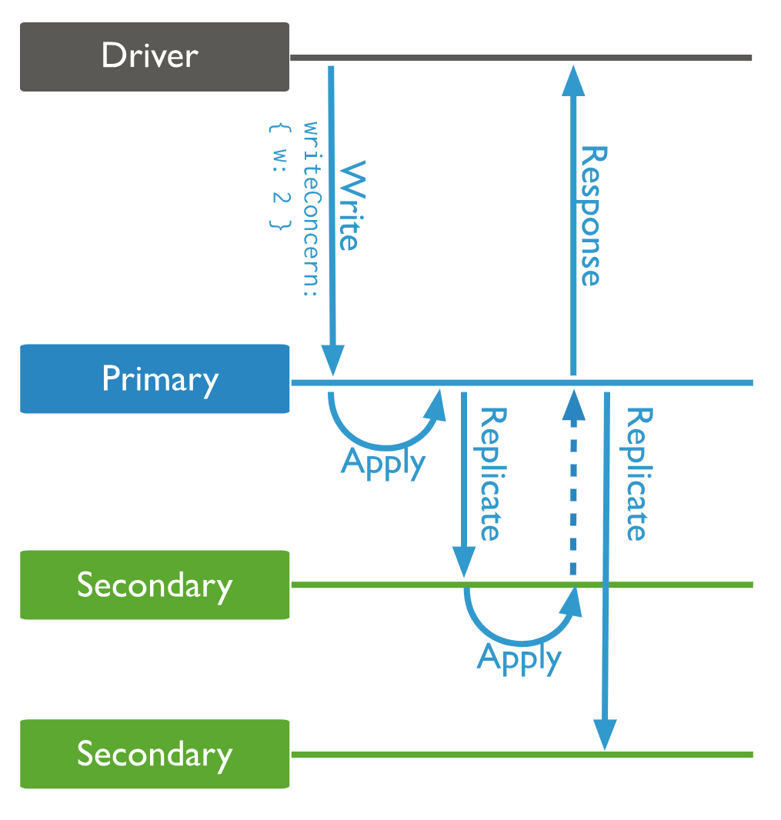
共识算法的性能代价
必须多轮通讯才能完成一次更新操作。

Slide 25
MongoDB Write Concerns
{ w: <value>, j: <boolean>, wtimeout: <number> }
w:1 Requests acknowledgement that the write operation has propagated to the primary in a replica set.
w:”majority” Requests acknowledgement that write operations have propagated to the majority of voting nodes, including the primary.

Slide 26
MongoDB Read Concerns
readConcern: { level: <level> }
Level:"local“/“available” returns data from the instance with no guarantee that the data has been written to a majority of the replica set members (i.e. may be rolled back).
Level:"majority" guarantees that the data read has been acknowledged by a majority of the replica set members (i.e. the documents read are durable and guaranteed not to roll back).

Slide 27
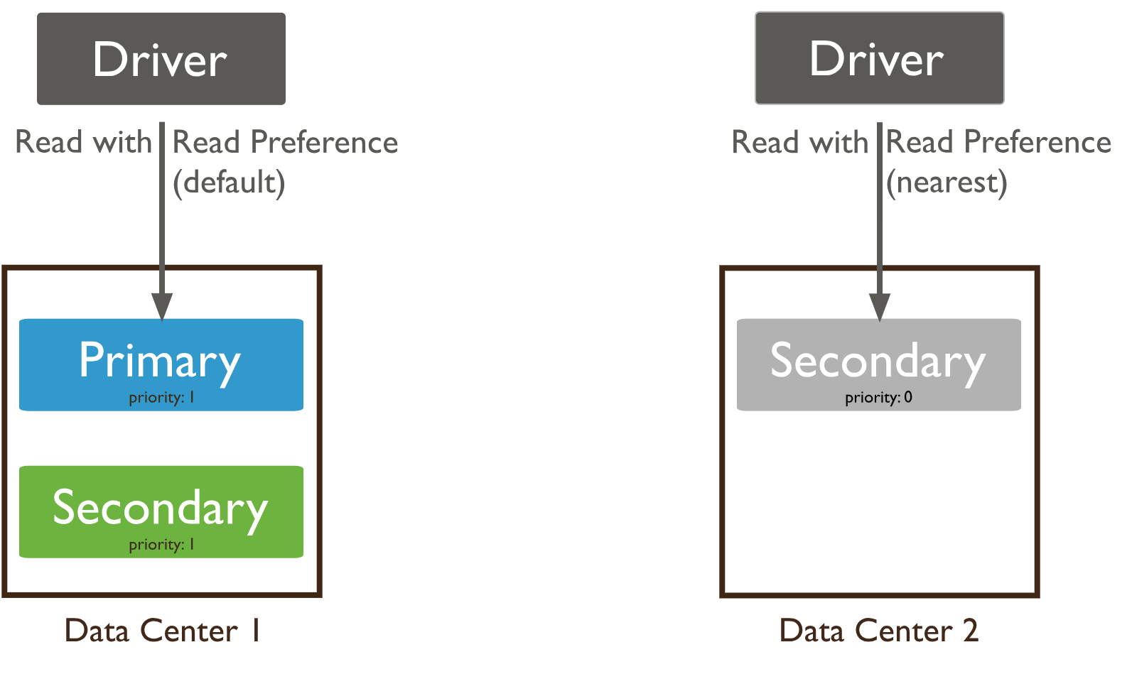
MongoDB Read Preference

Slide 28
什么配置可以实现Linearizability？

Slide 29
Linearizability（线性一致）
All function calls have a linearization point at some instant between their invocation and their response.
All functions appear to occur instantly at their linearization point, behaving as specified by the sequential definition.

Slide 30
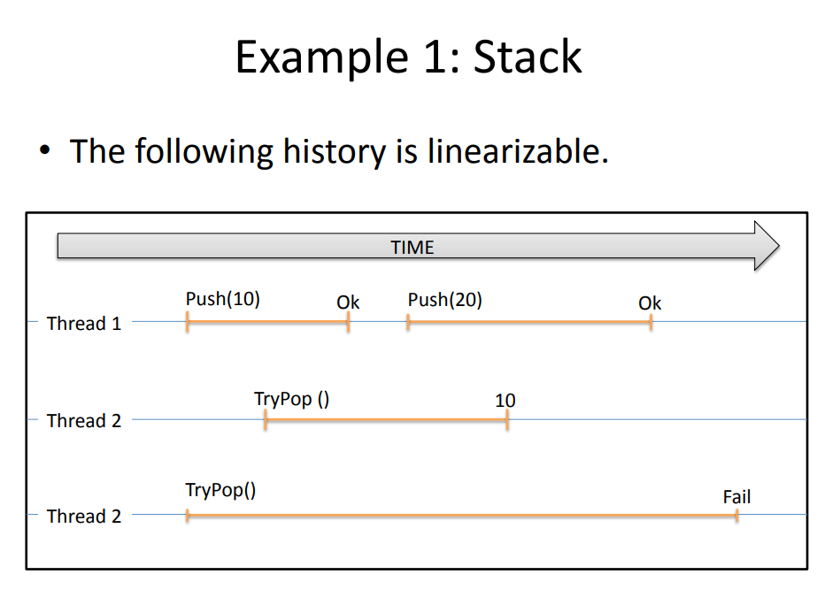

Slide 31
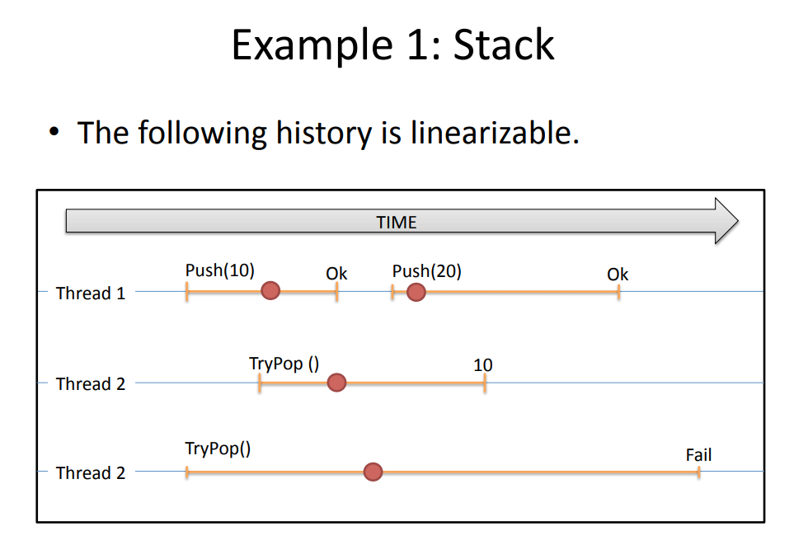

Slide 32
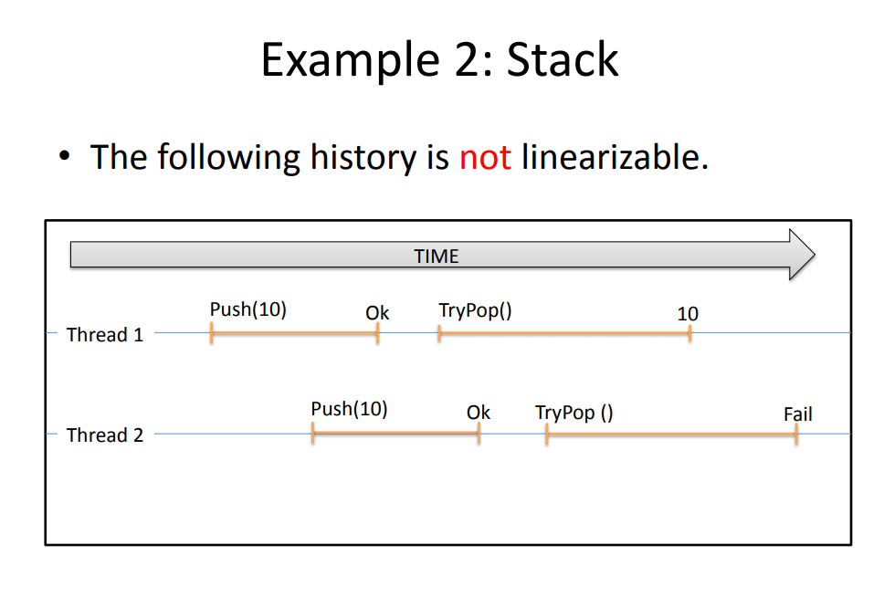

Slide 33
