Slide 1
测验：题1
如课程中提到的，嵌套循环算法的I/O代价可以表示为 B(R) + B(S)*B(R)/M，其中B(R)代表外循环表的页数，B(S)代表内循环表的页数，M代表内存能容纳的页数。那么以下哪种方案无法提升该算法的效率？
增加内存容量
将小表放到内循环（作为S），大表放到外循环（作为R）
将大表放到内循环（作为S），小表放到外循环（作为R）
更换速度更快的硬盘

Slide 2
测验：题2
课程中介绍了两种连接操作执行算法，嵌套循环和散列连接。以下哪种场景更适合使用嵌套循环算法？
一张表很大，一张表很小。小的表几乎可以容纳到内存中。
两张表都比较大，都无法容纳到内存中。
两张表都比较小，都可以容纳到内存中。
几乎在所有情况下，散列连接的效率都更高

Slide 3
测验：题3
假设R表有1000行，S表有100行；每页可以容纳10行数据（无论R表或S表）；内存可以容纳3页；R表和S表均有x属性，并且在x属性上均创建了索引；假设x具备很高的辨识度并且分布均匀。那么，理论上实现R和S在x上的等值连接的最佳算法是？
嵌套循环
散列连接
索引连接
都一样

Slide 4
作业1
在做散列连接的时候，可能会遇到数据分布不均的情况，比如在连接属性上取值为k的元组特别多，多到连内存都容纳不下。请问这种情况应该如何应对？

Slide 5
作业2
除了课程介绍的连接算法，你是否能想到其他高效的算法，它甚至在某些情况下比前面介绍的算法更快?

Slide 6
作业3
请为以下问题设计一个I/O代价低的算法： 给定一张表R(a,b,c,d)，找到R中在属性a上发生次数少于k次的所有取值。（如果R中一共有n个元组在属性a上的取值为x，我们称x在R中发生了n次；假设R很大，无法容纳于内存中；假设a的不同取值个数很多，这些取值也无法都容纳于内存中。）

Slide 7
OLTP vs OLAP
二者的数据有何区别？
OLTP：State of the Current World
OLAP：History
二者的负载有何区别？
OLTP：Query & Update
OLAP：Aggregation Query

Slide 8
历史上的一些名词
数据仓库（Data Warehouse）
store current and historical data in one single place that are used for creating analytical reports for workers throughout the enterprise
主要系统：DBMS
商务智能（Business Intelligence）
process for analyzing data and presenting actionable information to help workers of enterprises make informed business decisions
主要工具：OLAP on DBMS
如今：逐步演化成含义更丰富的概念
Data Warehouse → Big Data Platform / Data Lake / Lakehouse
BI → Data Analytics / Data Driven Approaches / AI
OLAP成为众多分析工具中的一种

Slide 9
数据仓库的Data Flow
Data is periodically extracted
Data is cleansed and transformed
Users query the data warehouse (OLAP)
Source Systems
Data Staging Area
Data Warehouse
(OLTP)

Slide 10
历史名词：ETL
ETL = Extraction, Transformation, & Load
Extraction: Get the data out of the source systems
Transformation: Convert the data into a useful format for analysis
Load: Get the data into the data warehouse (…and build indexes, materialized views, etc.)
现代的名词：Data Curation Process
Data Integration, Cleansing, Annotation, ….

Slide 11
数据仓库的数据模型

Slide 12
Data Cube
Axes of the cube represent attributes of the data records
Generally discrete-valued / categorical
e.g. color, month, state
Called dimensions
Cells hold aggregated measurements
e.g. total $ sales, number of autos sold
Called facts
Real data cubes have >> 3 dimensions
Auto Sales
Red
Blue
WA
OR
Gray
CA
Jul
Aug
Sep

Slide 13
Slicing and Dicing
Red
Red
Blue
Blue
WA
WA
OR
OR
Gray
Gray
CA
CA
Jul
Aug
Sep
Jul
Aug
Sep

Slide 14
Querying the Data Cube
Number of Autos Sold
Cross-tabulation
“Cross-tab” for short
Report data grouped by 2 dimensions
Aggregate across other dimensions
Include subtotals
Operations on a cross-tab
Roll up (further aggregation)
Drill down (less aggregation)
 | CA | OR | WA | Total
Jul | 45 | 33 | 30 | 108
Aug | 50 | 36 | 42 | 128
Sep | 38 | 31 | 40 | 109
Total | 133 | 100 | 112 | 345

Slide 15
Roll Up and Drill Down
Number of Autos Sold
Number of Autos Sold
 | CA | OR | WA | Total
Jul | 45 | 33 | 30 | 108
Aug | 50 | 36 | 42 | 128
Sep | 38 | 31 | 40 | 109
Total | 133 | 100 | 112 | 345
CA | OR | WA | Total
133 | 100 | 112 | 345
Roll up by Month
Drill down by Color
Number of Autos Sold
 | CA | OR | WA | Total
Red | 40 | 29 | 40 | 109
Blue | 45 | 31 | 37 | 113
Gray | 48 | 40 | 35 | 123
Total | 133 | 100 | 112 | 345

Slide 16
数据仓库系统

Slide 17
MOLAP vs. ROLAP
MOLAP = Multidimensional OLAP
Store data cube as multidimensional array
(Usually) pre-compute all aggregates
Advantages:
Very efficient data access → fast answers
Disadvantages:
Doesn’t scale to large numbers of dimensions
Requires special-purpose data store

Slide 18
Sparsity
Imagine a data warehouse for Safeway.
Suppose dimensions are: Customer, Product, Store, Day
If there are 100,000 customers, 10,000 products, 1,000 stores, and 1,000 days…
…data cube has 1,000,000,000,000,000 cells!
Fortunately, most cells are empty.
A given store doesn’t sell every product on every day.
A given customer has never visited most of the stores.
A given customer has never purchased most products.
Multi-dimensional arrays are not an efficient way to store sparse data.

Slide 19
MOLAP vs. ROLAP
ROLAP = Relational OLAP
Store data cube in relational database
Express queries in SQL
Advantages:
Scales well to high dimensionality
Scales well to large data sets
Sparsity is not a problem
Uses well-known, mature technology
Disadvantages:
Query performance is slower than MOLAP
Need to construct explicit indexes

Slide 20
Creating a Cross-tab with SQL
Grouping Attributes
Measurements
SELECT state, month, SUM(quantity)
FROM sales
GROUP BY state, month
WHERE color = 'Red'
Filters

Slide 21
What about the totals?
State Month SUM
CA Jul 45
CA Aug 50
CA Sep 38
OR Jul 33
OR Aug 36
OR Sep 31
WA Jul 30
WA Aug 42
WA Sep 40
SQL aggregation query with GROUP BY does not produce subtotals, totals
Our cross-tab report is incomplete.
Number of Autos Sold
 | CA | OR | WA | Total
Jul | 45 | 33 | 30 | ?
Aug | 50 | 36 | 42 | ?
Sep | 38 | 31 | 40 | ?
Total | ? | ? | ? | ?

Slide 22
One solution: a big UNION ALL
SELECT state, month, SUM(quantity)
FROM sales
GROUP BY state, month
WHERE color = 'Red‘
UNION ALL
SELECT state, "ALL", SUM(quantity)
FROM sales
GROUP BY state
WHERE color = 'Red'
UNION ALL
SELECT "ALL", month, SUM(quantity)
FROM sales
GROUP BY month
WHERE color = 'Red‘
UNION ALL
SELECT "ALL", "ALL", SUM(quantity)
FROM sales
WHERE color = 'Red'
Original
Query
State
Subtotals
Month
Subtotals
Overall
Total

Slide 23
A better solution
“UNION ALL” solution gets cumbersome with more than 2 grouping attributes
n grouping attributes → 2^{n} parts in the union
OLAP extensions added to SQL 99 are more convenient
CUBE, ROLLUP
SELECT state, month, SUM(quantity)
FROM sales
GROUP BY CUBE(state, month)
WHERE color = 'Red'

Slide 24
Results of the CUBE query
State Month SUM(quantity)
CA Jul 45
CA Aug 50
CA Sep 38
CA NULL 133
OR Jul 33
OR Aug 36
OR Sep 31
OR NULL 100
WA Jul 30
WA Aug 42
WA Sep 40
WA NULL 112
NULL Jul 108
NULL Aug 128
NULL Sep 109
NULL NULL 345
Notice the use of NULL for totals
Subtotals at all levels

Slide 25
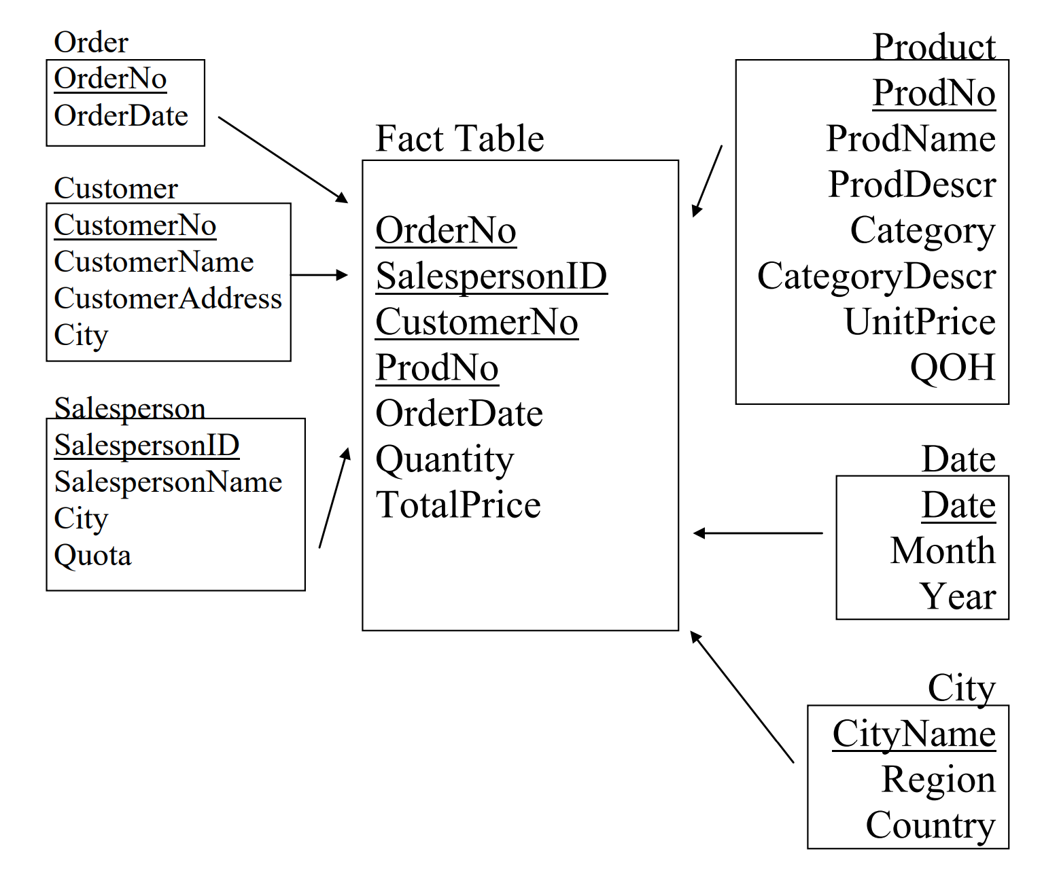
Star Schema

Slide 26
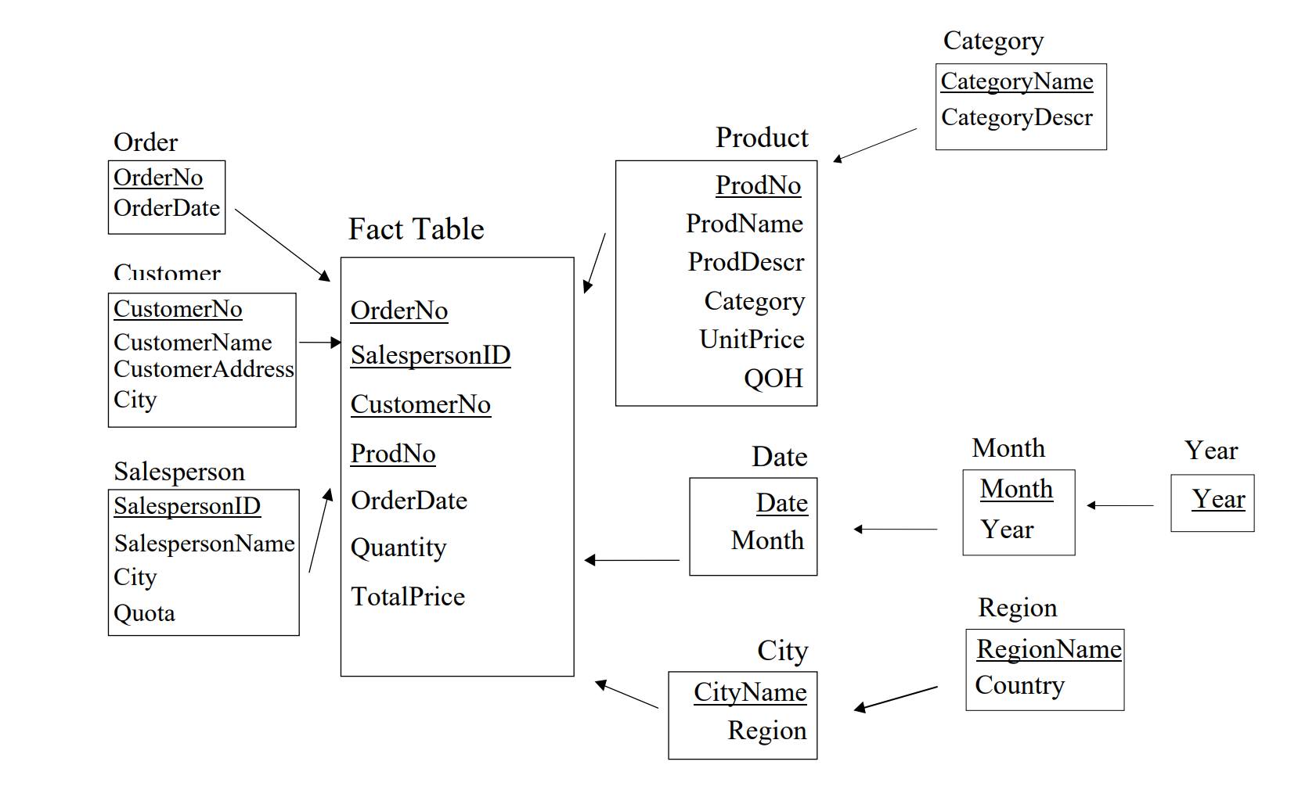
Snowflake Schema

Slide 27
现代语境下的数据分析 – 更广义的概念

Slide 28
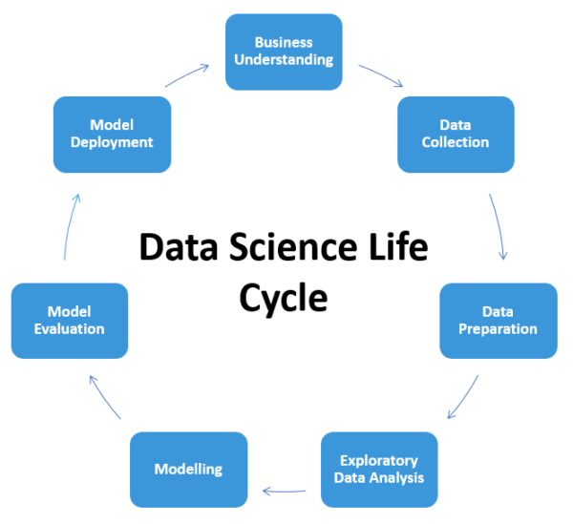
Data Science 生命周期

Slide 29
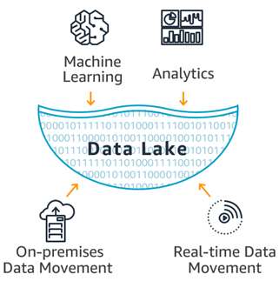
数据湖

Slide 30
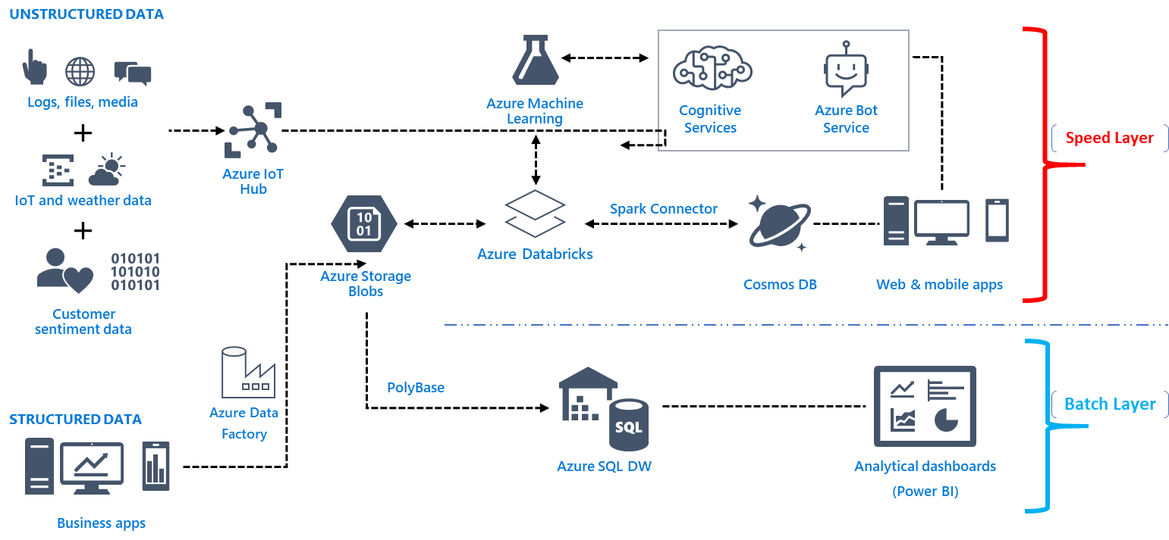
Big Data Ecosystem (Microsoft)

