Slide 1
Chapter 1
Import Protection Policy ：Tariff

Slide 2
Chapter 1
1. Basic Concepts of Tariff
2. Partial Equilibrium Analysis of Tariff
3. General Equilibrium Analysis of Tariff
Notes:
局部均衡
在假定其他市场条件不变的情况下，孤立地考察单个市场或部分市场的供求与价格之间的关系或均衡状态，而不考虑它们之间的相互联系和影响。
一般均衡
在承认供求与市场上各种商品价格和供求关系存在相互联系和相互影响条件下，所有市场上各种商品的价格与供求的关系或均衡状态。一般均衡理论的代表人物是瓦尔拉斯。

Slide 3
1. Basic Concepts of Tariff
Territory
Customs Territory
Notes:
Customs territory

Slide 4
1. Basic Concepts of Tariff
Import Tariff
Export Tariff
Transit Duty

Slide 5
1. Basic Concepts of Tariff
Ad valorem tariff
Specific tariff
Compound tariff
Notes:
Customs territory

Slide 6
1. Basic Concepts of Tariff
Slide tariff
Tariff quota

Slide 7
1. Basic Concepts of Tariff
General tariff rate
MFN(most-favored-nation) tariff rate
Conventional tariff rate
Special preferential tariff rate
GSP(Generalized system of Preferences) tariff rate
Notes:
Customs regulation

Slide 8
2. Partial Equilibrium Analysis of Tariff
Equilibrium Analysis of Tariff
Partial Equilibrium
General Equilibrium

Slide 9
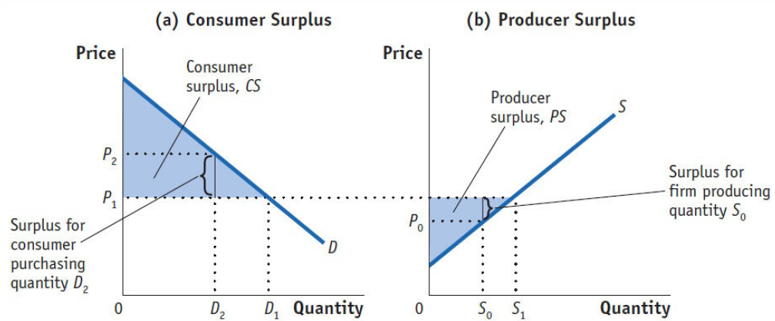
Gains from Trade
Consumer surplus
Producer surplus

Slide 10
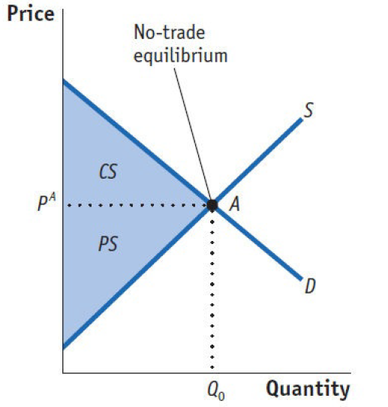
Gains from Trade
Home Welfare：No Trade

Slide 11
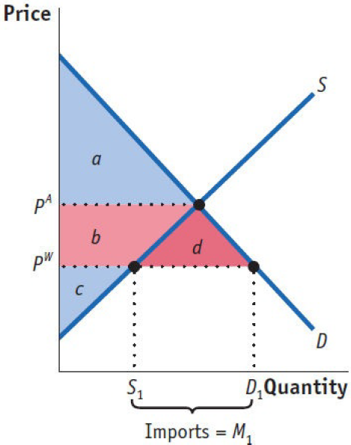
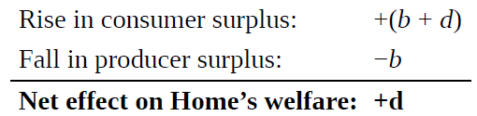
Gains from Trade
Home Welfare：Free Trade
Small Country / Large Country
Gains from trade

Slide 12
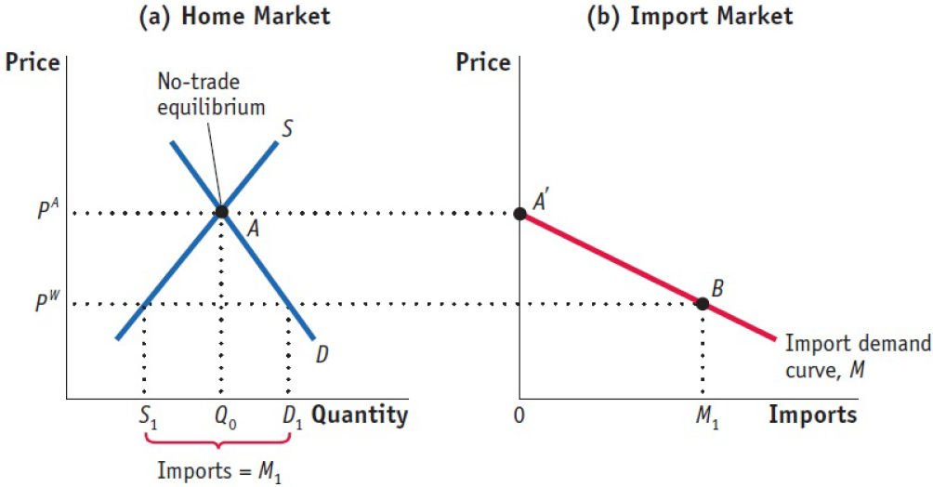
Gains from Trade
Home Welfare：Free Trade
Home Import Demand Curve

Slide 13
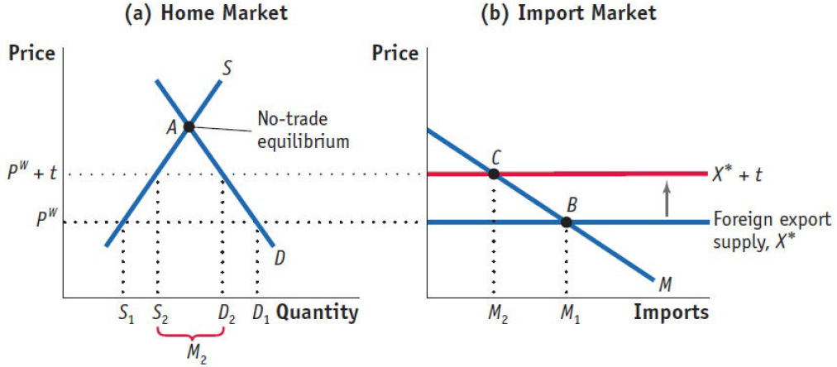
Import Tariffs for a Small Country

Slide 14
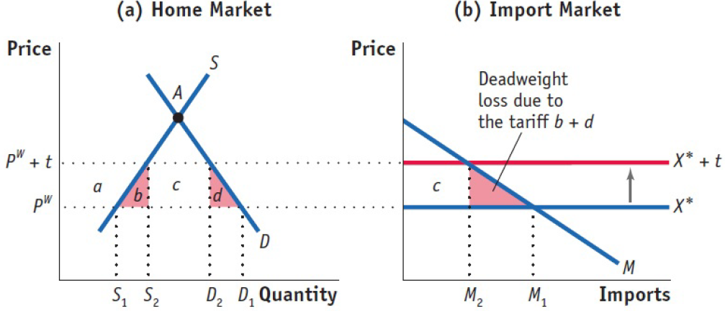
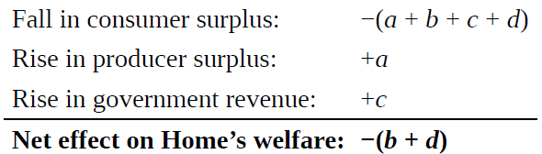
Import Tariffs for a Small Country

Slide 15
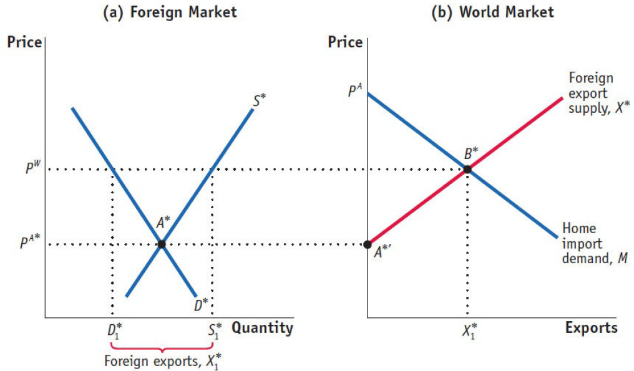
Import Tariffs for a Large Country

Slide 16
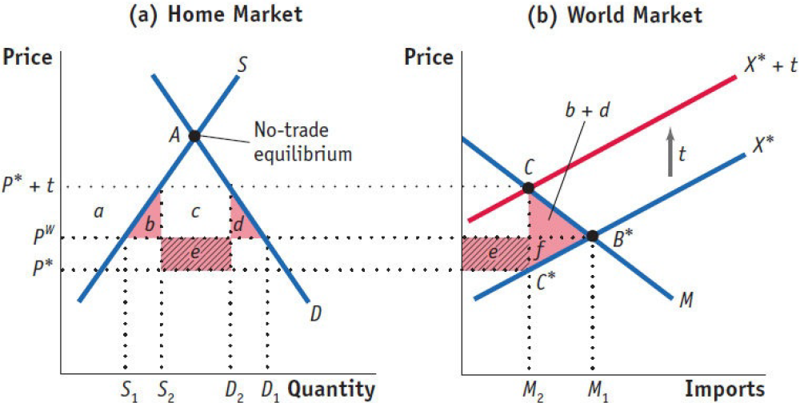
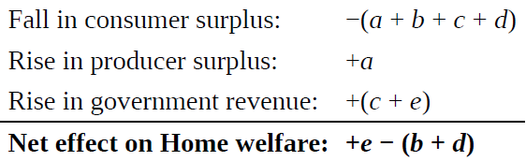
Import Tariffs for a Large Country

Slide 17
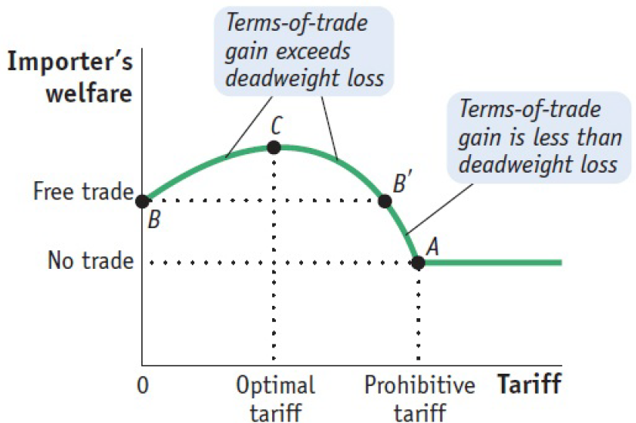
Optimal Tariff

Slide 18
Optimal Tariff
dP*/d τ<0
dP/d τ>0
dM/d τ<0

Slide 19
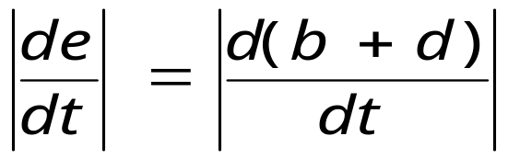
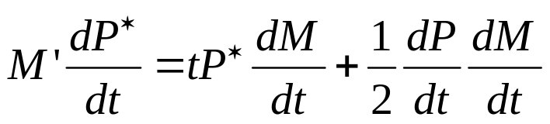
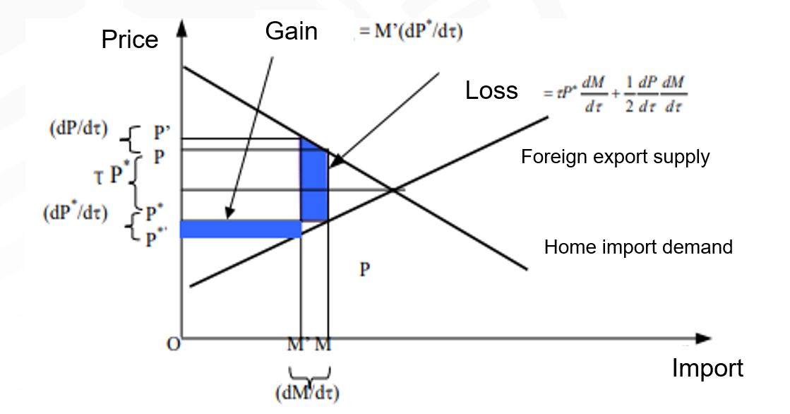
Optimal Tariff

Slide 20
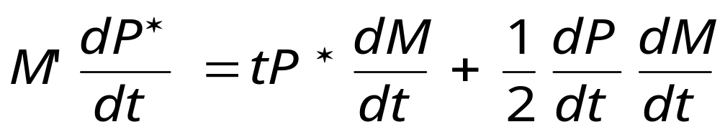
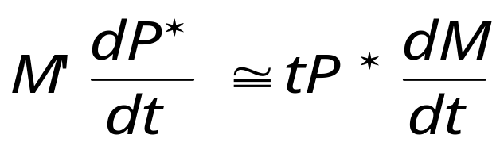
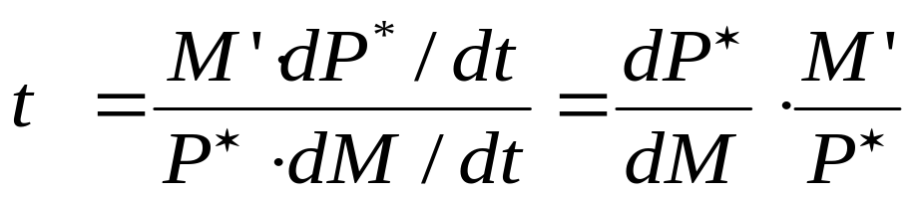
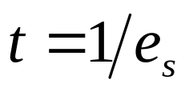
Optimal Tariff
es : Price elasticity of supply

Slide 21

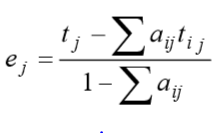
Effective Rate of Protection
Nominal tariff rate
Effective Rate of Protection
Why do you need to consider the effective protection rate？

Slide 22
General Equilibrium Analysis of Tariff
PDF（Production Possibility Curves）
CIC（Community Indifference Curve）
Y
I
A
C
0
B
X

Slide 23
General Equilibrium Analysis of Tariff
No Trade
Y
I
A
C
0
B
X

Slide 24
General Equilibrium Analysis of Tariff
Free Trade
Y
W
D
I
II
A
C
W’
E
W
P
0
S’
S
B
X

Slide 25
General Equilibrium Analysis of Tariff
Import Tariff(Small Country)
Y
III
W’
W
D
I
F
II
A
C
W’
E
W
P
T
0
S’
S
B
X

Slide 26
General Equilibrium Analysis of Tariff
Import Tariff(Large Country)
Y
W’
W
E
T’
E’
T
I’
I
A
P’
P
0
B
X

Slide 27
General Equilibrium Analysis of Tariff
Import Tariff(Large Country)
W’
T’
Y
W
E
E’
I’
T
I
A
P’
P
0
B
X

Slide 28
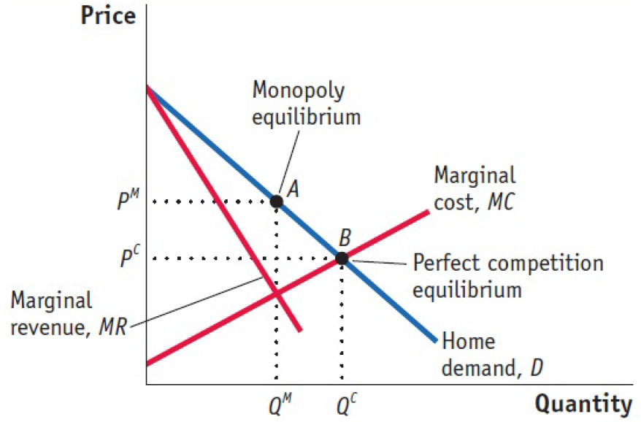
Import Tariff：under Imperfect Competition
Home Monopoly

Slide 29
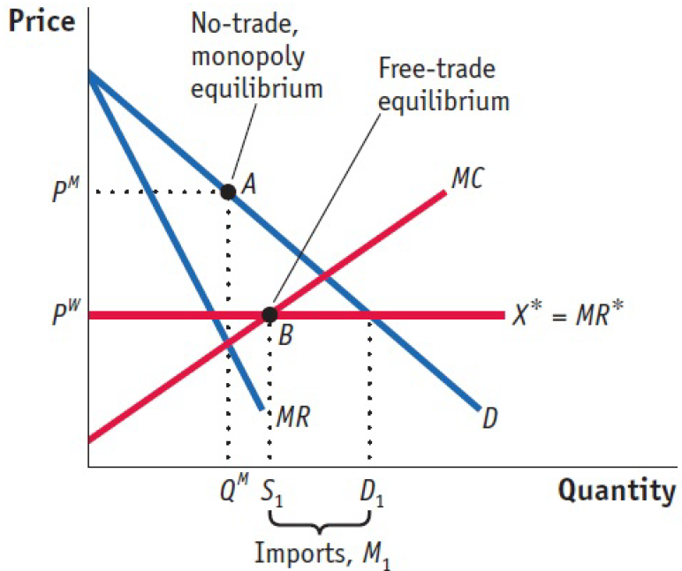
Import Tariff：under Imperfect Competition
Comparison with Perfect Competition

Slide 30
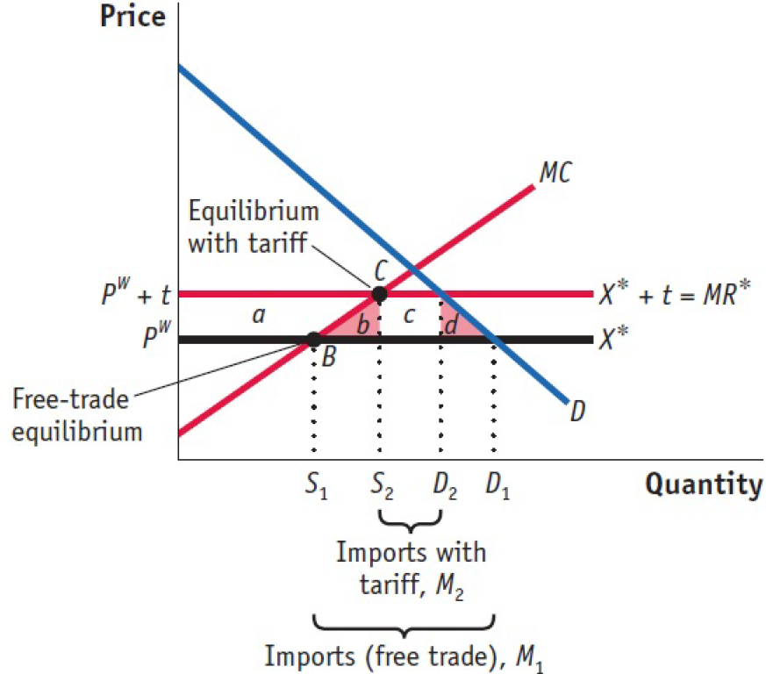
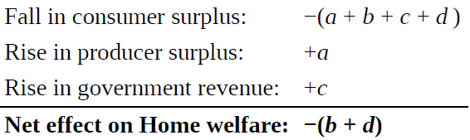
Import Tariff under Imperfect Competition
Effect of Home Tariff

