Slide 1
Chapter 2
Import Protection Policy: Non Tariff Barriers

Slide 2
Chapter 1
1. Import Quota and Voluntary Export Restraints(VER)
2. Domestic Policies that Affect Foreign Trade
3. Contingent Trade Protection

Slide 3
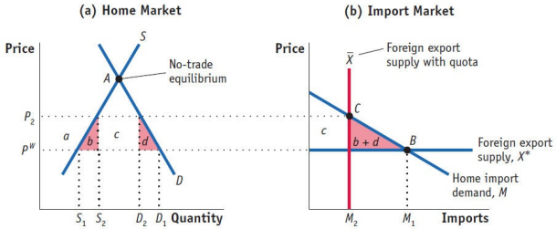
1. Import Quota and Voluntary Export Restraints(VER)
Import Quota under Perfect Competition
(Small Country)

Slide 4
1. Import Quota and Voluntary Export Restraints(VER)
“Voluntary” Export Restraints
Is it really "voluntary"?
What is the difference in the impact in this case?

Slide 5
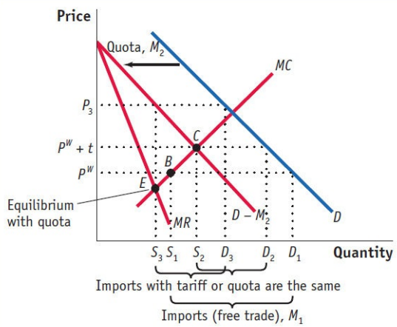
1. Import Quota and Voluntary Export Restraints(VER)
Import Quota under Imperfect Competition ：Home Monopoly

Slide 6
1. Import Quota and Voluntary Export Restraints(VER)
Import Quota under Imperfect Competition ：Home Monopoly
Price
MC
PW+t
Pw
MR
Dd
D
Quantity
Qf Qq Qt C3 C2 C1

Slide 7
1.Import Quota and Voluntary Export Restraints (VER)
The impact of increased domestic demand
Price
S
Price
D‘
Quota
D
t
D’m
Sx
Dm
Home market
Quantity
Import
Import market

Slide 8
1.Import Quota and Voluntary Export Restraints (VER)
The impact of increased international supply
Price
Price
Pw+t
Pw
Pw’=Pw-t
Import market
Import
World market
Quantity

Slide 9
1.Import Quota and Voluntary Export Restraints (VER)
Impact | increased domestic demand |  | increased international supply
 | Quota | Tariff | Quota | Tariff
Import Domestic price Domestic Production Domestic consumption Government income or Rent Loss(Compared with free trade) | - ↑ ↑ ↑ ↑ ↑ | ↑ - - ↑ ↑ - | - - - - ↑ ↑ | ↑ ↓ ↓ ↑ ↑ -

Slide 10
2. Domestic Policies that Affect Foreign Trade
Industrial policy
Price
f=t
a
b
d
Pw
Quantity
Notes:
Customs territory

Slide 11
2. Domestic Policies that Affect Foreign Trade
Industrial policy
Price
Pw
a
b
Quantity
Notes:
Customs territory

Slide 12
2. Domestic Policies that Affect Foreign Trade
Technical standard and social standard
Technical Barriers to Trade
Corporate social responsibility
Other trade barriers

Slide 13
3. Contingent Trade Protection
Anti-dumping
Price
b
d
a
t
MC+t
c
MC
MR
D
Quantity

Slide 14
3. Contingent Trade Protection
Countervailing duty
Price
A B
P₀
Export subsidy
Countervailing duty
P₁
D C
D_{M}
Import

Slide 15
3. Contingent Trade Protection
Economic safeguard measures

