Slide 1

Macroeconomics (宏观经济学)
周三
13:50-15:05
15:20-16:20
文附楼125

Slide 2
Macroeconomics Self Introduction
Yi Miao(易苗)，graduated at Nankai University, now department of international trade of ECNU.
Email: yimiao20110059@126.com （答疑、请假）
请假请在课前发邮件给我：邮件说明请假原因，课后补假条。
Office: 华东师范大学中北校区理科大楼A802室
周三上午：8:30-10:00
It’s time to know you!

Slide 3


Macroeconomics Teaching Mode
线下授课和答疑
线上作业和答疑
注意：课件、网上资源等课程资料不得网上传播，考试以上课内容为主！

Slide 4
Why do we study Macroeconomics?
Help you understand the world in which you live.
Why do some countries have high rates of inflation while others have stable prices?
Why are jobs easy to find in some years and hard to find in others?

Slide 5
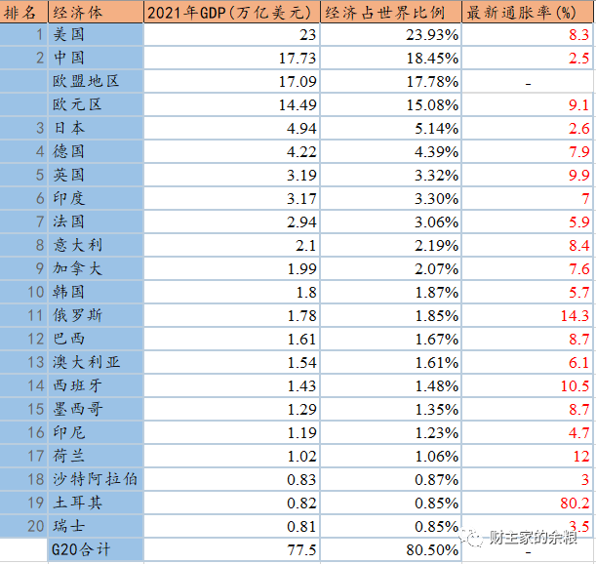
前20大经济体2022年8月通货膨胀率
价格指数较去年的增长率
3.5

Slide 6
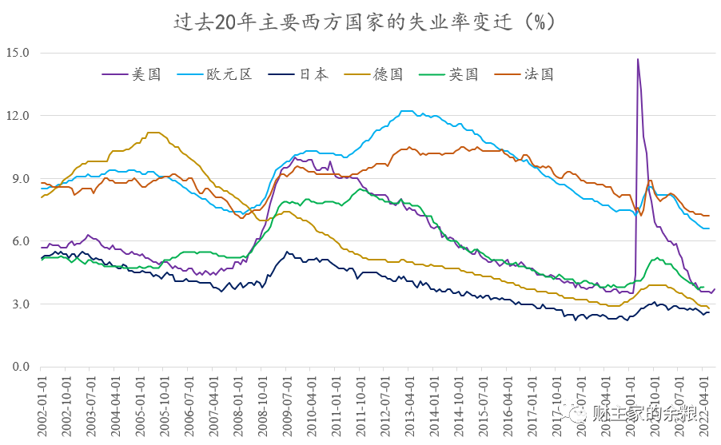
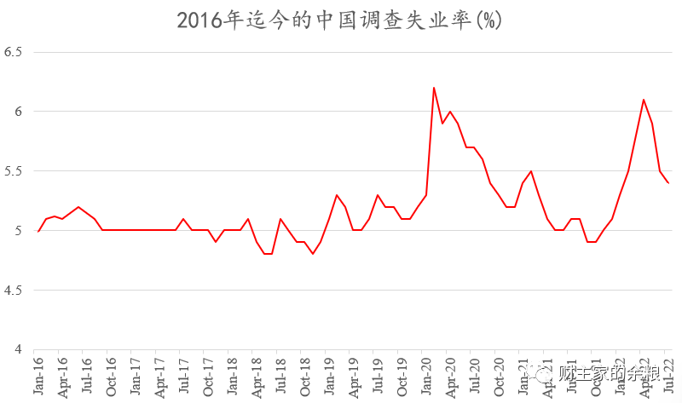
中西失业率比较

Slide 7

Why do we study Macroeconomics?
2. Give you a better understanding of the potential and limits of economic policy.
What are the effects of free trade with other countries?
What is the best way to protect the environment?
上海发布22条稳经济新政

Slide 8
Why do we study Macroeconomics?
Answers to these question can help you make appropriate decisions in your future lives, including：
choosing a city where you live and work
hunting a job
finding the best time to buy a home

Slide 9
How do we study Macroeconomics?
Key Concepts: You need to know the reason why we have these in our macroeconomic analysis and figure out how we use it.
Core Questions: Each chapter has some core questions, and you have to learn the effective method to answer these questions.

Slide 10
How do we study Macroeconomics?
Effective Applications
We learn Macroeconomics not for paperwork, but for using it to better understand the society, the government, and the world.
So, use it!

Slide 11
Macroeconomics Objectives
Understand the fundamental concepts of Macroeconomics, eg. GDP, CPI;
Know how macro economy operate in the long run and short run;
Use macroeconomics to analyze real problems in our lives.

Slide 12
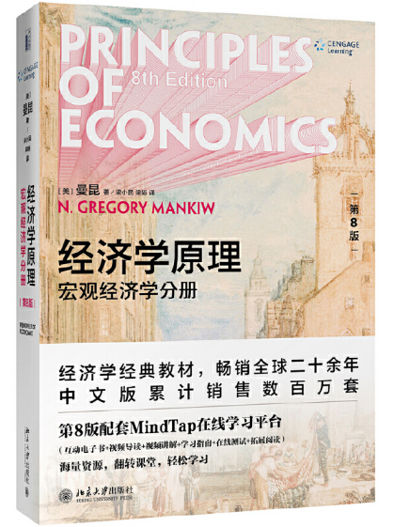
Macroeconomics Text Book
Principles of Economics
8th Edition
Macroeconomics Part
Published by：
北京大学出版社
Publish Time:2020.05.

Slide 13
Macroeconomics Score Composition
Regular grades（40%）+ Final Exam（60%） Regular grades
Attendance（20/40）+ Homework（20/40）
Attendance: I will ask question on class, if you are absent you will lose 2/20 each time.
Homework
Submit your homework on time!!!
Usually the deadline is every Monday
Final Exam: closed-book exam

Slide 14
Syllabus (3 parts and 5 chaps)
Part 1 THE DATA OF MACROECONOMICS
Chap 23 Measuring a Nation’s Income
Chap 24 Measuring the Cost of Living
Part 2 THE REAL ECONOMY IN THE LONG RUN
Chap 25 Production and Growth
Chap 26 Saving, Investment, and the Financial System
Chap 28 Unemployment

Slide 15

Macroeconomics Syllabus
PART 3 MONEY AND PRICE IN THE LONG RUN
Chap 29 The Money System
Chap 30 Money Growth and Inflation
PART 4 SHORT RUN ECONOMIC FLUCTUATIONS
Chap 33 Aggregate Demand and Aggregate Supply
Chap 34 The Influence of Monetary and Fiscal Policy on Aggregate Demand

Slide 16
Do you have any questions?

