Slide 1
British Airways
Web scraping to gain valuable insights
16/03/2023

Slide 2
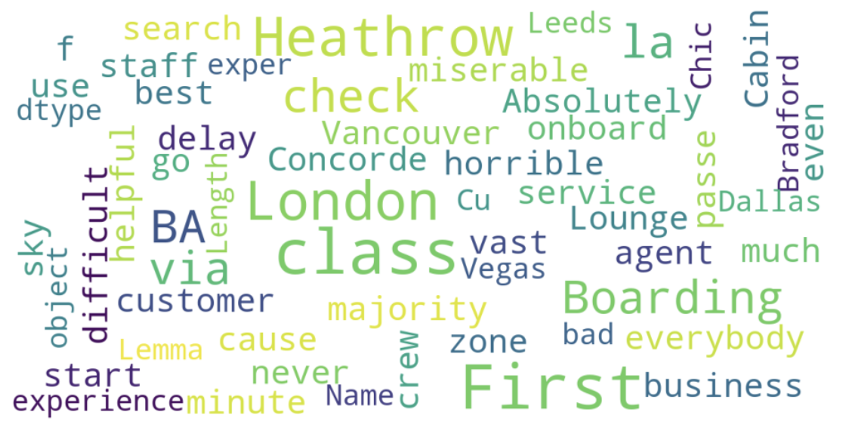
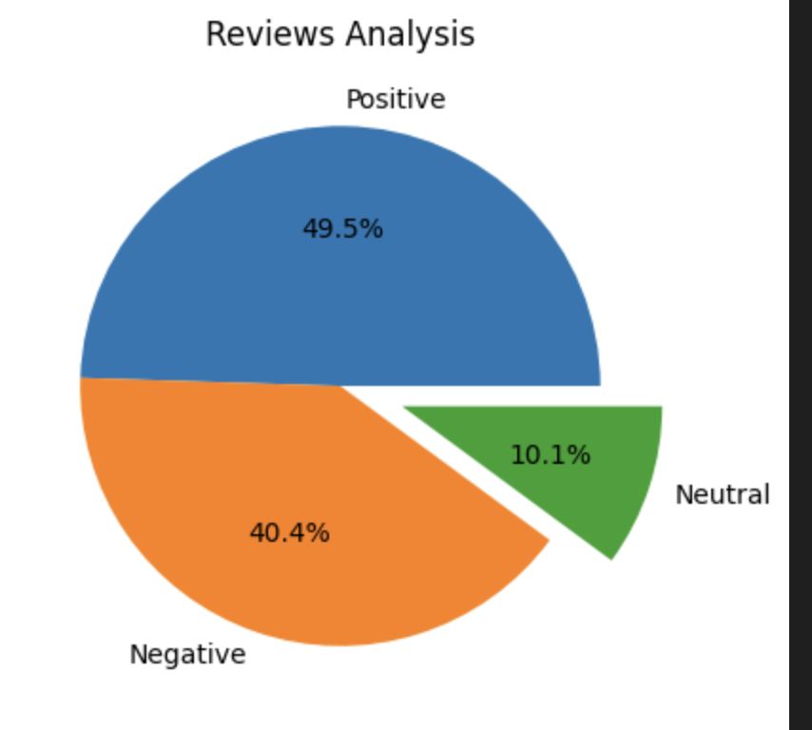
Customer review insights
Wordcloud of words used in reviews:
Web scraping https://www.airlinequality.com/airline-reviews/british-airways for 1000 reviews showed:
495 positive reviews
404 negative reviews
101 neutral reviews

