Slide 1

British Airways
Predicting customer buying behaviour

Slide 2
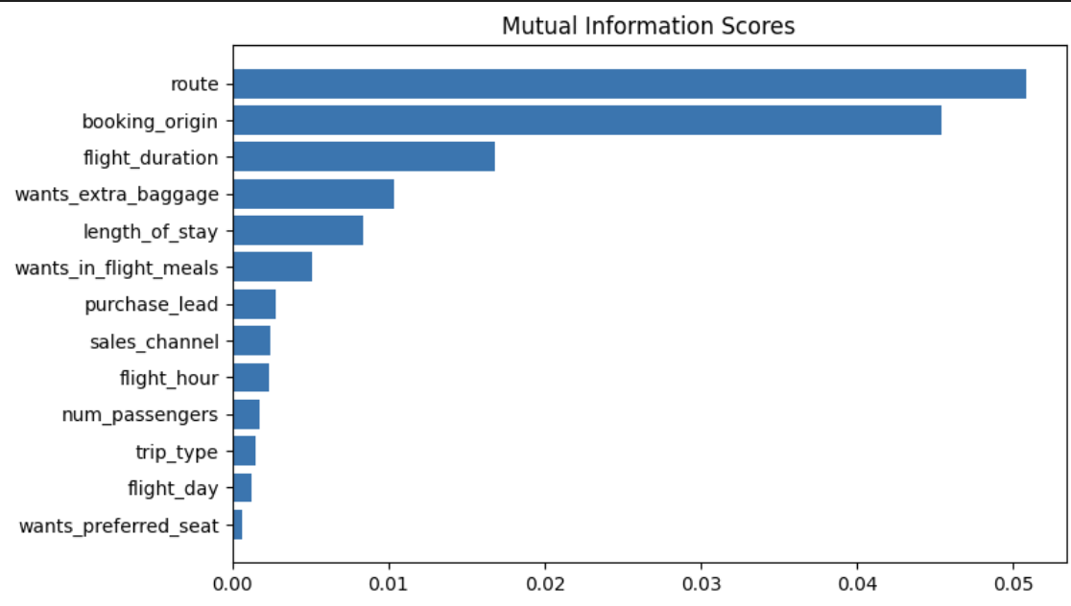
Machine learning model to predict customer buying behaviours
We trained our data set with a Random Forest Classifier Model:
Accuracy – 85.26
AUC score – 0.566
Top 5 features that influenced customer buying behaviours:
1. Route
2. Booking_origin
3. Flight_duration
4. Wants_extra_baggage
5. Length_of_stay

