Slide 1
Modeling the Within-Host Dynamics of HIV

Slide 2
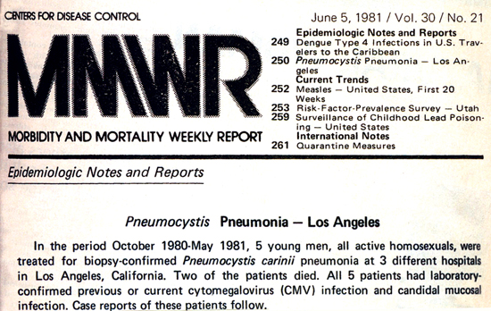

Slide 3
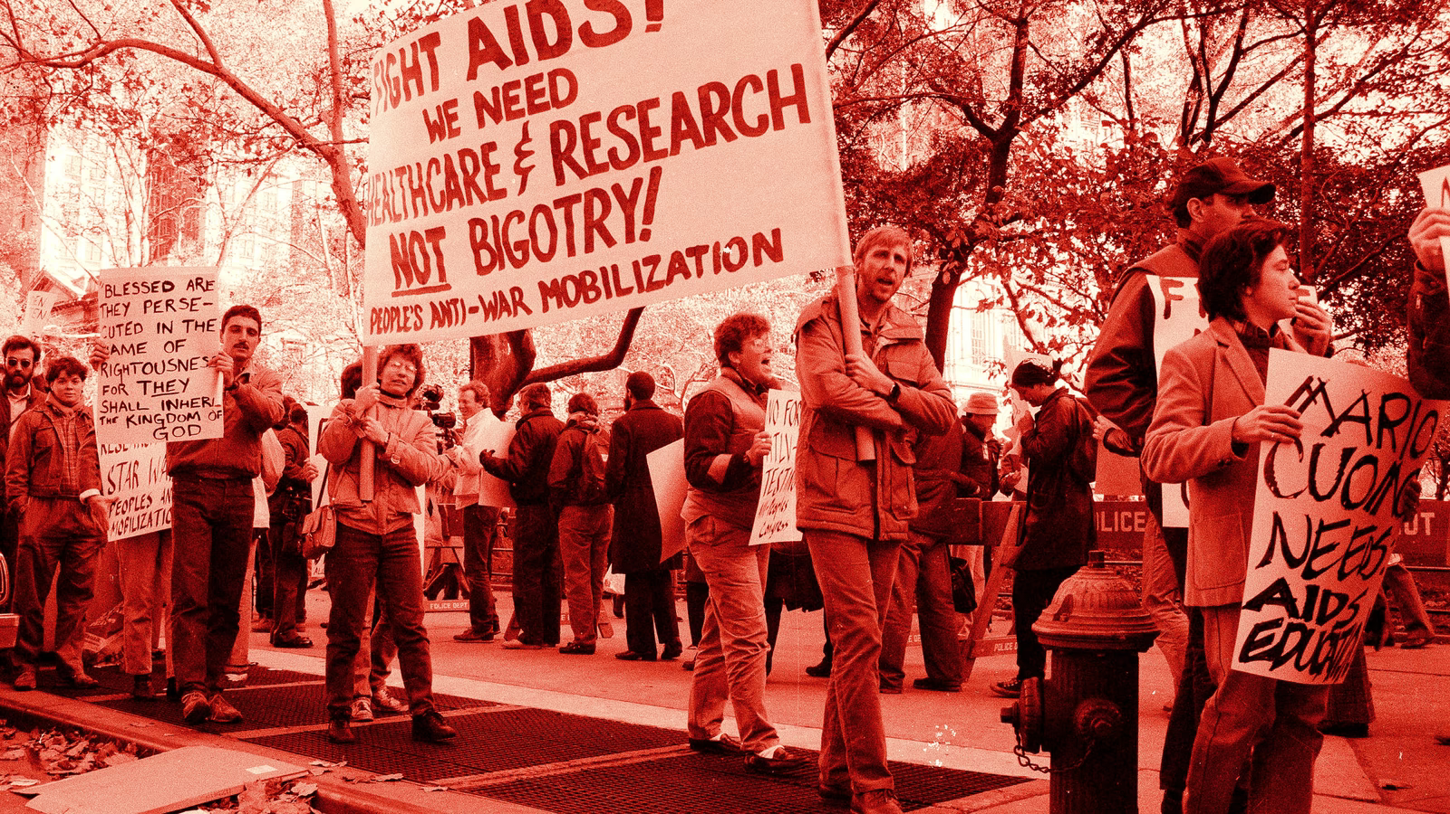
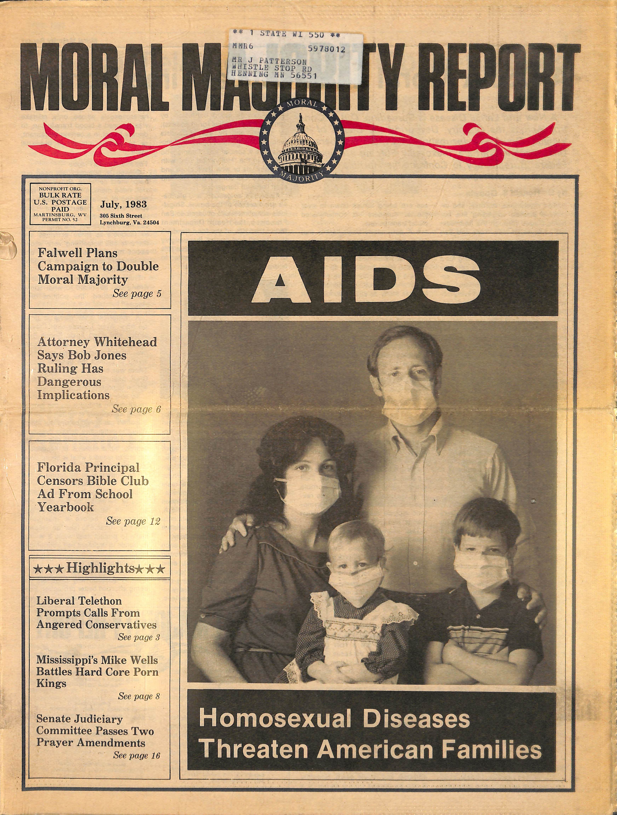

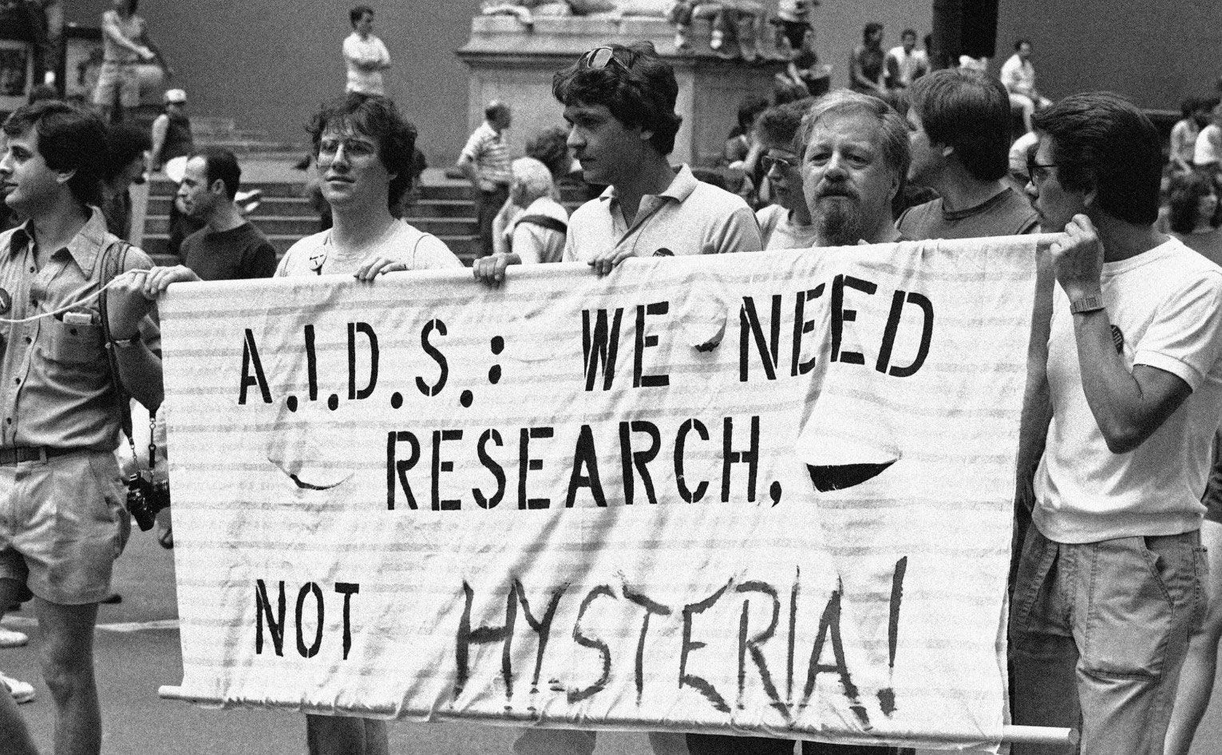

Slide 4
Stage 1: Acute Infection
- 2-8 weeks
- Viral load is high
Stage 2: Chronic Infection
- 10 years
- Steady state
- CD4+ T-cell count declines
Stage 3: AIDS
- Final stage
- Opportunistic infections
take advantage of damaged
immune system

Slide 5
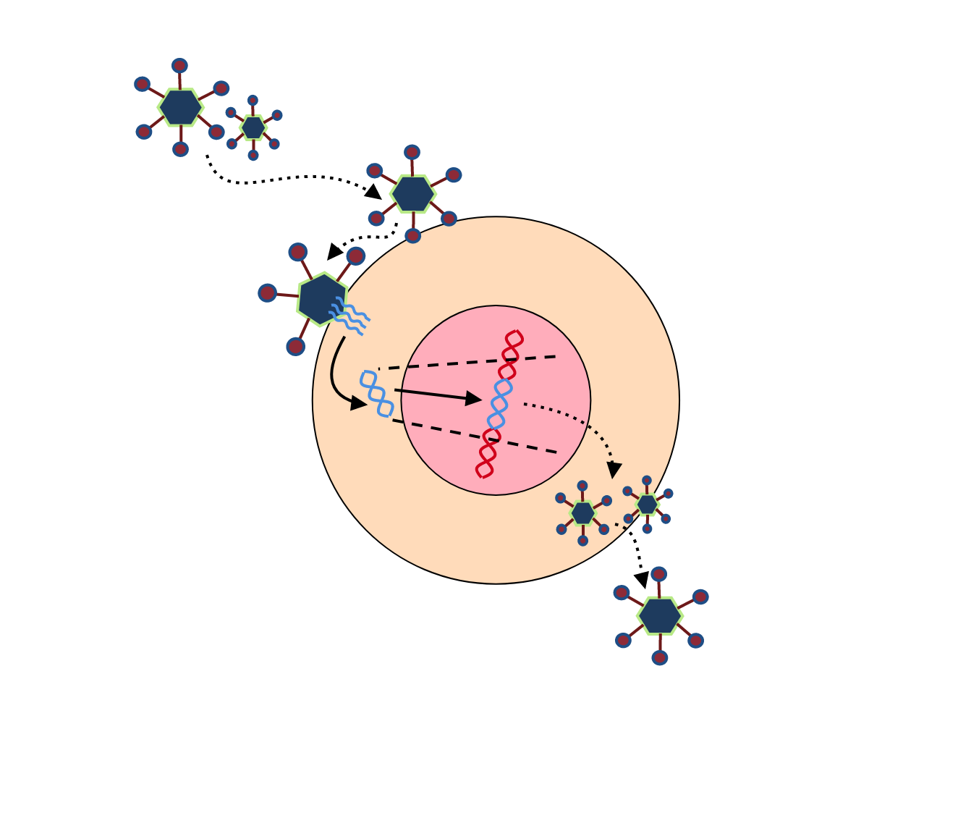
HIV Life Cycle

Slide 6
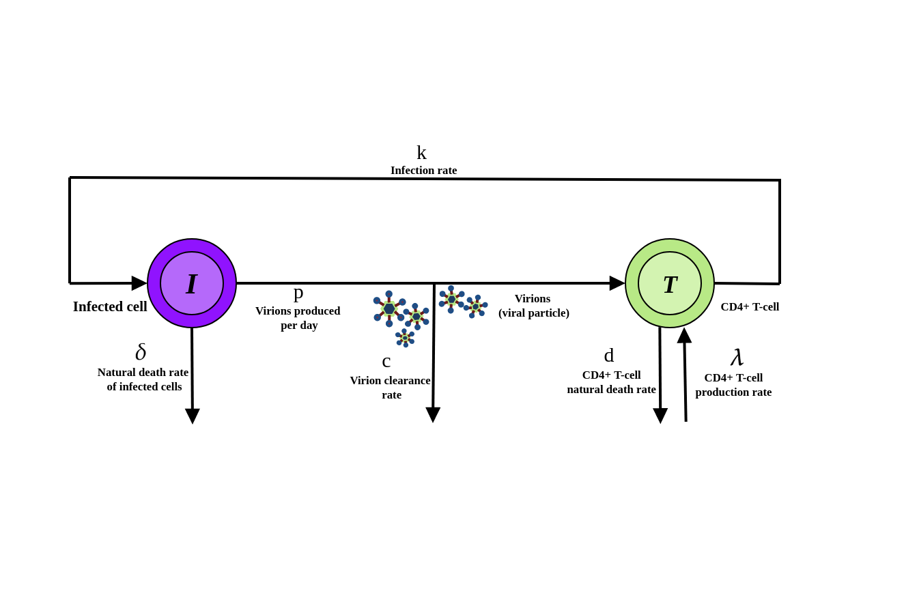
The TIV Model

Slide 7
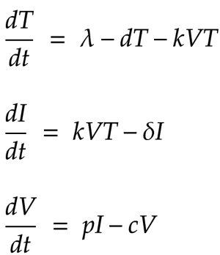

Slide 8
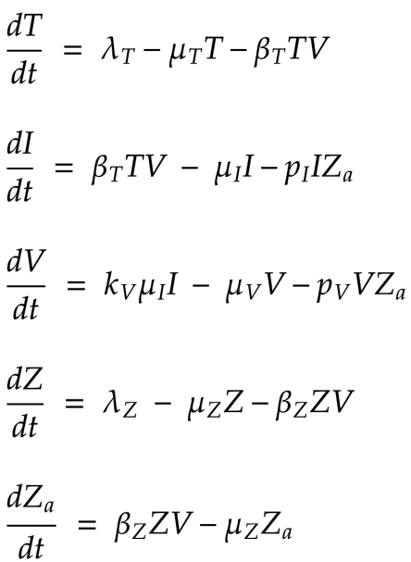

Slide 9
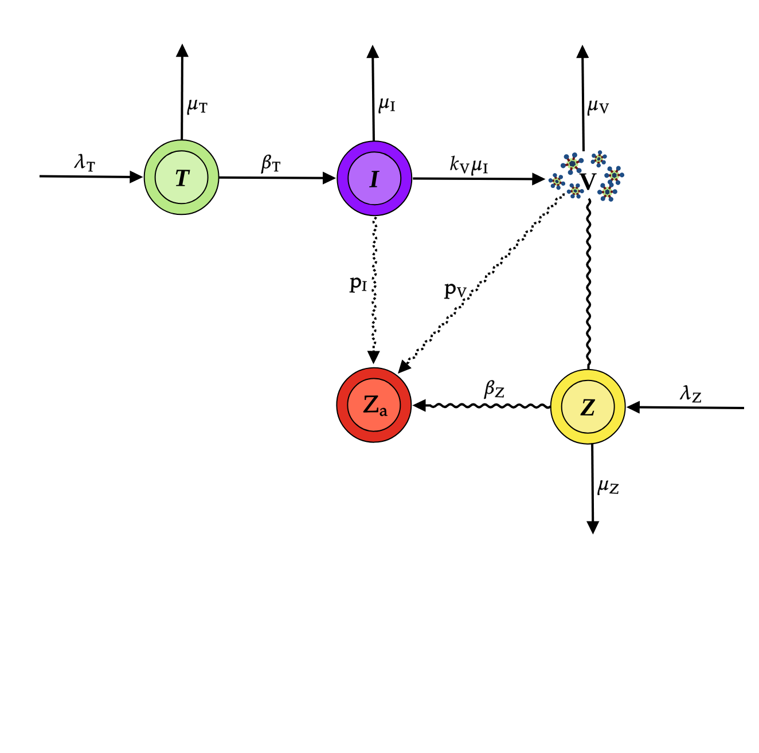

Slide 10


Slide 11
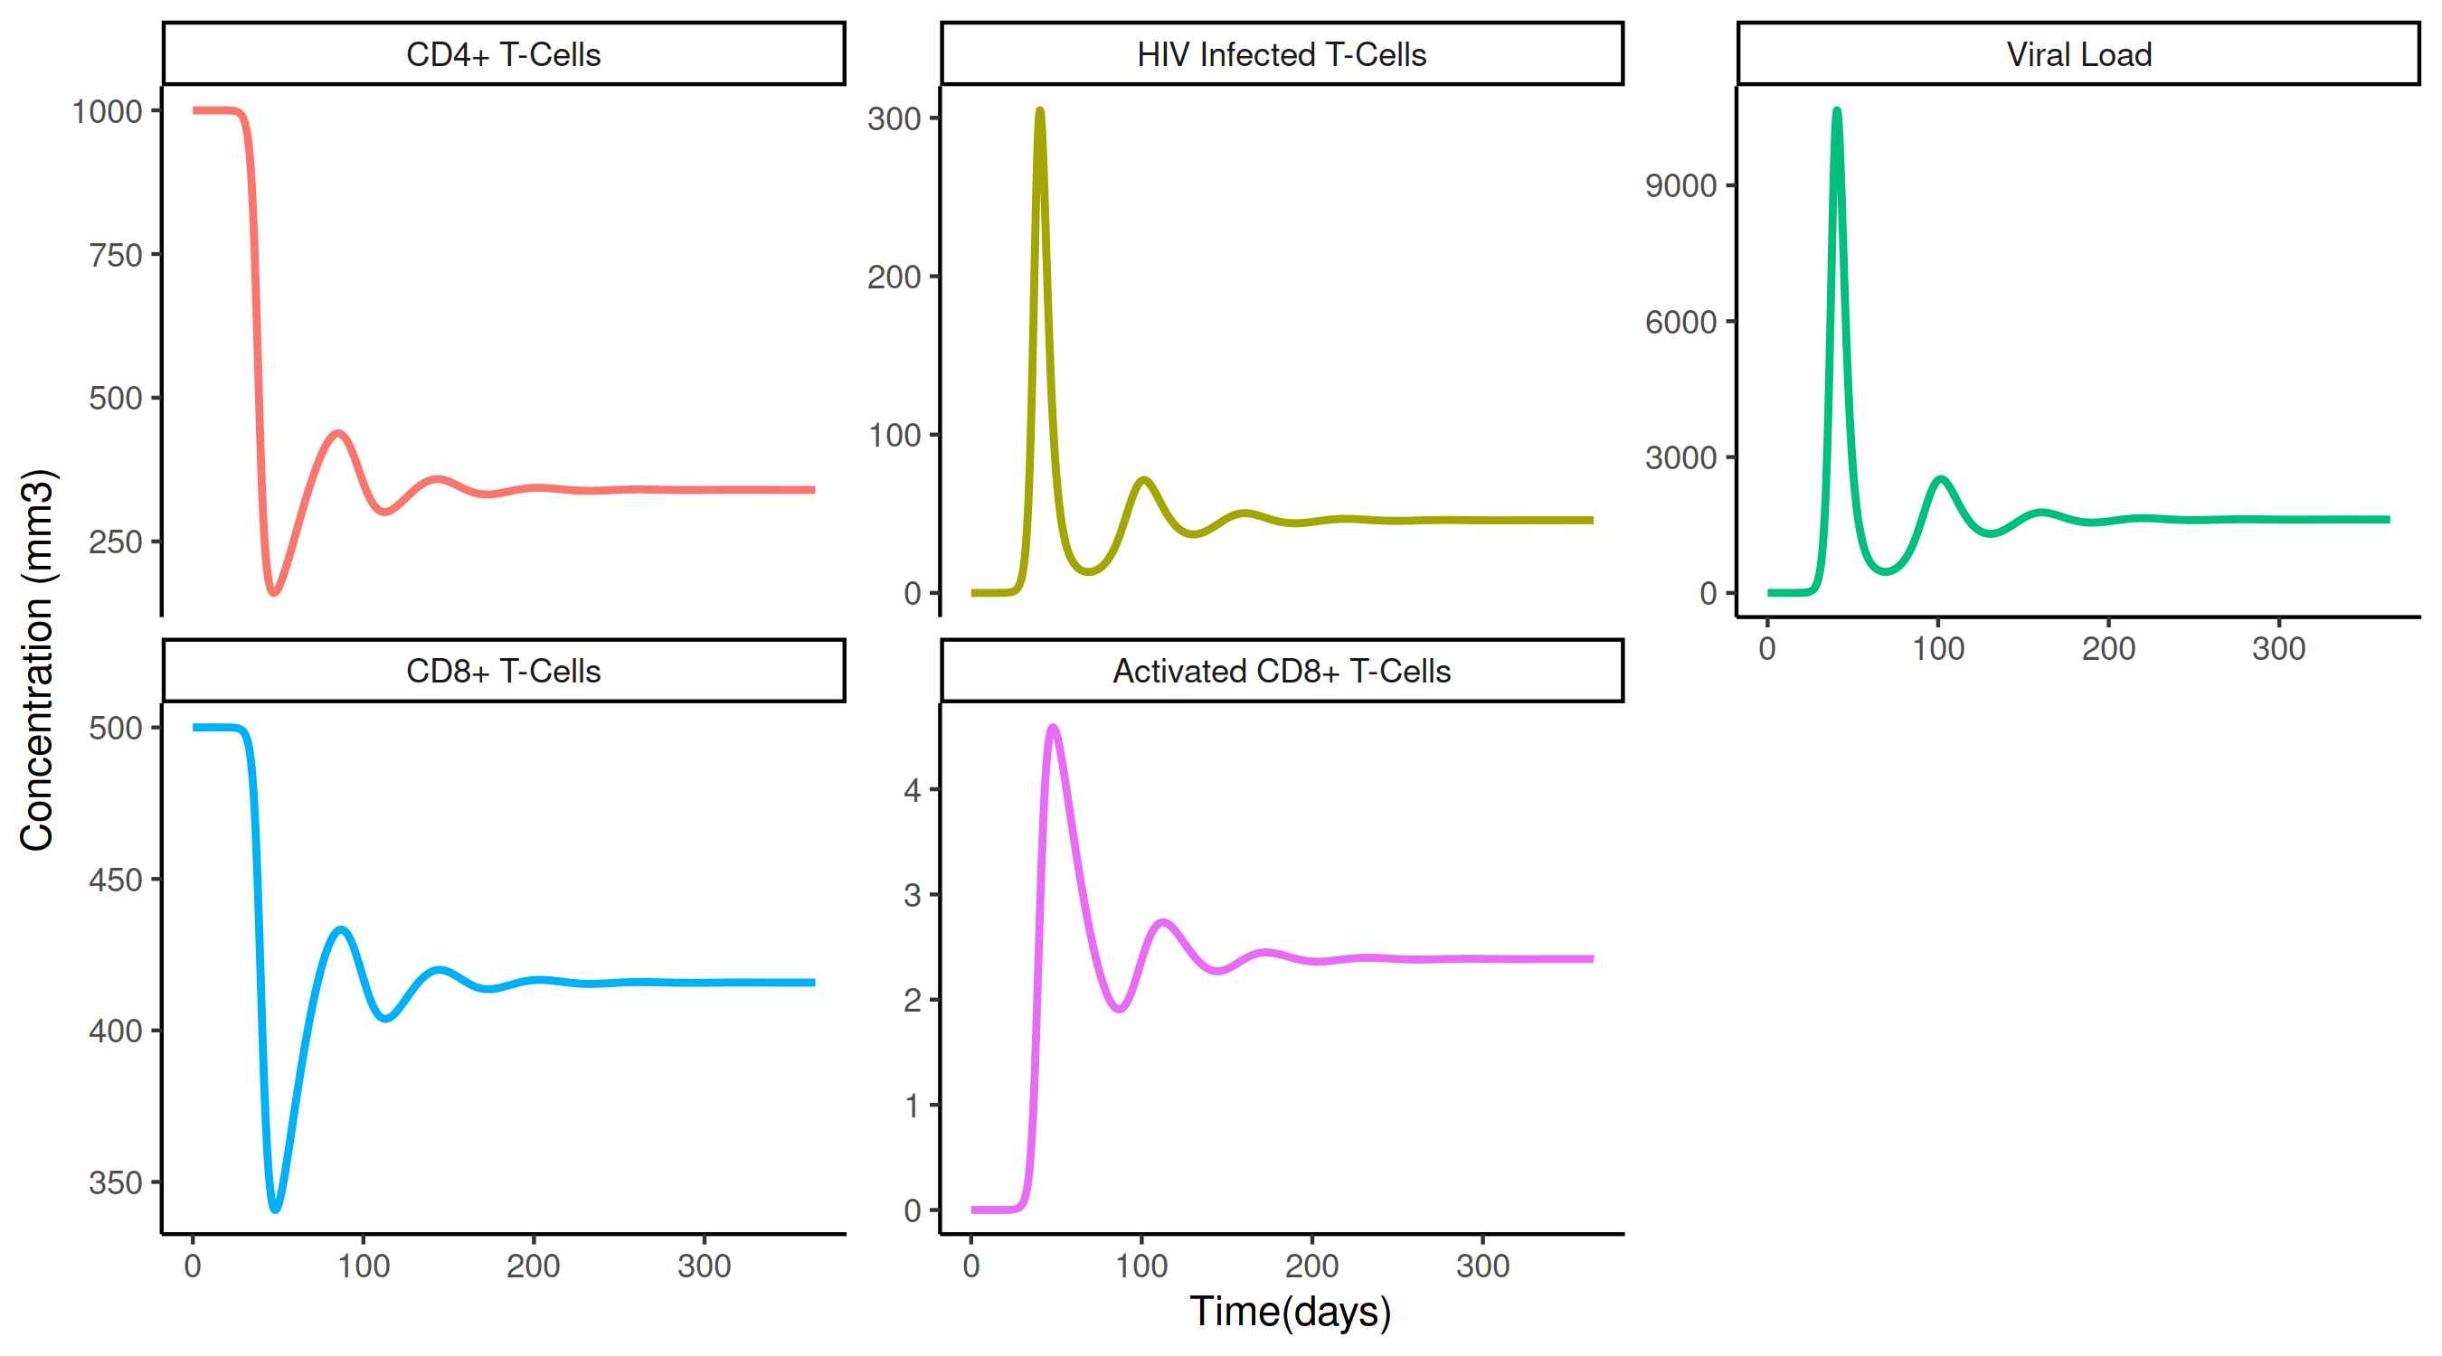

Slide 12
Drug Class | Purpose
Reverse Transcriptase Inhibitors | Prevents viral RNA from being converted to DNA, prevents virus from productively infecting the cell
Protease Inhibitors | Prevents new virions from maturing, meaning non-infectious viral particles are produced
Integrase Inhibitors | Blocks integration of HIV DNA with cell DNA
Entry Inhibitors | Stops HIV from binding to, and then entering, a cell
Pharmacokinetic Enhancers | Prevents drug breakdown allowing another drug to remain in the body for longer boosting another drugs effectiveness

Slide 13
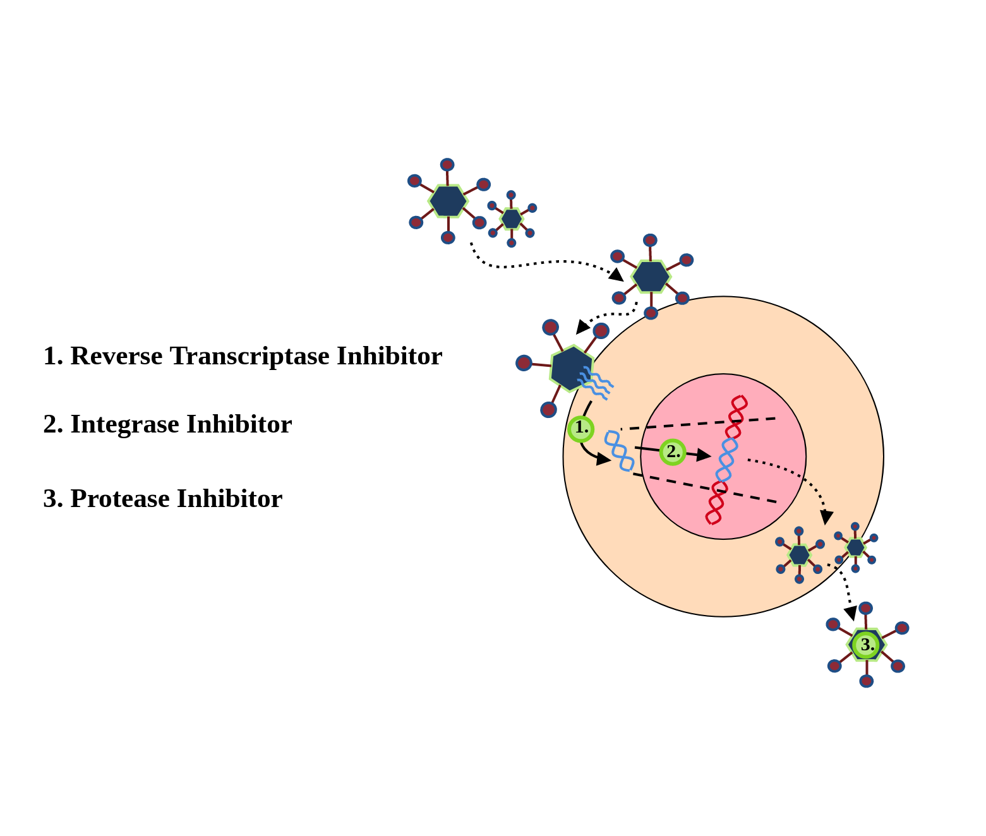

Slide 14
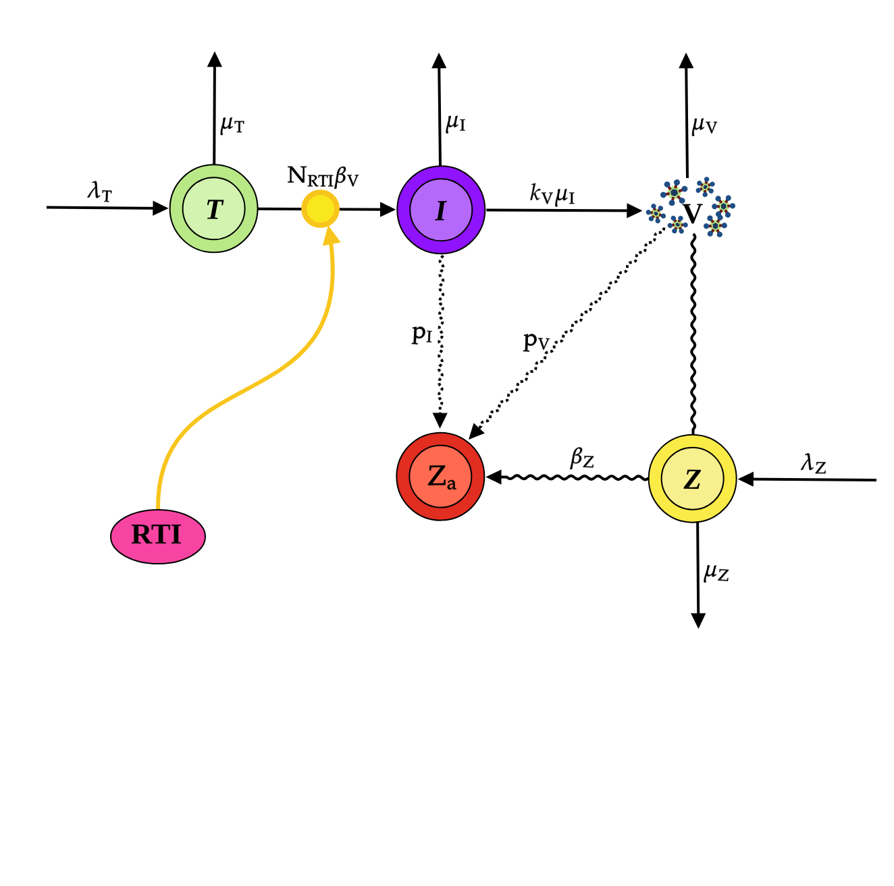

Slide 15
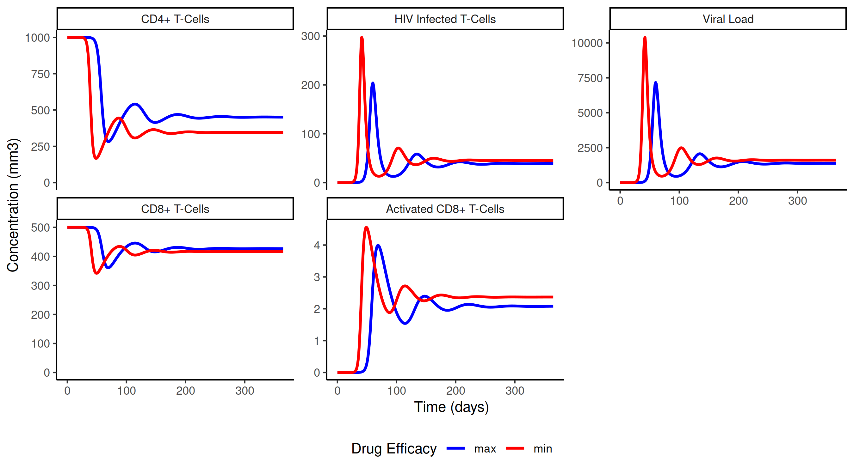

Slide 16
Next steps...

