Slide 1
Imperial Capital Allocation
AI-powered investment guidance for founders and investors
Using public data, portfolio analysis, and LLMs to recommend how a client should invest capital responsibly
Notes:
This project turns public information and portfolio data into a simple decision-support tool. It helps a client understand how to allocate capital, what risks matter, and why the recommendation is sensible.

Slide 2
The Client
Startup founders deciding how to deploy capital in tax-efficient ways
Early-stage investors comparing portfolio strategies

Slide 3
The Data

Slide 4
What the AI does

Slide 5
The recommendations

Slide 6
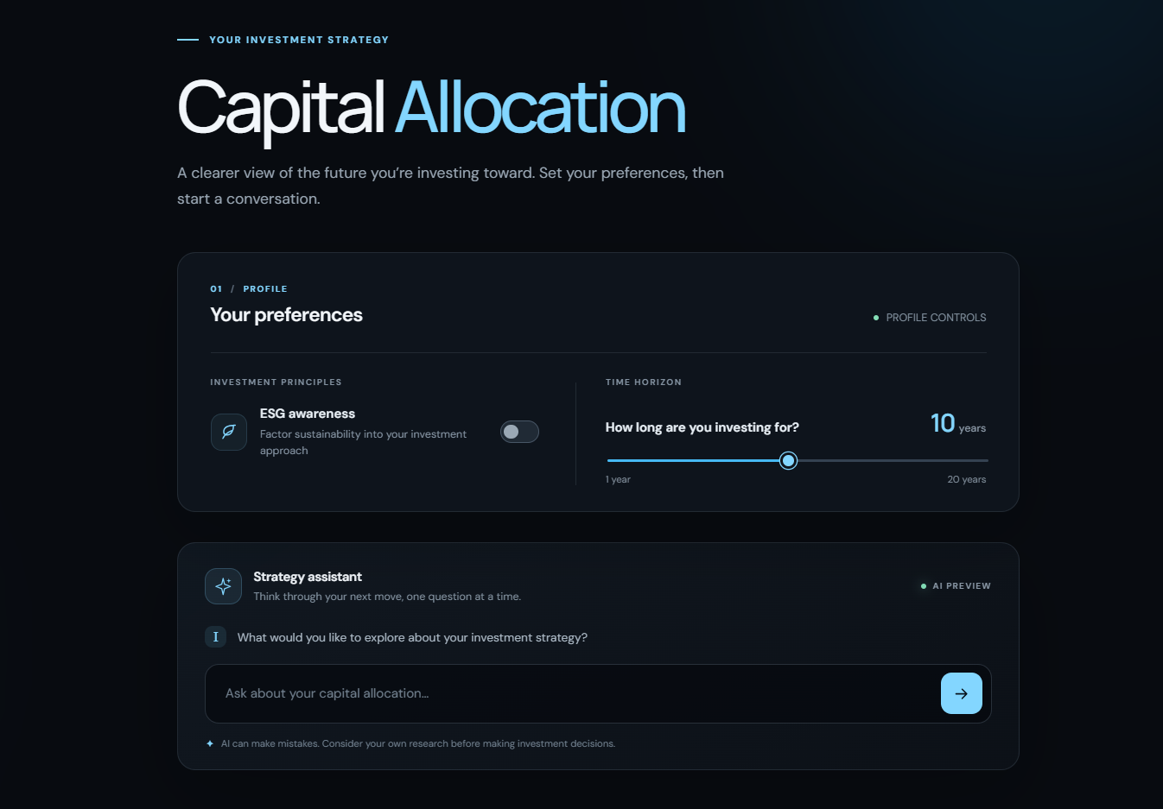
Live Demo

