Slide 1
Next Word Prediction with LSTM model
Group1: Yuze Han, Xiaoyong Ma, Jialin Shi, Lily Wang

Slide 2
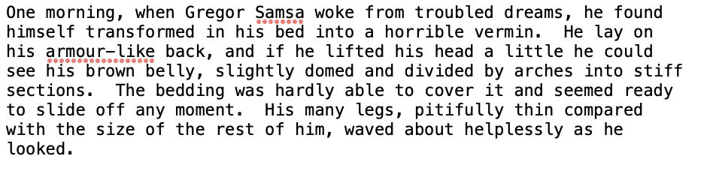
Data preprocessing (Kafka’s Metamorphosis)
length of the corpus: 119164; number of unique words: 2572
Clean the text: convert to form for coding
Tokenization:
Why? LSTM only understand real numbers
Create a feature sequences, containing all unique words
Convert to integers with the tokenizer package

Slide 3
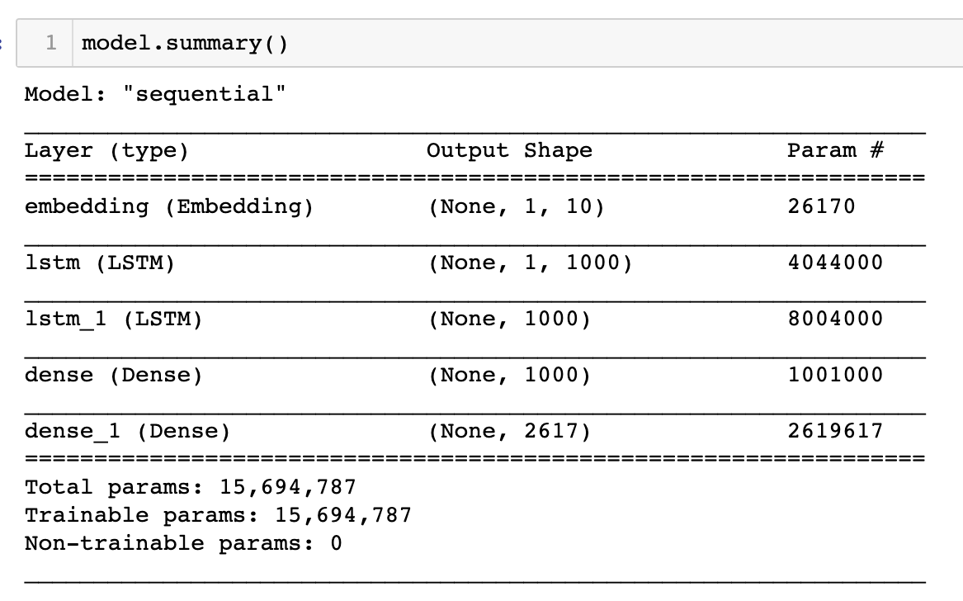
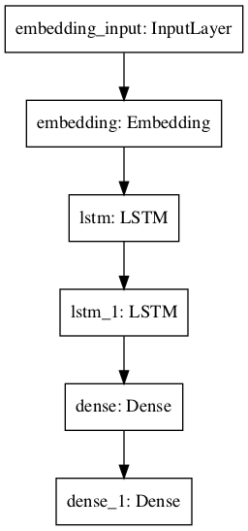
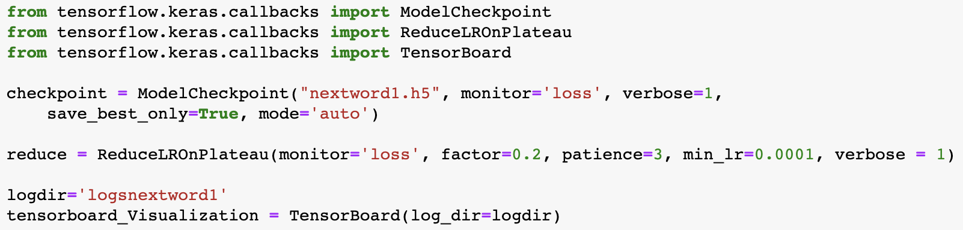
Build the model

Slide 4
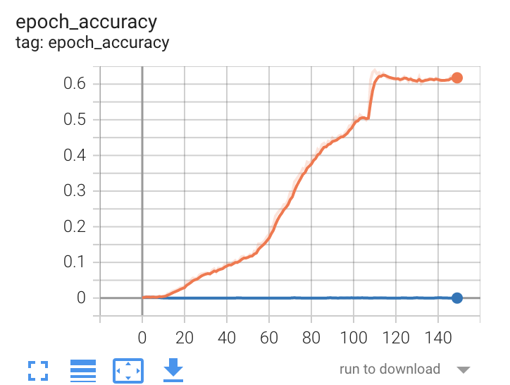
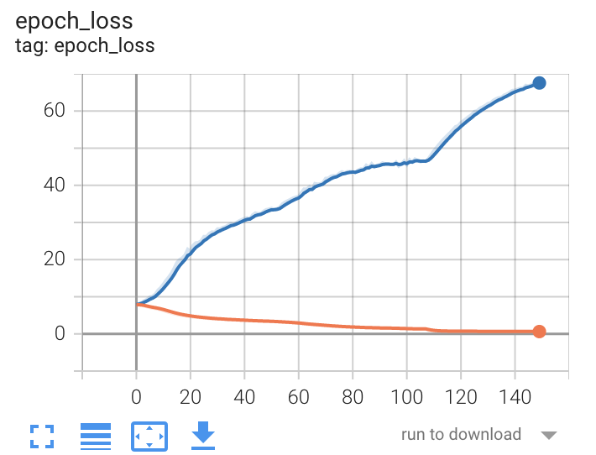
Evaluate the model (tensorboard visualization)
http://localhost:6007/

Slide 5
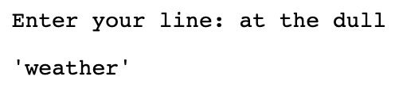
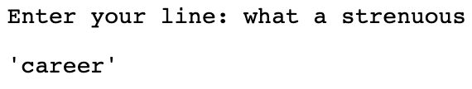
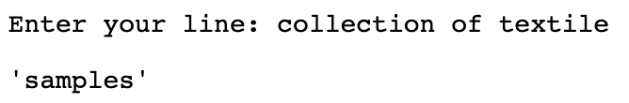
Predict with the model
model.predict function
Load the restored tokenizer to map numbers back to words

Slide 6
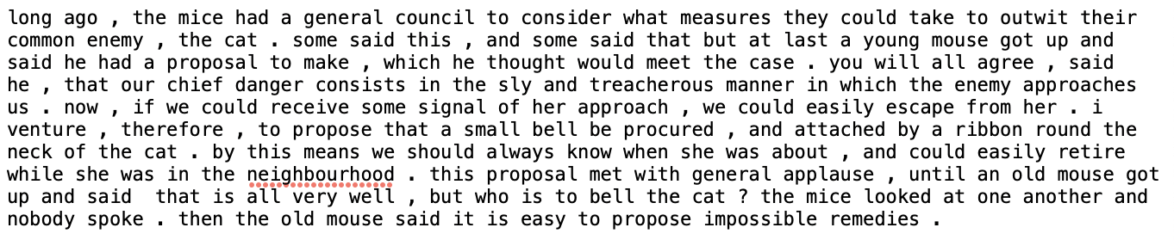
Interesting takeaways: Data size and overfitting
Description of data set: belling the cat
length of the corpus is: 980
number of unique words are: 109

Slide 7
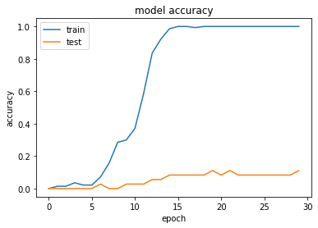
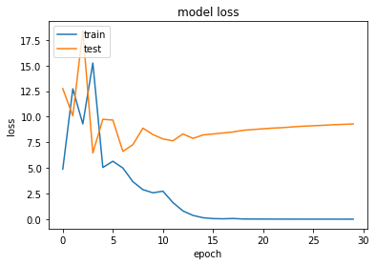
Interesting takeaways: Data size and overfitting
Output: belling the cat, model1

Slide 8
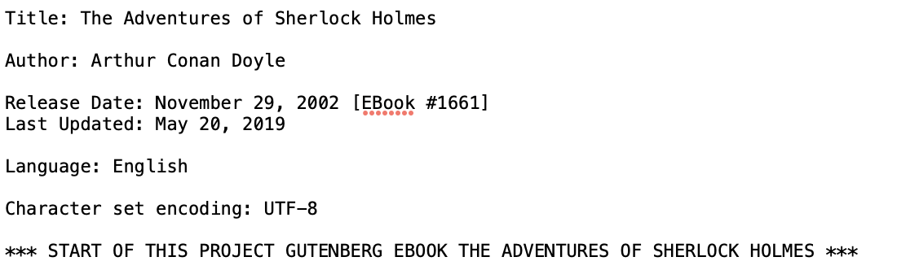
Interesting takeaways: Data size and overfitting
Description of data set: sherlock
length of the corpus is: 581888
number of unique words are: 8201

Slide 9
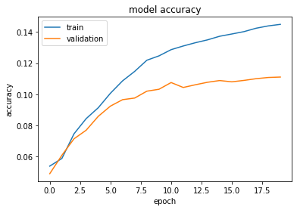
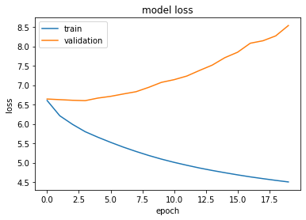
Interesting takeaways: Data size and overfitting
Output: sherlock, model2
Next step: Still confusing loss?

Slide 10
Interesting takeaways: Data size and overfitting
Small data size may highly result in overfitting
Large data size does not guarantee success…

Slide 11
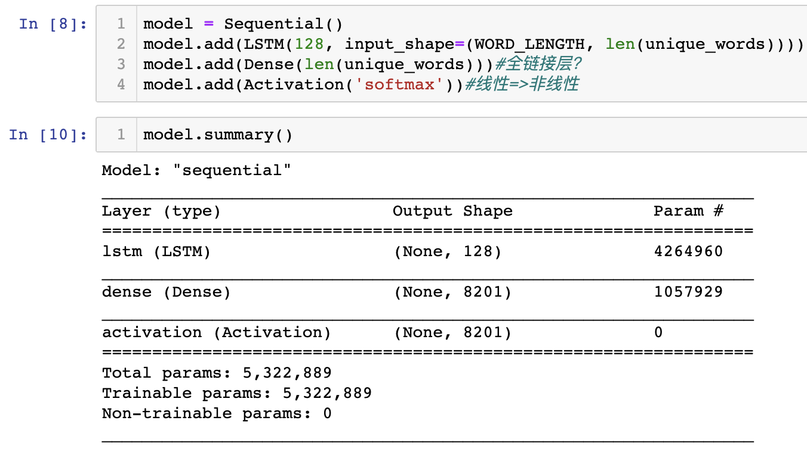
Next step: Results of different models
Model 1 Structure

Slide 12
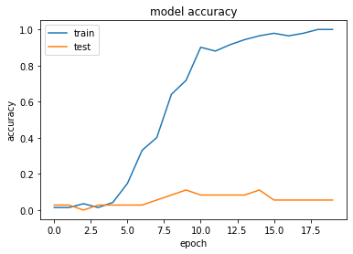
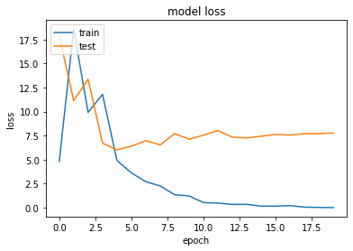
Next step: Results of different models
Output: metamorphosis dataset, model 1

Slide 13
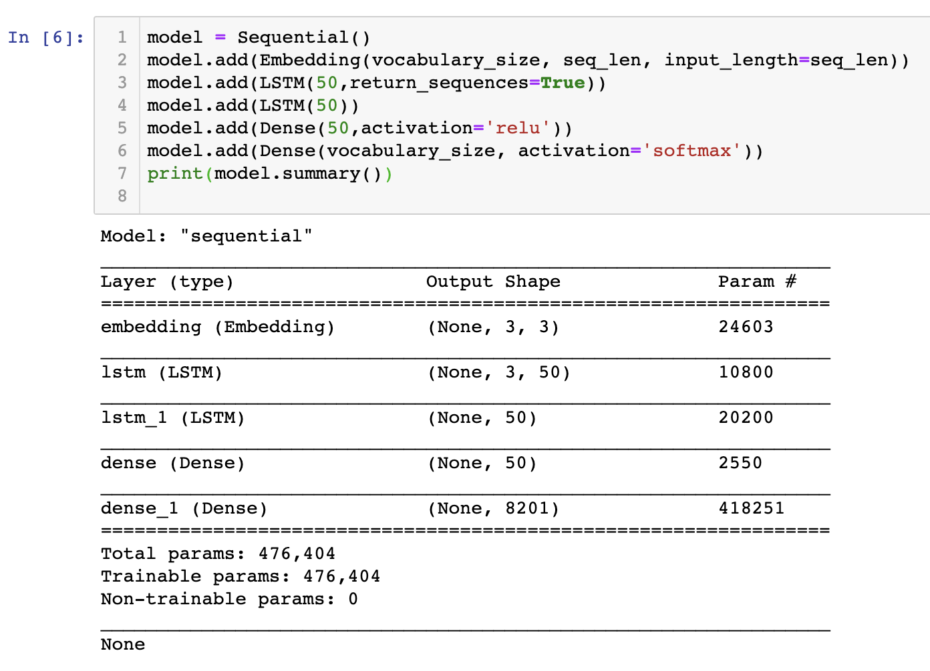
Next step: Results of different models
Model 2 Structure

Slide 14
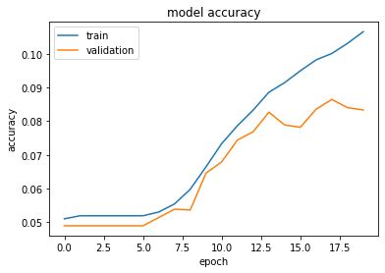
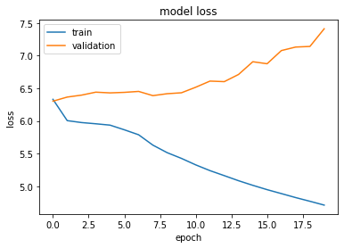
Next step: Results of different models
Output: metamorphosis, model2

Slide 15
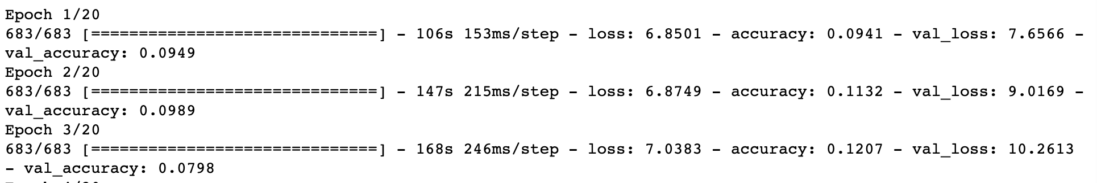
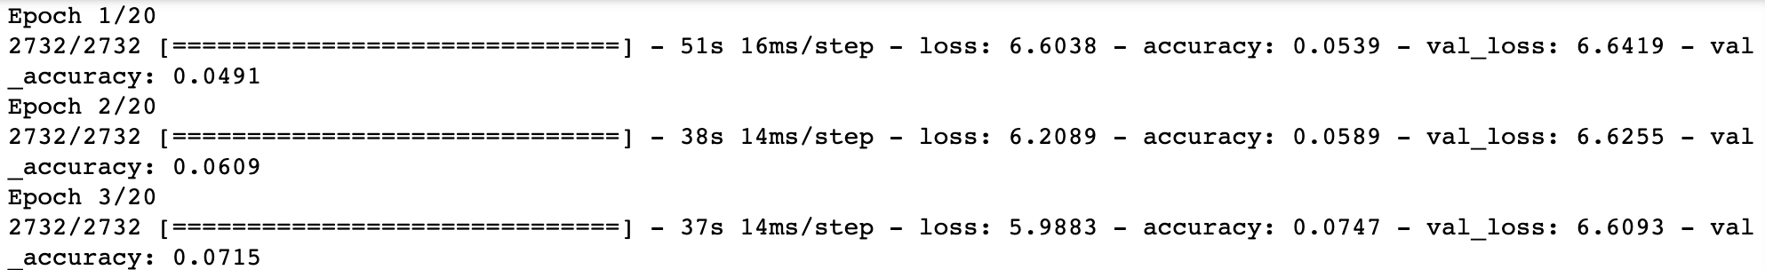
Next step: Results of different models
Running time of model1, sherlock
Running time of model2, sherlock

Slide 16
Next step: Results of different models
Different models could have rather different performance on the same training data
How to design the model to best fit the training data? What parameters/optimizers to change? Layers to add or drop?
What defines a good training data?

Slide 17
References
https://towardsdatascience.com/next-word-prediction-with-nlp-and-deep-learning-48b9fe0a17bf
https://towardsdatascience.com/exploring-the-next-word-predictor-5e22aeb85d8f
https://thecleverprogrammer.com/2020/07/20/next-word-prediction-model/
https://shiva-verma.medium.com/understanding-input-and-output-shape-in-lstm-keras-c501ee95c65e

Slide 18
Questions?

