Slide 1
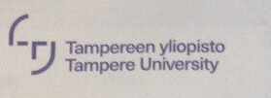
Self-introduction
Qin He

Slide 2
1. Neurodynamic Lab (ECUST), bachelor(maths and applied maths, English)
Granger prediction, BIC, DTF, PDC, time serious, stationary wave(normalized), MVAR, jackknife resampling, ANN Striatum and Frontal Cortex, LPFC recorded by EEG, phase-lock signal analysis, functional analysis, monkey saccade experiment, water reward
AP, synchronization, ion channel (Hodgkin Model), effect of Dopamin, second transmitter
Cognitive and Behavior study
2. Maths department (TAU), University Hospital, Biophysics department, master(data engineering and machine learning, Physics)
Neural imaging, forward and inverse problem ( dipole reconstruction of neuro source), E/MEG, preprocessing(normalization, baseline correction, onset detection, filter, domain transformation), spectrum analysis, forward simulation, inversion (Bayesian Inference, MAP, MCMC), outlier detection, feature selection, SVM, LDA, GANs, recurrent/regulated/adaptive machine learning methods and etc., pattern detection, signal decomposition, efficiency evaluation (Bayesian Optimization)
Image processing (MRI, CT), audio processing(segmentatin, feature extraction, HMM) and etc(deep learning).
Spikes/train/bursts detection, AP and network analysis, spectrum analysis, MEA, embedding, phase space analysis, recurrent network analysis.
Genetic, cellular and molecular study, scRNA sequencing, protein/RNA alignment, Protein analysis(LOESS normalization, MASS, MDS, FDR correction).
Clinical study (Somatosensory, Hippocampus, Epilepsy)
Hobby: biostatistics, machine learning, computation and molding, biomedical, bioinformatics, nature science and etc.

Slide 3
E/MEG, MEA
Preprocessing(normalization, baseline correction, onset detection, filter, domain transformation)
Methods: rotation/translation, Log/Z normalization, autocorrelation analysis, BIC, bandpass filters with different windows (hanning, hamming…), Jack-knife resampling, ERP, GLFP, baseline correction, different masks (Normal/ Laplacian/Power Law and etc. operators)
Tool: Matlab(SPM, Brainstorm), python
https://github.com/LilyHeAsamiko/Biophysics/tree/master/experimen2/updated2

Slide 4
E/MEG, MEA
Forward and inversion
Methods: Bayesian modeling(inverse with different given Likelihood/distribution), signal decomposition and generation, feature extraction, MCMC, MAP, machine learning and etc. develop one plugin on my supervisor’s GUI
Tool: Matlab (SPM, Brainstorm), python
https://github.com/LilyHeAsamiko/BrainQ2

Slide 5
E/MEG, MEA
Evaluation
Methods: SME, SRME, residule(amplitude, angle, prior), machine learning, Bayesian optimization
Tool: Matlab, python
https://github.com/LilyHeAsamiko/Biophysics/tree/master/Bayes

Slide 6
Application on Epilepsy:
NolinearTimeSeriesAnalysis-new\experiment2\updated2\Epilepsy.mlx
My plugin on E/MEG :
..\..\TUT\neuro imaging\brain Q app\app new\somatosensory.mlapp

Slide 7
Genetic, cellular and molecular study
Preprocessing(normalization, baseline correction, transformation)
Methods: Log/LOESS/MAD normalization, baseline correlation analysis, (MA plot), BIC
Tool: Matlab(SPM, Brainstorm), python, R
https://github.com/LilyHeAsamiko/Introduction-to-R

Slide 8
Genetic, cellular and molecular study
DNA, RNA, Protein analysis
Methods: QC test(MA plot, T-test, ks-test), FDR correction, MDS plot, dimensional analysis, volcano plot, Amino Acid Analysis, Protein analysis(MASS analysis), VENN, heatmap, sequencing and alignment(WGS, indel model, MCMC, HMM, Bayesian Inference)
Tool: Matlab(SPM, Brainstorm), python, R, C++
https://github.com/LilyHeAsamiko/Biophysics/tree/master/experimen2
https://github.com/LilyHeAsamiko/Biophysics/tree/master/Bayes

Slide 9
Genetic, cellular and molecular study
ScRNA analysis
Methods: TF, expression analysis, pseudo-time analysis
Tool: Matlab(SPM, Brainstorm), python, R
https://github.com/LilyHeAsamiko/Biophysics/tree/master/gnome-tsne
https://github.com/LilyHeAsamiko/Biophysics/tree/master/single%20cell%20sequencing

Slide 10
Genetic, cellular and molecular study
RNA clustering, biomarker classification
Methods: Machine Learning (t-SNE, KNN and etc.)
Tool: Matlab(SPM, Brainstorm), python, R
https://github.com/LilyHeAsamiko/Biophysics/tree/master/gnome-tsne
https://www.overleaf.com/read/jsrmjhrdwyfb
https://github.com/LilyHeAsamiko/BrainQ3/tree/master/media%20analysis%20project
https://github.com/LilyHeAsamiko/Biophysics/tree/master/experiment

Slide 11
Clinical Application:
Monkey saccade learning with water reward, Finger Stimulation(Somatosensory compare with Thalamus), Epilepsy(Hippocampus, GC, MC)
Publication:
Granule and mossy cell gene expression study: single cell sequence and alignment monitored by electroencephalography scans with Markov Chain and Bayes Hierarchical Model:
https://drive.google.com/open?id=1RXb_AKoQXHK3o0_zIzPl4Yh6fzm65q9J
Bayes Inference in structure detection(applied in seismic waves and t-SNE):
https://drive.google.com/open?id=1q2w3OWrdqJqhUdAAMayExBrkplDWrX0C
An Extended Application 'Brain Q' Processing EEG and MEG Data of Finger Stimulation Extended from 'Zeffiro' based on machine learning and signal processing.
https://drive.google.com/file/d/1PmD1cDCWHdX73fL5coMF8qa2zhDSZ9ui/view?usp=sharing
Hierarchical Bayesian inversion of evoked N20 somatosensory current distribution in E/MEG with finite element forward simulation
https://drive.google.com/file/d/1ldE0rynZRohdZkFxR-Dn1FqOerdm9bF4/view?usp=sharing
SOURCE LOCALIZATION APPLYING H(DIV) SOURCE MODEL AND HIERARCHICAL BAYES MODEL IN EEG AND MEG COMBINING MACHINE LEARNING.(Master Thesis)
https://drive.google.com/file/d/1HDyi1yJKnPz0cvJPOt-cK0qkcKs6KG4V/view?usp=sharing
Zeffiro user interface for electromagnetic brain imaging: a GPU accelerated FEM tool for forward and inverse computations in Matlab
https://drive.google.com/file/d/1b1PfjHf_1odgdJvIw10U3GbSq8I-ZGmQ/view?usp=sharing
Artificial Intelligence and Data Mining on basis of Neuronal Network and Granger Prediction(Bachelor Thesis)
https://drive.google.com/file/d/15Jft4raTKGcsZDXRbp8i0zJBNgVvJoTy/view?usp=sharing

Slide 12
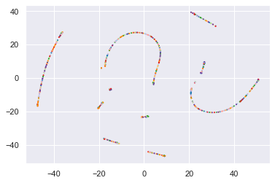
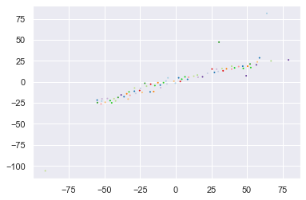
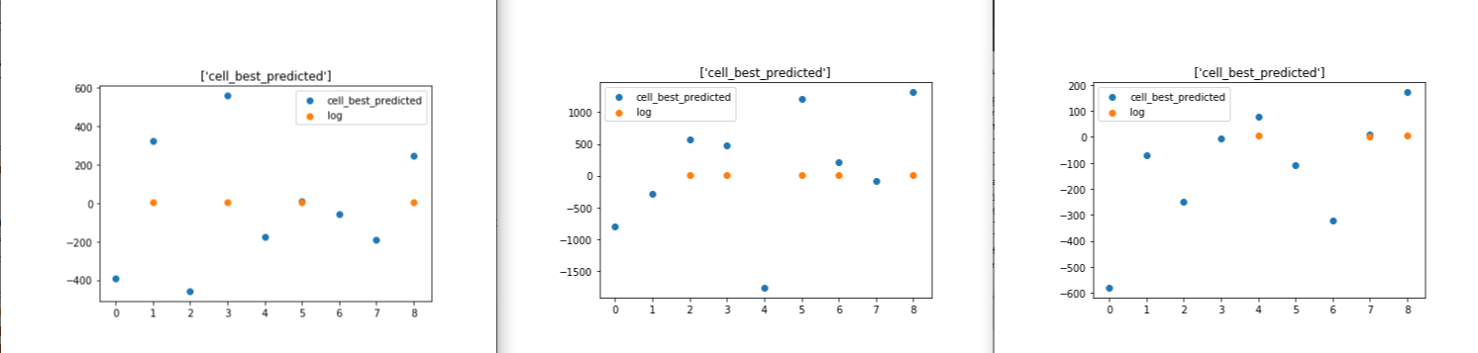
Application on R with exploration(online biobank data(fasta, microarray and etc.):
Project with GC, MC:

Slide 13
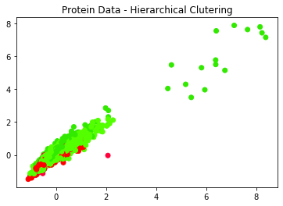
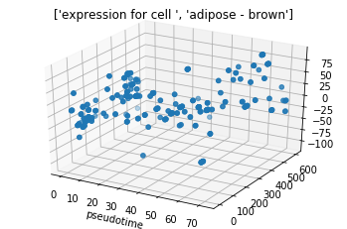

Slide 14
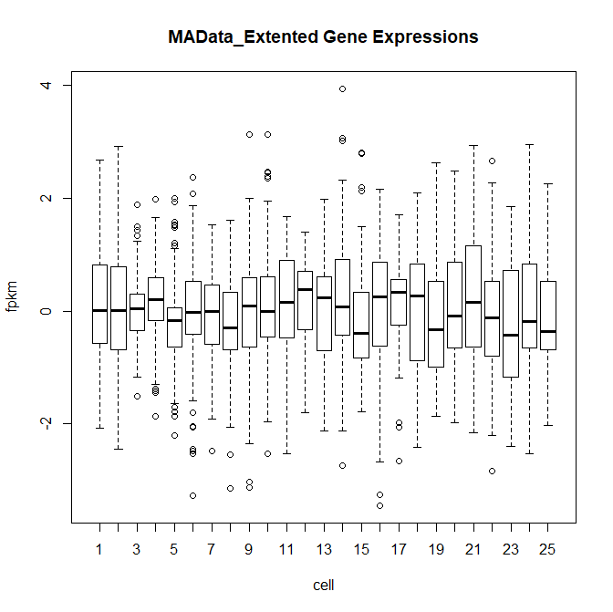
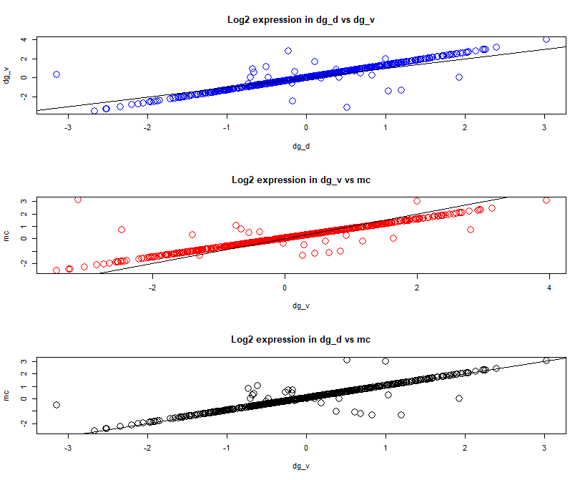
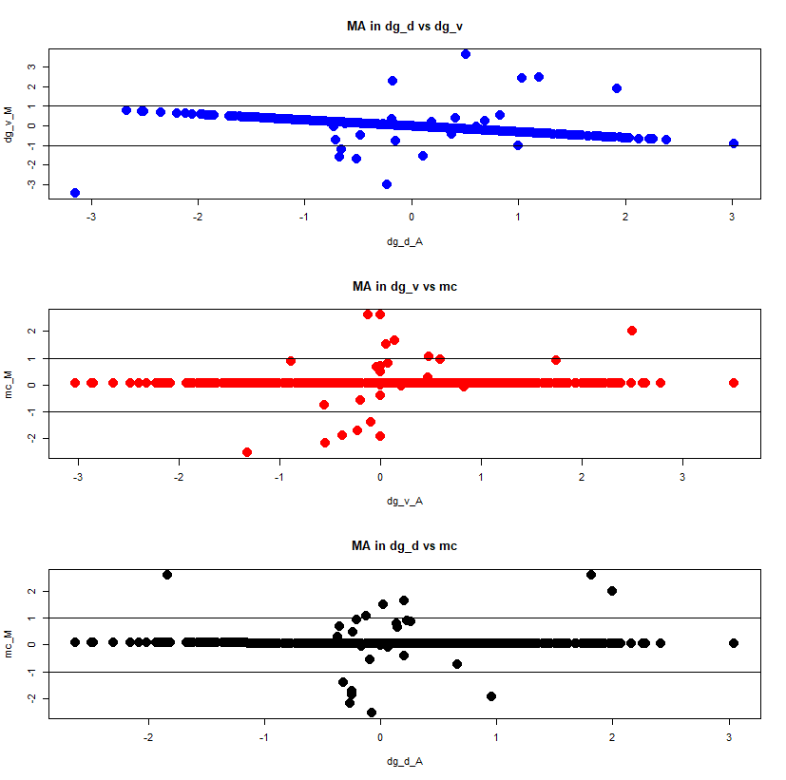
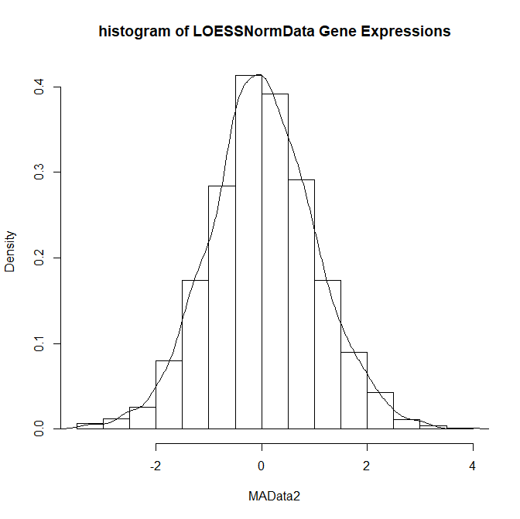

Slide 15
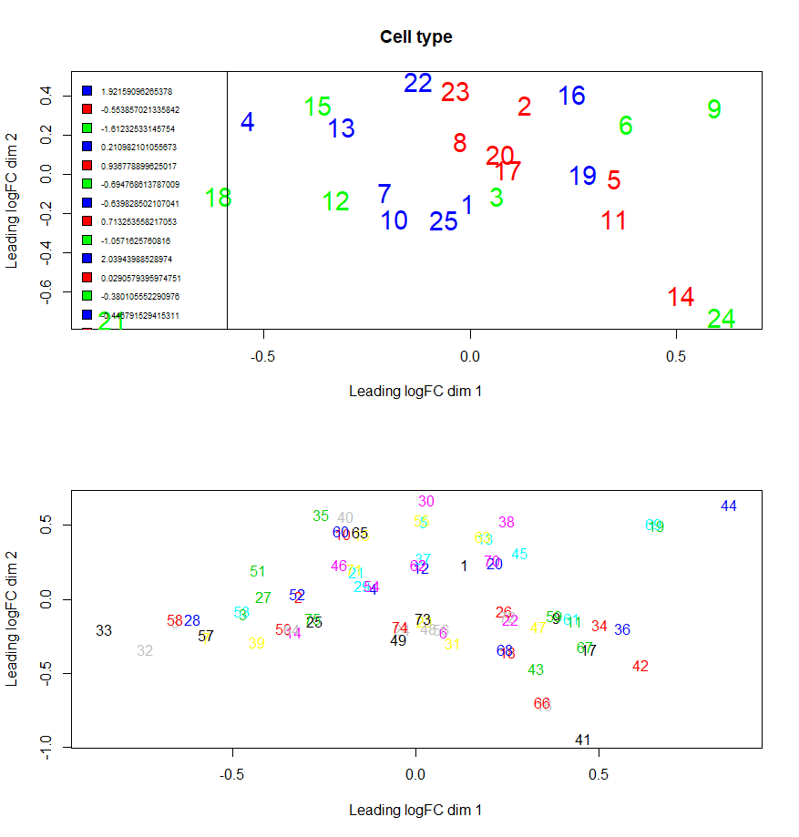
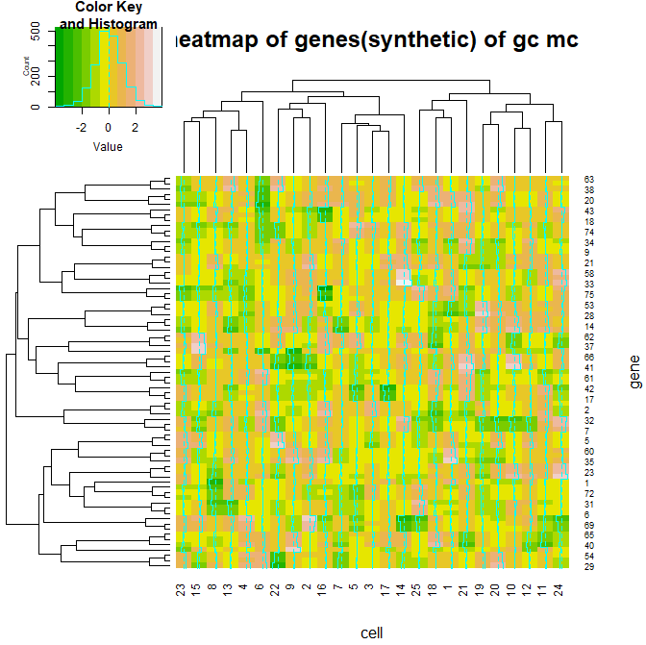
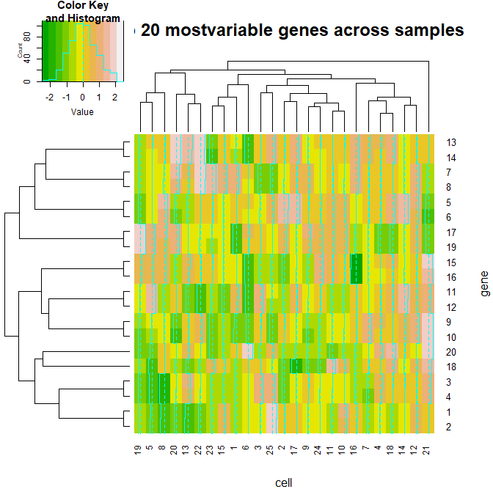
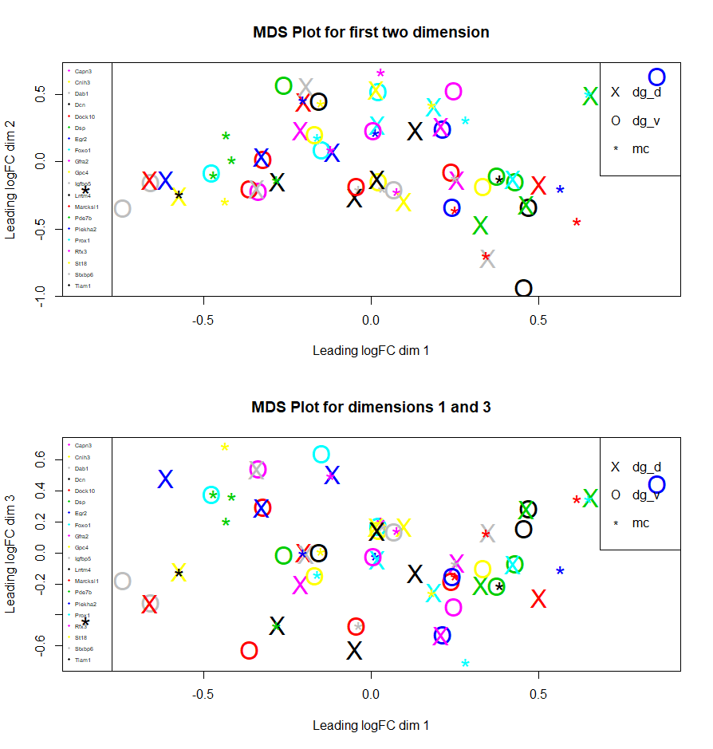

Slide 16
