Slide 1
Project 2
Qin He 272486
Completed: Warm up+ Problem 5
Extra: 6,7,9

Slide 2
Warm up
Read data from h5fp to python
f1 = h5py.File('P:\computational physics\computational-physics-master\computational-physics-master\project2\warm_up_data.h5','r+');
data = [];
x = [];
y = [];
# write into array
for d in f1["data"]:
data.append(d.T);
for xg in f1["x_grid"]:
x.append(xg)
for yg in f1["y_grid"]:
y.append(yg)

Slide 3
Warm up
1D interpolation

Slide 4
Warm up
1D itest on line y = x
def fun1(r_0, r_1, t):
r = zeros((np.size(t,0),1))
for i in range(0,len(t)):
r[i] = r_0+t[i]*(r_1-r_0)
return r

Slide 5
Warm up
spl1d = spline(x=x,f=mean(data,1), dims=1)
fig = plt.figure()
plt.plot(x,spl1d.eval1d(x),'r--',x,y[1:8],'o')
plt.title('interpolation1D of data')
plt.savefig('interp1D.pdf',dpi=200)
# initialize the 2d interpolation
spl2d = spline(x=x,y=y,f=array(data), dims=2)
X,Y = np.meshgrid(x,y)
fig = plt.figure()
plt.pcolor(X,Y,spl2d.eval2d(x,y).T)
plt.title('interpolation2D of data')
plt.savefig('interp2D.pdf',dpi=200)
tol = 0.1
# contour
t = linspace(0, 1, 100)
r_0 = -1.5
r_1 = 1.5
x = fun1(r_0, r_1, t)
fig = plt.figure()
X,Y = meshgrid(x,y)
# contour plot
fig = plt.figure()
plt.contourf(X,Y,spl2d.eval2d(x,y).T,30)
plt.title('contourfinterp')
plt.savefig('contouf.pdf',dpi=200)
plt.savefig('contorf 2D.pdf',dpi=200)
# data interpolation

Slide 6
Warm up
2D interpolation

Slide 7
Problem5 (Ising Model)
for i in range(Nblocks):
#count
EbCount = 0
#iter in Niters steps
for j in range(Niters):
site = int(random.rand()*M)
# old spin
s_old = 1.0*Walkers[site].spin
# old energy
E_old = site_Energy(Walkers,Walkers[site])
#choose the spin
if random.rand()>0.5:
s_new = 0.5
else:
s_new = -0.5
# update into new spin
Walkers[site].spin = 1.0*s_new
# update into new energy
E_new = site_Energy(Walkers,Walkers[site])
# difference of E
deltaE = E_new-E_old
q_s_sp = exp(-beta*deltaE)
A_s_sp = min(1.0,q_s_sp)
# configuration
if (A_s_sp > random.rand()):
Accept[i] += 1.0
else:
Walkers[site].spin=1.0*s_old
AccCount[i] += 1
#Update energy and observables
if j % obs_interval == 0:
E_tot = Energy(Walkers)
Eb[i] += E_tot
Eb2[i] += E_tot**2
mag = magnetization(Walkers)
mb[i] += mag
mb2[i] += mag**2
EbCount += 1
Eb[i] /= EbCount
Eb2[i] /= EbCount
mb[i] /= EbCount
mb2[i] /= EbCount
Accept[i] /= AccCount[i]
print('Block {0}/{1}'.format(i+1,Nblocks))
print(' E = {0:.5f}'.format(Eb[i]))
print(' Acc = {0:.5f}'.format(Accept[i]))
#Initialize the E, observables, Walkers
#length of the Walkers
M = len(Walkers)
#initialize the Energy
Eb = zeros((Nblocks,))
#initialize the square of the Energy
Eb2 = zeros((Nblocks,))
#initialize the magnetization
mb = zeros((Nblocks,))
#initialize the square of the magnetization
mb2 = zeros((Nblocks,))
#initialize the count
Accept=zeros((Nblocks,))
AccCount=zeros((Nblocks,))
#observables interval
obs_interval = 5 #H,He,Li,Be,B

Slide 8
Problem5 (Ising Model)
figure() # Energy
errorbar(T,Edata[:,0]/grid_size,Edata[:,1]/grid_size)
ylabel('Energy per spin2 with grid_size')
xlabel('Temperature')
savefig('Energy per spin2 with grid_size.pdf' % str(grid_side), mpi = 200)
for i in range(len(T)):
figure() # Magnetization
errorbar(T,Mdata[:,0]/grid_size,Mdata[:,1]/grid_size)
ylabel('Magnetization per spin2 with grid_size %s' % str(grid_side))
xlabel('Temperature')
savefig('Magnetization per spin2 with grid_size’,mpi = 200)
figure() # Capacity
Cv = (Edata2[:,0]-Edata[:,0]**2)/T**2/grid_size
plot(T,Cv,'-o')
plot([2.27, 2.27],[0.0, 1.03*amax(Cv)],'k--')
ylabel('Heat Capacity per spin2 with grid_size ' )
xlabel('Temperature')
savefig('Heat Capacity per spin2 with grid_size.pdf'), mpi = 200)
figure() Suscibility
chi = (Mdata2[:,0]-Mdata[:,0]**2)/T**2/grid_size
plot(T,chi,'-o')
plot([2.27, 2.27],[0.0, 1.03*amax(chi)],'k--')
ylabel('Susceptibility per spin2 ')
xlabel('Temperature')
savefig('Susceptibility per spin2 with grid_size.pdf', mpi = 200)
show()
#calculate transition tamperature (# Notice: T_c_exact = 2.27)
Tc = 1.0/(3.16681*10**(-6)*M)
print('The transition tamperature with grid_size ’)
plot(Tc)
savefig('The transition tamperature with grid_size.pdf'), mpi = 200

Slide 9
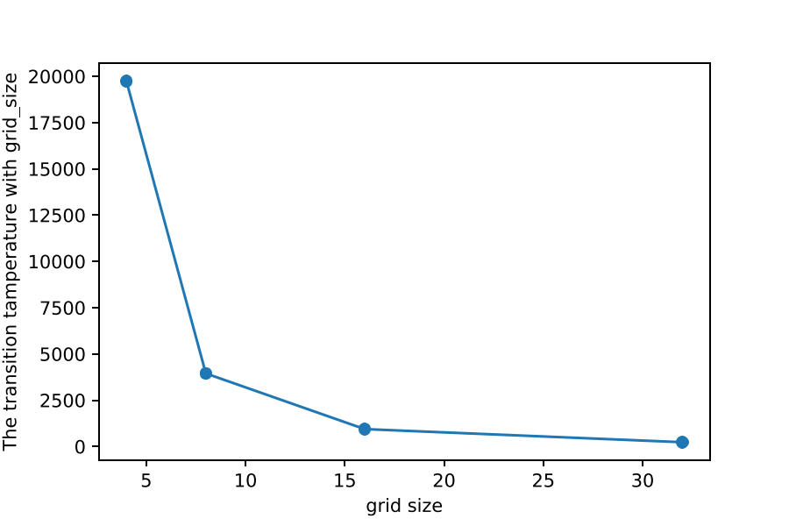
Problem5 (Ising Model)
For spin models, we have a finite d-dimensional lattice of sites.
But only get a true phase transition (i.e., divergence).
For a finite system, get rounded peaks rather than divergences.
The peaks narrow and increase in height as L is increased,
and the location of the peak shifts slightly.

Slide 10
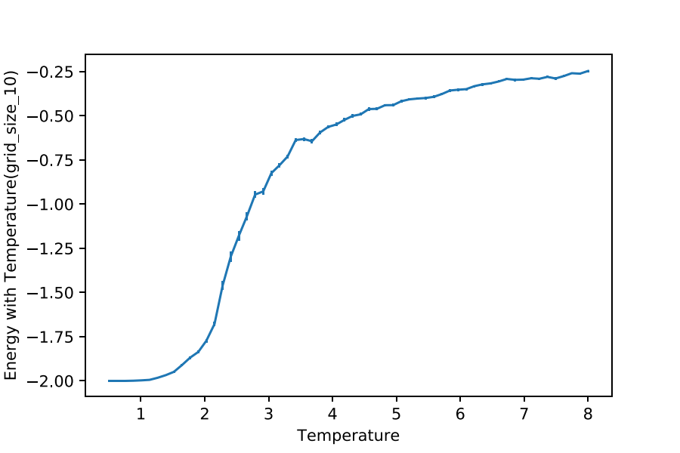
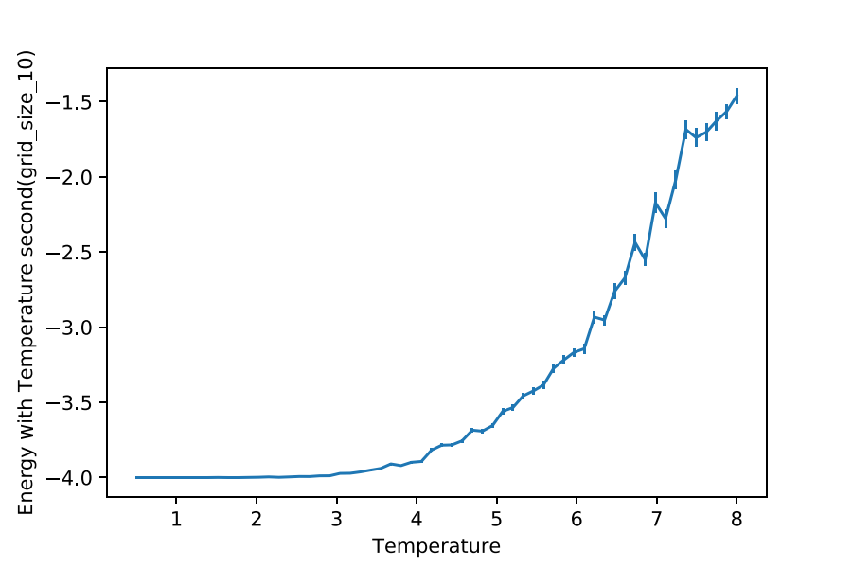
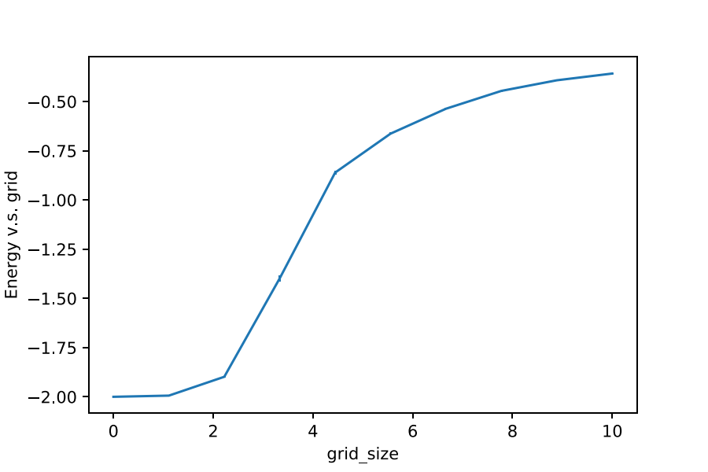
Problem5 (Ising Model)
Energy

Slide 11
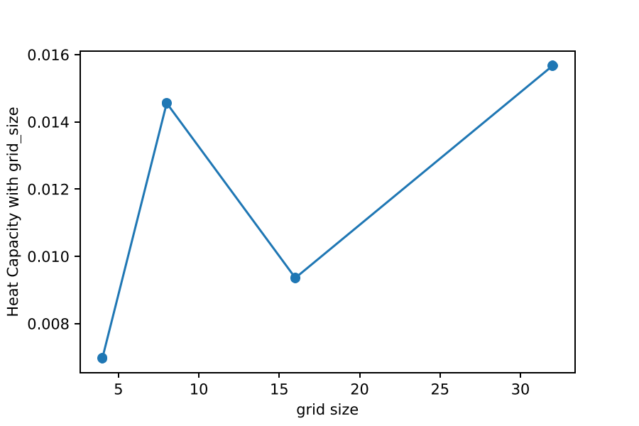
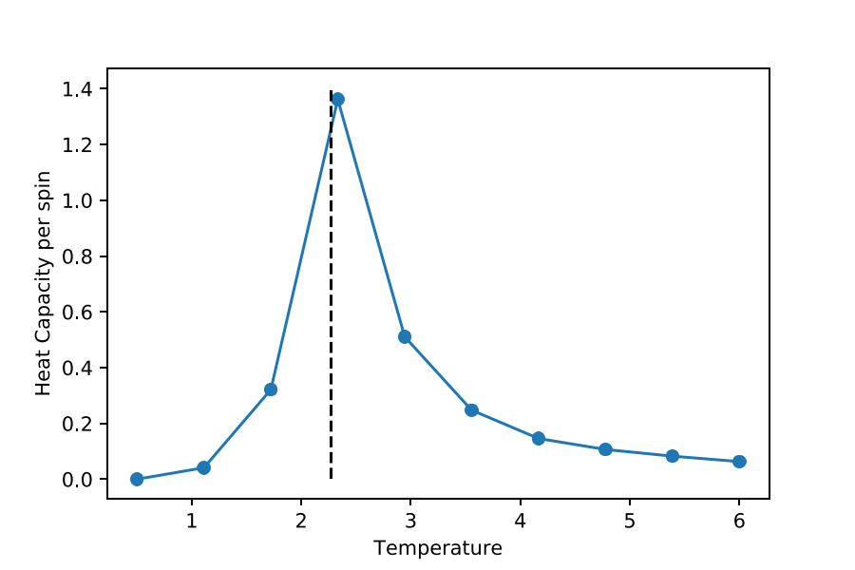
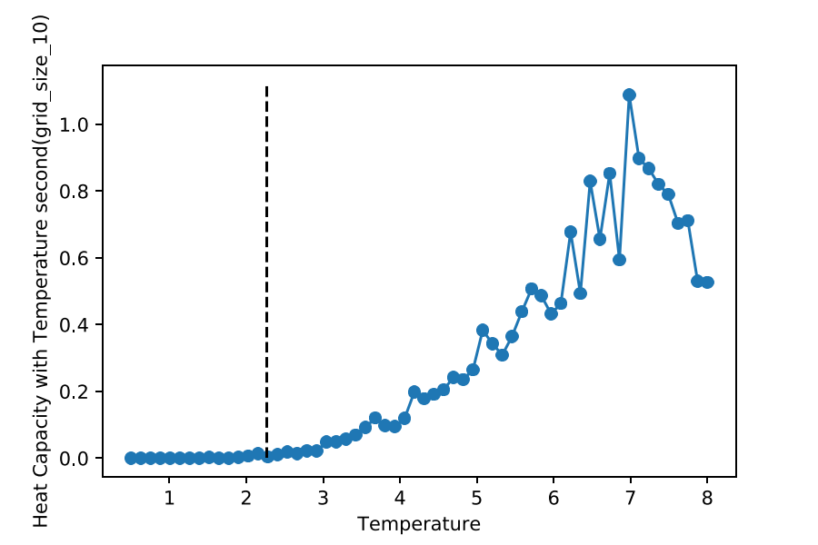
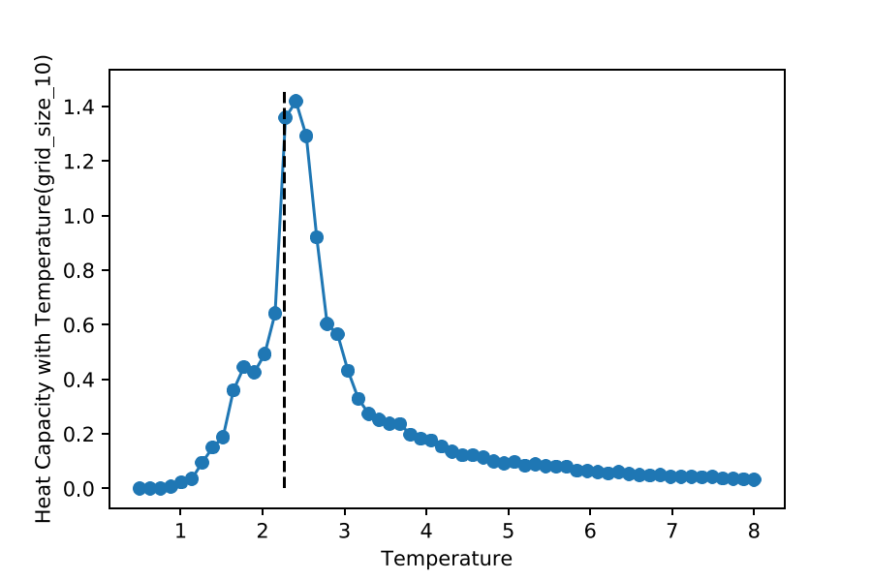
Problem5 (Ising Model)
Heat Capacity

Slide 12
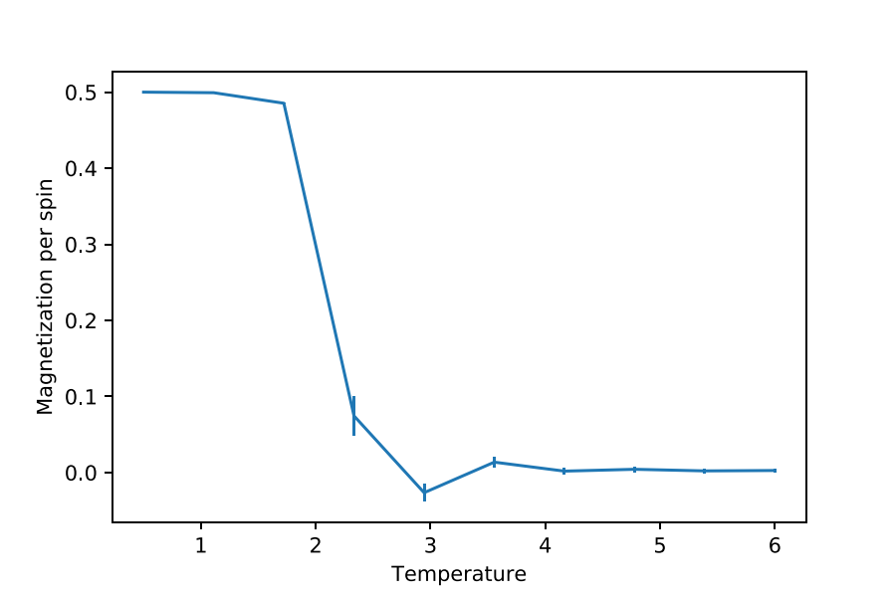
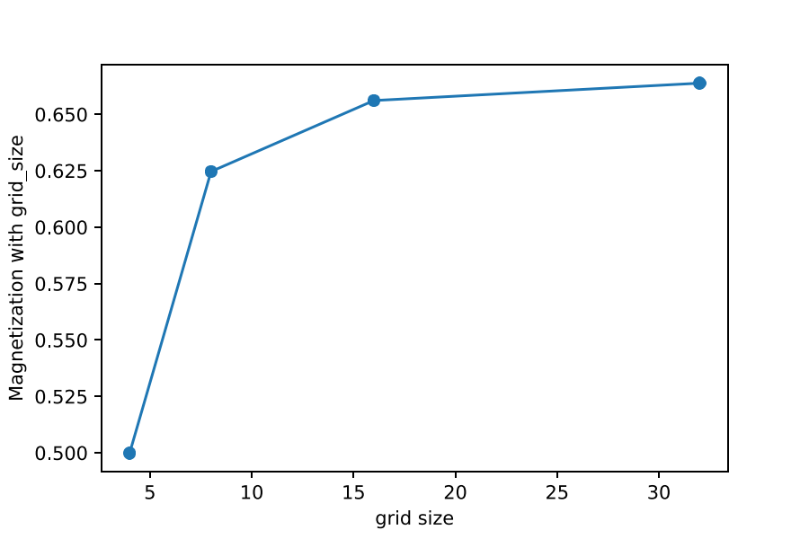
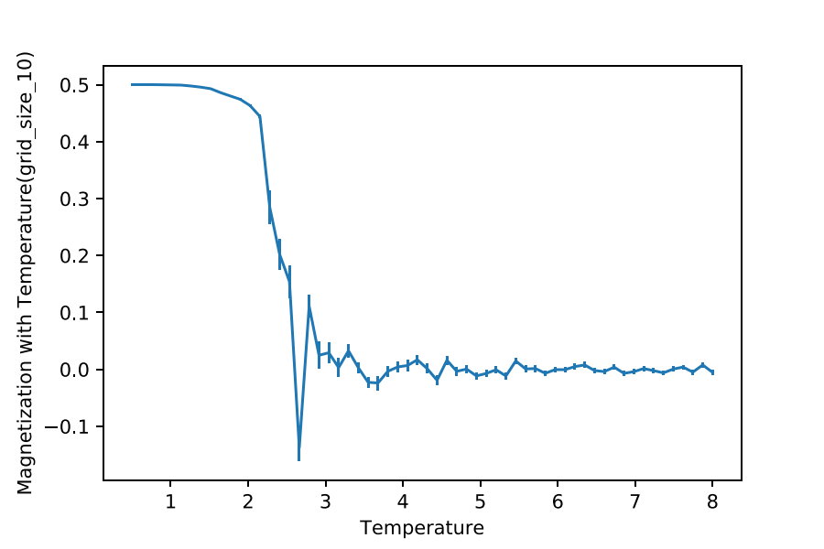
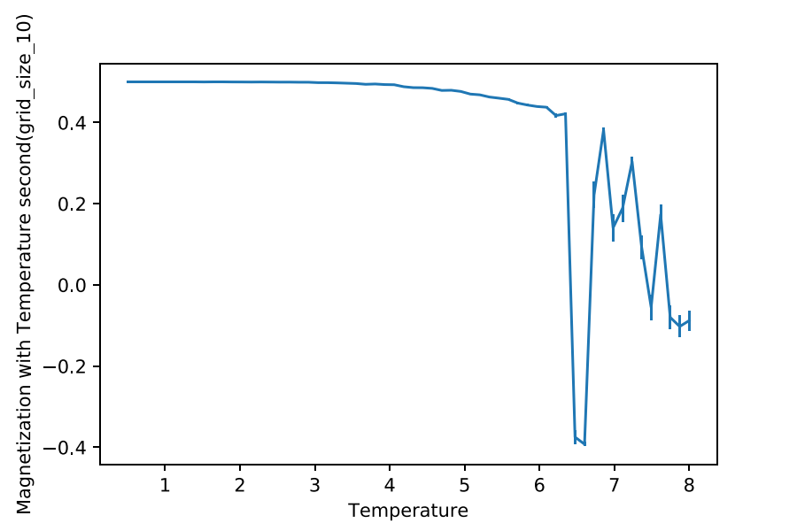
Problem5 (Ising Model)
Magnetization

Slide 13
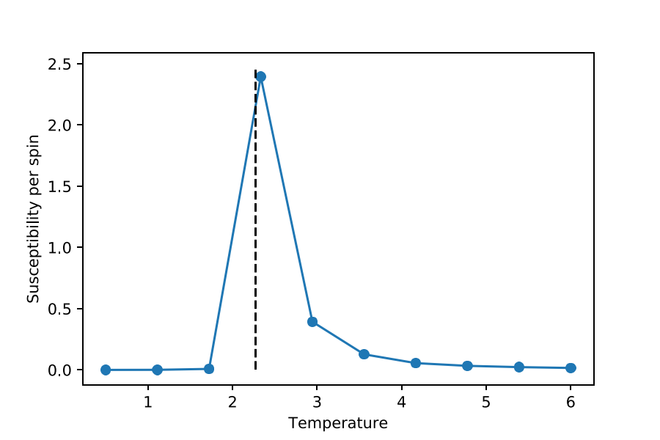
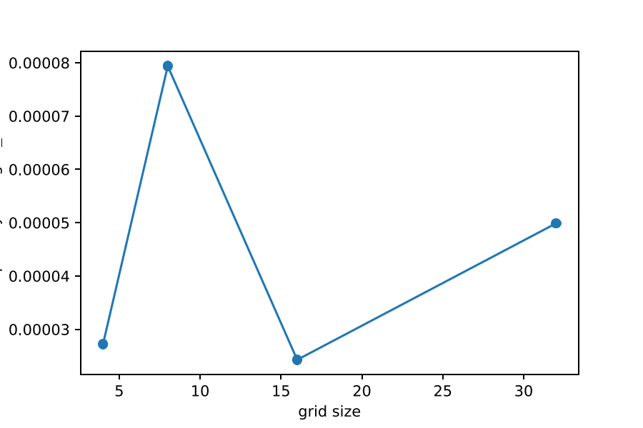
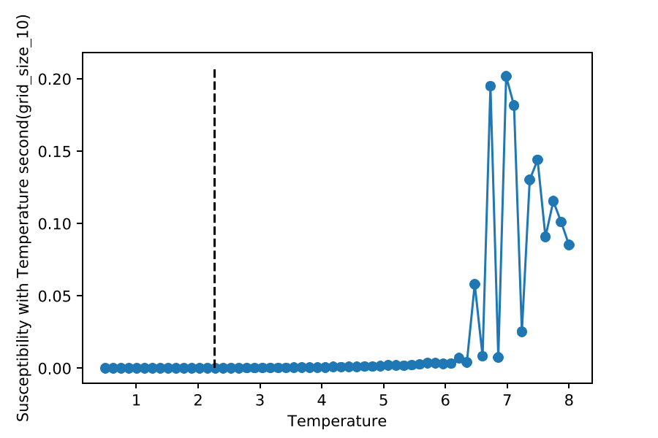
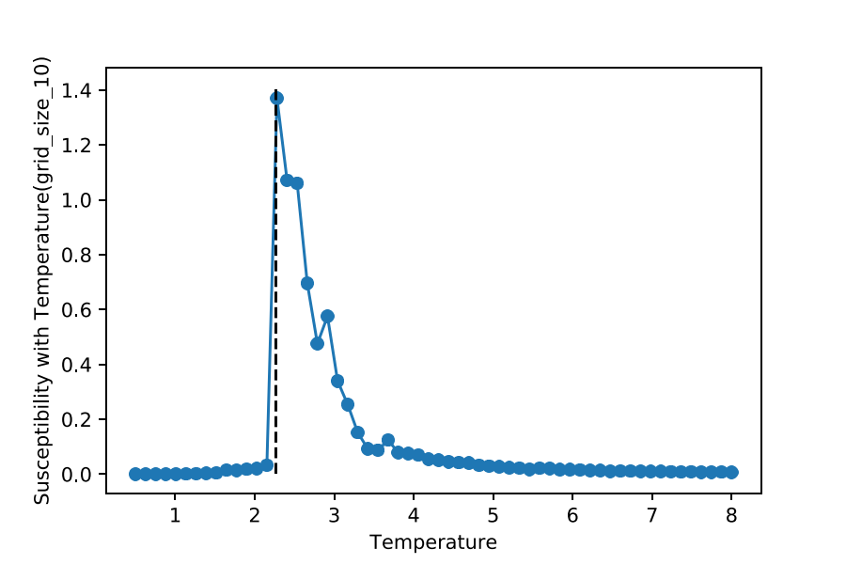
Problem5 (Ising Model)
Susceptibility

Slide 14
Problem6
Modify the H,He,Li,Be,B OCC and Atoms:
B: N_e = 5
occ = [0,0,1,1,2]
Spin = [0,0,1,1,1] ududu
# e.g., means lowest up and down, next lowest up and down,next up
Be: N_e =4
occ = [0,0,1,1] # occ = [0,1,2,3] means all spin up
Spin = [0,0,1,1] udud
Li:
occ = [0,0,1]
Spin = [0,1,1] udu
He:
occ = [0,1]
Spin = [0,1] ud
H:
occ = [0]
Spin = [0] u/d
Modify the columb external potential:
def Coulumb_potential(N_e, x):
"""
Exchange potential of Hartree-Fock using Columb
"""
U = 0.0
for i in range(len(x)):
fo
j in range(i+1, len(x)):
U += -N_e**2 / sqrt((x[i] - x[j])**2+1)
return U

Slide 15
#calculate hartree potential
Vhartree=hartree_potential(N_e,ns,x)
VSIC=[]
for i in range(N_e):
VSIC.append(ns*0.0)
Veff=sp.diags(Vext+Vhartree,0)
H=T+Veff
Problem6 (Hartree, Hartree Flock)
# Update
Veff_old = Veff
ns=density(orbitals)
Vhartree=hartree_potential(N_e,ns,x)
if (HF_run):
"""Hartree-Fock"""
VSIC=calculate_Vx(orbitals,spin,x)
else:
"""Hartree"""
VSIC=calculate_SIC(N_e, orbitals, x)
Veff_new=sp.diags(Vext+Vhartree,0)
if check_convergence(Veff_old,Veff_new,threshold):
break
else:
Veff=(1.0-mix)*Veff_new+mix*Veff_old
H = T+Veff
#calculate hartree energy with hartree fock
for i in range(maxiters):
print('\n\nIteration #{0}'.format(i))
orbitals=[]
for i in range(N_e):
print(' Calculating orbitals for electron ', i+1)
eigs, evecs = sla.eigs(H+sp.diags(VSIC[i],0), k=N_e, which='SR')
eigs=real(eigs)
evecs=real(evecs)
print(' eigenvalues', eigs)
evecs[:,occ[i]]=normalize_orbital(evecs[:,occ[i]],dx)
orbitals.append(evecs[:,occ[i]])

Slide 16
Problem6
1s
1s
2s
2s
2s 2p

Slide 17
Problem7
Modify the H_He pimc :
for i in [0,2,4,6]:
tau1 = 1.0*Walkers[i].tau
lambda1 = 921+1 # Mass of #hydrogen: proton + electron
for i in [1,3,5,7]:
tau2 = 1.0*Walkers[i].tau
lambda2 = 1450 # Mass of #helium: proton He
Lennard_jones_potential:
return 4 * epsilon * ((sig/r)**12 - (sig/r)**6)
for i in range(M):
U += potential(Walkers[i])
if (Walkers[i].Ne == 1 & Walkers[i].Nn ==1):
if (i<M-1): K += d/2/Walkers[i].tau-sum((Walkers[i].Re-Walkers[i+1].Rn)**2)/4/lambda1/tau**2
else: K += d/2/Walkers[i].tau-sum((Walkers[i].Re-Walkers[0].Rn)**2)/4/lambda1/tau**2
elif (Walkers[i].Nn == 2 & Walkers[i+1].Nn ==2):
for j in range(Walkers[i].Nn*1):
if (i<M-1):
K += d/2/Walkers[i].tau-sum((Walkers[i].Rn[j]-Walkers[i+1].Rn[j])**2)/4/lambda1/tau**2
else:
K += d/2/Walkers[i].tau-sum((Walkers[i].Rn[j]-Walkers[0].Rn)**2)/4/lambda1/tau**2
#calculate the energy
def Energy(Walkers):
M = len(Walkers)
d = 1.0*Walkers[0].sys_dim
tau1 = Walkers[0].tau
tau2 = Walkers[1].tau
lambda1 =922
lambda2 =1450
U = 0.0
K = 0.0
elif (Walkers[i].Nn == 2 & Walkers[i+1].Nn ==1): for j in range(Walkers[i].Nn*1): if (i<M-1): K += d/2/Walkers[i].tau-sum((Walkers[i].Rn[j]-Walkers[i+1].Rn)**2)/4/lambda1/tau**2 else: K += d/2/Walkers[i].tau-sum((Walkers[i].Rn[j]-Walkers[0].Rn)**2)/4/lambda1/tau**2 return K/M,U/M

Slide 18
def potential(walker):
V = 0.0
r_cut = 1.0e-12
# e-ion
if (walker.Ne == 1): a = walker.Re
elif (walker.Nn == 1): b = walker.Rn
elif(walker.Ne == 2 & walker.Nn == 2):
for i in range(walker.Ne*1):
for j in range(walker.Nn*1):
a = walker.Re[i]
b = walker.Rn[j]
r = sqrt(sum((a-b)**2))
epsilon = walker.epsilon
sig = walker.sig
V += lennard_jones_potential(r, epsilon, sig)
Return V
# calculate the intra-distance
def distance(Walkers):
d = 0.0
for walker in Walkers:
# assert(walker.Ne == 2)
if (walker.Ne == 2):
d += sqrt(sum((walker.Re[0]-walker.Re[1])**2))
return d / len(Walkers)
# calculate the magnetization
def magnetization(Walkers):
m = 0.0
for i in range(len(Walkers)):
m += Walkers[i].spins
return m

Slide 19
for i in [1,3,5,7]:
walker = Walkers.append(Walker(Ne=1*1,
Re=array(0.3),
epsilon=sqrt(0.1745*3.2*10**(-5)),
sig=(4.73+1.25)/2,
spins=array(0),
Nn=1,
Rn=array(0.1),
Zn=2.0,
tau = 0.1,
dim=1))
Walkers= []
T = 300.15
Ms = 2**np.arange(6) # [1,2,4,8...]
taus = 1 / (T*Ms)
# initialize the walkers
for i in [0,2,4,6]:
walker = Walkers.append(Walker(Ne=2*1,
Re=array([0.5,-0.5]),
epsilon=sqrt(0.1745*3.2*10**(-5)),
sig=(4.73+1.25)/2,
spins=array([0,1]),
Nn=2,
Rn=array([0.7,-0.7]),
Zn=array([1.0,1.0]),
tau = 0.5,
dim=1))

Slide 20
Problem9
# analytical solution of magnetic field on x field
def Bx(x, a, b, I):
B = b*4*np.pi*I*a**2/(2*(x**2+a**2)**(3/2))
return B
def diff_field(dl, r_hat, r, b, I):
dB = b*I*np.cross(dl, r_hat)/(LA.norm(r))**2
dBx = np.zeros((len(r_hat),3))
dBy = np.zeros((len(r_hat),3))
dBz = np.zeros((len(r_hat),3))
y = np.linspace(-5, 5, 10)
z = np.linspace(-5, 5, 10)
[Y, Z] = np.meshgrid(y, z)
plt.quiver(Y,Z,By,Bz)
plt.savefig('B_yz.pdf',dpi=200)
#magnetic field on x direction
dBx[i] = b*I*np.cross(dl, r_hatx)/(LA.norm(r))**2
#magntic field on y direction
dBy[i] = b*I*np.cross(dl, r_haty)/(LA.norm(r))**2
#magntic field on z direction
dBz[i] = b*I*np.cross(dl, r_hatz)/(LA.norm(r))**2
return dB, dBx, dBy, dBz
for i in range (0, len(rc)-1):
# the segmentation of electric circuit
dl = rc[i+1,:]-rc[i,:]
# the r_hat is the normalized unit electric circuit
r_hat[i,:] = rc[i,:]/LA.norm(rc[i,:])
# the difference between the P and rc
diff[i,:] = P[i,:] - rc[i,:]
dB, dBx, dBy, dBz = diff_field(dl, r_hat[i,:],
np.transpose(diff[i,:]), b, I)
dB.append(dB)
dBx.append(dBx)
dBy.append(dBy)
dBz.append(dBz)
By = np.zeros((len(dBx)))
Bz = np.zeros((len(dBx)))
for i in range (0,len(dBx)):
B[i] = sum(dB[i])
By[i] = sum(dBy[i])
Bz[i] = sum(dBz[i])
def field_yz_loop_x(O, a, b, I, P):
# electric circle coordinates: (y-O[1])**2 + (z-O[2])**2= a**2
x = np.repeat(O[0],len(P))
theta = np.linspace(0,2*np.pi,len(P))
# y = np.linspace(O[1]-a, O[1]+a, len(P))
for i in range(0, len(theta)):
y = a*np.cos(theta)
z = a*np.sin(theta)
# z = -np.sqrt(a**2 - (y-O[1])**2) + O[2]
# make the array of the magnetic field equation
rc = np.array([x, y, z]).T
r_hat = np.zeros((len(rc),3))
diff = np.zeros((len(rc),3))
dB = []
dBy = []
dBz = []
for i in range(0, len(r_hat)-1):
#r_hatx = unit r on x direction
r_hatx = [r_hat[i+1,0]-r_hat[i,0], 0, 0]/LA.norm(r_hat)
#r_haty = unit r on y direction
r_haty = [0, r_hat[i+1,1]-r_hat[i,1], 0]/LA.norm(r_hat)
#r_hatz = unit r on z direction
r_hatz = [0, r_hat[i+1,2]-r_hat[i,2], 0]/LA.norm(r_hat)

Slide 21
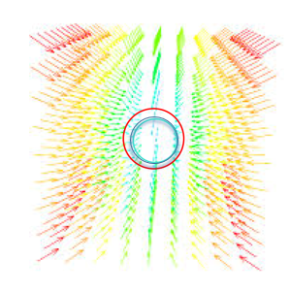
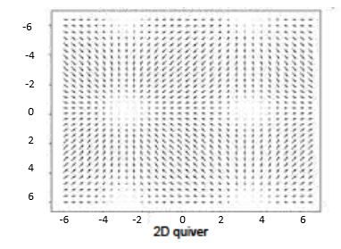
#color_array
c = np.zeros(shape=(len(B_0x), len(B_0y), len(B_0z), 4))
c[:, :, :, 0] = u c[:, :, :, 1] = v c[:, :, :, 2] = w c[:, :, :, 3] = np.ones(shape=(len(B_0x), len(B_0y), len(B_0z)))
c = np.abs(c)
c2 = np.zeros(shape=(len(B_0x)*len(B_0y)*len(B_0z), 4))
l = 0
for i,j,k in np.ndindex((len(B_0x), len(B_0y), len(B_0z))): c2[l]=c[i,j,k] l+=1 c3 = np.concatenate((c2, np.repeat(c2,2, axis=0)), axis=0)
# 3D quiver figure
fig = plt.figure() ax = fig.gca(projection='3d') ax.quiver(P[0:8,0],P[0:8,1],P[0:8,2],B_0x,B_0y,B_0z,pivot = 'middle', color = c3) plt.savefig('B_3D_quiver.pdf',dpi=200) print('B_3D_y_z:') print(B)
# 3D wire, contour figure
fig2 = plt.figure() ax1 = fig2.add_subplot(211, projection='3d')
ax1.plot_wireframe(B_0x,B_0y, np.array([B_0z,B_0z])) plt.savefig('B_3D_framewire.pdf',dpi=200)
ax2 = fig2.add_subplot(212, projection='3d')
X,Y = np.meshgrid(B_0x,B_0y) ax2.contour(X, Y, np.array([B_0z,B_0z])) plt.savefig('B_3D.pdf',dpi=200)
plt.show()

Slide 22
Thank you!
Learned a lot from basic to advance, for instances: interpolation, (linear/spline),
integral(simpson tripzoid, and etc),
electric/magnetic field (2d, 3d, QUIVER),
atom structures(spin, occ),
Hartree, Hartree Flock
Marcov Chain(path integral/classical/spin and etc… )

